Slide 1
Disaster Nephrology: The role of a Renal Disaster Task Force
Prof Dr. Serhan Tuğlular, MD, FERA
Marmara University, Marmara School of Medicine
Division of Nephrology, Istanbul, TURKEY
Renal Task Force of Turkish Society of Nephrology, Chair
Renal Relief in Disasters Task Force of ERA, Chair
Renal Disaster Preparedness WG of ISN, Vice Chair

Slide 2
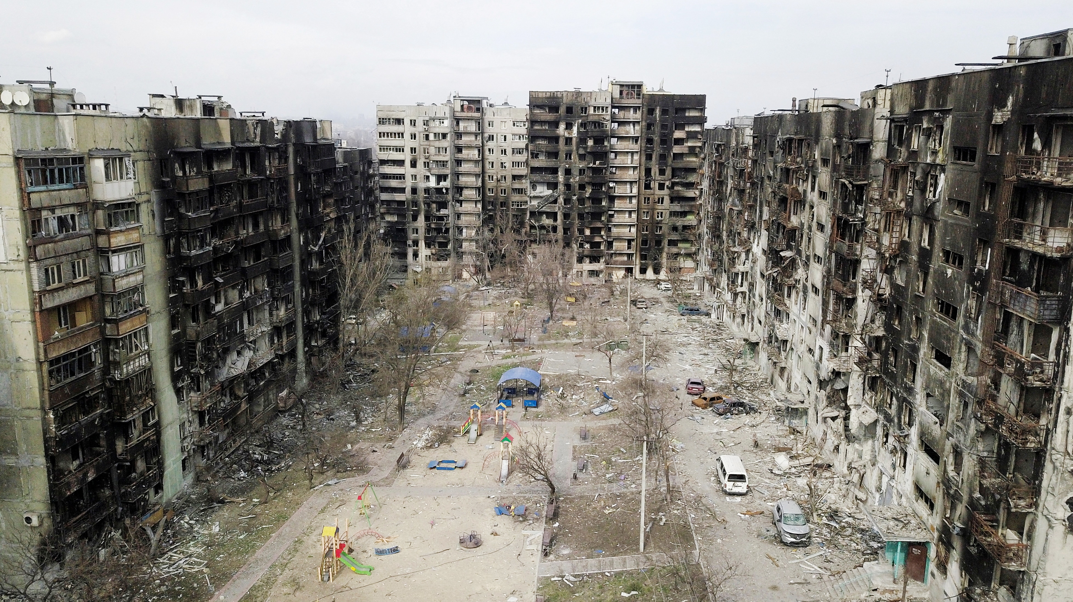
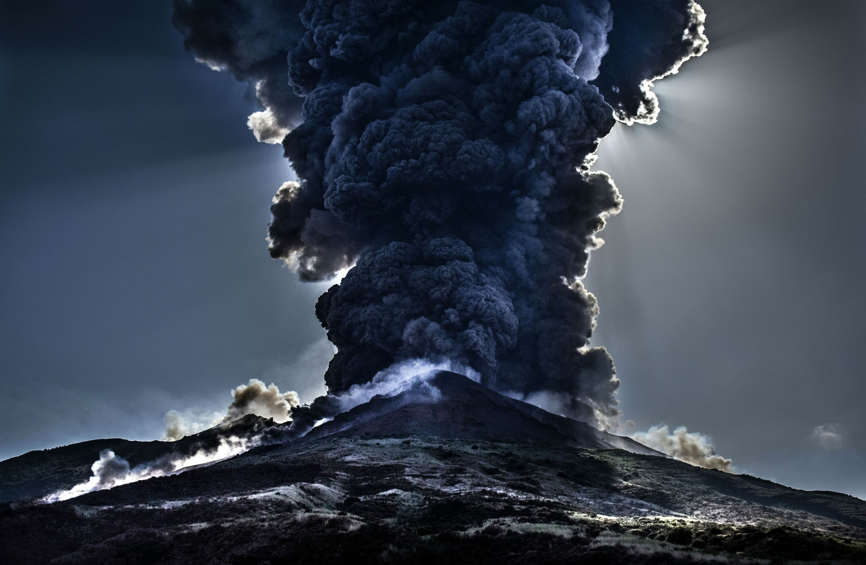
DISASTERS
Geophysical
Man-Made
Earthquakes
Volcano explosions
Hunger
Pollution
Industrial disasters
Fires
Nuclear accidents
Wars
Mass migration
Climate Associated
Tropical Syclons
Tornedos, hurricanes
Heat Waves
Extreme Cold
Floods
Biological: epidemics
The WHO :
‘Serious disruptions of the functioning of a society causing widespread human, material,
economical, or environmental losses ‘

Slide 3
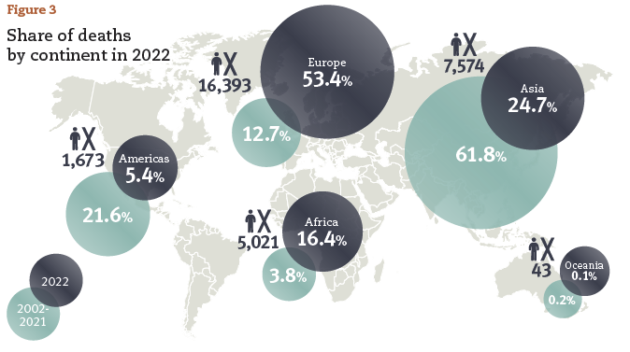
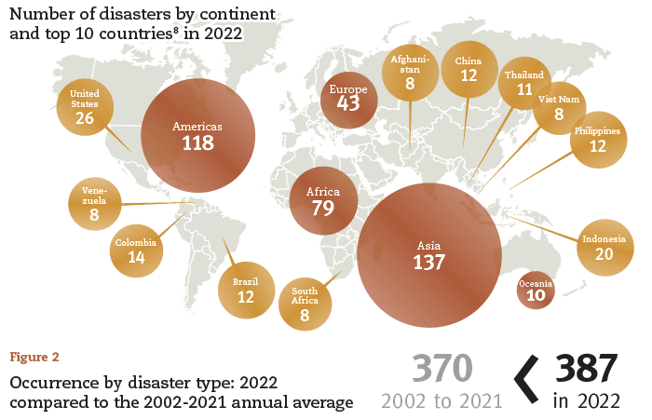
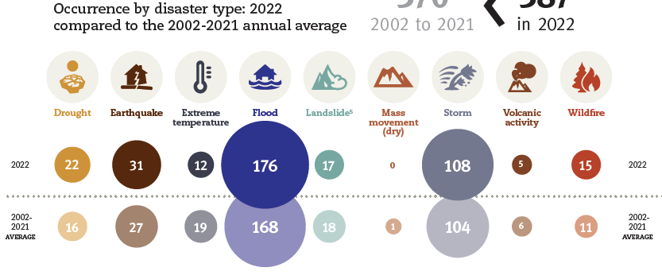
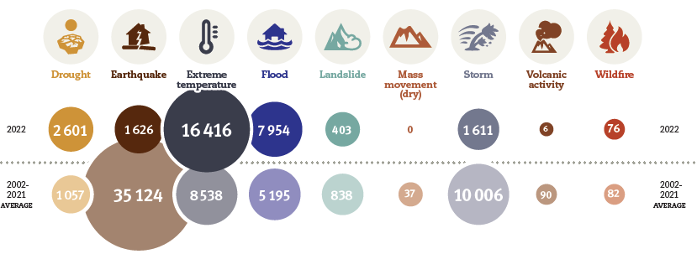
Medical aid following Mass disasters: A Real Challenge !
Thousands of injured people
Marmara Earthquake 1999:
~16.000.000 affected
133.683 buildings collapsed
17 000 death toll
23 000 injured
Southeastern Turkey- North Syria Earthquake 2023
~ 13 421 699 affected
~ 518 009 buildings collapsed/ cannot be used
~ 50 000 death toll
~ 100 000 injured
War in Ukraine 2022- :
~ 6,591 dead
~ 11,684 injured
War in Sudan 2023-
~ 459 dead
~ 4,072 injured
Centre for Research on the Epidemiology of Disasters
Report for 2022
Notes:
In the case of massive disasters overall pressure on the community is overwhelming; the number of victims is enormous; damage to infrastructure is extensive; local organization is disturbed,
and society is affected by severe disruption of
its activities, necessitating external help to subsist
In 2022, the total death toll of 30,704 was three
times higher than in 2021 but below the 2002-2021
average of 60,955 deaths, the latter being influenced by
a few mega-disasters, such as the 2010 Haiti earthquake
(222,570 deaths). For a more useful comparison, the 2022
toll is almost twice the 2002-2021 median of 16,011 deaths.5
The impact of heat waves on the elderly is a statistic
that is increasingly documented and reflected in EM-DAT’s
figures. Accordingly, heatwave-related excess mortality
in Europe, with a provisional estimate of 16,305 deaths,
accounted for over half of the total death toll in 2022. There
were at least five record-breaking heat waves in Europe in
2022, with summer temperatures reaching 47°C.
The drought-induced famine in Uganda caused
2,465 deaths, making it the second deadliest disaster
event in 2022 after the European heat waves. In addition,
droughts impacted 88.9 million people in six African
countries (the Democratic Republic of the Congo, Ethiopia,
Nigeria, Sudan, Niger, and Burkina Faso) in 2022. Notable
drought events 6 also occurred in China (where 6.1 M people
were affected, costing damage worth US$ 7.6 B), in the USA
(US$ 22 B), and in Brazil (US$ 4 B).
The Pakistan June-September floods affected 33 million
people, causing 1,739 deaths and economic damage
costing US$ 15 billion. Monsoon floods also struck India
(2,035 deaths, US$ 4.2 B), Bangladesh (7.2 M people affected),
and China (US$ 5 B). In Nigeria, floods caused 603 deaths
and resulted in an economic cost of US$ 4.2 billion, while
there were 544 flood-related lives lost in South Africa. The
February flood in Brazil killed 272 people, and the floods in
Eastern Australia in February and March cost US$6.6 billion.
The past year (2022) was marked by three major storm
events, including two in the Philippines: Tropical Storm
Megi in April (346 fatalities) and Tropical Storm Nalgae in
October (3.3 M people affected). Hurricane Ian struck the
USA, causing damage worth US$ 100 billion, making it the
costliest disaster event of 2022.
As for earthquakes, three events stood out in 2022, with
two of these ranking among the top ten deadliest disaster
events: the southeastern Afghanistan earthquake in June
(1,036 fatalities) and the Indonesia earthquake in November
(334 fatalities). Finally, the Fukushima earthquake of 2022
resulted in damage costing US$ 8.8 billion, making it the
event with the fourth-highest economic impact.

Slide 4
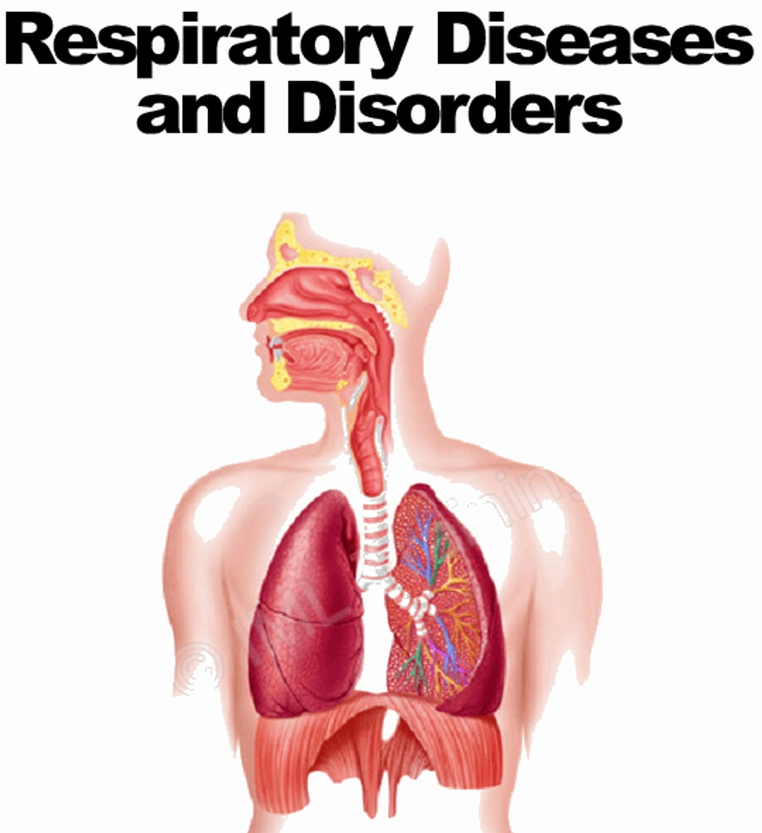
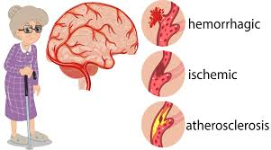
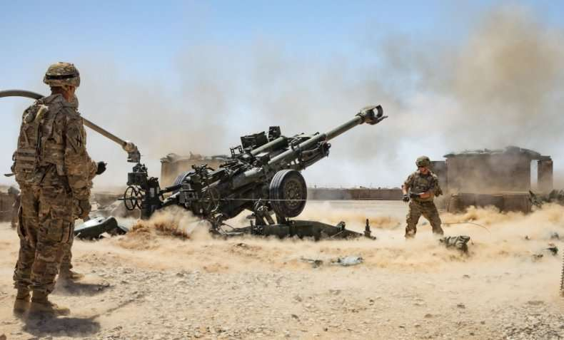
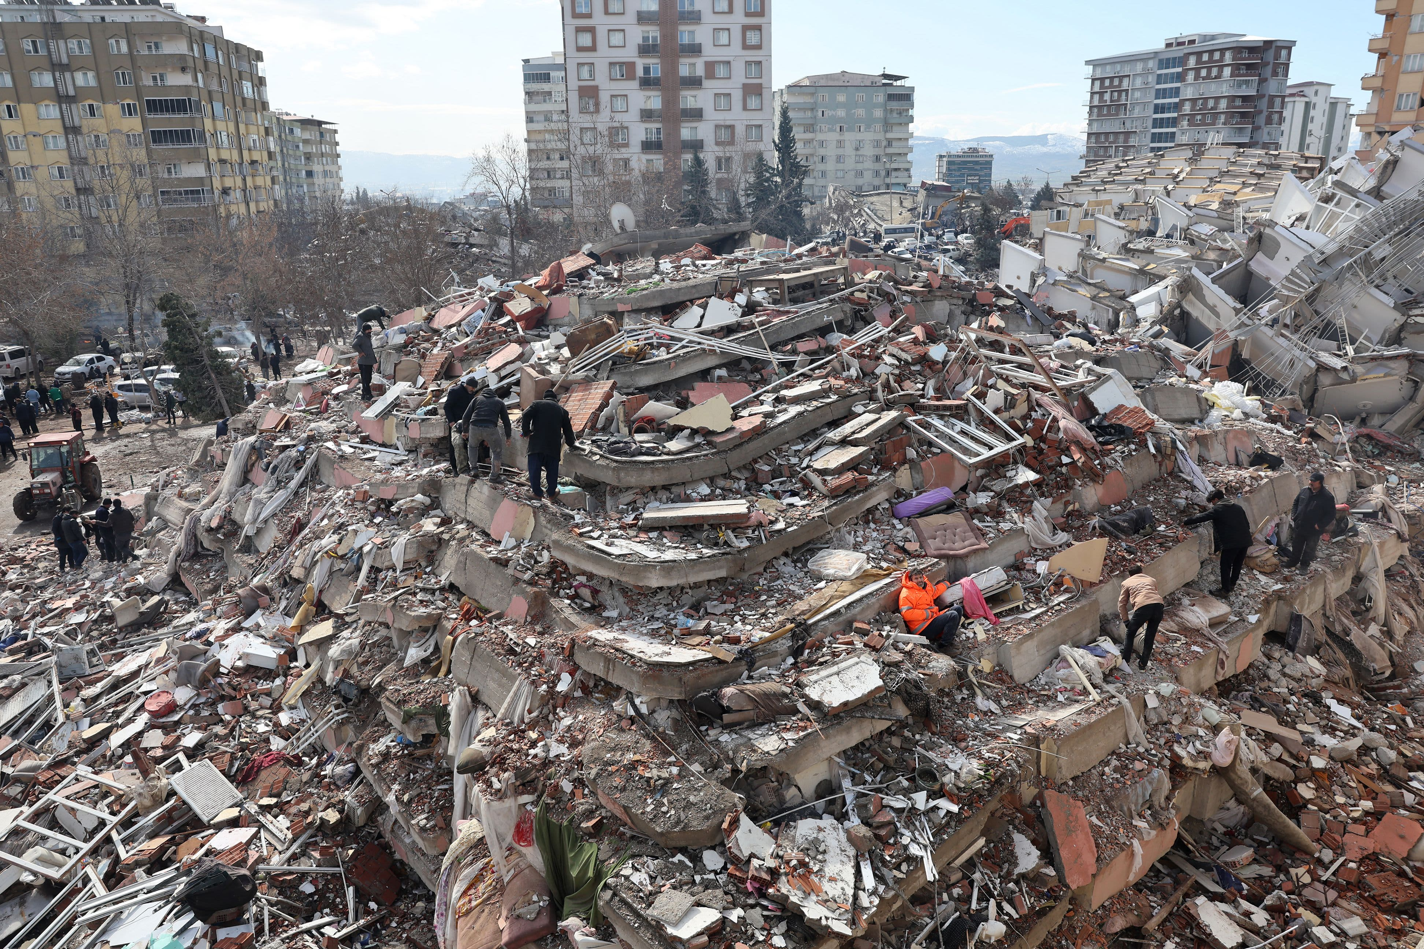
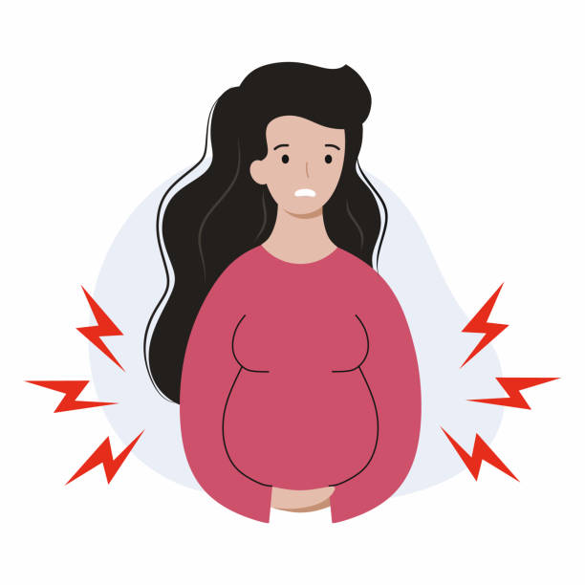
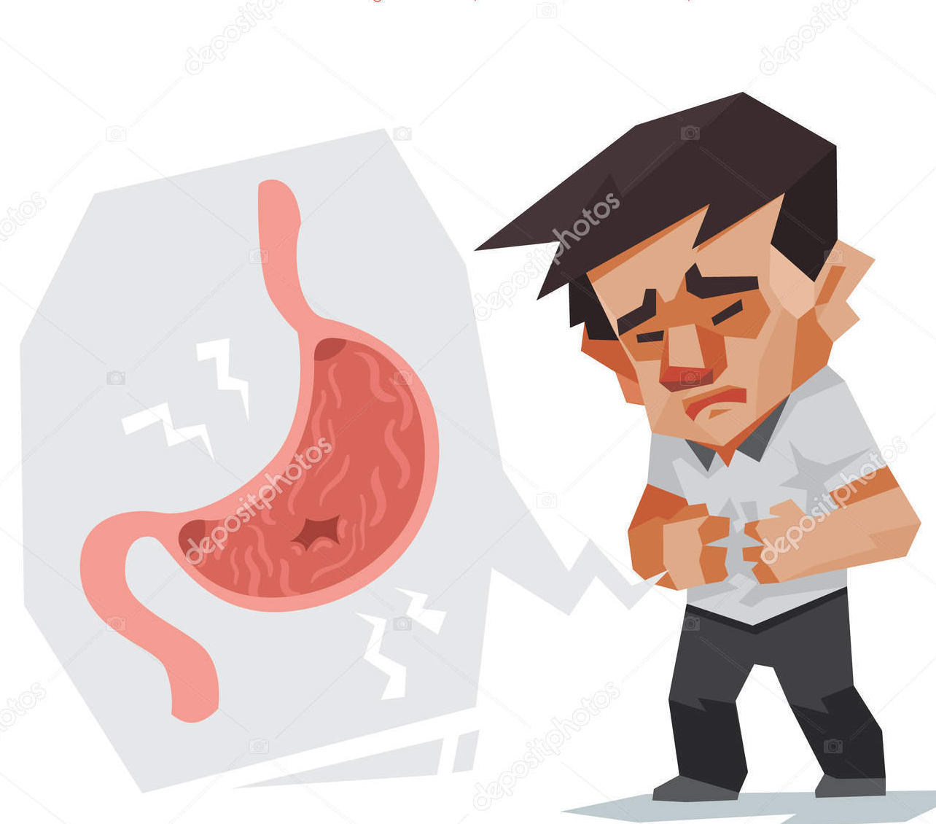
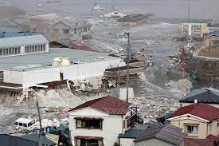
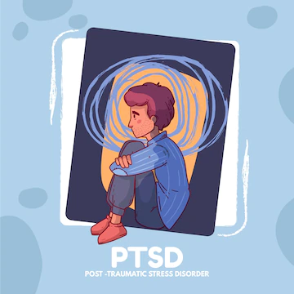
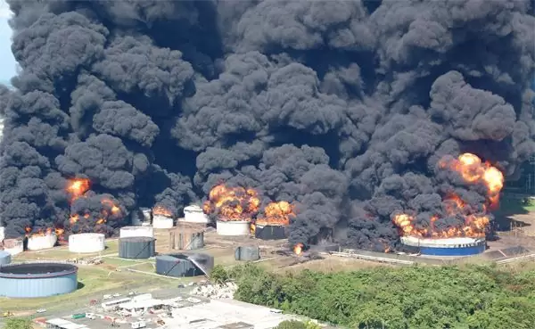
Spectrum of Medical Problems During Disasters (1): Problems Occurring within disaster period
Unrelated to the type of disaster
Related to particular disasters
Wars
Armed conflicts
Gunshot wounds
Penetrating and blunt traumas
Terrorist attacks
Hurricanses
AMI
Stroke
Eathquakes
Crush Syndrome
Tsunamis
Floods
Obstetrical
problems
Peptic ulcer&
GI bleeding
Seizures
Drowning
Typhoons
Nuclear wars
Accidents
Acute radiation syndrome
Other psychiatric disorders
& suicides
Industrial
Accidents
Chemical burns
Infections
PTSD
Sever et al, American Journal of Disaster Medicine, 2018; Vol. 13, No. 4
Notes:
to several parts of the body (after disasters causing collapse of buildings,
In the case of massive disasters overall pressure on the community is overwhelming; the number of victims is enormous; damage to infrastructure is extensive; local organization is disturbed,
and society is affected by severe disruption of
its activities, necessitating external help to subsist

Slide 5
Nephrological Problems at Times of Disasters
Crush Syndrome
AKI due to other reasons
Organization of patiens on RRT
Hemodialysis
Peritoneal Dialysis
Renal transplant patients
Management of patients with CKD, hypertension, GN and others

Slide 6
CRUSH SYNDROME

Slide 7
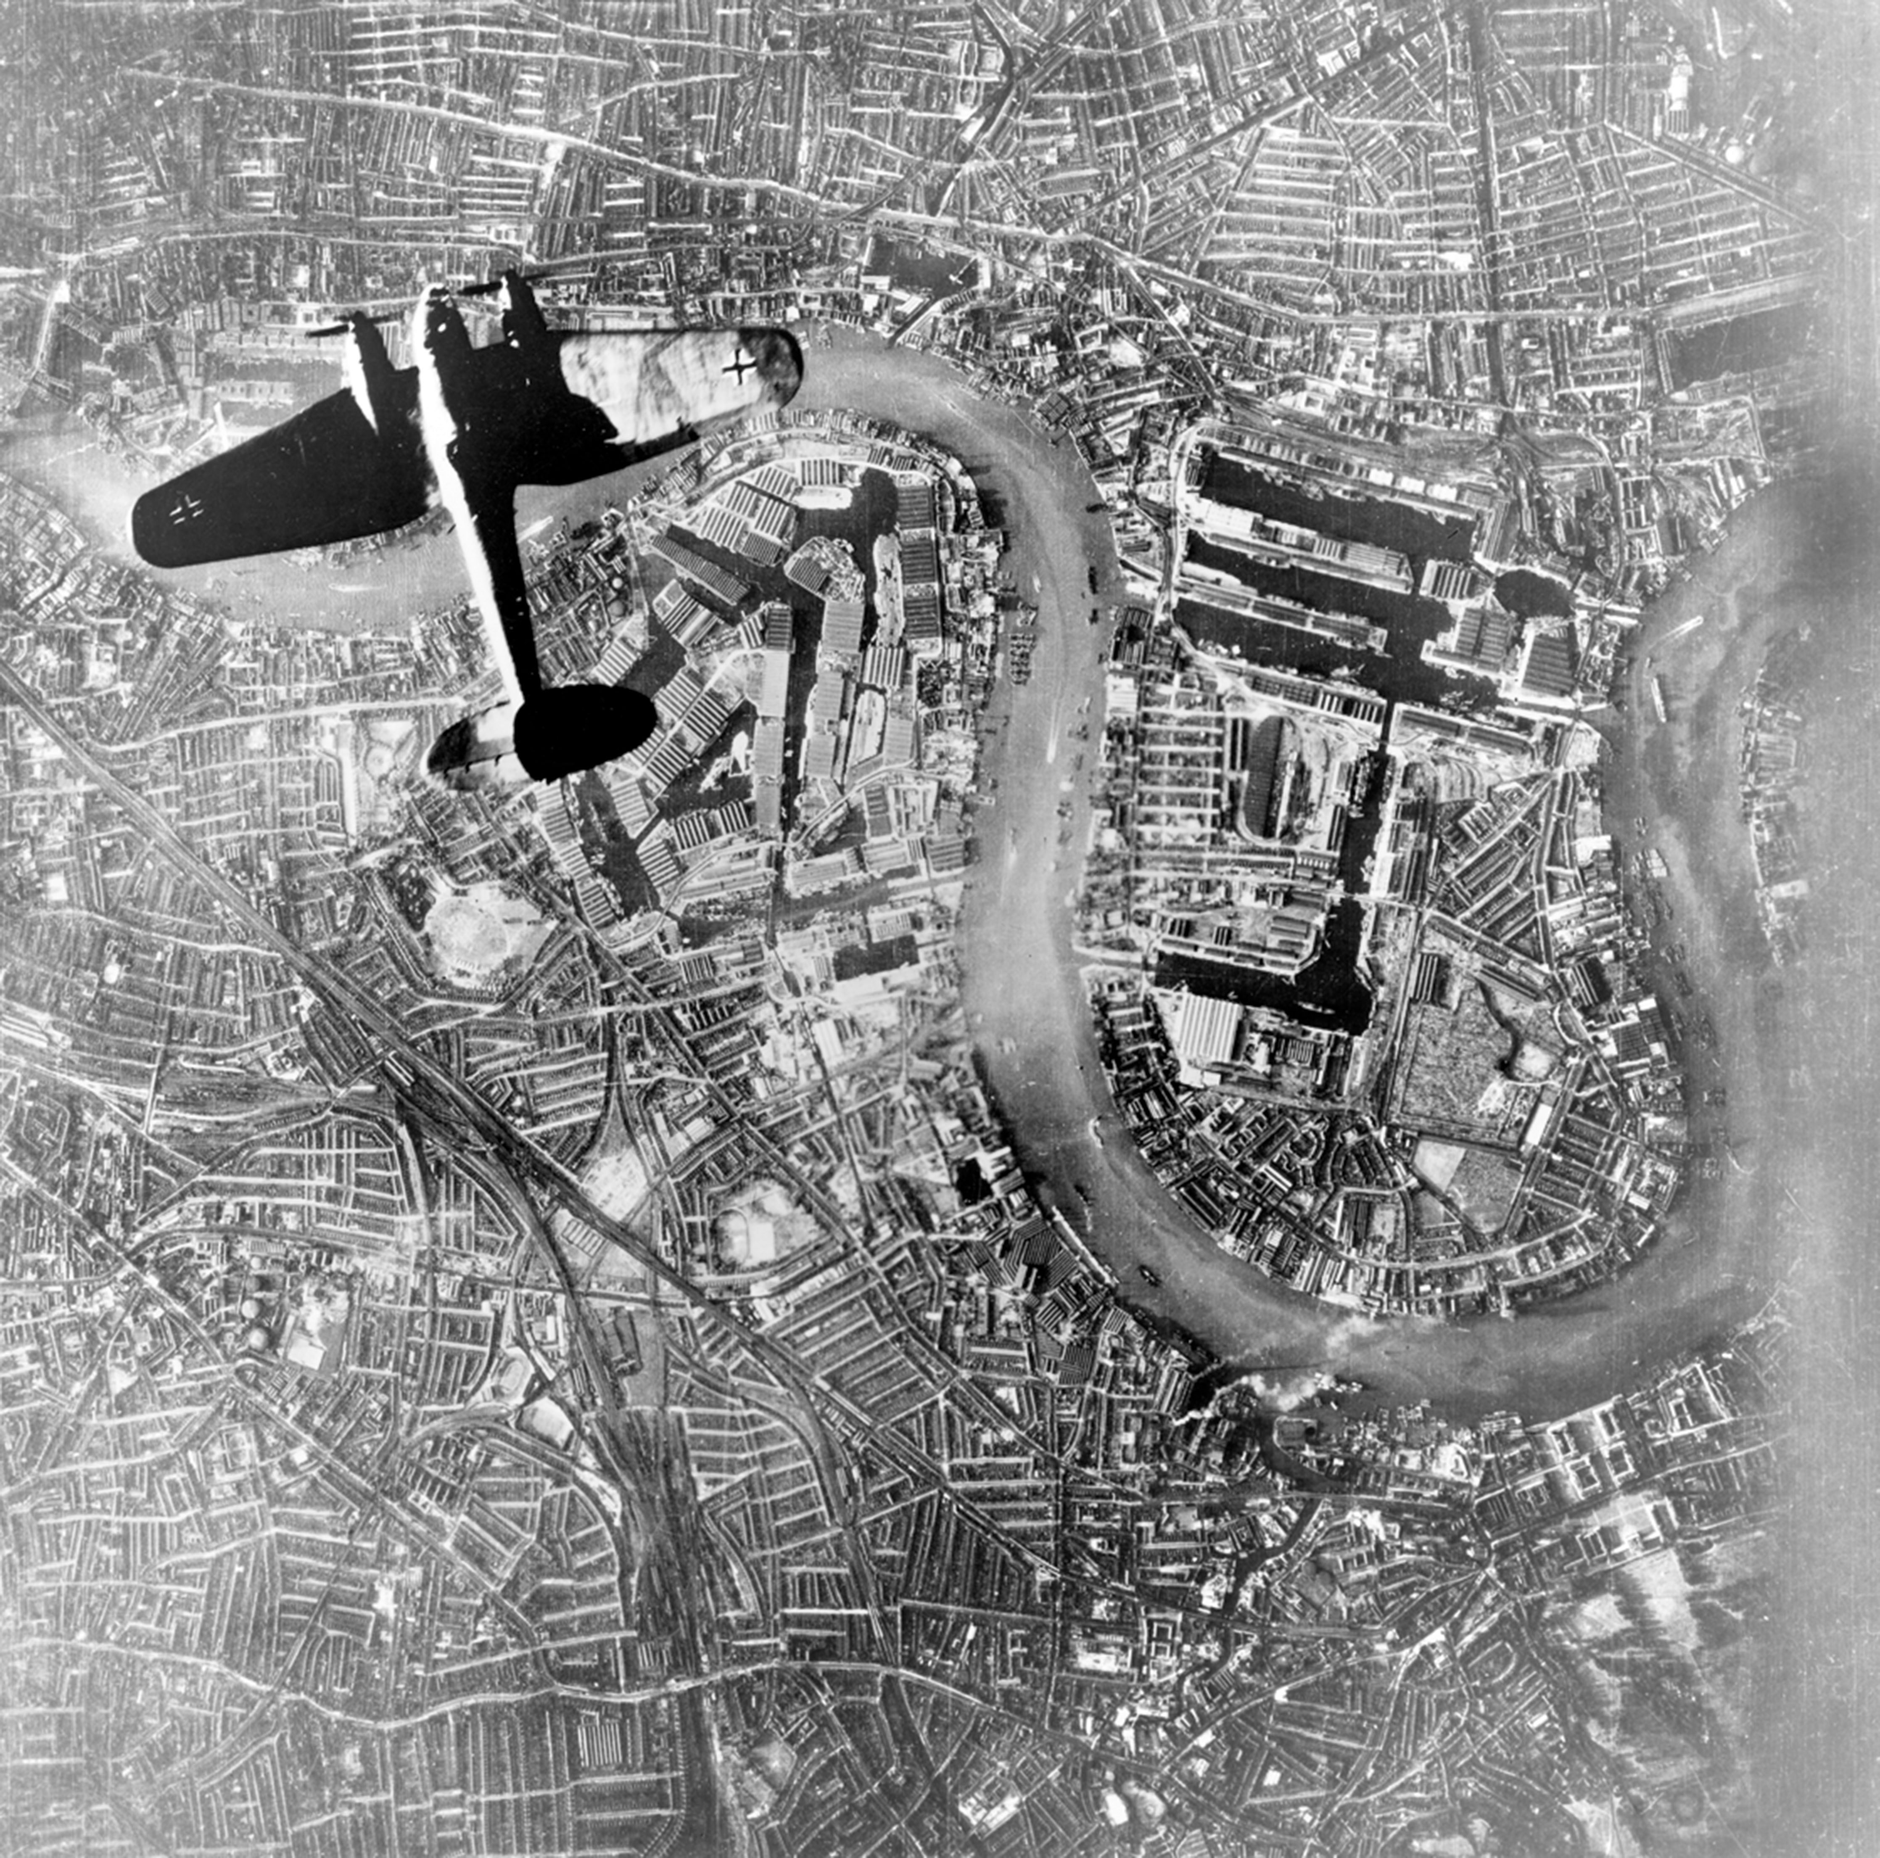
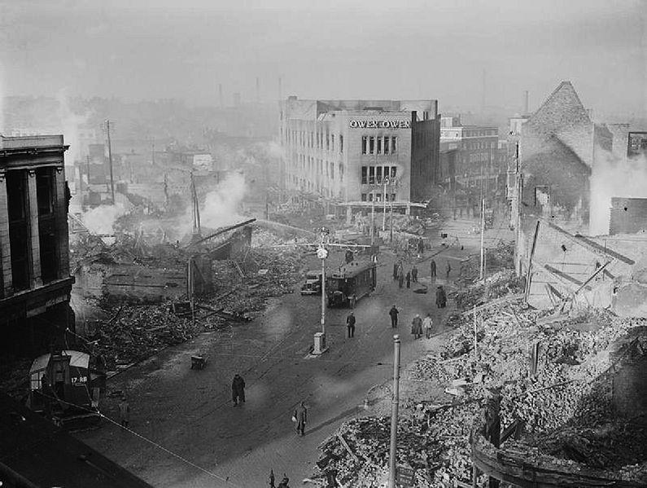
The Blitz
London bombing during the II.World War
> 40 000 civilians died

Slide 8
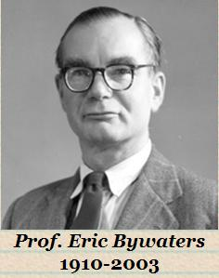
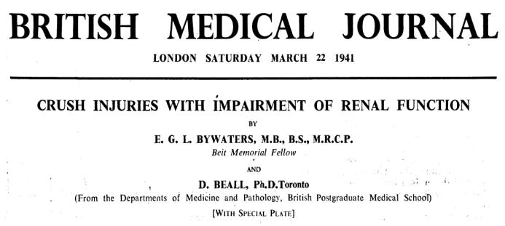
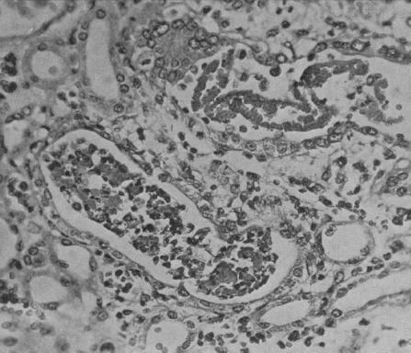
4 cases of Crush Syndrome
3 oliguric
Dark coulered Urine
All died
Conclusion:
Kidney failure caused by Crush Syndrome frequently result in death

Slide 9
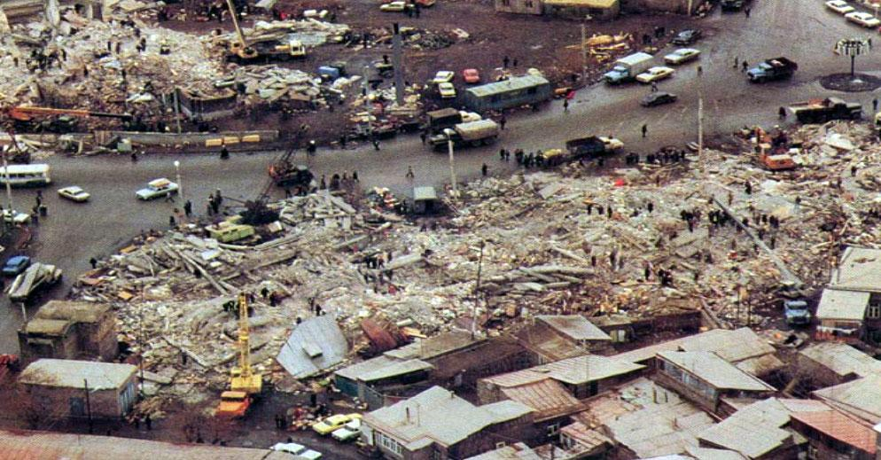
THE ARMENIAN EARTHQUAKE (1988)
Intensity: 6.8; deaths: 100,000?
‘‘RENAL DISASTER’’

Slide 10
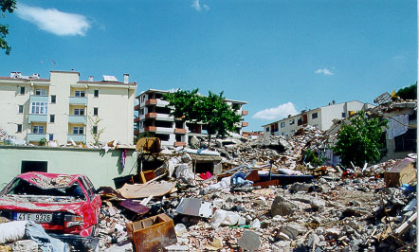
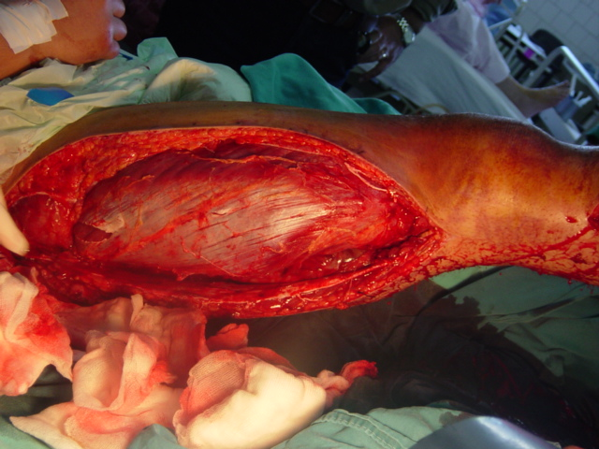
Crush Syndrome
80% ⇒ Acute Death
10% ⇒ Minor injury
10% ⇒ Major injury
After Acute Death due to Major Trauma
(Most common 2. cause of Death)
“R E N A L D I S A S T E R”
Ron et al. Arch Intern Med 1984
Ukai. Ren Fail 1997

Slide 11
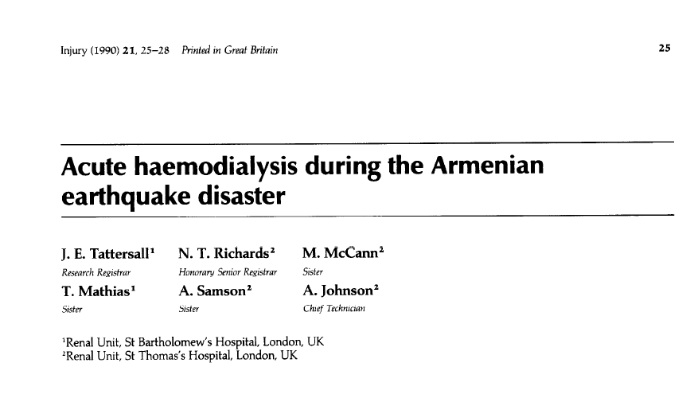
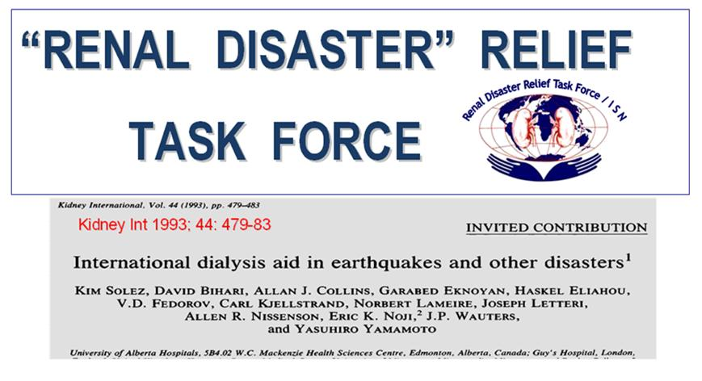
No organized international support structure was available
Eknoyan G. Ren Fail 1992; 14: 241

Slide 12
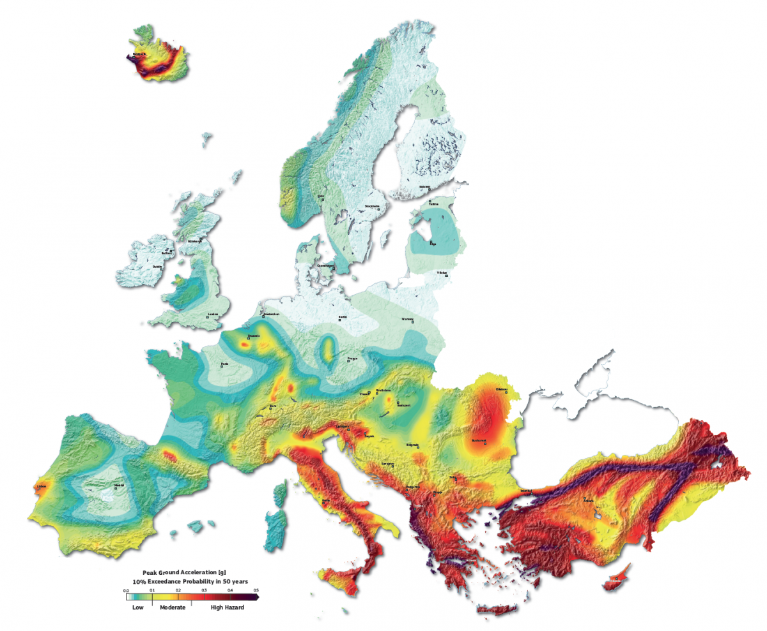
The Balkan region is one of the most seismically active regions in Europe
Slovenia
Croatia
Bosnia & Herzegovina
Montenegro
Albania
Serbia
Romania
Bulgaria
Greece
Turkey
The European Seismic Hazard Map
Notes:
The European Seismic Hazard Map displays the ground motion expected to be reached or exceeded with a 10 % probability in 50 years. Blue colours indicate comparatively low hazard areas, yellow to orange colours indicate moderate hazard areas, and red colours indicate high hazard areas.© SHAREThe European Seismic Hazard Map. Blue colours indicate comparatively low hazard areas, yellow to orange colours indicate moderate hazard areas, and red colours indicate high hazard areas.© SHARE
All the information was combined on a single map that shows thick purple zones running through the areas of south-east Europe where earthquakes are more likely, and where they can cause the greatest damage to society. It shows the areas where there is a 10 % or larger probability of experiencing the mapped level of ground shaking within 50 years.
‘It is the first state-of-the-art reference hazard model for Europe,’ said Dr Artur Pinto, the head of the European Laboratory for Structural Assessment at the Joint Research Centre, the EU’s in-house science service, in Ispra, Italy. ‘It can be useful for future policies regarding different kinds of buildings and infrastructure such as dams, tall buildings or even bridges.’
< The #Balkan region is one of the most seismically active regions in Europe,where major material damages and human losses due to earthquakes havebeen recorded throughout history. In this paper we analyze data on earthquakes, collected from the OFDA/CRED International Disaster Database. Catastrophic losses were caused by 62 earthquakes in countries within the region: Slovenia, Croatia, Bosnia and Herzegovina, Montenegro, Albania, Serbia, Romania, Bulgaria,Macedonia and Greece. A significant number of people in the Balkan region were killed (4974) or were affected (2033723) by the earthquakes and that many countries suffered significant material damages (10410.16 million USD) >>

Slide 13
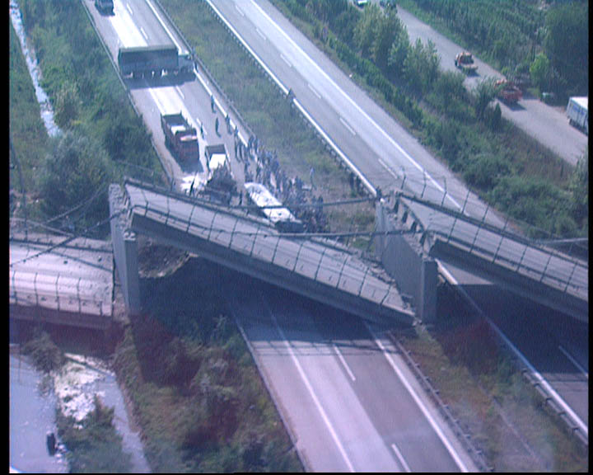
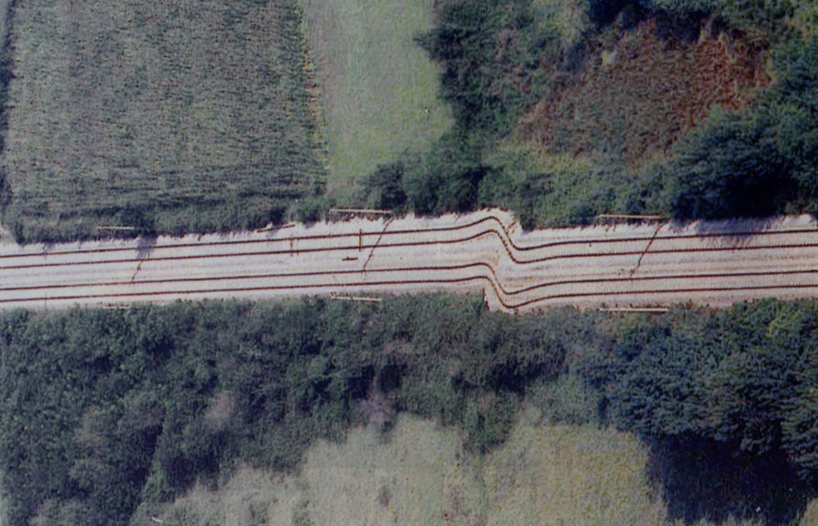
1999-Marmara Earthquake
LESSONS LEARNT

Slide 14
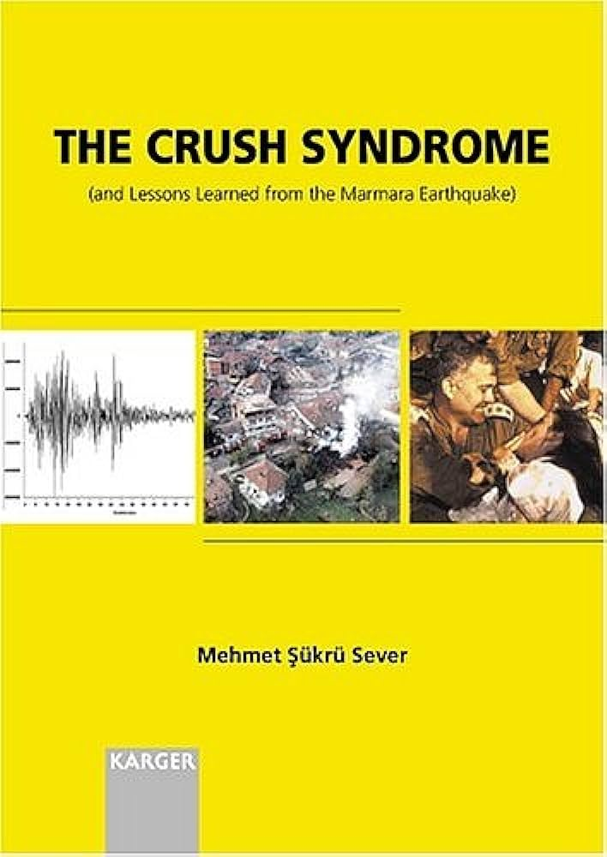
Lessons Learnt from the 1999 Marmara Earthquake
Crush syndrome occurs in 2-5% of all victims rescued from under the rubble at times of earthquakes
50-75& of crush patients need RRT-Hemodialysis
Rescue operations should continue relentlessly for at least 2 weeks
Fasciotomies should be made with the right indications, right extent : otherwise infections and sepsis is unavoidable
Amputation should only be made if the extremity is threatening the life
Organization before the disaster occurs is key to mitigate the after effects

Slide 15
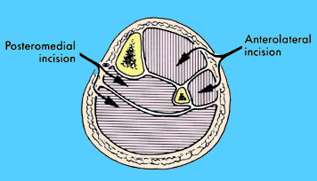
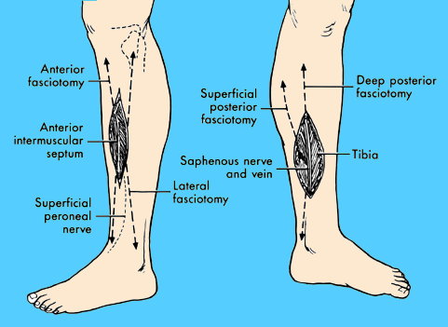
CRUSH SYNDROME
SURGİCAL
Local Findings
Compartment syndrome
Other traumas
thorax, abdomen, head, spine
Medical
Hyperkalemia
Acidosis
Hypovolemic shock
AKI
CV &Respiratory Failure
Infections
TRAUMATİC
RHABDOMYOLISIS
OF ALL İNJURED %2-5
OF ALL RHABDOMYOLİSİS %30-50
Notes:
DEFINITIONS AND EPIDEMIOLOGYSystemic manifestations that are induced by crush injury are often referred to as crush syndrome. According to some estimates, the incidence of crush syndrome ranges between 2 and 5 percent of all injured victims of catastrophic earthquakes [7-10] and 30 to 50 percent of patients with traumatic rhabdomyolysis. Children are at a lower risk of suffering from crush-related injury [9,11,12] and, if injured, have a lower risk of mortality [9]. All disaster victims, irrespective of whether they are mildly or severely injured, should be considered at increased risk of crush syndrome. (See "Severe crush injury in adults", section on 'Crush syndrome'.)
The incidence of crush-injury-related AKI and the frequency with which dialysis is required in these cases have varied widely in different studies. The following reports have analyzed these aspects as part of crush injury following catastrophic earthquakes.

Slide 16
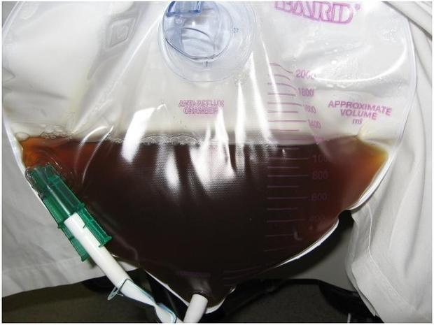
Crush Syndrome : Clinical & Laboratory Findings Initial management
Traumatic Crush findings
Other trauma findings (+/-)
Hypotension (+/-)
Oliguria/Anuria
Dark urine (+/-)
+in 50%
Hyperpotassemia
Acidosis
Hyperphosfatemia
Hypocalsemia
Creatinine kinase increase
AST increase
İv insülin /dx
Calcium
Bicarbonate
Betamimetics
HEMODIALYSIS
Notes:
Biochemical abnormalities — The biochemical abnormalities that characterize rhabdomyolysis-associated AKI include hyperkalemia that may be life threatening, hyperphosphatemia, hypocalcemia (which is occasionally followed by hypercalcemia during the recovery stage), a high creatine kinase (CK), and a low fractional excretion of sodium. These are discussed elsewhere. (See "Clinical features and diagnosis of heme pigment-induced acute kidney injury".)
High serum levels of myoglobin are very rarely detected because of the short half-life of myoglobin and its quick clearance from the plasma.
DIAGNOSISPatients with rhabdomyolysis-induced acute tubular necrosis (ATN) typically present with a red to brown color of the urine without presence of erythrocytes at microscopic examination, pigmented granular casts in the urinary sediment, varying severity of kidney dysfunction, and a marked elevation in the plasma creatine kinase (CK) level. (See "Clinical manifestations and diagnosis of rhabdomyolysis".)
Myoglobinuria dependent on myoglobin content, GFR, urinary concentration

Slide 17
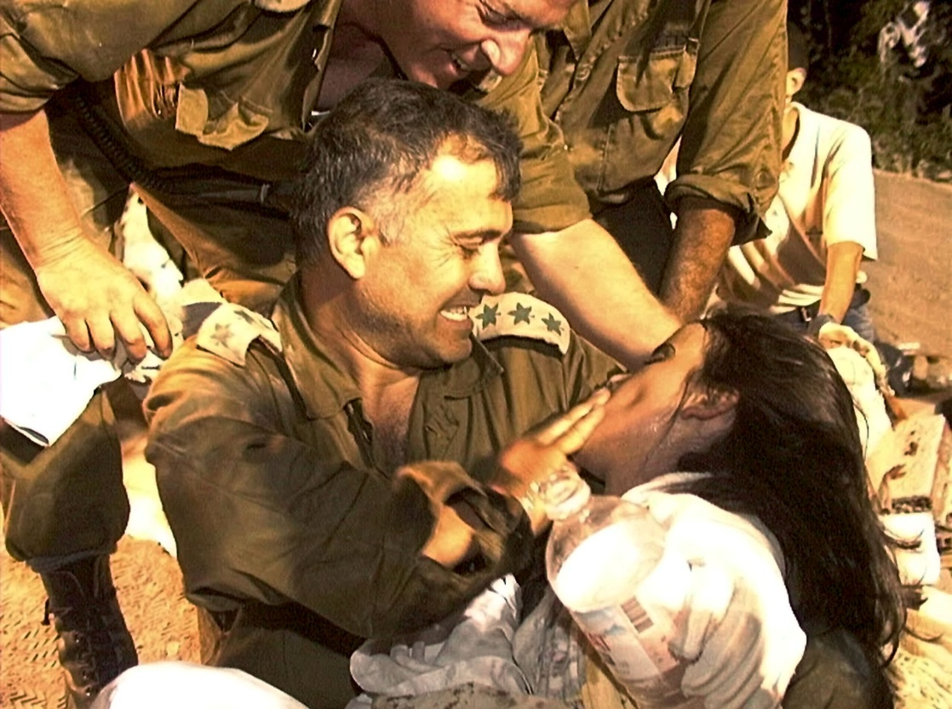
The victim rescued from under the rubble can rapidly deteriorate and die
Severe metabolic acidosis
Hyperkalemia
RESCUE
DEATH
Rescue teams must have first aid instructions
Medical staff should be present in rescue teams

Slide 18
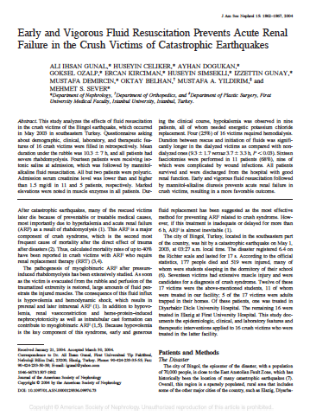
Is it Possible To Prevent Crush Syndrome?
The best preventive measure in the disaster field is correcting the fluid deficiency
Aggressive fluid ressucitation should be started during the rescue efforts
Early and intense fluid treatment will prevent AKI
Vanholder R, Sever MS : Crush-related acute kidney injury Uptodate; Sep 18, 2020
Notes:
The most important preventive measure at the disaster field is the correction of volume depletion. During volume resuscitation, the timing and rate of fluid administration, volume of fluids, and also types of fluid are important elements to consider.
Before and during extrication — Aggressive fluid repletion should be started before the extrication of entrapped subjects who are prone to develop crush syndrome, if possible
Third spacing at the site of muscle injury worsens hypovolemia. Thus, patients with rhabdomyolysis may require massive amounts of fluid (up to 20 liters) to trigger and maintain a vigorous diuresis [22].
Children similarly require early and aggressive fluid resuscitation. Intravenous fluids at the rate of 15 to 20 mL/kg/h should be started when the victim is still under the rubble. If extrication takes longer than two hours, then the rate of fluid administration should be reduced to 10 mL/kg/h or lower [25]. If fluids cannot be given before extrication, then volume resuscitation should begin as soon as possible after extrication

Slide 19
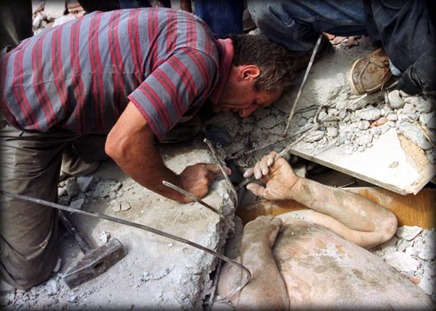
A victim has been localized under a rubble
BEFORE EXTRICATION FROM UNDER THE RUBBLE
Try to find an iv access
Couldn’t find i.v. access
Found i.v. access
Fluids not started
Start Isotonic saline (NaCl) 1L/h
DURING EXTRICATION FROM UNDER THE RUBBLE
Continue Isotonic saline (NaCl) 1L/h
Rescue lasted > 2 hours
Slow down the infusion: Isotonic saline (NaCl) < 0.5L/h
Vanholder R, Sever MS : Crush-related acute kidney injury Uptodate; Sep 18, 2020
Notes:
*The rate is reduced because patients cannot be closely monitored when they are under the rubble and there is a risk of giving too much fluid
¶ Generally, up to 12 L/day IV fluid can be administered in patients with good urine output (ie, >300 mL/hour). We give 4 to 4.5 L more than total fluid loss from the prior day.
The actual amount depends on extent of injuries, body mass index, ambient temperature, urine production, amount of overall

Slide 20
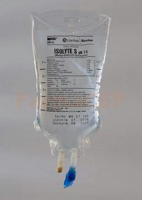
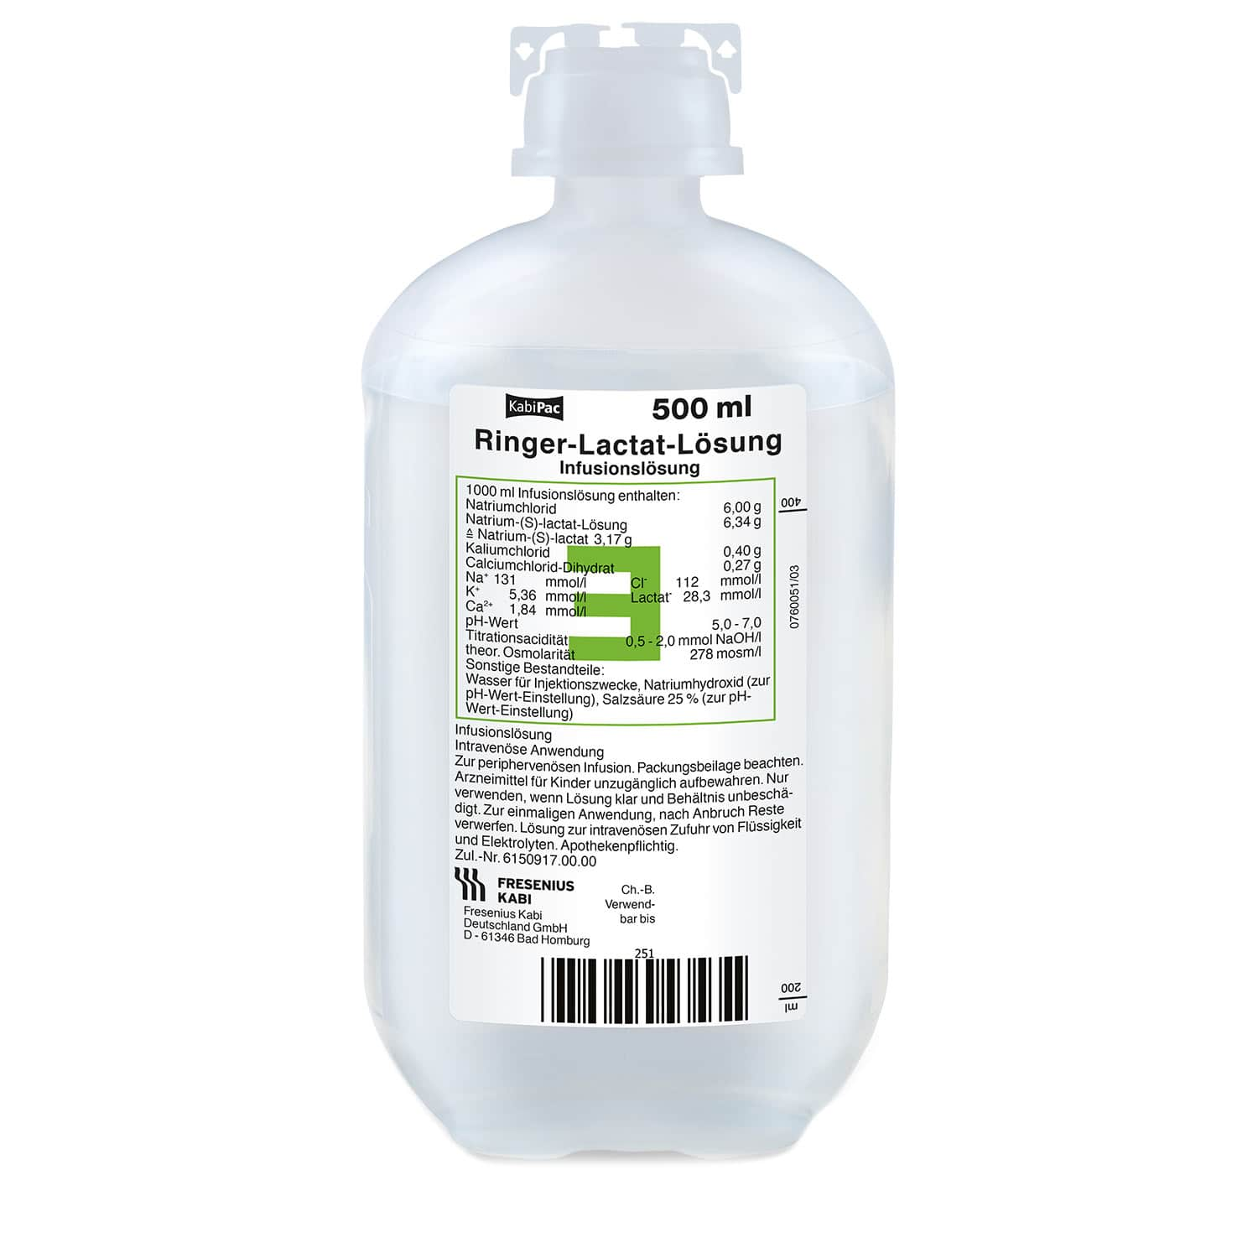
FOLLOWİNG RESCUE
(No fluid before rescue)
(Received fluid during rescue)
Start Isotonic NaCl
Continue Isotonic NaCl
Give 3-6L overall (can be subject to change according to circumstances)
(Watchful follow-up for 6 hours)
Anuria
Urinary Output +
0.5-1 L/day + calculated loss of the previous day i.v
Close follow-up
impossible
Close follow-up
possible
3-6 L/day i.v.
6 L/day i.v.
Vanholder R, Sever MS : Crush-related acute kidney injury Uptodate; Sep 18, 2020

Slide 21
Following Mass Disasters…
Authorities concentrate on the most urgent needs
Housing/Shelter
Food
Sanitation- prevention of epidemia
Rescue operations
Transportation
Safety issues
What about patients with chronic diseases and with special needs
Diabetes, Oncology, Chronic Kidney Disease, CVD, HT
Patients on dialysis, elderly, disabled
General
Population
Patients with
Special needs
Notes:
Patients with special needs are a minority of the general population, their needs may be overlooked by the authorities.

Slide 22
Patients on RRT at times of Disasters: Challenges
For patients on HD
Access to dialysis centers may not be possible
Dialysis staff may themselves be unable to reach to the center and/or may not be able to work
Acess to medications may be impaired
Dialysis centers may be unable to operate
Patients may be on dialysis during the disaster
For patients on PD
Access to solutions may not be possible
APD may not be used due to power cut-offs
Hygienic environment may not be available
For patients with kidney transplant
Access and availability of immunosuppressive medications may be a problem

Slide 23
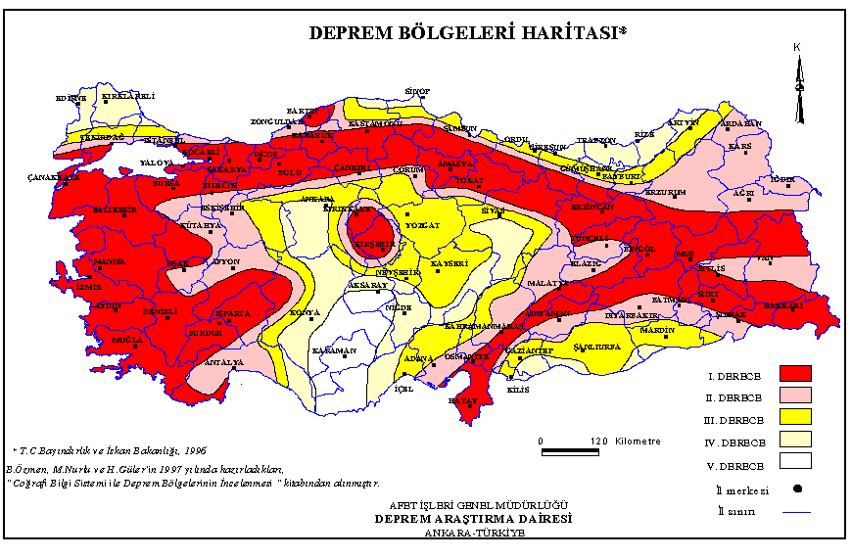
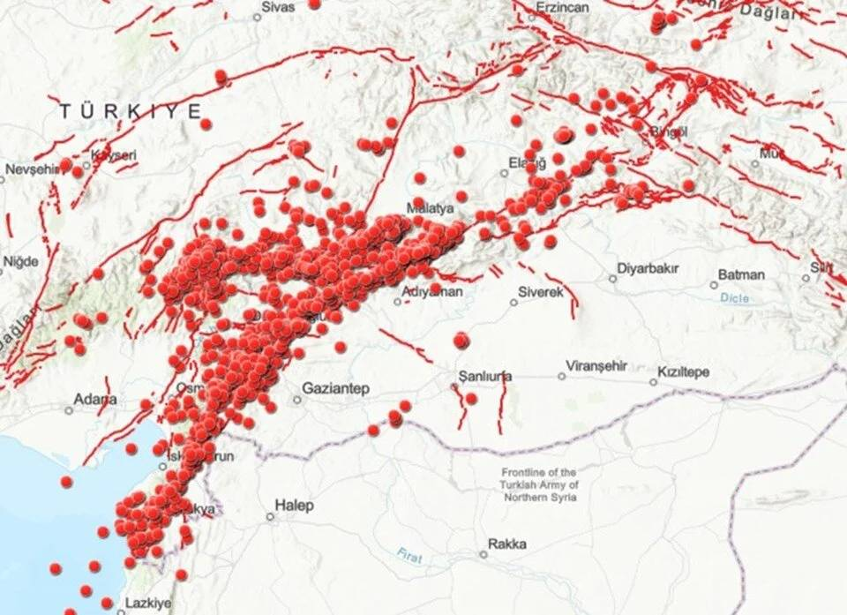
Notes:
6 Şubat 2023 sabah saat 04:17’de doğu Anadolu bölgesi önceden yaşanan depremlerden belki hiçbiriyle mukayese edilemeyecek kadar büyük bir yıkıma yol açan deprem ile sarsıldı.
İlk çalışmalar 7,7’lik depremi yaratan faydaki yırtılmanın, Pazarcık, Narlı civarından başlayarak, Çelikhan’a doğru, daha sonra Kırıkhan’civarından Türkoğlu’na doğru geliştiğine işaret ediyor.

Slide 24
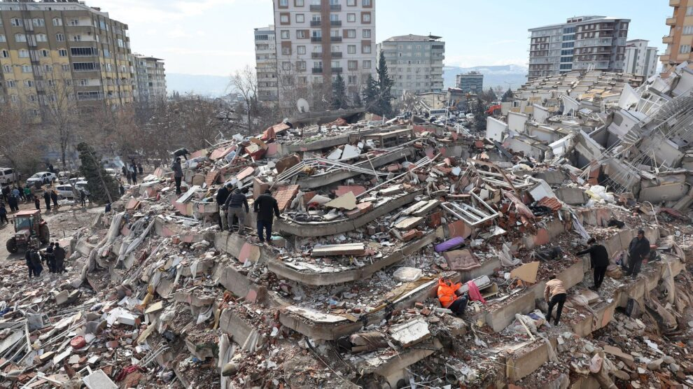

Slide 26
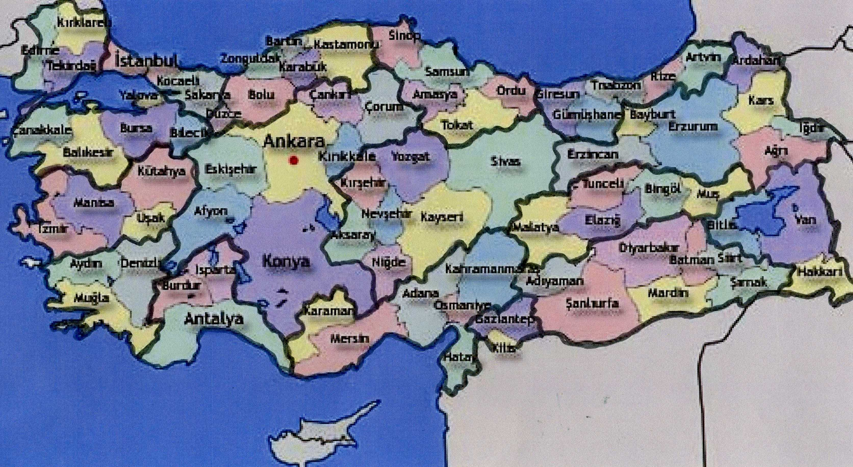
Renal Disaster Task Force of TSN and Distribution of Regions
2021
Dr. Dr. S. Tuğlular
Dr. M. Koç
Dr. R. Kazancıoğlu
Dr. S. Öztürk
Dr. Mahmut Gök
Dr.M. Polat
Dr. H. Sayarlıoğlu
Dr. M. Sipahioğlu
Dr. İ Koçyiğit
Dr. A.Uyanık
Dr. K. Kaynar
Dr. S. Üstündağ
2
1
Dr Faruk Hilmi Turgut –Antakya
Dr Çiğdem Mengiç-Adıyaman
Dr.Özkan Güngör - KMaraş
Dr.Erkan Mahsereci-Gantep
Dr Mehmet Tuncay-Gantep
Dr Kenan Turgutalp –Mersin
Dr Ayşe J.G Keskin-Mersin
Dr Serhan Pişkinpaşa-İskenderun
Dr Ramazan Danış-Diyarbakır
Dr Dilek Torun-Adana
Dr. Berfu Korucu-Osmaniye
15
14
Dr. A. Oruç
13
3
12
17
4
16
11
10
Dr. C. Çavdar
Ender Hür
9
Dr. Y. Yeniçerioğlu
Dr. B. Dursun
5
6
7
8
Dr. F. Sarı
Dr. Z. Eren
Dr. E. Coşkun
Dr. F. Dede
Dr. İ. Karayaylalı
Dr. C Usalan
Dr T Şahutoğlu
Dr. A Doğukan
Dr. Z. Yılmaz
Notes:
Koordinatörlerin koordinatları

Slide 27
What does the local RDTF do?
Disaster free
period
Immediate disaster period
Recovery
Phase
Educational activities
Health staff/rescue teams
Prevention and treatment of Crush Syndrome
Organization of dialysis
Patients
How to survive when dialysis not available
Drink less, avoid K containing food ect.
Medications should be within easy reach, ready to grab- a month’s supply
How to detach from dialysis
Planning of services
Rapid communication within the TF
Information about the extent of damage- regular updates through local coordinators
Defining the needs: supplies, medication, health staff: dialysis nurses support
Re-organize patient distribution
Avoid burn out, support through volunteers
Re-assess the needs
Define pitfalls
Assess the damage, lossess
Analyze data

Slide 28
The First Day of the Earthquake: 06.02.2023/05:08
RDTF whatsapp group activated immediately
Information about the extent of damage/problem from local coordinators
Patients with Crush injuries can arrive at the hospitals only after rescue operations start: At least 6-12 hours
Preparing a volunteer list of nephrologists/ dialysis nurses/technicians who can rotate to the region to avoid burn out
Learning about dialysis capacity in the cities outside the earthquake region through another communication group with dialysis centers- functional-nonfunctional dialysis centers – transfer of patients to functional units
Communicating with all the local nephrologists through local coordinators
Sharing documents already prepared before
Diagnosis and Treatment of Crush Syndrome- short
Crush Guidelines (2012)– ERBP/ERA paylaşıldı
Treatment of Crush Syndrome on the field -TSN
Daily virtual meetings with the local coordinators to re assess the needs and plan
Antakya Emir Diyaliz

Slide 29
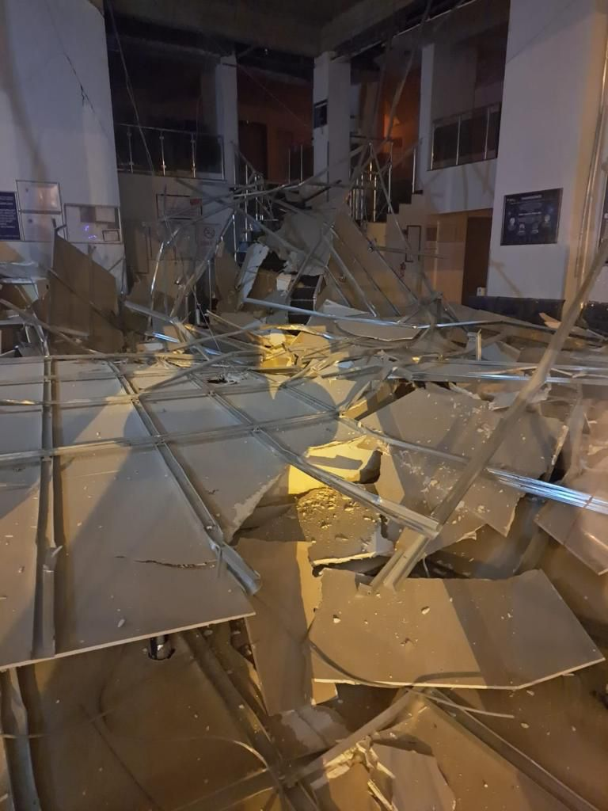
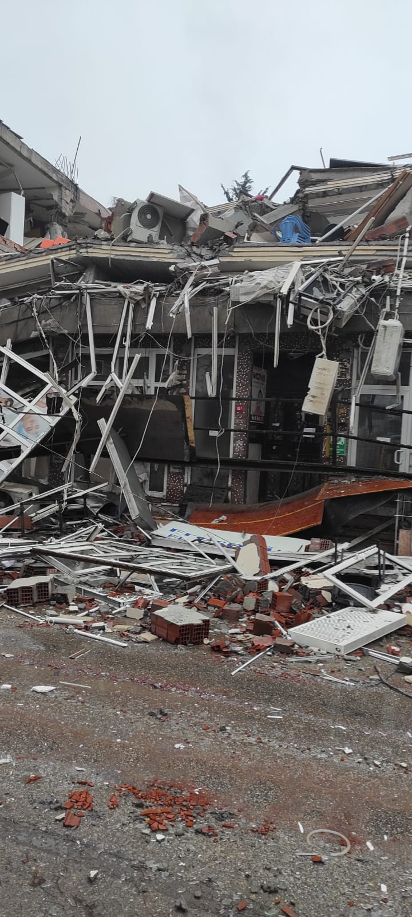
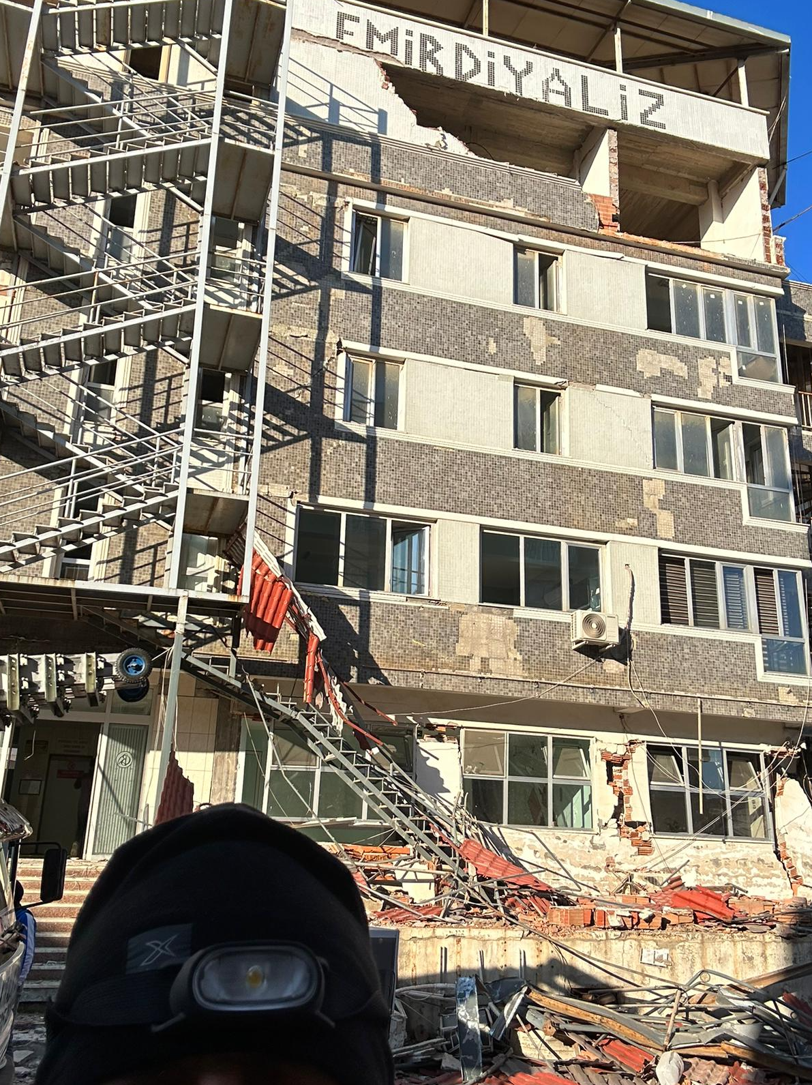
Reyhanlı
Dörtyol
Adana
İskenderun
Mersin
Diğer iller
Hatay Emir Diyaliz
Malatya Diyaliz Merkezi
Adıyaman Diyaliz Merkezi

Slide 30
Major points of planning
Estimated number of crush injuries- 1500
Transfer of patients on chronic dialysis to private/state satellite units
Preparing the hospitals to receive crush injuries
Organizing the shifts for nurses and doctors
Numbers of patients with Crush injuries reaching the hospitals

Slide 31
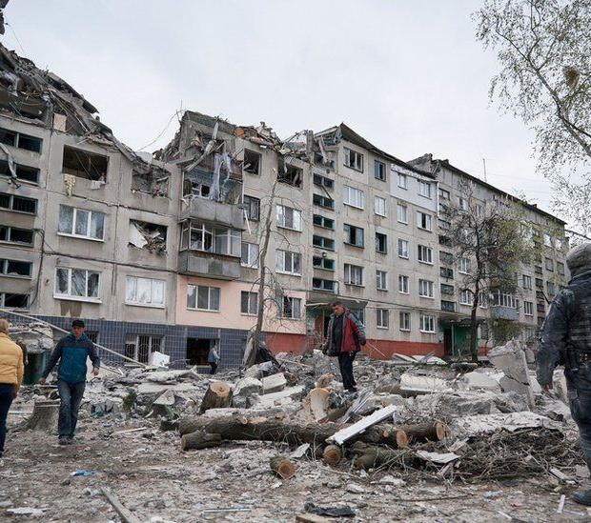
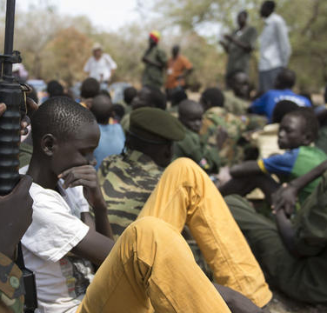
Sudan
Man –Made Disasters:
Armed conflicts
Ukraine

Slide 32
How is an International RDRTF helpful
Supporting for supplies: dialysis, catheters, medications, health staff: dialysis nurses, technicians, doctors.
Catalyzing communication between NGOs, procurers
Marmara Earthquake
1999
>600 Crush cases
Ukraine Crisis/2022
Armed conflict
10000 Dialysis pts/ 700 displaced
1500 tx pts-
Sudan Crisis
Civil War
2022
8000 Dialysis Pts
4000 Tx Pts
ISN-RDRTF
MSF
ERA-RDRTF
MSF/WHO/Direct Relief
FMC/Bbraun
Chiesi/Vifor
ISN-ERA-ASN
AFRAN

Slide 33
To conclude…
No where in the World is free from disasters
Patients with kidney diseases are among the most vulnerable
Preparedness is the key to mitigate the effects of disasters
Renal Disaster Task Forces may have an important role in preparedness for disasters
Notes:
personel ve materyalin kesintisiz şekilde
temini, dağıtımı, yerinin değiştirilmesi

