Slide 1
THE IMPACT OF CORONAVIRUS DISEASE- 19 (COVID- 19) ON KIDNEY TRANSPLANT FUNCTION
Severova G¹, Canevska- Taneska A¹, Janeku- Kartalov M², Dzekova- Vidimliski P¹, Milenkova M¹, Spasovska A¹, Gjorgjievski N¹, Pushevski V¹, Nikolov I¹, Severova- Stojanovska A¹, Janevski Z¹, Trajceska Lada¹, Rambabova- Bushletik I¹ and Spasovski G¹.
¹ University Clinic of Nephrology
² University Clinic for Infectious Diseases and Febrile Conditions

Slide 2
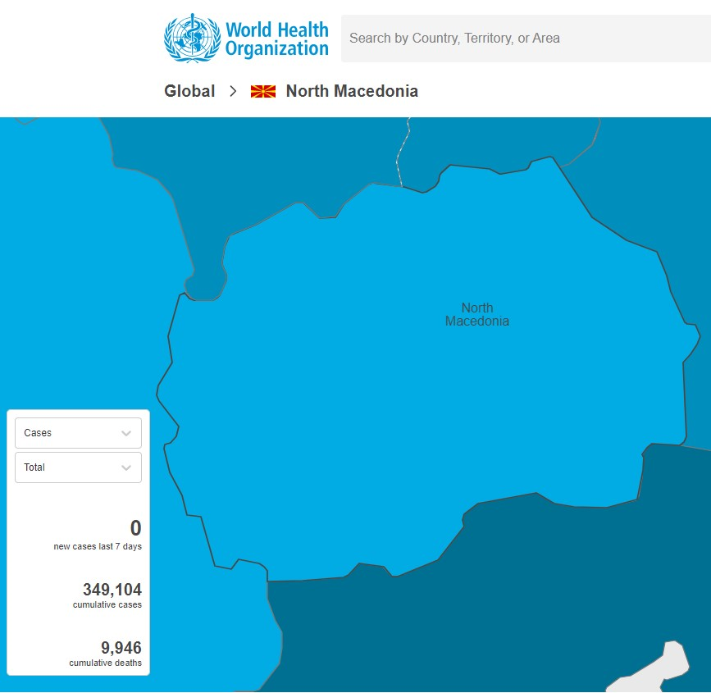
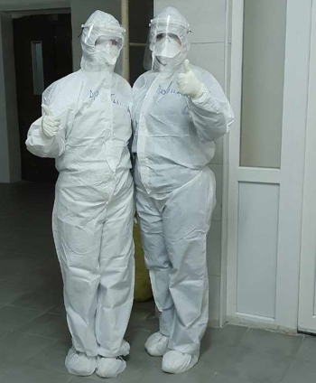
INTRODUCTION Aim: Does COVID-19 affects the function of the transplanted kidney 1 year later?
general practitioners, UC for infectious diseases and febrile conditions, departments for infective diseases in general hospitals, COVID- 19 centers at internal clinics and at surgical clinics
treated according to the protocols for COVID-19 by the local authorities
population in RN Macedonia ~ 2 milliоns
population on hemodialysis ~ 1500
kidney transplant patients ~ 300 (population with an increased risk of any type of infection) great challenge.

Slide 3
MATERIAL AND METHODS
period: March 2020 to March 2022
patients with transplanted kidney and positive PCR for SARS CoV-2
symptoms of mild, moderate and severe form of COVID-19
followed for one year, with standard laboratory tests
renal function was evaluated by monitoring of:
- serum creatinine (µmol/L),
- calculating glomerular filtration rate (GFR) with CKD epi equation (ml/min)
- proteinuria (qualitatively and quantitatively)
D0- baseline (before COVID-19) and D1- one year later.

Slide 4
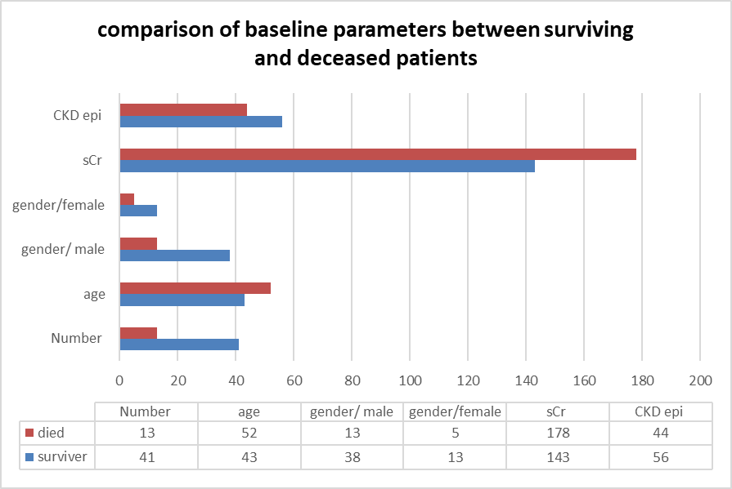
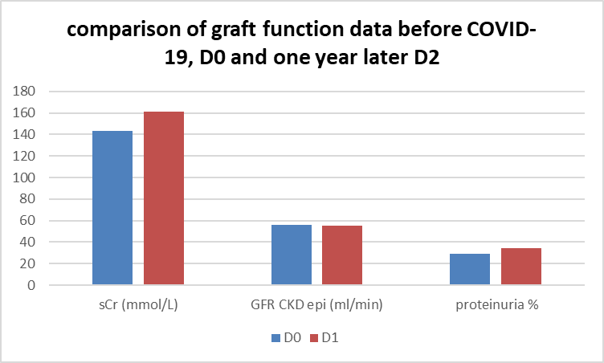
RESULT:
total 64 patients
mean age of 44±1.4
hospitalization 47 (73%), mechanical ventilation 12 (56%), 10 (15%) hemodialysis
13 (20%) died
57 v.s. 44; p=0,012
173 v.s. 143; p= 0.04
29% v.s. 34%

Slide 5
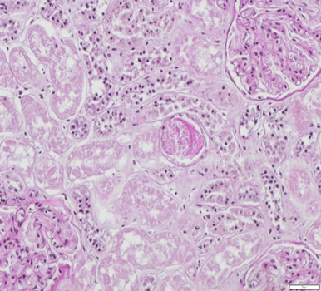
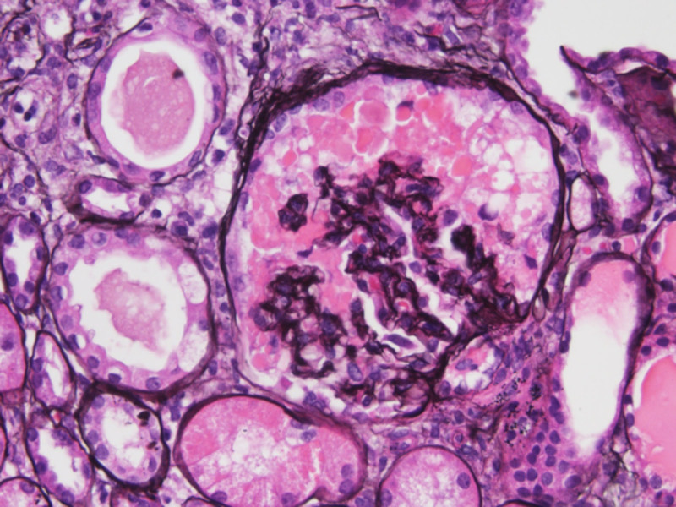
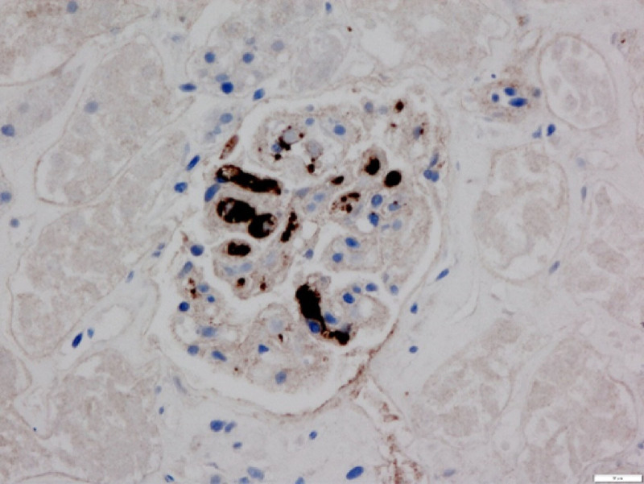
DISCUSION
Pathohistological findings from renal biopsy in COVID-19 pts
Meghan E.Kapp et all. Renal Considerations in COVID-19: Biology, Pathology, and Pathophysiology. ASAIO J. 2021 Oct; 67(10): 1087–1096.
increase in serum creatinine
decrease in GFR
appearance of proteinuria
Fig.1 Acute tubular injury with cytoplasmic vacuolization, blebbing, and loss of brush border (periodic acid Schiff, original magnification ×200).
Fig.2 Collapse of glomerular tuft with overlying visceral epithelial cell hyperplasia with protein droplets diagnostic of collapsing glomerulopathy (Jones’ silver stain, original magnification ×400).
Fig.3 Thrombosis in glomerular capillary loops with CD61-positive staining (anti-CD61 IHC, original magnification ×200).

Slide 6
CONCLUSION
COVID-19 affects graft function
Further follow-up at 3 and 5 years is needed for more precise results.

