Slide 1
MORTALITY AND RISK FACTORS FOR COVID-19 IN PATIENTS ON HEMODIALYSIS: SINGLE CENTER STUDY
Vlatko Karanfilovski, MD
University Clinic of Nephrology, Skopje,
Republic of N. Macedonia

Slide 2
COVID-19 IN PATIENTS ON HEMODIALYSIS
Hemodialysis (HD) patients are particularly vulnerable to SARS-CoV-2 infection due to uremia-related immune system dysfunction and coexistence of comorbid conditions like obesity, hypertension, diabetes mellitus (DM) and cardiovascular diseases (CVD)¹.
The prognosis of HD patients was poorer than in the general population, with the majority requiring hospitalization and more than one in five deaths¹.
The aim of our study was to assess outcome and risk factors for mortality from COVID-19 among patients on chronic hemodialysis.
Methods:
Retrospective, observational, single-center study included 71 patients on HD with SARS CoV-2 infection confirmed by RT-PCR, hospitalized in the COVID unit at University Hospital of Nephrology in Skopje (Nov. 2020 to Feb. 2022).
Medical histories were used to collect data for demographic characteristics, laboratory parameters, treatment, and outcomes of the patients.
1. Stefan G et al. Ren Fail. 2021

Slide 3
COVID-19 IN PATIENTS ON HEMODIALYSIS
Characteristics of the study cohort
Characteristic | Result
Gender | 39 patients (54.9%) male |  | 32 patients (45.1%) female
Mean age | 66.9 ± 11.3 years
Mean HD vintage | 57.4 ± 62.8 months
Etiology of kidney failure | Hypertension (28.2% - 20 patients) | Diabetes (19.7% - 14 patients)
Mean period from a positive COVID-19 test to hospitalization in the COVID unit |  | 5.7 ± 5.8 days
Mean hospital duration in the COVID unit |  | 9.8 ± 5.8 days
Need for O2 therapy on admission | 83.1% were on O2 therapy (O2 saturation 87.9±9.4%)
 | 16.9% were not on O2 therapy (O2 saturation 92±6.4%)
Comorbidities | 50.7% had hypertension, 47.9% had CVD, 8.5% had DM, 29.6% had gastrointestinal disorders, 15.5% had malignancy, and 70.4% had KF plus 2 other comorbidities
Therapy | All patients were treated with antibiotics, 83.1% received oxygen therapy, and 85.9% received corticosteroids.
Notes:
Mild
• Any signs/symptoms of COVID-19 without shortness of breath or low SpO2 or clinical
signs of pneumonia or abnormal chest X-ray finding
Moderate
• Clinical signs of pneumonia or imaging suggest pneumonia without low SpO2
Severe
• *SpO2 <90% on room air or Respiratory rate >30 breaths/min or signs of severe
respiratory distress such as inability to complete full sentences, use of accessory muscle
Use
Critical
Respiratory failure, septic shock and/or multiple organs dysfunction

Slide 4
COVID-19 IN PATIENTS ON HEMODIALYSIS Comparison between survived and deceased patients
Characteristic | Survived patients (42 patients – 59.2%) | Deceased patients (29 patients – 40.8%) | p - value
Albumin on 1th day | 34.4 ± 4.3 g/l | 31.6 ± 7.7 g/l | 0.000
Lactate dehydrogenase (LDH) on 1th day | 309.5 ± 108.5 U/l | 396.4 ± 234 U/l | 0.002
D-dimer on 1th day | 2209.3 ± 3487.1 ng/ml | 4994.2 ± 6462.4 ng/ml | 0.002
Albumin on 5th day | 32.6 ± 3.8 g/l | 29.9 ± 6.8 g/l | 0.005
LDH on 5th day | 252.2 ± 101 U/l | 474.4 ± 262.2 U/l | 0.000
Creatine kinase (CK) on 5th day | 209.4 ± 961.0 U/l | 1144.3 ± 4310.4 U/l | 0.015
C-reactive protein (CRP) on 5th day | 45.5 ± 40.8 mg/L | 96.3 ± 84.3 mg/L | 0.040
Need for O2 Therapy | 29 patients | 42 patients | 0.020
For all other analyzed demographic and laboratory parameters there was no statistically significant difference between survived and deceased patients.
The serum level of LDH on the 5th day was the only independent predictor associated with mortality in HD patients with COVID-19 (p<0.009) and was higher in deceased pts
Notes:
Univariate Cox regression analysis for risk factors associated with COVID-19-related death in dialysis patients showed significant increases in risks with …
In a multivariate analysis, only LDH 5 was found to be significantly associated with death

Slide 5
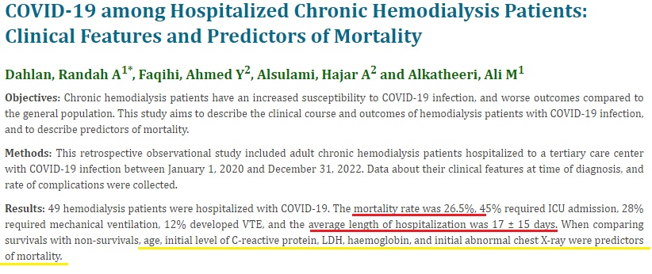
COVID-19 IN PATIENTS ON HEMODIALYSIS
According to our internal data (total 1486 patients) the overall in-hospital mortality of general population with COVID-19 was 25.5 %. Comorbidity that was most significantly associated with in-hospital mortality was pre-existing CKD (OR 3.37).
Cancarevic et al. (meta analysis – 37.280 HD patients)²:
2/3 of patients infected by COVID-19 were hospitalized
17.4% required ICU admission and 23.3% died
Risk factors for mortality: Diabetes, lower SpO2, dyspnea, elevated White blood cells (WBC), CRP and ferritin were associated with adverse outcome.
Conclusion: The need for oxygen therapy, low albumin levels, and high LDH, D-dimer, CK, and CRP levels were associated with the outcome of HD patients with COVID-19 infection, but only LDH level on the 5th day was the independent predictor associated with mortality.
²Cancarevic I et al. World J Virol. 2022

Slide 6
Thank You for Your attention

