Slide 1
“LYMPHOCYTE SUBPOPULATIONS HAVE PREDICTIVE VALUE IN THE DEVELOPMENT OF ANTIBODIES AFTER VACCINATION AGAINST SARS-COV-2 IN HEMODIALYSIS PATIENTS AND KIDNEY TRANSPLANT RECIPIENTS”
I. Mallioras¹, Ch. Georgopoulos ¹, A. Duni^{1,2}, G. S. Markopoulos³, C. Pappas^{1,2}, E. Pappas⁴, V. Koutlas², E.Tzalavra², G. Baxevanos^{3,5}, Si.Priska⁶, G. Katagis⁷, Konstantina Gartzonika⁷, George Vartholomatos³, C. Milionis⁸, E. Christaki⁸, M. Mitsis², E. Dounousi^{1,2,6}
¹Department of Nephrology, University Hospital of Ioannina, Greece, ²Department of Surgery and Kidney Transplant Unit, University Hospital of Ioannina, Greece, ³Laboratory of Hematology - Unit of Molecular Biology, University Hospital of Ioannina, Greece, ⁴Renal Unit, General Hospital of Filiates, Greece, ⁵Ιnternal Medicine Department, Hatzikosta General Hospital of Ioannina, Greece, ⁶Department of Nephrology, School of Medicine, University of Ioannina, Greece, ⁷Microbiology Laboratory, Faculty of Medicine, School of Health Sciences, University of Ioannina, Greece ⁸ Department of Internal Medicine, School Of Medicine,University Of Ioannina,Greece

Slide 2
Introduction and aim
During the COVID-19 pandemic, mortality due to SARS-COV-2 infection in hemodialysis (HD) patients and kidney transplant recipients (KTRs) has been reported high
The adequacy of the respective generated immune responses is significantly lower than the general population
Booster doses have been recommended by multiple health systems and the World Health Organization
The aim of our study was to determine the predictive value of lymphocyte subpopulations in the production of antibodies against SARS-CoV-2 after the second dose of the vaccine
Notes:
As we all know….

Slide 3
Notes:
This is our first publication regarding the matter, where we prove that the production of antibodies against sars cov-2 is associated with cd19 b lymphocytes and the ratio of cd45RA and cd45RO

Slide 4
MethodS
Multicenter, prospective study from January 2021 and still ongoing… (ClinicalTrials.gov, NCT04932876)
Study population: 34 HD patients and 54 KTRs who received two doses of the BNT162b2 (Pfizer–BioNTech)
Exclusion criteria included previous infection by SARS-CoV2 as well as infection during study follow-up
Lymphocyte subpopulations (B cells, CD4+ and CD8+ T cells as well as naïve and memory T lymphocytes subpopulations) were analyzed
34 HD patients
54 KRTs
1st Dose
2nd Dose
Τ0
Τ1
Τ2
January 2021
Notes:
As for the methods of our study, this is…

Slide 5
MethodS
Titers >50 arbitrary units (AU)/ml were considered positive for seroconversion at T1 and at T2.
A multiple linear regression model was applied, separately to the two subgroups of patients
Notes:
Titers above…..
And we applied a….

Slide 6
Results -KTRs
The mean age of the kidney transplanted recipients was 58,5 years of age
The populations of CD19+, CD3+CD16+56+ and CD4+CD45RO have predictive role on antibody formation (p-ANOVA<0.001) based on the multiple regression model:
Ab=4869+519*CD19-226*CD3+CD16+56-139* CD4+CD45RO.
Notes:
Starting with the KTRs…
and the mr model proved that the ……

Slide 7
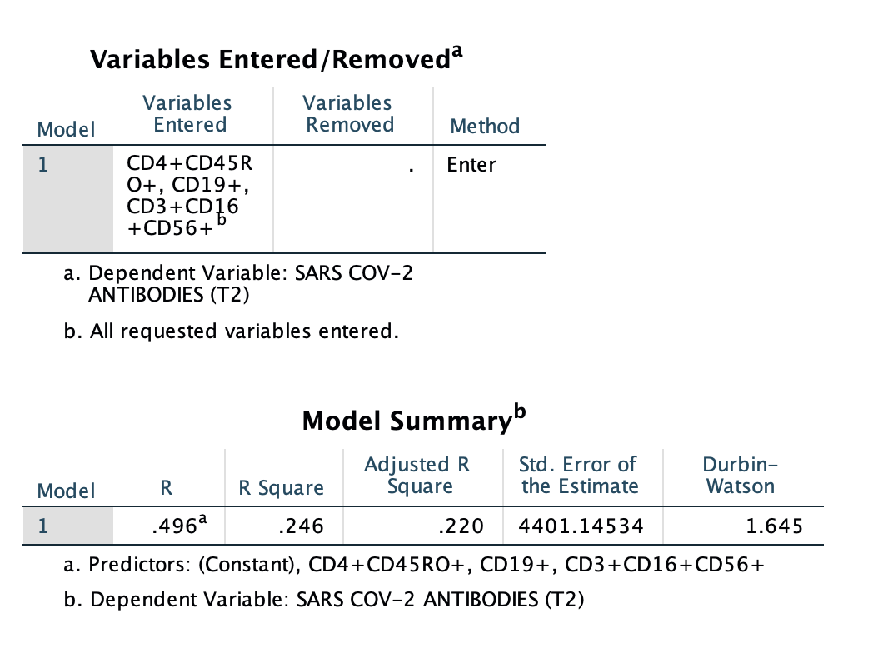
Results -KTRs
The multiple regression model meets the following criteria:
No multicollinearity of the variables was observed ( all VIF<10)
No autocorrelation of the residuals was found ( D>du>1.505)
Normality and homoscedasticity of the independent variables
The regression model explains the variation of the dependent variable (Ab), according to the adjusted $R^{2}$ index, at a rate of 24%
Notes:
Of course when a mr model is applied we need to check for statistical errors…
The regression model meets all the necessary criteria since …..
Another important take from this regression model is the high percentage

Slide 8
Results-HD patients
The mean age of HD patients was 68,5 years of age
The analysis of HD patients revealed that the populations of CD19+, CD45RA+CD45RO, CD4/CD8, CD3-CD16+56+ and CD4+CD45RO can predict antibody formation (p-ANOVA<0.001) based on the multiple regression model:
Ab=20267+835.3*CD19-286*CD45RA+CD45RO-
375.2*CD4+CD45RO+851*CD4/CD8-187.3*CD3-CD16+56+
Notes:
Moving to the hemo patients….
And the really interesting take from this regression model is that there seems to be at least 6 sub-populations of lymphocytes that play an important role in the antibody formation .

Slide 9
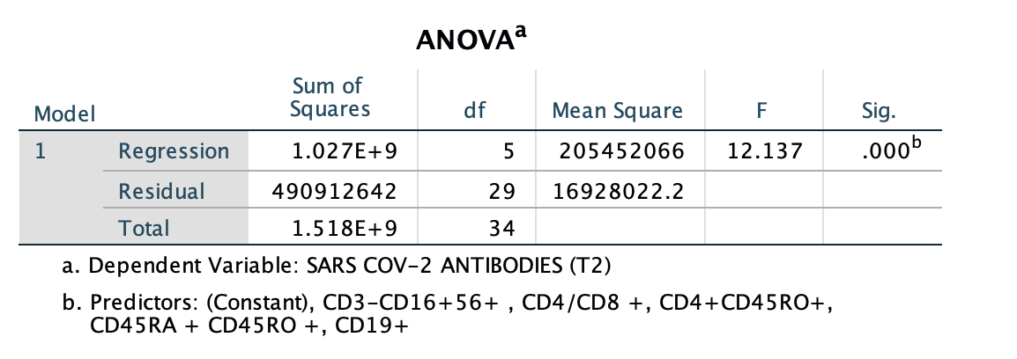
Results-HD patients
The multiple regression model meets the following criteria:
No multicollinearity of the variables was observed (all VIF<10)
No autocorrelation of the residuals was found (D>du>1.671)
Normality and homoscedasticity of the independent variables
The regression model explains the variation of the dependent variable (Ab), according to the adjusted $R^{2}$ index, at a rate of 67%
Notes:
With statistically significant results, as you see the p-value of anova is lower than 0.05
And checking for statistical errors, no….

Slide 10
Limitations of the study
Relatively small sample size may cause the model to “overfit” the data, reducing the model’s generalisability
As always a multiple regression model can only establish correlations and not causations
Many other confounding factors may affect the regression model results (KTRs –immunosuppressants)
Notes:
The limitations of our analysis is a relatively small sample ….

Slide 11
Conclusions
Quantification of lymphocyte subpopulations by flow cytometry appears to have a significant prognostic value regarding development of antibodies after vaccination against SARS-CoV-2 in KTRs and HD patients
Of particular interest is the significant difference in lymphocyte populations affecting antibody production between HD patients and KTRs, as more populations appear to influence antibody generation in HD patients than in KTRs
More studies are needed to validate these predictive models

Slide 12
Thank you for your attention!

