Slide 1
FREQUENCY OF ADVERSE EVENTS ASSOCIATED WITH THE SARS-COV2 VACCINATION AMONG PATIENTS WITH GLOMERULAR DISEASES
SOPHIA LIONAKI¹, PELAGIA KRIKI², SMARAGDI MARINAKI³, DIMITRA GALITSIOU⁴, EVAGGELIA DOUNOUSI⁵, SOPHIA FLOUDA⁶, IOANNIS BELLOS³, VASILEIOS LIAKOPOULOS⁷, VASILEIOS VAIOS⁷, AGGELIKI SARDELI¹, ZOI KLEINAKI³, DIMITRA PETROU¹, PETROS KALOGEROPOULOS¹, LOUIZA GKIKA-ZERVOU⁵, MARIOS PAPASOTIRIOU⁸, DIMITRIOS GOUMENOS⁸, ALIKI VENETSANOPOULOU⁹, PARASKEVI VOULGARI⁹, EIRINI GRAPSA¹⁰, KONSTANTINOS STYLIANOU¹¹, STYLIANOS PANAGOUTSOS², IOANNIS N. BOLETIS³
1 Department of Nephrology, 2nd Propaedeutic Internal Medicine, Attikon University Hospital, National and Kapodistrian University of Athens, Greece
2 Department of Nephrology, University of Thrace, Alexandroupolis
3 Nephrology and Transplantation clinic, Laiko Hospital, National and Kapodistrian University of Athens, Greece
4 Department of Nephrology, Gennimatas Hospital
5 Department of Nephrology, University of Ioannina
6 Rheumatology and clinical immunology Unit, Attikon University Hospital, National and Kapodistrian University of Athens, Greece
7 Division of Nephrology and Hypertension, 1st Department of Internal Medicine, AHEPA Hospital, Aristotle University of Thessaloniki, Thessaloniki, Greece.
8 Department of Nephrology and Renal Transplantation, Patras University Hospital, Patras, Greece.
9 Rheumatology Department, University of Ioannina, Ioannina, Greece.
10 Department of Nephrology, Aretaieio Hospital, National and Kapodistrian University of Athens, Athens, Greece.
11 Department of Nephrology, University Hospital of Heraklion, Heraklion, Greece.

Slide 2
SARS-CoV-2 vaccination
ADVERSE EVENTS (AE)
LOCAL
Pain
Swelling
Tenderness
Itching
Skin Rash
Allergic Reaction
SYSTEMIC
Headache
Myalgias
Arthralgias
Fever
Chills
Fatigue
Diarrhea
Nausea
Lymphadenopathy

Slide 3
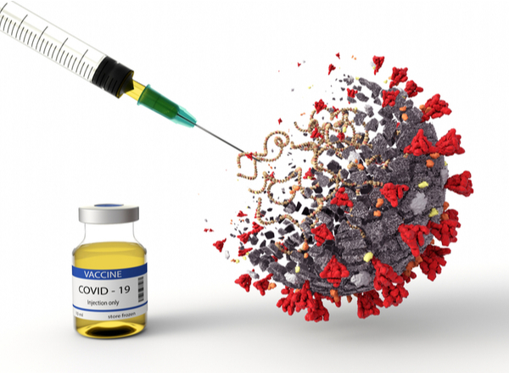
Aim of the study
Evaluate the frequency of AE from the SARS-CoV-2 vaccination in patients with diagnosed glomerular disease (GD)
Evaluate the most common AE in this group
A possible effect of vaccination on kidney function of these patients
Incidence of a GD relapse after vaccination
The difference in relapse rate by histopathological diagnosis

Slide 4
Methods
Retrospective Study
Inclusive criteria:
History of GN diagnosis
Histologically confirmed GN
At least one dose of SARS-CoV-2 vaccination
Exclusive criteria:
Patients with first GN diagnosis after vaccination
Patiens in ESKD before vaccination

Slide 5
GLOMERULAR DISEASES: DEFINITIONS
ANCA-GN
Complete remission: no evidence of active disease – negative urine sendiment – no more need for dialysis
Partial remission: consistent hematuria despite improved renal function (cr_{s})
Relapse: proof of activity in any system
Lupus-GN
Remission: proteinuria <0.5g/24h, stabilization of cr_{s} and improved haematuria
Relapse: Reapperance of hematuria, with or without red blood cells casts, wbc in urine sediment without evidence of infection, increased proteinuria, with or without impaired renal function (increase of serum creatinine)
Minimal Change Disease (MCD)
Complete remission : proteinuria <300 mg/d, stable value of cr_{s} and Alb_{s} >3.5 g/dL
Partial remission: decrease of proteinuria>50 %, between 300 mg and 3.5 g/d
Relapse: proteinuria > 3.5 g/d
Membranous nephropathy (ΜN)
Complete remission : proteinuria <300mg/d and Alb_{s} ≥3.5 g/dL
Partial remission: decrease of proteinuria ≥50 % and proteinuria between 0.3 and 3.5 g/d
Relapse: proteinuria > 3.5 g/d
Focal segmental glomerulosclerosis (FSGS)
Complete remission: proteinuria <300 mg/d, stable value of cr_{s} and Alb_{s} >3.5 g/dL
Partial remission: decrease of proteinuria>50 %, with values between 300 mg and 3.5 g/d, with or without improvement in Alb_{s}
Relapse: proteinuria > 3.5 g/d in patients with complete remission, or an increased proteinuria >50% in patients with partial remission
IgA nephropathy
Remission proteinuria <1g/24h, no hematuria
Relapse: proteinuria >1g/24h, eGFR impairment

Slide 6
Methods
Retrospective, multicenter study
Demographics
Histopathological diagnosis
Immunosuppressive Regiments
Induction therapy
Maintenance therapy
Outcomes (of GN)
Vaccination type, number of doses and timing
Adverse Events of vaccination
(local or systemic)
Potential effect on the clinical course of GN
Laboratory tests before and after vaccination
Kidney function before and after vaccination

Slide 7
Vaccinated patients’ characteristics
Parameter | Number of patients (N=315)
Age at diagnosis | 51 [36-63]
Male sex | 142 (45.1%)
Histological diagnosis
ANCA-GN |  | 66 (20.9%)
Lupus-GN |  | 69 (21.9%)
IgA nephropathy |  | 41 (13.0%)
Minimal Change Disease (MCD) |  | 29 (9.2%)
Membranous nephropathy (ΜN) |  | 63 (0.2%)
Fibrillary GN |  | 1 (0.3%)
C3 GN |  | 1 (0.3%)
Focal segmental glomerulosclerosis (FSGS) |  | 38 (12.1%)
IgA vasculitis |  | 3 (0.9%)
Other |  | 4 (1.3%)

Slide 8
Vaccinated patients’ characteristics
Immunosupression | Number of patients (N=315)
Induction therapy
Cyclophosphamide | 121 (38.4%)
Corticosteroids | 256 (81.3%)
Mycophenolate mofetil | 17 (5.4%)
Calcineurin inhibitor | 43 (13.7%)
Rituximab | 23 (7.3%)
Maintenance therapy
Cyclophosphamide | 9 (2.9%)
Corticosteroids | 49 (15.65)
Mycophenolate mofetil | 68 (21.6%)
Azathioprine | 36 (11.4%)
Rituximab | 24 (7.6%)
First outcome | 301
Remission | 267 (88.7%)
Treatment resistant | 34 (11.3%)

Slide 9
Vaccination type | Number (Ν=315)
BNT162b2 (Pfizer) | 303 (96.2%)
mRNA-1273 (Moderna) | 9 (2.9%)
Janssen (Johnson & Johnson) | 1 (0.3%)
ChAdOx1 nCoV-19 (Astra-Ζeneca) | 2 (0.6%)
Number of vaccine doses | 3 [3-4]
Time from GN diagnosis to 1st vaccine dose (months) | 48.9 [19.8-106.2]

Slide 10
Vaccination ΑΕ - Systemic
Systemic ΑΕ, Ν=315 | Ν=66 (21.0%)
Headache | 33 (10.5%)
Myalgias | 43 (13.7%)
Arthralgias | 17 (5.4%)
Fever | 24 (9.5%)
Chills | 9 (3.5%)
Fatigue | 26 (8.3%)
Diarrhea | 1 (0.3%)
Nausea | 1 (0.3%)
Lymphadenopathy | 5 (2.0%)
ΑΕ from kidney | 3 (1,0%)
Acute renal injury | 2 (0,6%)

Slide 11
Vaccination AE - local
Local ΑΕ | Ν=122 (38.7%)
Pain | 41 (13.0%)
Itching | 4 (1.3%)
Allergic reaction | 1 (0.3%)
Rash | 2 (0.6%)

Slide 12
GN relapse after vaccination
Parameter | Vaccinated (N=255)
GN at vaccination
Remission | 224 (87.8%)
Relapse GN after vaccination | 23 (9.0%)
Histological diagnosis
ANCA-GN | 2 (8.7%)
IgA nephropathy | 7 (30.4%)
Minimal Change Disease (MCD) | 6 (26.1%)
Membranous nephropathy (ΜN) | 5 (21.7%)
Lupus-GN | 1 (4.3%)
Focal segmental glomerulosclerosis (FSGS) | 2 (8.7%)
Time from vaccination to relapse (months) | 2.5 [1.2-6.4]
Follow up time (months) | 18.2 (15.5-20.1)

Slide 13
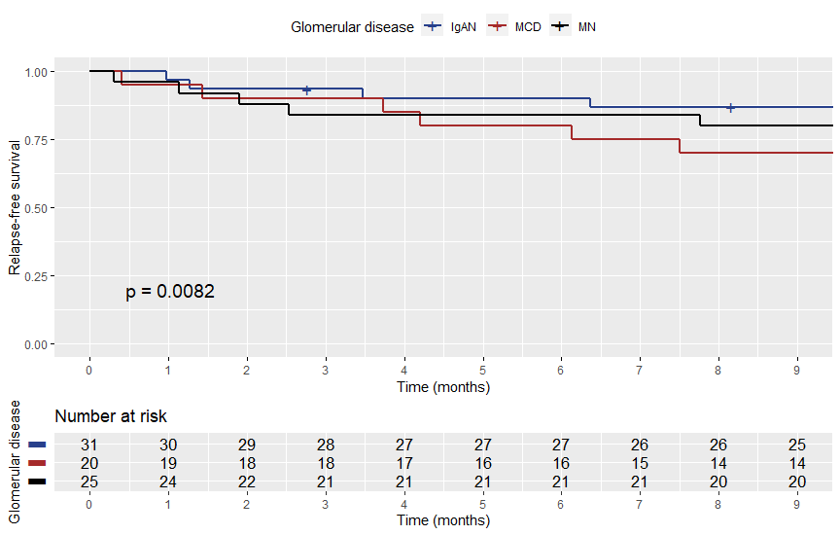

Slide 14
Laboratory tests before and after vaccination
Parameter | Before vaccination | After vaccination | P-value
Hemoglobin (g/dl) | 13.2±1.6 | 13.1±1.7 | 0.426
WBC count (/μL) | 7100 [5908-9338] | 6870 [5680-8700] | 0.162
Neutrophil count (/μL) | 4300 [3358-6100] | 4144 [3188-5849] | 0.168
Lymphocyte count (/μL) | 2000 [1540-2520] | 1886 [1411-2371] | 0.094
Neutrophil-to-lymphocyte ratio | 2.29 [1.69-3.08] | 2.32 [1.65-3.20] | 0.941
Serum lactate dehydrogenase (U/L) | 211.9±56.5 | 216.8±70.0 | 0.451
C-reactive protein (mg/L) | 0.98 [0.36-2.00] | 1.00 [0.40-2.00] | 0.368

Slide 15
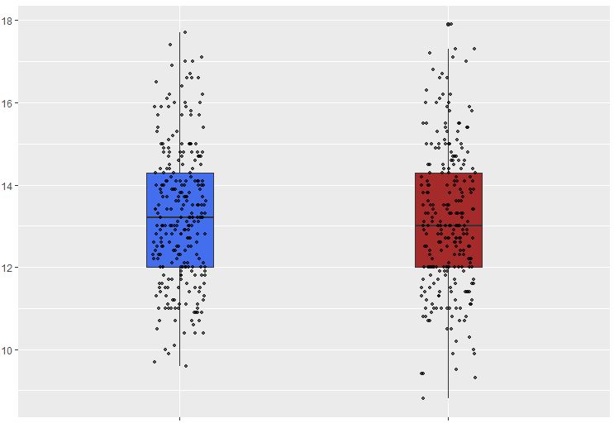
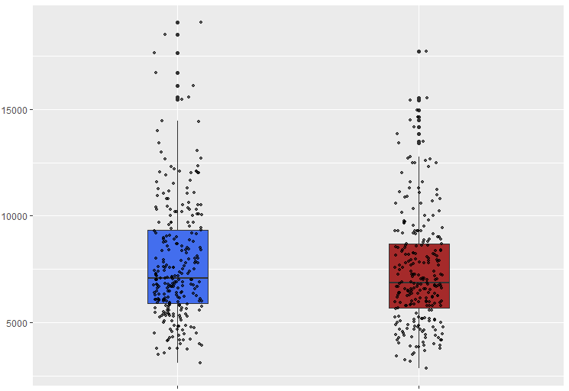
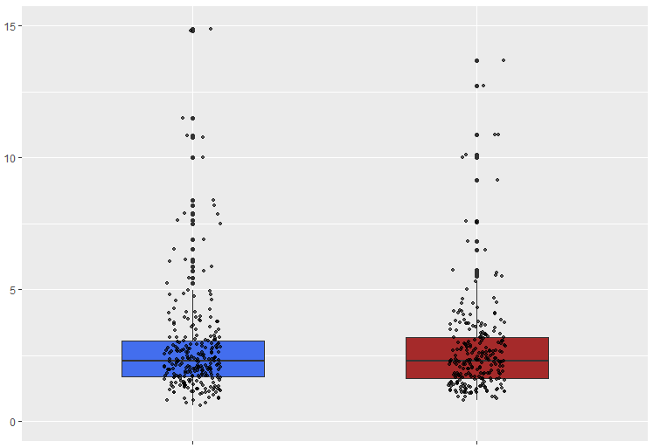
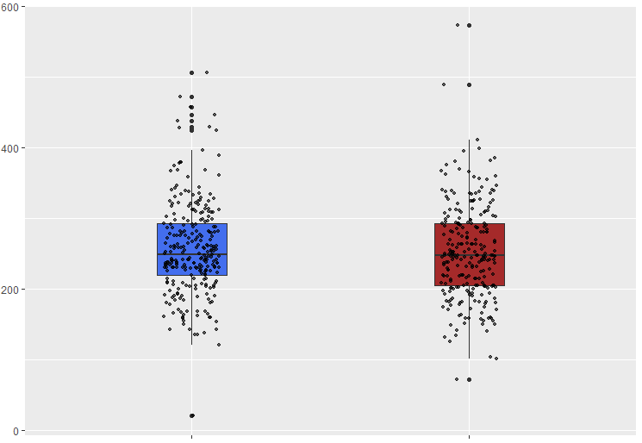
Hemoglobin (g/dl)
WBC count (/μL)
Neutrophil/lymphocyte ratio
Platelet count (k/μL)
Before vaccination
After vaccination
Before vaccination
After vaccination

Slide 16
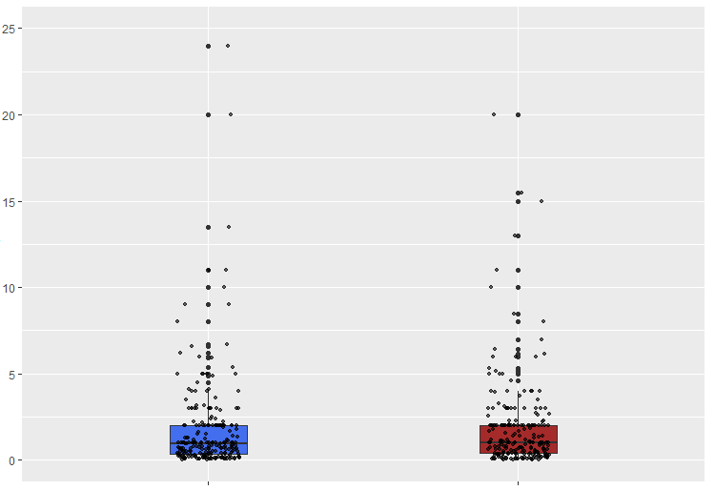
C-reactive protein (mg/L)
Before vaccination
After vaccination

Slide 17
Kidney function before and after vaccination
Parameter | Before vaccination | After vaccination | P-value
Serum creatinine (mg/dl) | 1.06 [0.80-1.50] | 1.09 [0.80-1.47] | 0.812
eGFR (ml/min/1.73 m²) | 72.9±29.7 | 71.5±30.4 | 0.595
24h urinary protein excretion (mg) | 432.5 [110-1154] | 372 [132-1038] | 0.883
Max urine RBC per high power field | 2 [1-4] | 2 [1-3] | 0.077

Slide 18
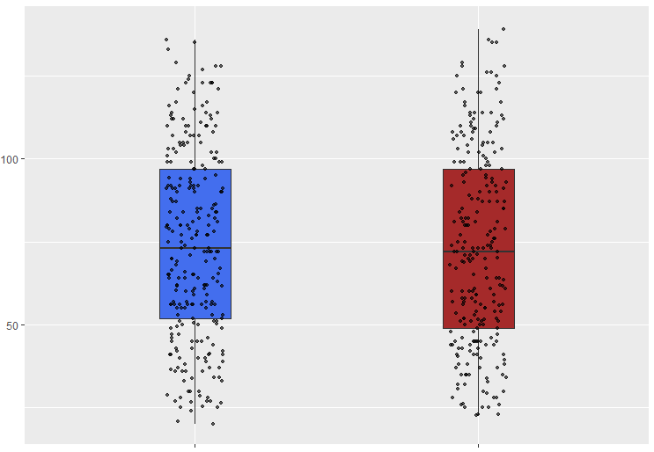
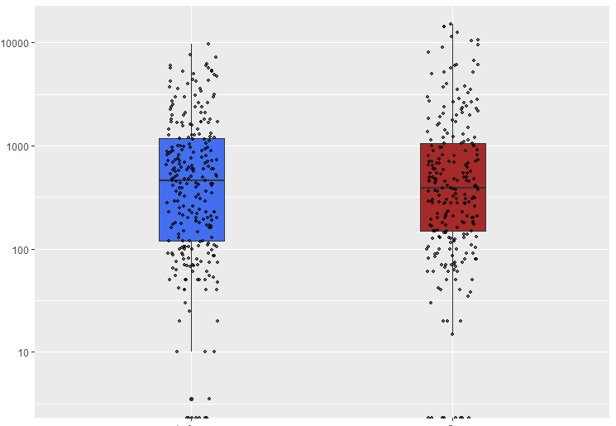
eGFR (ml/min/1.73 m²)
Proteinuria (mg/24h)
Before vaccination
After vaccination
Before vaccination
After vaccination

Slide 19
Conclusions
AE of SARS-CoV-2 vaccination in patients with GN were mostly local and didn’t differ from those of the general population
Possibility of relapse after vaccination was 9%, with a median time of relapse 2,5 months
No alteration in laboratory tests before and after vaccination
No change in kidney function before and after vaccination

Slide 20
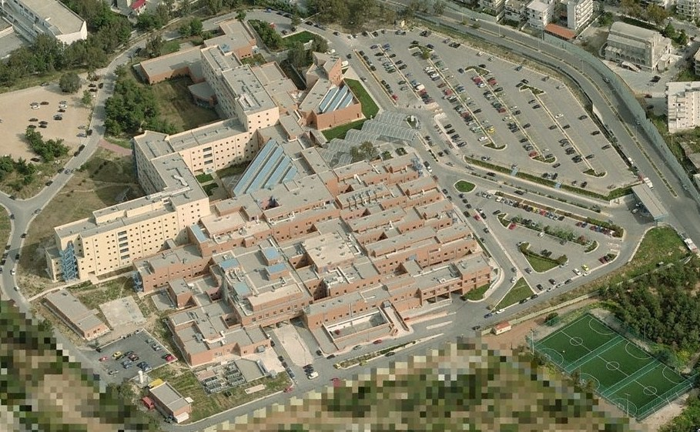
Thank you

