Slide 1
CLINICAL PRESENTATION AND OUTCOMES OF SARS-CoV-2 INFECTION IN PATIENTS WITH LUPUS NEPHRITIS AND ITS POTENTIAL EFFECT IN THE PROBABILITY OF RELAPSE
A. Sardeli ¹,P. Giannakopoulos¹ ,S. Flouda², S. Marinaki³, K. Kantartzi⁴, P. Kriki⁴, A. Venetsanopoulou⁵, P. Voulgari⁵, P. Kalogeropoulos¹, D. Petrou¹,
S. Panagoutsos⁴, I. Michelakis³, D. Boumpas², IN. Boletis³, S. Lionaki¹
¹ Department of Nephrology, 2nd Propaedeutic Internal Medicine, Medical School, National and Kapodistrian University of Athens, Attikon University Hospital, Athens, Greece
² Rheumatology and Clinical Immunology, Medical School, National and Kapodistrian University of Athens, Attikon University Hospital, Athens, Greece
³ Department of Nephrology and Renal Transplantation, Medical School, National and Kapodistrian University of Athens, General Hospital of Athens Laiko, Athens, Greece
⁴ Department of Nephrology, Medical School, Democritus University of Thrace, Alexandroupolis, Greece
⁵ Rheumatology Clinic, Department of Internal Medicine, Medical School, University of Ioannina, Ioannina, Greece

Slide 2
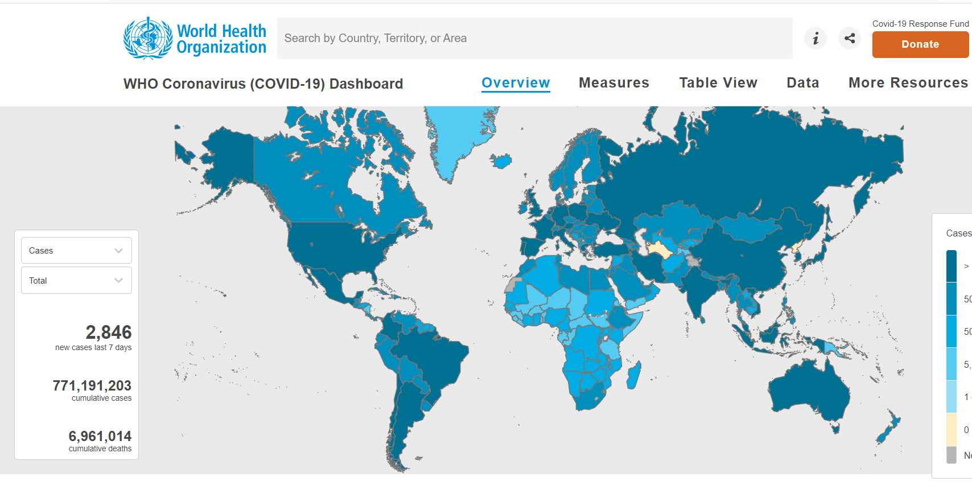
Introduction
https://covid19.who.int

Slide 3
Aim
The present study is aiming to record the clinical presentation and outcome of SARS-CoV-2 infection in patients with lupus nephritis (LN).

Slide 4
Methods
Retrospective study
5 different research centers in Greece
82 patients
56 (68.3%) had a positive test for SARS-CoV-2 and were compared with the remaining 26 who did not

Slide 5
Methods
Inclusion criteria
Age >18 years Histologically confirmed LN
Exclusion criteria
ESKD before SARS-CoV-2 infection diagnosis

Slide 6
Methods
LN
Age at diagnosis
Gender
Histopathological diagnosis Lupus-GN, WHO class
Past medical history
Immunosuppression at diagnosis (induction and maintenance treatment)
Type of immunosuppression
1st outcome (Remission/ treatment resistant)
History of vaccination
Type of vaccination
Doses of vaccination
SARS-CoV-2 infection
Reason for testing
Type of symptoms
Time (months) from biopsy to SARS-CoV-2 infection
COVID-19 outcome
Post-COVID-19 LN outcome
Time to relapse (weeks) from SARS-CoV-2 infection

Slide 7
LUPUS NEPHRITIS
Classification
Minimal mesangial LN (class I) {normal urinalysis, no or minimal proteinuria, and a normal serum creatinine}
Mesangial proliferative LN (class II) {microscopic hematuria and/or proteinuria}
Focal LN (class III) {hematuria and proteinuria. Maybe hypertension, a decreased GFR, and/or nephrotic syndrome. Less than 50 % of glomeruli are affected}
Diffuse LN (class IV) {the most common histologic pattern and most severe. Hematuria and proteinuria. Frequently nephrotic syndrome, hypertension, and reduced GFR. More than 50 % of glomeruli are affected.}
Lupus membranous nephropathy (class V) {10-20 % of patients with LN. Nephrotic syndrome +/-hematuria and hypertension}
Advanced sclerosing LN (class VI) {kidney dysfunction, proteinuria and a relatively bland urine sediment. Global sclerosis of more than 90 % of glomeruli

Slide 8
LN Outcomes- Definitions
Complete remission is defined, by a UPCR <500–700 mg/d (<50–70 mg/mmol) by 12 months with normal or near-normal GFR (according to the 2019 update of EULAR/ERA-EDTA recommendations for LN),.
Partial remission is defined by a reduction in proteinuria of at least 25% by 3 months or 50% by 6 months.
Resistant to treatment

Slide 9
Outcomes of SARS-CoV-2 infection - Definitions
Recovery was defined as the complete and permanent relief of symptoms accompanied by release from the need for oxygen therapy and hospitalization and administration of specific or non-specific treatment
Long-COVID was defined as the presence of symptoms (physical and/ or mental) for a period of time greater than 2 months from the beginning of the infection.
Death

Slide 10
Demographics, clinical and histopathological data
Parameter | Number of patients (N)
LN | 82
Gender | 70F, 12M
LN and positive SARS-CoV-2 test | 56
Age | 33 (12,7%)
Proliferative LN | 43 (76,8%)
On immunosuppression at positive test | 37 (66%)

Slide 11
Results
52 (94.6%) patients were tested due to symptoms
5 (9.01%) patients required hospitalization mainly due to hypoxemia.
11 (19.6%) patients received specific treatment for SARS-CoV2 infection,
51 (91.6%) patients had complete recovery, 2 (3.57%) prolonged symptomatology, and 1 (1,785%) died.

Slide 12
LN Outcome after SARS-CoV-2 infection
6 (10.9%) patients with SARS-CoV-2 infection, who were in remission before infection, experienced a relapse of LN 2.7(±2.1) months later.
None of the patients without SARS-CoV2 infection relapsed in the same time period (p=0.09).

Slide 13
Conclusions
SARS-CoV-2 infection affects the morbidity of patients with LN.
It may possibly enhance the possibility of LN relapse in those who have previously achieved remission.

Slide 14
Thank you for your attention!

