Slide 1
MULTICENTER RETROSPECTIVE STUDY EVALUATING THE CLINICAL PICTURE AND OUTCOME OF THE SARS-CoV-2 INFECTION AMONG PATIENTS WITH GLOMERULAR DISEASES
S. Lionaki¹, S. Marinaki², K. Kantartzi³, D. Galitsiou⁴, G. Moustakas⁴, E. Dounousi⁵, I. Bellos^{2,} S. Flouda⁶, D. Boumpas⁶, V. Liakopoulos⁷, V. Vaios⁷, A. Sardeli¹, P. Kalogeropoulos¹, C. Mpintas², P. Giannakopoulos¹, L. Gkika-Zervou⁵, M. Papapsotiriou⁸, D. Goumenos⁸, A. Venetsanopoulou⁹, P. Voulgari⁹, E. Androkinidi10, K. Stylianou¹¹, S. Panagoutsos³, IN. Boletis²
¹Department of Nephrology, Attikon University Hospital, National and Kapodistrian University of Athens, Greece ²Nephrology and Transplantation clinic, Laiko Hospital, National and Kapodistrian University of Athens, Greece³Department of Nephrology, University of Thrace, Alexandroupolis⁴Department of Nephrology, Gennimatas Hospital ⁵Department of Nephrology, University of Ioannina ⁶Rheumatology and Clinical Immunology Unit, Attikon University Hospital, National and Kapodistrian University of Athens, Greece⁷Division of Nephrology and Hypertension, 1st Department of Internal Medicine, AHEPA Hospital, Aristotle University of Thessaloniki, Thessaloniki, Greece⁸Departmentof Nephrology and Renal Transplantation, Patras University Hospital, Patras, Greece.⁹Rheumatology Department, University of Ioannina,Ioannina,Greece.¹⁰Department of Nephrology, Aretaieio Hospital, National and Kapodistrian University of Athens, Athens, Greece¹¹Department of Nephrology, University Hospital of Heraklion, Heraklion, Greece

Slide 2
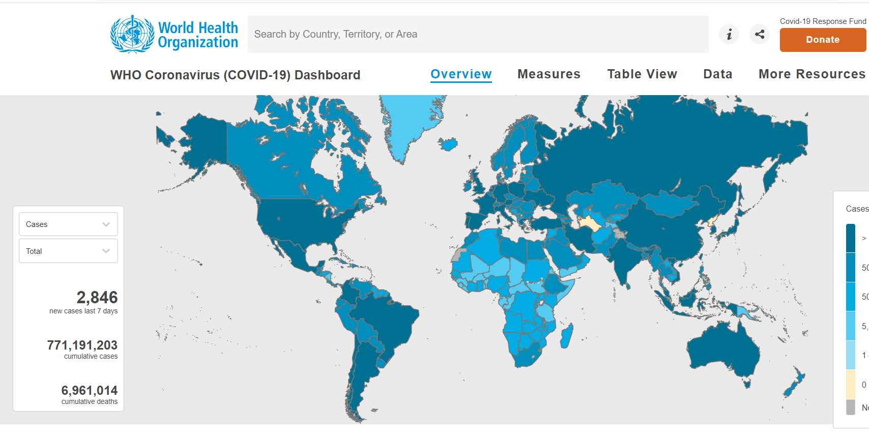
Introduction
https://covid19.who.int

Slide 3
Aim
This is a retrospective study exploring the clinical picture and outcome of SARS-CoV-2 infection in patients with glomerular diseases (GD) and
Its possible impact in the probability of relapse of the GD.

Slide 4
Methods
Retrospective study
11 different research centers in Greece
312 patients

Slide 5
Methods
Inclusion criteria
Age >18 years Biopsy proven GD
Documented SARS-CoV-2 infection
Exclusion criteria
ESKD before SARS-CoV-2 infection diagnosis

Slide 6
Methods
Glomerulal Diseases
Age at diagnosis
Gender
Histopathological diagnosis
Past medical history
Immunosuppression at diagnosis (induction and maintenance treatment)
Type of immunosuppression
1st outcome (Remission/ treatment resistant)
SARS-CoV-2 Infection
Reason for testing
Type of symptoms
Time (months) from biopsy to SARS-CoV-2 infection
Status of GD at the time of SARS-CoV-2 infection
COVID-19 outcome
Post-COVID-19 GD outcome
Time to relapse (weeks) from SARS-CoV-2 infection

Slide 7
GLOMERULOPATHIES:
ANCA-GN
Complete remission: no evidence of active disease – negative urine sendiment – no more need for dialysis
Partial remission: consistent hematuria despite improved renal function (cr_{s})
Relapse: proof of activity in any system
Lupus-GN
Remission: proteinuria <0.5g/24h, stabilization of cr_{s} and improved haematuria
Relapse: Reapperance of hematuria, with or without red blood cells casts, wbc in urine sediment without evidence of infection, increased proteinuria, with or without impaired renal function (increase of serum creatinine)
Minimal Change Disease (MCD)
Complete remission : proteinuria <300 mg/d, stable value of cr_{s} and Alb_{s} >3.5 g/dL
Partial remission: decrease of proteinuria>50 %, between 300 mg and 3.5 g/d
Relapse: proteinuria > 3.5 g/d
Membranous nephropathy (ΜN)
Complete remission : proteinuria <300mg/d and Alb_{s} ≥3.5 g/dL
Partial remission: decrease of proteinuria ≥50 % and proteinuria between 0.3 and 3.5 g/d
Relapse: proteinuria > 3.5 g/d
Focal segmental glomerulosclerosis (FSGS)
Complete remission: proteinuria <300 mg/d, stable value of cr_{s} and Alb_{s} >3.5 g/dL
Partial remission: decrease of proteinuria>50 %, with values between 300 mg and 3.5 g/d, with or without improvement in Alb_{s}
Relapse: proteinuria > 3.5 g/d in patients with complete remission, or an increased proteinuria >50% in patients with partial remission
IgA nephropathy
Remission proteinuria <1g/24h, no hematuria
Relapse: proteinuria >1g/24h, eGFR impairment

Slide 8
Outcomes of SARS-CoV-2 infection- Definitions
Recovery was defined as the complete and permanent relief of symptoms accompanied by release from the need for oxygen therapy and hospitalization and administration of specific or non-specific treatment
Long-COVID was defined as the presence of symptoms (physical and/ or mental) for a period of time greater than 2 months from the beginning of the infection.
Death

Slide 9
Results
312 patients were included
214(68,5%) had a positive test for SARS-CoV-2 during the follow up time, while 98 were not.

Slide 10
Results
Infected patients were younger compared to those not infected [44 (28-59.75) vs. 53 (38-64) years, p<0.001]
The mean time from the diagnostic biopsy to the SARS-CoV-2 infection was 67,6 (±59,3) months

Slide 11
Results
82,5% had been vaccinated against SARS-CoV-2
49,1% were on immunosuppressive therapy at vaccination

Slide 12
SARS-CoV-2 Infection hospitalization
28(13%) required admission to hospital
Median length of stay in hospital was 8,3(±5,1) days

Slide 13
SARS-CoV-2 Outcome
84,2% experienced complete recovery of the infection
24(11%) had symptoms for more than 3 months (long-COVID)
4(1,9%) died due to Covid-19

Slide 14
GD relapse after SARS-CoV-2 infection
Among patients in remission for the GD, the frequency of the GD relapse was higher in infected patients versus those not infected
(11.9% vs. 2.1 %, p=0.007).

Slide 15
Conclusions
According to our findings, SARS-CoV-2 infection appears to have an impact in patients with GD, related to morbidity.
SARS-CoV-2 infection may increase the probability of relapse of the primary glomerular disease.

Slide 16
Thank you for your attention!

