Slide 1

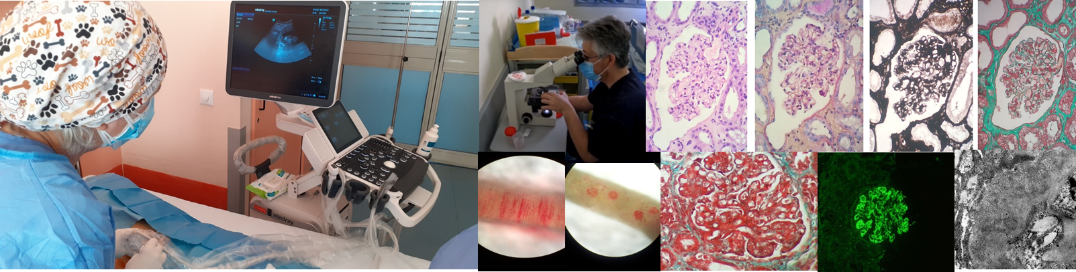

BEDSIDE MICROSCOPY FOR ADEQUACY ASSESSMENT OF NON-SURGICAL RENAL BIOPSIES
Panagiotis Pateinakis¹, Parthena Kyriklidou¹, Eleni Manou¹, Stella Panagakou¹, Achilleas Karras¹, Stavroula Pervana², Dorothea Papadopoulou¹
¹Department of Nephrology and ²Department of Pathology, General Hospital “Papageorgiou”, Thessaloniki, Greece.

Slide 2
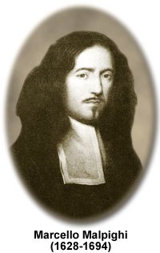
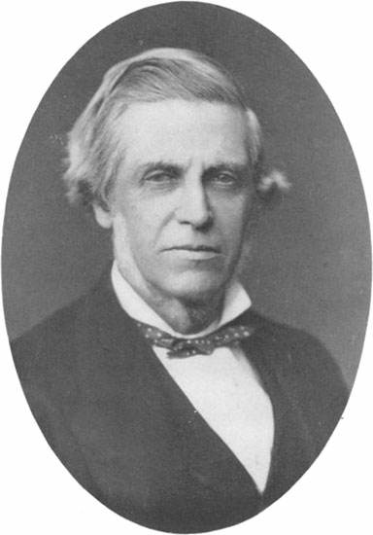
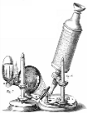
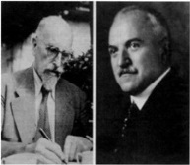
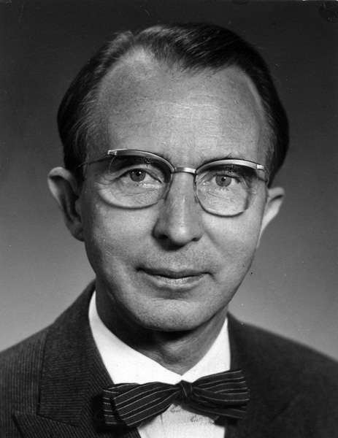
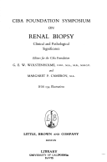
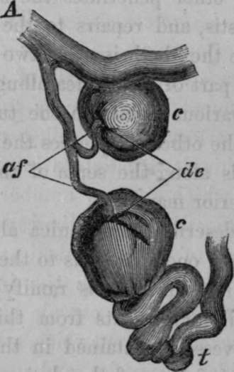
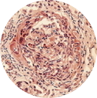
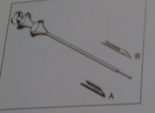
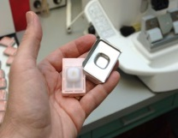
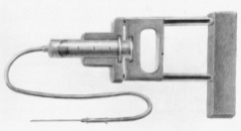
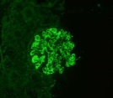

1666
1850
1870
1916
1944
1952
1955
1957
1961
1966

Slide 3
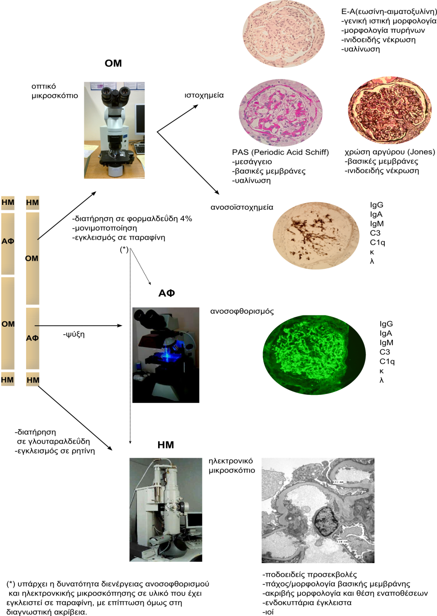
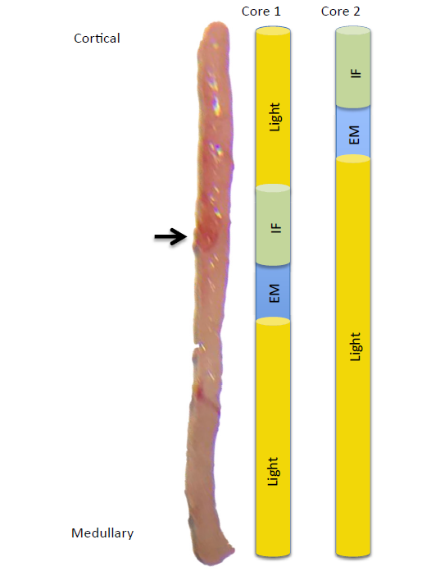

Histochemistry
SAA
C4d
CDs
…
Immumohistochemistry
Immunfluorescence
Electron microscopy
Am J Kidney Dis. 73(3): 404-415

Slide 4

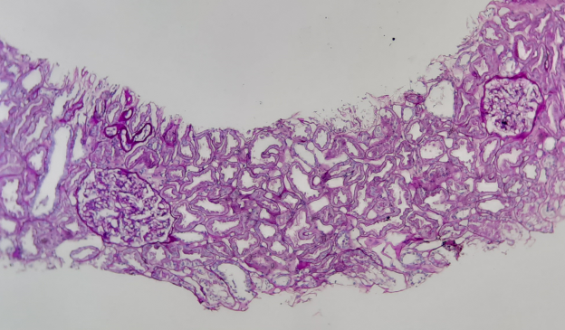
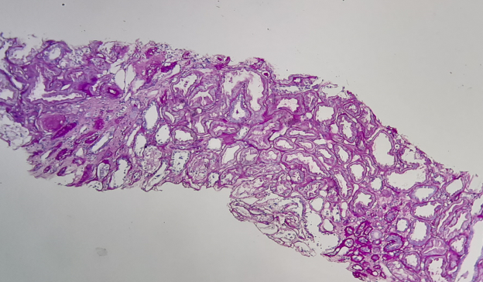

Adequacy
Native kidney biopsies must contain cortex with glomeruli to be adequate for diagnosis and treatment plans
Inadequate sampling only exposes the patient to the risks of the invasive biopsy procedure

Slide 5
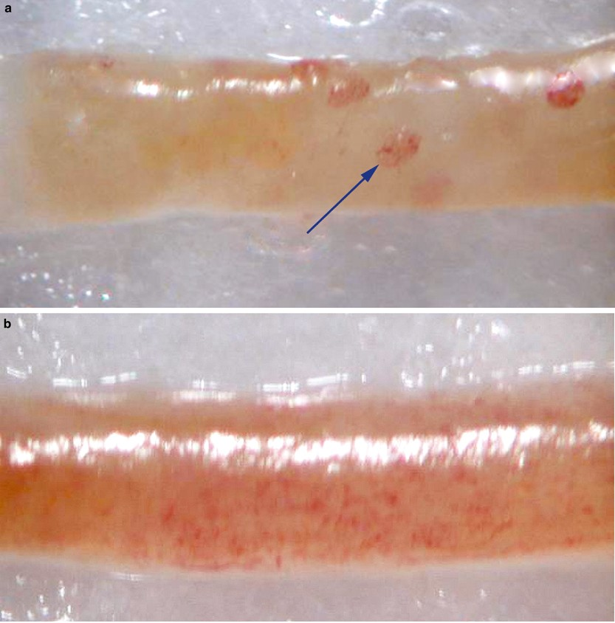
Bedside sample evaluation (BSE)
Real time bedside sample evaluation
under dissecting or standard light microscopy
enhances probability of adequate sampling
JASN 32: 3024–3026, 2021
J Clin Pathol 151: 205–208, 2019
Modern Pathology (2004) 17, 1555–1563

Slide 6
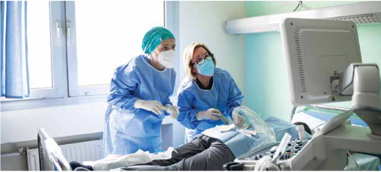
Aim
To evaluate the impact of BSE on native kidney biopsy adequacy rates
Adequacy was defined as 7 or more glomeruli per sample

Slide 7
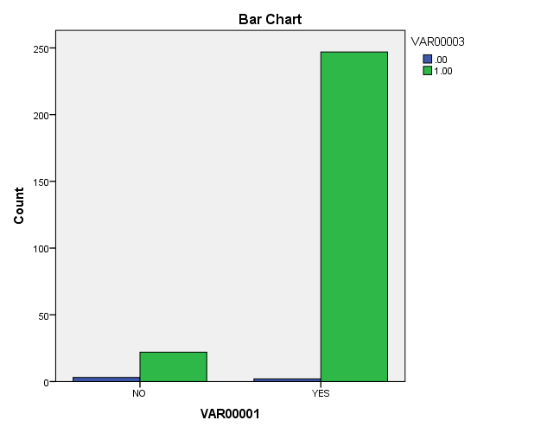

Sample
285 native kidney biopsies
25 biopsies without BSE
260 biopsies with BSE
260
25

Slide 8
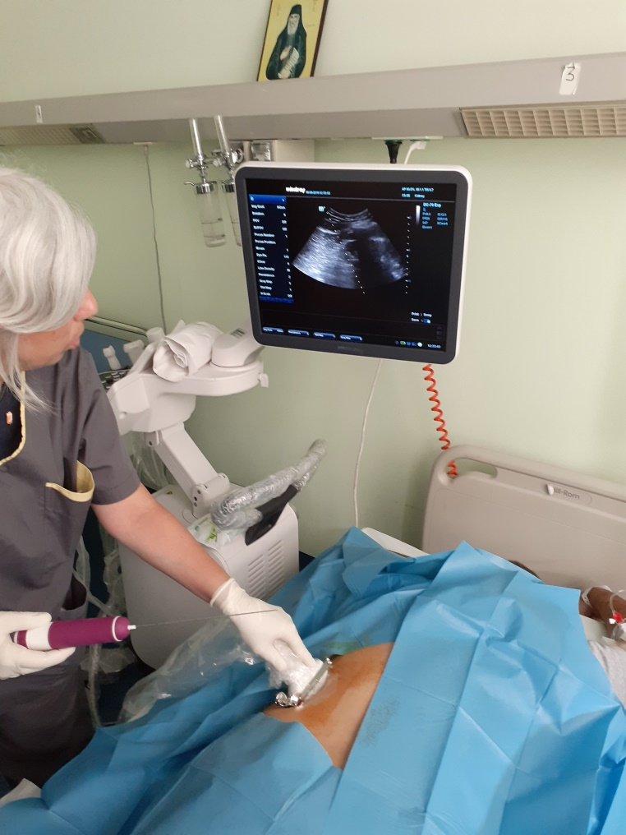
Technique
Real time US guided biopsy
18g full automatic needle
Biopsy core on saline soaked sieving paper in transparent Petri’s dish
Standard light microscope
X100 total magnification
Nephrologist/pathologist
2-7 passes until at least 2 cores with glomeruli containing cortex obtained

Slide 9
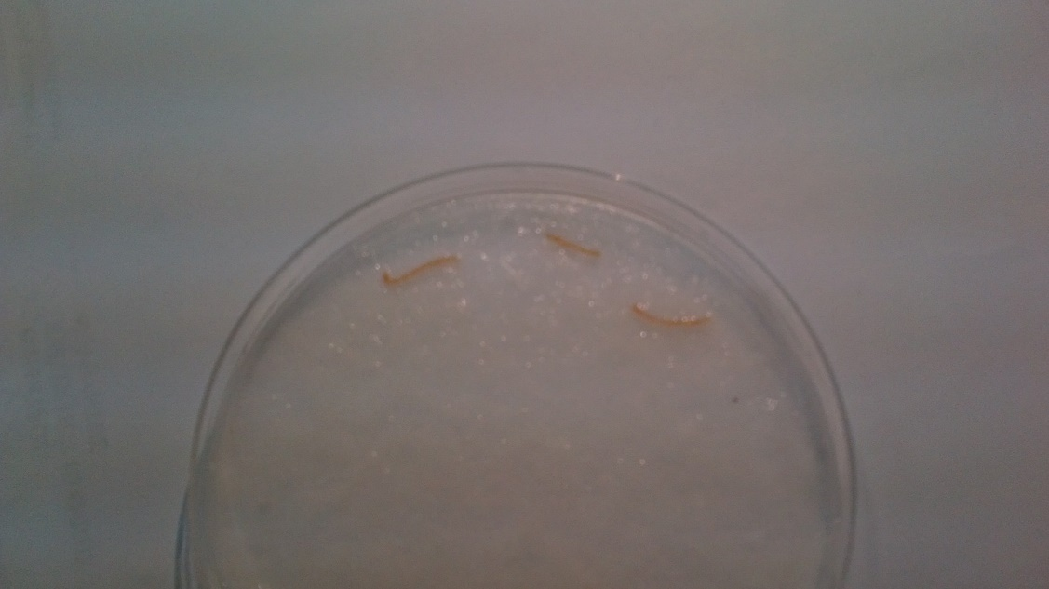
Technique
Real time US guided biopsy
18g full automatic needle
Biopsy core on saline soaked sieving paper in transparent Petri’s dish
Standard light microscope
X100 total magnification
Nephrologist/pathologist
2-7 passes until at least 2 cores with glomeruli containing cortex obtained

Slide 10
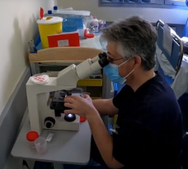
Technique
Real time US guided biopsy
18g full automatic needle
Biopsy core on saline soaked sieving paper in transparent Petri’s dish
Standard light microscope
X100 total magnification
Nephrologist/pathologist
2-7 passes until at least 2 cores with glomeruli containing cortex obtained

Slide 11
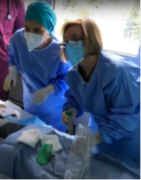
Technique
Real time US guided biopsy
18g full automatic needle
Biopsy core on saline soaked sieving paper in transparent Petri’s dish
Standard light microscope
X100 total magnification
Nephrologist/pathologist
2-7 passes until at least 2 cores with glomeruli containing cortex obtained

Slide 12
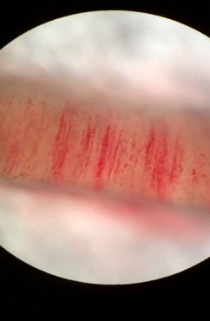
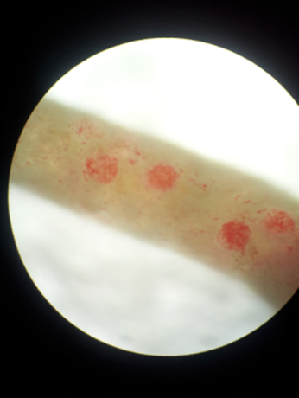
Photos taken with smartphone camera

Slide 13
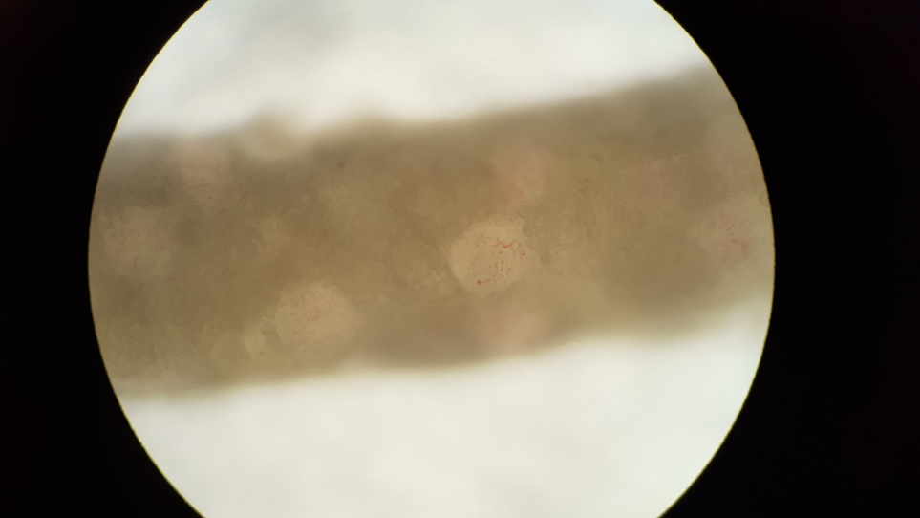

Slide 14
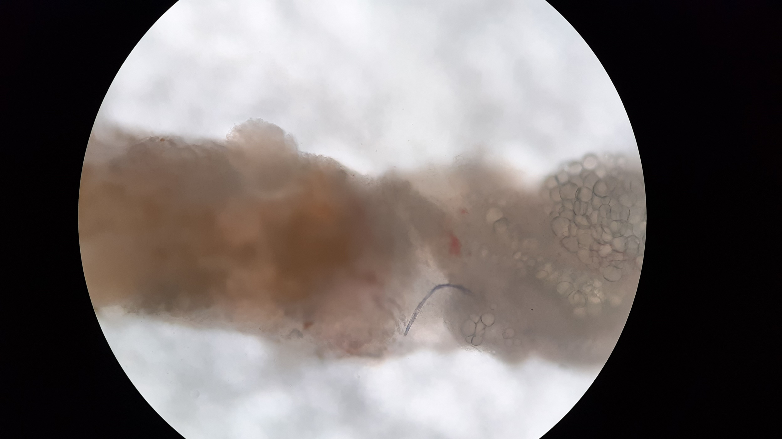

Slide 15
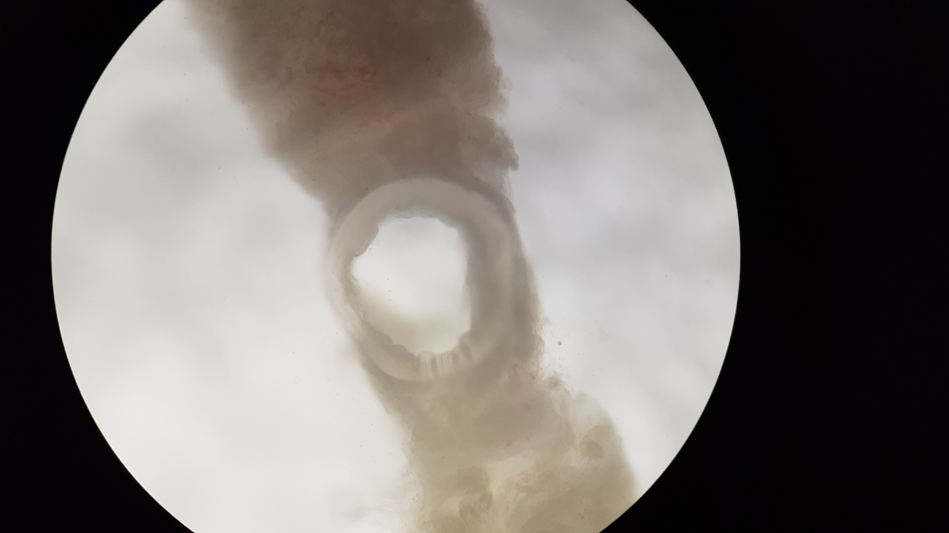

Slide 16
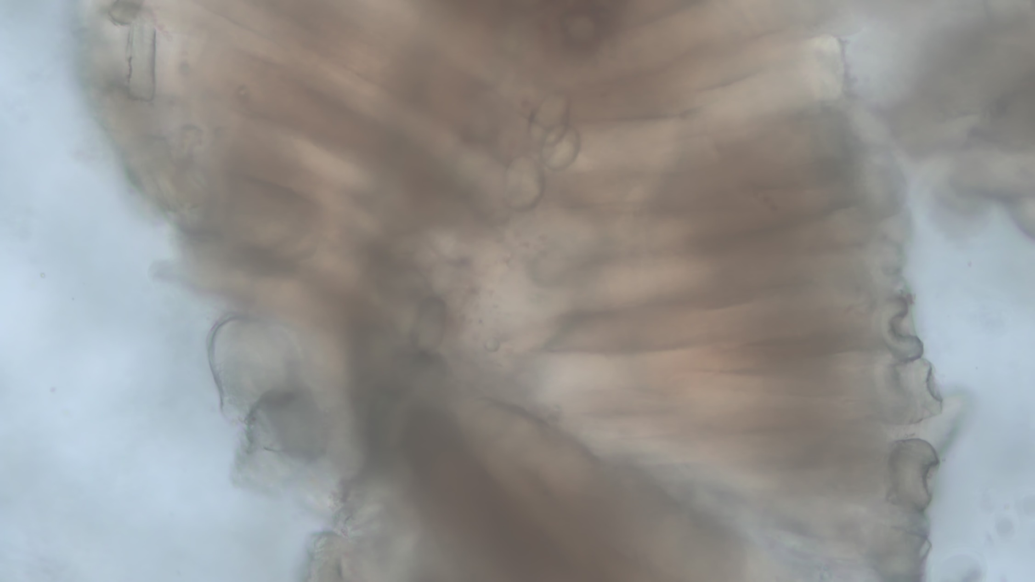

Slide 17
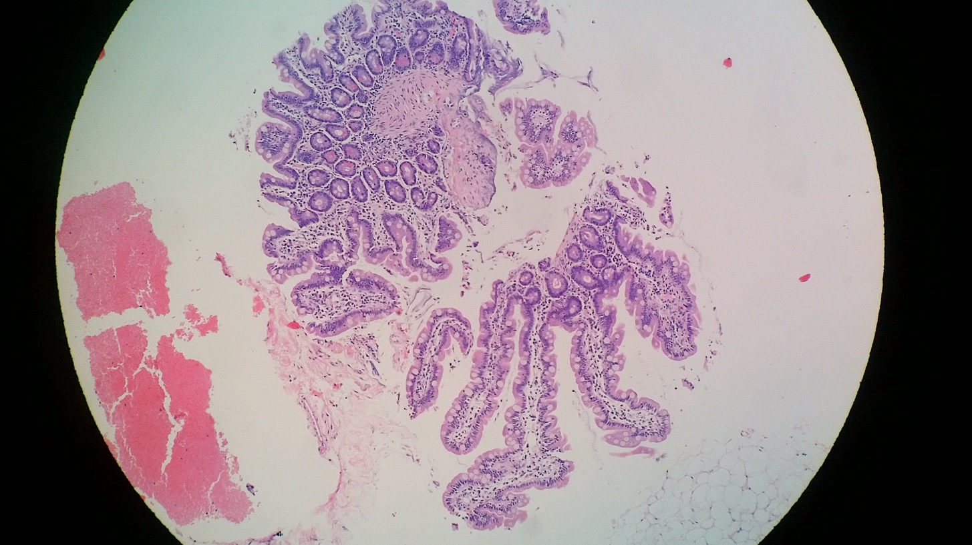
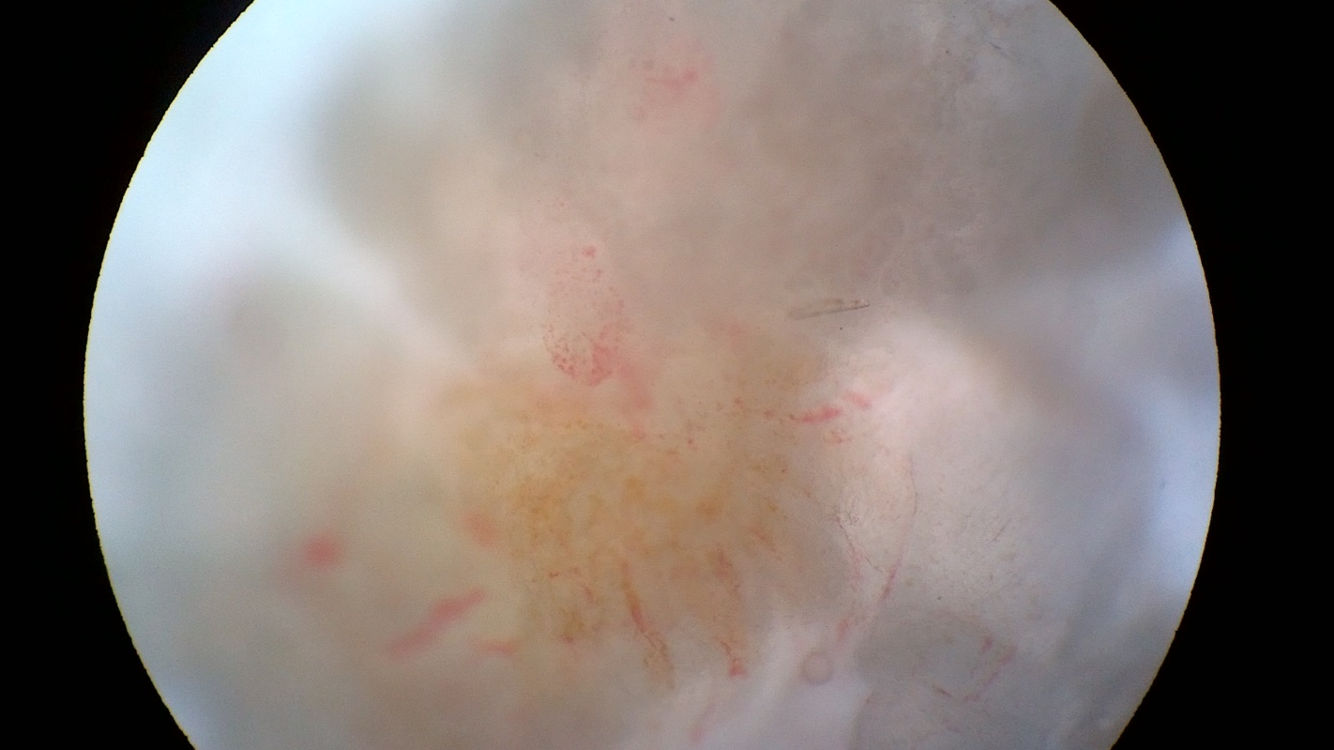

Slide 19


Results
258
p: 0.000
22
One very obese pt
One uncooperative pt
3
2
88% (22/25)
99.2% (258/260)

Slide 20
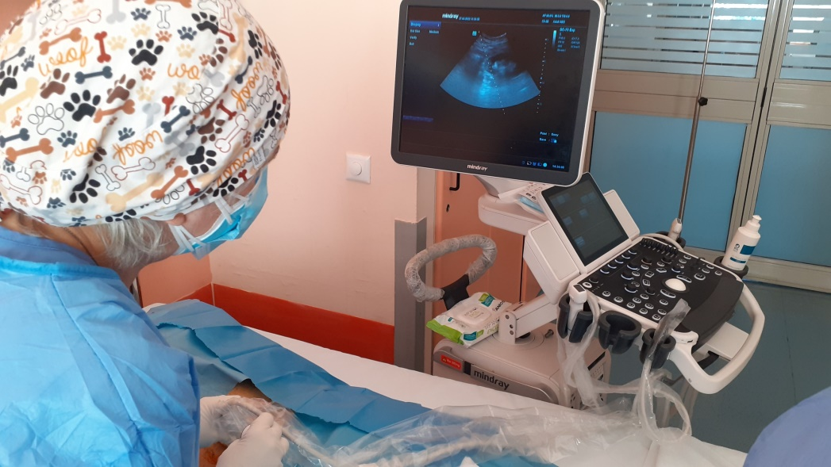
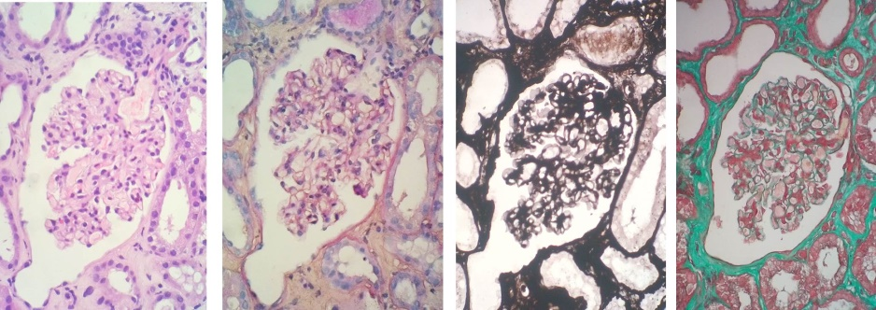

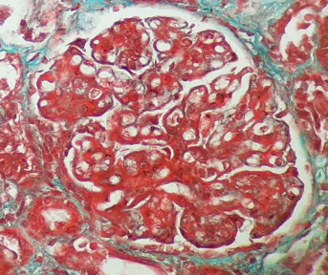
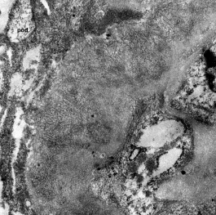
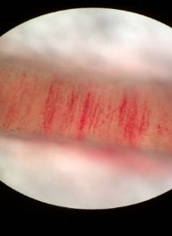
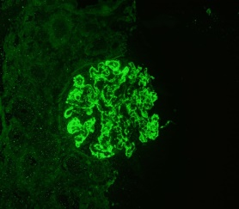
Conclusion
Bedside assessment of non-surgical native renal biopsy samples was associated with high adequacy rates, thus maximizing the procedure’s benefits for the patient.

Slide 21
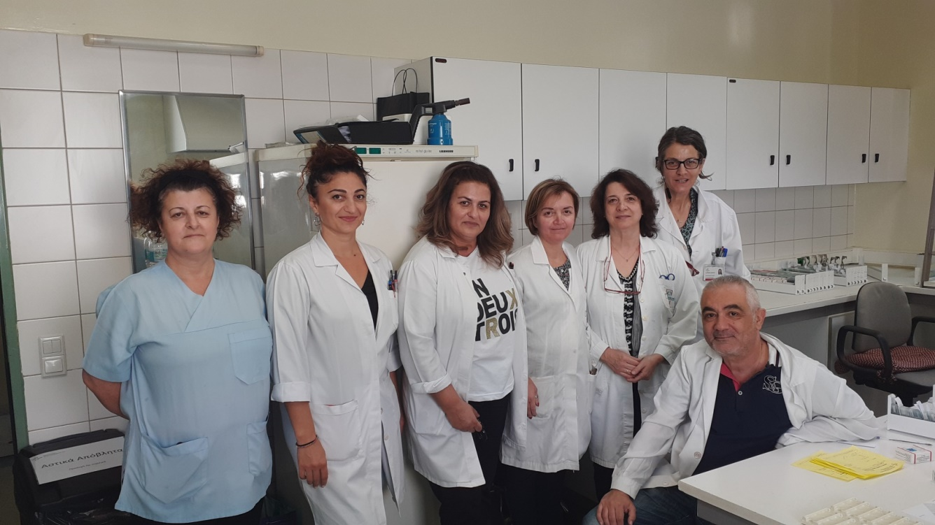
Thank you for your attention

