Slide 1
Comparison between Berden and ANCA Risk Score classification models regarding their ability to predict short and long term outcome of ANCA-associated glomerulonephritis
Michalis Christodoulou¹, Eleni Moysidou¹, Georgios Lioulios¹, Stamatia Stai¹, Konstantinos Bandis¹, Nikolaos Flaris², Christina Nikolaidou², Asimina Fylaktou³, Aikaterini Papagianni¹, Pantelis Sarafidis¹, Maria Stangou¹
¹School of Medicine, Aristotle University of Thessaloniki, Department of Nephrology, Hippokration Hospital, 54642 Thessaloniki, Greece.
²Department of Pathology, Hippokration General Hospital, 54642 Thessaloniki, Greece.
³Department of Immunology, National Histocompatibility Center, Hippokration General Hospital, 54642 Thessaloniki, Greece.

Slide 2
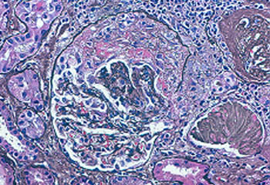
ANCA-associated vasculitides (AAV)
Represent a group of systemic diseases
Characterized by inflammation and necrosis of small or medium-sized blood vessels
Include granulomatosis with polyangiitis (GPA), eosinophilic granulomatosis with polyangiitis (EGPA) and microscopic polyangiitis (MPA)
Accompanied by the presence of Anti-neutrophil cytoplasmic antibodies (ANCA) in the serum

Slide 3
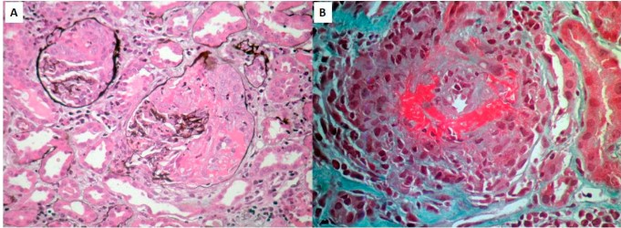
Renal lesions in ANCA associated vasculitis-glomerulonephritis (AAV/GN)
Focal and segmental glomerular fibrinoid necrosis
Tubulointerstitial inflammation and fibrosis
Small vessel necrotizing vasculitis
Crescents formation
Notes:
Histopathology of ANCA associated glomerulonephritis include the following renal lesions:

Slide 4
Berden classification vs ANCA Renal Risk Score (RRS)
Renal Biopsy Classification Systems
Proposes four classes
Focal (>=50% normal <50% injured glomeruli)
Crescentic (>=50% active crescents)
Mixed (>=50% injured glomeruli, <50% crescents, <50% global sclerosis)
Sclerotic (>=50% global sclerosis)
Is calculated according to the percentage of :
normal glomeruli (0 points if >25%, 4 points if 10-25%, 6 points if <10%),
the percentage of interstitial fibrosis and tubular atrophy (IFTA: 0 points if ≤25%, 2 points if >25%)
the eGFR at diagnosis (0 points if >15 ml/min, 3 points if ≤15 ml/min)
Proposes three classes
Low Risk(Total of 0 points)
Medium Risk( 2-7 points)
High Risk (8-11 points)
Notes:
various classification systems have been developed in order to classify patients. In our study we used and compared the following ones. Firstly the berden system, which proposes 4 classes based on the percentage of normal and damaged glomeruli , and the ARRS, which proposes 3 classes and is it calculated according to the percentage of normal glomeruli,of interstitial fibrosis and tubular atrophy, and of eGFR at diagnosis

Slide 5
Our prospective observational study
Methods:
N=94 AAV/GN patients
Kidney biopsy
Classification according to Berden and RRS
Same treatment protocol
60 months of follow-up
Renal function recorded at three (T3), six (T6) and sixty (T60) months of follow-up
Results compared to both classification systems
Notes:
This was a prospective observational study, which included 94 patients. All of them underwent kidney biopsy and were classified according to berden and RRS. The treatment protocol was the same for all of them, and the follow up was up to sixty months. Renal function was recorded at three, six, and sixty months after, and we compared the results to both classification systems.

Slide 6
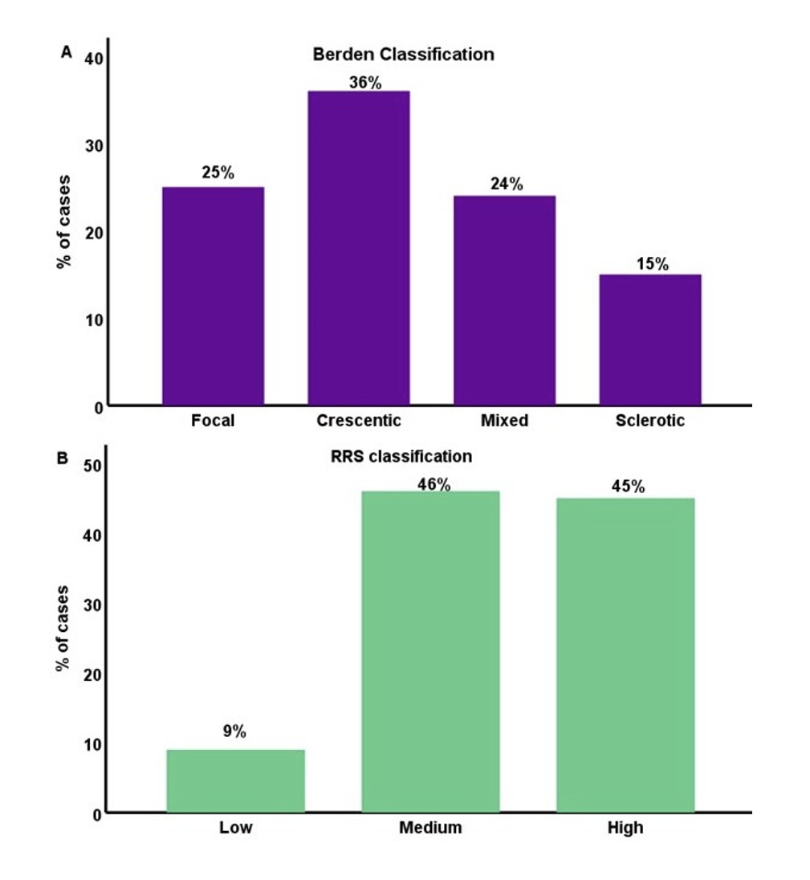
Our Results
According to Berden Classification, patients were grouped as Focal (n=24), Crescentic (n=35), Mixed (n=21) and Sclerotic (n=14)
According to RRS, patients were classified as Low (n=8), Medium (n=47) and High (n=39) risk
Notes:
Here is a presentation of the classification of our patients based on both systems. According to Berden classification system, biopsies from 24 patients were defined as focal, 35 as crescentic, 21 as mixed and 14 as sclerotic. As for the ARRS, 8 patients were grouped as low risk, 47 as medium and 39 as high risk.

Slide 7
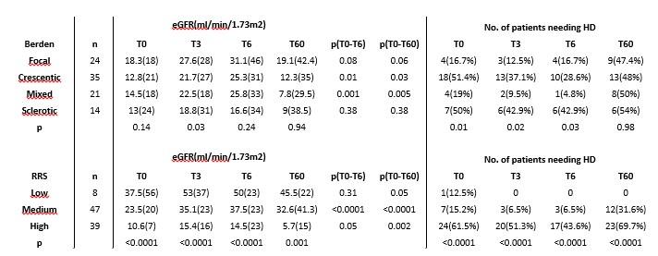
Our Results
Notes:
To our results.
According to Berden classification, there were significant differences in eGFR levels only at 3 months after diagnosis (t3)
As for the RRS classification, there were significant differences in eGFR at all time points investigated even sixty months after diagnosis.
We also examined the parameter of need for HD. significant differences were found only in the short term of follow up according to Berden score. On the contrary, RRS could predict end stage renal disease additionally atlong term with statistical significance. (long term of follow up)
Even patients classified as Mixed (Berden) and as Medium or High risk (RRS) had significant improvement from T0 to T6, p=0.001, p<0.0001, p=0.05, respectively
Ενημερωτικά για να διάβάσει η Λένα τι κάναμε
Berden:
Based on the results described on table , there were significant differences in eGFR levels between patients with Focal, Crescentic, Mixed and Sclerotic lesions (Berden classification score) but this was merely at time point T3.
There were significant differences in the number of patients requiring HD according to Berden classification score, as described on the table.
These differences however were prominent at presentation and during the acute phase, but disappeared at the end of follow up.
Very interestingly, patients classified as Focal, showed a benign course from T0 to T6, with severe deterioration thereafter, patients classified as Crescentic and Mixed types had a similar course, with improvement from T0 to T6, followed by significant deterioration, and finally, patients classified as Sclerotic showed an unfavorable outcome early in the course of the disease.
At time point T60 there were no significant differences between the Berden classification groups.
RRS:
The eGFR differences between groups, with Low, Medium and High RRS were significant at all time points, T0, T3, T6 and T60 as they are depicted at this table . Interestingly, Low RRS patients had improved renal function during follow up, and remained stable thereafter, until the end of follow up. Medium RRS showed a temporary improvement, eGFR increased during the acute phase, and, remained relatively stable, until T60. In contrast, High RRS patients had a completely different progression, they started with a compromised renal function at T0, 10.6(7)min/1.73m², slightly improved to 14.5(23) at T6, and progressed to 5.7(15) at T60.
The percentage of patients needed HD at all time points had significant differences between RRS groups. At the end of the acute phase, T6, this proportion was ranging from 0% for the Low risk, to 6.5% and 43.6% for the Medium and High risk, respectively, p<0.0001, and at the end of follow up, T60, this difference became even more prominent from 0% to 31.6% and 69.7% at T0, T6 and T60, respectively, p<0.0001

Slide 8
Conclusions
Both classification systems were able to discriminate patients with declining renal function or reaching ESKD during the acute phase of the disease, but RRS showed a clear superiority in predicting long term outcome of renal function
The proportion of normal glomeruli in renal biopsy has indeed showed the best predictive ability for renal function outcome
Tubulointerstitial pathology and clinical presentation, as they are included in RRS, seem to predict long term outcome
Renal function can be improved even in patients with severe histopathology

Slide 9
Thank you

