Slide 1
Circulating CD14++CD16+ monocytes, NK cells and lymphocyte subsets correlate with conventional and novel deformation related indices of left ventricular function in kidney transplant recipients with no established cardiovascular disease.
Anila Duni¹^{,2}, Lampros Lakkas³ , Aris Bechlioulis³, George Markopoulos⁴, Vasilios Koutlas², Eirini Tzalavra², Vasilios Tatsis², Ioanna Theodorou¹, Charalambos Pappas¹, George Vartholomatos⁴, Michalis Mitsis², Aikaterini Naka³, Evangelia Dounousi¹^{,2}.
Department of Nephrology, University Hospital of Ioannina, Greece¹
Department of Surgery and Kidney Transplant Unit, University Hospital of Ioannina, Greece²
2nd Cardiology Department, University Hospital of Ioannina, Greece³
Laboratory of Hematology - Unit of Molecular Biology, University Hospital of Ioannina, Greece⁴

Slide 2
Introduction
Kidney transplant recipients (KTRs) carry a great burden of cardiovascular disease (CVD) despite improved left ventricular (LV) remodeling after transplantation.
Kidney allograft dysfunction and the immunosuppressed milieu play a major adverse role in myocardial structural changes in asymptomatic KTRs.
There is an intricate relationship between immune system responses with heart failure syndromes, including aberrant activity and counts of proinflammatory CD14++CD16+ monocytes, of natural killer (NK) cells and of T regulatory cells (Tregs).
The associations of immune cell subpopulations with subclinical markers of CVD remain to be determined in KTRs.
The aim of our study was to investigate potential correlations between blood levels of specific immune cells subsets with conventional and novel deformation related indices of LV function in KTRs.

Slide 3
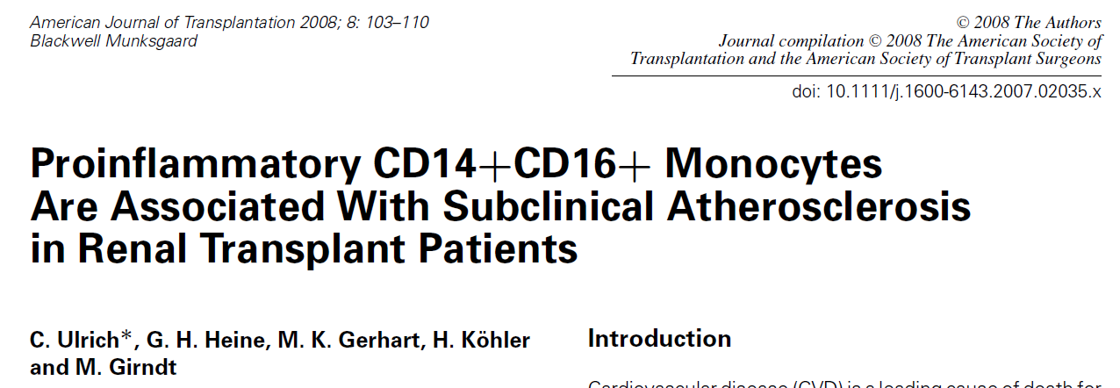
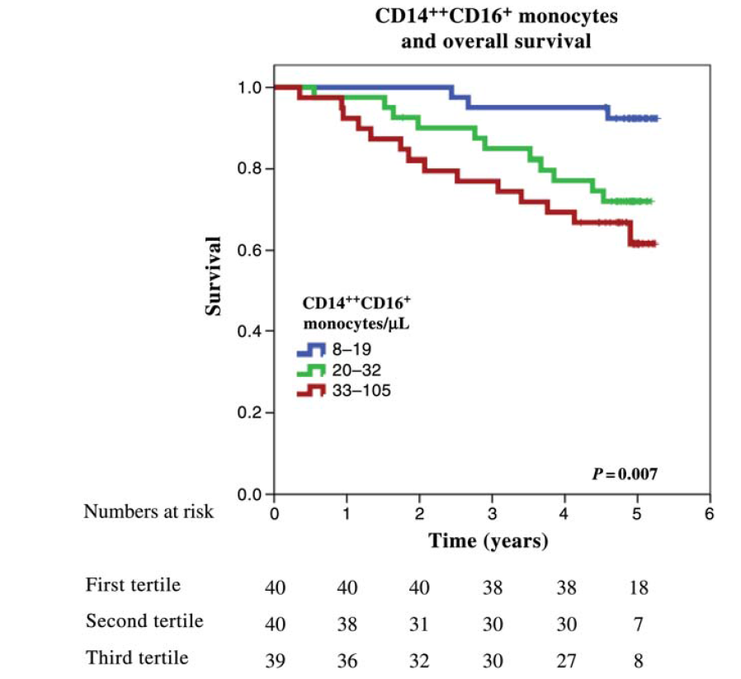
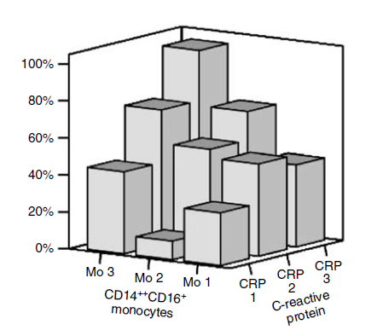
CD14++CD16+ monocytes are independently associated with CV
events in CKD
Proinflammatory monocyte subpopulations decrease after renal transplantation.
152 stable ambulatory patients with CKD
5 year follow-up
94 dialysis patients
35 months FU
Rogacev et al, Eur Heart J 2011
Heine et al, Kidney Int 2008

Slide 4
Winterberg, JASN 2019
Notes:
Background: Uremic cardiomyopathy, characterized by left ventricular hypertrophy, diastolic dysfunction, and impaired myocardial strain, contributes to increased cardiovascular mortality in patients with CKD. Emerging evidence suggests a pathogenic role for T cells during chronic heart failure.
Methods: To determine whether T cells contribute to uremic cardiomyopathy pathogenesis, we modeled this condition by inducing CKD via 5/6th nephrectomy in mice. We used flow cytometry to assess expression of markers of T cell memory or activation by lymphocytes from CKD mice and controls, as well as lymphocyte capacity for cytokine production. Flow cytometry was also used to quantify immune cells isolated from heart tissue. To test effects of T cell depletion on cardiac function, we gave CKD mice anti-CD3 antibody injections to deplete T cells and compared heart function (assessed by echocardiography) with that of controls. Finally, we correlated T cell phenotypes with structural and functional measures on clinically acquired echocardiograms in children with CKD.
Results: Mice with CKD accumulated T cells bearing markers of memory differentiation (CD44hi) and activation (PD-1, KLRG1, OX40), as reported previously in human CKD. In addition, mice with CKD showed T cells infiltrating the heart. T cell depletion significantly improved both diastolic function and myocardial strain in CKD mice without altering hypertension or degree of renal dysfunction. In children with CKD, increasing frequency of T cells bearing activation markers PD-1 and/or CD57 was associated with worsening diastolic function on echocardiogram.
Conclusions: CKD results in an accumulation of proinflammatory T cells that appears to contribute to myocardial dysfunction.

Slide 5
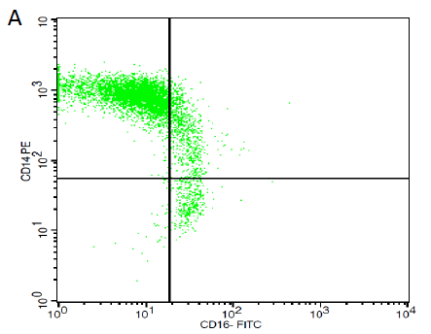
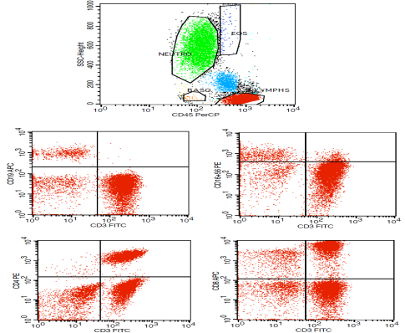
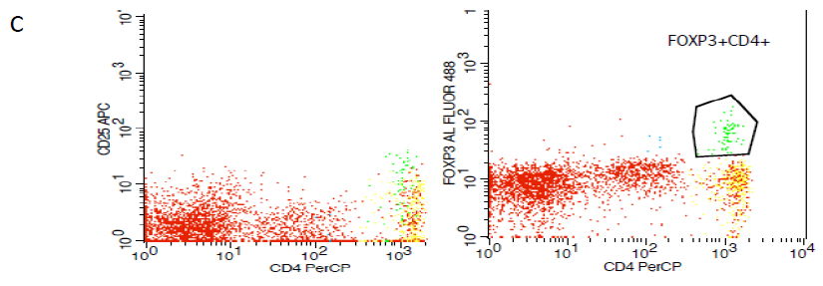
Methods
31 stable KTRs (mean age 58 +/-9.28 years, 67% males, 13% diabetics) without established CVD were enrolled.
Control population included 17 patients with chronic kidney disease (CKD) stage G3 and without history of CVD, matched for age and eGFR.
Additional exclusion criteria were history of malignancy, autoimmune disease and active or chronic infections.
The peripheral blood immune cell subsets CD14++CD16-, CD14++CD16+ and CD14+CD16++ absolute values and percentages out of total monocytes, NK cells (CD3+CD16+56+), CD3-CD19+ B lymphocytes, CD3+ CD4+ T cells, CD3+CD8+ T cells and Tregs (CD4+CD25+ FoxP3+) absolute values and percentages out of total lymphocytes were measured by flow cytometry (FC).
Conventional (left atrial volume index (LAVI), LV mass index (LVMI), E/E’) and novel 2D speckle tracking (2DST) echocardiographic indices of LV function (global longitudinal strain (GLS), global circumferential strain (GCS), global radial strain (GRS), TWIST AND UNTWIST) were assessed simultaneously with FC.
B

Slide 6
Results
KTRs had a mean eGFR of 58 +/-18 ml/min/1.73 m2 (CKD-EPI) and mean 24-hour proteinuria (PER) 707 +/-1185 mg/24h.
Total lymphocytes, B-cells, T-cells and CD8+ T cells counts correlated positively with eGFR (p<0.05).
Increased non-classical CD14+CD16++ monocytes were associated with PER (p <0.01).
There was an inverse correlation between the percentage of classical CD14++CD16- monocytes with PER (p <0.05).
 | KTRs (No=31) | CKD (No=17) | P value
WBC (No/mm³) | 8675+/-2852 | 7060 +/-1671 | 0.003
Monocytes (No/mm³) | 629 +/-246 | 453 +/-144 | 0.000
CD14++ (No/mm³) | 517 +-/223 | 356 +/-137 | 0.000
CD14++ (%) | 86 +/-8.3 | 79 +/-8.3 | 0.001
CD14+CD16++ (No/mm³) | 22 +/-14 | 31+/-16 | 0.008
CD14+CD16++ (%) | 3.8+/-2.5 | 7.2+/-3.7 | 0.000
T lymphocytes (%) | 81.4 +/-8.3 | 76.6 +/-8.4 | 0.011
NK cells (%) | 13.4 +/-7.9 | 17.1 +/-7.8 | 0.039
Tregs (No/mm³) | 22 +/-13 | 38 +/-34 | 0.006
Tregs (%) | 1.2 +/-0.75 | 2 +/-1.4 | 0.002
KTRs displayed higher CD14++CD16- and lower CD14+CD16++ monocytes, a lower percentage of NK cells and T cells and lower Tregs, compared to CKD patients.

Slide 7
Correlation of immune cells subsets with classical and novel LV dysfunction indices
Increased total monocytes were associated with elevated LAVI (p<0.05).
An increased percentage of the intermediate pro-inflammatory CD14++CD16+ monocytes correlated positively with an increased E/E’ value (p<0.05).
Both CD4+ T cells number and Tregs percentage were inversely correlated with E/E’ (p<0.01).
Increased pro-inflammatory monocytes levels were directly associated with LV TWIST and inversely associated with LV UNTWIST values (p<0.05).
Increased NK cells were associated with more negative GLS and GCS values (p<0.05).
No significant correlations were observed between the rest immune cells with the classical or novel LV dysfunction indices.

Slide 8
Conclusion
Alterations of immune cells subsets correlate with subclinical markers of LV dysfunction in KTRs with no established CVD.
Future research is required to evaluate the role of immune subpopulations as tools to identify KTRs who are at the highest risk for complications and guide interventions.
Acknowledgments: None
References
Dounousi E , Duni A, Naka KK, Vartholomatos G, Zoccali C. The Innate Immune System and Cardiovascular Disease in ESKD: Monocytes and Natural Killer Cells. Curr Vasc Pharmacol 2021;19(1):63-76

