Slide 1
Longitudinal analysis of immune cell phenotypes in the circulation of kidney transplant recipients and clinical correlations – a prospective study.
ANILA DUNI^{1,2}, ATHANASIOS KITSOS^{1,2}, GEORGIOS MARKOPOULOS³, VASILEIOS KOUTLAS², EIRINI TZALAVRA², VASILEIOS TATSIS², JOHN ALEKOS¹, LUIZA GKIKA¹, GERASIMOS BAXEVANOS³, HARALAMBOS PAPPAS^{1,2}, GEORGIOS VARTHOLOMATOS³, MICHAEL MITSIS², EVANGELIA DOUNOUSI^{1,2}.
Department of Nephrology, University Hospital of Ioannina, Greece¹
Department of Surgery and Kidney Transplant Unit, University Hospital of Ioannina, Greece²
Laboratory of Hematology - Unit of Molecular Biology, University Hospital of Ioannina, Greece³

Slide 2
Introduction
Immune cellular responses are implicated in all clinical aspects of kidney transplantation.
There are little data regarding the additional clinical value of regular monitoring of immune cells phenotypes expression in the circulation of kidney transplant recipients (KTRs).
The aim of our prospective study, was a longitudinal follow-up analysis of immune cell subtypes, including monocytes subpopulations, natural killer (NK) cells and regulatory T cells (Tregs) in the circulation of KTRs and potential clinical correlations.

Slide 3
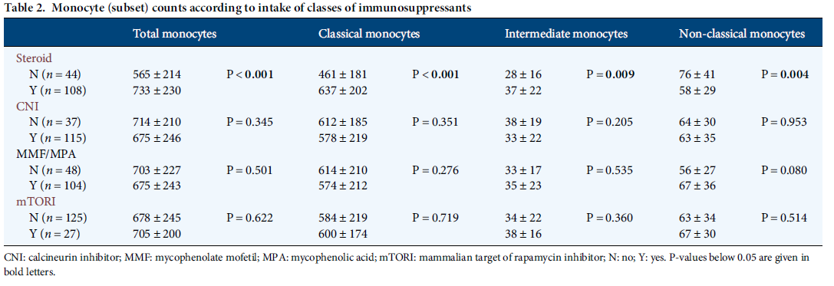
In KTx, steroid intake was associated with higher total, classical and pro-inflammatory monocyte counts, but fewer non-classical monocytes.
Notes:
Background. Monocytes are critical in innate immunity and
transplantation. Three monocyte subsets exist, CD14++CD16−,
CD14++CD16+ and CD14+CD16++ monocytes; cell counts of
CD14++CD16+ and CD14+CD16++ monocytes are increased
in pre-transplant chronic kidney disease. Interestingly, the
effect of immunosuppressants on monocyte heterogeneity has
not been well studied.
Methods. The impact of immunosuppressants on monocyte
subsets was studied: (i) in 152 kidney transplant (KTx) recipients
to characterize subset distribution in the steady state, (ii)
in patients after autologous (n = 10) versus allogenic (n = 9)
haematopoietic stem cell transplantation (HSCT) to analyse
monocyte subset development and (iii) in an in vitro model
to compare the effect of immunosuppressants on monocyte
subset biology.
Results. In KTx, steroid intake was associated with higher total,
CD14++CD16− and CD14++CD16+ monocyte counts, but fewer
CD14+CD16++ monocytes, whereas intake of mycophenolate,
calcineurin inhibitors (CNI) and mammalian target of rapamycin
inhibitors (mTORI) did not affect monocyte (subset)
counts. In linear regression analysis, only steroid intake was a
significant determinant of monocyte (subset) counts: total
monocytes (β = 0.331; P < 0.001), CD14++CD16− monocytes
(β = 0.374; P < 0.001), CD14++CD16+ monocytes (β = 0.221;
P = 0.010) and CD14+CD16++ monocytes (β = −0.169; P =
0.049). After HSCT, CD14++CD16− monocytes were the first to
arise, followed by CD14++CD16+ and later by CD14+CD16++
monocytes. Monocyte subset distribution did not differ significantly
in patients after allogenic compared with autologoustransplantation. CNI, mycophenolate and methotrexate did not
influence monocyte subset development, but modified surface
receptor expression (CCR2, HLA-DR, ENG, TEK and TLR4) in
allogenic HSCT.
Conclusion. Chronic low-dose steroids are associated with
monocytosis and higher counts of CD14++CD16− and of
proinflammatory CD14++CD16+ monocytes.

Slide 4
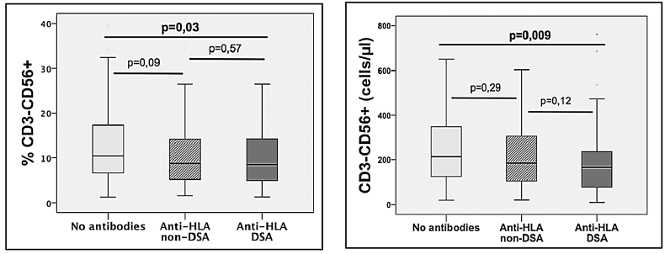
DSA and HLA non-DSA patients displayed lower proportions of NK-cells compared with patients without detectable anti-HLA antibodies.
Notes:
Background. Persistent CD4 T-cell lymphopenia after kidney
transplantation has been associated with an increased occurrence
of opportunistic infections,malignancies and evenmortality,
but studies have focussed only on the first few years after
kidney transplantation. In this study, we investigated the risk factors
and clinical significance of long-term profound CD4 lymphopenia
detected ≥10 years after renal transplantation.
Methods. Between 2007 and 2010, 6206 CD4 T-cell counts, including
1507 counts <300/mm3, were identified in an active
cohort of 1876 kidney transplant patients. We identified 27
HIV-negative lymphopenic kidney transplant recipients out
of 513 patients with graft survival over 10 years. We compared
this cohort to 54 non-lymphopenic controls matched for the
date of kidney transplantation.
Results. The prevalence of CD4 lymphopenia 10 years after
transplantation was 5.3%. CD4 T-cell lymphopenia was associated
with significantly lower thymic output and with B-cell
lymphopenia (P < 0.05). The duration of pre-transplant dialysis,
but not the use of lymphopenic induction or recipient age,
was significantly associated with a persistent CD4 lymphopenia
(6.1 versus 3.0 years, P = 0.008). CD4 lymphopenia was
associated with a higher frequency of cancer (50 versus
29.6%, P = 0.047). Most strikingly, long-term lymphopenia
was significantly and independently associated with anaccelerated decline in renal allograft function (P = 0.005), despite
a similar rate of biopsy-proven acute rejection and comparable
immunosuppression.
Conclusions. Our study shows an association between longterm
CD4 T-cell lymphopenia in kidney recipients and malignancy
and an accelerated decline of kidney allograft function

Slide 5
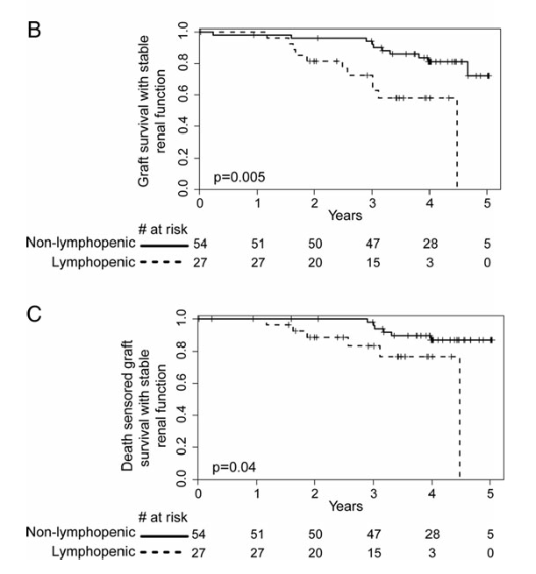
Long-term CD4 lymphopenia significantly associated with a hastened decline in graft function [HR = 3.89 P = 0.005] even after censoring for death [HR = 3.52, P = 0.04].

Slide 6
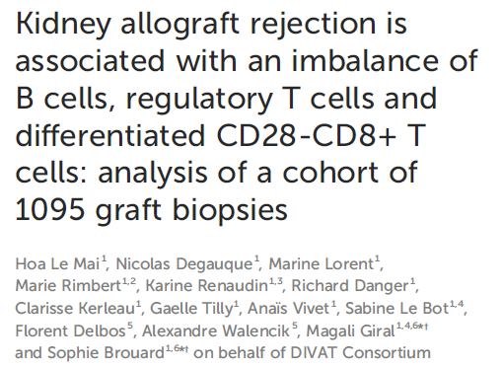
Compared to normal/subnormal biopsies, rejection of all types was marginally associated with a decrease in the percentage of circulating B cells and significantly associated with an increase in the ratio of CD28-CD8+ T cells to Tregs (p=0.01).
Notes:
Introduction: The human immune system contains cells with either effector/
memory or regulatory functions. Besides the well-established CD4
+CD25hiCD127lo regulatory T cells (Tregs), we and others have shown that B
cells can also have regulatory functions since their frequency and number are
increased in kidney graft tolerance and B cell depletion as induction therapy may
lead to acute rejection. On the other hand, we have shown that CD28-CD8+ T
cells represent a subpopulation with potent effector/memory functions. In the
current study, we tested the hypothesis that kidney allograft rejection may be
linked to an imbalance of effector/memory and regulatory immune cells.
Methods: Based on a large cohort of more than 1000 kidney graft biopsies with
concomitant peripheral blood lymphocyte phenotyping, we investigated the
association between kidney graft rejection and the percentage and absolute
number of circulating B cells, Tregs, as well as the ratio of B cells to CD28-CD8+
T cells and the ratio of CD28-CD8+ T cells to Tregs. Kidney graft biopsies were
interpreted according to the Banff classification and divided into 5 biopsies
groups: 1) normal/subnormal, 2) interstitial fibrosis and tubular atrophy grade
2/3 (IFTA), 3) antibody-mediated rejection (ABMR), 4) T cell mediated-rejection
(TCMR), and 5) borderline rejection. We compared group 1 with the other groups
as well as with a combined group 3, 4, and 5 (rejection of all types) using
multivariable linear mixed models.
Results and discussion: We found that compared to normal/subnormal biopsies,
rejection of all types was marginally associated with a decrease in the percentageof circulating B cells (p=0.06) and significantly associated with an increase in the
ratio of CD28-CD8+ T cells to Tregs (p=0.01). Moreover, ABMR, TCMR
(p=0.007), and rejection of all types (p=0.0003) were significantly associated
with a decrease in the ratio of B cells to CD28-CD8+ T cells compared to
normal/subnormal biopsies. Taken together, our results show that kidney
allograft rejection is associated with an imbalance between immune cells with
effector/memory functions and those with regulatory properties.

Slide 7
Methods
48 stable KTRs were initially enrolled.
All patients were under triple immunosuppressive regimen, including corticosteroids, mycophenolate mofetil or mycophenolate acid and calcineurin inhibitors (CNIs) (43% on cyclosporine and 57% on tacrolimus).
Exclusion criteria included history of acute rejection, cardiovascular disease (CVD), malignancy, autoimmunity and active or chronic infections.
Clinical and laboratory parameters were recorded at baseline (T0).
Patients were then prospectively followed and clinical and laboratory parameters were recorded at 12 months (T1).
Patients who developed acute rejection, new-onset CVD, malignancy or who were hospitalized during the follow-up period were excluded.

Slide 8
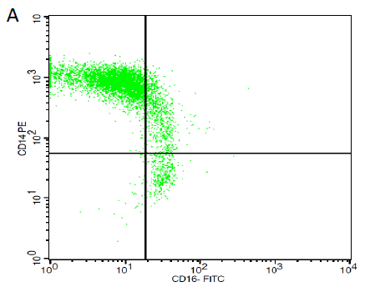
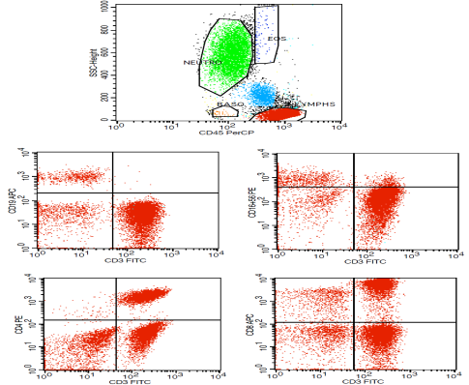
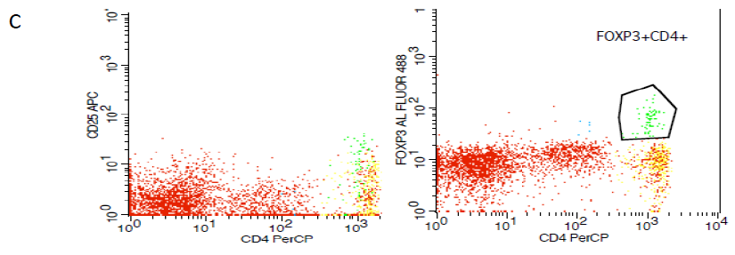
Methods
The peripheral blood immune cell subsets were measured by flow cytometry at baseline (T0) and after 12 months (T1):
CD14++CD16-, CD14++CD16+ and CD14+CD16++ absolute values and percentages out of total monocytes
NK cells (CD3+CD16+56+) absolute values and percentages out of total lymphocytes
CD3-CD19+ B lymphocytes, CD3+ CD4+ T cells, CD3+CD8+ T cells and Tregs (CD4+CD25+ FoxP3+) absolute values and percentages out of total lymphocytes
B

Slide 9
Results
40 KTRs (mean age 58 +/-9.28 years, 67% males) were included in the study analysis.
Mean eGFR (CKD-EPI) declined from 58 +/-17 at T0 to 53 +/-18ml/min/1.73 m2 (p< 0.01).
No significant changes in spot urine protein to creatinine ratio (UPCR) nor in inflammatory markers (CRP, ESR) were observed between T0 and T1.
Overall, there was a decrease in mean monocytes counts ((648±241/µL versus 537 ±194/µL, p=0.01) and mean lymphocytes counts (2115 ±127/µL versus 1925±724/µL, p=0.49 respectively).
The mean counts of the classical CD14++CD16- monocytes subtype increased at T1 (533±224/µL) compared to T0 (451±185/µL) (p=0.04), whereas the rest immune cell subsets did not show any significant change.
CNI blood levels displayed no significant changes during the follow-up period compared with baseline.
A greater increase in the difference (Δ) of the pro-inflammatory CD14++CD16+ monocytes count from T1 to T0 (ΔCD14++CD16+ monocytes = CD14++CD16+ monocytes at T1-CD14++CD16+ monocytes at T0) was associated with a greater eGFR decline (ΔeGFR = eGFR T1 – eGFR T0) (ρ = -0.339, p=0.046).

Slide 10
Conclusion
The results of our study suggest that greater increases in levels of pro-inflammatory CD14++CD16+monocytes are associated with increased yearly graft function loss.
Future research studies with longer follow-up are required to specify the role of immune subpopulations as potential prognostic biomarkers in KTRs.
Acknowledgments: None
References
Dounousi E , Duni A, Naka KK, Vartholomatos G, Zoccali C. The Innate Immune System and Cardiovascular Disease in ESKD: Monocytes and Natural Killer Cells. Curr Vasc Pharmacol 2021;19(1):63-76

