Slide 1
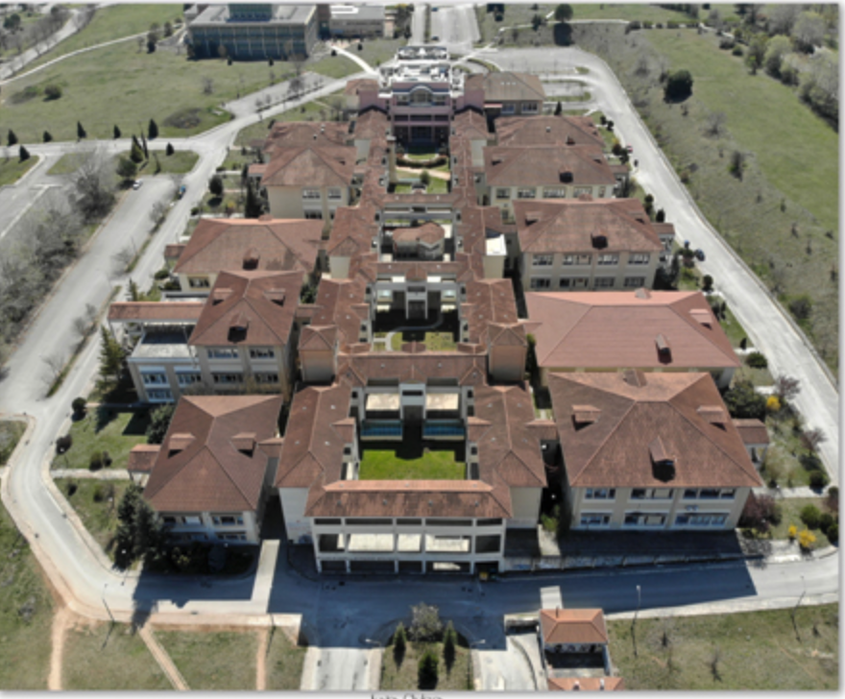
Identifying individuals at risk of needing CKD associated medications in a European kidney disease cohort
Eleni Stamellou^{1,2,*}, Turgay Saritas¹, Marc Froissart³, Florian Kronenberg⁴, Peter Sternvinkel⁵, David C. Wheeler⁶, Kai-Uwe Eckardt⁷, Jürgen Floege¹, James Fotheringham⁸
¹Department of Nephrology, RWTH University of Aachen, Aachen, Germany,² Department of Nephrology, University Hospital of Ioannina, Ioannina,³ Centre de Recherche Clinique (CRC), Lausanne University Hospital, Lausanne, Switzerland,⁴ Department of Genetics, Institute of Genetic Epidemiology, Medical University of Innsbruck, Innsbruck, Austria, ⁵ Division of Renal Medicine, Department of Clinical Science, Intervention and Technology, Karolinska Institutet, Stockholm, Sweden, ⁶ Department of Renal Medicine, University College London, London, UK,⁷ Department of Nephrology and Medical Intensive Care, Charité-Universitätsmedizin Berlin, Berlin, Germany,⁸ Northern General Hospital, Sheffield Kidney Institute, Herries Road, Sheffield, South Yorkshire, S5 7AU, UK, ⁹ School of Health and Related Research, University of Sheffield, Sheffield, UK.
University of Ioannina
Notes:
1

Slide 2
Background
Despite advances in care people on dialysis still face high mortality rates
Suboptimal care during CKD stages G4/G5ND is a possible contributing factor
Earlier specialized nephrology care before dialysis is associated with significantly better outcomes
Anemia and CKD-MBD are modifiable risk factors for cardiovascular and kidney disease progression, emphasizing the need for early recognition and treatment.
VDRA
Phosphate binders
ESAs
Iron
Notes:
Suboptimal care during the predialysis period
As we know that earlier specialized nephrology care…
As Anemia and CKD-MBD are modifiable risk factors for cardiovascular and kidney disease progression, in this study we investigated variables that could predict future use of medications that could treat these conditions like: Vit. D R activators (VDRA), phosphate binders, (ESAs) and iron

Slide 3
Analyzing Data, recognizing Excellence and Optimizing Outcomes (ARO) cohort III
Retrospective cohort of pre-haemodialysis patients enrolled in FMC
- 1 Apr 2012 to 30 Jun 2014
- Follow-up to 31 Dec 2016
Inclusion/exclusion criteria:
Pre-haemodialysis patients CKD 4/5 aged ≥18
At least ≥90 days of follow-up
Aro3 cohort by country:
Czech Republic
Italy
Russia
Serbia
Slovak Republic
Bosnia
Stamellou E et al. under Revision CKJ
Notes:
For this purpose we used the aro3 cohort , which is a retrospective cohort of pre-haemodialysis patients enrolled in FMC
Inclusion/exclusion criteria were
Pre-haemodialysis patients CKD 4/5 older ≥18
witht least ≥90 days of follow-up
2471 patients were recruited in total
Of them 2196 patients were included in the present analysis. Patients who were transplanted during the pre-dialysis period (n=9), with <90 days of follow-up in the pre-dialysis period (n=173), and who were dialyzed in the pre-dialysis period (n=93) were excluded,
Then we divided our cohort in a derivation and validation groups in a (2:1) ratio

Slide 4
Baseline Characteristics
Mean age: 69 years old
52% women
Diabetic nephropathy followed by hypertensive nephropathy were the most common causes of CKD.
eGFR at baseline: 18.6 ml/min/1.73m².
Derivation and Validation cohort: no significant differences and shared similar traits with the entire cohort.
Stamellou E et al. under Revision CKJ
Notes:
BL: the mean age was 69 years, with 52% beingwomen.
Diabetic nephropathy followed by hypertensive nephropathy were the most common causes of CKD.
At baseline, eGFR was 18.6 ml/min/1.73m².
Validation and derivation cohort exhibited no significant differences and shared similar traits with the entire cohort.

Slide 5
Risk of requiring CKD-related pharmacotherapy
Stamellou E et al. under Revision CKJ
Notes:
Following backward selection,
Significant predictors for the prescription of ESAs included VDRA and iron therapy already at referral, hemoglobin levels <120 g/l and iPTH levels >150 ng/l
Regarding iron therapy, predictors included low eGFR at baseline and treatment with ESAs already at referral.
The predictors for prescription of phosphate binders included younger age, serum albumin concentration >35 g/l, baseline iPTH levels >150 ng/l and hemoglobin <120 g/l.
Lastly, the prescription of VDRA therapy was associated with a history of diabetes, baseline iPTH > 150 ng/l, serum albumin >35 g/l and abnormal calcium levels (< 2.1 mmol/l or ≥2.6 mmol/L)
The models showed varying prediction capabilities, which were best for ESAs and phosphate binders.

Slide 6
Conclusion
Age, history of diabetes, iPTH, hemoglobin, calcium and serum albumin levels predicted medication needs.
The models showed varying prediction capabilities, which were best for ESAs and phosphate binders.
16% of patients were predicted to have a likelihood of receiving any of these medications of less than 20%.
By identifying low-risk patients who may require less frequent follow-up the study has the potential to optimize the use of healthcare resources and enhance patient care.
This holistic approach could lead to more individualized and effective management of CKD-related complications, ultimately benefiting both patients and healthcare systems.
Stamellou E et al. under Revision CKJ
Notes:
The present study investigated risk factors for CKD-related medication in a cohort of CKD4 patients
Age, history of diabetes, iPTH, hemoglobin, calcium and serum albumin levels predicted medication needs.
16% of patients were predicted to have a likelihood of receiving any of these medications of less than 20%.
By identifying low-risk patients who may require less frequent follow-up the study has the potential to optimize the use of healthcare resources and enhance patient care.

