Slide 1
GFR SLOPE AS A PREDICTOR OF KIDNEY FUNCTION RELATED TO ANTHROPOMETRIC PARAMETERS
VJOLLCA GODANCI KELMENDI¹, MIMOZA RAMADANI PIRAJ¹,
SHEGA KONJUFCA², FATIME YMERI²
University Clinical Centre of Kosova, Nephrology Clinic
¹Asklepi Med Ambulance for Internal Medicine – Nephrology

Slide 2
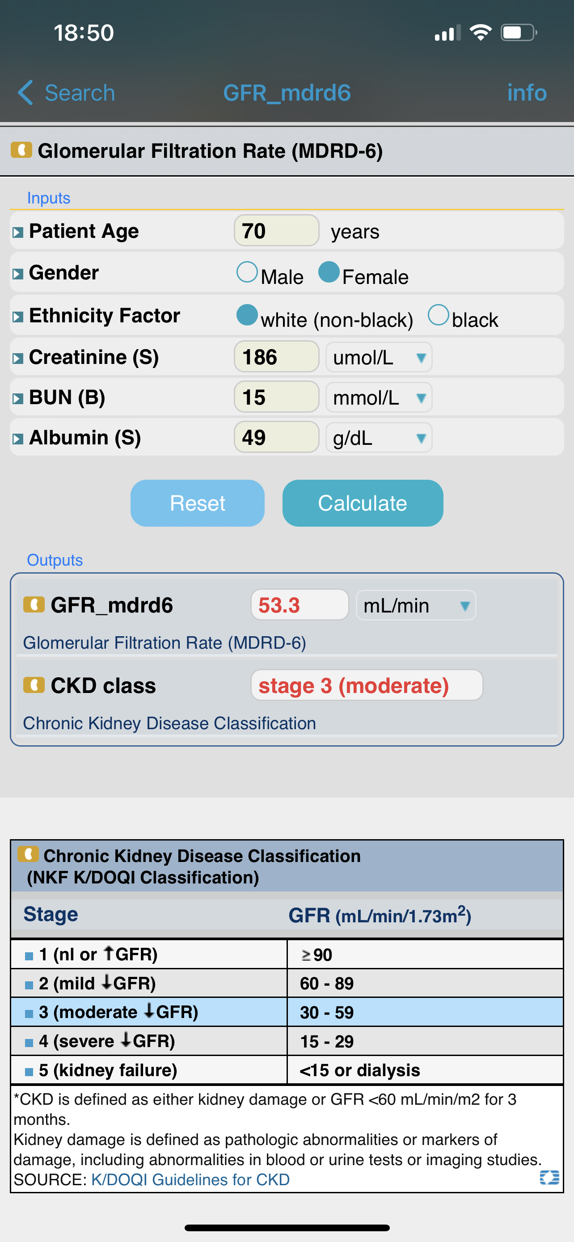
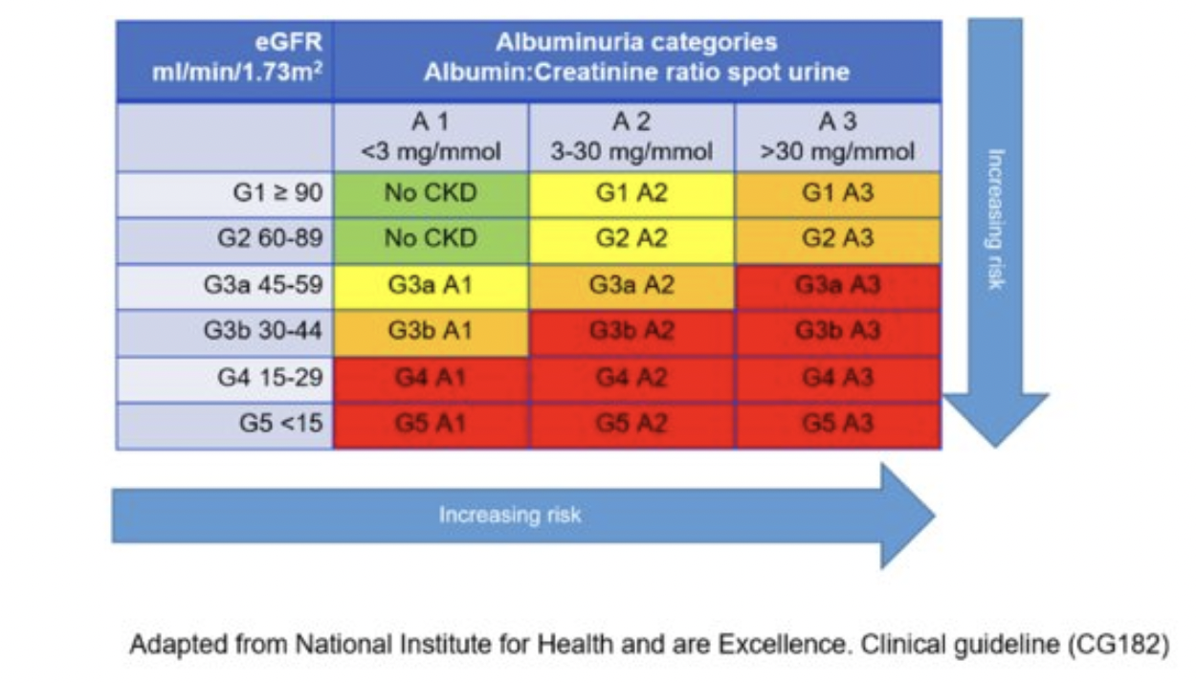

Slide 3
GFR slope as a predictor of kidney function related to anthropometric parameters
Estimating GFR
A
RETROSPECTIVE COHORT
36 MO FOLLOW UP
450 CKD AMBULANTORY PT
One center study
CREATININE
eGFR
ALBUMINE
BMI
BSA
B
D
INCLUSION
C
AIM OF THE STUDY
CKD slope 3 mo after baseline randomization
BSA MDRD
CKD EPI FORMULA
Attenuating CKD progression

Slide 4
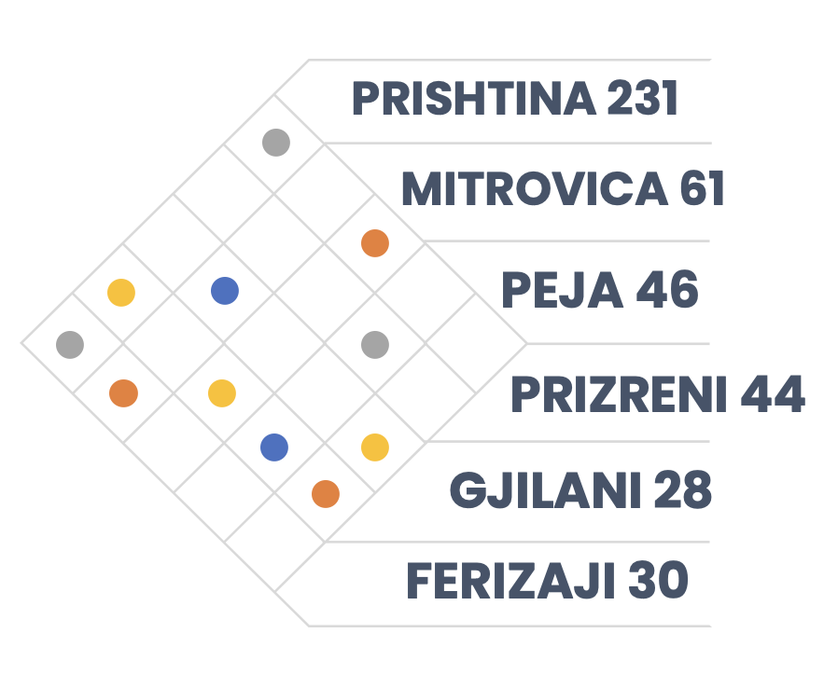
DEMOGRAPHICS OF OUR SAMPLE
INSIDES FROM GFR SLOPE STUDY
61%
39%

Slide 8
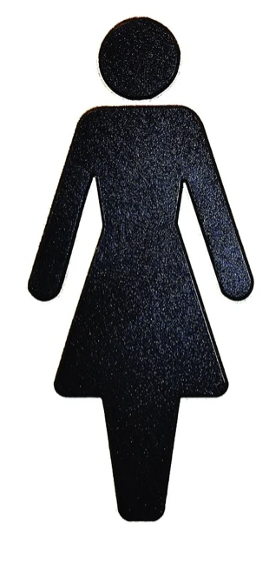
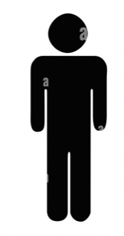
MINUS 84 kg/m²
MINUS 34 kg/m²
MINUS 6 m²

Slide 9
eGFR SLOPE
BSA
mGFR
eGFR standardized
eGFR personalized
Imoportant parameter in CKD EPI and eGFR MDRD equation
The measurement of choice !!!!!
Useful for laboratory medicine
More accurate

Slide 10
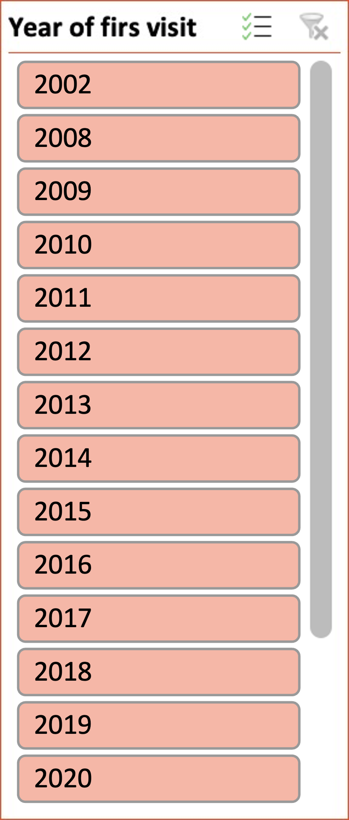
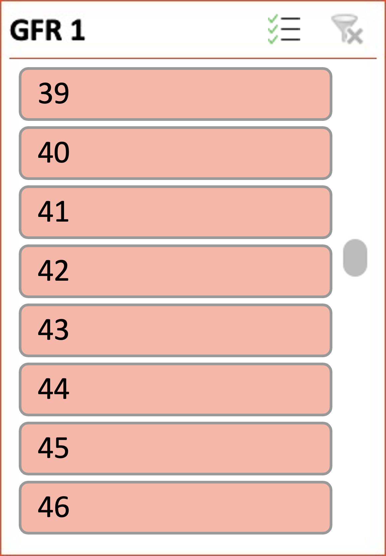
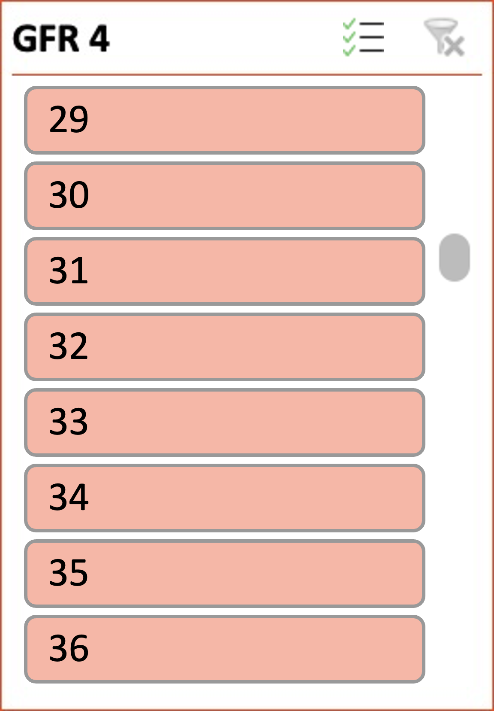
SUMMARIZE
36
1 st
last
MONTHS
eGFR
eGFR
eGFR4
17453
40.0 ml/min
20 HD 3 KT
Average
Count
MINUS 510 ml/min
eGFR1
17963
40.1 ml/min

Slide 11
Late break conclusions
Insides from ongoing study
450
01
- 510 ml
BSA
02
1 % 1.73kg/m²
BMI
03
- 118 kg
eGFR
04
5% 20 D, 3 T
2
eGFR CKD EPI
05
eGFR MDRD
CKD
BSA
BMI
eGFR
eGFR SLOPE

Slide 12
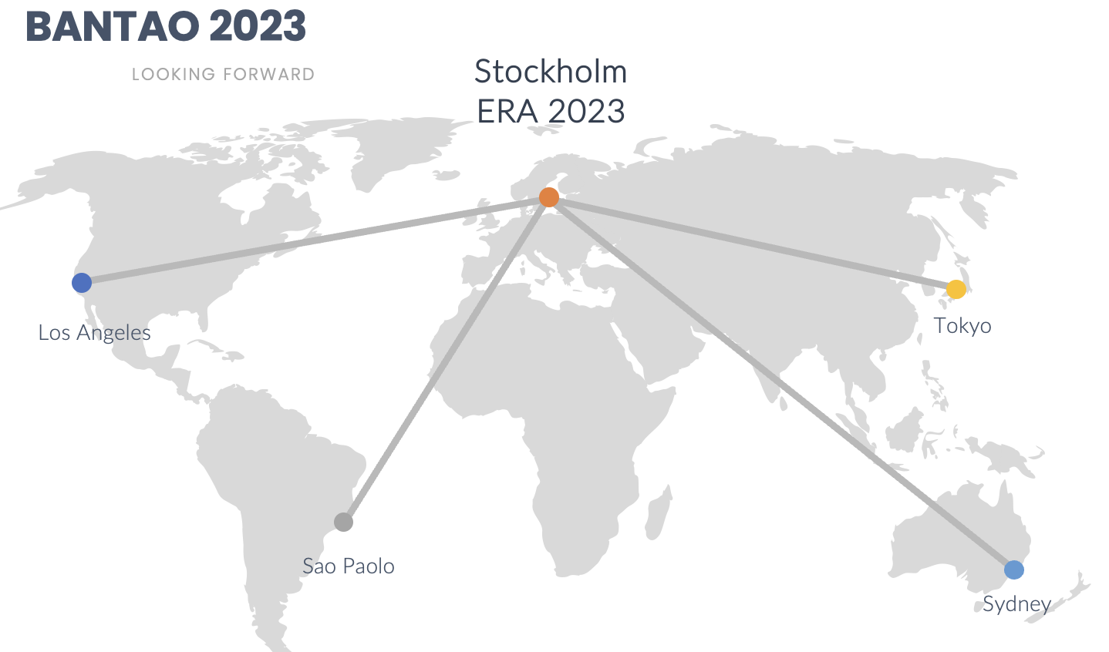
THANK YOU ALL FOR YOUR ATTENTION

