Slide 1
1ST DEPARTMENT OF
NEPHROLOGY
HIPPOKRATION HOSPITAL
EFFECTS OF SODIUM-GLUCOSE CO-TRANSPORTER 2 INHIBITORS ON HEART FAILURE IN CHRONIC KIDNEY DISEASE: A SYSTEMATIC REVIEW AND META-ANALYSIS
M. THEODORAKOPOULOU¹, ME. ALEXANDROU¹, E. PELLA¹, F. IATRIDI¹, A. TSITOURIDIS¹, V. KAMPERIDIS², E. SAMPANI¹, E. KARKAMANI¹, A. XANTHOPOULOS³, A. PAPAGIANNI¹, P. SARAFIDIS¹
1) First Department of Nephrology, Hippokration Hospital, Aristotle University of Thessaloniki, Thessaloniki, Greece; 2) First Department of Cardiology, AHEPA Hospital, Greece; 3) Cardiology Department, University of Thessaly, Larissa, Greece
Notes:
Now the second one,

Slide 2
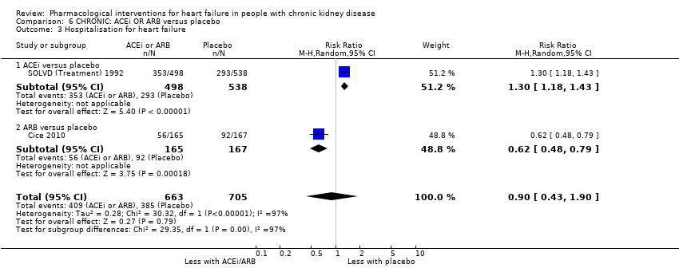
RAS blockers and HHF risk in CKD
Notes:
RAS blockers were shown to reduce hospitalizations for HF (HHF) among hypertensive patients and those with LV
dysfunction but not in patients with CKD, and therefore existing evidence was deemed as insufficient to provide specific treatment recommendations for prevention
of HF events in CKD patients

Slide 3
Beneficial effects of SGLT-2inh
Notes:
Over the past 7 years, an increasing number of clinical trials in various populations at high CV risk, have shown that 2 (SGLT-2) inhibitors offer potent cardioprotective and nephroprotective properties

Slide 4
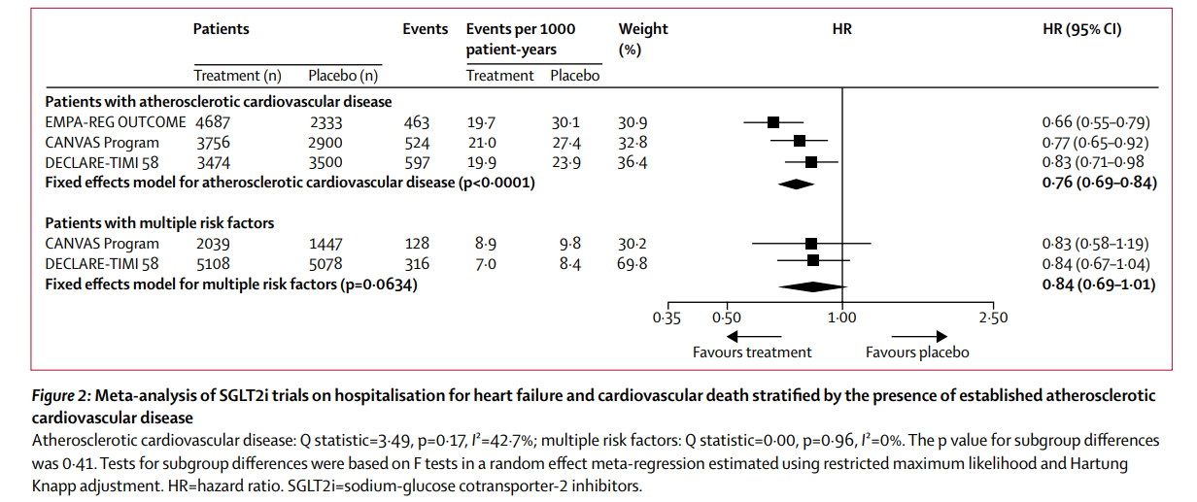
SGLT-2inh and HHF risk in T2DM
Zelniker et al, Lancet 2018
Notes:
Over the past 7 years, an increasing number of clinical trials in various populations at high CV risk, have shown that SGLT-2 inhibitors reduced the relative risk for HHF by 30% in patients with T2D ¹⁹.
In patients with diabetic kidney disease and an eGFR of 30 to <90 ml/min/1.73m², an even more dramatic reduction in HHF by 39% was observed for canagliflozin²⁰. Empagliflozin ²¹ and recently dapagliflozin ²² were shown to reduce CV outcomes even in patients with HF with preserved ejection fraction (EF), a population in which few studies had previously succeeded in improving prognosis ¹². In a recent trial involving patients with CKD and normo-, micro-, and macro-albuminuria, no significant effect on the risk for HHF was observed for empagliflozin.²³

Slide 5
SGLT-2inh and HHF risk in heart failure
DAPA-HF
EMPEROR-Reduced
EMPEROR-Preserved
Placebo
Empagliflozin
Dapagliflozin
McMurray JJV, et al. N Engl J Med. 2019
Packer M, et al. N Engl J Med. 2020
Anker SD, et al. . N Engl J Med. 2021
Notes:
SGLT-2 inhibitor reduce the risk for HHF in patients with HF, either with reduced

Slide 6
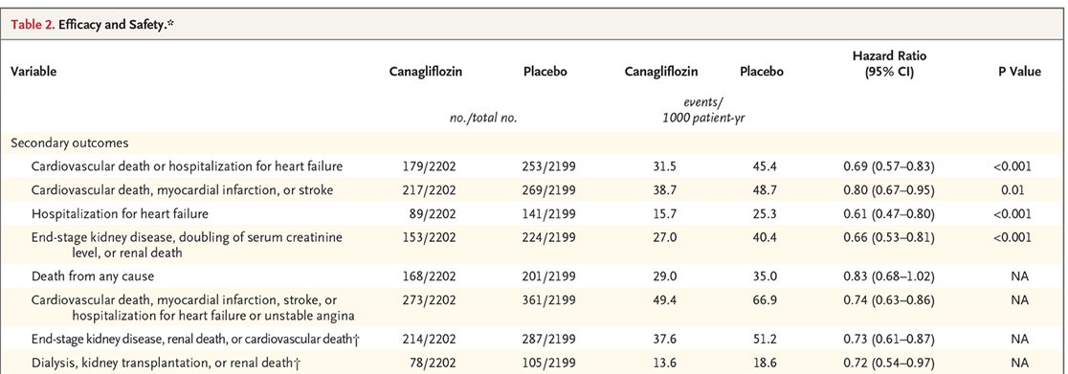
SGLT-2inh and HHF risk in CKD
DAPA-CKD
CREDENCE
Heerspink, et al. N Engl J Med. 2020
Perkovic, et al. N Engl J Med. 2019
Notes:
In patients with diabetic kidney disease and an eGFR of 30 to <90 ml/min/1.73m2, an even more dramatic reduction in HHF by 39% was observed for canagliflozin20. Empagliflozin 21 and recently dapagliflozin 22 were shown to reduce CV outcomes even in patients with HF with preserved ejection fraction (EF), a population in which few studies had previously succeeded in improving prognosis 12. In a recent trial involving patients with CKD and normo-, micro-, and macro-albuminuria, no significant effect on the risk for HHF was observed for empagliflozin.23

Slide 7
Aim
We aimed to perform a meta-analysis exploring the effect of SGLT-2 inhibitors on HF events in patients with CKD and across subgroups defined by baseline kidney function.
Notes:
Whether the beneficial effects of SGLT-2 inhibitors on reducing HF events are consistent as kidney function decreases has not yet been investigated. On the light of
the above, we conducted a systematic literature review and a meta-analysis of randomized controlled trials (RCTs) to assess the effect of currently approved SGLT-2
inhibitors on HF events in patients with CKD and across subgroups stratified by baseline kidney function.

Slide 8
Methods
Systematic review and meta-analysis (PROSPERO ID: CRD42022382857).
A literature search was conducted in major electronic databases (PubMed/MEDLINE, Scopus, Cochrane Library and Web of Science) up to 15 November 2022.
Randomized controlled trials providing data on the effect of SGLT-2 inhibitors on the primary outcome, time to hospitalization or urgent visit for worsening HF in patients with prevalent CKD at baseline or across subgroups stratified by baseline eGFR were included.
Primary outcome: time to hospitalization or urgent visit for worsening HF in patients with CKD
Notes:
We performed a systematic literature search in PubMed/MEDLINE, Scopus, Cochrane Library and Web of Science) up to 15 November 2022 and we included …….
The primary outcome was

Slide 9
Study flow-chart
12 studies with 89,191 participants
Notes:
Here is the flow chart, from a total of 6662 reports initially screened, 12 studies with … were included in the final metaanalysis

Slide 10
Effects of SGLT-2inh on HF events in CKD
32%
Notes:
With regards to the primary outcome, Treatment with an SGLT-2 inhibitor led to a significant reduction in the risk for HF events compared to placebo by 32% (hazard ratio [HR] 0.68; 95%CI 0.63-0.723), with no significant heterogeneity detected between (I²=0%, p=0.62).

Slide 11
Effects of SGLT-2inh on HF events in CKD Subgroup analysis according to SGLT-2inh type
Notes:
In subgroup analysis of the treatment effect of type of SGLT-2 inhibitor in patients with CKD at baseline (Figure 4), treatment with canagliflozin (2 RCTs, 14,543 participants: HR 0.60; 95%CI 0.48-0.75) and ertugliflozin (1 RCT, 8,246 participants: HR 0.50; 95%CI 0.33-0.76) appeared to be associated with a greater reduction in the risk of HF events; however these differences did not reach statistical significance (p-subgroup=0.44).

Slide 12
Effects of SGLT-2inh on HF events in CKD Subgroup analysis according to eGFR
Notes:
*Reduction in HF events with SGLT-2 inhibitors appeared to be greater in patients with eGFR<60 ml/min/1.73m² (HR 0.68; 95%CI 0.62-0.74) than in those with eGFR≥60 ml/min/1.73m² (HR 0.76; 95%CI 0.69-0.83)(p-subgroup-difference=0.08), again with no significant heterogeneity detected within each subgroup (I²=0% for both). Additional analyses of data stratified by eGFR subgroups of ≥30 vs. <30 ml/min/1.73m² (Figure 3b) did not reveal any significant differences in the magnitude of the treatment effect of SGLT-2 inhibitors between earlier and more advanced stages (Stage 4). In the analysis of data stratified by KDIGO CKD risk categories, patients at high and very high-risk groups appeared to experience greater risk reduction, but the test for subgroup analysis did not reveal subgroup effect (Supplemental Figure 3).

Slide 13
Sensitivity analysis: patients with T2DM
Notes:
Sensitivity analysis from trials including only diabetic patients revealed an even more pronounced effect in patients with eGFR <60 ml/min/1.73m2 (HR 0.62; 95%CI 0.54-0.70), compared to those with eGFR ≥60 ml/min/1.73m2 (HR 0.76; 95%CI 0.67-0.87) (p-subgroup=0.03).

Slide 14
Επίδραση SGLT-2inh στην καρδιακή ανεπάρκεια σε ΧΝΝ

Slide 15
Conclusions
Treatment with SGLT-2 inhibitors led to a significant reduction in HF events in patients with CKD, with or without diabetes
These beneficial effects are independent of GFR levels and CKD risk group
These findings may change the landscape of HF treatment in patients with advanced CKD.

Slide 16
THANK YOU

