Slide 1
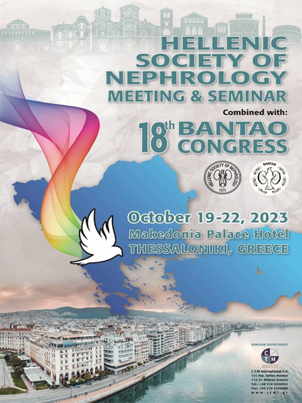
EFFECTS OF SODIUM-GLUCOSE CO-TRANSPORTER 2 INHIBITORS ON CARDIOVASCULAR MORTALITY IN CHRONIC KIDNEY DISEASE: A SYSTEMATIC REVIEW AND META-ANALYSIS
E. PELLA¹, ME. ALEXANDROU¹, M. THEODORAKOPOULOU¹, A. TSITOURIDIS¹, F. IATRIDI¹, A. KARAGIANNIDIS¹, D. FAITATZIDOU¹, E. SAMPANI¹, V. KAMPERIDIS², A. PAPAGIANNI¹, P. SARAFIDIS¹
1) First Department of Nephrology, Hippokration Hospital, Aristotle University of Thessaloniki, Thessaloniki, Greece; 2) First Department of Cardiology, AHEPA Hospital, Greece
1ST DEPARTMENT OF
NEPHROLOGY
HIPPOKRATION HOSPITAL
Notes:
Thank you very much for your kind introduction, I am very happy to be here to present a meta-analysis of our group, on the ….

Slide 2
Notes:
RAS blockade, that has been established as the cornerstone of
nephroprotection according to the highest level of evidence, was also shown to reduce
cardiovascular morbidity and mortality in patients with hypertension or heart failure
(HF). 4 Nevertheless in a large observational study undertaken in patients with
estimated glomerular filtration rate (eGFR) &lt;30 ml/min/1,73m 2 at baseline, these
agents did not reduce all-cause death or the risk for the composite cardiovascular
endpoint (CV death, myocardial infarction [MI], or stroke) compared to calcium-
channel blockers.

Slide 3
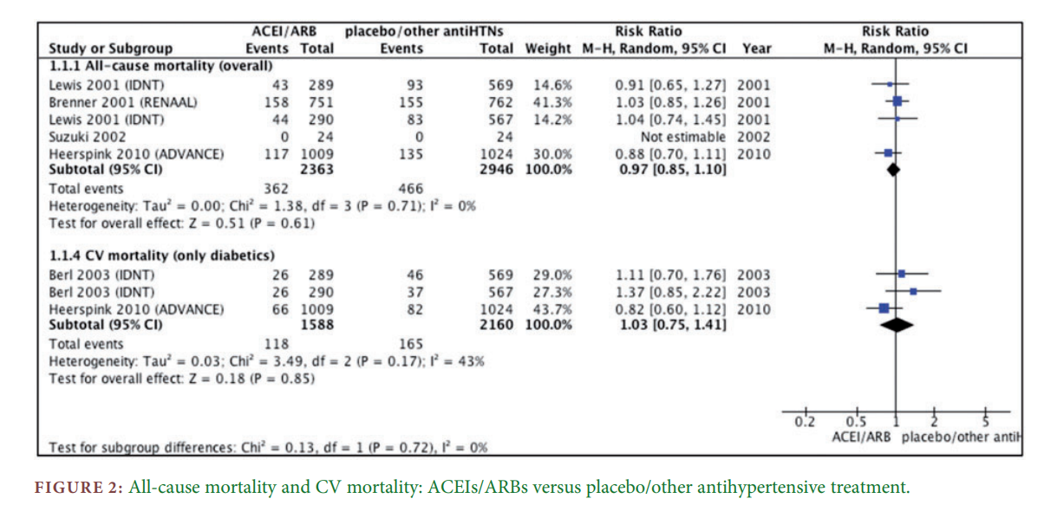
RAS blockers and mortality in CKD
Nistor et al, Nephrol Dial Transplant 2018
Notes:
RAS blockers, represent the cornerstone of nephroprotection, but it is known from studies of patients with chronic kidney disease (CKD) that these agents dο not reduce cardiovascular (CV) events or mortality

Slide 4
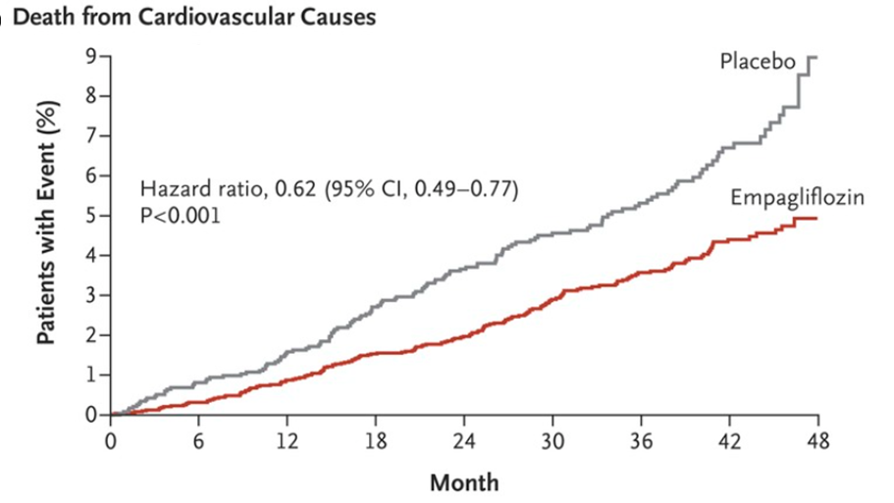
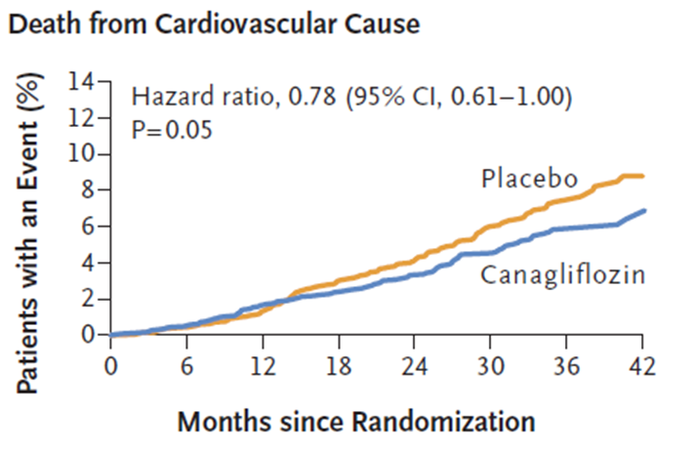
SGLT2i and CV mortality in T2DM
EMPA-REG OUTCOME
CREDENCE
Zinman et al, NEJM 2015
Perkovic et al, NEJM 2019
Notes:
Over the past 7 years, an increasing number of clinical trials in various populations at high CV risk, have shown that 2 (SGLT-2) inhibitors offer potent cardioprotective and nephroprotective properties, and they significantly reduce CV mortality in different subgroups, including patients with DM,

Slide 5
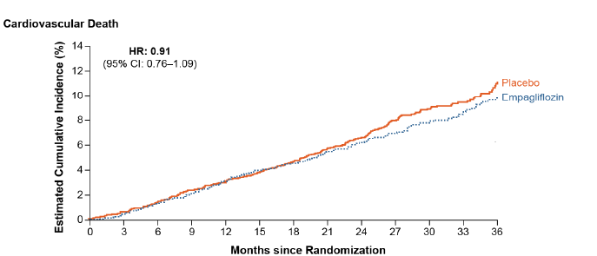
SGLT2i and CV mortality in HF
HFpEF
EMPEROR-Preserved
Anker al, NEJM 2021
HFrEF
EMPEROR-Reduced
DAPA-HF
Zelniker et al, Lancet 2018
Notes:
As well as in patients with HF, either with reduced

Slide 6
Aim
The aim of this meta-analysis was to evaluate the effect of SGLT2 inhibitors on CV mortality in patients with CKD and across subgroups defined by baseline kidney function
Notes:
the effect of presently approved SGLT-2 inhibitors on CV and all-cause mortality and MACE in patients with CKD and across subgroups stratified by baseline kidney function.

Slide 7
Methods
Systematic review and meta-analysis (PROSPERO ID: CRD42022382863)
A literature search was conducted in major electronic databases (PubMed/MEDLINE, Scopus, Cochrane Library and Web of Science) up to 15 November 2022.
We included RCTs assessing the effect of SGLT-2 inhibitors (vs placebo or other active treatment) on the primary outcome in patients with prevalent CKD at baseline or across subgroups stratified by baseline eGFR.
Primary outcome: CV mortality
Secondary outcomes: all-cause mortality and major adverse CV events (MACE).
Notes:
Η έρευνα πραγματοποιήθηκε σε τέσσερις μηχανές αναζήτησης βιβλιογραφικών αναφορών (PubMed/MEDLINE, Scopus, Cochrane Library και Web of Science) (PROSPERO ID: CRD42022382863). Συμπεριλήφθηκαν τυχαιοποιημένες κλινικές δοκιμές που αξιολογούσαν την επίδραση των αναστολέων SGLT-2 στο πρωτεύον καταληκτικό σημείο, τον χρόνο μέχρι τον καρδιαγγειακό θάνατο, σε ασθενείς με ΧΝΝ κατά την έναρξη της μελέτης. Τα δευτερεύοντα καταληκτικά σημεία περιλάμβαναν την ολική θνησιμότητα και τα μείζονα ανεπιθύμητα καρδιαγγειακά συμβάματα (MACE).

Slide 8
Study flow-chart
11 studies with 83,203 participants
Notes:
Έντεκα μελέτες με 83.203 ασθενείς με ΧΝΝ συμπεριλήφθηκαν στην μετα-ανάλυση.

Slide 9
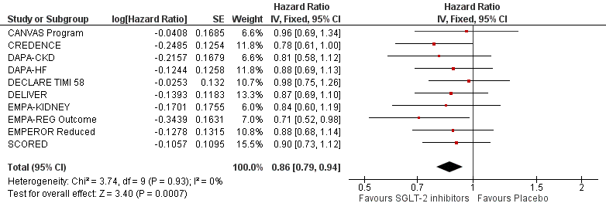
Primary outcome: SGLT2i effects on CV mortality
14%
Notes:
With regards to the primary outcome, treatment with SGLT-2 inh reduced by 14% the risk for CV death compared to placebo,
Η θεραπεία με SGLT-2 αναστολείς, σε σύγκριση με το εικονικό φάρμακο, μείωσε τον κίνδυνο καρδιαγγειακού θανάτου κατά 14% (HR 0,86; 95%CI 0,79-0,94),

Slide 10
SGLT2i effects on all-cause mortality
15%
SGLT2i effects on MACE
13%
Notes:
Similarly, …….
Η θεραπεία με SGLT-2 αναστολείς, σε σύγκριση με το εικονικό φάρμακο, μείωσε τον κίνδυνο θανάτου από κάθε αιτία κατά 15% (HR 0,85; 95%CI 0,79-0,91) και τον κίνδυνο για MACE κατά 13% (HR 0,87; 95%CI 0.81-0.93).

Slide 11
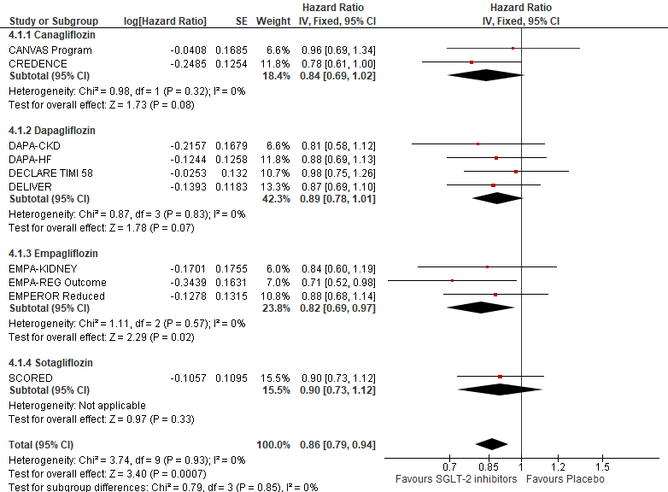
SGLT2i effects on CV mortality
Subgroup analysis according to SGLT2i type
Notes:
These beneficial effects were independent of the agent used as indicated by this subgroup analysis according to sglt2 type, with all of agents used canagliflozin, dapaglifozin, empagliflozin, sotagliflozin reduce the CV mortality without between group differences , suggesting the presence a class – and not a drug-effect
Παρατηρήθηκε σταθερή θεραπευτική επίδραση στο πρωτεύον καταληκτικό σημείο με όλους τους αναστολείς SGLT-2 (καναγλιφλοζίνη: HR 0,84; 95%CI 0,69-1,02, δαπαγλιφλοζίνη: HR 0,89; 95%CI 0,78-1,01, εμπαγλιφλοζίνη: HR 0,82; 95%CI 0,69-0,97 σοταγλιφλοζίνη: HR 0,90; 95%CI 0,73-1,12) που μελετήθηκαν (ανάλυση υποομάδων p=0,85).

Slide 12
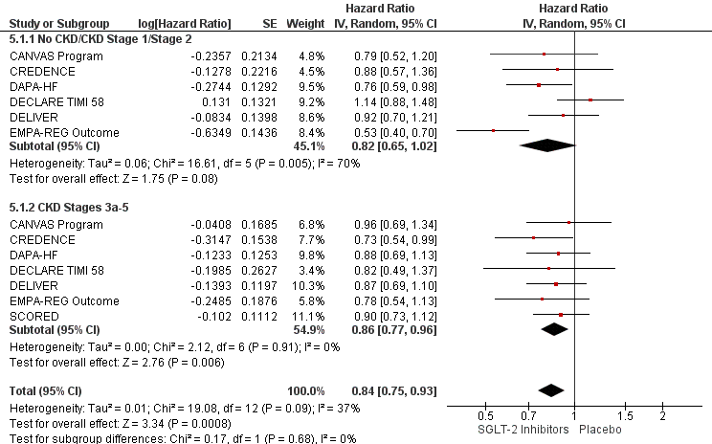
SGLT2i effects on CV mortality
Subgroup analysis according to eGFR
18%
14%
Notes:
A consistent treatment effect was observed across eGFR subgroups (≥60 ml/min/1.73m2: HR 0.82, 95%CI 0.65-1.02; <60 ml/min/1.73m2: HR 0.86, 95%CI 0.77-0.96, p-subgroup-difference=0.68) (Supp. Figure 4a) and KDIGO risk categories (p-subgroup-difference=0.69), although reduction in the risk of CV death with SGLT-2 inhibitors tended to be greater in the highest risk categories (low risk: HR 0.91, 95%CI 0.67-1.23; moderate risk: 0.81, 95%CI 0.63-1.05; high risk: 0.82, 95%CI 0.55-1.21; very high risk: HR 0.66, 95%CI 0.43-1.01)

Slide 13
Sensitivity analysis: patients with T2DM
14%
Notes:
Στην ανάλυση ευαισθησίας που συμπεριέλαβε δεδομένα από μελέτες που περιείχαν μόνο διαβητικούς ασθενείς διαπιστώθηκαν παρόμοια αποτελέσματα (HR 0,86΄95%CI 0,770,97).

Slide 14
Conclusions
Treatment with SGLT-2 inhibitors led to a significant reduction in the risk for CV and all-cause mortality in CKD patients
This beneficial effects remains unaltered also in high-risk groups, including patients with T2DM and lower eGFR.
These findings support the use of these agents also for protection against cardiovascular events and death in CKD.

Slide 15
THANK YOU

