Slide 1
Patients with diabetic nephropathy on the waiting list for kidney transplantation
Ε. A. Zolota, E. Kasimatis, E. Sampani, G. Myserlis, G. Katsanos, N. Antoniadis, A. Kofinas, G. Tsakiris, S. Vasileiadou, K.E. Karakasi, S. Neiros, G. Tsoulfas, A. Papagianni.
Renal Transplant Unit, Aristotle University of Thessaloniki, General Hospital “Hippokratio”, Greece

Slide 2
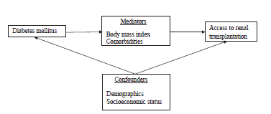
INTRODUCTION
Patibandla BK. Clin Transplant, 26:E307, 2012
Diabetic Nephropathy is caused by Type 1 (T1DM) or Type 2 (T2DM) Diabetes Mellitus. Our purpose is to record the comorbidity of patients with diabetic nephropathy on the waiting list for a deceased-donor kidney transplant.

Slide 3
PATIENT AND METHODS
Out of the total 405 prospective kidney recipients on the list, 51 patients with insulin-dependent Diabetes Mellitus (DM) were studied
Characteristics assessed:
Type of DM (T1DM and T2DM)
Length of stay on dialysis
Body mass index (BMI)
Cardiovascular morbidity
Diabetic retinopathy
Indication for combined kidney and pancreas transplants
Cause of temporary exclusion from the list

Slide 4
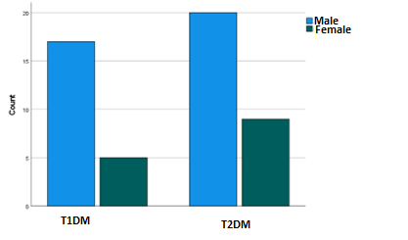
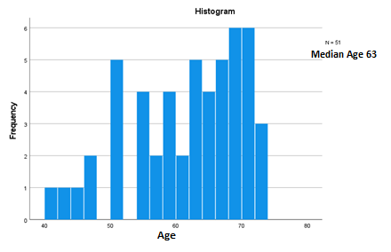
PATIENT DEMOGRAPHICS
 | N | %
T1DM | 22 | 43,1%
T2DM | 29 | 56,9%
Patients were classified into two groups, 22 of whom with T1DM (17 men, age 62±11 years) and 29 with T2DM (20 men, age 63±12 years) respectively.

Slide 5
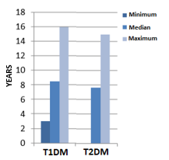
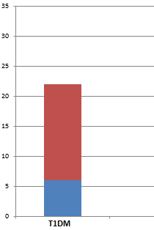
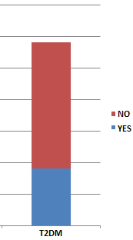
TIME ON DIALYSIS - REASSESSMENT
The median time spent on dialysis was 8 years, with no significant difference between the two groups.
Reassessment was considered in 30% of the patients.

Slide 6
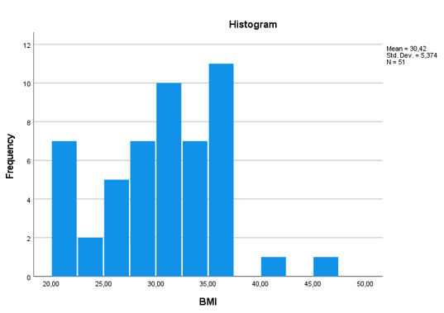
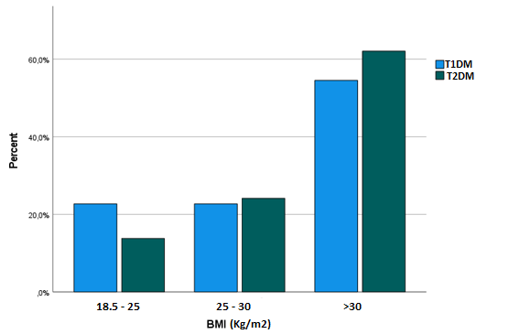
BODY MASS INDEX
The majority of the diabetic patients (59%) were obese, with no significant difference between the two groups.

Slide 7
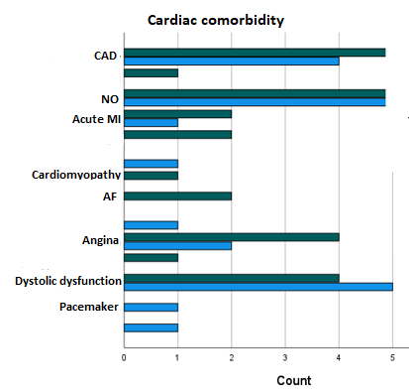
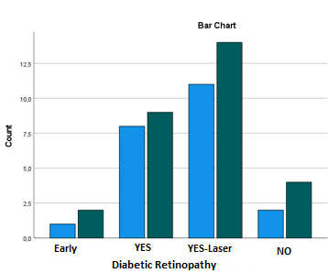
COMORBIDITIES
Diabetic retinopathy was recorded in 88% of the patients and cardiovascular disease in 53%, with no difference between the two groups.

Slide 8
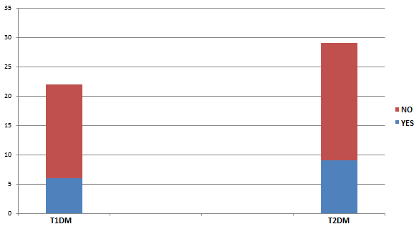
COMBINED KIDNEY & PANCREAS TRANSPLANT
Age < 60
BMI < 35 (30)
The criteria for combined kidney and pancreas transplant (SPK) were met by 10% of the patients,
with the percentage of patients with T1DM (13.6%) being higher than those with T2DM (6.9%).

Slide 9
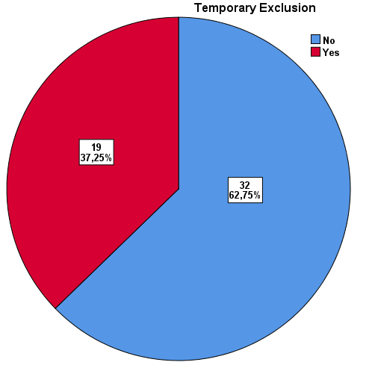
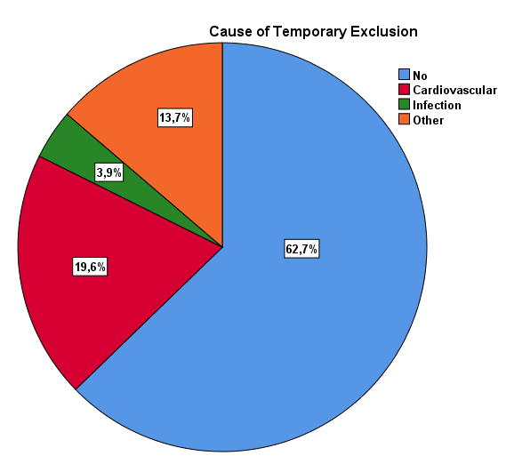
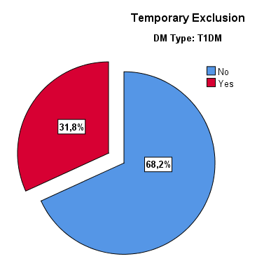
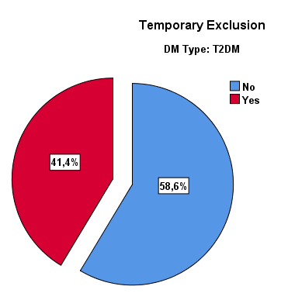
TEMPORARY EXCLUDED FROM THE LIST
Temporary exclusion was recorded in 37.3% of patients (31.8% with T1DM and 41.4% with
T2DM). The main reason was CVD.

Slide 10
CONCLUSIONS
Despite the significant cardiovascular comorbidity, patients with T1DM and T2DM remain on the list for a deceased-donor transplant for a long period of time.
A significant percentage of temporary exclusion was recorded while the advantages of a kidney transplant combined with pancreas are not exploited

