Slide 1
Characteristics of patients on the waiting list for kidney transplantation
Ε. A. Zolota, E. Kasimatis, G. Myserlis, E. Sampani, G. Katsanos, N. Antoniadis, G. Tsakiris, A. Kofinas, S. Vasileiadou, K.E. Karakasi, S. Neiros, G. Tsoulfas, A. Papagianni.
Renal Transplant Unit, Aristotle University of Thessaloniki, General Hospital “Hippokratio”, Greece

Slide 2
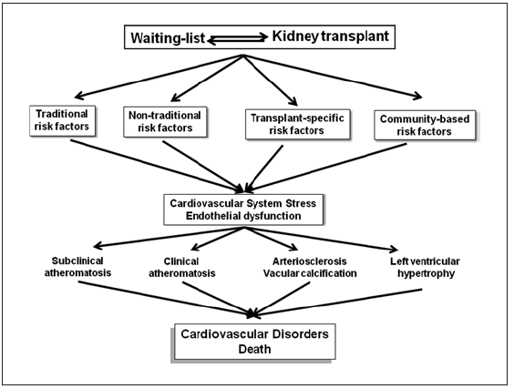
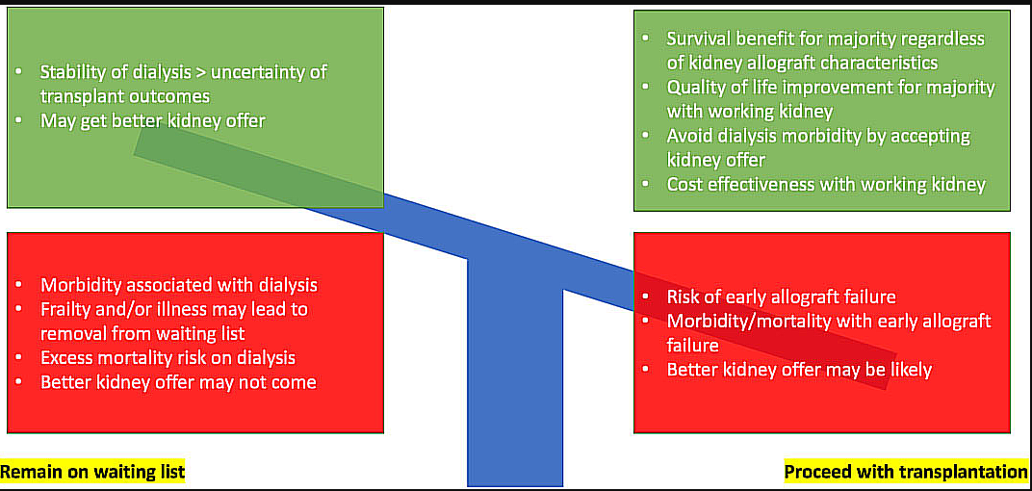
INTRODUCTION
Sharif A. Transpl Int, 35:10482, 2022
Hernández D. Blood Press Res, 45:1, 2020
Kidney transplantation is the preferred option for patients with end-stage CKD.
Remaining for long on the list for a deceased donor graft impairs their eligibility for transplantation.
Specific characteristics of patients on the list are likely to affect the prognosis of kidney transplantation.

Slide 3
PATIENT AND METHODS
The study included 405 patients who were enrolled on the waiting list for a deceased donor kidney graft
Characteristics assessed:
Primary disease
Length of stay on dialysis
Body mass index (BMI)
Cardiovascular morbidity
Frequency and cause of temporary exclusion from the list

Slide 4
PATIENT DEMOGRAPHICS (n=405)
GENDER | Male: 263 (65%)
AGE | 55 ± 12
RETRANSPLANTATION | 56 (13.8%)
HIGHLY SENSITIZED | 54 (13.3%)

Slide 5
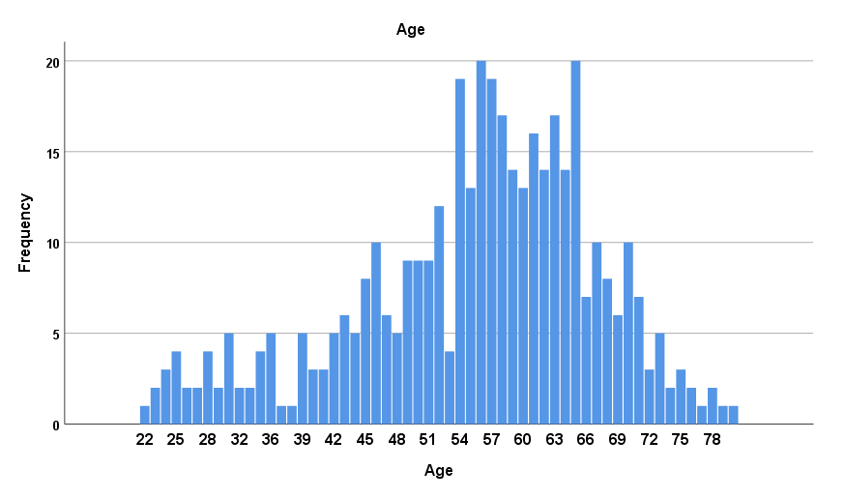
AGE DISTRIBUTION
n=150 (37%)
Eligible for an “old-for-old” kidney graft
Median age 57 (49, 64)

Slide 6
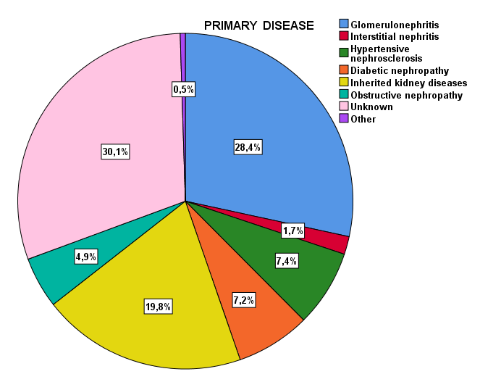
PRIMARY DISEASE
Regarding the primary disease, the cause of nephropathy was unknown in a large group of patients (30.1%).

Slide 7
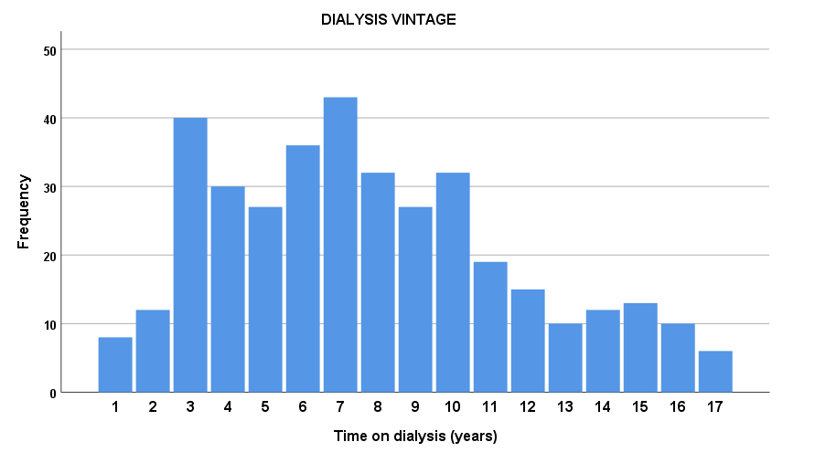
TIME ON DIALYSIS
Median time 7 years

Slide 8
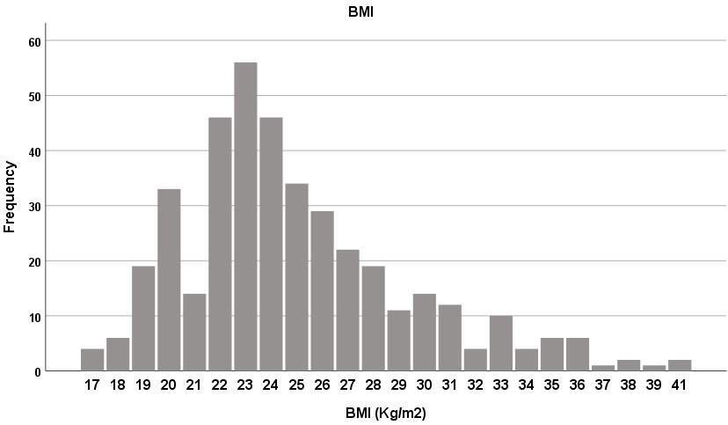
BODY MASS INDEX
Overweight and obese were recorded in 28.4% and 8.1% of the patients on the list, respectively.

Slide 9
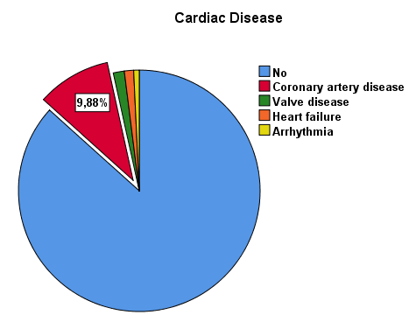
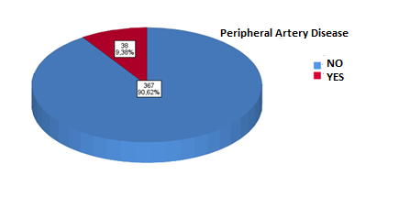
CARDIOVASCULAR COMORBIDITIES
The main cause of cardiac comorbidity was CAD

Slide 10
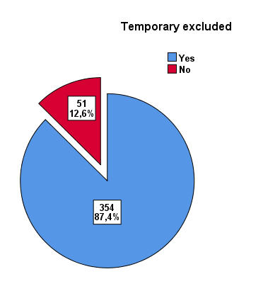
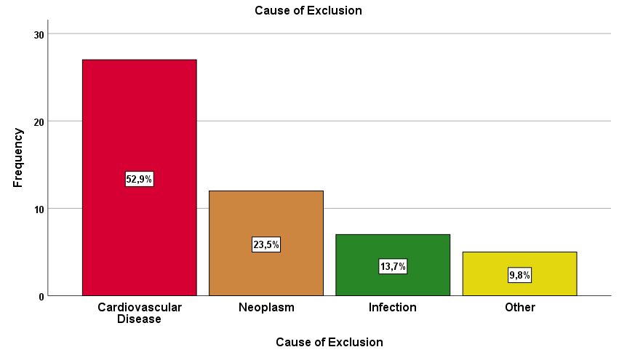
TEMPORARY EXCLUDED FROM THE LIST
During their stay on the list, 12.6% of patients had to be temporarily excluded from it with the
most frequent reason being CVD, in particular, coronary angioplasty.

Slide 11
CONCLUSIONS
Long-term stay of kidney graft candidates on the waiting list should be considered in their scheduled reassessment.
Their reassessment should be focused on cardiovascular diseases as they comprise the main comorbidities and the most frequent reason for temporary exclusion from the list.

