Slide 1
SGLT-2 inhibitors and AKI
Paraskevi Liaveri
Consultant Nephrologist
Nephrology Department
General Hospital of Athens “G.Gennimatas”

Slide 2
Sodium-Glucose Co-Transporter 2 Inhibitors (SGLT2is)
Journal of Nephrology 2023;36:31–43

Slide 3
Pharmacovigilance Reports
The proportion of reports with ARF among reports with SGLT2 inhibitor was almost three-fold higher compared to reports without these drugs (ROR 2.88, 95% CI 2.71–3.05, p < 0.001).
Acute renal failure with sodium-glucose-cotransporter-2 inhibitors: Analysis of the FDA adverse event report system database. Nut Met Cardiovasc Dis 2017;27;1108-13
The reporting odds ratio (ROR) values of AKI events associated with all SGLT2is was 2.84 (95% CI 2.71−2.98) in patients with diabetes. When SGLT2is were combined with RAAS blockers, the corresponding ROR was even higher, reaching 4.05(3.66−4.48). Of note, these ROR values were slightly higher when SGLT2is were combined with diuretics (ROR 6.07, 5.27−7.00) or with NSAIDs (ROR 4.66, 3.79−5.74).
Risks of acute kidney injury due to sodium glucose co-transporter 2 inhbitors: a study based on the related data in the US Food and Drug Administration Adverse Event Reporting System. Adverse Drug Reactions J 2019;21:190-7
The ROR for acute renal failure with SGLT2is versus other glucose-lowering drugs was calculated as 1.0 (95% CI 0.9−1.2).
Acute renal failure, ketoacidosis, and urogenital tract infections with SGLT2 inhibitors: signal detection using a Japanese spontaneous reporting database. Clin Drug Invest 2020;40;645-52.

Slide 4
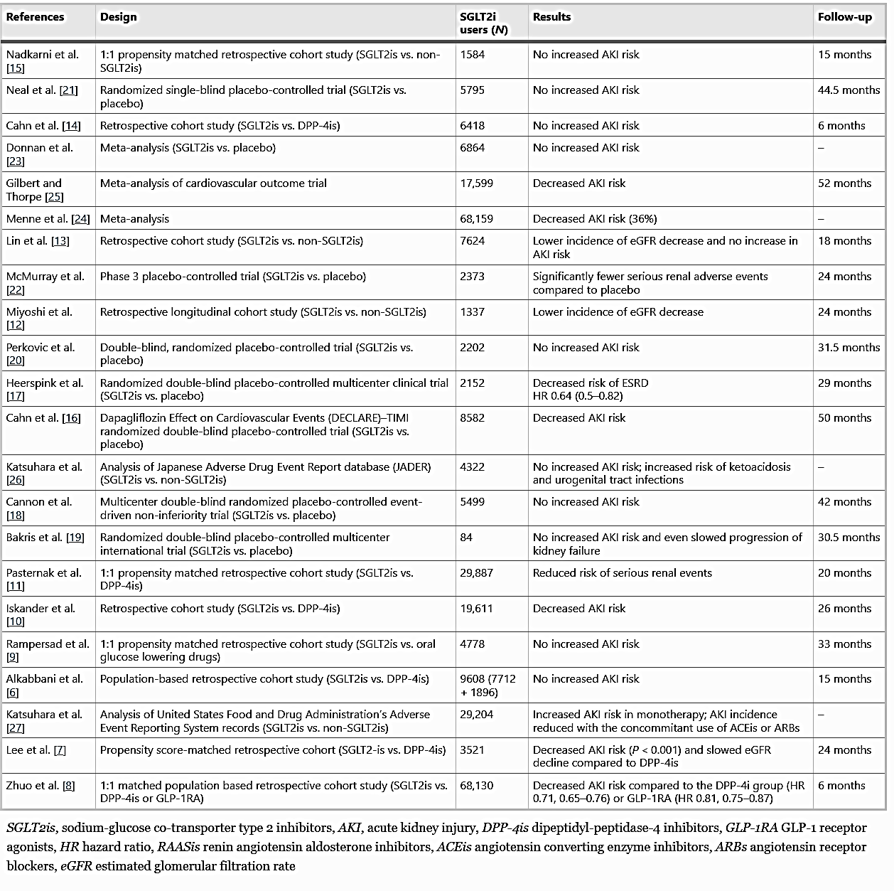
Journal of Nephrology 2023;36:31–43

Slide 5
Acute kidney injury risk factors when using sodium-glucose co-transporter type 2 inhibitor
Journal of Nephrology 2023;36:31–43

Slide 6
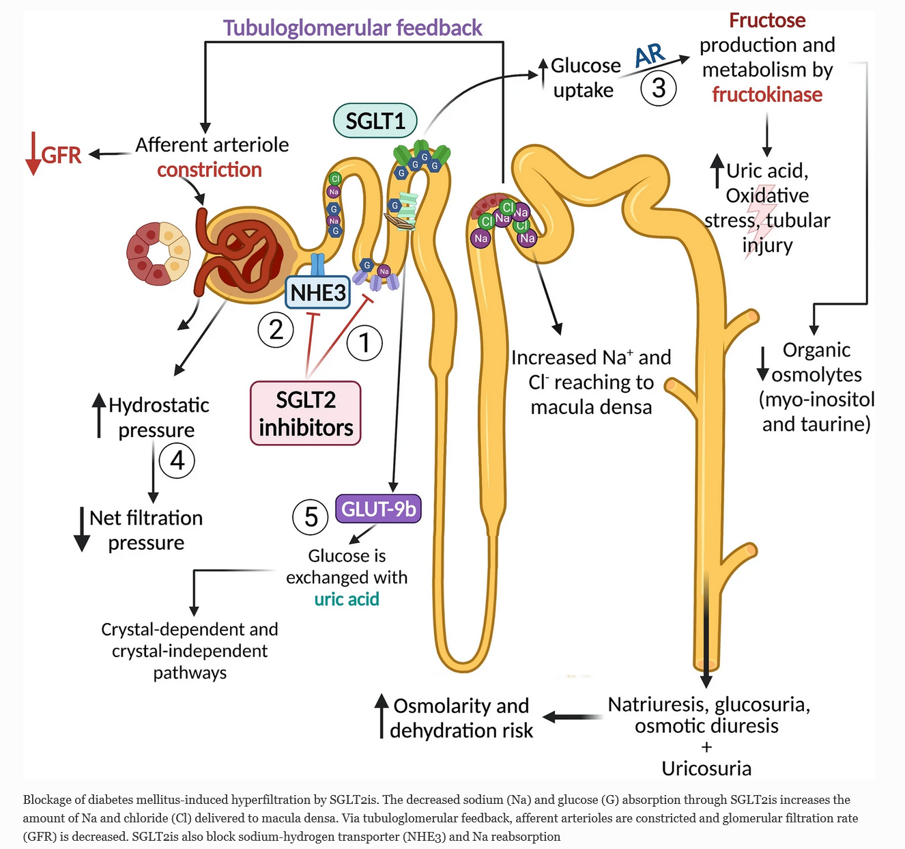
SGLT2is might be regarded as diuretics, with some 200-600ml excess of urine volume per day and a 2-5mmHg drop in systolic blood pressure
Journal of Nephrology 2023;36:31–43

Slide 7
Can SGLT2 Inhibitors Cause Acute Renal Failure? Plausible Role for Altered Glomerular Hemodynamics and Medullary Hypoxia
SGLT2is are not true tubulotoxic mediators but exert renal injury through the induction of hypoxic medullary injury.
Drug Saf 2018;41:239–252

Slide 8
SGLT2is: O₂ tension in the renal Cortex and Medulla
Acute SGLT inhibition normalizes O₂ tension in the renal cortex but causes hypoxia in the renal medulla in anaesthetized control (n=12) and diabetic rats (n=9)
Am J Physiol Renal Physiol 2015;309: F227–F234

Slide 9
Biomarker evidence for distal tubular damage but cortical sparing
AKI Group= 21 pts
No AKI Group= 25 pts
Serum creatinine in the AKI and non-AKI groups. While baseline (pre-hospital) levels are comparable, serum creatinine is significantly higher upon admission (* p = .002) and at peak levels during hospitalization (** p < .0001, means ± SEM, student t-test).
Renal Failure 2020;42(1): 836–844

Slide 10
Biomarker evidence for distal tubular damage but cortical sparing
Serum and urine NGAL and KIM-1 in the AKI and non-AKI groups (n ¼ 21 and 25, respectively). While KIM-1 levels are comparable in the two groups, NGAL levels both in serum and urine samples are significantly higher in the AKI group (*p=.006 and **p = .032, respectively, means ± SEM, student t-test)
Renal Failure 2020;42(1): 836–844

Slide 11
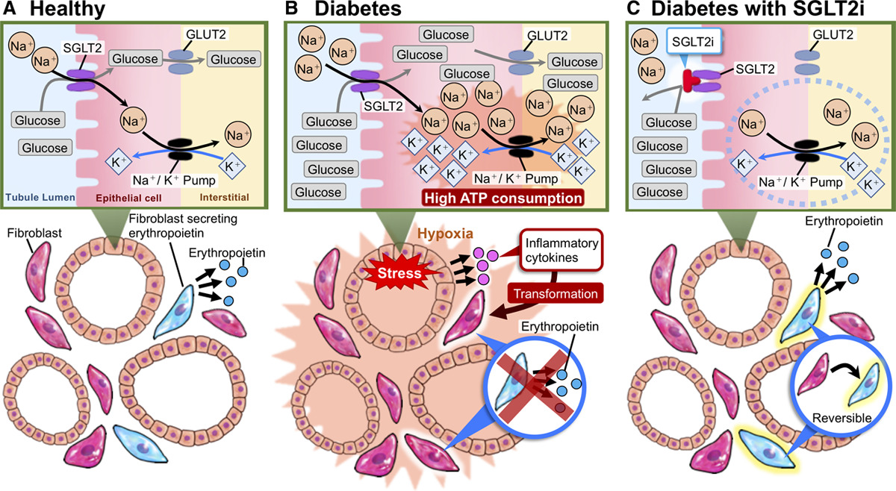
Possible Mechanism of Hematocrit Elevation by SGLT2is and Associated Beneficial Renal and Cardiovascular Effects
Circulation. 2019;139:1985–1987

Slide 12
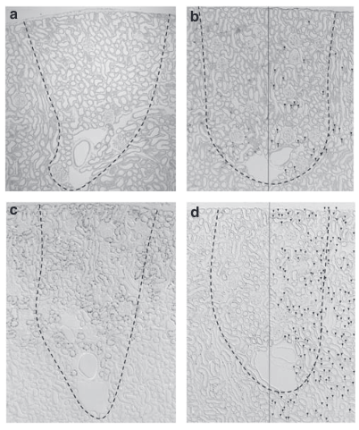
SGLT2is Alter the Renal Oxygenation Profile
SGLT2is Alter the Renal Oxygenation Profile Hypoxia-inducible factor-2a-expressing interstitial fibroblasts are the only renal cells that express erythropoietin under hypoxia-inducible factor stabilization
Kidney International 201077, 312–318

Slide 13
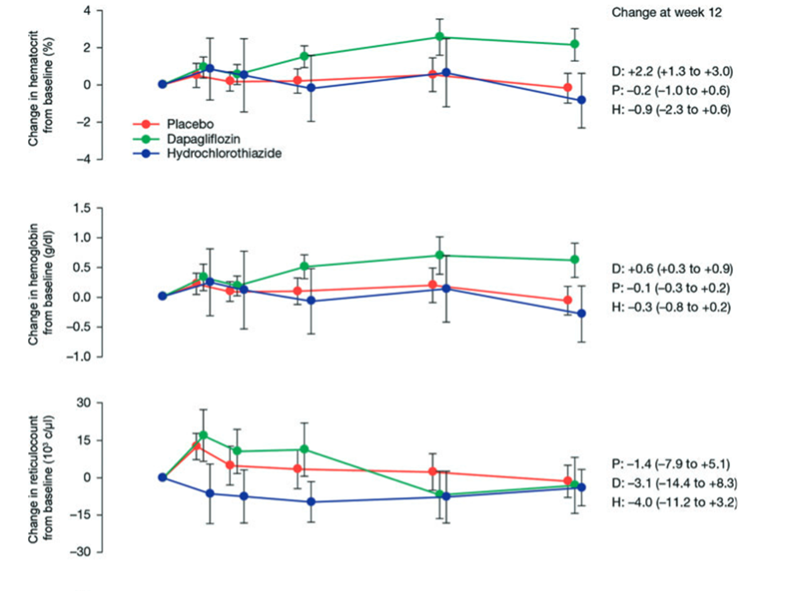
SGLT2is Alter the Renal Oxygenation Profile
Diabetes, Obesity and Metabolism 2013;15: 853–862

Slide 14
Additional Mechanisms that may predispose to SGLT2is-Related Renal Impairment
Journal of Advanced Research 2017;8:529–536

Slide 15
Effect of luseogliflozin on the serum uric acid (SUA) level. Changes in the SUA level from the baseline after a single dose
(A, n = 3–14) and after multiple doses (B, n = 8) are shown. Data are mean ± SEM. **p < 0.01 vs placebo (0 mg) (Dunnett’s test)
Effects of luseogliflozin on the urinary excretion rate (UEUA ) and the renal clearance (CLUA ) of uric acid. Changes in UEUA and CLUA from the baseline after a single dose (A and C, n = 3–14) and after multiple doses (B and D, n = 8) are shown. Data are mean ± SEM. **p < 0.01 vs placebo (0 mg) (Dunnett’s test)
Biopharm. Drug Dispos. 2014;35: 391–404

Slide 16
Dapagliflozin as a cause of acute tubular necrosis with heavy consequences: a case report
a Acute tubular injury with epithelial cell coarse vacuolization or flattened epithelium with detached cells leaving areas of tubular basement membrane covered by a thin layer of cytoplasm from adjacent cells (arrowhead). Necrotic luminal debris (transparent arrow). Regeneration with mitosis (black arrow). Interstitial mononuclear infiltration is also observed . b.Flattened tubular epithelium with diminishing or loss of brush borders and cytoplasmic vacuolization. c. Cytoplasmic vacuolization in higher magnification . d Among the interstitial inflammatory cells, some eosinophils are discerned (white arrows) . e Tubulitis in a non-atrophic tubule (black arrows)
CEN Case Rep 2018;7:17–20

Slide 17
Tubulointerstitial Nephritis after Using a SGLT2i
Tubulointerstitial nephritis in the patient after empagliflozin use. (A, B, D) Tubular atrophy and interstitial fibrosis were observed diffusely in approximately 70% of the area. (A, B) Tubular interstitium showed infiltration mainly composed of lymphocytes and monocytes. (C) The glomerulus had slight mesangial matrix expansion without mesangial cell proliferation. (E) The small and medium-sized arteries showed moderate arteriosclerosis with fibroelastosis, (F) while arteriolar hyalinosis was not observed in the arterioles. (G: CD3, H: CD22, I: CD68) Immunostaining showed cells expressing CD3 (T cells) and CD68 (macrophages) but did not show cells expressing CD22 (B cells). Cells expressing CD3 and CD68 infiltrated more strongly around the tubular region than around the glomerulus.
Intern Med 2022; 61: 3239-3243

Slide 18
Acute interstitial nephritis due to SGLT2i Empagliflozin
Renal histology following native renal biopsy, showing marked acute tubulointerstitial nephritis with lymphocytic infiltrates and eosinophils in the interstitium and focal tubulitis. No granulomas are present and no significant fibrosis is seen. Background changes are suggestive of early diabetic nephropathy.
Clinical Kidney Journal 2021;14(3)1020–1022

Slide 19
Development of osmotic vacuolization of proximal tubular epithelial cells following treatment with SGLT2is in type II DM patients‑3 case reports
a) Case 1Proximal tubule is vacuolated (arrows) (Hematoxylin–Eosin stain, Periodic Acid Schiff stain and CD10 stain 400 ×). Brown color shows positivity for CD 10 stain, consistent with proximal tubule). EM analysis revealed round or elliptical vacuolization as confirmed on proximal tubules. b ) Case 2 shows that proximal tubule is vacuolated (arrows) (Hematoxylin–Eosin stain, Periodic Acid Schiff stain and CD10 stain 400 ×). Brown color shows positivity for CD 10 stain, consistent with proximal tubule).EM analysis showed round or elliptical vacuolization as confirmed on proximal tubules. c ) Case 3 showed that proximal tubule is vacuolated (arrows) (Hematoxylin–Eosin stain,, Periodic Acid Schiff stain and CD10 stain 400 ×). Brown color shows positivity for CD 10 stain, consistent with proximal tubule). EM analysis showed curved stripe-formed vacuolization as confirmed on proximal tubules
CEN Case Reports 2021;10:563–569

Slide 20
Osmotic Nephrosis and Acute Kidney Injury Associated With SGLT2i Use: A Case Report
Osmotic nephrosis in a patient with canagliflozin-mediated acute kidney injury. (A) Low- and (B) high-power view of proximal tubules with osmotic tubulopathy (periodic acid–Schiff stain; original magnification, A: ×10, B: ×40). (C) Oil Red O staining shows the presence of rare positive lipid deposits in some proximal tubules (arrows; original magnification, ×40). (D) Ultrastructural studies show clear vacuoles within the proximal tubules, arguing against lipid droplets. (E) Immunofluorescence of some proximal tubules for aldose reductase (white arrows; original magnification, ×40). (F) Immunofluorescence for fructokinase (white arrows; original magnification).
Am J Kidney Dis.2020;76(1):144-147

Slide 21
Progression after AKI: Understanding Maladaptive Repair Processes to Predict and Identify Therapeutic Treatments
Journal of the American Society of Nephrology 2016;27(3):687-697

Slide 22
Kidney International 2018;94, 524–535

Slide 23
A sodium-glucose cotransporter 2 inhibitor attenuates renal capillary injury and fibrosis by a vascular endothelial growth factor–dependent pathway after renal injury in mice
Kidney International 2018;94, 524–535

Slide 24
Contrast-induced Acute Kidney Injury in Diabetic Patients and SGLT-2 Inhibitors: A Preventive Opportunity or Promoting Element?
J Cardiovasc Pharmacol 2022;80:661–671

Slide 25
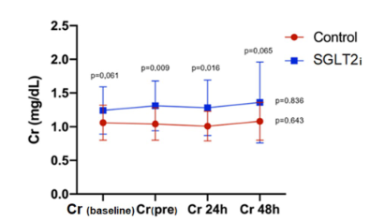
The safety of SGLT-2 inhibitors in diabetic patients submitted to elective percutaneous coronary intervention regarding kidney function: SAFE-PCI pilot study
NGAL value (ng/dL) 6 h after percutaneous coronary
intervention. There was no difference in the primary endpoint of the study. Mean serum NGAL 6 h after PCI was 199 ng/dL in the SGLT2i group and 150 ng/dL in the control group (p = 0.249). *Test‑t used to compare two different groups
Diabetology & Metabolic Syndrome 2023;15:138

Slide 26
Randomized controlled trials reporting an initial dip of eGFR
Kidney360 2021;2: 1042–1047

Slide 27
eGFR Decline after SGLT2 Inhibitor Initiation: The Tortoise and the Hare Reimagined
Kidney360 2021;2:1042–1047

Slide 28
Renal effects of SGLT2is in cardiovascular patients with and without chronic kidney disease: focus on heart failure and renal outcomes
Heart Failure Reviews 2023; 28:723–732

Slide 29
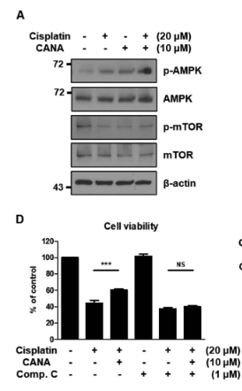
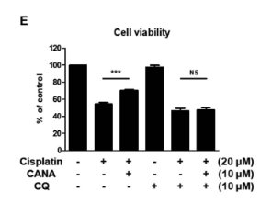
Canagliflozin protects against cisplatin-induced acute kidney injury by AMPK-mediated autophagy in renal proximal tubular cells
Canagliflozin protects HK-2 cells from cisplatin by inhibiting apoptosis
Canagliflozin activates AMPK and inhibits mTOR in HK-2 cells and protects HK-2 cells from cisplatin in an AMPK activation-dependent manner.
Canagliflozin induces autophagy in HK-2 cells and protects HK-2 cells from cisplatin in an autophagy-dependent manner
Cell Death Discovery 2022;8:12-23

Slide 30
Canagliflozin protects against cisplatin-induced acute kidney injury by AMPK-mediated autophagy in renal proximal tubular cells
Canagliflozin attenuates cisplatin-induced AKI and increases autophagy in mice
Cell Death Discovery 2022;8:12-23

Slide 31
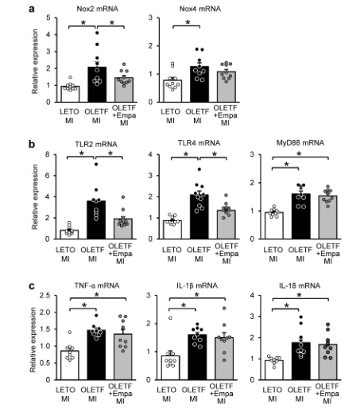
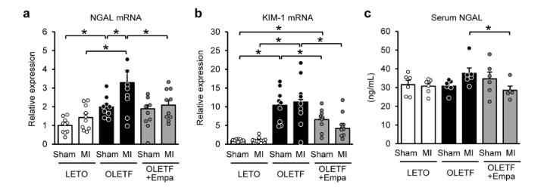
Empagliflozin attenuates acute kidney injury after myocardial infarction in diabetic rats
Enlargement of the glomerular area
Sci Rep.2020;29;10(1):7238

Slide 32
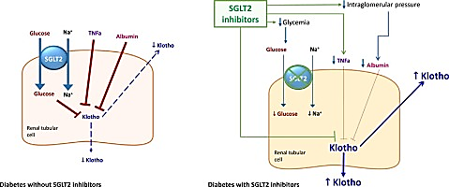
SGLT2is increase Klotho in patients with diabetic kidney disease: A clinical and experimental study
Percent reductions with respect to baseline in urine tumor necrosis factor-alpha (TNFa) and soluble (serum and urine) Klotho in patients treated with SGLT2i and DPP4i.
Biomedicine & Pharmacotherapy 2022;154:113677

Slide 33
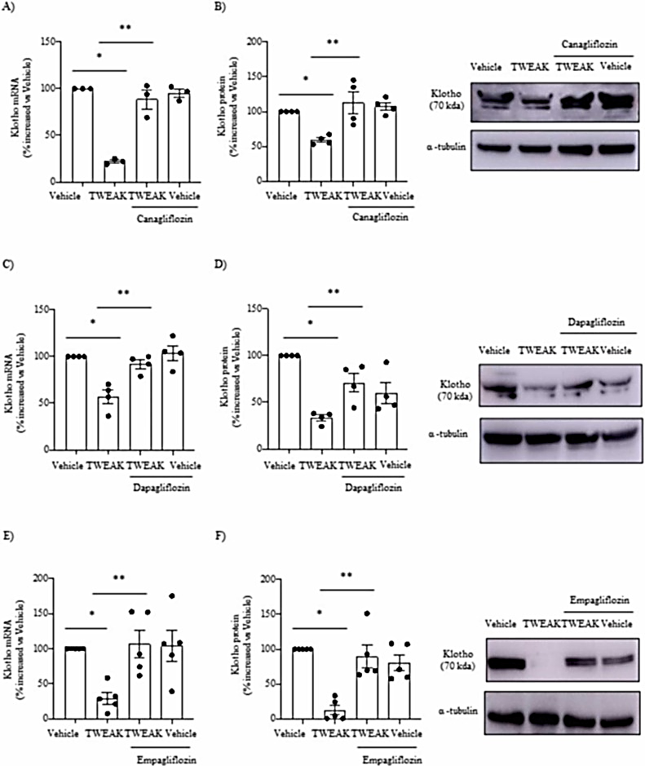
SGLT2is increase Klotho in patients with diabetic kidney disease: A clinical and experimental study
Biomedicine & Pharmacotherapy 2022;154:113677

Slide 34
SGLT2i Dapagliflozin limits podocyte damage in proteinuric nondiabetic nephropathy
JCI Insight. 2018;3(15):e98720

Slide 35
Potential use in non-Diabetic Kidney Disease
Current Opinion in Nephrology and Hypertension 2017;26(5):358-367

Slide 36
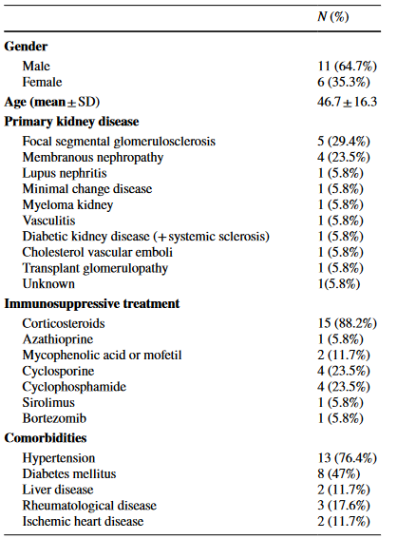
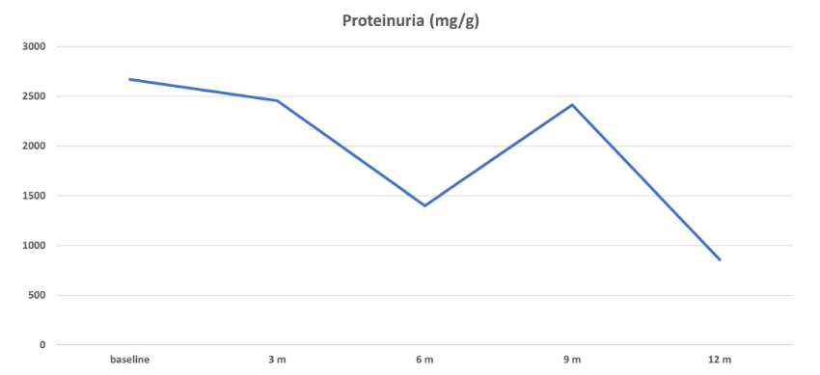
Safety of SGLT2 inhibitors in patients with different glomerular diseases treated with immunosuppressive therapies
Mean eGFR: 59.09±31.86 62.89±31.59ml/min
Mean spot urinary ACR 2669 858mg/g
European Journal of Clinical Pharmacology 2023;79:961–966

Slide 37
SGLT2i in kidney transplant recipients: what is the evidence?
Τher Adv Endocrinol Metab 2022;13:1–14

Slide 38
The Efficacy and Safety of SGLT2 Inhibitor in Diabetic Kidney Transplant Recipients
N-202 SGLT2i users after propensity score matching
N=554 Non-SGLT2i users after propensity score matching
Transplantation 2022;106: e404–e412

Slide 39
SGLT2i in kidney transplant recipients: what is the evidence?
Τher Adv Endocrinol Metab 2022;13: 1–14

Slide 40
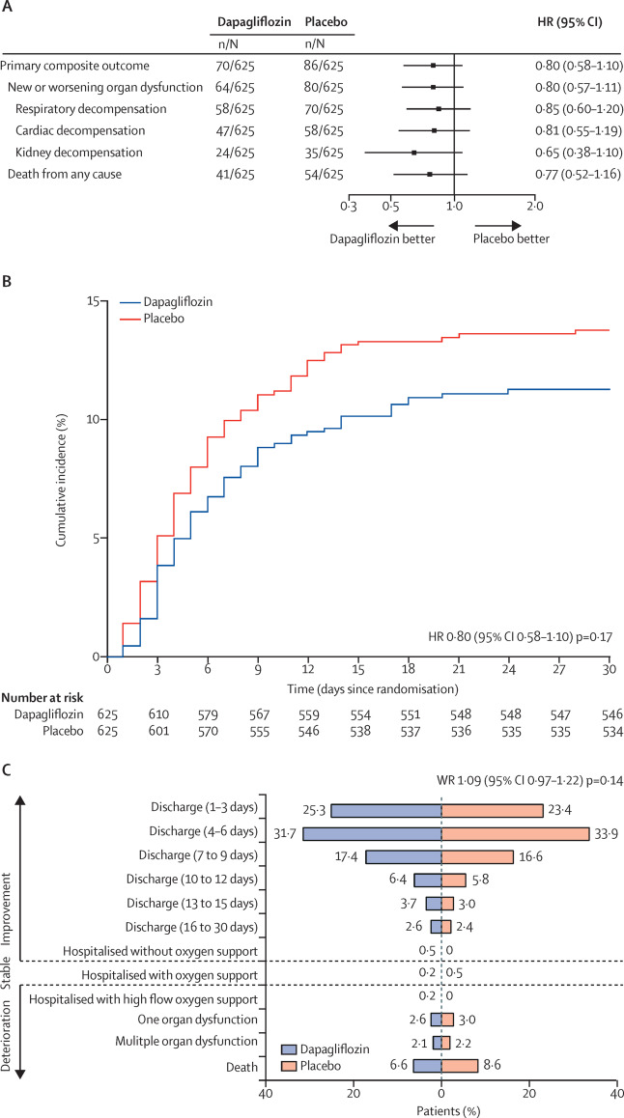
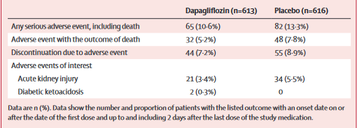
Dapagliflozin in patients with cardiometabolic risk factors hospitalized with COVID-19 (DARE-19): a randomized, double-blind, placebo-controlled, phase 3 trial
Figure 2
Inhibition of glycolysis (a pathway that can be used by respiratory pathogens
Stimulation of lipolysis
Reduction of Oxidative Stress and Inflammation
Improved endothelial dysfunction
Improved Oxygen carrying capacity
Safety outcomes in the safety population
Lancet Diabetes Endocrinol 2021;9(9):586-594
Notes:
Primary outcomes
(A) Forest plot of the primary outcome of prevention (new or worsened respiratory, cardiovascular or kidney organ dysfunction or death from any cause) and its components; (B) Kaplan-Meier of the cumulative estimate of the primary outcome of prevention; (C) the proportion of patients for each of the components of the primary outcome of recovery. HR=hazard ratio. WR=win ratio.

Slide 41
Cardiac and Renal Effects of Sodium-Glucose Co-Transporter 2 Inhibitors in Diabetes

Slide 42
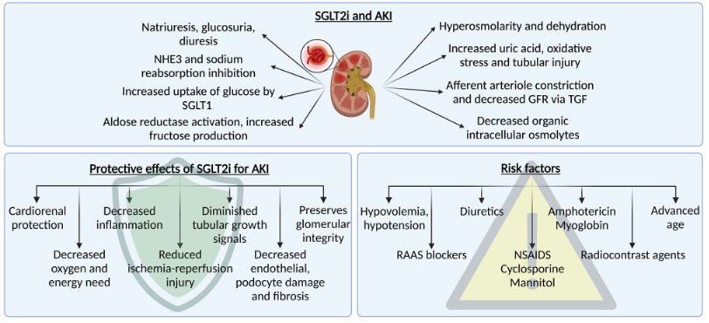
Journal of Nephrology (2023) 36:31–43

Slide 43
Key points
SGLT2is are approved for the treatment of hyperglycemia in patients with T2D.
Owing the mechanism of their action, these agents provide cardio- and renal protection.
Based on proximal tubular natriuretic effects, SGLT2is have therapeutic potential for use in nondiabetic patients.
Should SGLT2is be withheld in the presence of high-risk clinical situations?

Slide 45
Clinical Randomized Trials on SGLT2i and Renal Outcomes
J Cardiovasc Pharmacol 2022;80:661–671

Slide 46
ACUTE KIDNEY INJURY
Lancet 2019; 394: 1949–64

Slide 47
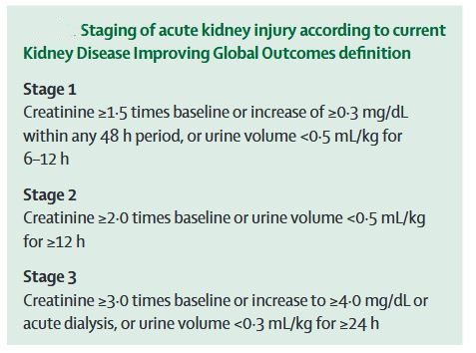
ACUTE KIDNEY INJURY
Lancet 2019; 394: 1949–64

Slide 48
Determinants of medullary oxygen balance: major factors affecting renal medullary oxygen consumption and expenditure for tubular transport activity
Drug Saf 2018;41:239–252

Slide 49
Drugs affecting medullary oxygenation
Drug Saf 2018;41:239–252

