Slide 1
Treatment Updates in ANCA-associated vasculitis and glomerulonephritis
Sophia Lionaki
As. Professor in Nephrology
Department of Nephrology, University Hospital Attikon
National and Kapodistrian University of Athens, Greece

Slide 2
Kidney involvement in ANCA-vasculitis
77-85% within 2 years of diagnosis
Hoffman GS. Et al. Ann Intern Med 1992
Notes:
Kidney involvement is quite frequent in patients with ANCA associated vasculitis accounting for 80% within 2 years from diagnosis.

Slide 3
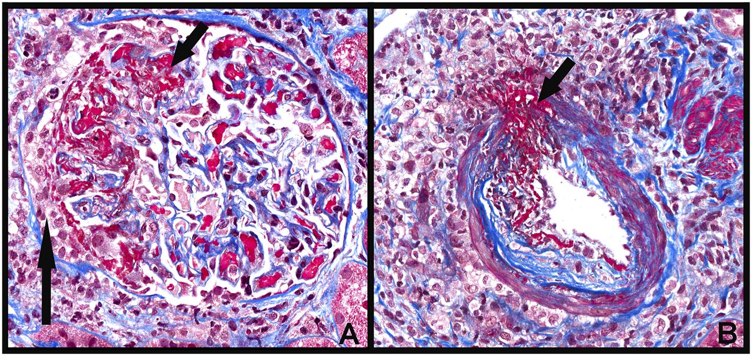
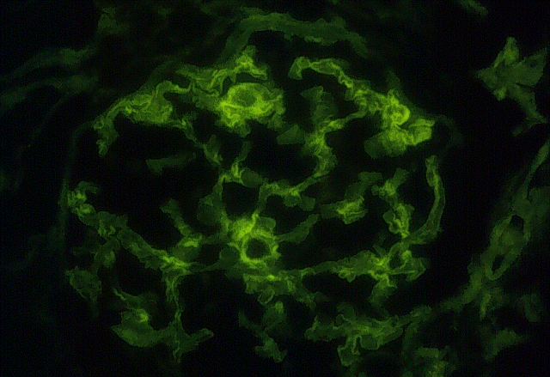
Pauci-immune glomerulonephritis
>85% of patients with pauci-immune GN are ΑNCA (+)
J. Charles Jennette, UNC Kidney Center
Notes:
The hall mark histologic lesions are crescents and fibrinoid necrosis, there are a few or no immune deposits. the vast majority of patients with pauci-immune GN are ΑNCA (+

Slide 4
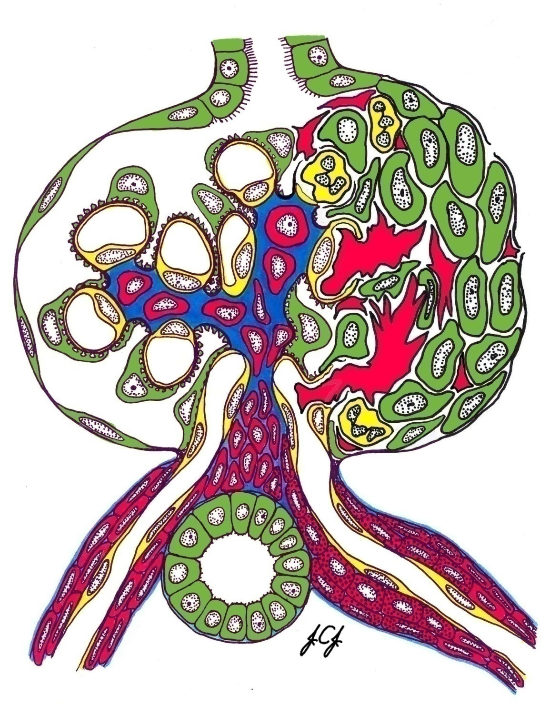
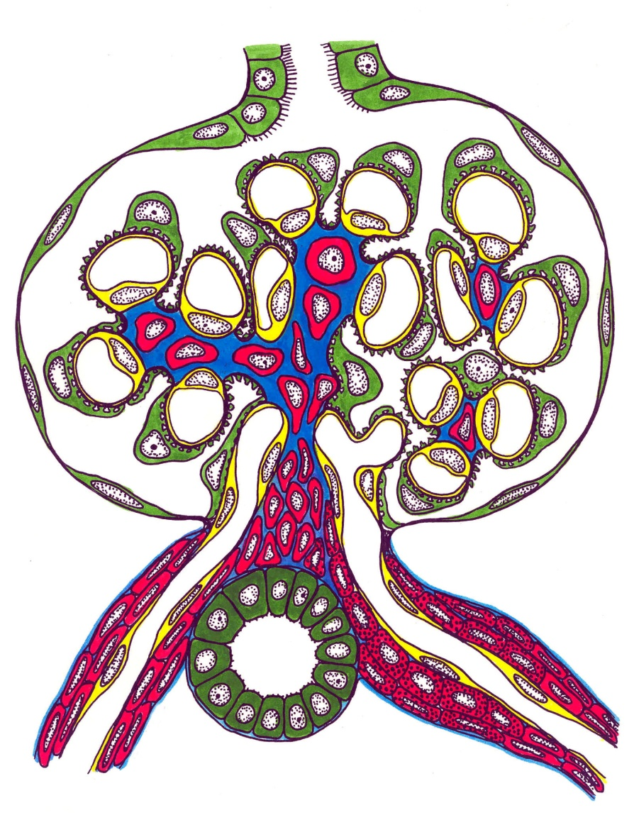
Normal glomeruli
Crescent
JC.Jennette
Notes:
Cellular glomerular crescents are defined as two or more layers of proliferating cells in Bowman's space and represent an histologic marker of severe glomerular injury although not specific. Can be circumferential or segmental.

Slide 5
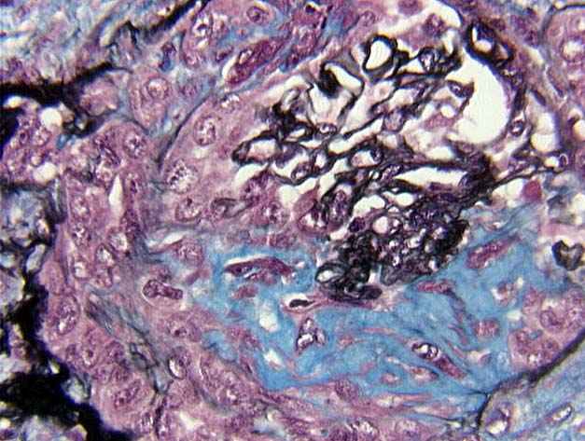
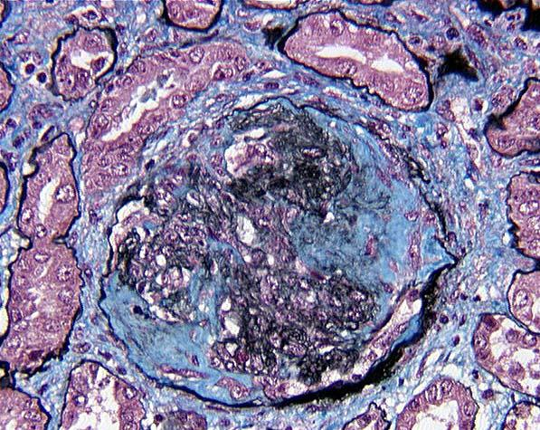
Aging crescent
Cellular
Fibro-cellular
Fibrous
Time
Notes:
As time goes the cellular crescent is changing, especially in untreated patients, is becoming fibro-cellular and then fibrous due to the production of interstitial collagen by fibroblasts.
Thus, the most important factor in relation with ANCA-GN, is the time interval from disease onset to initiation of therapy which is essential for renal outcomes.

Slide 6
Renal manifestations
Asymptomatic glomerular hematuria
Glomerular hematuria and rise in serum creatinine with a variable degree of proteinuria
Rapidly progressive glomerulonephritis
Progressive loss of renal function within days or weeks
>50% crescents
 | Serum Creatinine (mg/dl)
Crescentic ANCA-GN | 6.5±4 (0.8-22.1)
Notes:
What we clinically see is patients with a rising serum creatinine. However, some patients with crescentic GN may have a serum creatinine relatively low, which underlines the fact that histology is not always predictable.

Slide 7
ANCA-GLOMERULONEPHRITIS
(usually with necrosis and crescents)
Paucity of glomerular IF staining
for immunoglobulin
No
systemic
vasculitis
Vasculitis with
no asthma or
granulomas
Granulomas
and no
asthma
Eosinophilia,
asthma and
granulomas
Pauci-immune
GN
Microscopic
Polyangiitis
Granulomatosis
with Polyangiitis
Eosinophilic Granulomatosis with Polyangiitis
Notes:
ANCA GN may present as renal limited disease, which means with no evidence of systemic vasculitis, or with extra renal manifestations without granulomas=MPA or with granoulomatous inflammation most often in the respiratory tract=GPA or with granoulomas plus asthma plus eosinophilia=EGPA

Slide 8
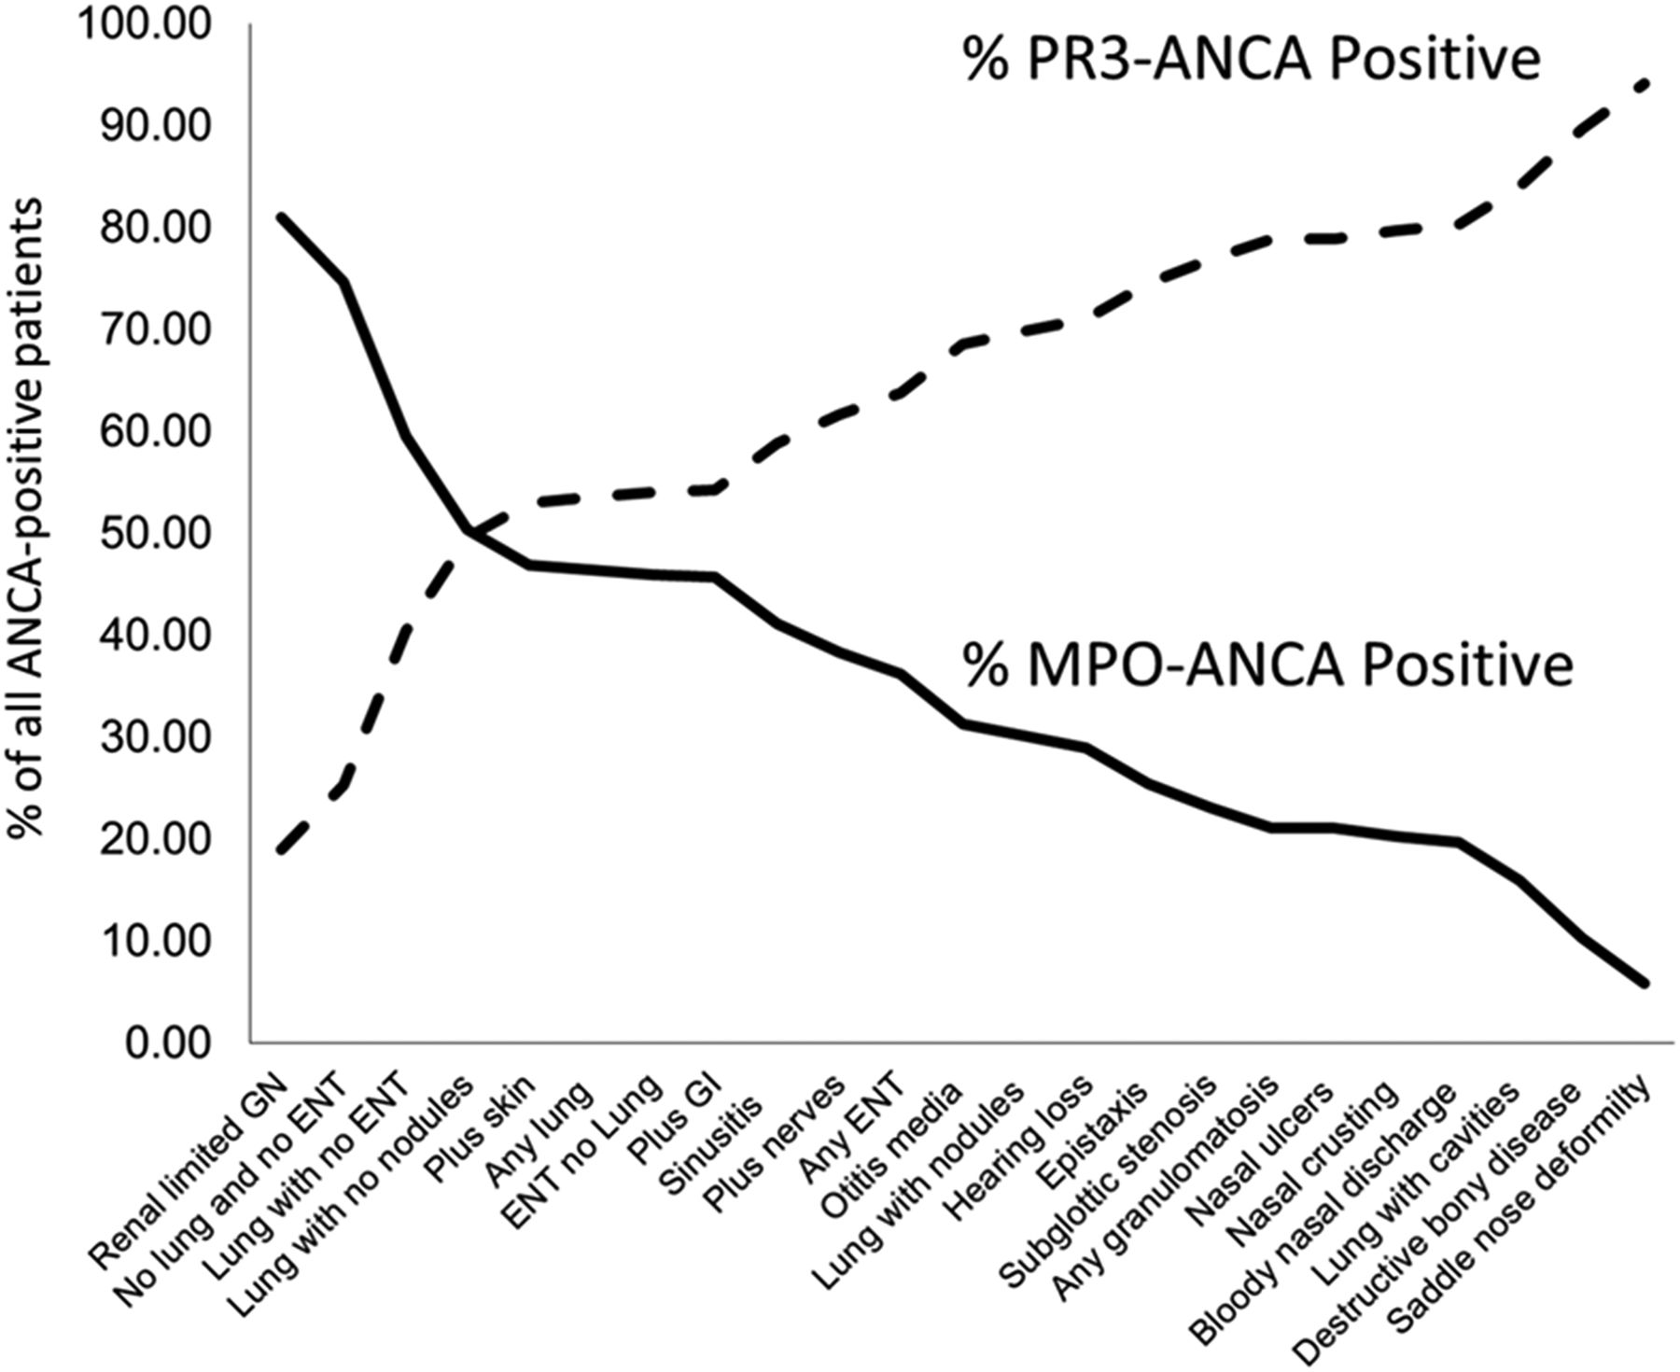
Serological classification
PR3-ANCA vasculitis
⬆︎ In northern Europe, north America, Australia
HLA-DP genetic association
⬆︎ Upper respiratory tract disease
⬆︎ Granulomatous inflammation
⬆︎ Necrosis at diagnosis
MPO-ANCA vasculitis
⬆︎ In southern Europe, southern Unites States, Asia
HLA-DQ genetic association
⬆︎ Renal disease
⬇︎ Granulomatous inflammation
⬆︎ Sclerosis at diagnosis
5% of patients with ANCA vasculitis also have anti-GBM antibodies in their circulation
Lionaki S et al. Arthritis & Rheumatology 2012
Notes:
PR3-ANCA and MPO-ANCA subtypes correlates with a particular organ system involvement and genetic profile.
Also 5% of patients with ANCA disease also have anti-GBM antibodies.

Slide 9
Pathogenesis: ANCA-GN mouse model
Injection anti-MPO IgG
ANCA-GN
Xiao H et al. J Clin Invest 2002
Notes:
Injection of anti-MPO-IgG ANCA serum in animal models resulted in development of ANCA-GN which is the same as in humans with crescents and necrosis

Slide 10
ANCA-glomerulonephritis diagnosis
Active urine sediment
Acute renal dysfunction
82-94% positive ANCA
↑ WBC, PLT
↓ Hb
↑ ESR
↑ C-reactive protein
± Radiographic tests
± Bronchoalveolar lavage (+) for blood
Renal biopsy
Establishment of diagnosis
Prognostication
Plan of therapy
Notes:
We can recognize ANCA GN in patients with …although the first 3 features are enough for therapy initiation we still need a biopsy in order to establish the diagnosis..

Slide 11
Outcome of ANCA-glomerulonephritis
Remission
Treatment resistance
End stage kidney disease
Relapse
Notes:
Immunosuppressive therapy is required in almost all patients with active ANCA-GN. Following appropriate treatrment the majority of patients go into remission, while some of them become resistant to therapy or end up in end stage renal disease. A proportion of the patients who achieve remission will experience relapse in the kidneys or any other organ.
Response= Gradual resolution of inflammation
Avoidance of irreversible tissue damage / death
Avoidance of dialysis, or dialysis independency

Slide 12
Induction of remission in ANCA-GN
Cyclophosphamide + glucocorticoids
Rituximab + glucocorticoids
(±) IV pulses methylprednisolone
(±) Plasma-exchange
Combined therapies
Aggressive therapy is justified as mortality rate ∼ 90% in 2 years due to:
Respiratory failure
Renal failure
Notes:
The standard of care for ANCA-GN as initial therapy typically consists of glucocorticoids combined with either cyclophosphamide or rituximab. Selected patients with severe disease may benefit from the addition of plasma exchange.
The use of aggressive therapy is justified because the mortality rate in untreated ANCA-disease is as high as 90% at 2 years usually due to respiratory or renal failure.

Slide 13
Rate and time to remission
 | Protocol | Response rate | Time to remission
Cycazarem | Cyclophosphamide p.o + GC | 93% | 3-6 months
CYCLOPS | Cyclophosphamide IV + GC | 88% | 2-6 months
WGET | Etarnecept | 91% | 3-6 months
RITUXVAS | Rituximab + CYC iv + GC | 76% | 6-12 months
RAVE | Rituximab + GC | 64% | 6 months
Notes:
Overall the response rate is similar across studies using these regimens inducing remission in 85-90% of patients with most remissions occurring between 3 and 6 months.

Slide 14
Cause of death within the first 12 months
All causes | 56 (10.7%)
Infection | 28 (50%)
Active vasculitis | 8 (14%)
Cardio/cerebrovascular disease | 7 (13%)
GI bleed/duodenal ulcer | 3 (5%)
PE or complication of anticoagulation | 3 (5%)
Malignancy | 1 (2%)
Pulmonary fibrosis | 2 (4%)
Other | 4 (7%)
Little MA et al. Ann Rheum Dis. 2010 Jun

Slide 15
Factors associated with 1-year mortality
Multivariable analysis | Hazard Ratio (95% CI) | p value
Infection burden score | 1.2 (1.1-1.23) | <0.001
Adverse event burden score | 1.3 (1.1-1.4) | <0.001
Leucopenia burden score | 1.2 (1.1-1.2) | <0.001
Cumulative Cyclophosphamide dose | 1.2 (1.05-1.4) | 0.04
GFR | 0.7 (0.6-0.9) | 0.002
Little MA et al . Ann Rheum Dis. 2010

Slide 16
Rituximab in ANCA disease
RAVE
RITUXVAS
N=197
Rituximab + IV MP or
Cyclophosphamide po + GCs
Mean GFR at entry >50ml/min
Mean BVAS: 8.5
N=44
Rituximab + Cyclophosphamide (2-3 pulses) + IV MP or
Cyclophosphamide (6-10 pulses) + IV MP
Mean GFR at entry: 18ml/min
Mean BVAS at entry: 19
Jones RB et al. N Engl J Med 2010
Stone JH et al. N Engl J Med 2010
Notes:
In this regard, 2 randomized trials have suggested that rituximab is and effective alternative to cyclophosphamide for the initial treatment of patients with newly diagnosed disease or have relapsed following therapy with cyclophosphamide.
in the RAVE trial patients had a mean BVAS of 8.5 and not advanced renal involvement while in the RITUXVAS trial which included patients with a mean BVAS of 19 and severe renal dysfunction the patients also received cyclophosphamide 2-3 monthly doses.
Rave: Primary end points: , BVAS=0, stop prednisone 6mo, RITUXVAS: Primary end point: Remission rate at month 12

Slide 17
Rituximab instead of Cyclophosphamide: RAVE
No difference in adverse events!
Total glucocorticoids exposure plays a major role in mediating adverse events.

Slide 18
New therapeutic targets in ANCA-SVV
Remission induction
Faster response (reduce non-reversible damage)
Increase response rates (↓treatment resistance)
Reduce toxicity (limitate dose and duration of GCs)

Slide 19
Combined therapies
Cyclophosphamide + rituximab + GCs

Slide 20
Antibody producing cells
Plasmablasts
Long lived plasma cells
Plasma cells
Cyclophosphamide
Glucocorticoids
Target for anti-CD20 therapy (Rituximab)
Rituximab: Little direct effect on ANCA-producing plasmablasts and plasma cells not expressing CD20.
Rituximab alone necessitates prolonged courses of high-dose glucocorticoids to control disease activity.
Notes:
the concept behind this has to do with the fact that CYC is targeting not only anti-CD20 lymphocytes but also

Slide 21
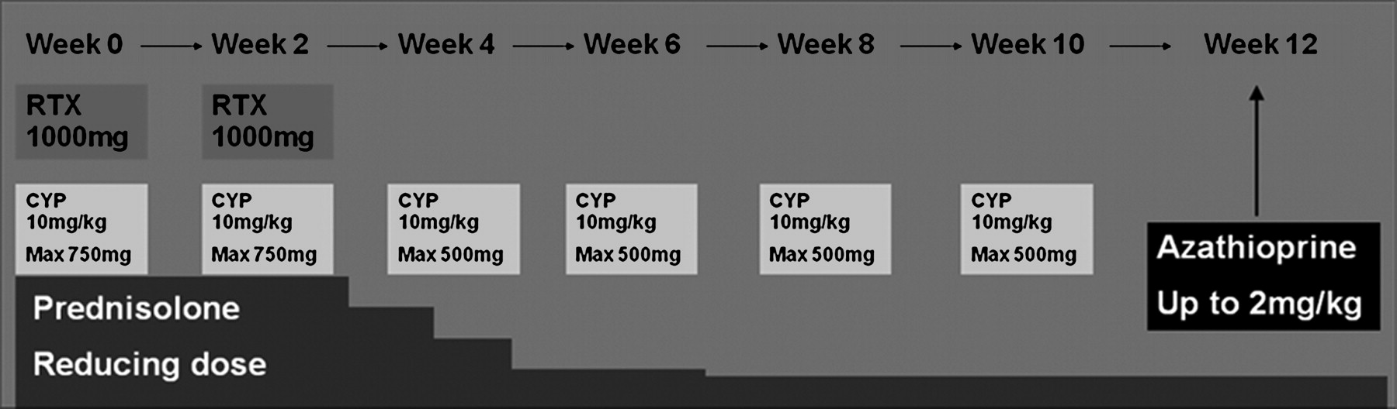
Rituximab + low-dose cyclophosphamide for renal ANCA-vasculitis
RTX 1 g, at day 0 and 14.
IV CYC, Day 0, every 14 days (6 doses), first 2 doses (max 750 mg), final 4 doses (max of 500 mg)
Oral prednisolone: 1 mg/kg with (max dose 60 mg), reduced to 10 mg by Week 13.

Slide 22
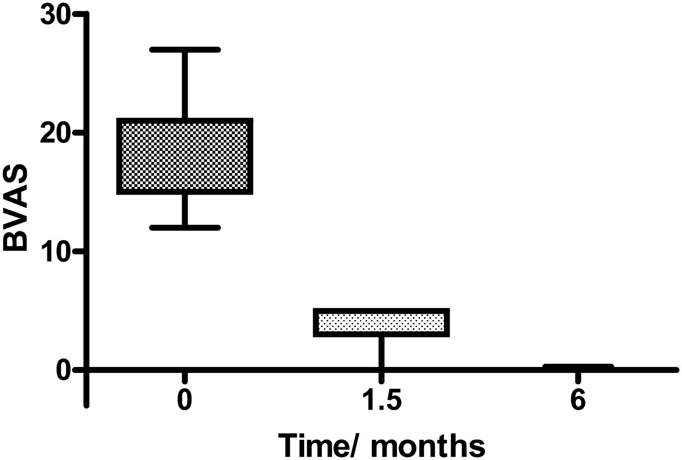
Rapid remission with combined therapy
Changes in BVAS over the first 6 months
Notes:
The change in the BVAS over the first 6 months showed rapid remission with therapy with patients achieving remission not in 3 months we knew by now but in 1,5 months.

Slide 23
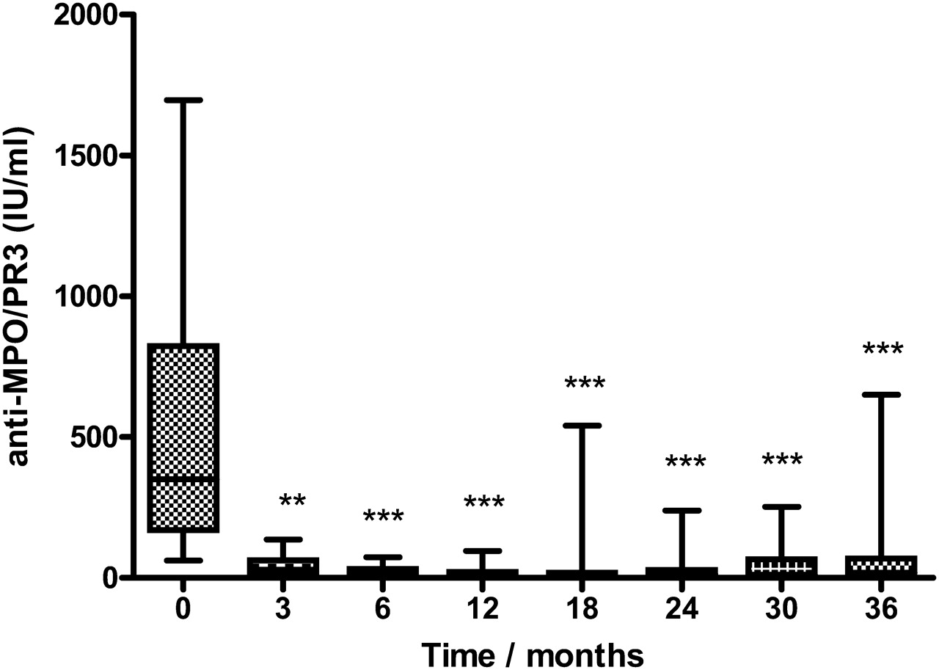
Quick decline in anti-MPO or anti-PR3 antibodies titers
Notes:
Fig. 4. Changes in titre of anti-MPO or anti-PR3 antibodies over time demonstrating a significant drop in MPO-and PR3-ANCA titres by 3 months (time 0 versus 3, 6, 12, 18, 24 and 36 months, all P < 0.001, one-way analysis of variance).
Unless provided in the caption above, the following copyright applies to the content of this slide: © The Author 2011. Published by Oxford University Press on behalf of ERA-EDTA. All rights reserved. For Permissions, please e-mail: journals.permissions@oup.com

Slide 24
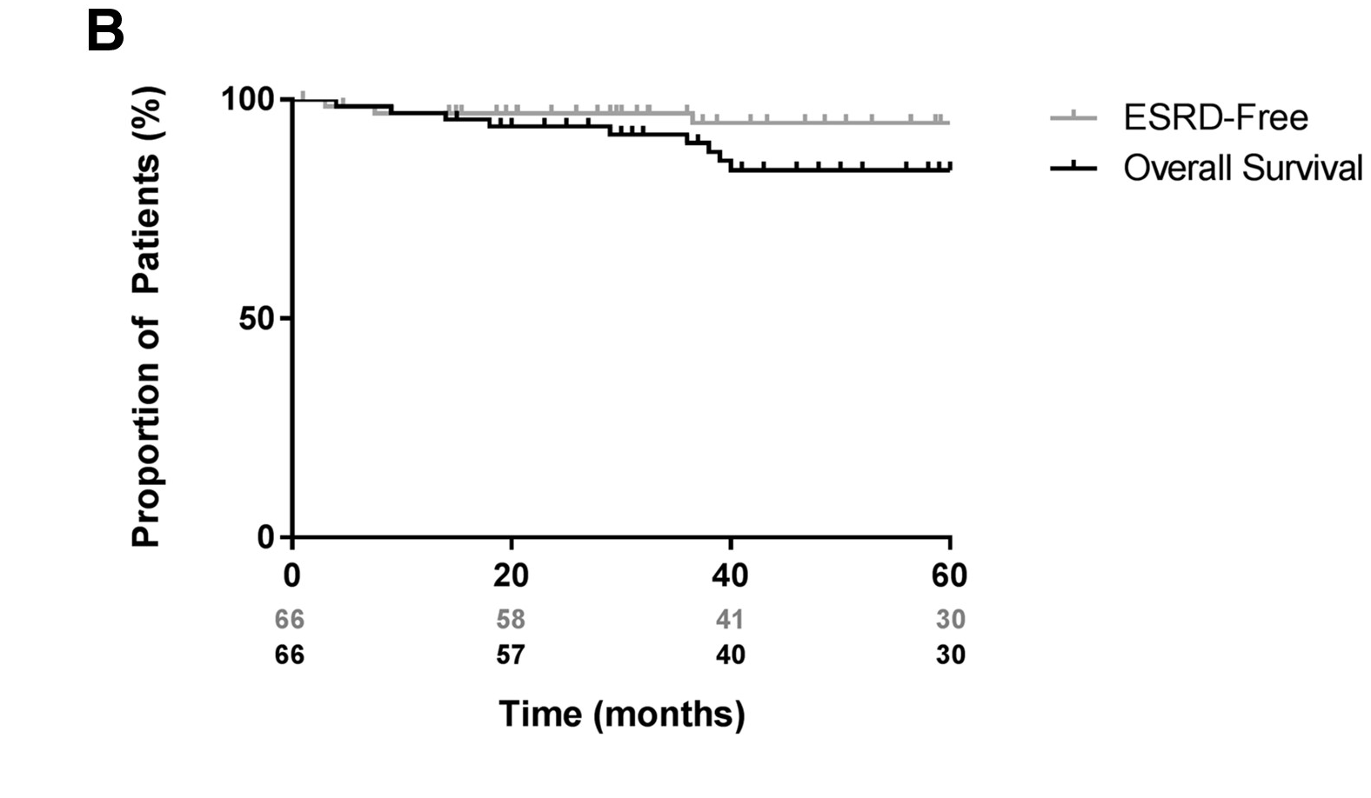
End stage kidney disease during 5-year follow-up
McAdoo S et al. Nephrol Dial Transplant, Volume 34, Issue 1, January 2019.
Notes:
From another study using the same combination of immunosuppressive agents you can see that at the end of the follow up period more than 98% of patients were alive and dialysis free.

Slide 25
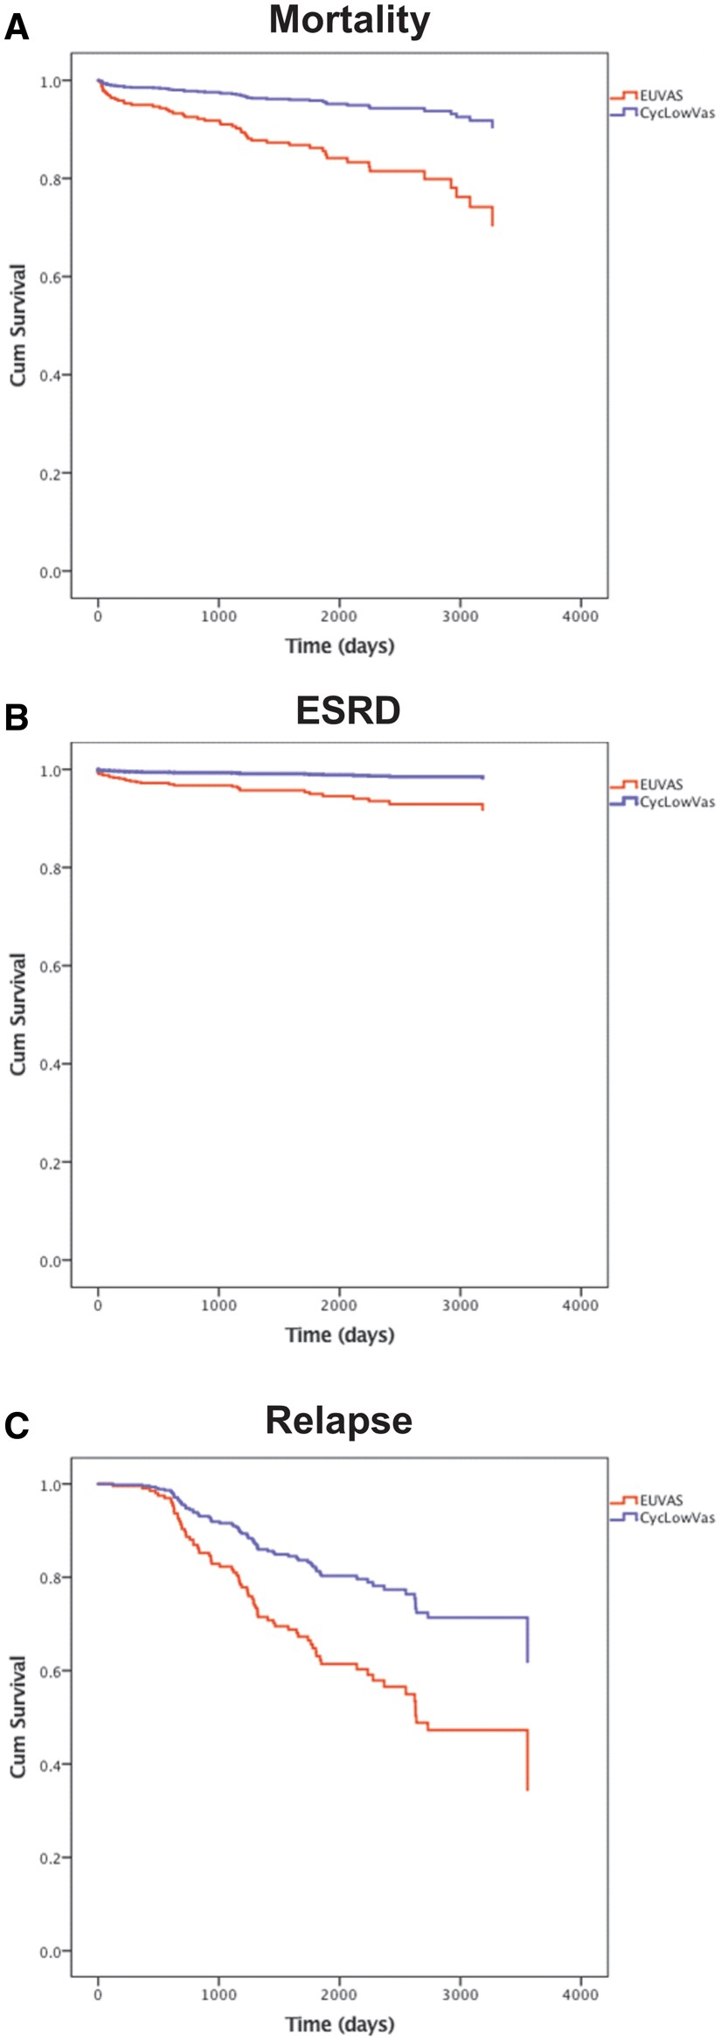
Case-control analysis with propensity-matched patients from EUVAS trials
CycLowVas:
↓ Risk of death {HR 0.29 [95% CI) 0.125–0.675], p= 0.004}
↓ Progression to ESKD [HR 0.20 (95% CI 0.06–0.65), p= 0.007]
↓ Risk of relapse [HR 0.49 (95% CI 0.25–0.97), p= 0.04].
McAdoo S et al. Nephrol Dial Transplant, Volume 34, Issue 1, January 2019.

Slide 26
Complement inhibition

Slide 27
Complement deficient mice
Injection anti-MPO IgG
ANCA-GN
In animal models complement depletion protects animals from developing ANCA-GN following injection of serum with anti-MPO IgG.
Xiao et al. AJP January 2007, Vol. 170.
Notes:
complement inhibition is a new approach for these diseasesd

Slide 28
Low C3 at diagnosis: major risk factor for ESKD or vasculitis-related death at 1st year
Parameter | Hazard ratio (95% CI) | p value
Low serum C3, mg/dl | 6.47 (1.47–28.35) | 0.013
Oliguria, present versus absent | 29.57 (4.74–184) | <0.0001
Chronicity score | 1.77 (1.23–2.54) | 0.002
Serum creatinine, mg/dl | 0.82 (0.57–1.19) | 0.3
Estimated GFR >30 ml/min per 1.73 m² | 0.08 (0.0001–52.1) | 0.44
Normal glomeruli >10% | 1.22 (0.13–3.13) | 0.59
Activity score | 1.37 (0.85–2.24) | 0.19
Acute dialysis requirement | 0.85 (0.12–5.81) | 0.87
Lionaki, S et al. Kidney international reports vol. 6,9 2425-2435. 12 Jun. 2021.
Notes:
And also is a major risk factor for ESKD AND vasculitis related death AT THE END OF THE 1ST YEAR

Slide 29
Renal survival of patients with ANCA-GN stratified by serum C3 at diagnosis
Normal serum C3 at diagnosis
Low serum C3 at diagnosis
Lionaki, S et al. Kidney international reports vol. 6,9 2425-2435. 12 Jun. 2021.
Notes:
It is shown here that the probability of renal survival is much lower when C3 at diagnosis is low

Slide 30
CCX168 (Avacopan): Small molecule acting as antagonist of the human C5aR Receptor
First given in an animal model which expressed the C5aR/CD88 receptor
It resulted in significant improvement of the GN, which had developed as a result of anti-MPO-ANCA serum
It is acting selectively in the C5a
It does not alter MAC formation
Hong Xiao et al. JASN 2014;25:225-231

Slide 31
ADVOCATE trial: Avacopan vs. high-dose GCs in ANCA-vasculitis
Double-blind, parallel-arm, randomized trial
N=331, newly diagnosed or relapsing GPA/MPA patients
eGFR>15 mL/min/1.73 m² , mean BVAS 16
Oral avacopan, 30 mg, twice per day or oral prednisone taper
With RTX or CYC , followed by AZA or MMF, for up to 1 year
Primary trial endpoints:
% patients in remission at week 26 (BVAS=0), not taking GCs
% sustained remission (week 26-week 52)

Slide 32
ADVOCATE study: Results
Remission at week 26:
72.3% in the avacopan group
70.1% in the prednisone group
(p<0.001 for the non-inferiority; p= 0.24 for superiority)
Sustained remission at week 52:
65.7% in the avacopan group
54.9%) in the prednisone group
(p<0.001 for non-inferiority; p= 0.007 for superiority)
Jayne DRW et al. ADVOCATE Study Group. N Engl J Med. 2021 Feb 18;384(7):599-609
Notes:
As you can see here the target of non-inferiority compared to GCs it was achieved at week 26 while for end of follow up week 52 patients win the avacopan group had more patients with sustained remission

Slide 33
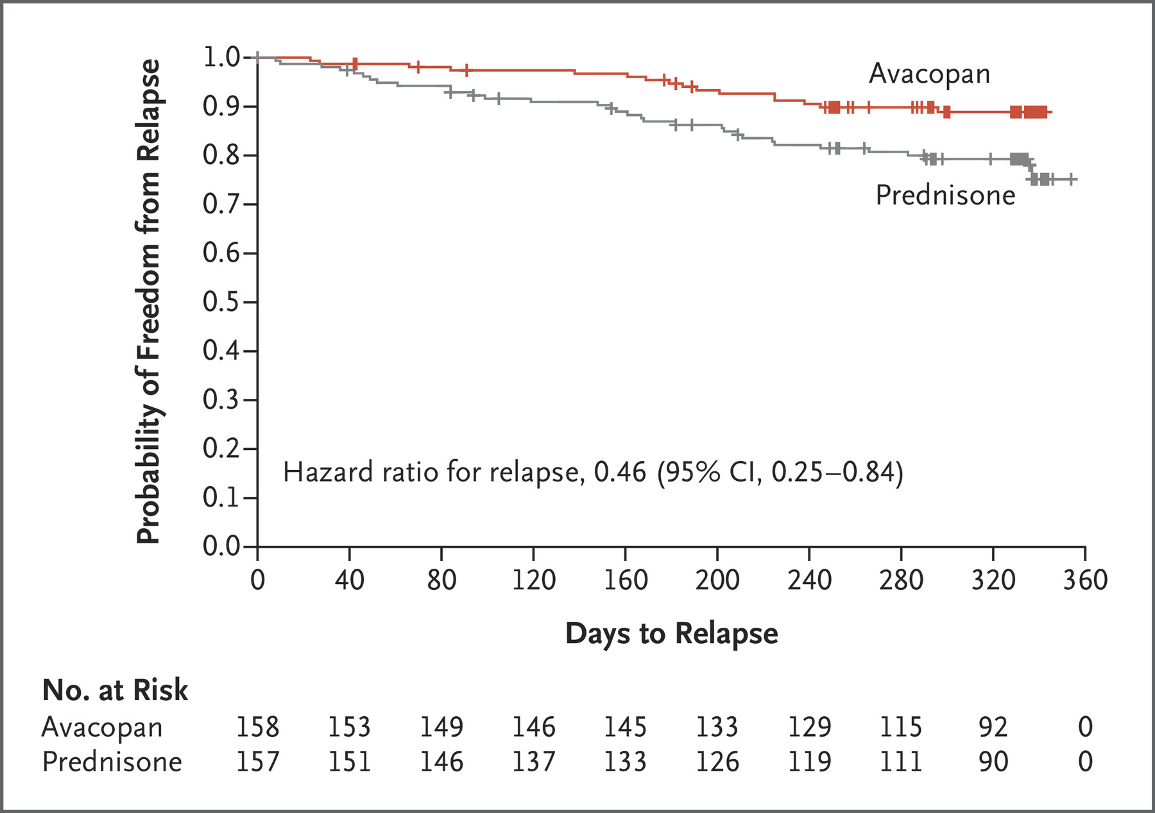
ADVOCATE study: Probability of disease relapse
Relapses
10.1%, avacopan group
21.%, prednisone group
HR for relapse
(avacopan vs prednisone):
HR: 0.46 (95% CI, 0.25-0.84)
Jayne DRW et al. ADVOCATE Study Group. N Engl J Med. 2021 Feb 18;384(7):599-609
Notes:
In addition the probability of relapse was higher in patients who received prednisone vs avacopan

Slide 34
Avacopan: Beneficial effect in renal function relative to GC
eGFR change from baseline:
81% of patients had renal involvement
Avacopan group: 7.3 mL/min/1.73 m²
Prednisone group: 4.1 mL/min/1.73 m² (difference: 3.2 mL/min/1.73 m²; 95% CI, 0.3-6.1)
Jayne DRW et al. ADVOCATE Study Group. N Engl J Med. 2021 Feb 18;384(7):599-609
Notes:
Interestingly the avacopan group had also better GFR at the end of the follow up period with 7 vs 4 ml/min increase from baseiline. This difference was also noted in patienst with advanced renal dysfunction

Slide 35
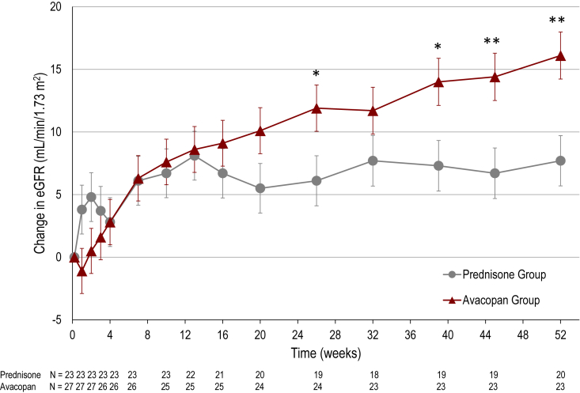
ADVOCATE trial: Stage 4 CKD, change in kidney function at week 52:
Avacopan group: 13.7 mL/min/1.73 m²
Prednisone group: 8.2 mL/min/1.73 m²
Cortazar F et al. Kidney Int Rep. 2023 Apr; 8(4): 860–870.
Notes:
https://www.skroutz.gr/s/20506494/Mobiak-Exetastiko-Krevati-Xylino-0808879.html

Slide 36
Avacopan vs. prednisone
Serious infections
13.3% of patients given avacopan
15.2% of patients given prednisone
Incidence of AEs potentially related to GCs
66.3% in the avacopan group
80.5% in the prednisone group
(difference: -14.2 % points; 95% CI, -23.7 to -3.8)
Jayne DRW et al. ADVOCATE Study Group. N Engl J Med. 2021 Feb 18;384(7):599-609
Notes:
Adverse events were not different in general and also in terms of serious infections patienst won GCs had more

Slide 37

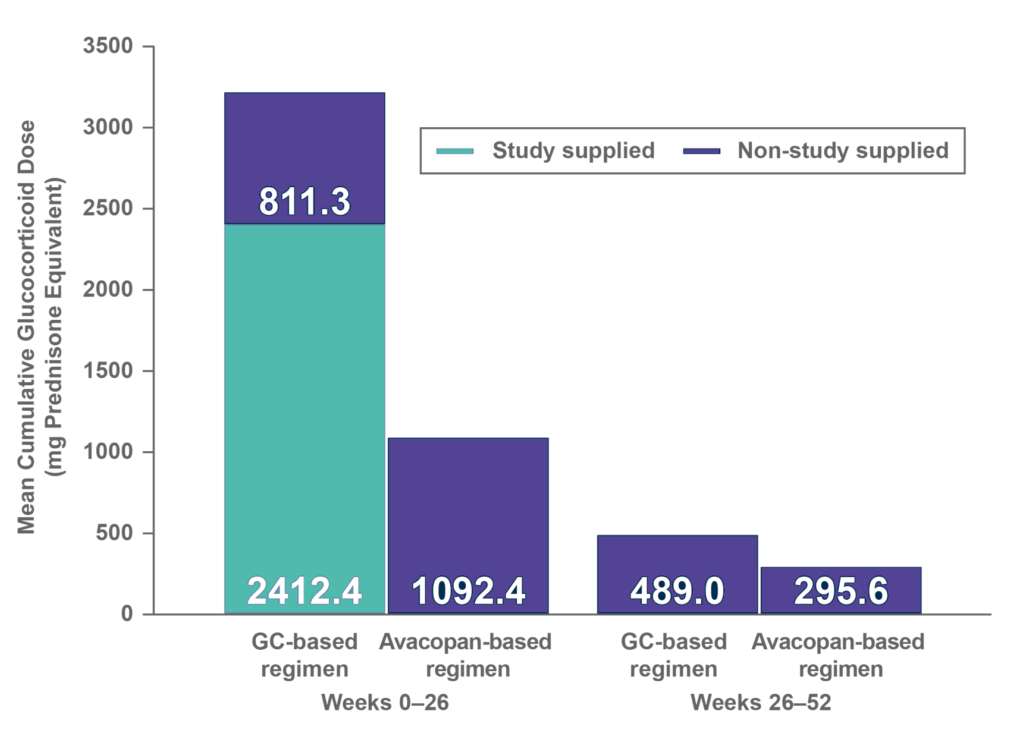
Avacopan based regimen lowers overall GC dose vs. GC-based regimen
Lower GC dosing with Avacopan-based regimen, including weeks 25-62
    Mean total GC dose:
    1,349 mg vs 3,655 mg
GC, glucocorticoid.
1. Jayne D, et al. N Engl J Med 2021;384(7):599–609.
2. Jayne D, et al. N Engl J Med 2021;384(7):599–609 [Suppl Appendix].
3. Vifor Pharma. Clinical Study Report: CL010_168. Data on file.
Notes:
SPEAKER NOTES / VOICE OVER
Another of the main ADVOCATE study results determined that an Avacopan-based regimen achieves equivalent disease remission at 26 weeks vs a GC-based regimen, and is superior to a GC-based regimen in sustaining remission at 52 weeks.¹
(Transition one) Approximately 65% lower overall GC dose was observed in an Avacopan-based regimen. The mean total GC dose was 1,349 mg in the Avacopan-based regimen vs 3,655 mg in the GC-based regimen. Per patient, this works out as 4mg per day in the Avacopan-based regimen group compared to 12mg per day in those treated with the GC-based regimen.^{1–3}
(Transition two) A 40% lower GC dose was observed with the Avacopan-based regimen during Weeks 26–52.²
(Transition three) Two-thirds of patients treated with the Avacopan-based regimen were GC-free during Weeks 26–52.^{2,3}
References
1. Jayne D, et al. N Engl J Med 2021;384(7):599–609.
2. Jayne D, et al. N Engl J Med 2021;384(7):599–609 [Supplementary Appendix].
3. Vifor Pharma. Clinical Study Report: CL010_168. Data on file.

Slide 38
Ιn 2021 the US FDA avacopan was approved, for the treatment of ANCA-vasculitis
Addition (30 mg twice daily) for induction of remission in new or relapsing ANCA-SVV treated with CYC or Rituximab
After starting avacopan a faster GCs tapering protocol aiming to stop in week 4 can be considered
Can be continued for 1 year

Slide 39
Indications of avacopan in ANCA-SVV to date
Patients with
Serious contraindications for high dose steroids
Severe kidney disease
Low serum C3 level at onset
Age
Diabetes
Obesity
Osteoporosis
Depression
Notes:
The question is why or when should we add avacopan in the standard of care? altough we need more data to answer we can say at the moment that patients with ...maybe candidates to receive avacopan...

Slide 40
Plasma-exchange (PLEX)
Notes:
Although the use of plasmna-exchange in ANCA disease is an old issue it is not clear if it is of benefit

Slide 41
MEPEX Trial:
PLEX or Methyl-prednisolone pulses
7 PLEX sessions
2 weeks
Oral CYC + GCs
Methyl-prednisolone
IV x 3 days
Oral CYC + GCs
Adjunctive therapy in patients with initial serum creatinine > 5.8 mg/dl
N=137
69% required dialysis
Jayne D. et al. J Am Soc Nephrol 2007
Notes:
The MEPEX trial enrolled 137 patients with a new diagnosis of ANCA-GN, the mean serum creatinine was 8.3 and 69% required dialysis. All patients were given cyclophosphamide and oral GCs and were randomly assigned to receive either plasma exchange or intravenous methylprednisolone.

Slide 42
MEPEX Trial:
PLEX (7 sessions) or Methyl-prednisolone pulses (3 days)
Plasma-exchange:
Likelihood of being alive and dialysis independent by month 3 (69% vs. 49%)
⬇︎ Risk of progression to ESKD at 1st year (19% vs. 43%)
⬇︎ Risk of progression to ESKD at 4th year (33% vs. 49%)
Jayne D. et al. J Am Soc Nephrol 2007
Notes:
The addition of PLEX was associated with significantly higher likelihood of being alive and having independent renal function at 3 months.
PLEX also reduced the risk of progression to to ESRD at 1 year and non-significantly reduced progression at 4 years.
Mortality was high in both groups

Slide 43
Predictors of dialysis independence at 1st year (Ν=67)
Compared outcomes | Variables | P value | Exp β | 95% CI of Exp β
Dialysis independence (IVMeP) versus dialysis (PLEX) | Arm | 0.008 | 0.08 | 0.01 to 0.52
 | Tubular atrophy | 0.005 | 17.2 | 2.4 to 122.7
 | Normal glomeruli | 0.025 | 0.91 | 0.84 to 0.99
Dialysis (IVMeP) versus death (PLEX) | Αrm | 0.056 | 4.1 | 0.97 to 17.4
 | Glomerulosclerosis | 0.061 | 0.03 | 0.001 to 1.2
Dialysis independence (IVMeP) versus death (PLEX) | Αrteriosclerosis | 0.042 | 4.7 | 1.1 to 20.5
de Lind van Wijngaarden RA et al. JASN 2007
Notes:
dialysis independence 1 year after diagnosis is more likely to occur in patients with less tubular atrophy and more normal glomeruli

Slide 44
PEXIVAS study: The effect of PLEX in remission induction, eGFR< 50 ml/min/1.73 m² or diffuse pulmonary hemorrhage
98 sites, 15 countries
41% PR3-ANCA, 59% MPO-ANCA
98% kidney involvement
27% alveolar hemorrhage
85% Cyclophosphamide (p.o or iv)
15% Rituximab
Mean follow up time: 2.9 years
N=704
7 PLEX sessions
No PLEX
Replacement : 60 ml human albumin /kg BW or FFP
Walsh M et al. N Engl J Med 2020;382:622-31.
Notes:
more recently The PEXIVAS study aimed to provide further clarity regarding the use of of PLEX in patients with severe ANCA disease.
A secondary aim was to assess the noniferiority of a reduced dose of oral glucocorticoids regimen compared to the standard dose

Slide 45
PEXIVAS study: PLEX in severe ANCA vasculitis
Death from any cause or ESKD was not different between groups
(28% vs. 31%, HR: 0.86; 95% CI: 0.65-1.13, p=0.27)
A kidney biopsy was NOT required for inclusion in the study.
Walsh M et al. N Engl J Med 2020;382:622-31.
Notes:
there was no difference in the rate of death or ESRD between patients who received PLEX and those who didn’t.
A problem regarding the renal outcome is the lack of kidney biopsies in all patients.

Slide 46
PEXIVAS: Glucocorticoids regimen and risk of death or ESKD
All patients received IV MP for 1-3 days, max 3 g
Standard dose of GCs
Reduced dose GCs
No difference
Prednisone dose was determined by patient’s weight.
At 6 months the cumulative dose of oral GCs in the reduced group was 60% less.
After 22 weeks both groups were on 5 mg prednisone per day.
Walsh M et al. N Engl J Med 2020;382:622-31.
Notes:
they also found that there was no difference with respect to the risk of death or ESRD between patients who received the standard and the reduced dose of GCs

Slide 47
PEXIVAS study
No evaluation of the prognostic effect of kidney histopathology
Just over 50% of patients had actually had a kidney biopsy
In the patients who did, it is unclear when the kidney biopsy was performed relative to their presentation
AKI at presentation: Acute inflammation or advanced sclerosis?

Slide 48
Kidney Histopathology to Predict PLEX benefit
Multicenter, retrospective study, France
Kidney biopsy data from patients with ANCA-SVV treated with PLEX
Evaluate if histopathologic findings could predict kidney function and identify which patients would most benefit from PLEX
Primary outcome: Mortality or ESKD at 12 months (M12)
Dorian Nezam et al. JASN 2022;33:628-637

Slide 49
Methods
Eligibility Criteria
Study participants were included retrospectively
31 French internal medicine and nephrology departments.
MPA, GPA, renal-limited vasculitis
Fulfilled ACR criteria or Chapel Hill consensus conference definitions
Diagnosed 2004-2019
Underwent a kidney biopsy at presentation
Both patients receiving PLEX (PLEX group) and those who did not (control group)
Patients with kidney biopsy was performed >1 month from the initiation of induction therapy were excluded
Dorian Nezam et al. JASN 2022;33:628-637
Notes:
I think the most important of the eligibility criteria was Patients with kidney biopsy was performed >1 month from the initiation of induction therapy were excluded

Slide 50
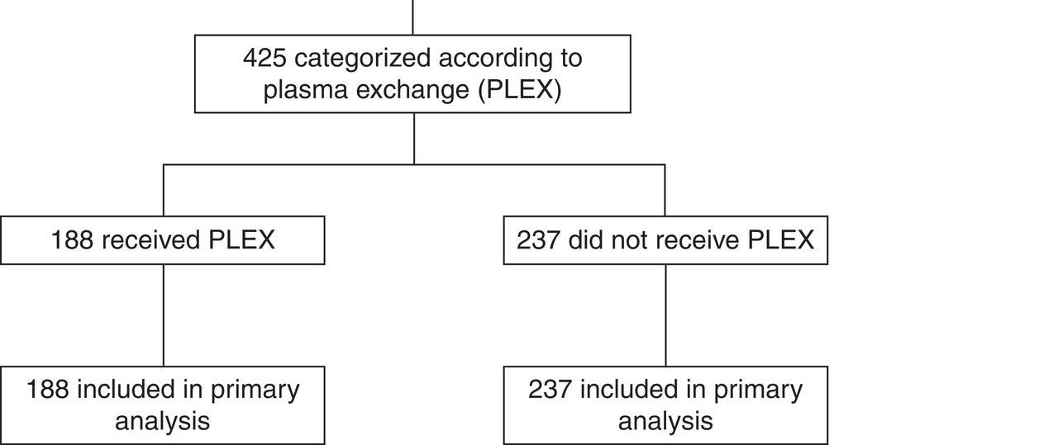
572 patients with AAV and severe renal flare
Study flow diagram
Dorian Nezam et al. JASN 2022;33:628-637
Notes:
Study flow diagram. Treatment effect of PLEX according to simplified score thresholds. ACR, American College of Rheumatology.

Slide 51
Prediction model:
Average treatment effect (ATE) estimation
To identify patients who would benefit from PLEX
Berden Classification (focal, crescentic, mixed, sclerotic)
Brix score (low, medium, high)
Kidney biopsy: Score >7 ⇒
Sensitivity 83.1%
Specificity 96.0%
Recommending PLEX
Dorian Nezam et al. JASN 2022;33:628-637
Notes:
Patients were identified using the berden and brix score

Slide 52
Results
Total population: No significant benefit of PLEX for the primary outcome
Dorian Nezam et al. JASN 2022;33:628-637
Notes:
Using very advanced math models the reserchers found that there was benefit for the total population from using PLEX

Slide 53
Results
Prediction model
42% of the total population had increased predicted probability with PLEX compared without PLEX of being alive and free from ESKD at M12.
Risk difference for death or ESKD at M12: ↓ 24.6% with PLEX
Dorian Nezam et al. JASN 2022;33:628-637
Notes:
BUT the prediction model showed that 42% of the total

Slide 54
Conclusions
Large cohort of patients with ANCA-SVV and kidney involvement:
PLEX was NOT associated with a better outcome for the whole population
42% of patients from this cohort could have benefitted from PLEX
The absolute risk reduction for death or ESKD at M12 of 24.6%
Dorian Nezam et al. JASN 2022;33:628-637

Slide 55
Systematic review and meta-analysis: The effects of PLEX in patients with ANCA-vasculitis
When PLEX added to standard therapies:
↓ Risk of ESKD at 1st year, regardless of baseline kidney function
↑ Risk of serious infections, a previously unrecognized effect
Did not change the risk of death
M. Walsh et al. BMJ 2022;376:bmj-2021-064604
Notes:
Which showed that PLEX was associated with lower risk of ESKD at 1 year and increased risk of serious infections which is a fact.

Slide 56
ANCA glomerulonephritis
Relapsing and remitting course
Various kidney presentations at baseline
Diffuse scarring can occur before the initial diagnosis
Baseline kidney biopsy: Required to distinguish between active inflammation or chronic sclerosis and predict outcome
Individualization of therapy is crucial in order to reduce toxicity and increase therapeutic benefit

Slide 57
Thank you for you attention!

