Slide 1
Discarded kidneys from deceased donors: how far can we push the boundaries?
Maria Darema
Nephrologist
Department of Nephrology and Renal Transplantation, National and Kapodistrian University of Athens Medical School,
Laiko General Hospital, Athens, Greece

Slide 2
Disclosures
I have no financial relationships to disclose relevant to my presentation
My presentation does not include a discussion of off-label or investigational drugs

Slide 3
Kidney transplantation vs. Long-term Dialysis
Improved patient survival
Better quality of life
Reduced costs to the health service
Kidney transplantation is confronted with an organ shortage
A large proportion of deceased donor kidneys are discarded

Slide 4
Organ “discard” definition
“An organ recovered for the purpose of transplantation but not transplanted”

Slide 5
Discard rates
In the US: 2022: 25% (with KAS250)
2021: 21%
2018: 20%
2010-2015: 18-19%
1988: 5.1%
In the UK: 10%-12%
In France: 9%
Eurotransplant: 8%
Curr Opin Organ Transplant 2023, 28:145–148
Am J Transplant. 2020;20:1309–1322
Curr Opin Organ Transplant 2019;24:92-96

Slide 6
Discarded kidneys
Non- procurement kidneys

Slide 8
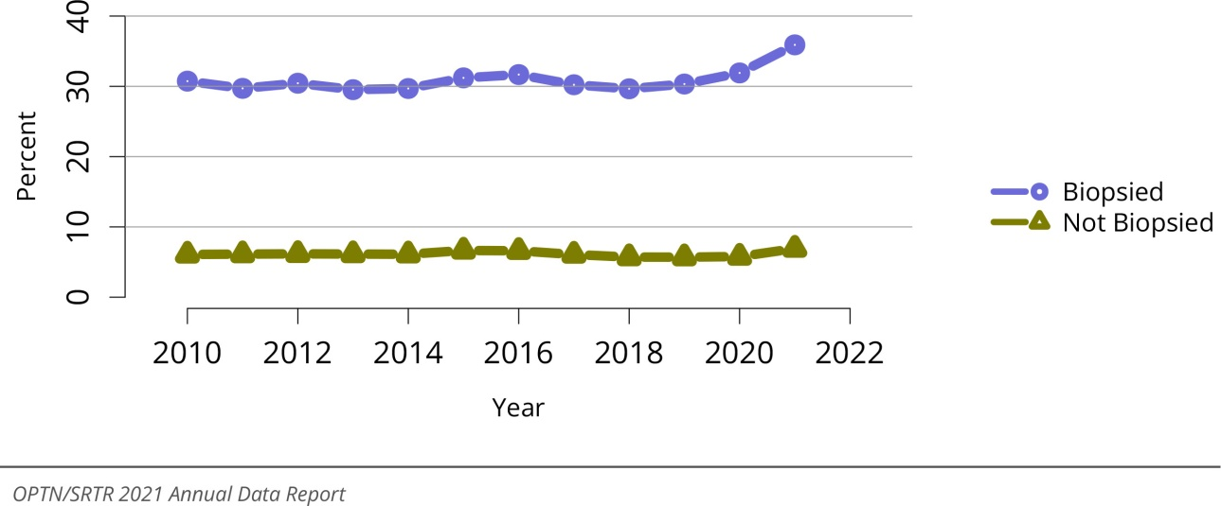
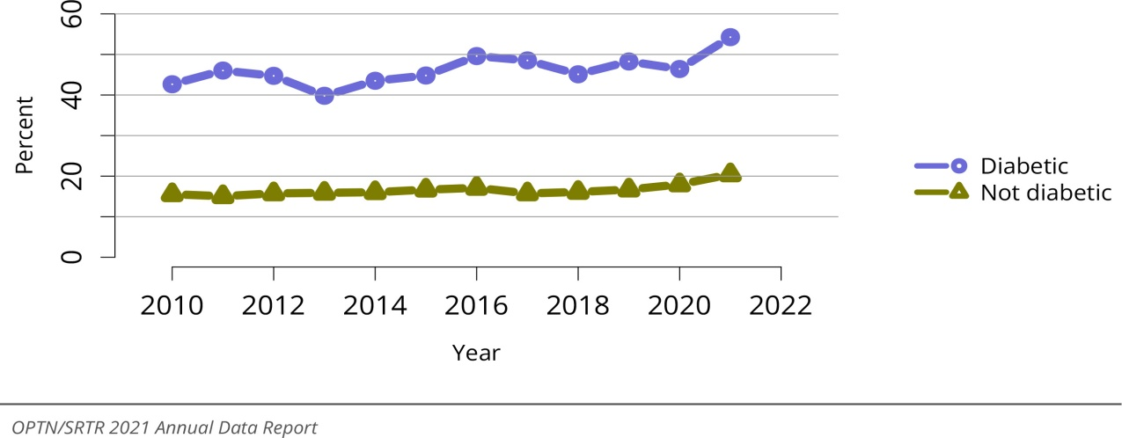
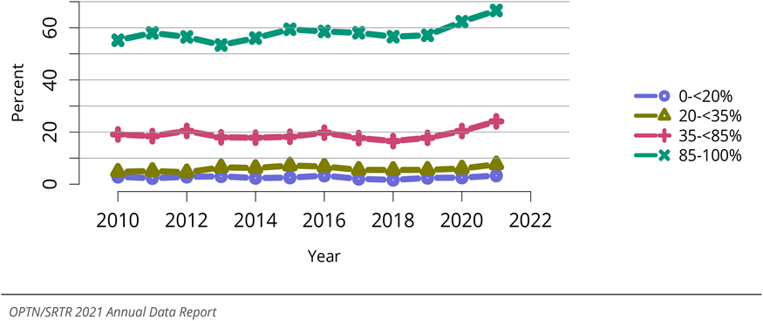
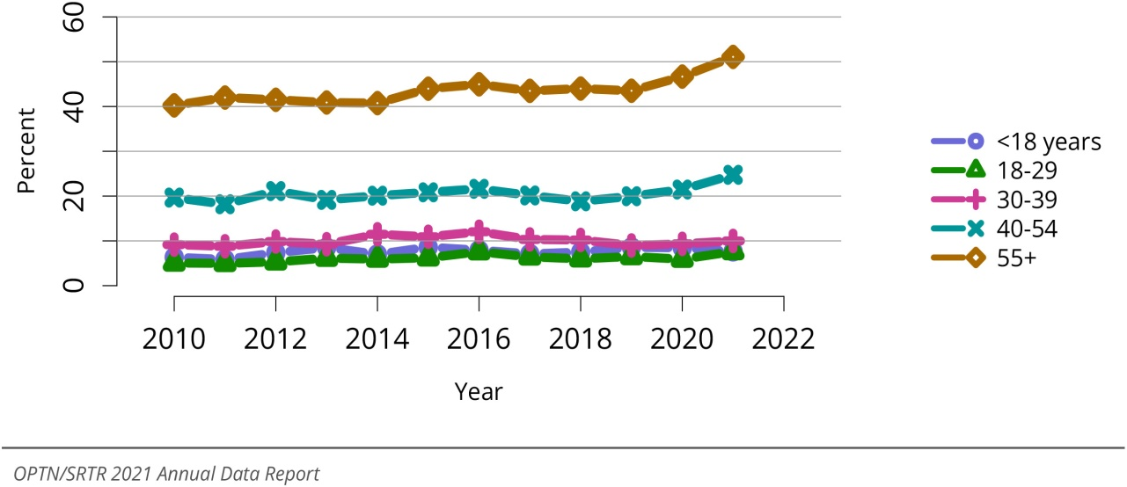
Percent of kidneys recovered for transplant and not transplanted by donor biopsy status
Percent of kidneys recovered for transplant and not transplanted by donor diabetes status
up to 35.9% in 2021
Percent of kidneys recovered for transplant and not transplanted by KDPI
Percent of kidneys recovered for transplant and not transplanted by donor age
American Journal of Transplantation 2023 23S21-S120DOI

Slide 9
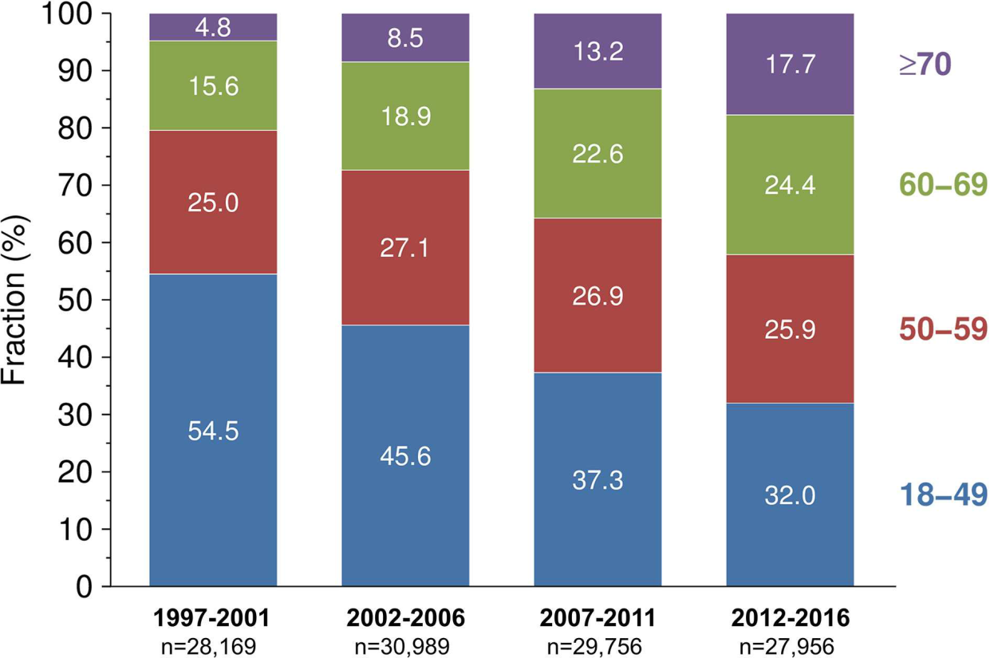
Kidneys From Elderly Deceased
Donors—Is 70 the New 60?
Data: 23 European countries
116,870 patients
Development of donor age in European adult recipients of first
DD kidney transplants across different time periods
Front Immunol 2019;10:2701

Slide 10
Kidneys From Elderly Deceased
Donors—Is 70 the New 60?
Within only one further decade (1997–2006 vs. 2007–2016) the 5-year death censored graft survival of kidneys from ≥ 70-year-old donors improved to the level of kidneys from 60 to 69-year-old donors in the previous decade
Data: 23 European countries
116,870 patients
Front Immunol 2019;10:2701

Slide 11
Factors leading to the discard of deceased donor kidneys in the United States
Kidney International (2018) 94, 187–198
SRTR registry
212,305 deceased donor kidneys - from 2000-2015
36,700 kidneys were discarded (17.3%)
bilateral discards: both kidneys from a donor were recovered and discarded
single discards: one kidney was recovered and discarded
unilateral discards: one kidney was discarded while the partner kidney was transplanted

Slide 12
Factors leading to the discard of deceased donor kidneys in the United States
Kidney International (2018) 94, 187–198
SRTR registry
212,305 deceased donor kidneys - from 2000-2015
36,700 kidneys were discarded (17.3%)
‘Biopsy Findings’ (38.2%): the most commonly reported reason for discard

Slide 13
Kidney International (2018) 94, 187–198
Unilateral discards
The reasons for discard: allocation system-related reasons, donor history, organ damage/anatomical abnormality, poor organ function, biopsy findings, but the highest proportion was attributed to ‘Other’ (23.8%) – for reasons unrelated to graft quality
Recipients of unilateral transplants, irrespective of the cause of the unilaterally discarded partner kidneys, experienced a 1-year death-censored graft survival rate of > 90%
Recipients of the kidney whose partner kidneys were discarded due to allocation system-related reasons experienced a 1- year graft survival rate of 96.5%

Slide 14
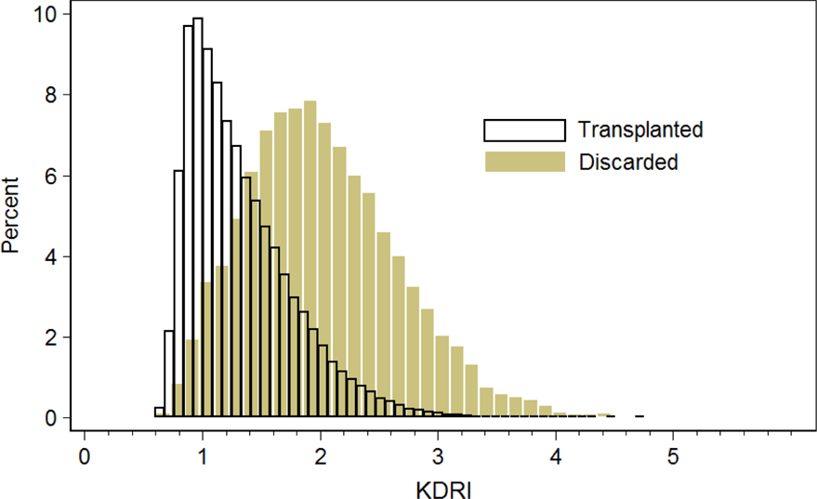
Kidney Donor Risk Index (KDRI) overlap of transplanted and discarded kidneys
Kidney Int. 2018;94:187–198

Slide 15
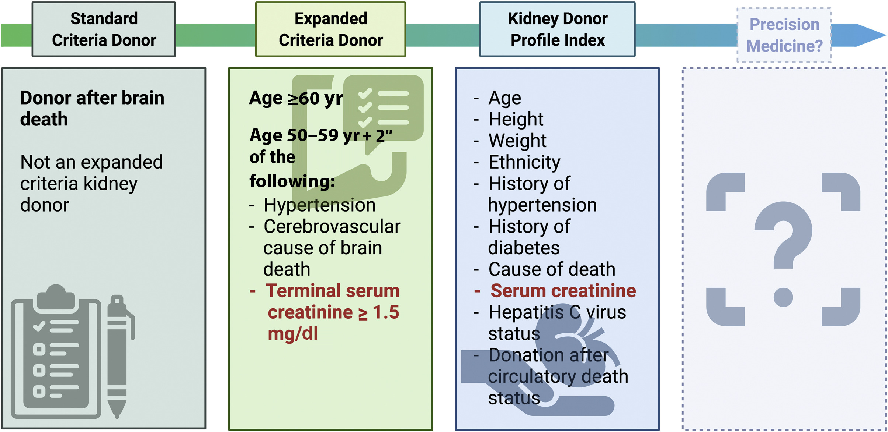
Evolution of kidney donor risk scoring
Kidney Int Rep (2021) 6, 2025–2027

Slide 16
Kidney Transplantation From Donors With Acute Kidney Injury: Are the Concerns Justified? A Systematic Review and Meta-Analysis
AKI criteria
RIFLE, AKIN, KDIGO

Slide 17
Graft quality assessment
Visual assessment

Slide 18
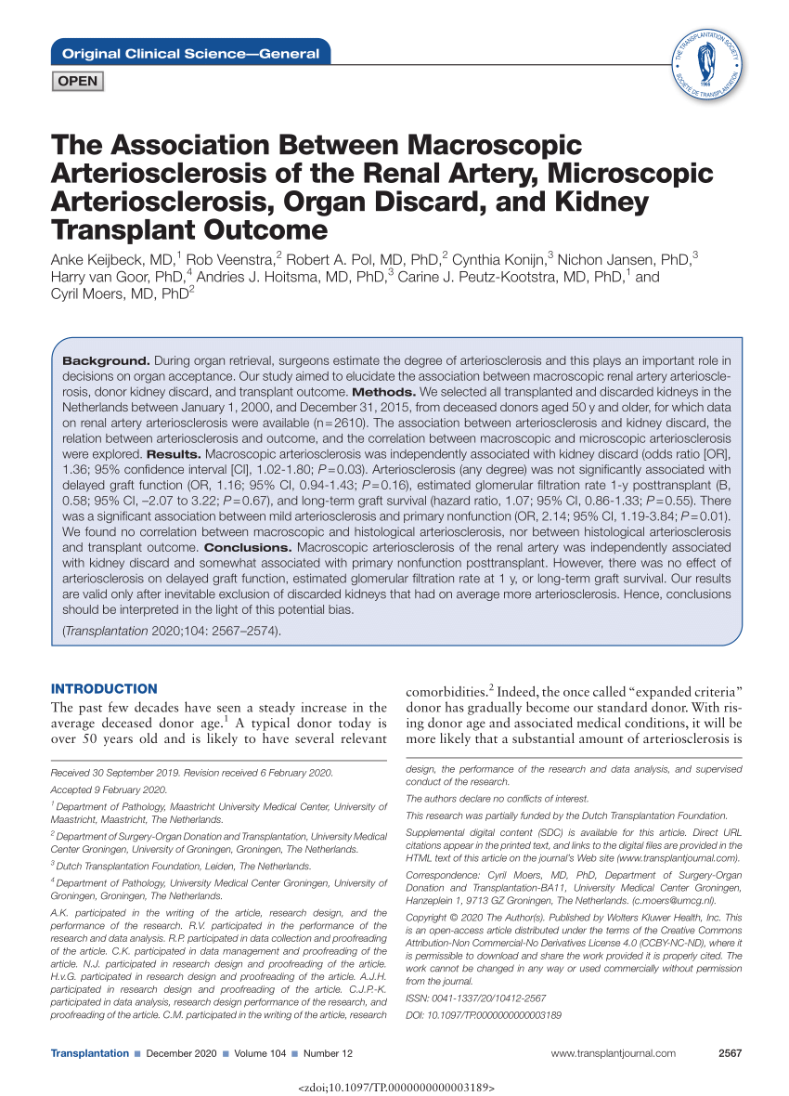
All transplanted and discarded kidneys in the Netherlands between 1/2000, and 12/2015, from DD aged 50 y, for which data on renal artery arteriosclerosis were available (n=2610)
Macroscopic arteriosclerosis was independently associated with kidney discard and somewhat associated with PNF post-Tx , but there was no effect on DGF, eGFR at 1y, long-term graft survival
More severe degrees of renal artery arteriosclerosis were not associated with an elevated risk of PNF
There was no sign of any relation between macroscopically observed renal artery arteriosclerosis and histological indicators of intragraft arteriosclerosis
… Kidney discard based on a very subjective macroscopic assessment of renal artery arteriosclerosis should be discouraged…
Data: from the Dutch Organ Transplantation Registry, Eurotransplant

Slide 19
Graft quality assessment
The role of renal transplant biopsy

Slide 20
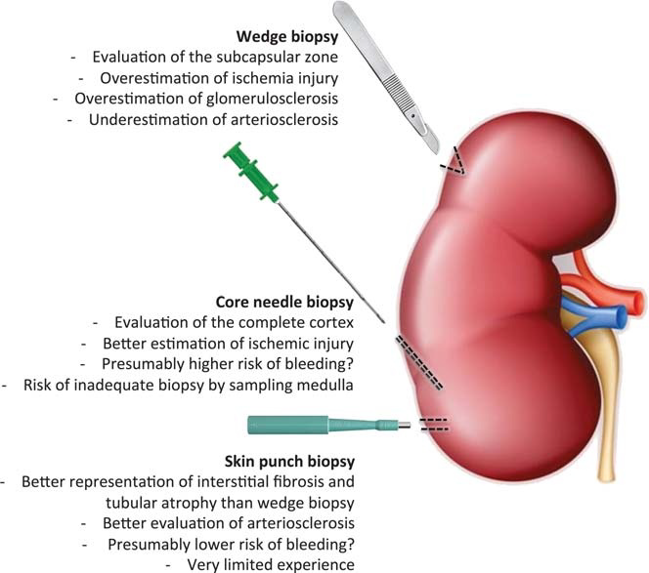
Pathologist's Experience
Interobserver variability may affect the interpretation of the histological lesions
Techniques for obtaining zero-time biopsies vary importantly
The choice of technique impacts the diagnostic value of different histological lesions
Transplantation 2016;100: 1425–1439

Slide 21
UNOS database, 22.006 deceased-donor kidneys with a KDPI score > 85% from 2005 to 2014
Glomerulosclerosis → Rate of kidney discard
0–10% (58.0%) → 33.6%
11–20% (13.5%) → 68.9%
> 20% (19.7%) → 77.4%
Among kidneys with >10% GS, there was no significant difference in death-censored graft survival between 11–20% GS and >20% GS.
J.Clin.Med. 2020,9,1469;doi:10.3390/jcm9051469

Slide 22
Assessment of the Utility of Kidney Histology as a Basis for Discarding Organs in the United States: A Comparison of International Transplant Practices and Outcomes
JASN February 2021;32(2):397-409

Slide 23
How far can we push the boundaries?
To 'push the boundaries' is to act in a way that goes beyond what's established or expected…
… expected for whom? For patients or for transplants?

Slide 24
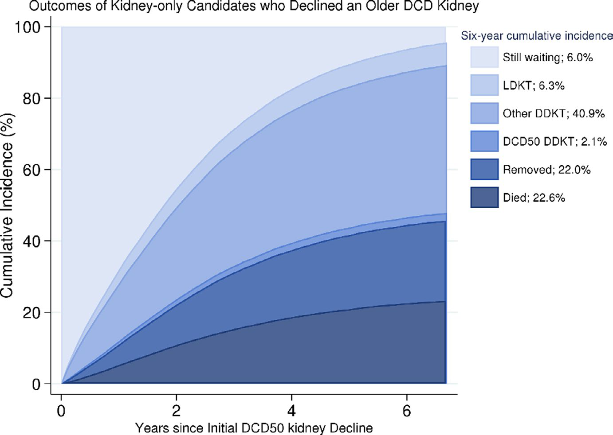
Survival benefit of accepting kidneys from older donation after
cardiac death donors
92,081 adult kidney transplant candidates who were offered a DCD50 kidney
34.6% of DCD50 were discarded
Candidates who accepted had 49% decreased mortality risk at 6 years compared with decliners
Outcomes following the initial decline of a DCD50 kidney among candidates who declined a DCD50 kidney between 1/1/2010 and 12/31/2018 – SRTR data
Am J Transplant. 2021;21:1138–1146

Slide 25
Evolution of kidney donor risk scoring
Kidney Int Rep 2021; 6: 2025–2027

Slide 26
Evolution of kidney donor risk scoring
Kidney Int Rep 2021; 6: 2025–2027

Slide 27
Rapid and accurate assessment of organ quality
Prognostic tools - Non-invasive biomarkers:
change the landscape of allocation
reduce the number of discarded deceased donor kidneys
improve organ availability to countless patients on the waiting list
Deceased donor biomarkers and genetic variations - under investigation
Uromodulin (UMOD) /Osteopontin (OPN) ratio
Urinary chitinase 3-like protein 1 (YKL-40)
Apolipoprotein L1 genotypes
‘Omics’ technologies
Advanced magnetic resonance imaging (MRI) techniques
J Clin Med 2022;11:487
ASN Kidney News, August 2022;14(8):19
J Clin Invest. 2021;131(22)
Transplantation 2021; 105:876–885

Slide 28
Optimum utilization of renal allografts
Reduced cold ischemia time
Dual transplantation (both kidneys from one donor into the same recipient)
Recondition marginal organs
Preservation techniques: promising results, need further results from the clinical setting
- Oxygenated hypothermic machine perfusion
- Normothermic machine perfusion (NMP): pre-transplant organ assessment tool
active organ reconditioning
J Clin Med 2023;12:3871
J Clin Med 2022;11:487
ASN Kidney News, August 2022;14(8):19
J Clin Invest. 2021;131(22)
Transplantation 2021; 105:876–885

Slide 29
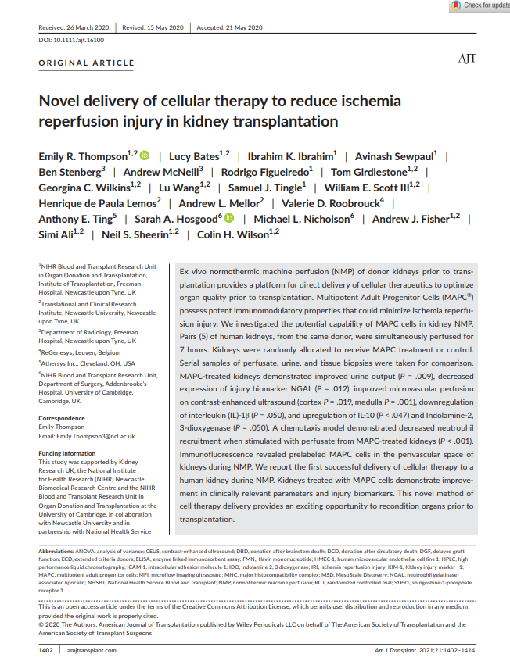
Ex vivo normothermic machine perfusion (NMP) of donor kidneys prior to transplantation
Multipotent Adult Progenitor Cells (MAPC®) possess potent immunomodulatory properties that could minimize IRI

Slide 31
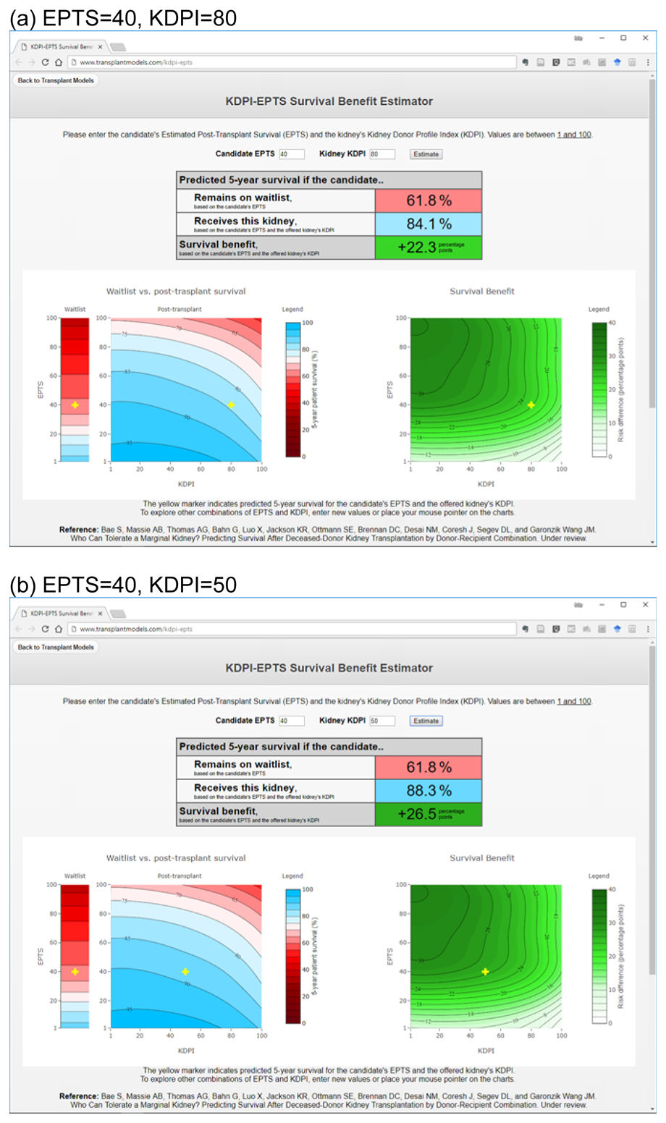
Who can tolerate a marginal kidney? Predicting survival after deceased donor kidney transplant by donor–recipient combination
Estimation of 5-year post-KT survival and wait-list survival
Combinations of KDPI and EPTS score
Survival benefit was defined as ‘’absolute reduction in mortality risk with KT’’
Estimated Post Transplant Survival (EPTS) score
Candidate time on dialysis
Current diagnosis of diabetes
Prior solid organ transplants
Candidate age
DD KT recipients (n=120.818)
Waitlisted candidates (n=376.272)
SRTR data
Am J Transplant. 2019;19:425–433

Slide 32
THANK YOU!

