Slide 1

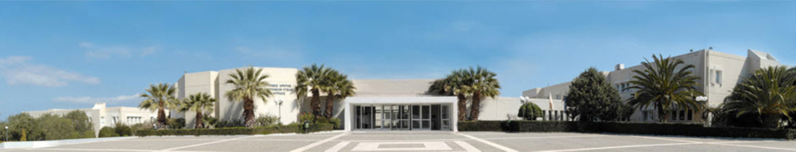
Genetic testing in CKD when, how and why
Kostas Stylianou
Assistant Professor of Nephrology
University of Crete
Head of the Nephrology Department
University Hospital of Heraklion

Slide 2
Kidney Genes
The human genome contains 3.2 billion base pairs and the average genome differs from the reference genome at 4 million sites (variation 0.1%)
There are 22000 known genes in the human genome, of which 4000 are known to cause disease, susceptibility to disease or benign changes in laboratory values
Of these genes, 625 (15%) are known to cause monogenic kidney disease
Susan Murray. Nephrol Dial Transplant (2020) 35: 1113–1132

Slide 3

Genetic or Familial CKD
Around 25-37% of patients with CKD self-report a positive family history of CKD . Despite this high percentage, Mendelian causes are estimated to account for approximately 10% of cases of adult ESRD. This proportion is much higher in children (70%)
Around 15% of all incident patients who reach ESRD lack a primary diagnosis (CKD or ESRD of unknown etiology). It is very likely that a significant proportion of them carry a genetic defect, responsible for the pathophysiology of their CKD.

Slide 4
Inherited kidney disease
There are many kidney diseases that are inherited in a monogenic fashion due to a variant in a single gene, but there are equally as many kidney diseases that are influenced in a polygenic fashion (DM, HTN)
Most Mendelian inherited kidney diseases are rare. However, as a group they represent a significant burden of disease.
They are the main cause of CKD and ESRD in the pediatric population.
doi:10.1038/nrneph.2017.167.

Slide 5
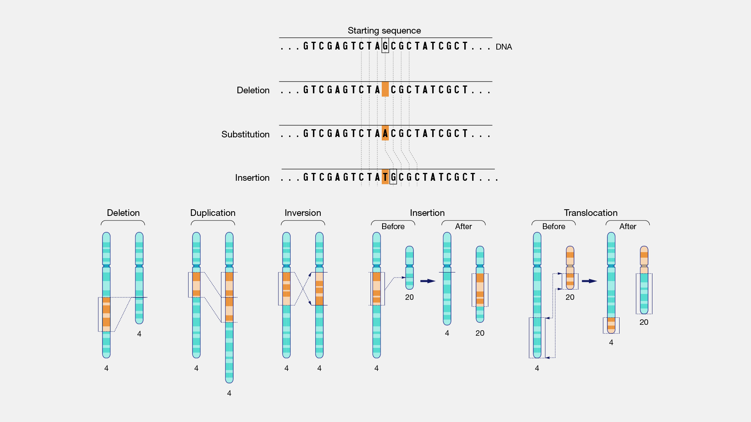
Mutations
Single nucleotide variations
Large structural variants (large DNA segments defects)

Slide 6
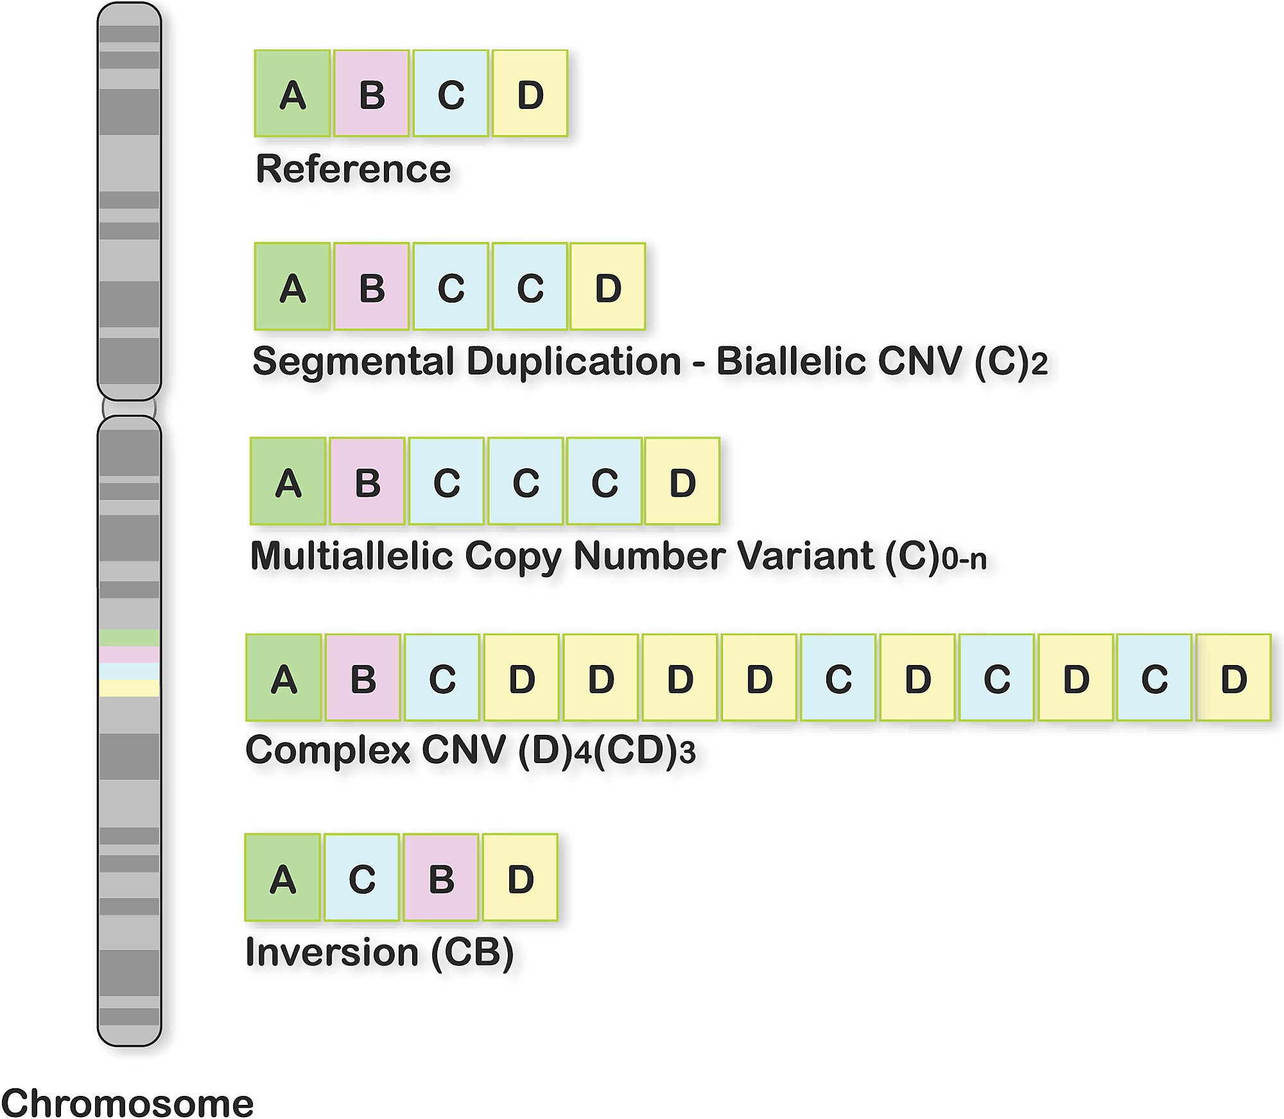
Types of Genomic Structural Changes Affecting Segments of DNA, Leading to Deletions, Duplications, Inversions, and CNV Changes (Biallelic, Multiallelic, and Complex)

Slide 7
Methods of genetic testing
large DNA defects
small DNA defects

Slide 8
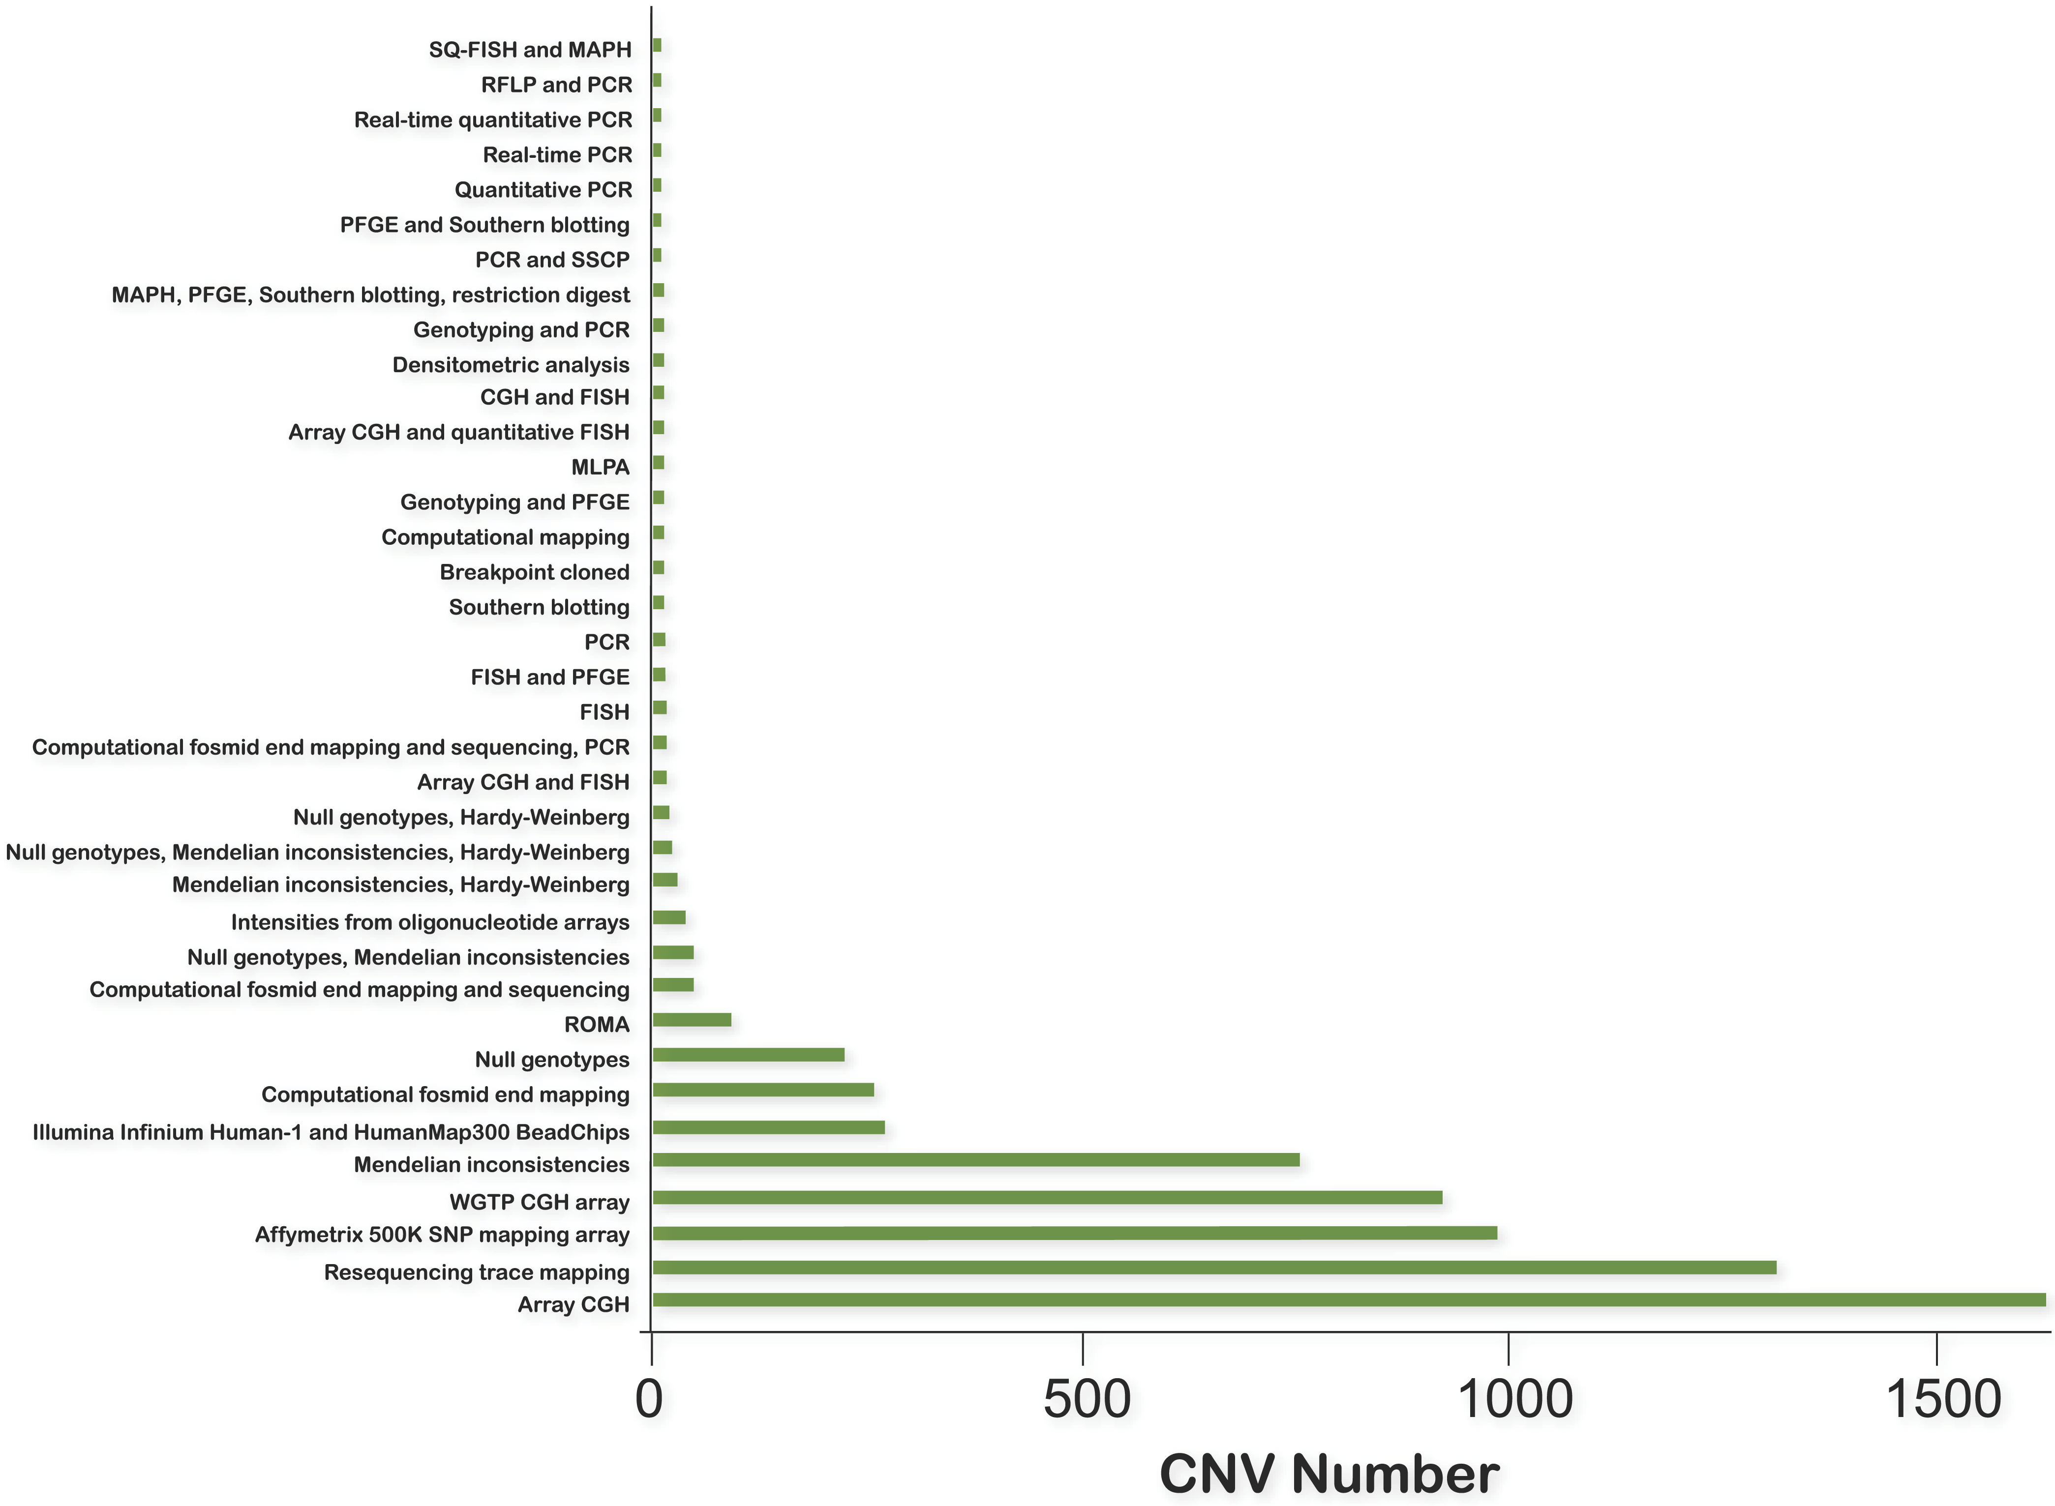
Myriad methods have been employed to identify structural variants in the human genome.
Estivill X, Armengol L (2007) Copy Number Variants and Common Disorders: Filling the Gaps and Exploring Complexity in Genome-Wide Association Studies. PLoS Genet 3(10): e190.

Slide 9
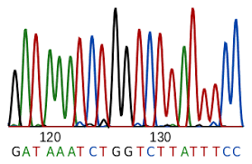
Genetic testing techniques
We use Sanger analysis when the phenotype is highly specific for a particular genetic disease and to verify results from other tests
Sanger sequencing is expensive and time consuming.
  Large genes (COL4A5, PKD1)
  Many Genes - Genetic heterogeneity (FSGS, nephrocalcinosis)
In these instances massively parallel sequencing (MPS) is the preferred option: a) Targeted gene panels (NGS panel), b) whole exome sequencing (WES), and c) whole genome sequencing (WGS).

Slide 10
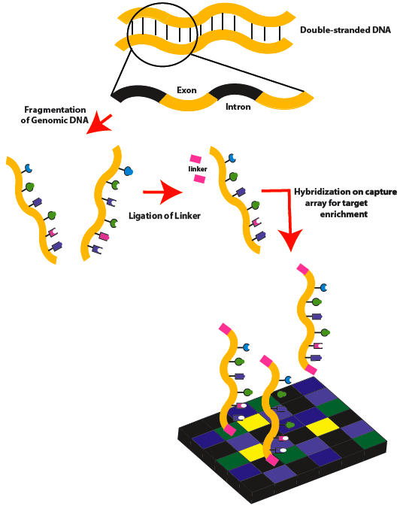
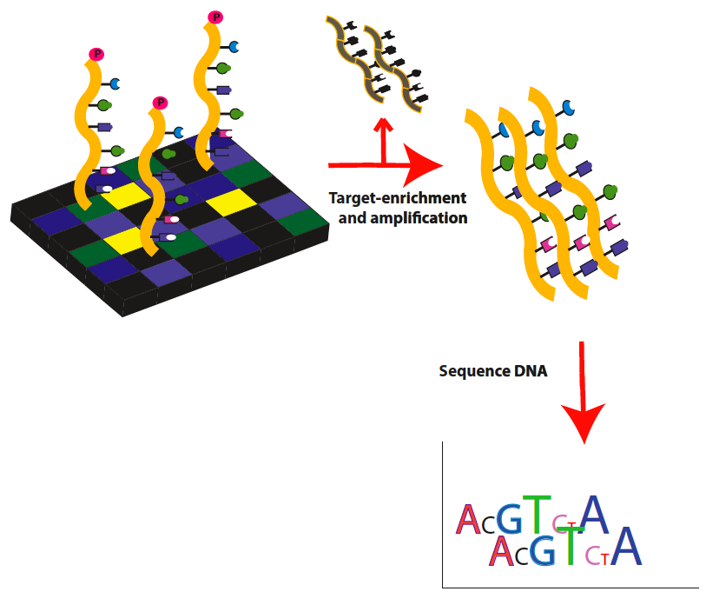
WHOLE ΕΧΟΜΕ & WHOLE GENOME SEQUENCING
(WES, WGS)
WES: Genomic technique for sequencing all protein-coding regions of genes (all exons = exome) constituting 1-2% of the genome.
WES can detect 75% of the pathogenic mutations in the genome
WGS analyzes whole genome (exons, introns, intergenic areas) and can detect the rest 25% of pathogenic mutations

Slide 11
WHOLE ΕΧΟΜΕ SEQUENCING (WES)
The diagnostic yield of WES outperforms targeted gene panels in both adults and children
WES allows for the discovery of new mutations, multiple mutations, incidental mutations in actionable genes, new phenotype-genotype correlations and for future re-analysis
CNV detection is also possible but not always optimal.
Difficult to analyze genes relevant to nephrology: a duplicated region of PKD1 and the tandem repeats of MUC1 (blind spots)

Slide 12
WHOLE GENOME SEQUENCING (WGS)
WGS can characterize noncoding regions, enabling detection of splicing or regulatory variants.
However, currently, there is limited benefit due to our incomplete understanding of the function of most of the noncoding regions
It is more efficient than WES for rich GC content areas, and for CNV detection, (duplicated region of PKD1 or the MUC1 tandem repeats)

Slide 13
Genetic testing in Nephrology
Method | Detects | Example | Diagnostic Yield
CMA (chromosomal micro arrays) | CNVs & large DNA rearrangements (100kb) | CAKUT | 10-17% cJASN 2020
NGS PANELS | SNV, small Indels in selected genes (<250 bp) | FSGS, ALPORT, OXALURIA | Up to 80% selected populations
WES | SNV Indels in coding DNA | CKD unknown etiology NPHP-Ciliopathies (>90genes) | Up to 70% για ΝPHP
WGS | SNV Indels in coding and non coding DNA | CKD unknown etiology, aHUS (DGKE), Alport, Gitelman, PKD1 | Detects 20-40% of mutations that are lost by CMA & WES
MLPA (multiplex ligation dependent probe amplification) | large deletion-duplications (<50kb) | PKD1, αGLA , HNF1b
Long-range PCR | GC-rich repeats | ADTKD-MUC1
Groopman, Nat Rev Nephrol. 2018

Slide 14
Diagnostic yield from several cohorts
tubulopathies
cystic
SRNS
CKD
CAKUT

Slide 15
The diagnostic yield depends on the presence of family history, age of presentation, and underlying pathology

Slide 16
Inverse correlation between frequency of a variant with the severity of phenotype (careful interpretation of the genetic results)
UMOD
The most rare variants: ADTKD
The most common variant: CKD
“polygenic risk scores”
medullary cystic kidney disease-2 (MCKD2), autosomal dominant tubulointerstitial kidney disease (ADTKD) familial juvenile hyperuricemic nephropathy (FJHN)

Slide 17
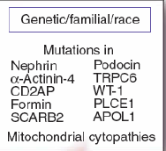
Hereditary podocytopathies
(first studied, early age)
80 genes so far

Slide 18
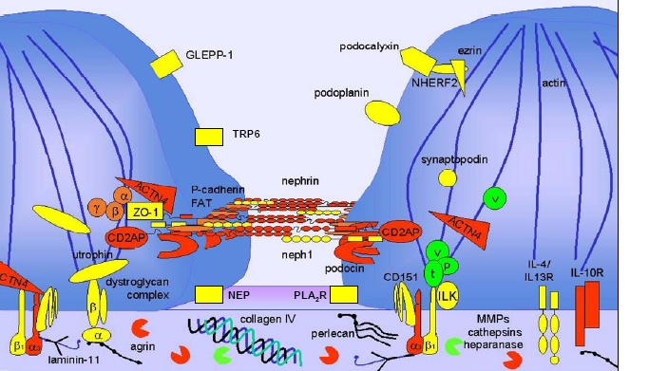
Podocyte proteins

Slide 19
FSGS

Slide 20
FSGS

Slide 21
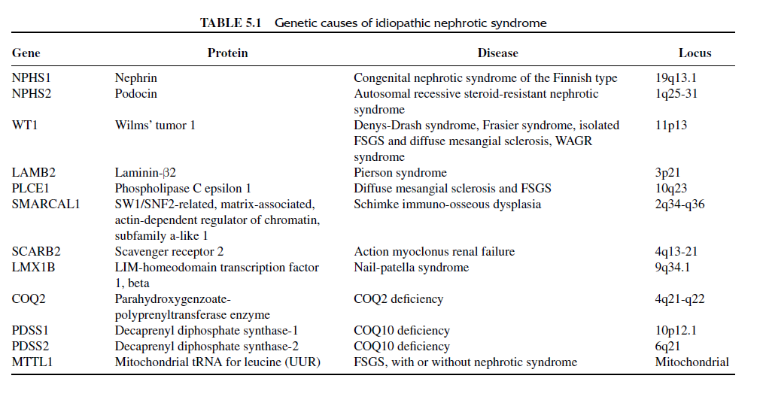
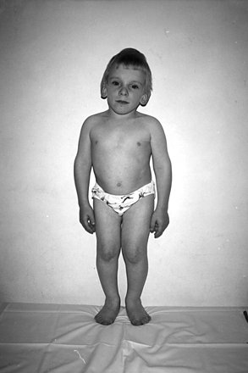
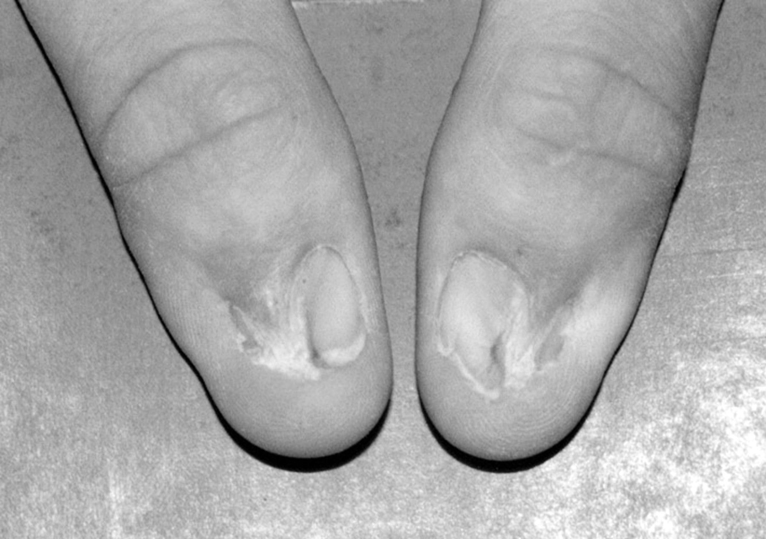
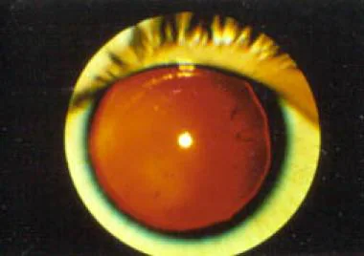
Schimke dysplasia
WAGR
Neil Patella

Slide 22
Identification of the cause of FSGS may have a significant impact on treatment.
The majority of monogenic forms of FSGS do not respond to corticosteroids and have a very low risk of recurrence after transplantation.
Identifying the underlying genetic cause may avoid unnecessary exposure to toxic steroid and other immunosuppressive regimens.
Conversely, the absence of genetic mutations in structural components of the filtration barrier, would indicate an acquired, immunologic cause of the condition and would support the use of immunosuppression

Slide 23
Identification of the cause of FSGS may have a significant impact on treatment
Genetic testing can identify cases that may respond to therapy with glucocorticoids (PLCE1) or cases that may benefit from other therapies:
  coenzyme Q10 supplementation when there is a coenzyme Q10 biosynthesis-associated mutations (ADCK4, COQ2, COQ6, PDSS2)
  vitamin B12 in the context of a cubilin mutation.

Slide 24
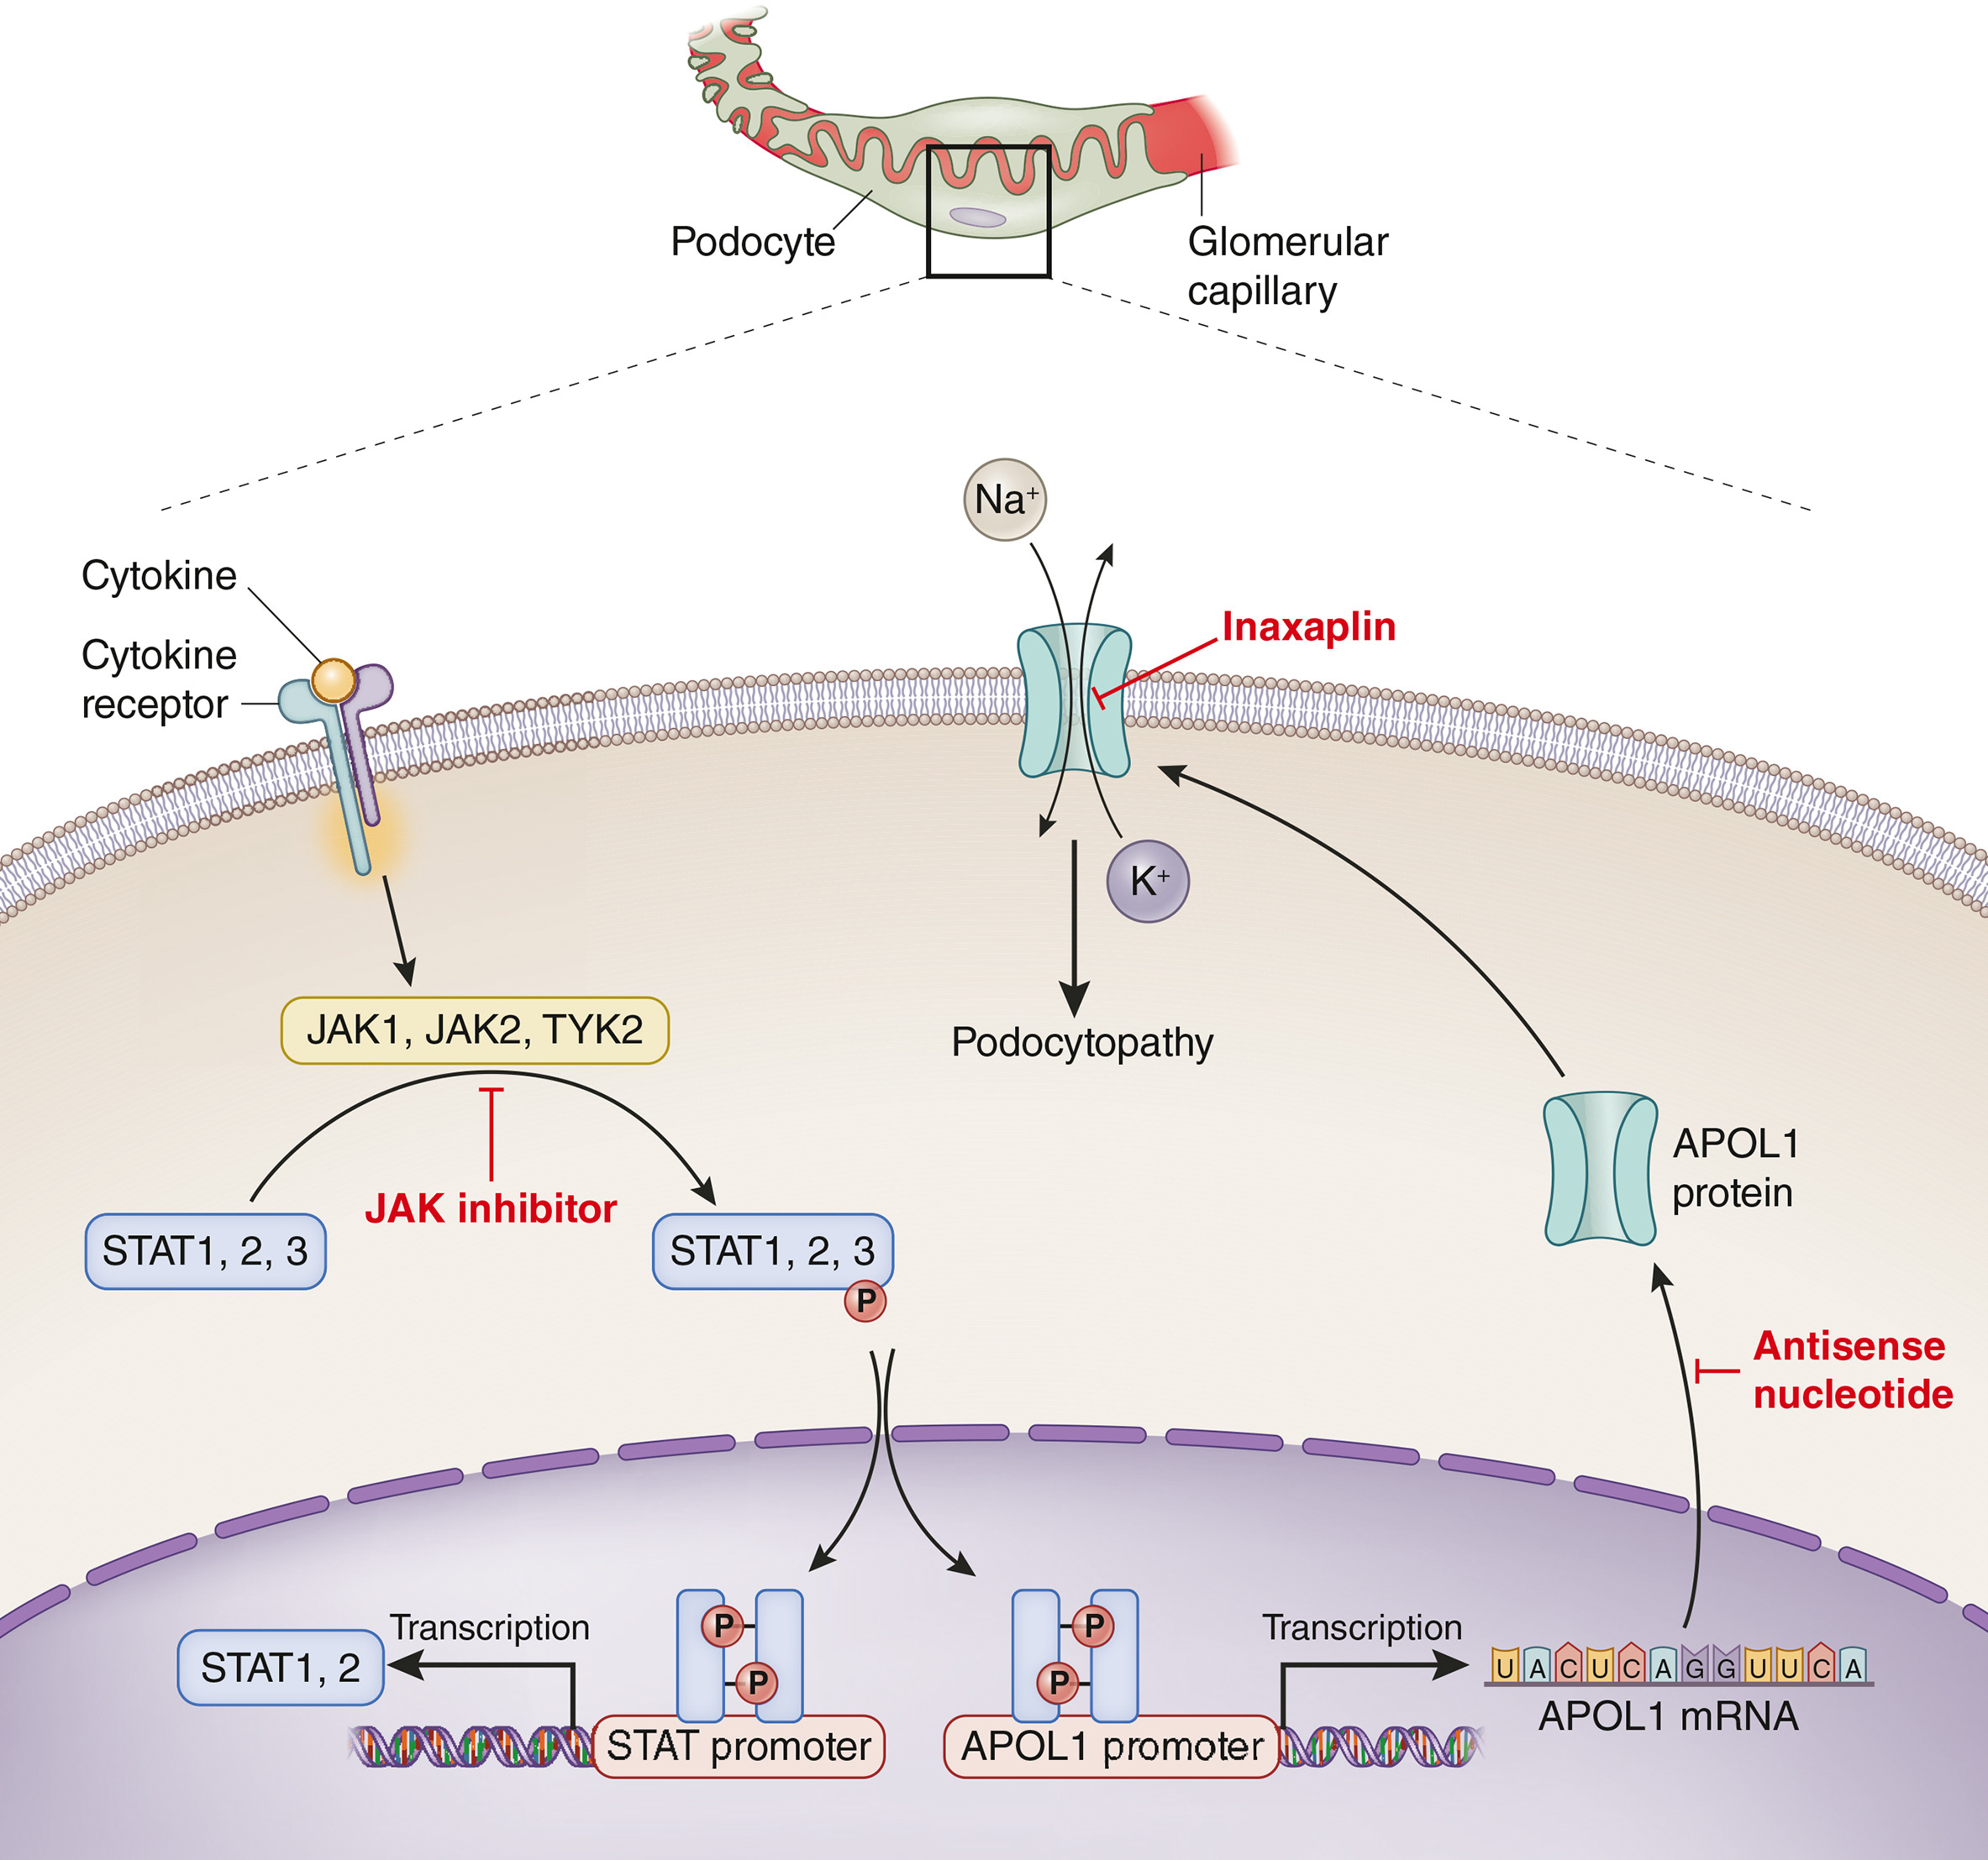
Figure 1
Kidney International 2023 DOI: (10.1016/j.kint.2023.04.022)
Genetics, pave the way for the discovery of new treatments.
Kidney disease–associated APOL1 variants (G1 and G2) proteins form cation pores at the plasma membrane (PM) that transport Na+ and K+ down their concentration gradients across the PM, thereby causing podocyte injury. Inaxaplin specifically blocks the aberrant cation channel function of G1 and G2 and thereby prevents podocyte injury. Egbuna et al.⁸ reported that Inaxaplin reduced proteinuria in APOL1-associated FSGS. Inhibition of APOL1 production either by blocking JAK-STAT signaling or by APOL1 antisense oligonucleotide is an alternative therapeutic strategy that is under investigation
Kidney International 2023 104228-230DOI: (10.1016/j.kint.2023.04.022)
Notes:
Kidney disease–associated APOL1 variants (G1 and G2) proteins form cation pores at the plasma membrane (PM) that transport Na+ and K+ down their concentration gradients across the PM, thereby causing podocyte injury. Inaxaplin specifically blocks the aberrant cation channel function of G1 and G2 and thereby prevents podocyte injury. Egbuna et al.⁸ reported that Inaxaplin reduced proteinuria in APOL1-associated FSGS. Inhibition of APOL1 production either by blocking JAK-STAT signaling or by APOL1 antisense oligonucleotide is an alternative therapeutic strategy that is under investigation.

Slide 25
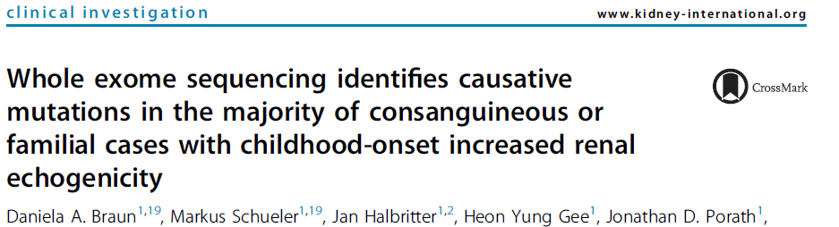
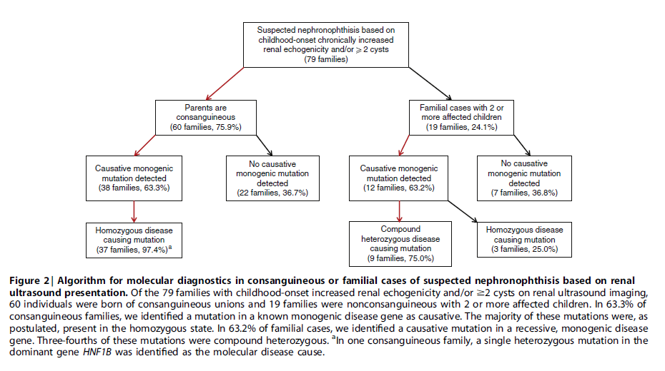

Slide 26
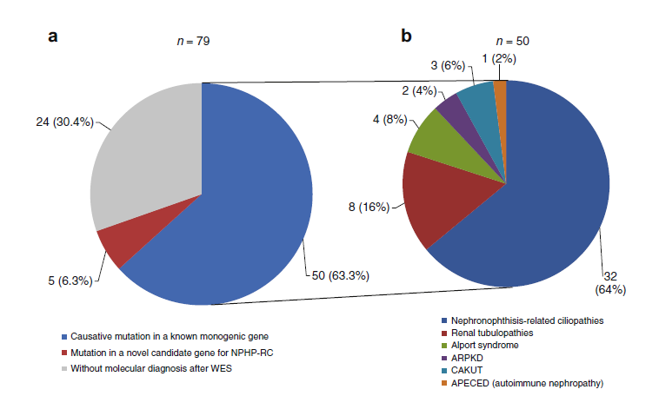
79 families with childhood-onset chronically increased echogenicity or ≥2 cysts on renal ultrasound.

Slide 27
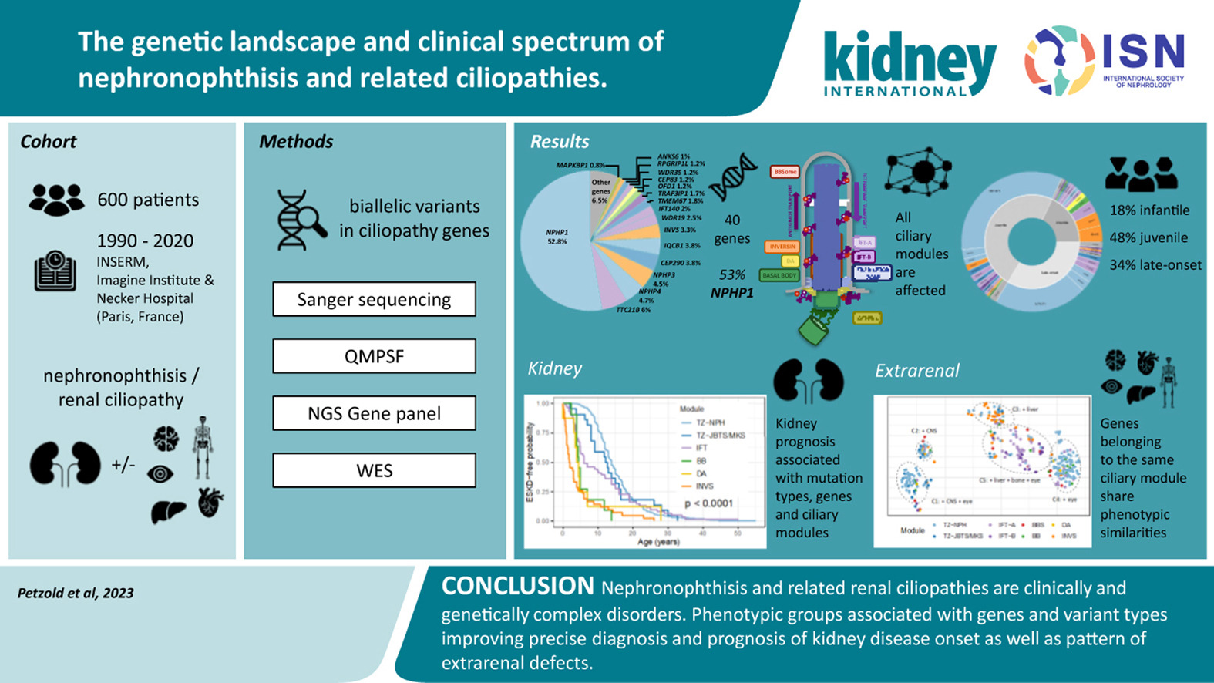
Identifying the specific mutation can help determine the prognosis regarding age of onset, kidney prognosis and dysfunction of other organs

Slide 28
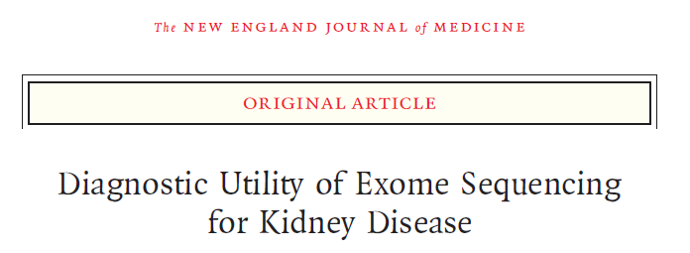
WES in 2 large cohorts combined:
Assessment of Survival and Cardiovascular Events (AURORA), a clinical trial involving 2773 patients with ESRD who were 50-80 years of age. 280 medical centers, in 25 nations (Greece included)
2187 patients from the Columbia University Medical Center (CUMC) Genetic Studies CKD project, a genetic research and biobanking study recruiting patients who are seen by the CUMC Nephrology Division for the evaluation and management of nephropathy
Emily E. Groopman. N Engl J Med 2019; 380:142-151DOI: 10.1056/NEJMoa1806891

Slide 29
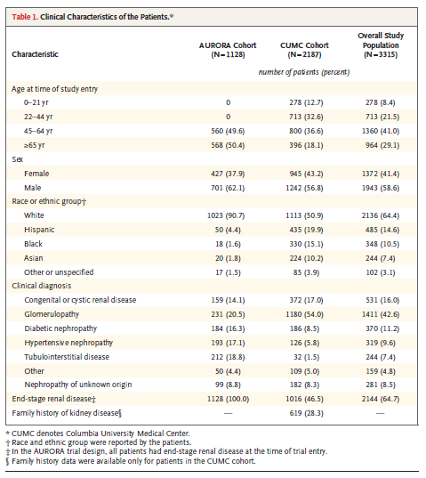

Slide 30
Results
625 nephropathy-associated genes examined
59 genes are recommended by the ACMG for reporting as medically actionable
diagnostic variants were detected in 307 of the 3315 patients (9.3%), encompassing 66 distinct monogenic disorders
  206 (67%) had an autosomal dominant disease,
  42 (14%) an autosomal recessive disease, and
  54 (18%) an X-linked disease
This yield is similar to that observed for cancer, for which genomic diagnostics are routinely used.

Slide 31
Results
202 variants (59%) had been previously reported as pathogenic
141 variants (41%) new.
The majority of diagnostic variants (228 of 343 [66%]) were absent from population control databases (new or extremely rare?)

Slide 32
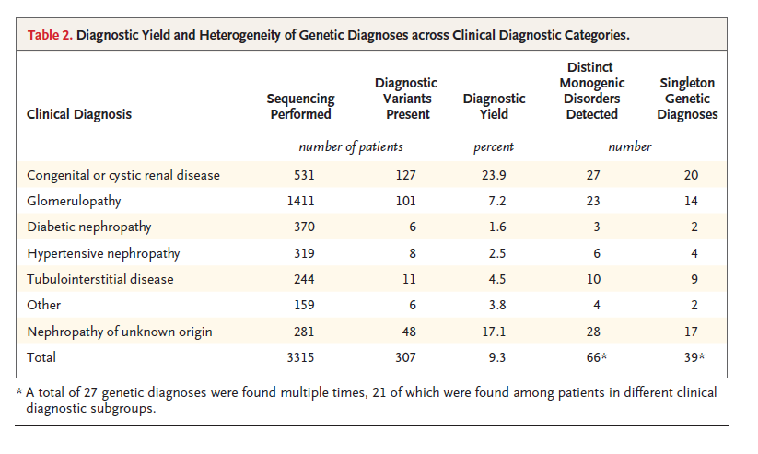
Results
652 renal genes, 39 diagnoses =6% have a clinical presence,
94% of known renal genes were not detected (extremely rare)

Slide 33
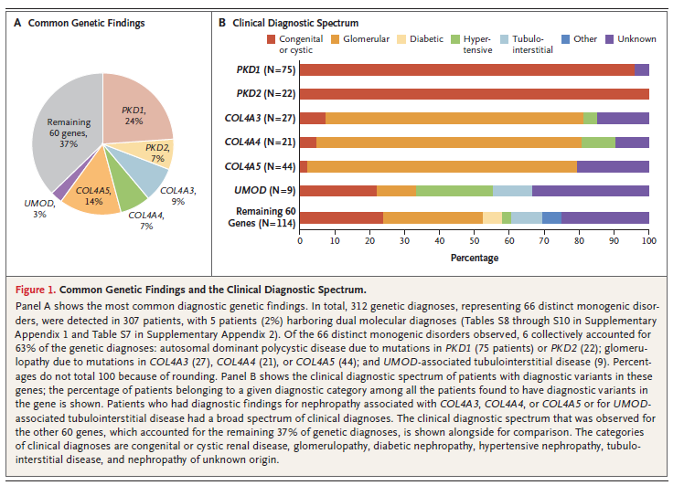
Variable clinical diagnostic spectrum before genetic testing

Slide 34
Results on Alport: in 62% we had no idea of the correct diagnosis
Only 35 of the 91 patients (38%) with diagnostic variants in COL4A3, A4, A5 had a correct clinical diagnosis (Alport syndrome or ΤBMD)
The remaining 56 patients (62%) had other clinical diagnoses
  FSGS (16%),
  unspecified glomerulopathy (22%)
  congenital renal disease (4%),
  hypertensive nephropathy (3%),
  nephropathy of unknown origin (15%)

Slide 35
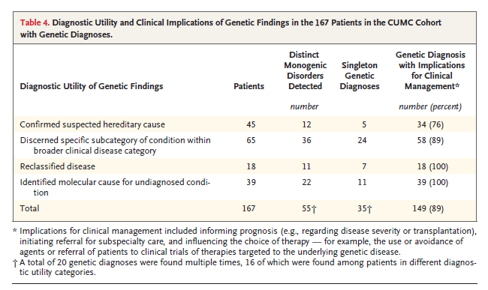
In the majority of these patients (89%), the genetic diagnosis gave a new clinical insight

Slide 36
Diagnostic implications
For 88 of the 167 patients (53%), the genetic diagnosis could initiate referral and evaluation for previously unrecognized extrarenal features of the associated diseases, spanning 15 different medical specialties (ENT, eye, etc)

Slide 37
Diagnostic implications
In a significant proportion of Pts (34%), the genetic findings reclassified their disease or provided a cause for undiagnosed nephropathy, emphasizing the usefulness of the “agnostic” approach of exome sequencing
This approach assesses genes that otherwise may have gone unevaluated with the use of single-gene or phenotype-driven panel testing.
Applying a phenotype-specific Gene panel in this study would have resolved, at most, 136 cases (44.3%) in the overall population.

Slide 38
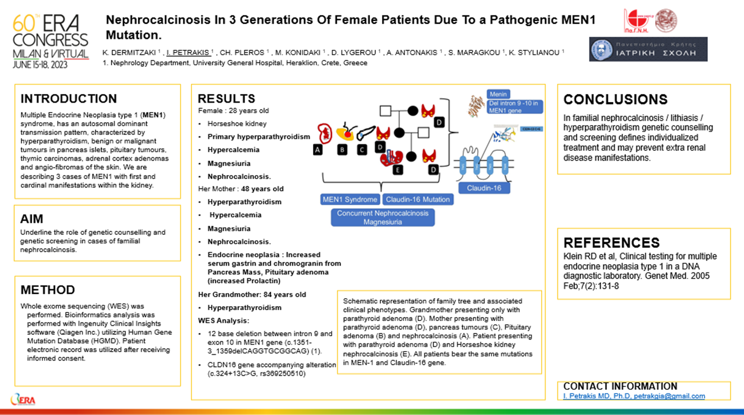
Genetic diagnosis can help the physician to diagnose extrarenal pathologies

Slide 39
Therapeutic implications (CKD cohort)
For 84 patients (50%), the genetic diagnosis could inform therapy:
  by disfavoring immunosuppression among patients who were found to have monogenic forms of FSGS,
  By initiating multidisciplinary care (e.g BRCA2),
  By leading to the initiation of tailored therapies (e.g Dent disease),
  By prompting referral to clinical trials that were targeted to the genetic disorder identified.

Slide 40
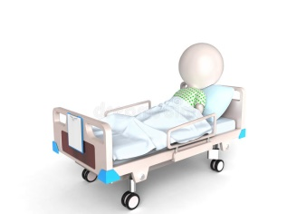
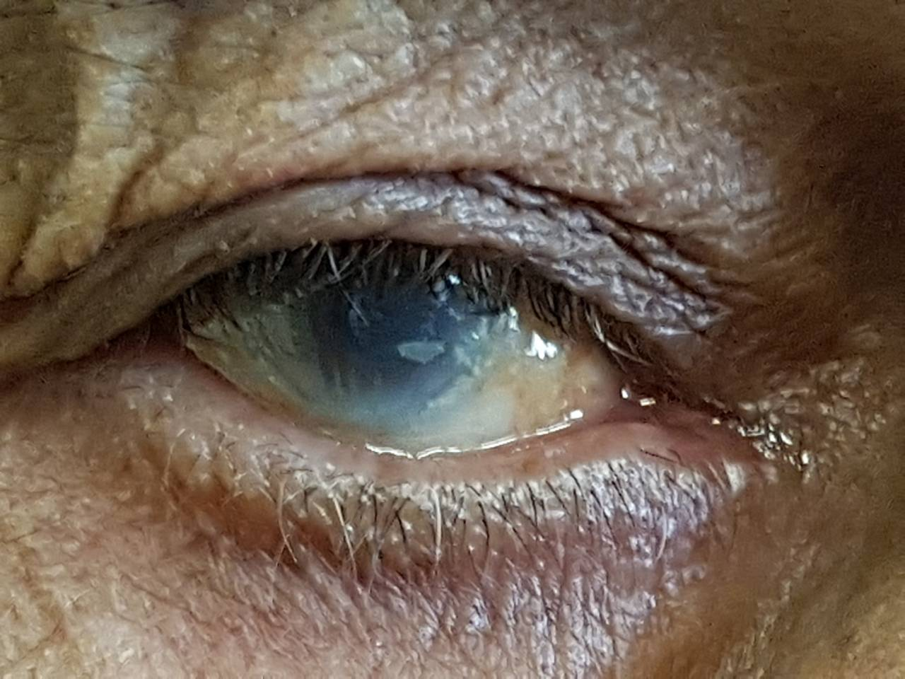
It always starts with a patient…
63 yo Male in Hematology ward
Splenomegaly
Anemia
Thrombocytopenia
Low HDL, CKD4, Corneal opacities
Familial LCAT deficiency
Chronic anemia- unknown cause
Proteinuria- 40yo
DMT2- 46yo
CKD3- 56yo
Notes:
Low HDL, CKD4

Slide 41
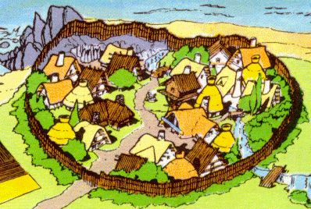
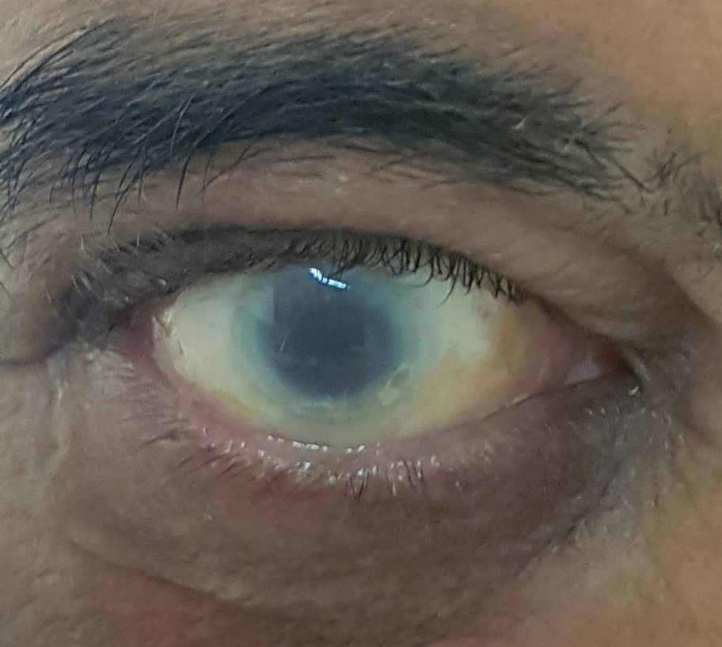

And then came a second one…
43 yo Male
Proteinuria
New onset DMT2
Recurrent macroscopic hematuria after RTIs since childhood
Corneal opacities
Very low HDL
eGFR 71ml/min/1,73m2
Notes:
Same village 1st cousins, we got our two first index patients

Slide 42
And ends up with hundreds of pts

Slide 43
Renal diseases: 71% (10/14) diagnostic rate with WES
Our early experience with WES
Pt. | Age (years) | Sex (M/F) | Phenotype | Gene | Disease
1ΧαΜα | 28 | F | Hematuria, proteinuria and hypertension | COL4A5 | Alport Syndrome
2ΒαΚα | 45 | Μ | Hypokalaemia, hypercalcaemia, and nephrocalcinosis | OCRL | Dent disease 2
3Καπ | 35 | M | Nephrotic syndrome, renal failure | MAGI2 | Nephrotic syndrome 15
4Ζακ | 40 | F | Hypokalemic alkalosis, hypocalciuria | SLC12A3 | Gitelman syndrome
5Ζοι | 22 | F | Focal segmental glomerulosclerosis | PLCE1 | Nephrotic syndrome 3
6 | 48 | M | Hypertrophic Cardiomyopathy & Keratosis palmoplantaris | MYH7 DSG1 | Cardiomyopathy, hyper- Keratosis palmoplantaris striata I
7Ιωα | 33 | F | retinitis pigmentosa proteinuria | ADCK4 | Nephrotic syndrome 9
8 | 50 | F | Cystic kidney disease, proteinuria ESRD | COL4A5 | Alport Syndrome
9Νιω | 30 | M | C3GN | CFH | C3 glomerulopathy
10Τσι | 32 | F | Severe Hypomagnesemia, Headaches | Cyclin M2 CNNM2 | Renal Hypomagnesemia 6

Slide 44


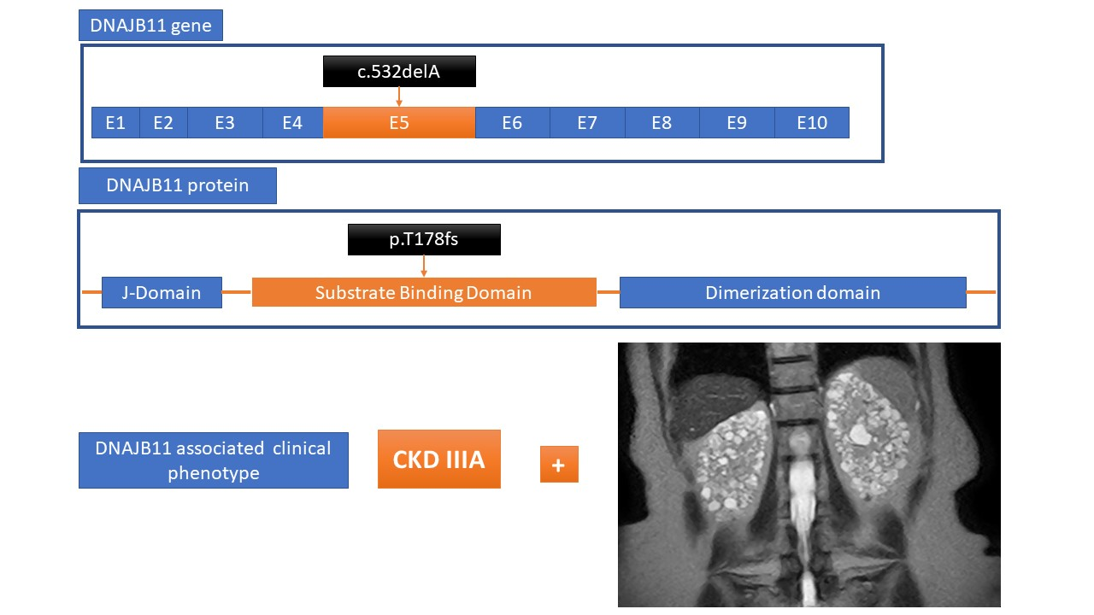

The first case DNAJB11 associated nephropathy in Greece (Autosomal Dominant Polycystic Kidney Disease-6/ ADPKD-6). WCN23-0585
K. Dermitzaki, I.Petrakis, E. Drosataki, M. Papapanagiotou, C. Pleros, D. Lygerou, I. Stavrakaki, M. Konidaki, M. Mitrakos, N. Papadakis, S. Maragou, A. Androvitsanea, N. Kroustalakis, K. Stylianou.
Department of Nephrology, Heraklion University Hospital, Medical School, University of Crete, Greece
Introduction: Many patients with a family history of chronic kidney disease (CKD) present multiple cystic kidney lesions without suffering from classical adult polycystic kidney disease (ADPKD). DNAJB11 associated nephropathy was first described in 2018 in 7 kindreds with monoallelic mutations in DNAJB11 gene (1). DNJAB11 shortage disrupts PKD1 maturation and transport in cellular membrane and causes an aberrant hold of uromodulin and MUC1 in the thick ascending limb of loop of Henle. These changes result in mixed polycystic and tubulointerstitial kidney disease phenotype with a late onset (60-90 years). DNAJB11 mutations are associated with the clinical phenotype in patients with ADPKD-6 (OMIM: 618061). The disease is transmitted with an autosomal dominant mode, renal cysts are usually small (0, 3-3 cm) and the kidneys are not enlarged. Some patients present with interstitial fibrosis and about half of them present liver cysts.
Methods: Whole exome sequencing (WES) was performed within 3 generations of a kindred with microcystic kidney disease and CKD progression in advanced age (over 50 years). Bioinformatics analysis was performed with Ingenuity Clinical Insights software (Qiagen Inc.) utilizing Human Gene Mutation Database (HGMD).
Conclusions: We are describing the first patient with ADPKD6 in Greece. The monoallelic mutation p.T178fd*10 in DNAJB11 causes polycystic kidney disease type 6 with late onset CKD and a full penetrance in each generation (2). Ongoing genetic analysis will show the exact prevalence in the island of Crete and will allow a better description of the clinical phenotype.
Results: Index patient is a 59-year-old Caucasian female with CKD stage IIIa, bearing multiple cortical cysts in both kidneys (maximum diameter 2 cm), without kidney size enlargement and a positive family history for CKD: Her father and her grandfather developed CKD-III and IV respectively in advanced age. Clinically, the patient showed a large amount of angiokeratomas in her periumbilical region. Routine blood biochemistry other than renal function was normal. After obtaining informed consent we performed WES which showed a c.532delA (p.T178fs*10) in DNAJB11 gene (Figure 1). Fabry disease was excluded.
Figure 1: Abundant renal cysts of variable dimensions within the renal parenchyma in our index patient (MRI) baring the mutation c.532delA (black box) resulting in an altered protein product (p.T178fs).

Slide 45
ADTKD
Renal biopsy will not provide a precise diagnosis in ADTKD,
Autosomal dominant pattern means that multiple family members may be affected, and the variable age of onset and bland radiological and urinary sediment findings mean it may be difficult to distinguish the affected from the unaffected through clinical screening alone. Thus, genetic testing is imperative.
Urinary staining may become a useful non-invasive test for ADTKD-MUC1 (MUC1-fs).
A small molecule P24 trafficking protein 9, has been shown to promote lysosomal degradation of the toxic MUC1-fs from cells and reverse proteinopathy.
The same therapy may have potential treatment implications for ADTKD-UMOD and other proteinopathies.

Slide 46
ADTKD example. WES or MLPA ?
Male 24 yo, progressive decline of eGFR
Left kidney agenesis, pancreatic body and tail agenesis
NID-DM since age 22, currently on GLP1 agonist
Normal liver function,
Magnesiuria, Hypomagnesemia, Hyperparathyroidism
Hypospadias repair surgery some years ago.
Brother with similar phenotype plus liver dysfunction
Grandmother and mother with DM

Slide 47
WES or MLPA ?
WES
  SLC12A3 c.791C>G HOMO, common variant
  COL4A3 C1721C>T (p.Pro574Leu) HOMO, benign
  HNF1A c.1460 G>A ,HOMO, DOM, CADD 18, benign
  HNF1A c.79A>C, HOMO DOM, CADD=22, benign
  PKD2 c.-82 G>C, benign
  PHEX c1482+31_1482+32delTT GnomAD=0%, VUS
MLPA:
  HETEROZYGOUS, DELETION of HNF1B gene, AUTOSOMAL DOMINANT DISEASE (MODY5)

Slide 48
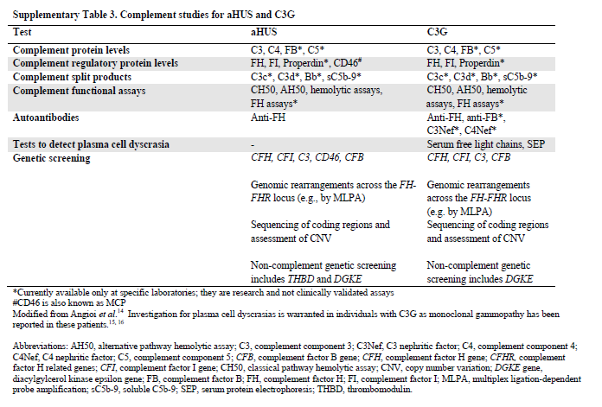
Study of complement proteins in aHUS & C3G (KDIGO)
Goodship: aHUS and C3 glomerulopathy: a KDIGO conference report Kidney International (2017) 91, 539–551

Slide 49
Diagnostic yield of genetic testing in aHUS
https://doi.org/10.1038/s41581-021-00424-4

Slide 50
Complement genetics in aHUS is a valuable tool
  To provide proof of a link between complement dysregulation and the disease,
  to assess disease severity
  to predict the risk of recurrence after kidney transplantation and enable prophylactic complement blockade
  To predict the risk of disease relapse after discontinuation of eculizumab treatment (60% vs 5%).

Slide 51
Conclusions: genetic testing can help
Set the correct diagnosis
Estimate the risk of nephropathy progression,
Identify other affected organs and to initiate multidisciplinary care
Guide family counseling
Allow donor selection for transplantation
Offer correct treatment, avoidance of unnecessary or dangerous treatments.
Discovery of new treatments

Slide 52
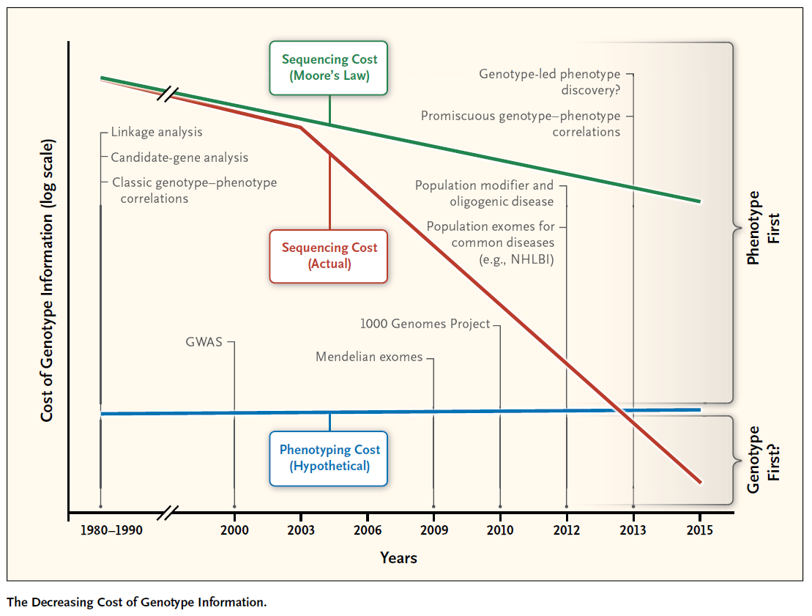
Lu et al, N Engl J Med, 2014

