Slide 1
Proteomic analysis in monitoring the kidney allograft function
Irena Rambabova Bushljetik
University Clinic of Nephrology
Un. Sts Cyril and Methodius
Skopje
N. Macedonia

Slide 6
The urgent need for new biomarker for early detection of graft dysfunction!

Slide 8
Urinary proteomes
Urinary proteome is a distinct entity from the conventional nosology of proteinuria
Urinary proteome constitutes the entire genomic protein content that is excreted in urine in health and disease states.
Proteomic urine analysis could predict the diagnosis of renal transplant pathologies early, which could impact the graft function and survival in the long run

Slide 9
The majority of urinary proteins are generated by the kidney, hence the urinary proteome holds substantial information on the kidney, and assessment of the urinary proteome could be considered a ‘liquid biopsy’

Slide 10
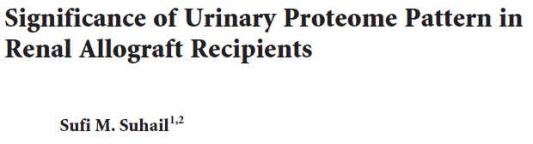
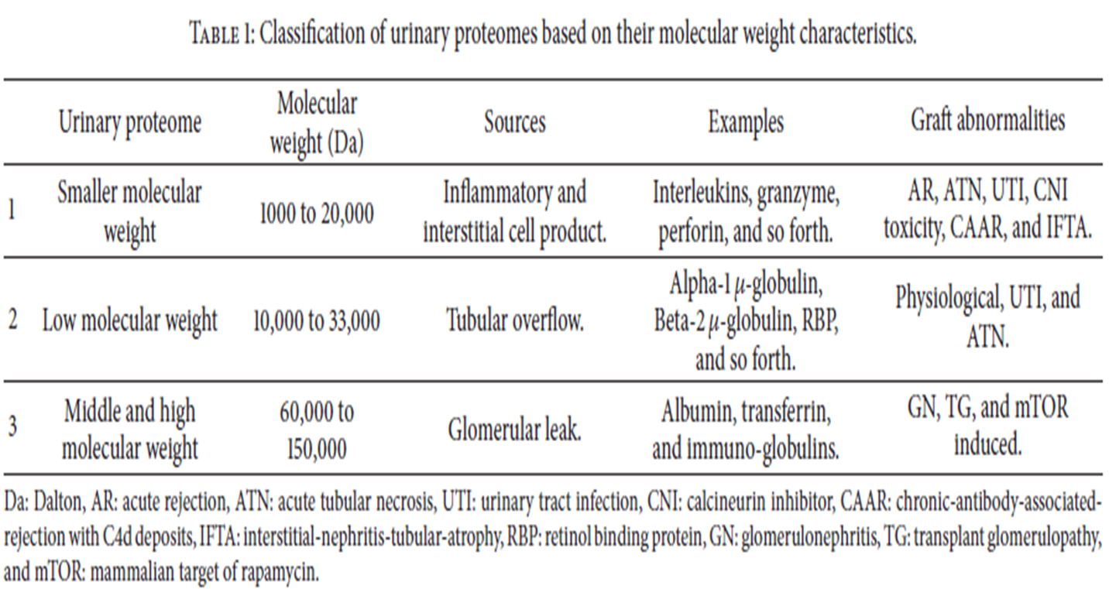


Slide 11
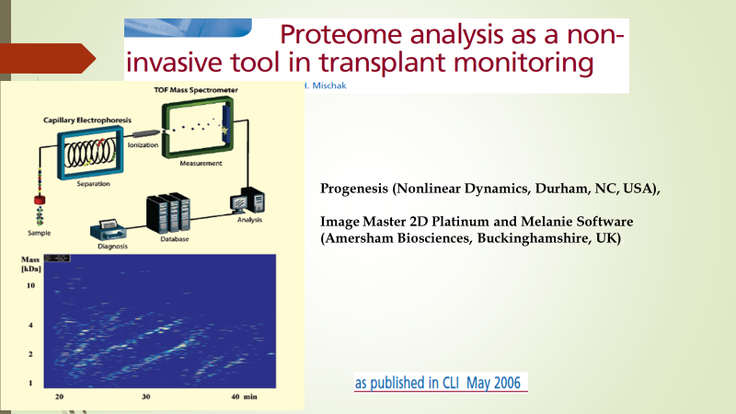

Slide 12
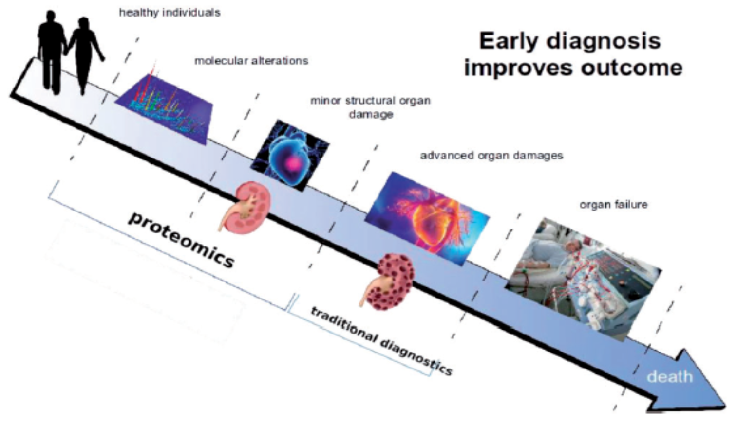
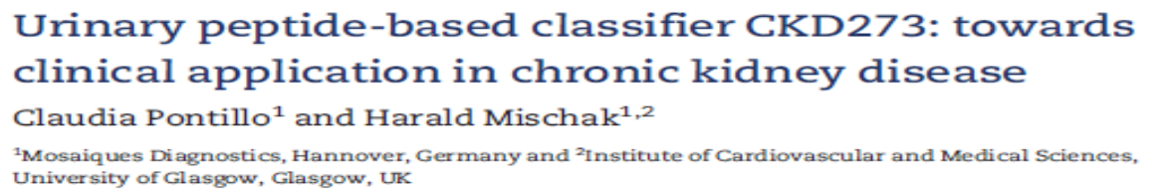

Slide 14

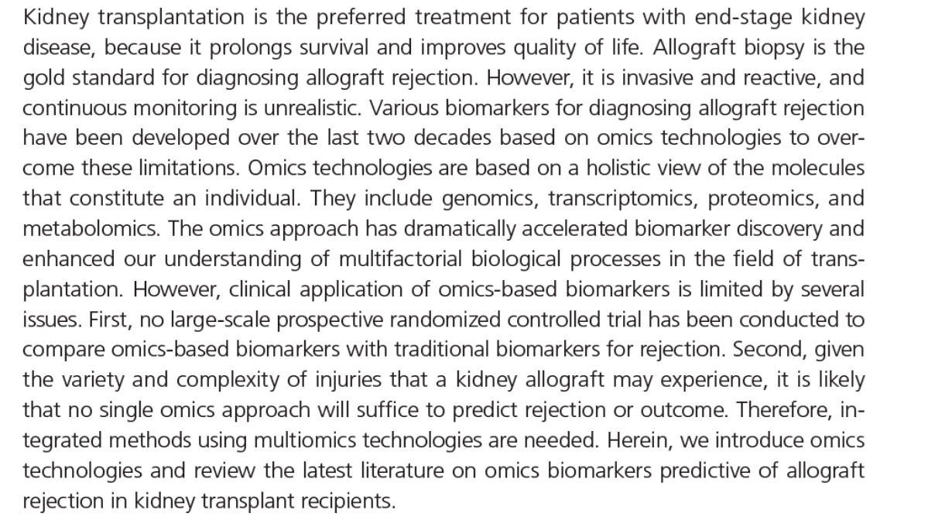

Slide 15
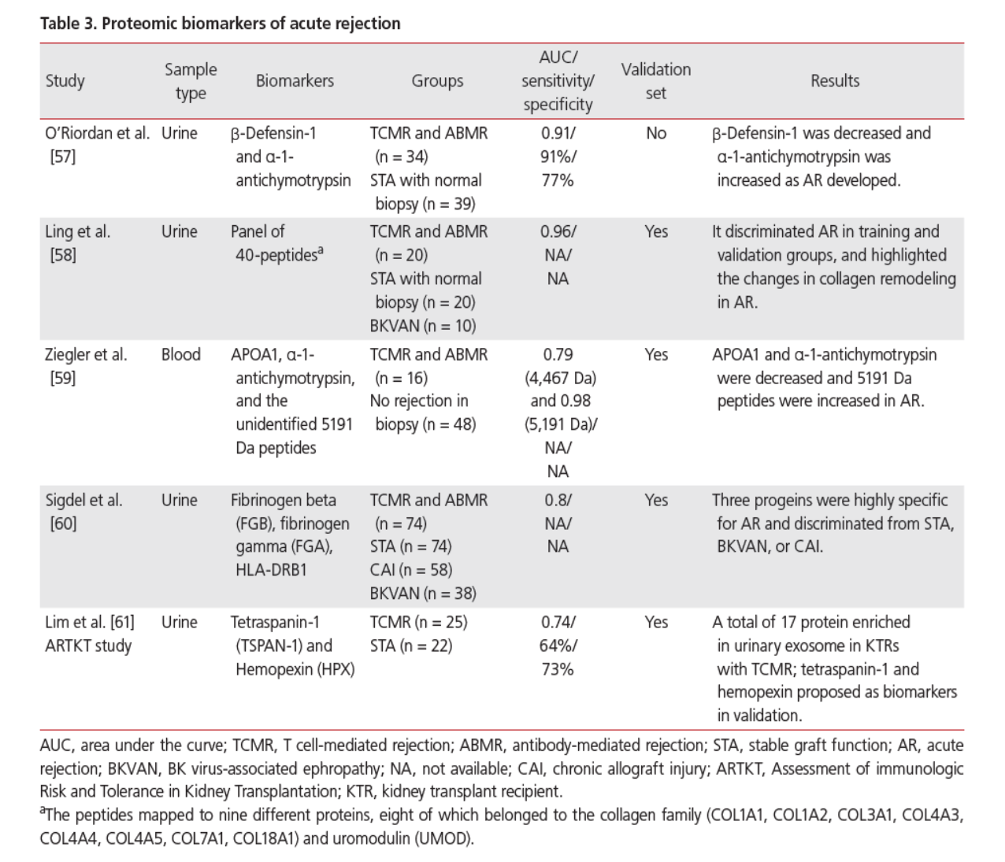

Slide 20
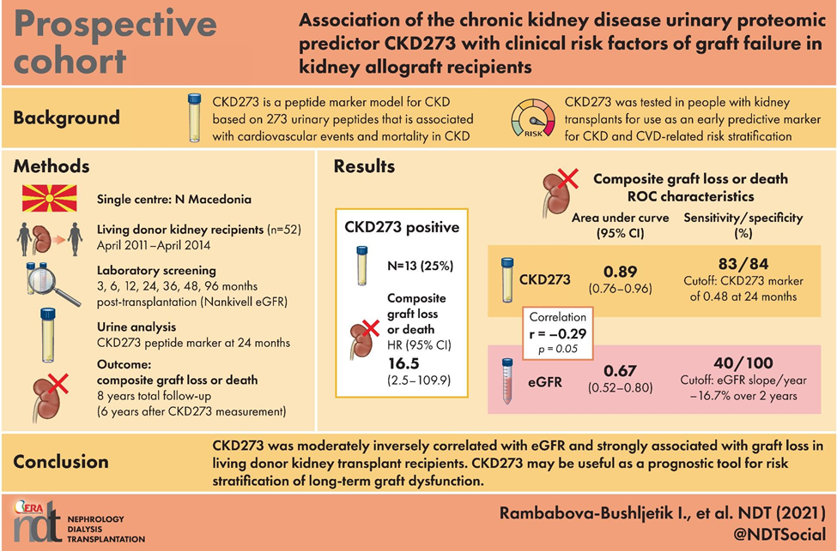

Slide 21
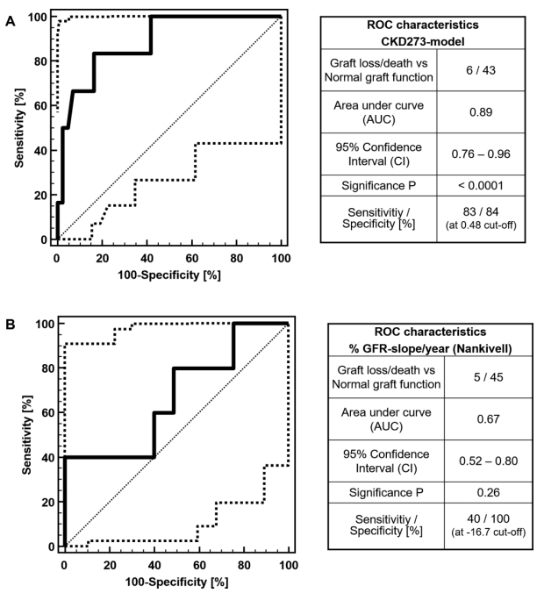
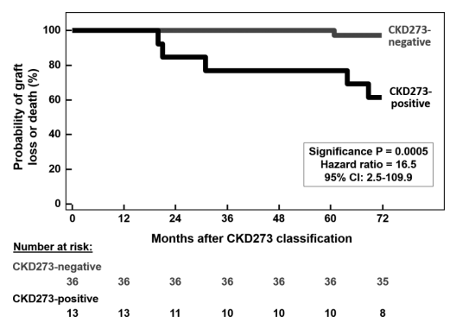
ROC analysis for the differentiation of patients with graft loss/death (5:1) from normals by (A) CKD273 at 24 months after KTx or (B) %eGFR slope/year.
Time to graft loss or death. Kaplan–Meier estimates for the composite endpoint graft loss and patient death in the CKD273 pattern positive (CKD273 classification value >0.48) and negative (CKD273 classification value <0.48).

Slide 22
CONCLUSION
Kidney transplantation is the best treatment option for ESKD but is still associated with a long-term graft failure
Identifying grafts with high failure risk before initial decline of eGFR with irreversible graft changes is a challenge for transplant professionals
Transplantation medicine is facing an emerging need for novel disease endpoint-specific biomarkers, with practical application in preventive screening, early diagnostic, and improved prognostic and therapeutic utility
Clinical application of urinary proteome analysis via the CKD classifier CKD273 is a valuable tool for risk stratification and prediction of long-term graft loss in KTRs
CKD273 may allow for close non-invasive monitoring of graft dysfunction even at the stage without clinical symptoms and may contribute to longer graft survival by timely initiation of preventive therapy or reduced waiting for a second transplant
The implementation into the clinical practice is missing

Slide 23
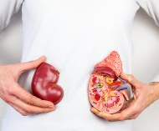
Thank YOU!!!

