Slide 1
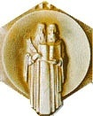
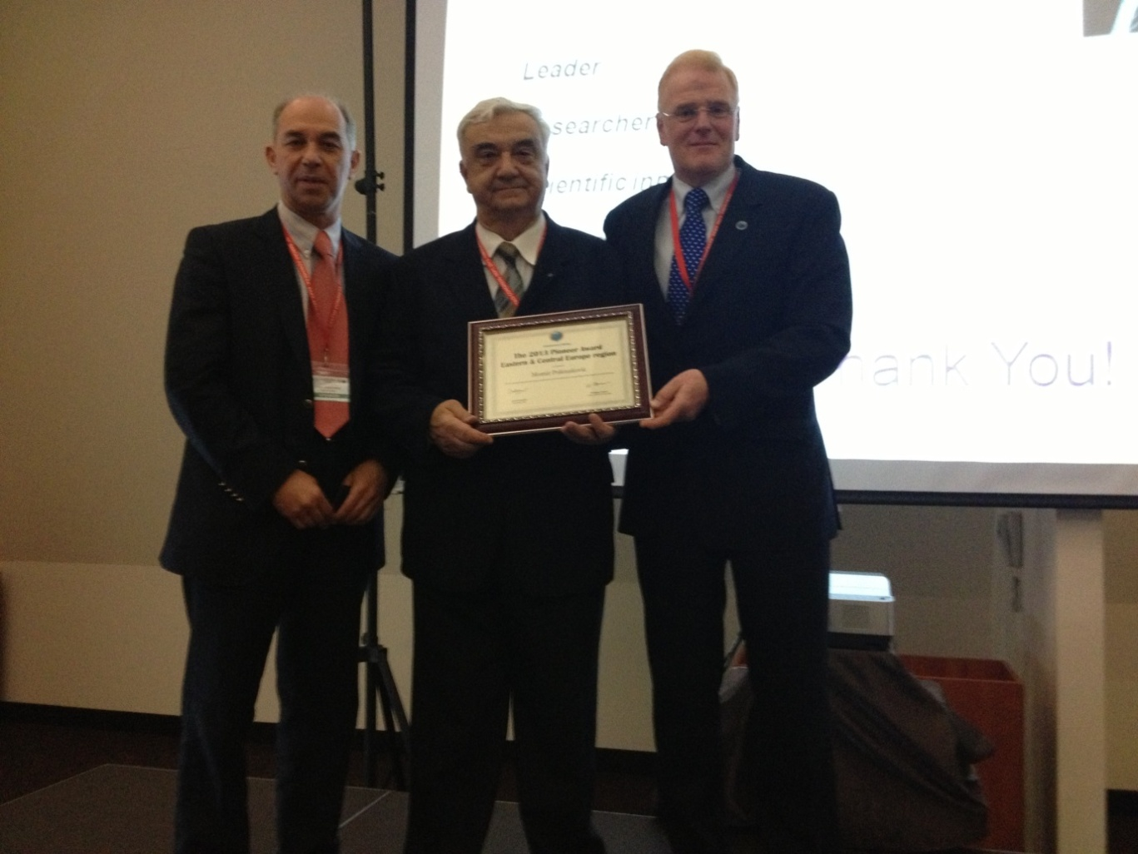
Acad. Momir Polenakovic
ISN Pioneering award
for his contribution to the development of nephrology in
Eastern and Central Europe,
BANTAO, September 26, 2013, Timisoara, Romania

Slide 2
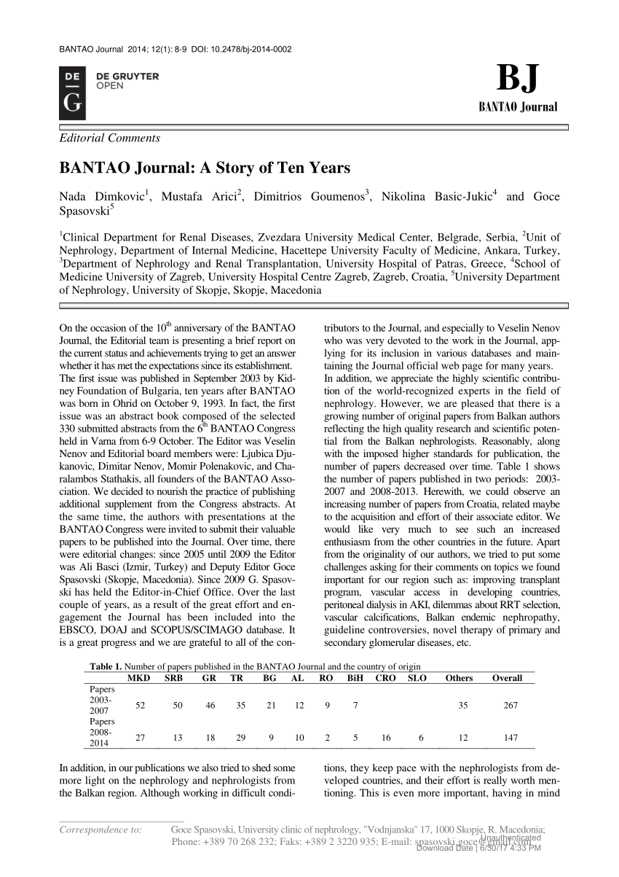
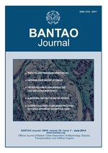
BANTAO journal grew up serving as the main connection between or a glue sticking together all members of the BANTAO Association. At present, it is, is incorporated into the public and internet-available databases of DOAJ, SCIMAGO, EBSCO, Google Scholar, De Gruyter Open and we currently consider application into the Medline (Pub Med) database

Slide 3
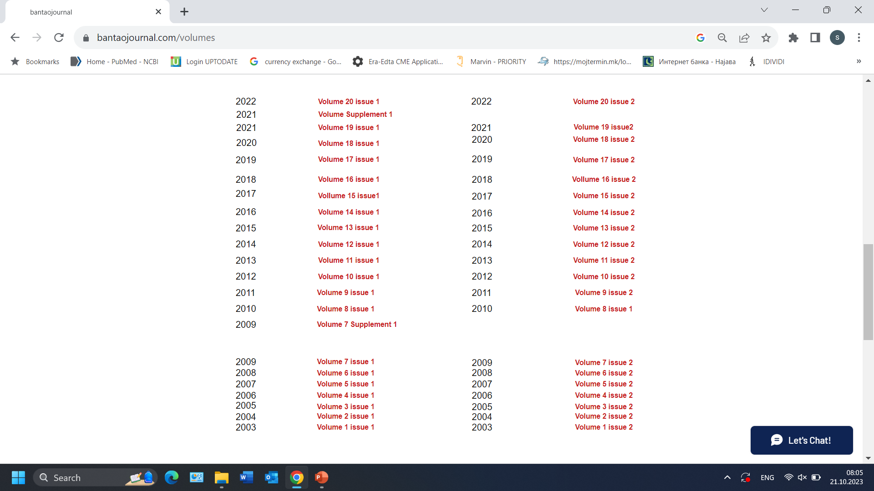

Slide 4
In summary
The BANTAO Society, BANTAO congresses and the BANTAO journal have succeeded in elevating nephrology knowledge and thus increased the standards of nephrology patient care throughout the Balkans. Standing above the divisive forces of politics, language and war, BANTAO gives a living example that collaboration and humility are feasible in times of maddening destruction, and are transformative.
Hence, we can achieve our goals only by joining together in our common beliefs and by collaborating and acting toward these objectives.
In this way, we can live in a ‘world without boundaries.
Thank you!

