Slide 1
Hypertensive disorders of pregnancy and CKD
Chrysostomos Dimitriadis, MD, PhD
Nephrologist,
1st Department of Nephrology,
Aristotles University of Thessaloniki
Hippokration General Hospital
Thessaloniki, Greece

Slide 2
OUTLINE
Definition of hypertensive disorders of pregnancy
Pre-eclampsia and kidney injury: villain or bystander ?
Risk factors and co-morbidities
CKD as a risk factor for hypertensive disorders of pregnancy
Pre-eclamptic syndromes as a risk factor for CKD

Slide 3

    > 20th week of gestation
    new onset Hypertension
Gestational Hypertension
Systolic BP ≥ 140 mmHg
and/or x2 (>4h)
Diastolic BP ≥ 90 mmHg
  ACOG Practice Bulletin No. 222 Obstet Gynecol. 2020;135(1):e237
Notes:
There have been recent advances in our understanding of the pathophysiology of preeclampsia, many reported this very decade, but as yet there is no specific cure, delivery of the placenta remaining the only definitive treatment. Thus, as of 2010 preeclampsia is still a leading cause of maternal mortality, preterm birth, and consequent neonatal morbidity and mortality. In developing countries, where access to safe, emergent delivery is less readily available, preeclampsia claims the lives of more than 60,000 mothers every year.
Early PE presentation <34 wks, preterm 37 wks, term PE at ≥37 wks of gestation

Slide 4
PRE-ECLAMPSIA
    > 20th week of gestation
    new onset Hypertension
    +
    Proteinuria
Gestational Hypertension
Systolic BP ≥ 140 mmHg
and/or x2 (>4h)
Diastolic BP ≥ 90 mmHg
≥ 0,3 g /24h
or x2 (>4h)
P/Cr ≥ 0,30 mg/mg
10% - 20% without proteinuria !
OR ??...
  ACOG Practice Bulletin No. 222 Obstet Gynecol. 2020;135(1):e237
  ACOG Practice Bulletin No. 222 Obstet Gynecol. 2020;135(1):e237
Notes:
There have been recent advances in our understanding of the pathophysiology of preeclampsia, many reported this very decade, but as yet there is no specific cure, delivery of the placenta remaining the only definitive treatment. Thus, as of 2010 preeclampsia is still a leading cause of maternal mortality, preterm birth, and consequent neonatal morbidity and mortality. In developing countries, where access to safe, emergent delivery is less readily available, preeclampsia claims the lives of more than 60,000 mothers every year.
Early PE presentation <34 wks, preterm 37 wks, term PE at ≥37 wks of gestation

Slide 5
Alternative definition/ ‘Atypical’ Pre-eclampsia
(no proteinuria / OR ??)
( ... > 20th week of gestation)
Newly diagnosed Hypertension
+
  Other maternal end-organ dysfunction
    Low platelets (<100.000)
    Impaired Liver function (transaminases > x2)
    Renal insufficiency (Cr >1,1 mg/dl)
    Pulmonary edema
    CNS (visual disturbances/severe headache)
Uteroplacental dysfunction
OR ??...
OR ??...
  ACOG Practice Bulletin No. 222 Obstet Gynecol. 2020;135(1):e237

Slide 6
Hypertensive disorders of pregnancy and CKD:
Villain or bystander ?

Slide 7
Pre eclamptic syndromes and kidney injury mechanisms
Specific Injury : the pathophysiology of pre eclampsia per se
or
Underlying disease ?:
    other, subclinical, chronic renal disease that flares and accelerates during pregnancy (eg glomerulonephritis) ?
    Common risk factors with other chronic diseases that are associated with renal injury ?
?
kidney injury

Slide 8
Pre eclamptic syndromes and kidney injury mechanisms
Specific Injury : the pathophysiology of pre eclampsia per se
?
kidney injury

Slide 9
  NORMAL ALTERATIONS of kidney function in normal pregnancy
STRESS test !!
Normal Pregnancy : ↑ Qp (GFR)
↑ GFR ~ 40 %
Lindheimer MD and Kanter D Obstet Gynecol 2010;115:365–75
Odutayo A and Hladunevich M Clin J Am Soc Nephrol 2012;7: 2073–80

Slide 10
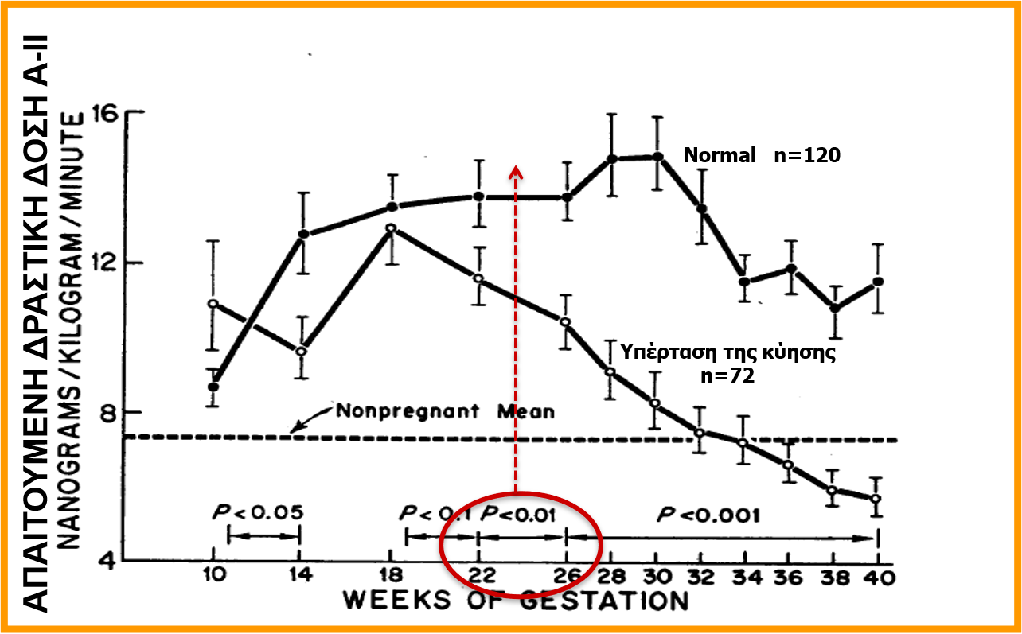
The normal decrease of BP in pregnany is associated with a diminished responsiveness to angiotensin II
↓ SBP ~ 17 mmHg
AII levels for vascular contraction
preeclampsia
Gant NF et al J Clin Invest 52: 2682, 1973
Notes:
50 years ago. The decrease in peripheral vascular resistance and arterial blood pressure that occur during normal pregnancy are usually absent or reversed in preeclampsia. Systemic vascular resistance is high and cardiac output is low during overt disease, owing to widespread vasoconstriction. There is exaggerated sensitivity to vasopressors such as angiotensin II and norepinephrine. Some women destined to develop preeclampsia have been shown to manifest impaired endothelium-dependent vasorelaxation and subtle increases in blood pressure and pulse pressure before onset of definitive hypertension and proteinuria, suggesting that changes in endothelial function are present early in the course of the disease. More attention has been recently addressed to the RAAS, to
provide understanding on the hypertension of preeclampsia.
In normal pregnancy, there are marked changes in the RAAS including considerably elevated ang II levels. There are several possible explanations for this enhanced sensitivity of ang II infusion. First, it may be mediated through increased placental ang II type 1 receptor expression, which has been specifically observed to be upregulated on the decidual or maternal side of the placenta. Second, angiotensin 1–7, a counterregulator of ang II, is decreased during preeclampsia compared with normal pregnancy. A third explanation is that circulating AT1-R autoantibody’ (AT1-AA) levels are elevated, which may explain the hypersensitivity to the effects of ang II

Slide 11
Pre-eclampsia and glomerular filtration compared to normal pregnancy
Ultrafiltration and decrease of BP in normal pregnancy !!
Hypertension and proteinuria in Pre eclampsia !!
Moran P et al J Am Soc Nephrol 14: 648–652, 2003

Slide 12
Pre-eclampsia and Proteinuria
GFR
Normal Pregnancy > Pre eclampsia
Pre eclampsia: Proteinuria
Lindheimer MD and Kanter D Obstet Gynecol 2010;115:365–75

Slide 13
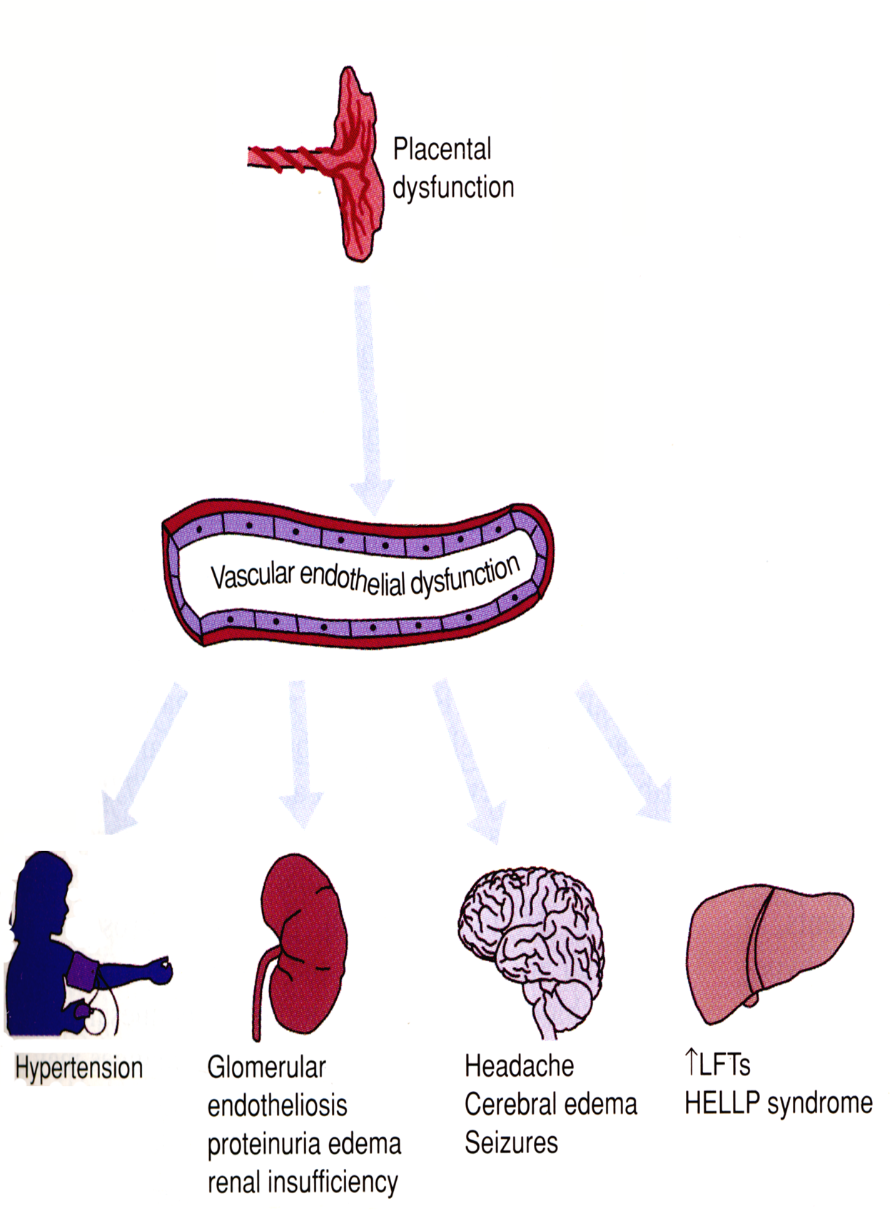
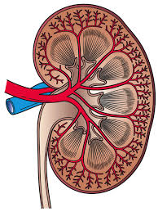
Specific ? pathogenetic mechanisms of kidney injury in pre eclamptic syndromes
?
Endothelium
Podocytes

Slide 14
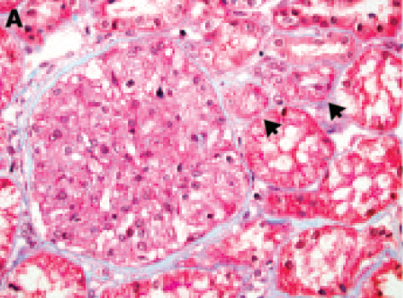
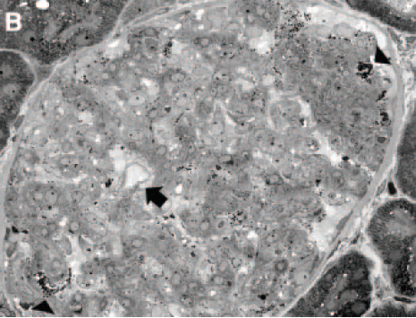
Specific histologic kidney lesion in pre eclampsia ?
‘Glomerular Endotheliosis’
Loss of endothelial fenestrations (ΕΜ)
Lafayette R Kidney Int, 67 (2005), pp. 1194–1203
Stillman IE and Karumanchi A J Am Soc Nephrol 18: 2281–2284, 2007

Slide 15
Anti angiogenetic factors from the ischemic placenta:
maternal endothelial dysfunction
Karumanchi SA et al. Kidney Int 67: 2101, 2005
Notes:
Observational evidence suggests the placenta has a central role in preeclampsia. Preeclampsia only occurs in the presence of a placenta—although not necessarily a fetus, as in the case of hydatidiform mole—and almost always remits quickly after delivery of the
placenta. In this respect there have been cases of postpartum eclampsia associated with retained placental fragments, with rapid improvement only after uterine curettage. In severe preeclampsia, there is pathologic evidence of placental hypoperfusion and ischemia, including acute atherosis, intimal thickening, necrosis, atherosclerosis, and endothelial damage, and placental infarction. Although these findings are not universal, they appear to correlate with severity of clinical disease. Overt placental ischemia
may be neither universal nor specific for preeclampsia, but instead may be an important secondary event observed in severe cases.
The tissue affected most is the maternal endothelium. The clinical manifestations of preeclampsia reflect widespread endothelial dysfunction, with vasoconstriction and end-organ ischemia. Exposure of endothelial cells to serum from women with preeclampsia results in endothelial dysfunction; hence, it has been hypothesized that circulating factors, probably originating in the placenta, are responsible for the manifestations of the disease. Dozens of serum markers of endothelial activation and endothelial dysfunction are deranged in women with preeclampsia, including von Willebrand antigen, cellular fibronectin, soluble tissue factor, soluble E-selectin, platelet-derived growth factor, and endothelin.

Slide 16
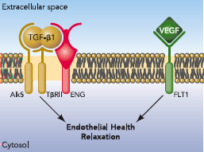
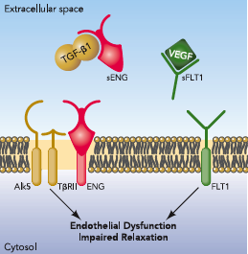
Anti angiogenetic factors (soluble receptors) and endothelium ( sFLTs , sENG )
The soluble forms (sFLT, sENG) of the receptors that are released from the ischemic placenta, act as antagonists
preventing the adherence of VEGF, TGFβ1 and PlGF to the endothelial receptors
Wang A et al. Physiology 24: 147, 2009
Notes:
sFlt1 and sEng cause endothelial dysfunction by antagonizing VEGF and TGF- signaling. There is mounting evidence that VEGF and TGF-1 are required to maintain endothelial health in several tissues, including the kidney and perhaps the placenta. During normal pregnancy, vascular homeostasis is maintained by physiological levels of VEGF and TGF-1 signaling in the vasculature. In preeclampsia, excess placental secretion of sFlt1 and sEng (two endogenous circulating antiangiogenic proteins) inhibits VEGF and TGF-1 signaling,
respectively, in the vasculature. This results in endothelial cell dysfunction, including decreased prostacyclin, nitric oxide production, and release of procoagulant proteins.
sEng is another anti-angiogenic biomarker that is up-regulated in preeclampsia in a pattern similar to sFlt1. sEng is a truncated form of endoglin (CD105), a cell surface receptor for TGF-β, which binds and antagonizes TGF-β. sEng amplifies the vascular damage mediated by sFlt1. Placenta-derived soluble TGF-B co-receptor endoglin (sEng)

Slide 17
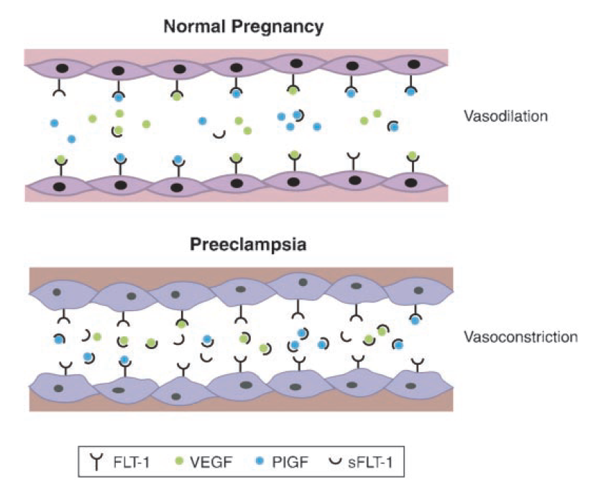
Anti angiogenetic factors (soluble receptors) and endothelium ( sFLTs , sENG )
NORMAL PREGNANCY
normal
vasodilation
PRE ECLAMPSIA
endothelial dysfunction/
vasoconstriction
Davison JM et al.
J Am Soc Nephrol
15: 2440, 2004
Notes:
sFlt1 results from alternative splicing of Flt1, an endothelial receptor for VEGF and PlGF. sFlt1 consists of the extracellular ligand-binding domain of Flt1, but lacks the transmembrane and intracellular signaling domain. Hence, it is secreted into the circulation where it binds and antagonizes VEGF and PlGF.
More recent studies haveidentified a second sFlt1 splice form expressed in cytotrophoblasts, which differs in its cterminus and also appears to be up-regulated in preeclampsia.29–32 The biologic significance of the different sFlt1 variants with regard to anti-angiogenic activity and their role in the pathogenesis of preeclampsia is a subject of ongoing study.
There is additional experimental evidence that supports the hypothesis that interference with VEGF/PlGF signaling could mediate endothelial dysfunction in preeclampsia. VEGF is important in the stabilization of endothelial cells in mature blood vessels. VEGF is
particularly important in the health of the fenestrated and sinusoidal endothelium found in the renal glomerulus, brain, and liver—organs severely affected in preeclampsia. VEGF is highly expressed by glomerular podocytes, and VEGF receptors are present on glomerular endothelial cells. Anti-VEGF therapies given to adult animals cause glomerular endothelial damage with proteinuria. The most striking experimental illustration of the effect of VEGF antagonism in human beings comes from anti-angiogenesis cancer trials, in which anti-VEGF antibodies produce proteinuria, hypertension, and loss of glomerular endothelial fenestrae. This suggests that VEGF deficiency, induced by excess sFlt1, can produce the characteristic renal manifestations of preeclampsia. The physiologic role of PlGF is less well understood than that of VEGF, but PlGF appears to stimulate angiogenesis under conditions of ischemia, inflammation, and wound healing, and may contribute to atherosclerosis. Blockade of both VEGF and PlGF is required to produce preeclampsia-like changes in pregnant rats, signifying that PlGF blockade may be important in the pathogenesis of sFlt1-induced endothelial dysfunction.

Slide 18
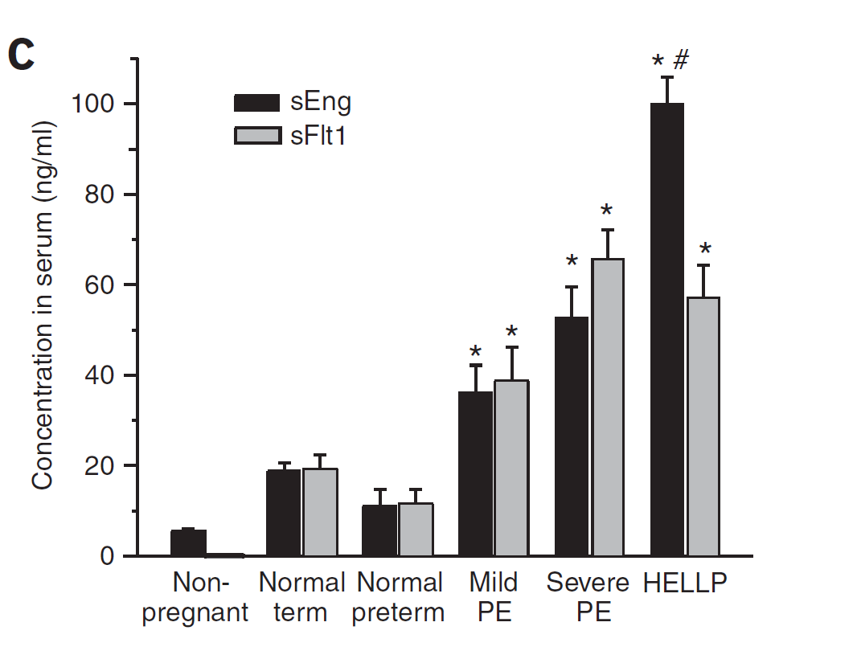

Levels rise proportionally to the severity of the preeclamptic disorder
Anti-angiogenetic factors ( sFLTs , sENG ) and Preeclamptic syndromes
Venkatesha S et al. Nature Medicine 12: 642, 2006

Slide 19

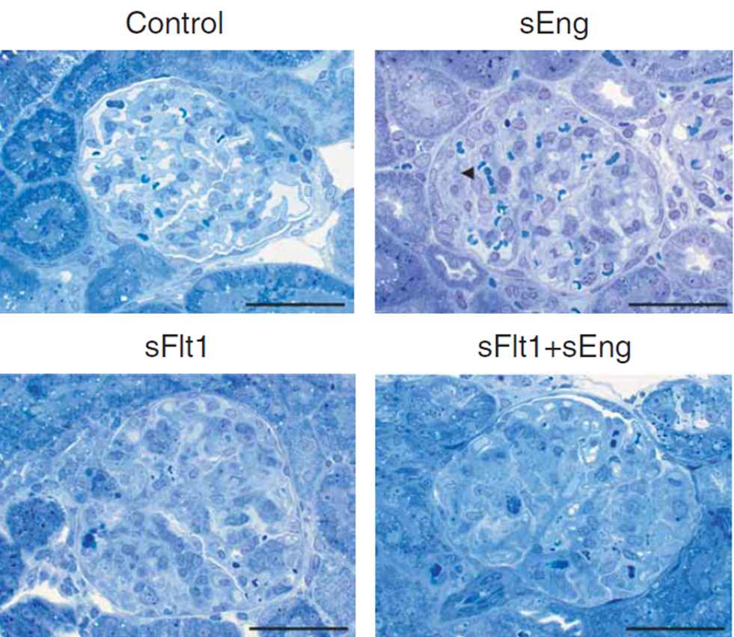
Anti-angiogenetic factors ( sFLTs , sENG ) and Preeclamptic syndromes
confirmatory Experimental models !
sFlt-1 and sEng : experimental Glomerular Endotheliosis
Venkatesha S et al. Nature Medicine 12: 642, 2006

Slide 20
Late endothelial dysfunction post Pre-eclampsia
... even after 1 year !
Germain et al Hypertension. 2007;49:90-95

Slide 21
Specific ? pathogenetic mechanisms of kidney injury in pre eclamptic syndromes
Endothelium
Podocutes
?

Slide 22



Specific histologic kidney injury in pre-eclampsia: Autopsy
pregnant
Non pregnant
Podocyte changes and Tram tracking are more specific than endotheliosis !
Penning ME et al Clin J Am Soc Nephrol 9: 1377–1385, 2014

Slide 23
Histologic findings of Podocyte injury and loss in Pre-eclampsia: Autopsy
↑ Replacement of lost original podocytes from migrating / differentiating parietal epithelial cells
Higher % of glomeruli with CD44 positive cells on vascular endothelial cell location in Pre eclampsia
FSGS.. ?
Penning ME et al Clin J Am Soc Nephrol 9: 1377–1385, 2014

Slide 24
Specific ? pathogenetic mechanisms of kidney injury in pre eclamptic syndromes
Endothelium
Podocutes

Slide 25
Specific histologic kidney lesion in pre eclampsia ?
BIOPSIES ??
Clinical Diagnosis of preeclampsia
Typical/ specific histology glomerular endotheliosis
Primigravidas : ~ 84%
MULTIPARAS : only 38%!!
Fisher KA MEDICINE 1981;60(4):267-276

Slide 26
Pre eclamptic syndromes and kidney injury mechanisms
Specific Injury : the pathophysiology of pre eclampsia per se
Underlying disease ?:
    other, subclinical, chronic renal disease that flares and accelerates during pregnancy (eg glomerulonephritis) ?
kidney injury
?

Slide 27
Histological Differential diagnosis of kidney diseases timely related to pregnancy
RENAL BIOPSIES during pregnancy or within 1 year postpartum
vs
Webster et al CJASN 2016 doi:10.2215/CJN.05610516

Slide 28
Histological Differential diagnosis of kidney diseases timely related to pregnancy
RENAL BIOPSIES during pregnancy or within 1 year postpartum
High percentage of underlying kidney diseases …and … FSGS
PE?
80% other, underlying
glomerular diseases
Webster et al CJASN 2016 doi:10.2215/CJN.05610516

Slide 29
Histological Differential diagnosis of kidney diseases timely related to pregnancy
RENAL BIOPSIES during pregnancy or within 1 year postpartum
faster GFR loss/ acceleration of underlying kidney disease during pregnancy
clinically presented/diagnosed as preeclampsia !?
compared to controls with the same glomerular disease unrelated to pregnancy
During pregnancy compared to those biopsied after pregnancy
Webster et al CJASN 2016 doi:10.2215/CJN.05610516

Slide 30
Pre eclamptic syndromes and kidney injury mechanisms
Specific Injury : the pathophysiology of pre eclampsia per se
or
Underlying disease ?:
    other, subclinical, chronic renal disease that flares and accelerates during pregnancy (eg glomerulonephritis) ?
    Common risk factors with other chronic diseases that are associated with renal injury ?
kidney injury
?

Slide 31
Risk factors for development of pre-eclampsia include … maternal cardiovascular co-morbidities !!
BMI > 35 kg/m²
Diabetes Mellitus (preceding and/or during gestation)
Chronic Hypertension
CKD/ Lower GFR
Antiphospholipid syndrome / other coagulation disorders
Chronic Autoimmune disease
Cardiovascular risk factors
Autoimmunity
Coagulation disorders

Slide 32
Cardiovascular risk factors and Pre eclampsia
The incidence of preeclamptic disorders is 3-5 times higher in women with Hypertension , Diabetes or Renal Disease
The list of risk factors that are associated with hypertensive disorders of pregnancy … is almost identical to the list of risk factors for cardiovascular disease and CKD …
Bystander ? association of hypertensive disorders of pregnancy and CKD ?

Slide 33
CKD as a risk factor for hypertensive disorders of pregnancy

Slide 34

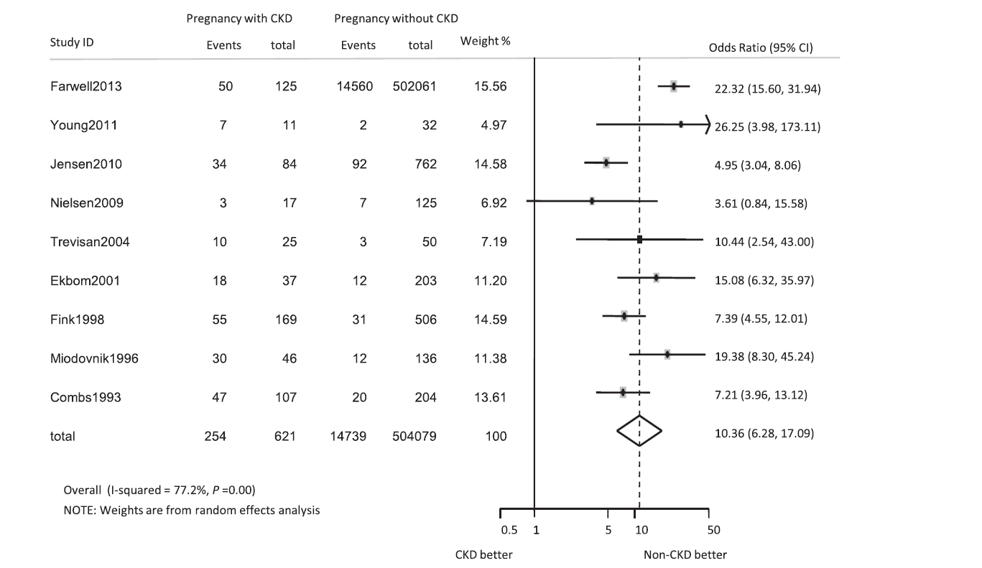
CKD as a risk factor for Pre eclampsia
Women with CKD have ~ 10 times higher odds ratio for pre-eclampsia
Zhang J J et al Clin J Am Soc Nephrol 10: 1964–1978, 2015

Slide 35
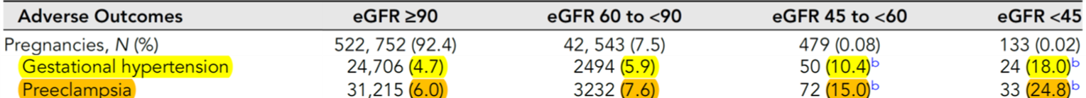
CKD as a risk factor for hypertensive disorders of pregnancy
The risk is higher as the GFR gets lower!!
Tangren J et al J Am Soc Nephrol. 2023 Apr 1;34(4):656-667

Slide 36
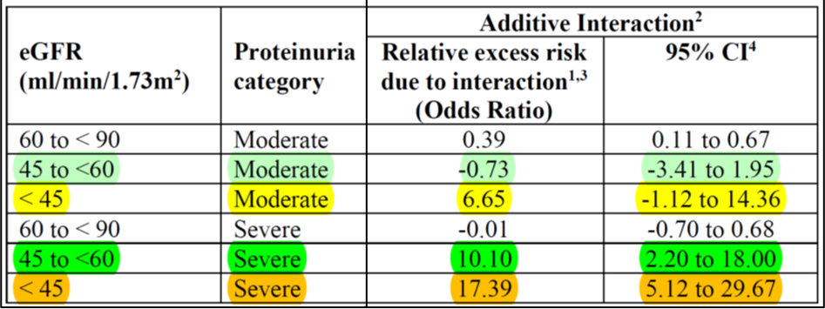
CKD as a risk factor for hypertensive disorders of pregnancy
The risk rises additively and proportionally to the level of proteinuria
... And even more so, when GFR <45 ml/min
Tangren J et al J Am Soc Nephrol. 2023 Apr 1;34(4):656-667

Slide 37
Pre eclamptic syndromes and kidney injury mechanisms
Specific Injury : the pathophysiology of pre eclampsia per se
or
Underlying disease ?:
    other, subclinical, chronic renal disease that flares and accelerates during pregnancy (eg glomerulonephritis) ?
    Common risk factors with other chronic diseases that are associated with renal injury ?
kidney injury

Slide 38
Hypertensive disorders of pregnancy as a risk factor for CKD
Proteinuria
GFR
ESRD/Dialysis

Slide 39
Residual morbidity after pre eclampsia ?
Usually quick Remission …
vasoconstriction and endothelial dysfunction within a few days
hypertension and proteinuria within 2 to 6 weeks
glomerular endotheliosis within 8 weeks
However … LATE residual morbidity!!
Notes:
20% των γυναικών έχουν μικρολευκωματινουρία μετά από 1 χρόνο. Στο slide (AJKD1026, 2010) παρόμοια επίπτωση με ΣΔ τύπου Ι. 8π
λάσια συχνότητα εάν βαριά προεκλαμψία. Aνάπτυξη ESRD? Μάλλον όχι εκτός βαριά ΡΕ.
Although several studies have found persistent microalbuminuria in formerly preeclamptic women several years after pregnancy, no differences were found in serum renal function parameters in formerly preeclamptic women. None of these studies have shown a significant difference in serum creatinine values or creatinine clearance between formerly preeclamptic women and healthy parous controls. However, ERPF lower and RVR higher.

Slide 40
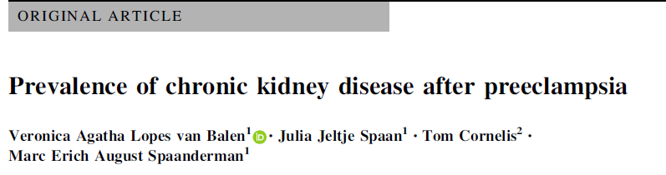
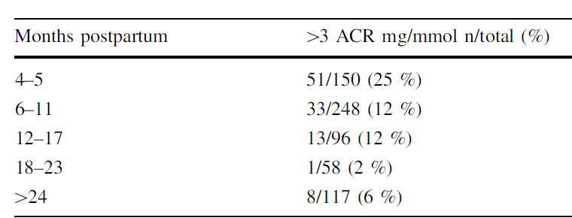
Pre eclamptic syndromes as a risk factor for CKD
Proteinuria – Short term remission
Starts to rise again 24 months postpartum …
Lopes van Balen et al J Nephrol (2017) 30:403–409

Slide 41
Pre eclamptic syndromes as a risk factor for CKD
Higher late risk for microalbuminuria (30-40% after 5 years)
40% of women 3-5 years post pre-eclampsia (versus 0% controls)
Bar J et al Nephrol Dial Tranplant (1999) 14: 1129–1132
META-ANALYSIS : 7 studies (273 PE vs 333 control) 7.1 years follow up
PE history 31% vs 7% controls
4 x relative risk
McDonald SD et al Am J Kidney Dis. 2010 Jun;55(6):1026-39

Slide 42
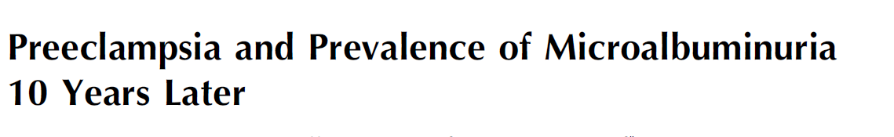
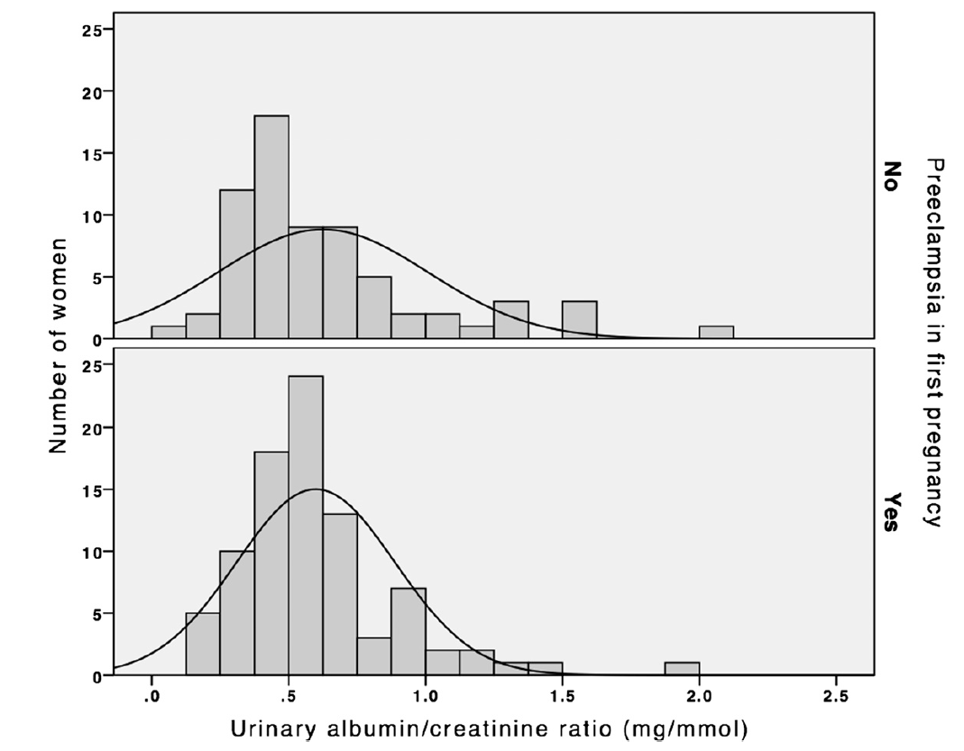
Pre eclamptic syndromes as a risk factor for CKD
Late microalbuminuria – non Specific ?
Medical Birth Registry Norway
89 pre eclampsia vs 69 controls
Excluding
DM, Autoimmune disease, Hypertension, Renal disease before gestation and/or history of Pre eclampsia
N.S. !
No difference in incidence of microalbuminuria when excluding co-morbidities!!
Sandvik et al Clin J Am Soc Nephrol 8: 1126–1134, 2013

Slide 43



Preeclamptic syndromes and long term risk for CKD
230 -300 % higher hazard ratio for CKD (x 2.3-2.9)
Kristensen et al BMJ 2019;365:l1516

Slide 44
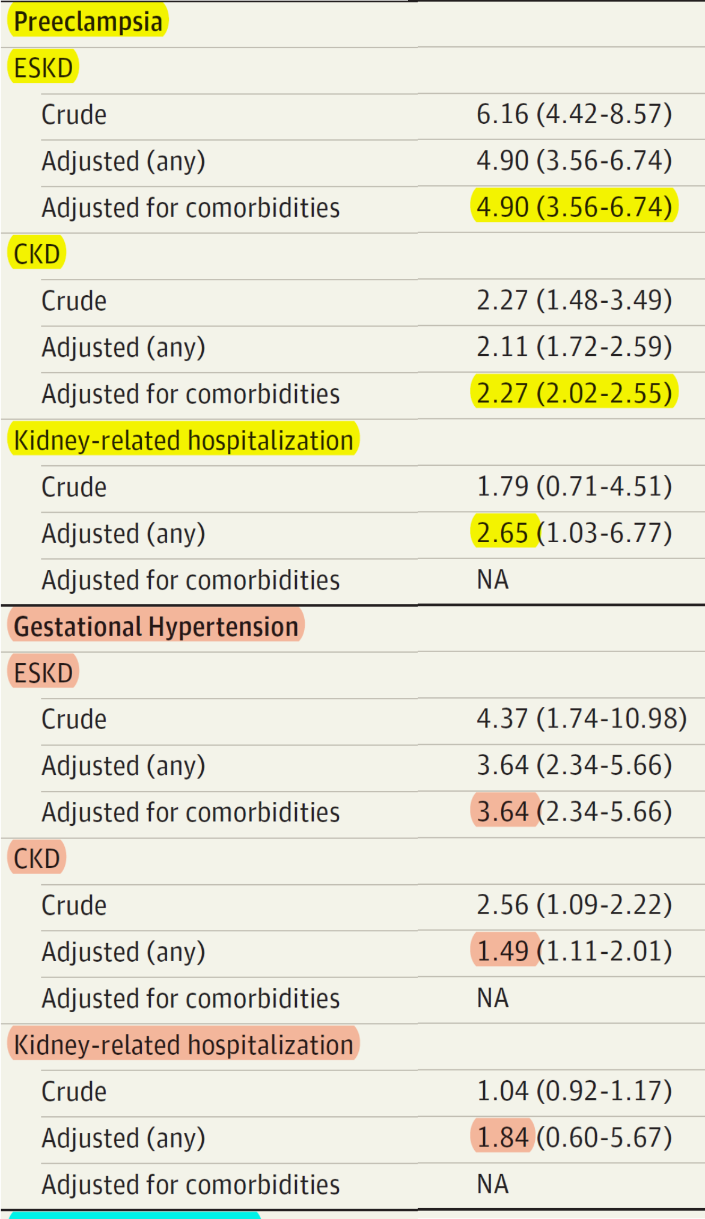
Preeclamptic syndromes and long term relative risk of CKD
Proportionally higher according to the severity of the pre eclamptic disorder
Barrett et al JAMA Network Open. 2020;3(2):e1920964

Slide 45
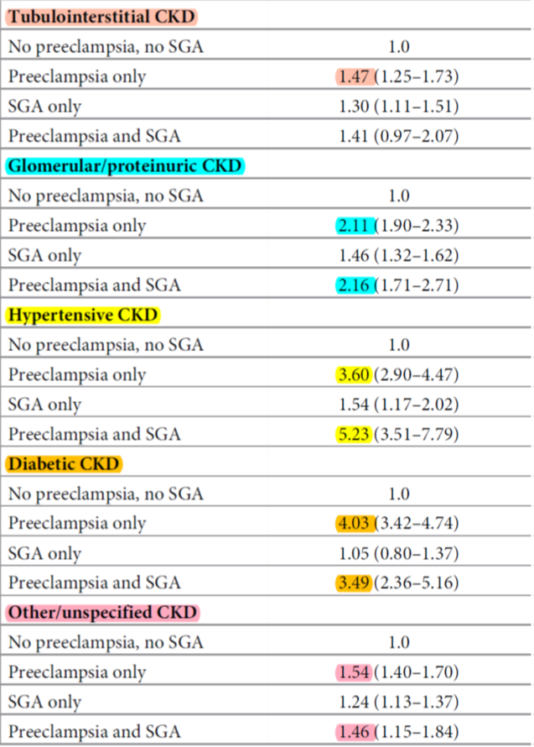
Preeclamptic syndromes and long term risk of CKD
Higher risk for any type of kidney disease (although different)
1.924.409 women
3.726.554 births
Barrett et al PLoS Med 2020; 17(8): e1003255

Slide 46
Preeclamptic syndromes and long term risk for CKD
(GFR<60 ml/min or Albuminuria)
Matched cohorts N= 2276 /group follow up ~ 8years
Srialluri N Am J Kidney Dis. 2023 Jul 27:S0272-6386(23)00732-1

Slide 47
Hypertensive disorders of pregnancy as a risk factor for ESRD
Proteinuria
GFR
ESRD/Dialysis

Slide 48
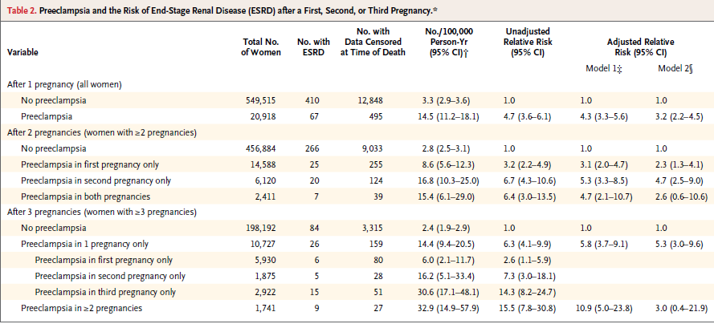
Preeclamptic syndromes and long term relative risk for ESRD
Relative risk x 3-5, rises according to the number of preceding pregnancies
~550.000 women
Vikse VE et al N Engl J Med 2008;359:800-9

Slide 49
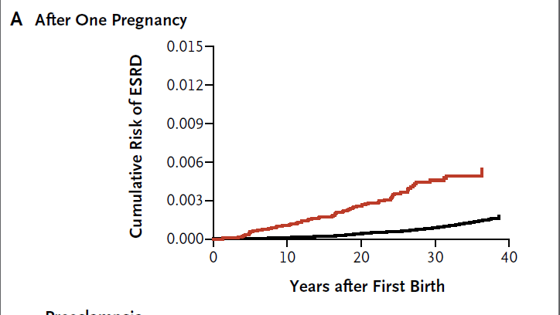
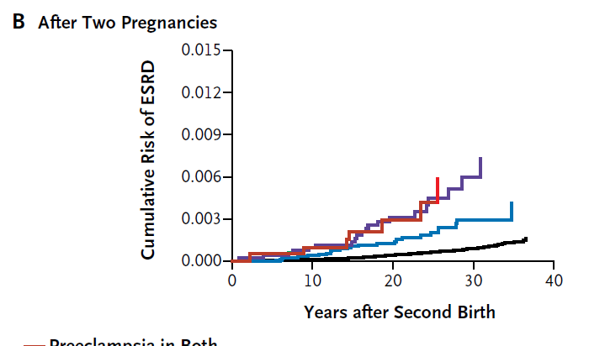
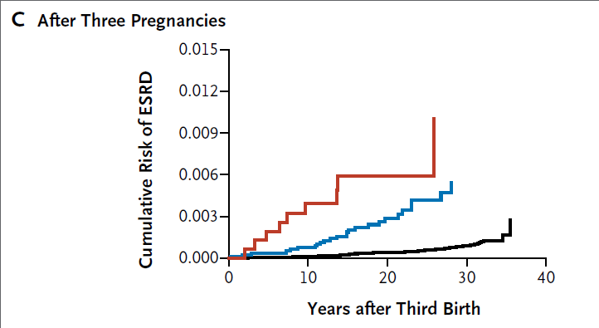
Preeclamptic syndromes and long term relative risk for ESRD
Relative risk x 3-5, rises according to the number of preceding pregnancies
PE 2nd
PE
PE 1+2
PE 1st
PE ≥2
and the total number of pre eclamptic pregnacies
PE x1
Vikse VE et al N Engl J Med 2008;359:800-9

Slide 50
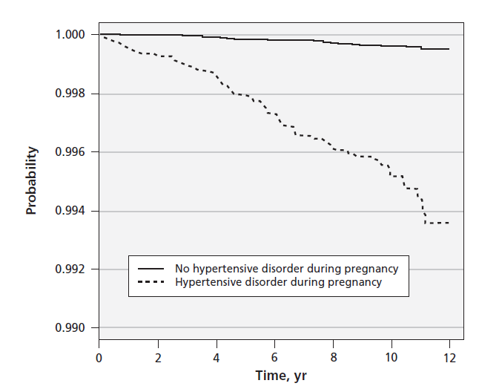
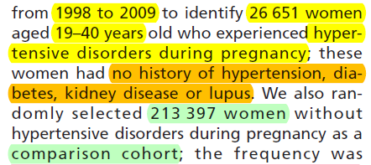
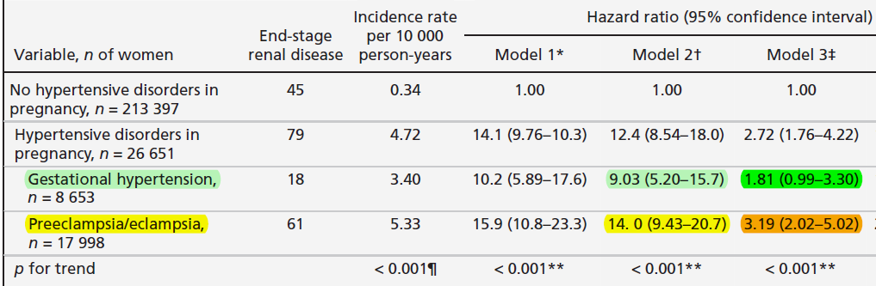
Hypertensive disorders of pregnancy as a risk factor for ESRD
Proportional to the severity of the pre-eclamptic disorder!
Wang et al CMAJ 2013; 185(3): 207-213

Slide 51
Hypertensive disorders of pregnancy as a risk factor for ESRD
Large proportion of the risk (~ 80%) is explained by adjustment for cardiovascular co-morbidities !!
Hypertension/DM
Wang et al CMAJ 2013; 185(3): 207-213

Slide 52
Preeclamptic syndromes and long term relative risk for ESRD
Barrett et al JAMA Network Open. 2020;3(2):e1920964

Slide 53

Hypertensive Disorders of Pregnancy
Chronic Kidney Disease
Cardiovascular morbidity

