Slide 1
Ultrafiltration in Heart Failure
Christina Chrysohoou
Cardiologist
Heat failure Unit
1rst Cardiology Clinic University of Athens, Greece

Slide 2
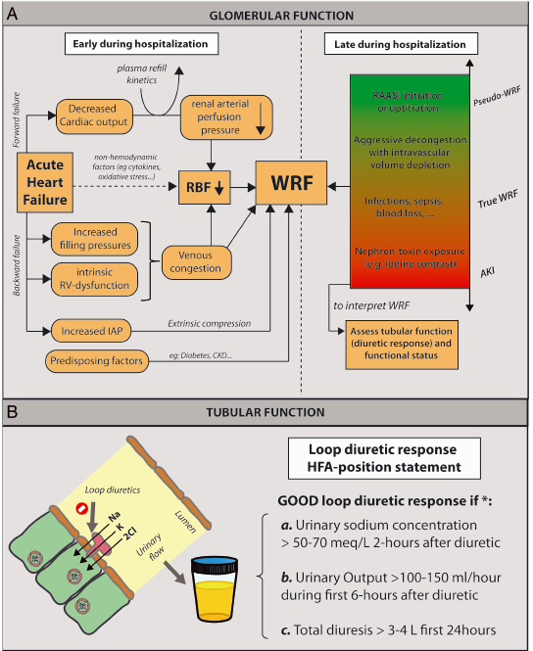
Pathophysiology and timing of renal function alterations in acute heart failure.
European Journal of Heart Failure (2020) 22, 584–603

Slide 3
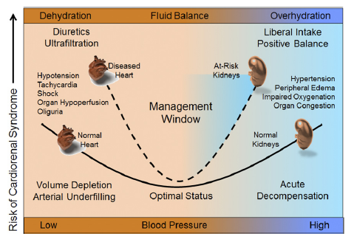
Goals of therapy in acute decompensated heart failure
achieving thorough decongestion without residual volume overload. Nevertheless, the optimal stopping point of decongestive therapy is often difficult to determine, as alluded to above.
Ensuring adequate perfusion pressures to guarantee organ perfusion.
the restoration of fluid balance must be cautious to prevent any hemodynamic instability, or it may restore the osmotic gradient within the loop of Henle.
when the ultrafiltration rate significantly exceeds the plasma refill rate, there is intravascular volume depletion, which in preload-dependent HF patients can lead to a further decrease in cardiac output.
Ronco C, et al. JACC 2012;60:2031-41
Heart Fail Rev. 2015 ; 20(1): 13–24.
chloride theory”, chloride is the key electrolyte for regulating the distribution of body fluid or water in each body compartment

Slide 4
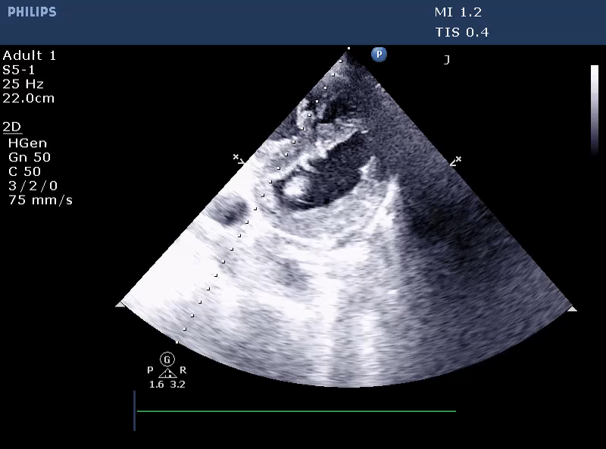
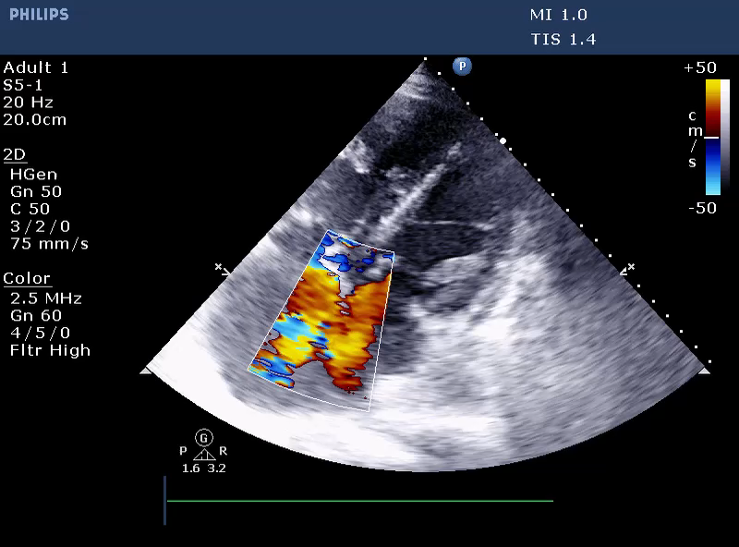
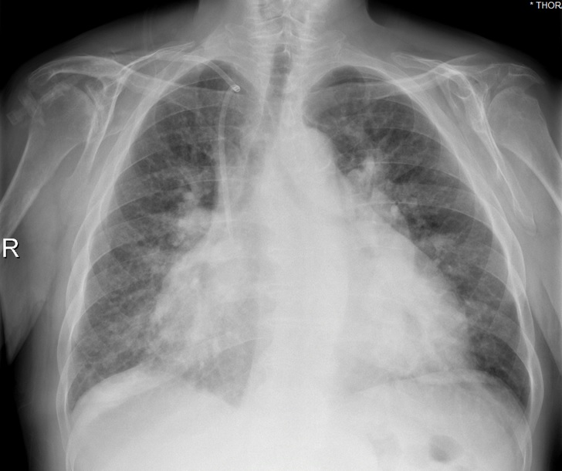
Patient Presentation
PRESENT COMPLAINT:
62-year-old male presented with worsening dyspnea at mild exertion, orthopnea and peripheral oedema
he had gained 20 kg during last two months
PAST MEDICAL HISTORY:
HOLT-ORAM syndrome
type 2 diabetes mellitus, atrial flutter
chronic obstructive pulmonary disease under oxygen therapy
INITIAL ASSESSMENT:
Afebrile, BP 110/75 mmHg, HR 80 bpm, 75% on air
Diffuse wheezing and basal coarse crackles bilaterally
Dilated JV, ascites, edema anasarca
ECHO: LV with normal dimensions and wall thickness and preserved ejection fraction, systolic and diastolic D-shape, RV notably enlarged with impaired systolic function. ASD with bidirectional flow. IVC dilated without respiratory variation and PASP estimated at 95-100 mmHg
Rx:
Tb furosemide 40mg BID,
Tb eplerenone 50mg QD,
Tb dapagliflozin 10mg QD,
Tb dabigatran 150mg BID,
Tb valsartan 160mg QD,
Tb metformin 1000mg QD,
Tb macitentan 10mg QD
Tb digoxin 0.25mg three times per week

Slide 5
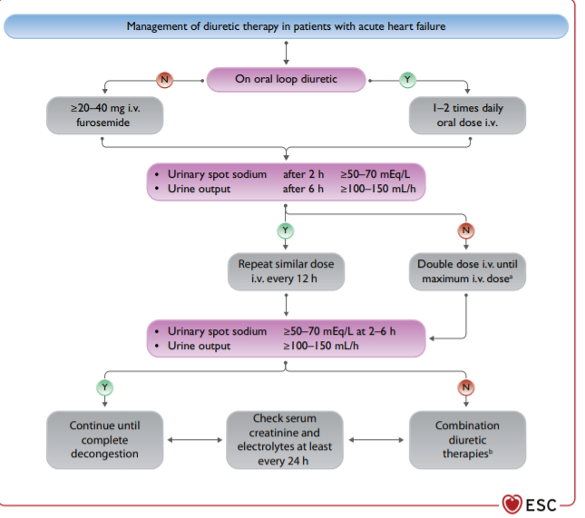

Slide 6
Mechanisms of Loop Diuretic Resistance
OAT, organic anion transporter
Maaten, et al. et al. Nat Rev Cardiol 2015; 12:184–192
Notes:
Mechanisms of loop diuretic resistance. Patients who are resistant to loop diuretics might have reduced absorption of the drug in the intestine, reduced filtration, or increased proximal or distal sodium reabsorption in the kidney, or reduced drug availability in the tubule. Abbreviations: CO, cardiac output; CVP, central venous pressure; GFR, glomerular filtration rate; OAT, organic anion transporter; RAAS, renin–angiotensin–aldosterone system; RBF, renal blood flow; SNS, sympathetic nervous system.
Τα περισσότερα διουρητικά (η βουμετανίδη λιγότερο) χρειάζονται επάρκεια αλβουμίνης για να δράσουν. Στην ΚΑ συνυπάρχει υποαλβουμιναιμία με συνέπεια η φουροσεμίδη να μετατρέπεται σημαντικά σε αδρανή μορφή.
Στην ΚΑ και τη ΧΝΑ υπάρχουν αυξημένα επίπεδα κυκλοφορούντων ενδογενών οργανικών οξέων, όπως η αμμωνία, τα οποία αναστέλλουν το ΟΑΤ (organic acid transport system) στο εγγύς σωληνάριο και συνεπώς μειώνουν την επάρκεια διουρητικού στο σημείο δράσης.
Τέλος, στη ΧΝΝ η νεφρική αιματική ροή είναι μειωμένη με συνέπεια τη μειωμένη ποσότητα φουροσεμίδης που φτάνει στο νεφρό.

Slide 7
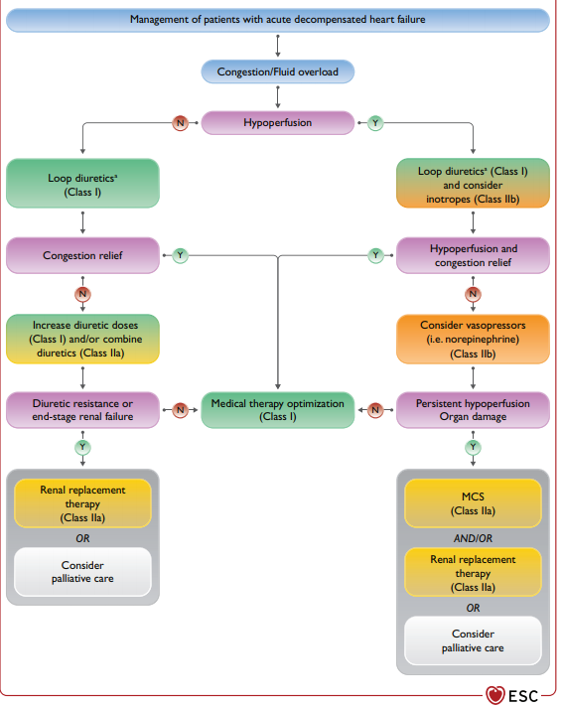

Slide 8
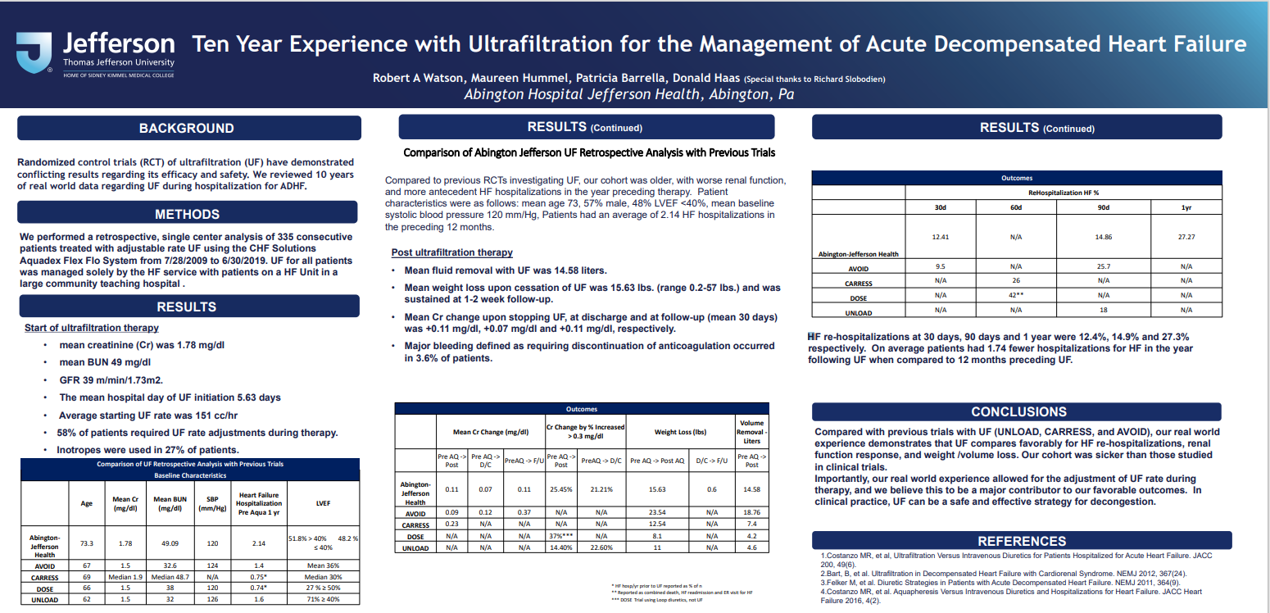

Slide 9
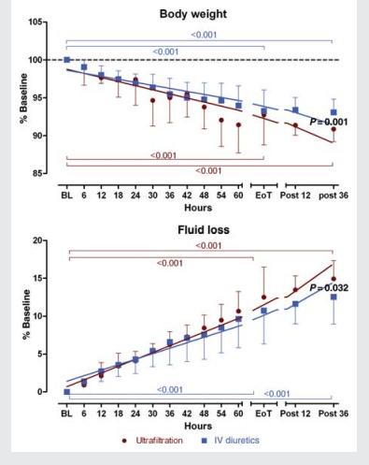
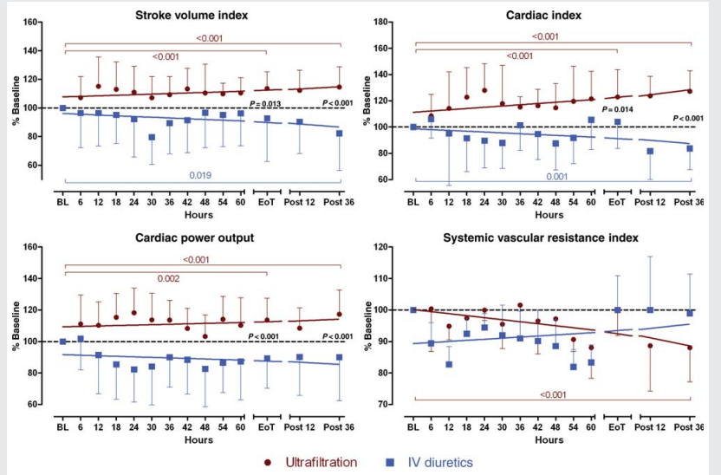
Effects of ULTRAfiltration vs. DIureticS on clinical, biohumoral and haemodynamic variables in patients with deCOmpensated heart failure: the ULTRADISCO study
The ultrafiltration group showed a significant improvement (% of baseline) in a number of haemodynamic parameters, including stroke volume index (114.0+11.7%; P , 0.001), cardiac index (123.0+20.8%; P , 0.001), cardiac power output (114.0+13.8%; P , 0.001), dP/dtmax (129.5+19.9%; P , 0.001), and cardiac cycle efficiency (0.24+0.54 vs. 20.14+0.50 units; P , 0.05), and a significant reduction in systemic vascular resistance 36 h after the treatment (88.0+10.9%; P , 0.001), which was not observed in the diuretic group
European Journal of Heart Failure (2011) 13, 337–346

Slide 10
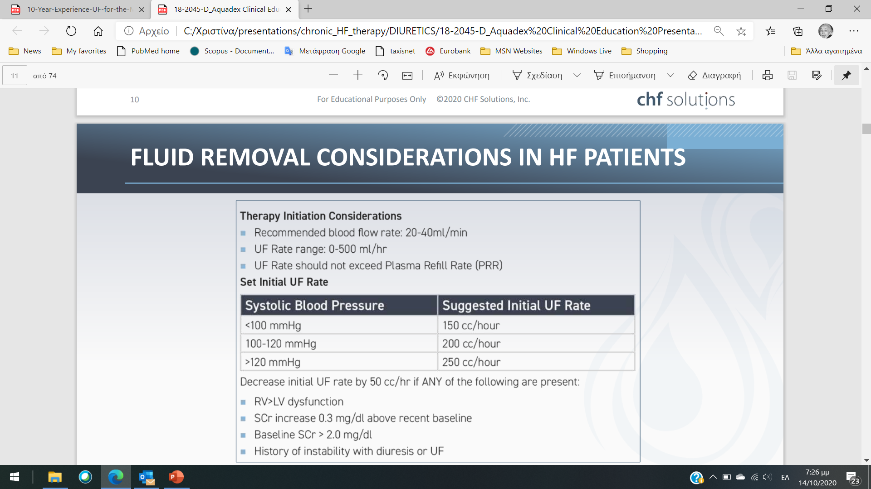
Source: Costanzo MR, et al. J Am Coll Cardiol. 2017 May 16;69(19):2428-2445.

Slide 11
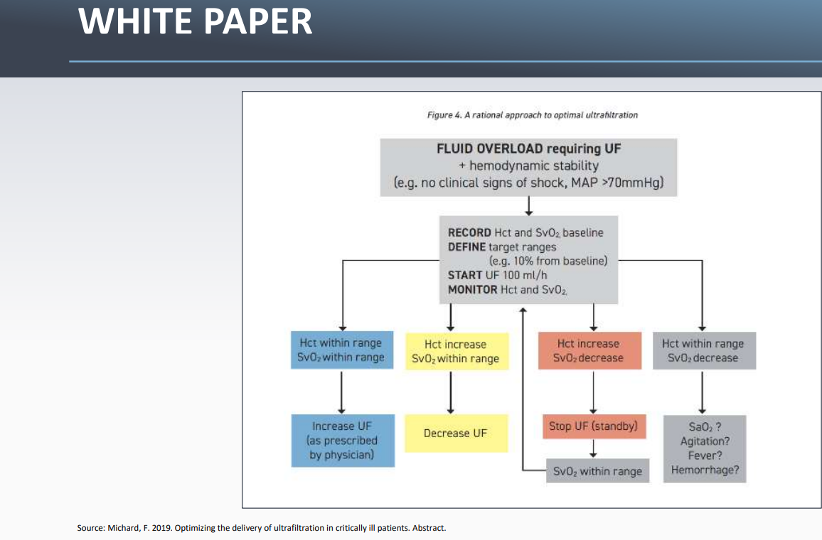

Slide 12
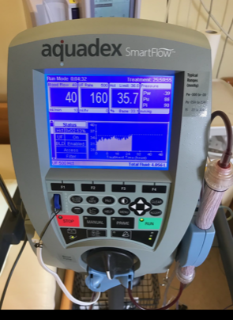
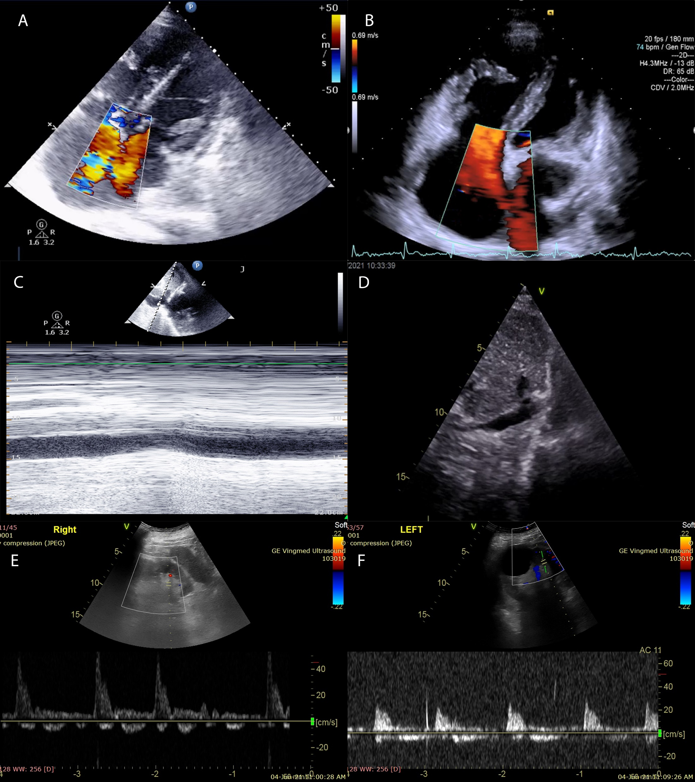
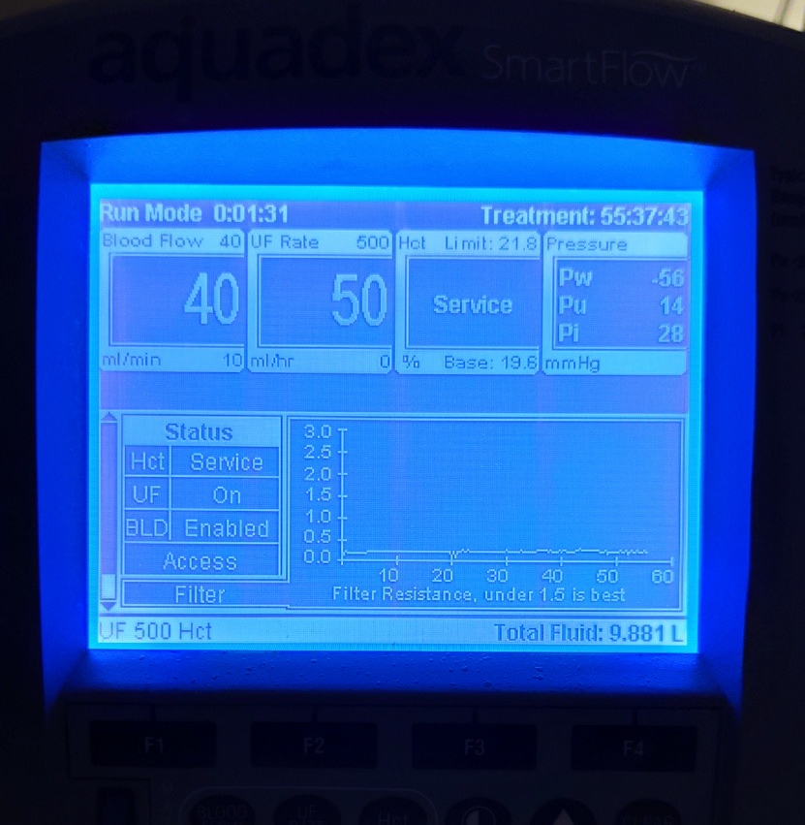

Slide 13
 | 25/5 | 26/5 | 27/5 | 28/5 | 29/5 | 30/5 | 31/5 | 1/6 | 2/6 | 3/6 | 4/6
BW |  | 109.5 |  | 104,8 | 100,5 | 99,8 | 98,7 | 98,5 | 90,6 | 90,4 | 88,9
V urine | 700 (16 h) | 2550 | 5200 | 3450 | 2500 | 2550 | 3000 | 4000 | 5000 | 3800
V UF |  |  | 1600 (11h) | 3014 | 3000 | 3646 | - | - | - | -
Total loss of 42 lt (15 lt ultrafiltration and 27 lt urine) Body mass loss of 20 Kg
He was dismissed asymptomatic, with minor ankle edema, blood pressure of 120/80 mmHg, oxygen saturation of 90% on ambient air

Slide 14
 | Baseline | Exit | 1 month | 3 months | 5 months
Hematocrit, % | 37.8 | 40.9 | 47.8 | 48.6 | 46
Hemoglobin, g/dl | 11.3 | 12.5 | 15 | 15.8 | 14.3
International normalized ratio | 1.7 | 1.4 | 1.8 | 1.7 | 1.6
Alanine aminotransferase, IU/L | 10 | 21 | n/a | 18 | 17
Aspartate aminotransferase, IU/L | 6 | 13 | n/a | 14 | 15
Total bilirubin, mg/dl | 1.46 | 1.1 | 0.9 | 1.1 | 1.0
Creatinine, mg/dl | 1.3 | 1.5 | 1.7 | 1.7 | 1.4
Urea, mg/dl | 103 | 103 | 137 | 115 | 96
Pro BNP, pg/ml | 5739 | 1608 | 1536 | 1271 | n/a
Na, mEq | 139 | 137 | 133 | 135 | 136
K, mEq | 4 | 4.8 | 4.1 | 4.4 | 4.5

Slide 15
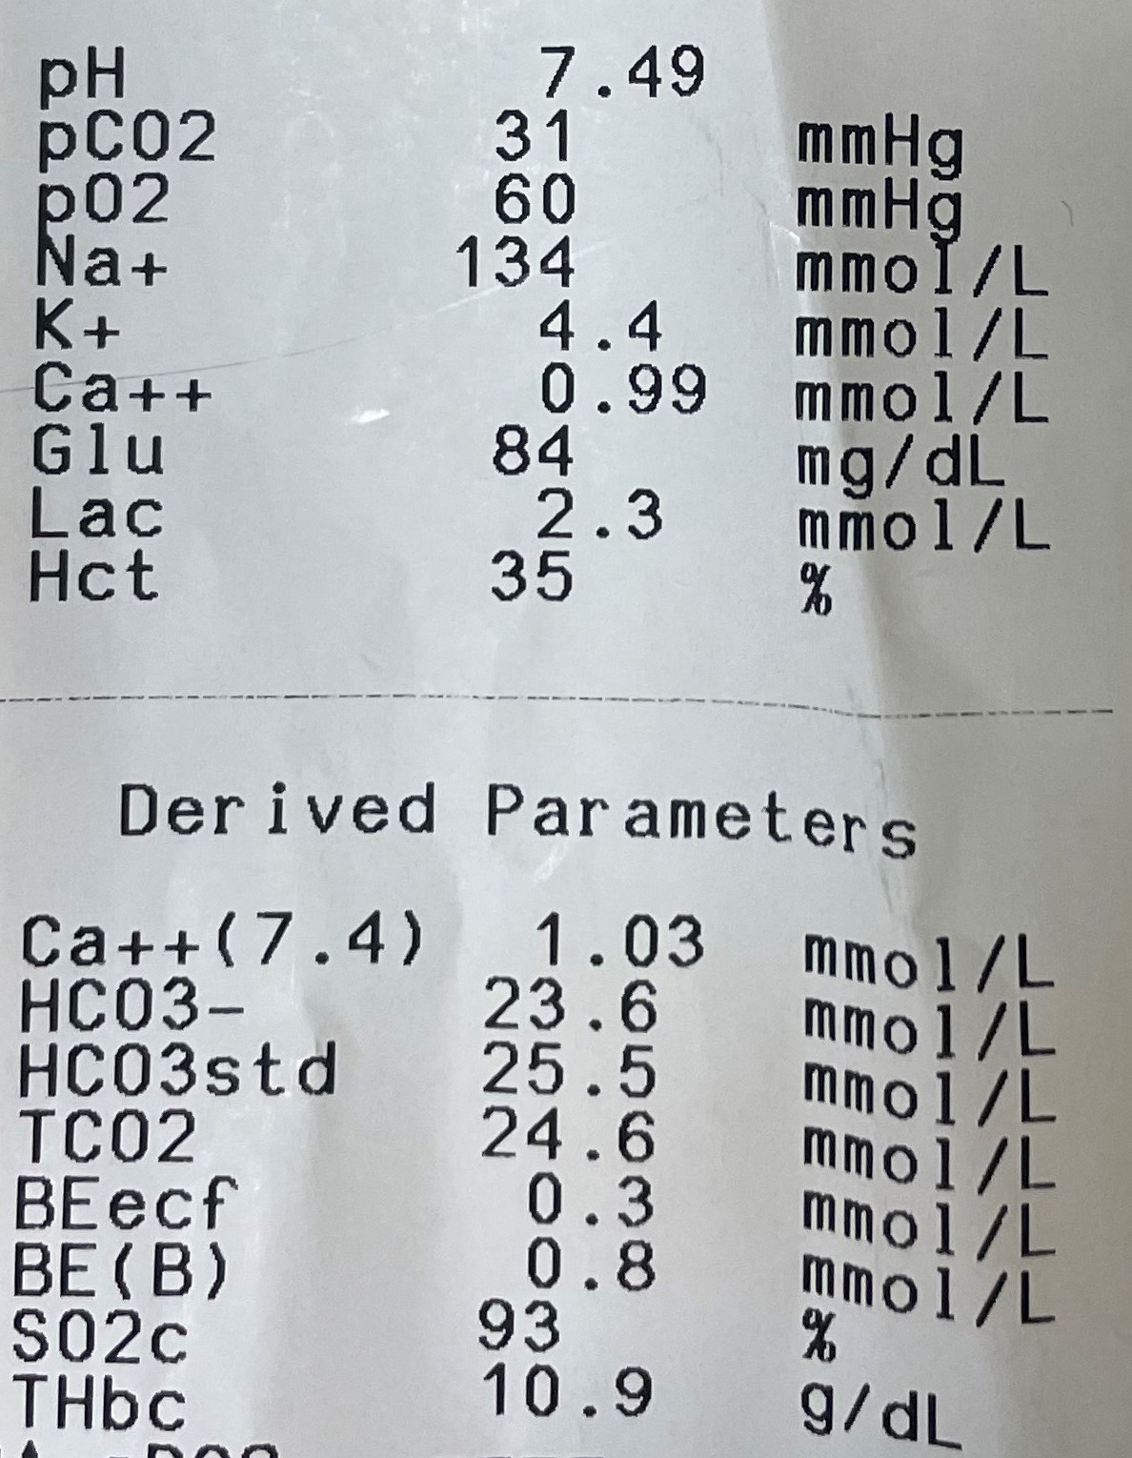
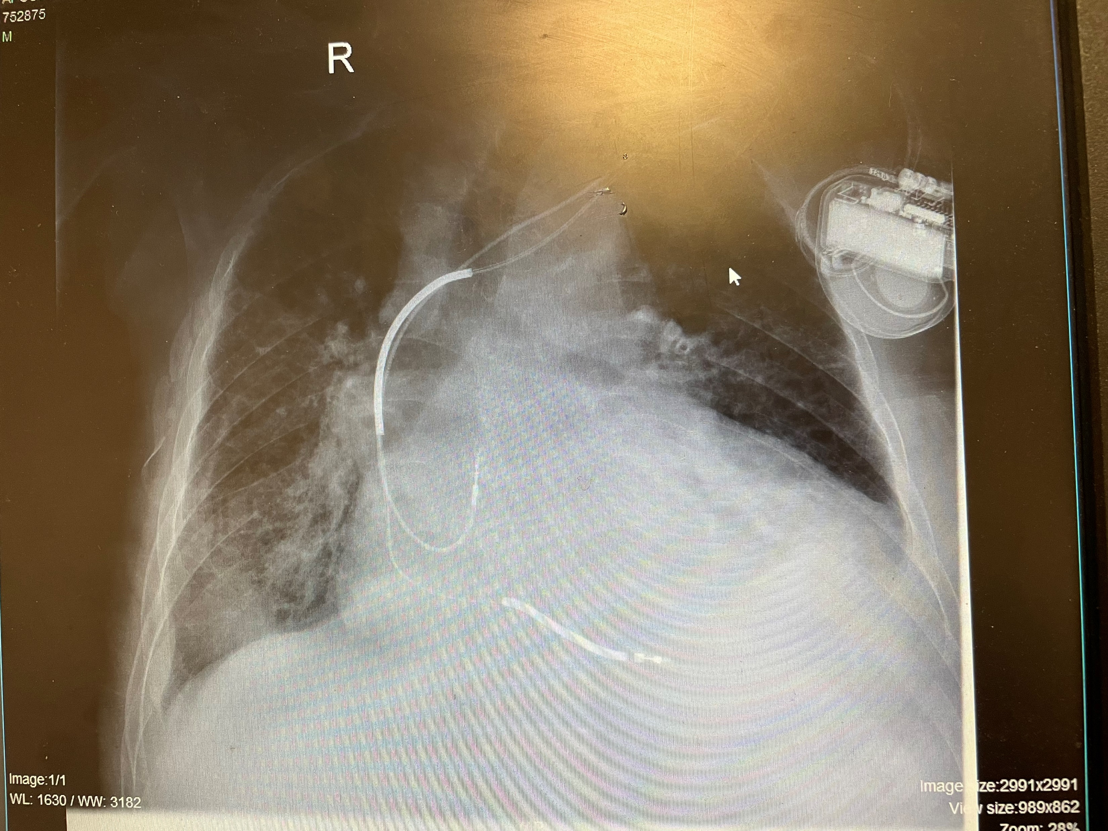
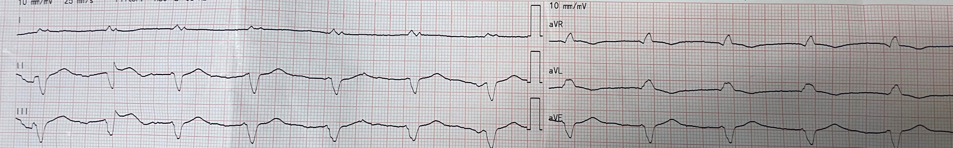
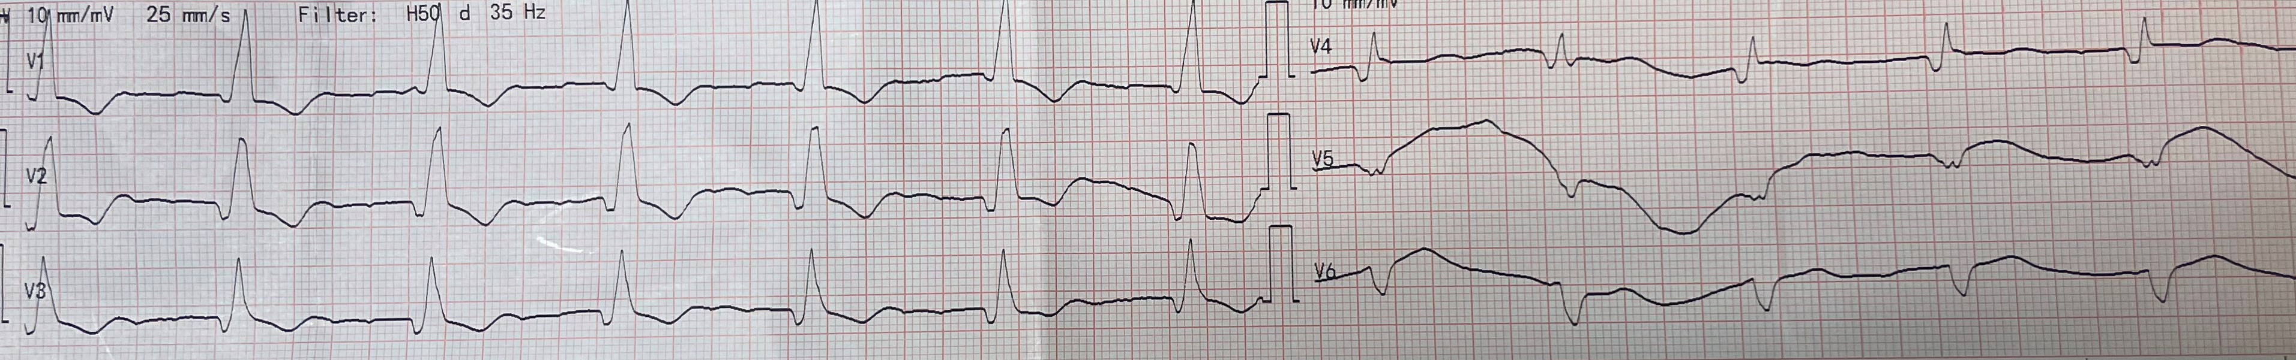
Patient Presentation
PRESENT COMPLAINT:
75-year-old male patient presented with worsening dyspnea, orthopnea and progressive edema during the last month.
Reported oliguria for 2 weeks.
PAST MEDICAL HISTORY:
HFrEF (EF=20%), CHD (PCI x 3 – last 2017)
PAF, ICD (2017), Hypothyroidism
CKD (Cr=2,5)
INITIAL ASSESSMENT:
Afebrile, BP 105/70 mmHg, HR 61 bpm, SpO2 97% nasal 2L
Expiratory wheezing bilaterally
Dilated JV, edema anasarca
ECHO: EF=20%, apical akinesia, RV dilated with impaired systolic function, IVC 3.5cm with impaired respiratory variation.
Rx:
Tb Salospir 100mg QD
tb Amiodarone 200mg QD
tb Esomeprazole 40mg QD
tb Furosemide 250mg TID
tb Atorvastatin 10mg QD
tb Bromazepam 1.5mg QD
tb Bisoprolol 2,5mg BID
tb Allopurinol 150mg QD
Syr Levothyroxine 25mcg QD

Slide 16
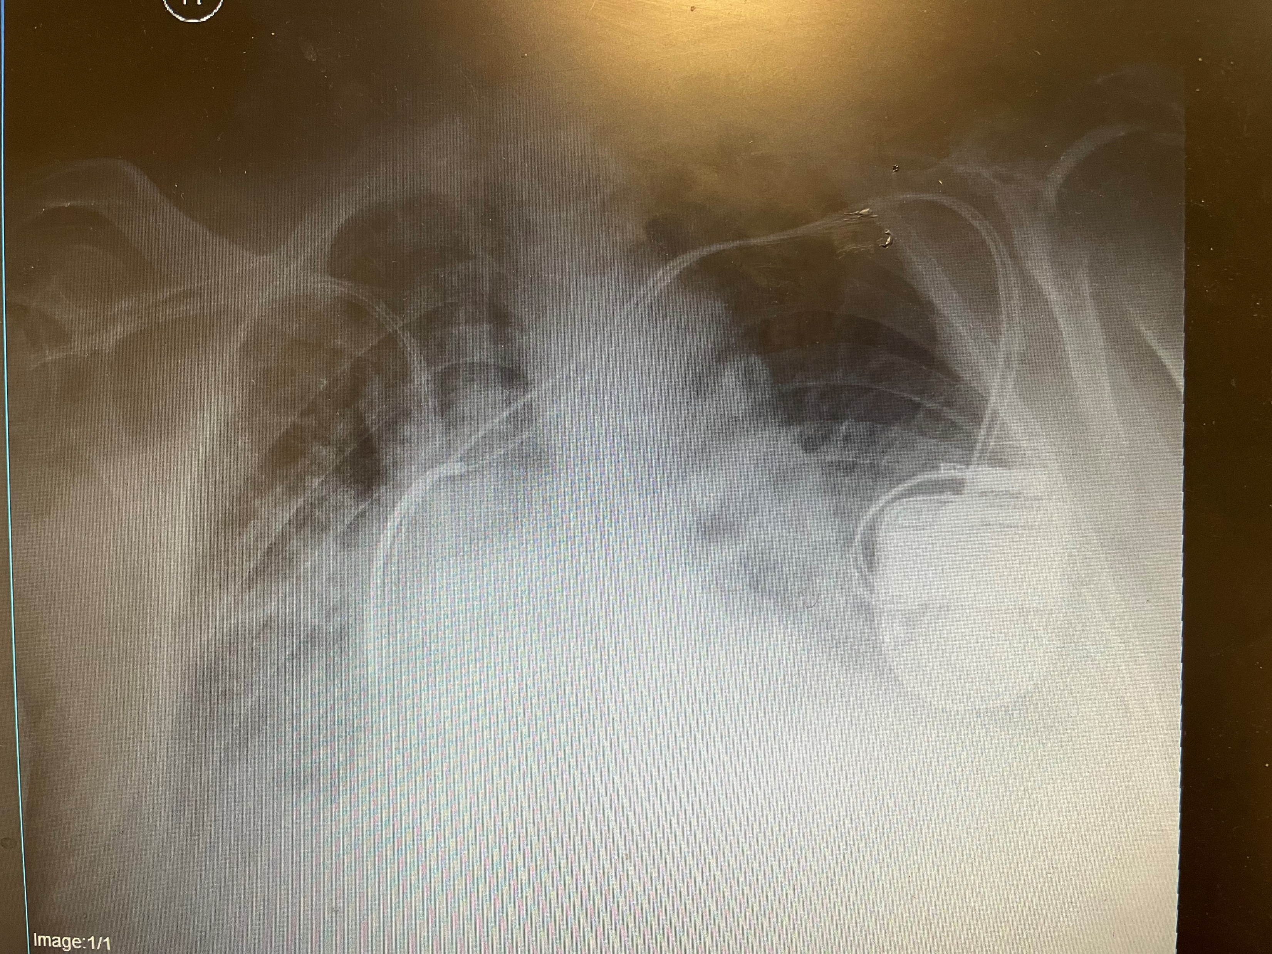
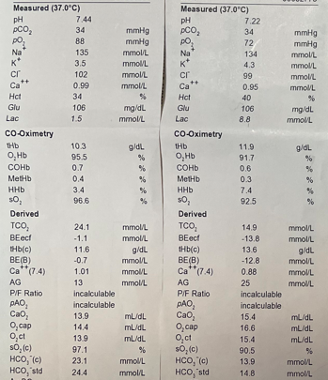
Initial management
DAY | 1 | 2 | 3 | UF FOR 2 HRS REMOVAL OF 2 LITERS | AFTER UF
IV FUROSEMIDE | 4 X 3 | 5 X 3 | 7x3 | ULTRAFILTRATION FOR 2 HRS REMOVAL OF 2 LITERS | 2500 IU bolus Heparin for continuous UF (enoxaparine stopped)
TB METOLAZONE 5MG | 1/2 | 1/2
URINE |  | 1600 | 950
CR | 3.3 | 3.2 | 3.8 |  | 3.9
BUN | 169 | 173 | 176 |  | 193
GLUC | 165 | 170 | 150 |  | 106
HT | 35.6 | 33 | 38 |  | 36
HB | 10.6 | 9.7 | 10.6 |  | 10.3 (8.5)
PLT | 90 | 73 | 80 |  | 57
SGOT | 55 | 38 | 39 |  | 146
SGPT | 21 | 22 | 22 |  | 49
LDH | 391 | 212 | 220 |  | 612
Chol | 1.8 | 1.7 |  |  | 2.9
APTT | 39 | 45 | 41 |  | EXTREME
INR | 1.5 | 1.6 | 1.5 |  | EXTREME
hemodilution
SpO2: 85% > 97% at FiO2 100%
Before UF
After UF
Additional treatment: SC Enoxaparine 0,4ml x 1, IV Piperacillin + Tazobactam 2,25 x 4, Neb ipratropium x 3, Neb budesonide x 2, Nasal O2 4L

Slide 17
AFTER CLASSIC 2hr UF SESSION
MANAGEMENT
Patient in coma – unresponsive to pain
Severe metabolic acidosis (pH=7.05, Lac=12, HCO3=10)
BP: 85/55 mmHg – no urine output
Clinical and laboratory manifestation of shock liver and probably acute ischemic adrenal insufficiency (increased LFTs, Gluc=10mg/dL)
Hemorrhagic tendency (Hyperheparinemia in the context of hepatic impairment/ HIT/ DIC?)
Drop in Ht/Hb and PLTs
Started continuous ultrafiltration
Rapid correction of glucose and pH with DW35% and NaHCO3
Treatment of adrenal insufficiency with IV hydrocortisone
Shock management with noradrenalin and dobutamine at moderate doses
STOP IV Heparin
Transfusion of 2 x FFPs and 1 x RBCs (persistent bleeding)
Use of 1mg Protamine Sulfate as an extreme measure to stop bleeding disorder
Continuous monitoring of vital signs, coagulation, Ht, ABGs

Slide 18
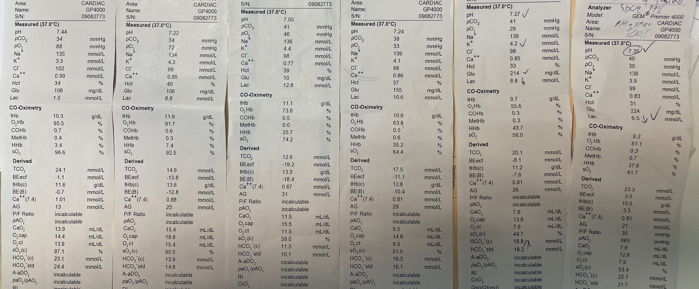

Slide 19
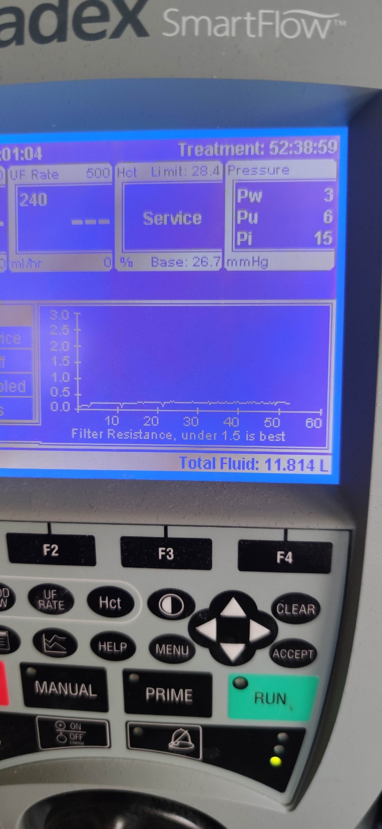
Initiation of continuous UF
Patient awake – fully responsive - Eating breakfast at bed. Oedema greatly reduced.
After correction of coagulation IV heparin was reinitiated.
Patient entered polyureic phase (IV furosemide remained at 7x3).
N/S was added at 60ml/hr.
UF stopped after 52 hrs of continuous function and IV heparin was stopped.
Gradual weaning from inotropes, stopped N/S, reduction of IV furosemide.
Total ultrafiltrate: 11,814 liters in 52 hrs.
Total urine output since application: 9,250 liters.
DAY | 3 | 4 | 5 | 6
ULTRAFILTRATE |  | 6000 | 5800 | stopped
URINE |  | 1250 | 5000 | 3000
CR | 3.9 | 4 | 3.8 | 3.5
BUN | 193 | 210 | 222 | 192
GLUC | 106 | 197 | 186 | 103
HT | 36 | 29.5 | 30.4 | 31.1
HB | 10.3 (8.5) | 8.9 | 9.4 | 9.7
PLT | 57 | 65 | 55 | 64
SGOT | 146 | 398 | 513 | 595
SGPT | 49 | 186 | 257 | 310
LDH | 612 | 780 | 922 | 790
Chol | 2.9 | 3.3 | 3.7
APTT (restart Heparin) | - | 52 | 73 | 66
INR (restart Heparin) | - | 2.3 | 2.5 | 2.1

Slide 20
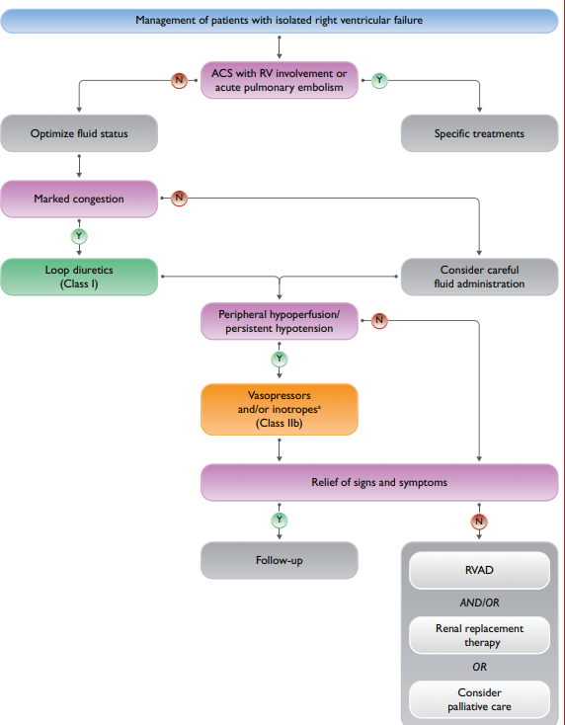
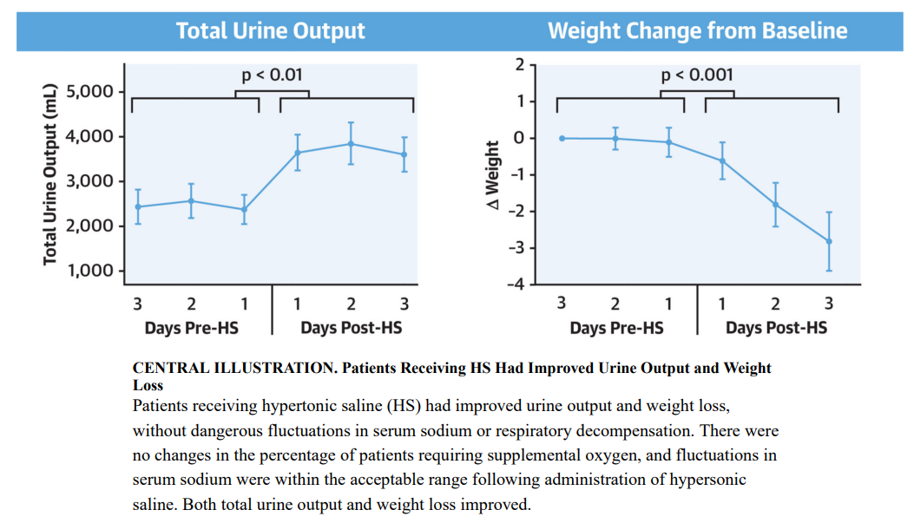
Right Heart Failure
How can we handle fluid balance in RHF?
Real World Use of Hypertonic Saline in Refractory Acute Decompensated Heart Failure JACC HF 2020

Slide 21
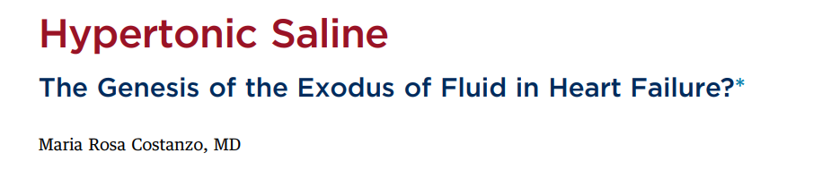
JACC: HEART FAILURE 2020
Among 248 patients with acutely decompensated HF, compared to those randomly assigned to highdose intravenous furosemide alone, the patients given the same LD dose in a small volume of HSS had greater reduction in concentrations of serum Trop I (independent risk factor for mortality in ADHERE study)
It was hypothesized that a bolus infusion of hypertonic saline can mobilize fluid from the interstitial space to the intravascular compartment through osmotic forces, thereby restoring effective intravascular volume, enhancing renal blood flow and improving the delivery of diuretic agents to the loop of Henle
Which is the most appropriate HSS, 1.4%, 3%, or 7.5%? How should a specific HSS be chosen? Should such selection be based upon serum sodium, blood pressure, severity of renal dysfunction, degree of diuretic resistance, or a combination of these variables?

Slide 22
The role of continuous ultrafiltration in severely ill patients admitted with acutely decompensated congestive heart failure and diuretic resistance.
ESC congress 2023
Methods: Twenty-seven consecutive patients with refractory ADCHF who underwent continuous UF, aged 69(11) years old (range 45-86), 21 men (78%), were recruited for this study. Major Adverse Cardiac Events (MACE) including cardiovascular death and rehospitalization were considered as the main outcomes of interest in the present analysis. Median follow-up (FU) duration was 74 days (range 3-586 days).
Results: The majority of patients had ischemic heart failure (15 patients, 55.6%) followed by valvular disease (26%). The mean hospital stay was 19 ± 12 days (range 5 – 50) and the mean UF therapy duration was 65 ± 32 hours (range 22.5 – 147). Mean time from exit to first MACE was estimated at 48 ± 41 days (range 3 – 132). 76.9% of patients were administered intravenous dobutamine, 65.4% were on noradrenaline and 27% required blood transfusion. Of note, intravenous furosemide was retained during UF at all patients. Nineteen patients (70.4%) developed MACE, four (14.8%) patients died during hospitalization, and six (22.1%) patients were re-hospitalized. Age was inversely associated with time to development MACE (b-coef (SE), -.011 (.003), p= 0.001). Body weight at baseline was positively associated with time to MACE (b-coef (SE), 3.57 (.690), p=0.004). An inverse association was noticed between NT-proBNP values at baseline and time to MACE (b-coef (SE), -1.18 10⁻⁵ (1.63 10⁻⁶), p< 0.001). However, NT-proBNP values changes during intervention were positively associated with time to MACE (b-coef (SE), .0001 (.002), p= 0.001), as well as time to CVD death (b-coef (SE), .015 (.005), p=0.05). In line with the previous findings, the higher the ultrafiltration volume the shorter the time to MACE (b-coef (SE), -5.50 10⁻⁵ (6.9 10⁻⁶), p< 0.001), as well as the time to death (b-coef (SE), -6.74 10⁻⁵ (6.7 10⁻⁶), p< 0.001). No significant associations were observed regarding the aforementioned markers with time to rehospitalization (all p-values >0.10).

Slide 23
Decompensated Heart Failure Fluid and ultrafiltration
According to the available data and experiences, continuous ultrafiltration could be considered in patients with congestion refractory to intravenous diuretics and diuretic combinations, low urine output, impaired renal function, compromised function of the right ventricle, and frequent hospitalizations for decompensated HF
It represents a method of energetic withdrawal of isotonic fluid from the venous system, performed with or without the assistance of inotropes and vasospastic drugs.
Especially for pre-load depended patients enables the energetic withdrawal of isotonic fluid from the venous system under a controlled rate according to the patient’s vital signs, without excessive neurohormonal activation
Concomitant use of IV furosemide in low doses / NS fluids can offer additive decongestion (chloride theory)
Chrysohoou C Nutrients 2022, 14, 1386

Slide 24
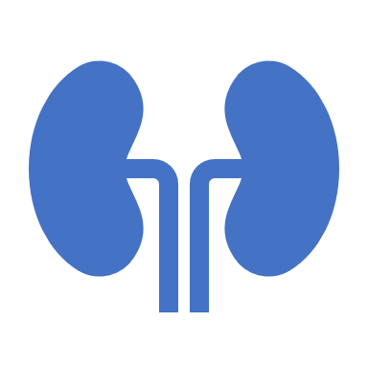
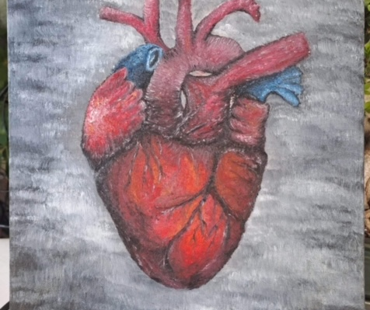
Cardio-renal syndrome: an entity cardiologists and nephrologists should be dealing with collegially
Alberto Palazzuoli • Claudio Ronco
Heart Fail Rev (2011) 16:503–508

