Slide 1
AKI in Cardiac Surgery
Athanasia Kapota
Consultant Nephrologist
Nephrology Department
General Hospital of Athens Hippokration

Slide 2
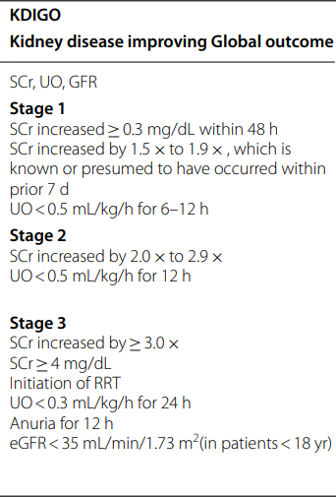
CSA-AKI: Cardiac Surgery associated Acute Kidney Injury Definition
Any patient who has undergone cardiac surgery in the previous 7 days and meets the KDIQO criteria for Acute Kidney Injury can be considered to have Cardiac Surgery-related Acute Kidney Injury
CSA-AKI can be classified as type 1 Cardiorenal Syndrome (acute CRS)

Slide 3
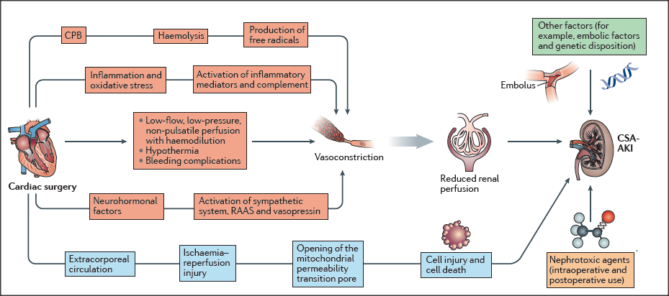
Pathophysiology
Renal hypoperfusion
Ischaemia - reperfusion Injury

Slide 4
CSA - AKI
The incidence of CSA-AKI is as high as 40% (studies based on KDIQO criteria)
Τhe second leading cause of AKI in the Intensive Care Units (ICU)
Αpproximately 3% of patients require Renal Replacement Therapy (RRT) – 30day mortality : 60%
25% will develop CKD
5-year survival 54%, 7-year survival 38%
It is independently associated with 3-8 times higher mortality, prolonged ICU hospitalization
Highest cost ($1 billion in 2022 in the United States)

Slide 5
Diagnosis of CSA-AKI
Early diagnosis is critical
AKI has no specific treatment
However, current diagnostic criteria are not suitable for rapid identification of AKI.

Slide 6
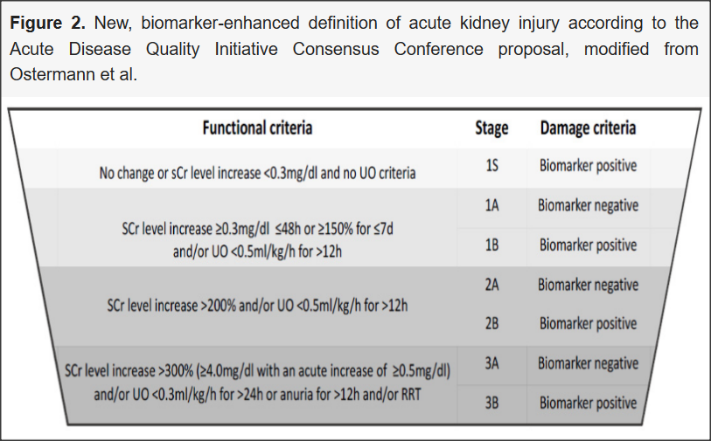
Biomarkers
> 60 biomarkers in serum and urine
Urine biomarkers more rapidly detect subclinical AKI
No validated diagnostic thresholds have been established
They have not been put into clinical practice
ADQI (Acute Disease Quality Initiative) proposed the inclusion of biomarkers in KDIGO staging
Ostermann M, Zarbock A, Goldstein S, Kashani K, Macedo E, Murugan R, et al. Recommendations on acute kidney injury biomarkers from the acute disease quality initiative consensus conference: a consensus statement. JAMA Netw Open. 2020

Slide 7
Biomarkers in CSA-AKI
CCA (TIMP-2, IGFBP7) : cell cycle arrest : Tissue inhibitor of metalloproteinases-2 (TIMP-2) and Insulin-like growth factor-binding protein 7 (IGFBP7)
Commercially available
The PrevAKI multicenter RCT showed a reduction in the incidence of stages 2 and 3 AKI after cardiac surgery, after detecting high-risk patients defined as [TIMP 2]×[IGFBP7]≥0.3
Zarbock A, et al. Prevention of cardiac surgery-associated acute kidney injury by implementing the KDIGO guidelines in high-risk patients identifed by biomarkers: the PrevAKI-multicenter randomized controlled trial. Anesth Analg. 2021
Urinary, Plasma, and Serum Biomarkers’ Utility for Predicting Acute Kidney Injury Associated With Cardiac Surgery in Adults: A Meta-analysis Julie Ho et al, Am J Kidney Dis. 2015

Slide 8
Imaging Indicators
Renal arterial Resistance Index (RRI) =(systolic velocity—diastolic velocity)/systolic velocity
Intraoperative RRI increase > 0.68 appeared to be an independent predictor of postoperative AKI. 70% sensitivity
Intraparenchymal renal resistive index variation (IRRIV) = the percentage reduction of RRI after abdominal pressure (10% of DB).
IRRIV predicted subclinical AKI after cardiac surgery with 46.1% sensitivity but 100% specificity
Severe venous congestion in the kidney presents with a monophasic diastolic wave. Intrarenal venous blood flow patterns are an independent predictor of AKI and mortality
Kajal K, et al. Intraoperative evaluation of renal resistive index with transesophageal echocardiography for the assessment of acute renal injury in patients undergoing coronary artery bypass grafting surgery: a prospective observational study. Ann Card Anaesth. 2022
Samoni Set al. Ultrasonographic intraparenchymal renal resistive index variation for assessing renal functional reserve in patients scheduled for cardiac surgery: a pilot study. Blood Purif. 2022
Beaubien-Souligny et al. Alterations in portal vein fow and intrarenal venous fow are associated with acute kidney injury after cardiac surgery: a prospective observational cohort study. J Am Heart Assoc. 2018

Slide 9
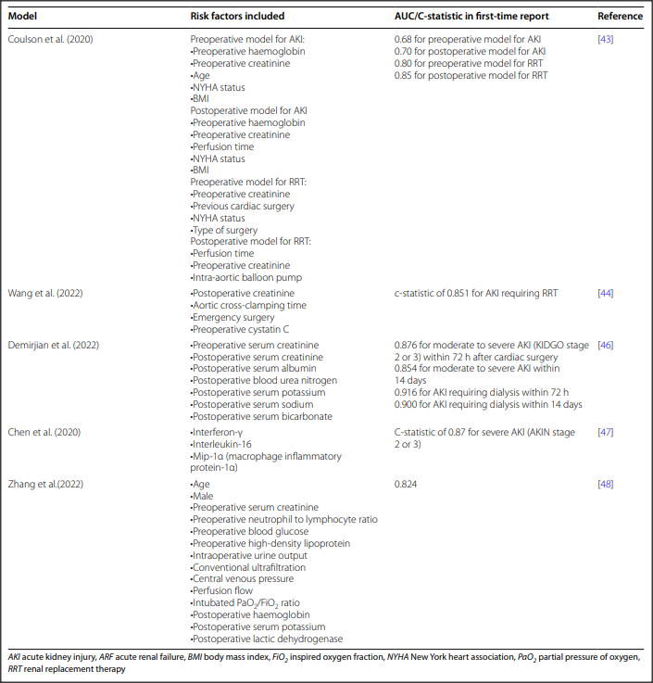
Prediction algorithms
Diagnostic accuracy 70-80%
Machine learning tools
Biomarkers, imaging indicators,
Key risk factors

Slide 10
Risk Factors

Slide 11
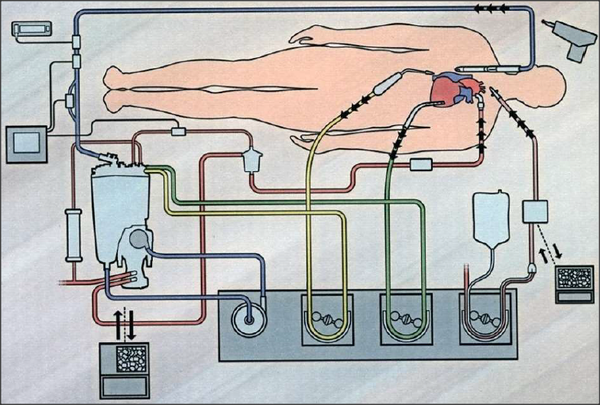
CPB: cardiopulmonary bypass
To use or not heart – lung machine
On – pump vs Off – pump

Slide 12
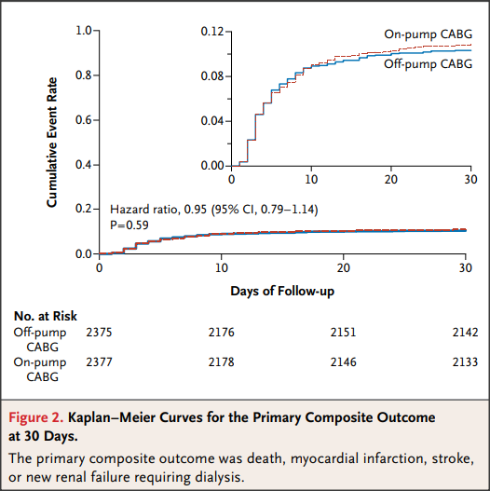
Off-pump vs on-pump
CORONARY trial (AKIN/RIFLE)
4752 pts
30 days
Primary endpoint: No statistically significant difference in AKI requiring RRT
Secondary endpoint: off-pump: fewer ΑΚΙ episodes But more revascularization episodes (PCI or CABG)

Slide 13
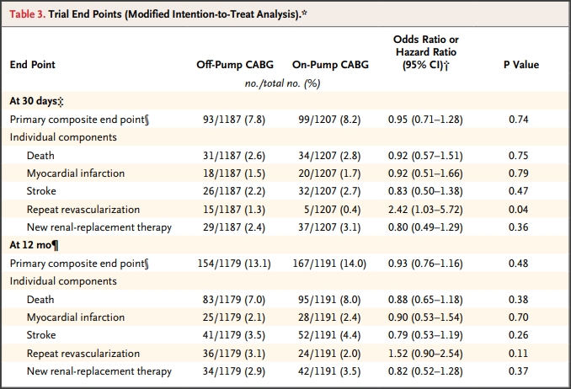
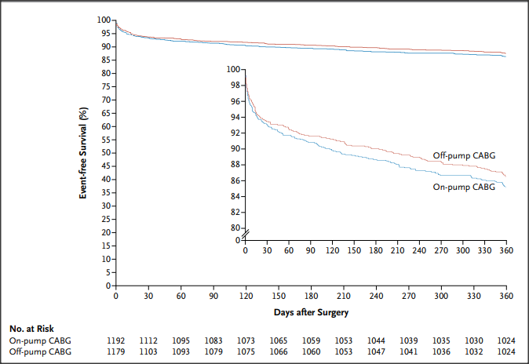
Off-pump vs on-pump
COPCABE trial
2539 pts > 75yrs
30 days and 1 year

Slide 14
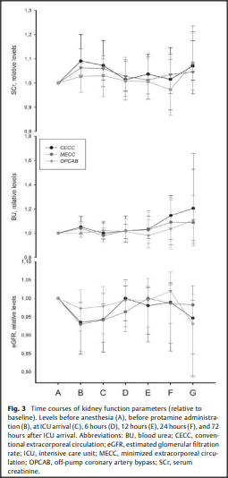
Off-pump vs on-pump
HEPCON trial
120pts
Conventional Extracorporeal Circulation (CECC) vs minimized extracorporeal circulation (MECC) vs off-pump coronary artery bypass grafting (OPCAB)
At 72 hours no difference between the 3 surgical techniques.
ΑΚΙ independent of the surgical technique at 48 hours .

Slide 15
CPB: pulsatile vs non-pulsatile
Pulsatile flow in the extracorporeal circulation creates higher circuit pressures, provides a higher mean arterial pressure to the patient, and possibly better microvascular blood flow. But it also creates greater shear forces that lead to greater hemolysis
Intravascular hemolysis leads to an acute increase in free hemoglobin, which through consumption of NO causes reduced renal perfusion. Free hemoglobin is directly toxic to the tubule.
Zihui Tan et al.Pulsatile Versus Nonpulsatile Flow During Cardiopulmonary Bypass: Extent of Hemolysis and Clinical Significance ASAIO j. Sep/Oct 2020
Vermeulen Windsant, I. C. et al. Hemolysis during cardiac surgery is associated with increased intravascular nitric oxide consumption and perioperative kidney and intestinal tissue damage. Front. Physiol. 5, 340 (2014).

Slide 16
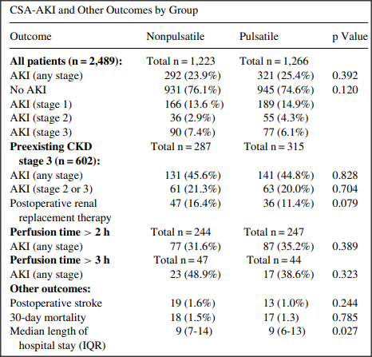
CPB: pulsatile vs non-pulsatile
2489 pts
KDIQO criteria
No difference in the incidence of AKI between the two methods
No difference in AKI stages
No difference in the incidence of AKI with prolonged use of either method

Slide 17
Management

Slide 19
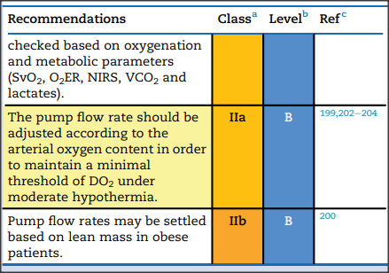
Goal-directed perfusion strategy
The concept of goal-directed oxygen delivery (GDP) refers to maintaining oxygen delivery above a critical value during CPB.
The recommended critical value during moderate hypothermia is 260–272 mL/min/m2
The EACTS/EACTA/EBCP guidelines state that the pump flow rate should be adjusted according to the arterial oxygen content to maintain a minimum threshold.

Slide 20
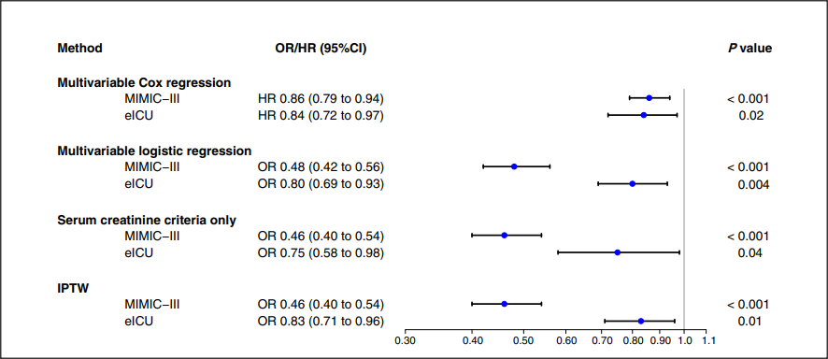
The overall incidence of severe AKI was 58% (3,390 patients) in the MIMIC-III cohort and 37% (1,431 patients) in the eICU cohort.
The benefit was consistent across sensitivity and subgroup analyses.
We have no dosage available

Slide 21
Renal Replacement Therapy (RRT)
Central role in the treatment of CSA-AKI
Continuous – RRT: the most used methods in ICUs
Continuous volume control
Hemodynamic stability

Slide 22
Renal Replacement Therapy (RRT)
What is the correct start time
What is the correct dose
What is the appropriate method

Slide 23
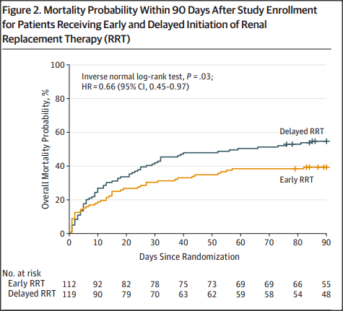
Time to start
ELAIN trial
231 pts – 108 patients after cardiac surgery
Early onset: 8 hours from KDIQO stage 2 diagnosis
Delayed onset: 12 hours from KDIQO stage 3 diagnosis
Early initiation of renal function replacement significantly reduced mortality at 90 days
Zarbock, A. et al. Effect of early versus delayed initiation of renal replacement therapy on mortality in critically ill patients with acute kidney injury: the ELAIN randomized clinical trial. JAMA (2016).

Slide 24
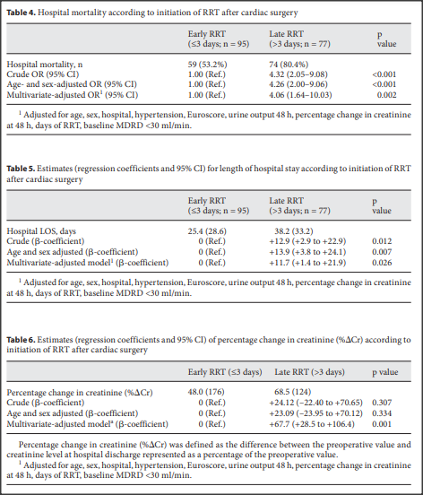
Time to start
203 pts
Early start < 3 days from the surgery
Delayed start > 3 days
Patients who underwent early RRT had better survival rates, better renal function at discharge, and shorter hospital stays
Garcia-Fernandez, N. et al. Timing of renal replacement therapy after cardiac surgery: a retrospective multicenter Spanish cohort study. Blood Purif.(2011).

Slide 25
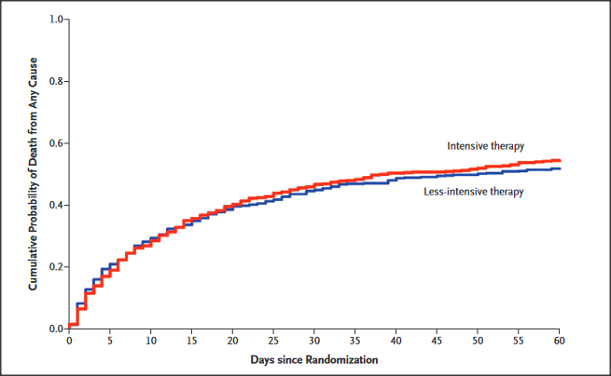
Dosage
ATN study : 1124 pts – 463 pts with CSA-AKI
High – intensity :daily IHD or CVVHD with 35ml/kg/hr
Low-intensity : IHD 3times/wk or CVVHD with 20ml/kg/hr
No difference in mortality, improvement of renal function
Meta-analysis: patients who received more extensive RRT needed more days of mechanical ventilation

Slide 26
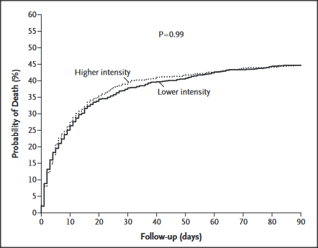
Dosage
Renal study: 1508 pts – 269 pts with CSA-AKI
CVVHD 40ml/kg/hr vs CVVHD 25ml/kg/hr
No difference in mortality at 28 and 90 days
No difference in duration of needed RRT or improvement in renal function

Slide 27
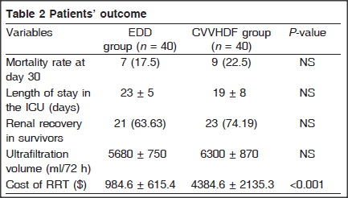
Method
80 pts with CSA-AKI
CVVHDF with 35ml/kg/hr vs EDD (extended daily dialysis) 6-8 hrs
Badawy, S., H. A. & Samir, E. M. A prospective randomized comparative pilot trial on extended daily dialysis versus continuous venovenous hemodiafiltration in acute kidney injury after cardiac surgery. Egypt. J. Cardiothorac. Anesth.(2013).

Slide 28
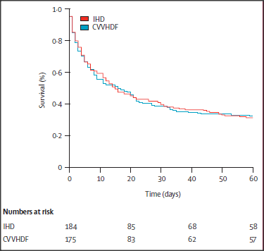
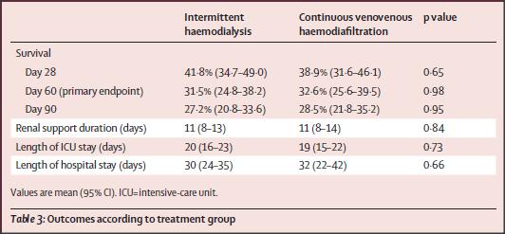
Method
360 pts -107 pts with CSA-AKI
CVVHDF ( 500ml/hr ) vs IHD 4hrs/48hrs ( low blood flow, low temperature, high sodium concentration)
Vinsonneau, C. et al. Continuous venovenous haemodiafiltration versus intermittent haemodialysis for acute renal failure in patients with multiple-organ dysfunction syndrome: a multicentre randomised trial. Lancet(2006).

Slide 29
Summarizing
High-risk patients with multiple comorbidities
Early detection
Immediate support
KDIQO approach
Open discussion on timing, dosage, method of RRT
Our purpose: the reduction of morbidity and mortality

