Slide 1
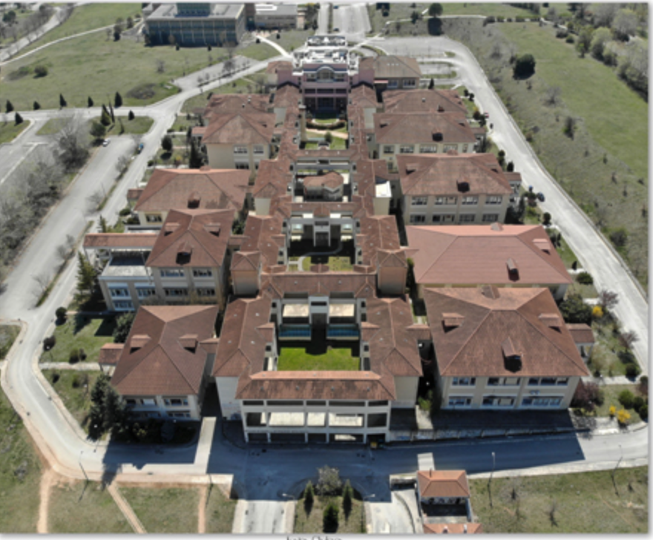


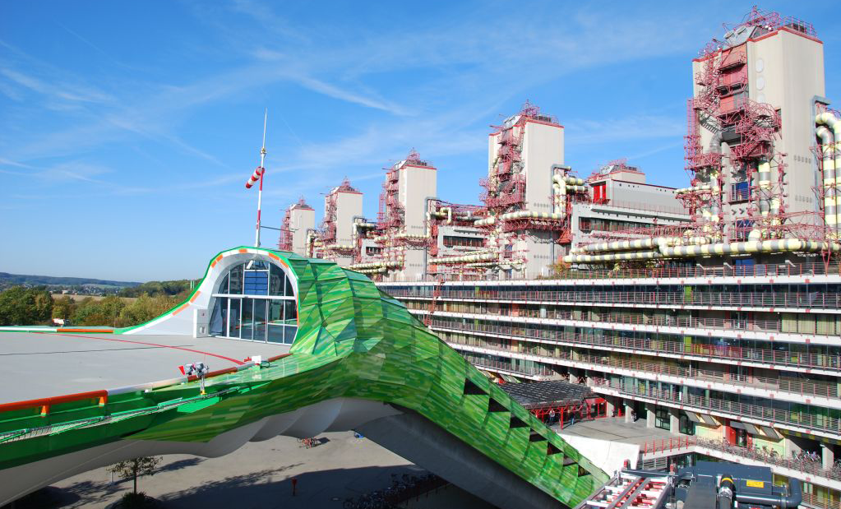
FSGS: Insights and Novel Treatment Perspectives
Eleni Stamellou, MD, PhD, M.Sc
Department of Nephrology, School of Medicine, University of Ioannina, Ioannina, Greece.
Department of Nephrology and Clinical Immunology, RWTH Aachen University Hospital, Aachen, Germany
University of Ioannina
Notes:
1

Slide 2
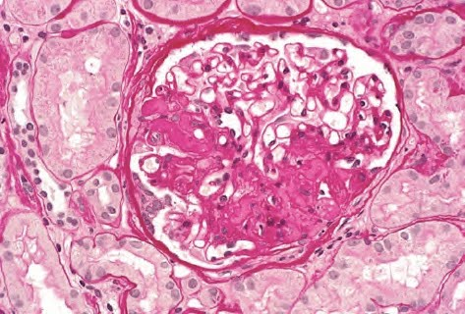
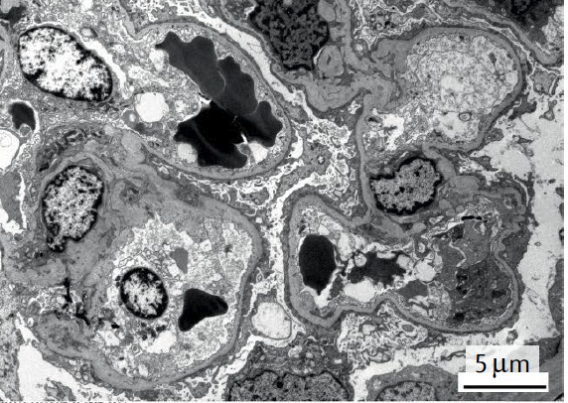
Patient #1
A Caucasian female, 23 years old with abrupt onset of full nephrotic syndrome:
  approx. 10 kg increase in body weight
  24h urine protein 12g/day
  Total protein 38 g/l
  Serum Albumin 15 g/l
LM: 21 Glomeruli. 1 globally sclerotic and 5 FSGS. Diffuse and severe tubular degenerative changes. No interstitial fibrosis
EM: complete FPE
Notes:
I will use 2 cases which will spring board this discussion. The first Patient is a caucasian woman in her thirties and she develops an abrupt onset of full NS . Proteinuria was..and the kidney biopsy showed primary FSGS

Slide 3
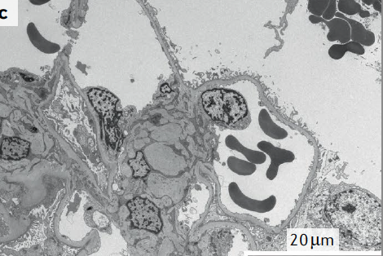
Patient #2
A Caucasian male, 28 years old with:
24h urine protein 6g/day
Normal total protein and serum albumin
No edema, increased BP (150/100mmHg)
Light microscopy: 18 glomeruli: 2 global sclerotic and 3 with FSGS
Electron Microscopy: partial FPE
→Primary FSGS

Slide 4
Are these patients the same?
Notes:
How would you manage these patients?
Are theese patinets the same?

Slide 5
FSGS
FSGS is a lesion and not a disease
It can be a result of a wide array of pathogenic processes
It cannot be purely diagnosed based on histology.
Notes:
5
We know is that FSGS is a histopathological ‘pattern of injury’ seen on light microscopy and NOT a specific disease entity.
The principal abnormality on electron microscopy (EM) is a variable degree of podocyte foot process effacement

Slide 6
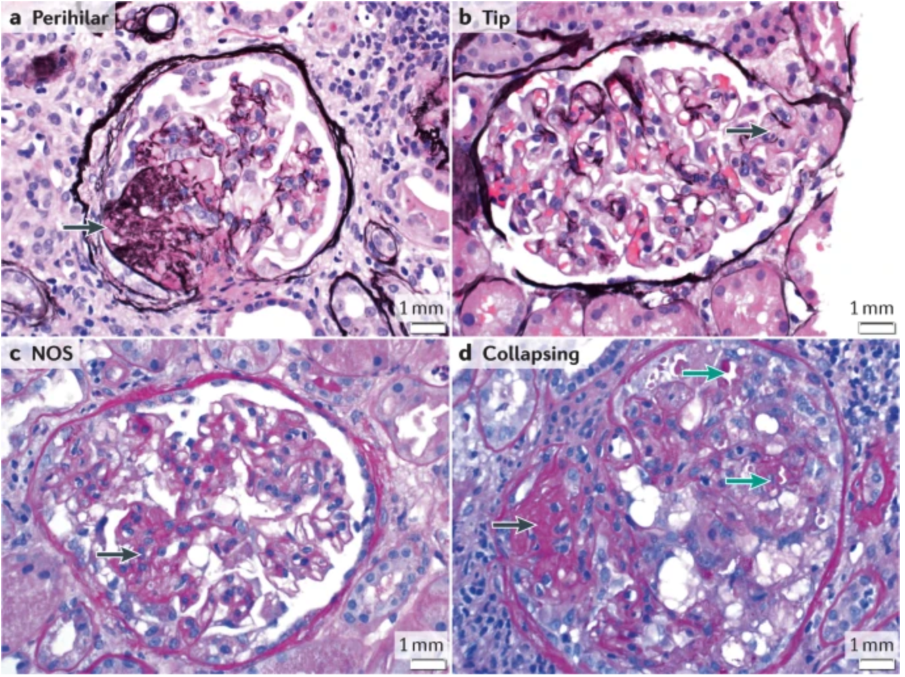
Does the histological subtype have
prognostic relevance?
D‘Agati VD Am. J. Kidney Dis. 43, 368–382 (2004).
Notes:
There five subtypes according to the Columbia classification collapsing, tip, cellular, perihilar and not otherwise specified
However this classification is based on LM examination only and does not take into account the degree of FPE on EM.
Still we do not know the factors that are responsible for these different histologic variants
What we know??
1. The collapsing variant is associated with the worst prognosis
2. A tip lesion, is generally found in therapy-responsive phenotypes and is associated with the best prognosis,
3. Perihilar may be is associated with hyperfiltration

Slide 7
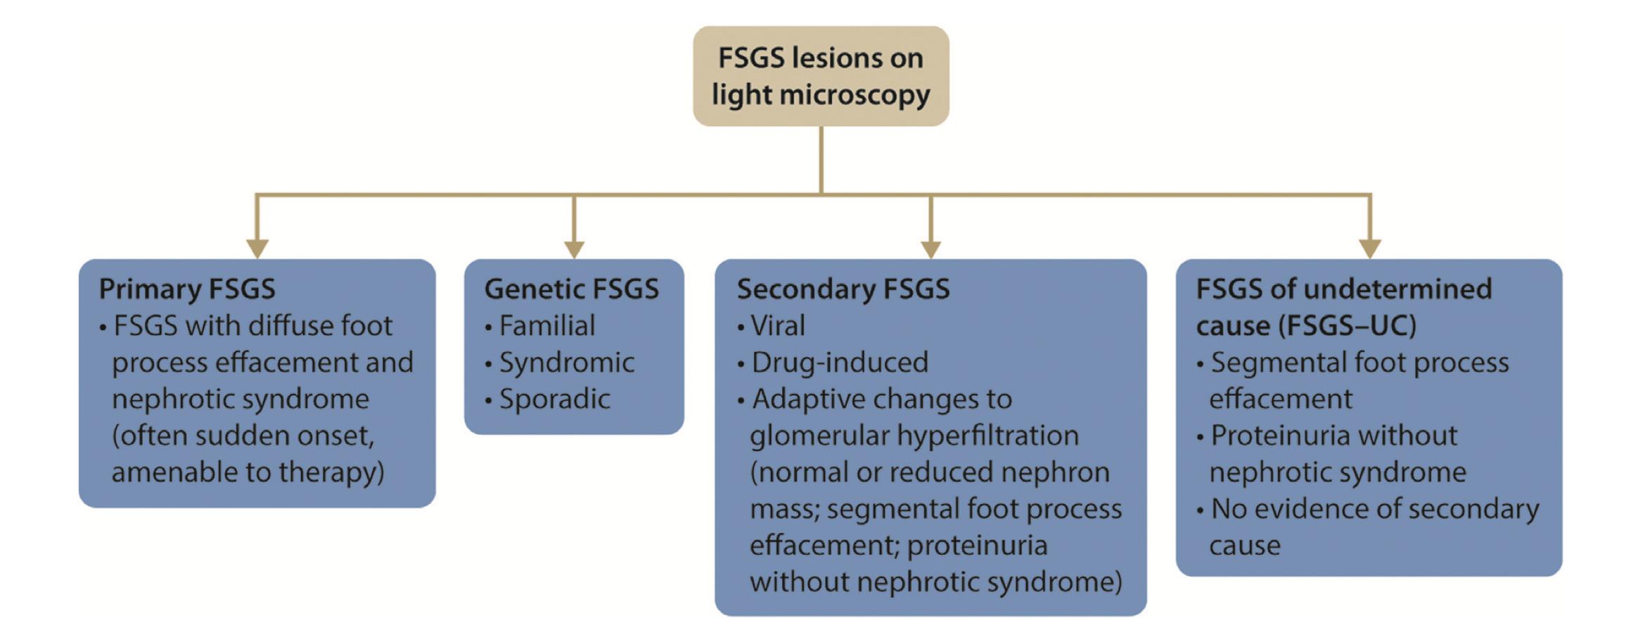

Classification of FSGS
Notes:
How to we classify our FSGS patients in our clinical practice?
This is the KDIGO classification. You can see in one side we have primary FSGS for patients whiith abruptonset of NS and diffuse FPE in EN
Then we have Secondary FSGS; with 3 completely distinct etiologies; viral and drug induced which are quite different to maladaptive
Then we have genetic FSGS which can be familial, syndromic or sporadic
Despite extensive evaluation, a clear aetiology cannot be determined for many patients with an FSGS lesion.
The clinical presentation and EM findings of these patients are often similar to those of patients with maladaptive FSGS. A study of patients with FSGS USA, showed that the cause of the lesion remained unknown in >60% of patients with features characteristic of secondary FSGS

Slide 8
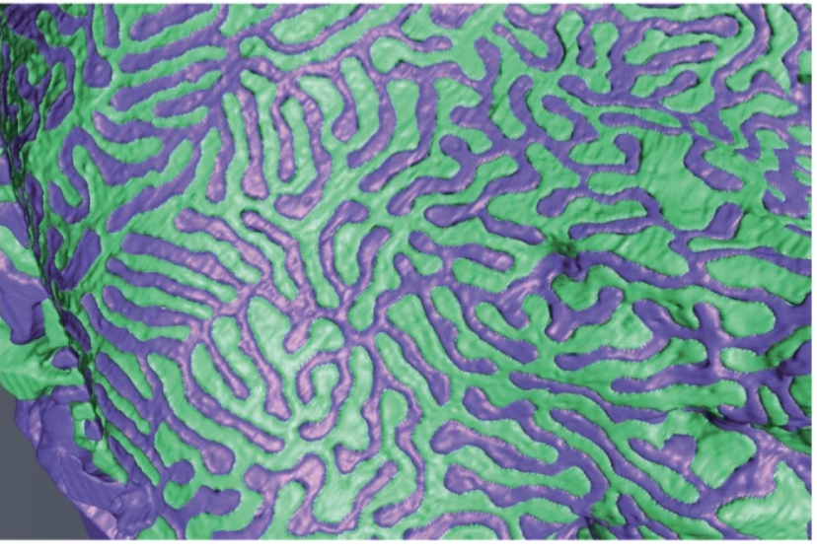
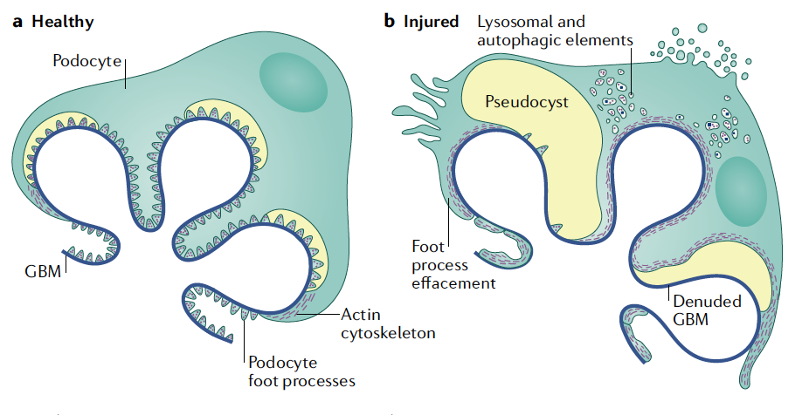
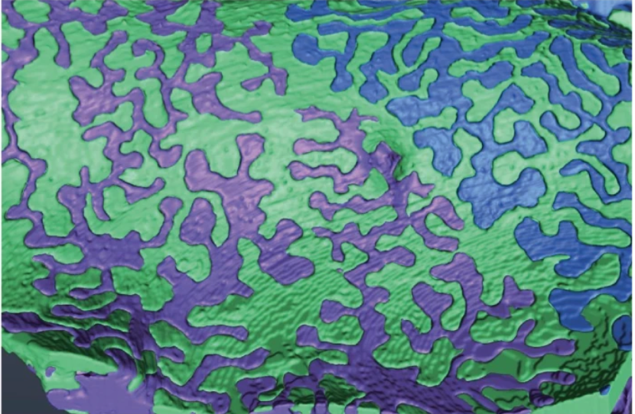
Mechanisms of podocyte injury
De Vriese AS Nat Rev Nephrol. 2021 Sep
Notes:
What is FSGS??→FSGS is a podocytopathy . The primary injury is the podocyte and we know that
Podocytes are end differentiating cells with no regeneration potential, podocyte injury leads to podocyte loss, denuded GBM , adhesion and fsgs
Podocytes respond to stress initially through loss of the interdigitating foot process pattern, → This process represents a survival strategy to broad and firm adhesion of the podocyte to the underlying GBM and prevent detachment

Slide 9
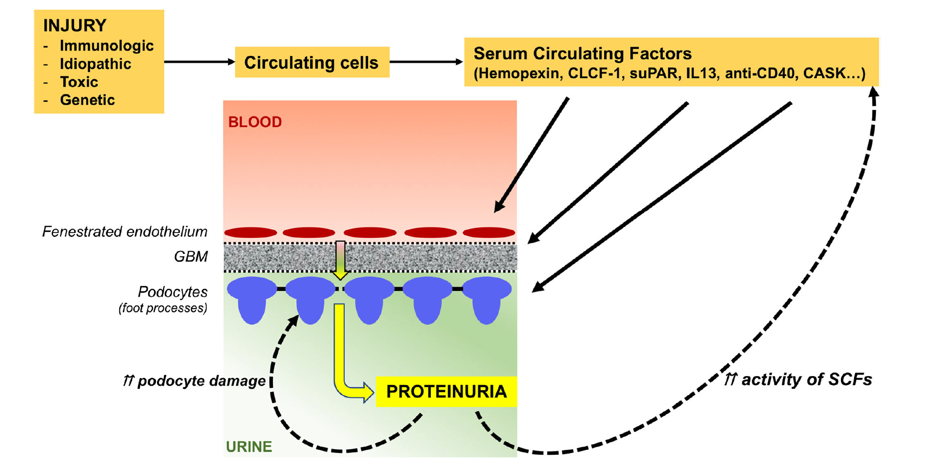
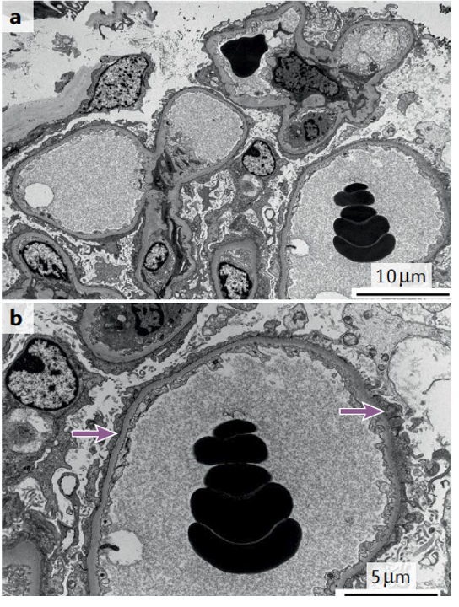
Primary FSGS = ppfFSGS
Affects ALL podocytes Diffuse FPE on EM
Candelier et al. Cell and Tissue Research 2019
Podesta M and Ponticelli C, Front Med. 2020
Notes:
Primary FSGS is presumed to be caused by a circulating permeability factor that is toxic to the podocyte and causes generalized podocyte dysfunction. The identity of the circulating factor(s) has not yet been clearly established, although several candidates have been proposed
resultant cytoskeletal dysregulation ensues in rapidly evolving and diffuse FPE

Slide 10
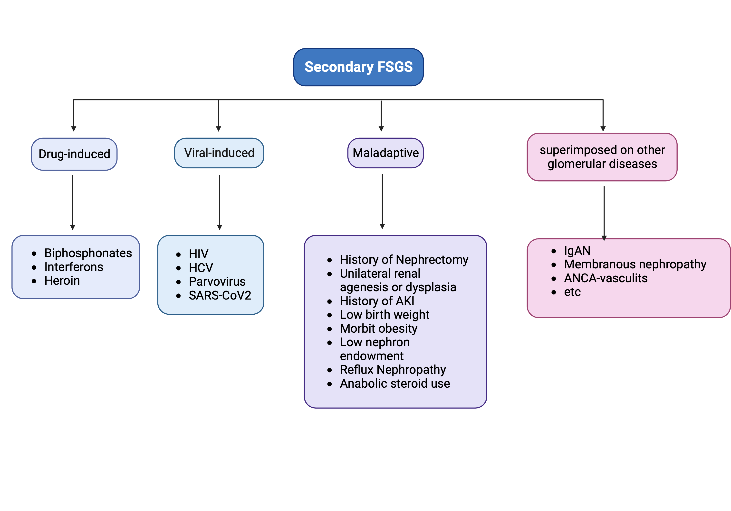
Secondary FSGS
Notes:
Secondary FSGS is an umbrella term for FSGS lesions caused by a diverse array of pathogenic events and can be subdivided in:
FSGS lesions might also be seen in other glomerular diseases (for example, sclerotic lesions in IgA nephropathy, membranous nephropathy, lupus nephritis and ANCA-associated vasculitis), but the clinical phenotype is usually dominated by the primary disease.
drug or viral induced FSGS in which direct podicyte TOXIC injury is the main pathophysiological process and which can bee presented with full NS an treatment encompasses treatment of the toxic factor either virus or drug
Maladaptive FSGS is characterized by an Increased demand on the glomerulus. Clinically patients present with nephrotic range or sunephrotic proteinuria but with normal serum albumin

Slide 11
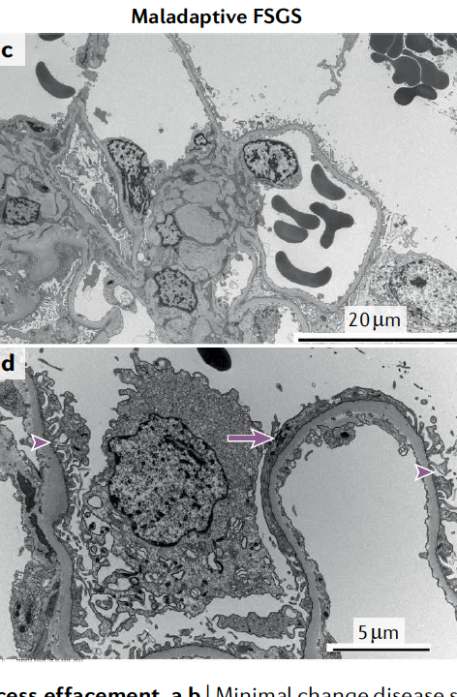
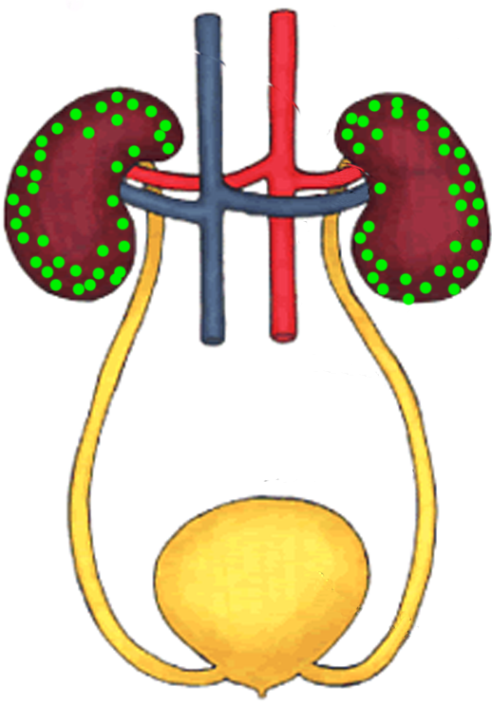
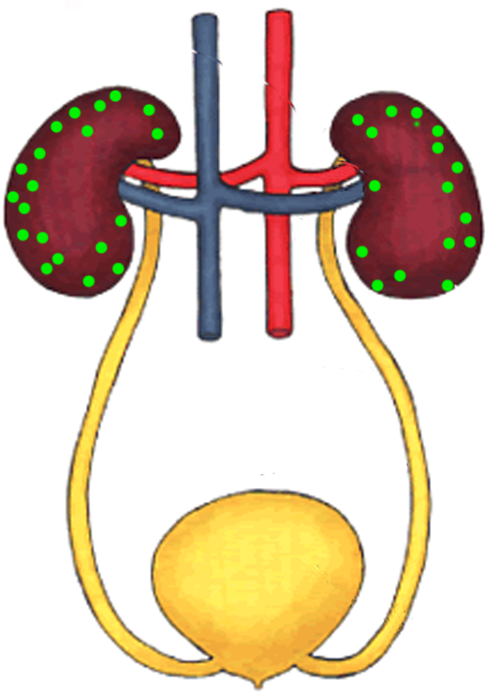
Maladaptive FSGS
Increase in total kidney GFR
congenital cyanotic heart disease
sickle cell anemia
obesity
androgen abuse
sleep apnea
high-protein diet.
Reduced renal mass
prematurity and/or small for gestation age
renal anomalies,
reflux nephropathy
AKI.
Rosenberg AC, Clin J Am Soc Nephrol. 2017
Notes:
Maladaptive FSGS occurs in conditions associated with: hyperfiltration, glomerular capillary hypertension and glomerular hypertrophy.And is characterized by
Increased hemodynamic stress: abnormal haemodynamic stress.
Reduced number of nephrons: a reduction in the number of functioning nephrons
Clinically patients present with nephrotic range or sunephrotic proteinuria but with normal serum albumin

Slide 12
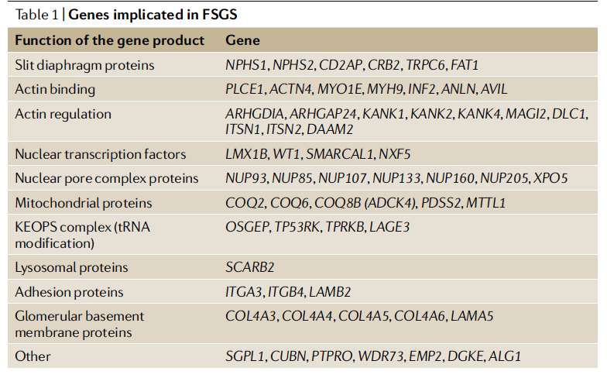
Genetic FSGS
respond to CNIs
respond to CNIs
respond favourably to RASi
Ashraf S. et al Nat. Commun. 2018 May 17;9(1):1960.
Malakasioti, G., Pediatr. Nephrol. 2020
Daina, E. et al. Nephron 2015
Notes:
Genetic FSGS may ensue from mutations in genes that encode podocyte proteins involved in slit diaphragm structure and function, actin cytoskeleton architecture and regulation, nuclear function and cellular metabolic pathways and adhesion to the GBM
mutations in COL4 genes — respond favourably to RAS inhibitors²³.
mutations in EMP2 (the protein product of which regulates CAVEOLIN-1 levels)²⁴ or in proteins that interact with Rho-like small GTPase, a key regulator of the actin cytoskeleton²⁵, respond at least partially to glucocorticoids, suggesting that glucocorticoids can exert direct effects on podocyte function.
Similarly, some mutations may respond to CNIs, although complete remissions are rare^{26,27}. Whether these therapeutic responses were the result of direct actions of CNI on the podocyte actin cytoskeleton, for example, through regulation of synaptopodin phosphorylation²⁸, or secondary to the haemodynamic effects of CNI, is unknown. The most favourable response was observed in patients with mutations in WT1 (ref.²⁷), which encodes a transcription factor that is essential for stabilization of the podocyte actin cytoskeleton.

Slide 13
Genetic FSGS
Common in infants and young children; up to 60% of children with SRNS
Large gene panels or whole exon sequencing can detect potentially pathogenic mutations in as many as 30% of adults with FSGS lesions
Proteinuria is variable
Most adult patients with persistent moderate-to-severe proteinuria progress to kidney failure, at variable rates
Notes:
Genetic FSGS is common in infants and young children and has been reported in up to 60% of children with steroid-resistant nephrotic syndrome²⁰.
adults with FSGS lesions can also harbour pathogenic mutations²¹.
Large gene panels or whole exon sequencing can detect potentially pathogenic mutations in as many as 30% of adults with FSGS lesions²².
Proteinuria is variable but can be high.

Slide 14
Genetic FSGS: When should be considered?
Mismatch between clinical presentation and EM findings
Looks like maladaptive FSGS but not cause can be identified
Appears as primary FSGS but fails to respond to therapy

Slide 15
Patient #1
A Caucasian female, 23 years old with abrupt onset of full nephrotic syndrome
  ca. 10 kg increase in body weight
  24h urine protein 12g/day
  Total protein 38 g/l
  Serum Albumin 15 g/l
  Cholesterin 327 mg/dl
Biopsy: 21 Glomeruli. 5 FSGS EM: diffuse FPE

Slide 16
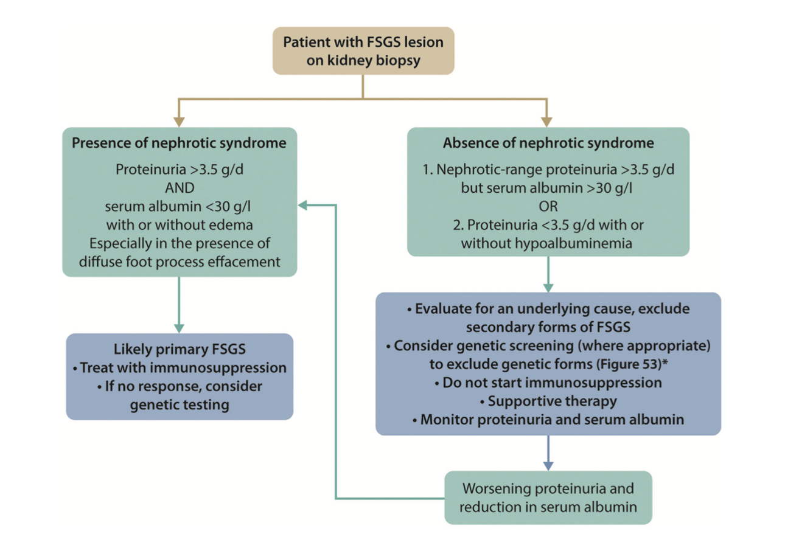
Approach to treatment with ppfFSGS
Immunosuppression
Initial immunosuppression remains high dose steroids
Strongest existing data
Treatment response helps support/refute classification of permeability factor mediated
Notes:
So this is an approach that KDIGO formulated. So If you have full NS defined by..so both oft these entities need to be present and if you have EM with…categorize these patients
So these patients should be considered for treatment
With high-dose glucocorticoids, which are the first-line therapy.
Patients who fail to respond to glucocorticoids or those with a contraindication to their use are treated with calcineurin inhibitors, particularly in patients with high risk for glucocorticoid-induced toxicity (eg, patients with obesity, diabetes, severe osteoporosis, or age >70 years
, alternative options might include mycophenolate mofetil (MMF)/enteric-coated mycophenolate sodium (EC-MPS), rituximab,

Slide 17
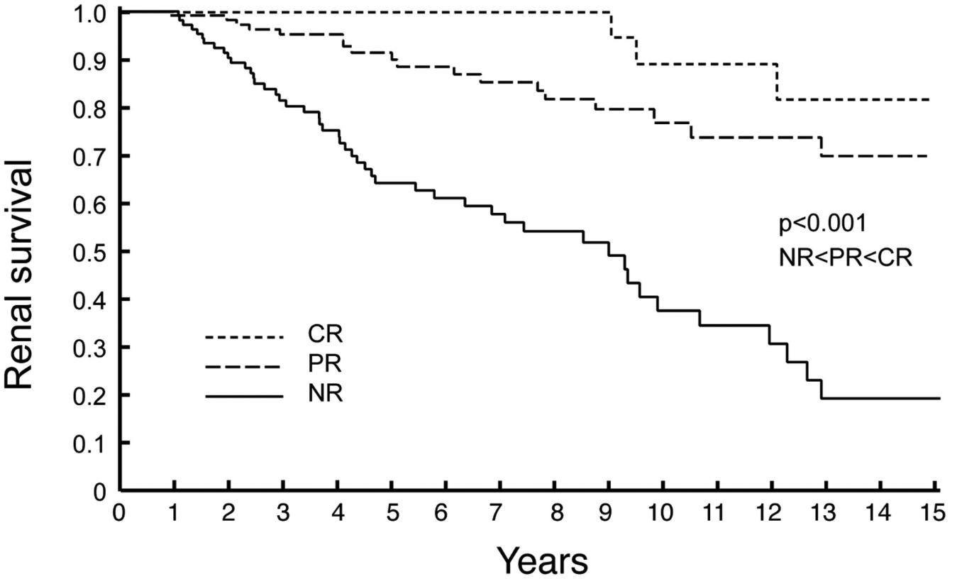
ZTtr
Goal of treatment: ppfFSGS
Study cohort 281 nephrotic FSGS patients
Troyanov S et al. JASN 2005;16:1061-1068
Notes:
CR and A PR was independently predictive of slope and survival from renal failure
That means the lower the better
A complete remission (CR) confers an excellent long-term prognosis, but the quantitative benefits of partial remissions (PR) have not been defined. This study evaluated the rate of renal function decline (slope of creatinine clearance) and renal survival in nephrotic FSGS patients with CR, PR, or no remission. It also examined relapse rate from remission and its impact on outcome. Multivariate analysis included clinical and laboratory data at presentation and over follow-up, BP control, the agents used, and immunosuppressive therapy. The study cohort was 281 nephrotic FSGS patients who had a minimum of 12 mo of observation and were identified from the Toronto Glomerulonephritis Registry. Over a median follow-up of 65 mo, 55 experienced a CR, 117 had a PR, and 109 had no remission.
A PR was independently predictive of slope and survival from renal failure by multivariate analysis (adjusted time-dependent hazard ratio, 0.48; 95% confidence interval, 0.24 to 0.96; P = 0.04). Immunosuppression with high-dose prednisone was associated with a higher rate of PR and CR. Relapse from PR was frequent (56%) and associated with a more rapid rate of renal function decline and worse renal survival compared with relapse-free partial remitters. Only female gender and the nadir of proteinuria during remission were associated with a sustained remission. A PR in proteinuria and its maintenance are important therapeutic targets in FSGS, with implications for both slowing progression rate and improving renal survival.

Slide 18
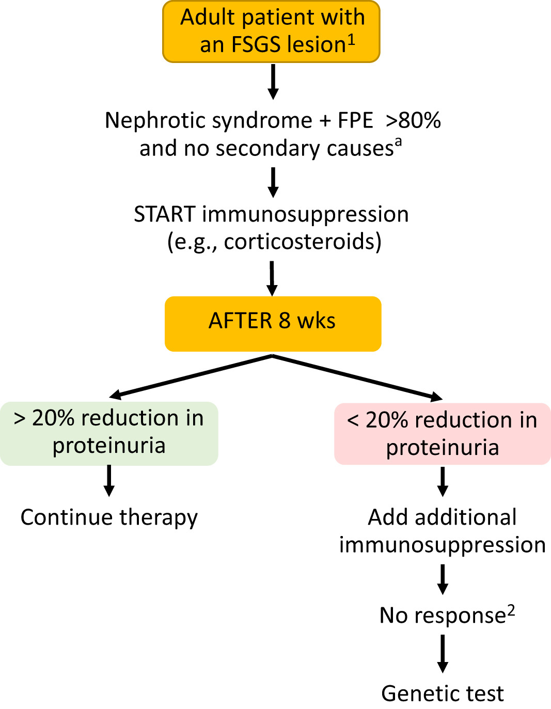
Steroid treatment in FSGS-how much and how long?
Retrospective anaylsis of cohort of 70 FSGS patients considered to be ppfFSGS treated with high dose steroids
20% or more reduction in proteinuria at week 8→strong predictor of response (partial or complete remission)
If less than 20% at 8 weeks highly unlikely to not have any response early steroid withdrawal
Kidney International Reports 2022 79-12DOI: (10.1016/j.ekir.2021.11.021)
Notes:
I think there is nothing more toxic than steroids in terms of therapeutic options.
Regarding how long, we have to intemtify early which pateints will respond, and this nicely demonstrated in a study publishes last year included 70 patients with primary nephrotic FSGS patients in this study they found that ----we suggest in ptients with less tha 20% reduction in proteinuria

Slide 19
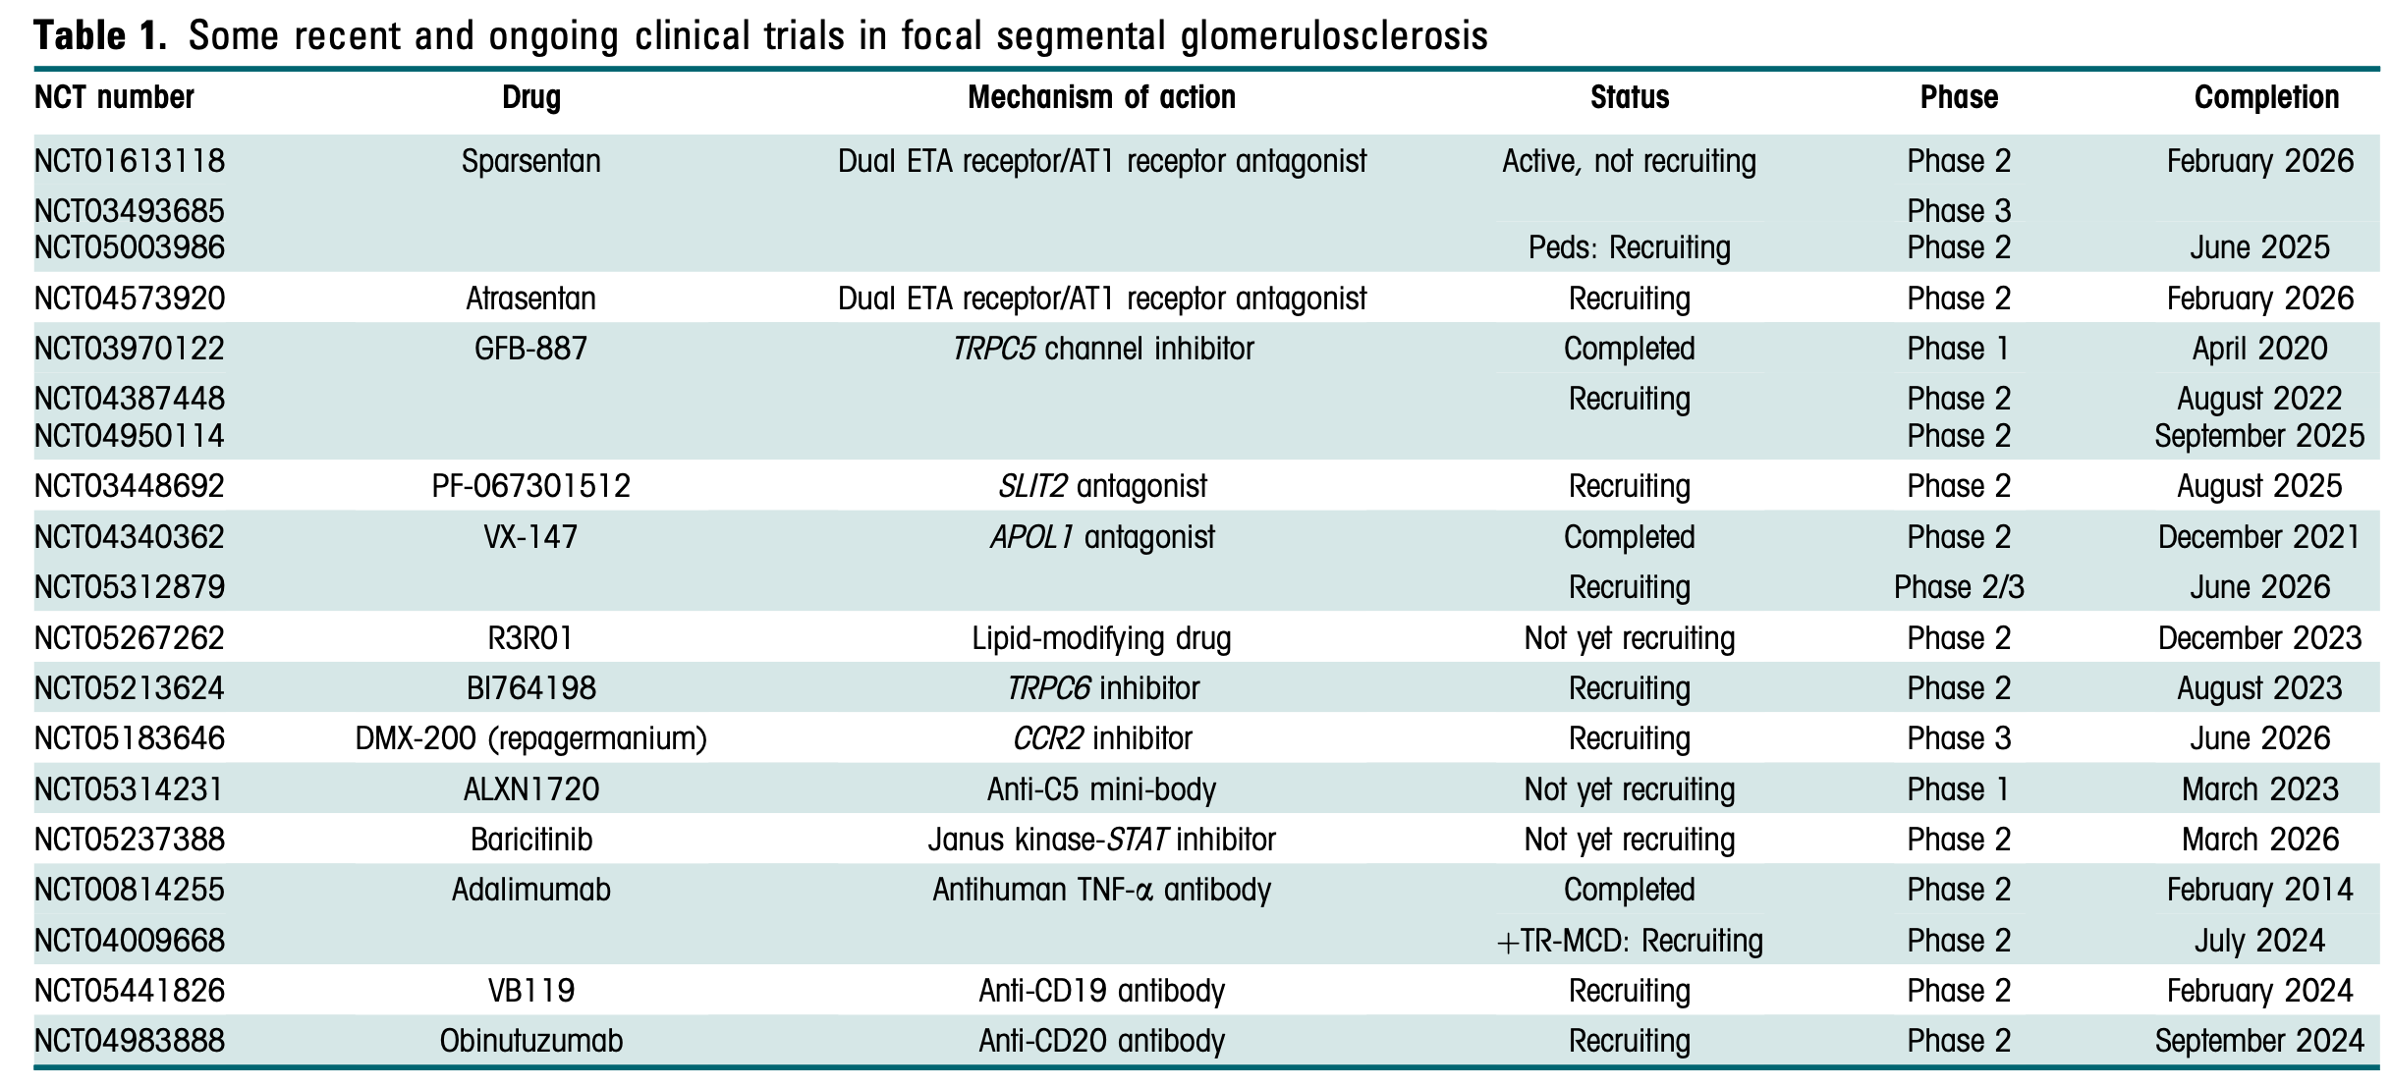
MCD and ppFSGS: what is on the horizon?
Targeting the permeability factor(s)
Suppressing permeability factor formation
Targeting haemodynamic abnormalities
Targeting geneting mutations
M de Cos et al. Kidney Int Rep (2023)
Notes:
Inntended to
to remove or inhibit the action of putative permeability factor(s) underlying ppfFSGS.
to interfere with the innate or adaptive immune response and suppress formation of the putative permeability factor(s)
to correct the haemodynamic abnormalities that promote podocyte shear stress,
developed to correct or ameliorate the injurious effects of a genetic mutation on podocyte or GBM structure or function.

Slide 20
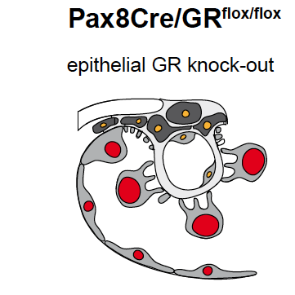
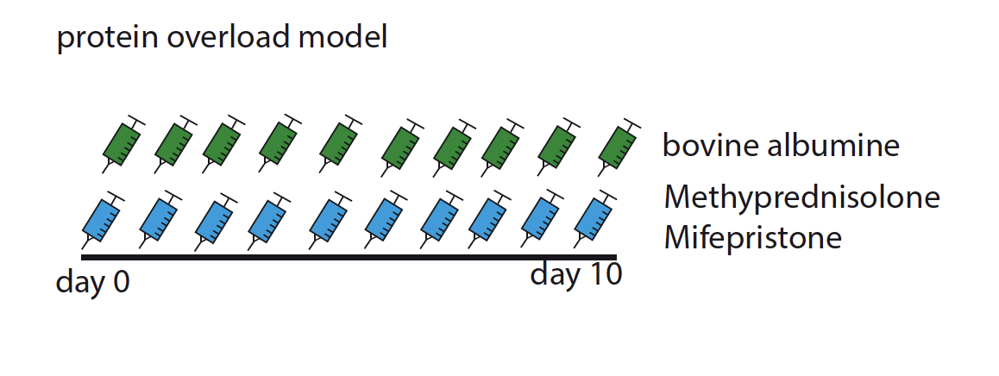
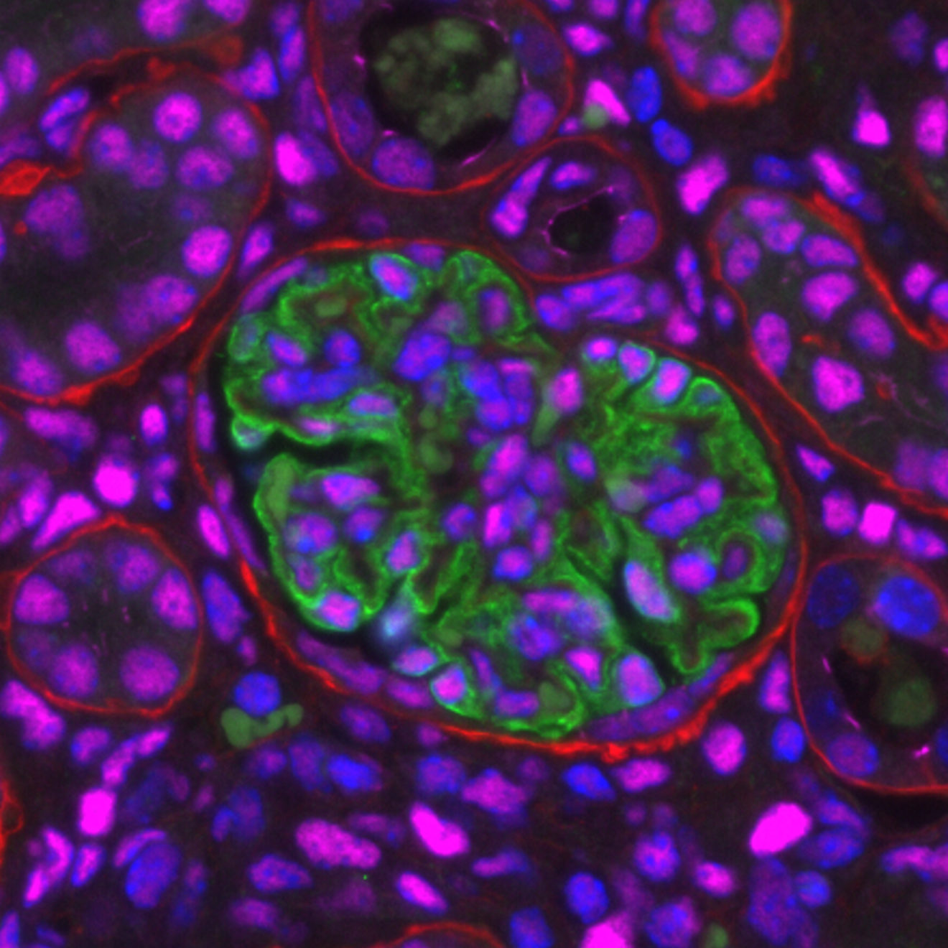
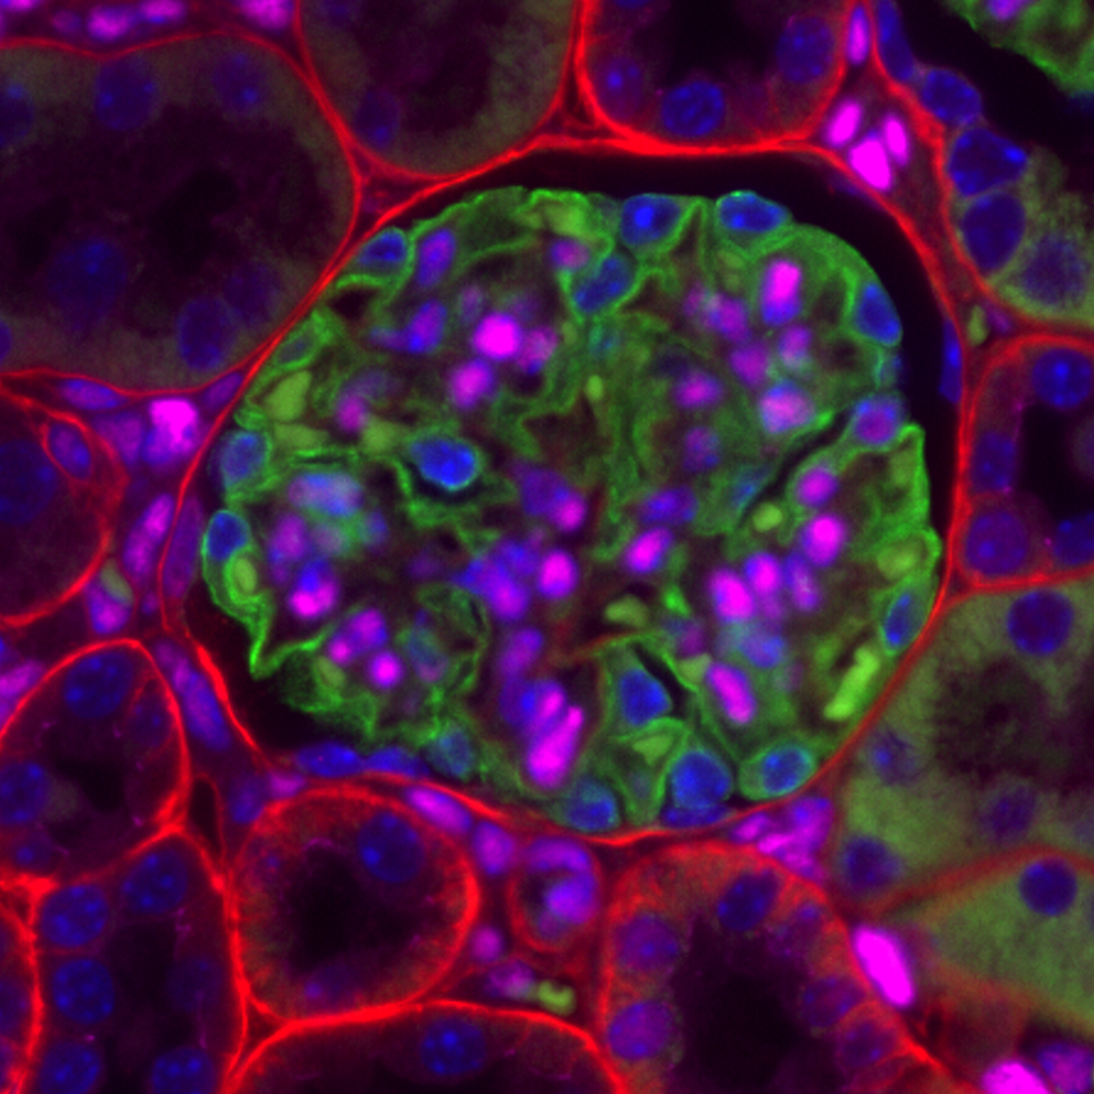
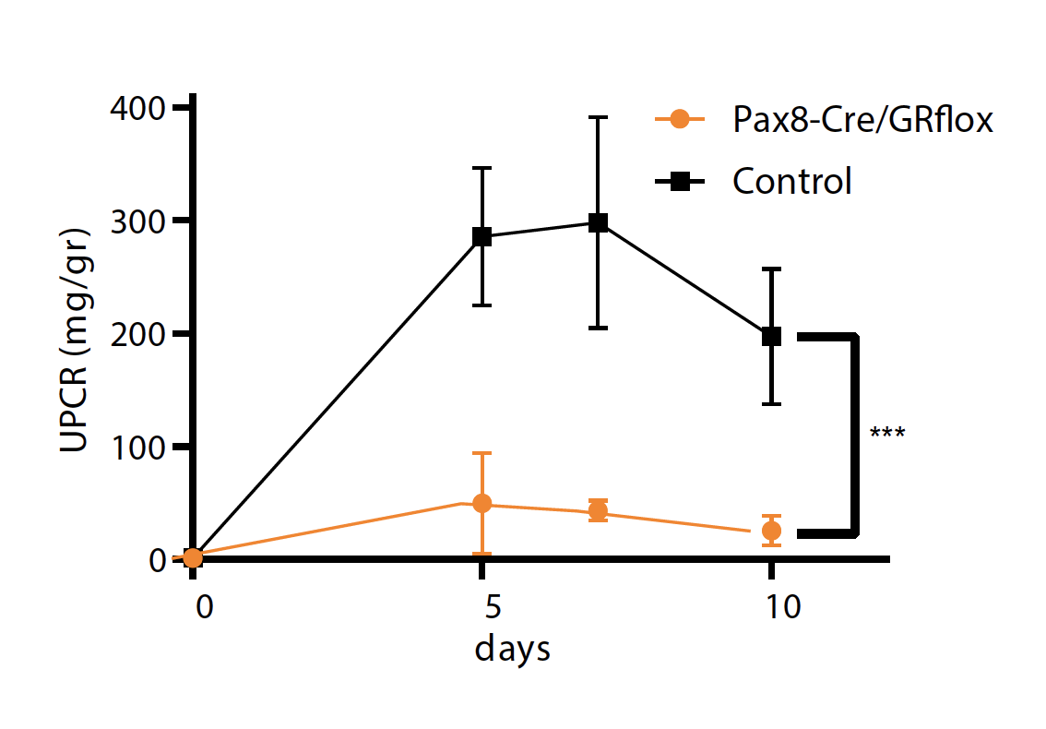
What is on the horizon? GR inhibition in nephrotic syndrome
wild-type
Pax8Cre/GR^{flox/flox}
LKIV/synaptopodin/GR
Stamellou E. et al. NDT under Revision
Kuppe et. al in revision
Notes:
20
Inactivate –knocked down the expression of GR in epithelial cells of the kidney
Next we looked for a good mouse model of MCD/FSGS : , protein-overload is a good model that results in reversible proteinuria, reversible foot-process effacement , partial steroid responsiveness
What happens if we inactivate GR signaling in podocytes?
Proteinuria is reduced 10x (!!!). That is very unexpected. We thought that proteinuria should be augmented by the KO of GR but not reduced. So inhibition of GR signaling in podocytes reduces proteinuria dramatically!

Slide 21
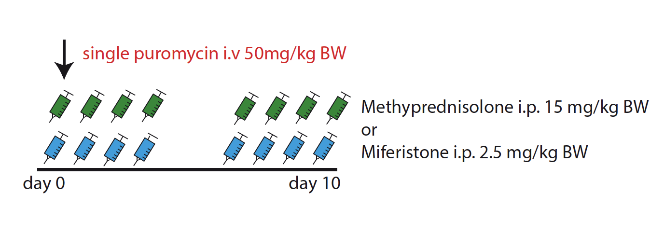
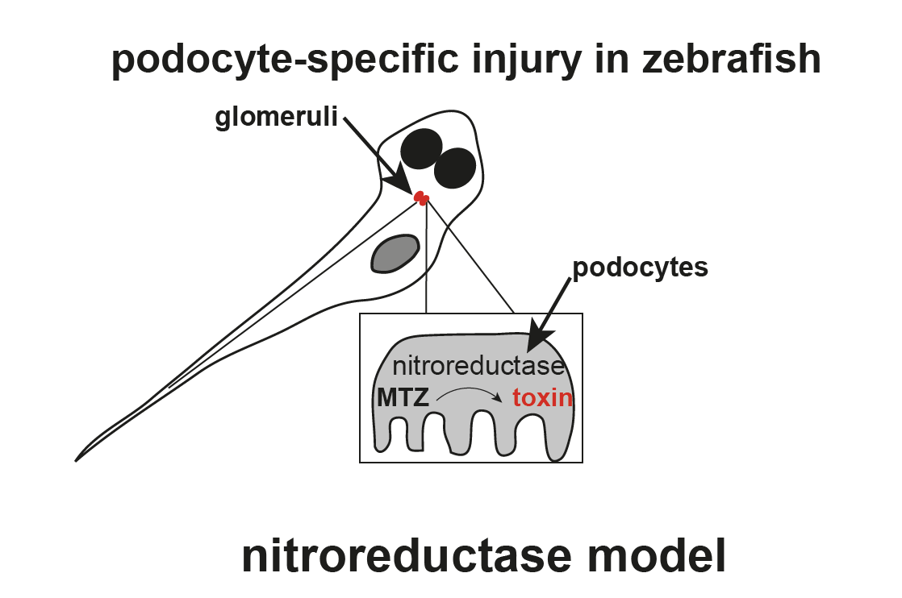
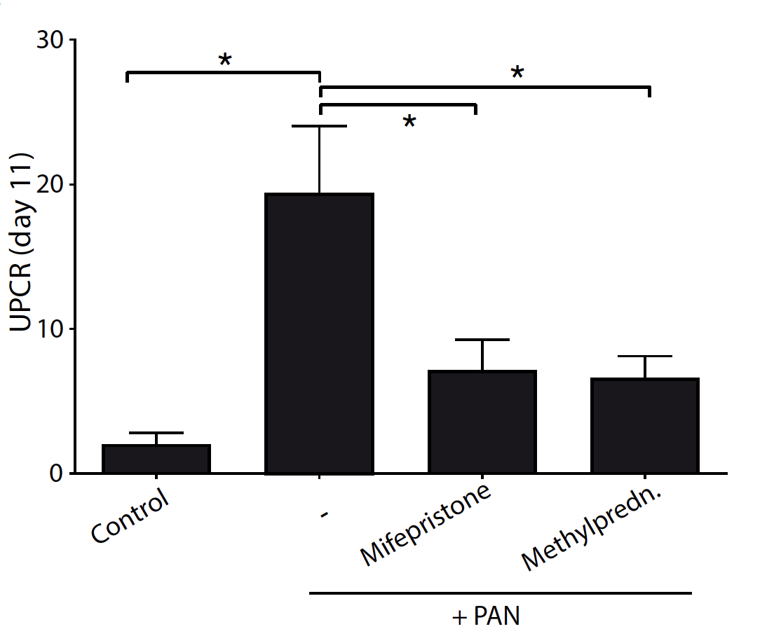
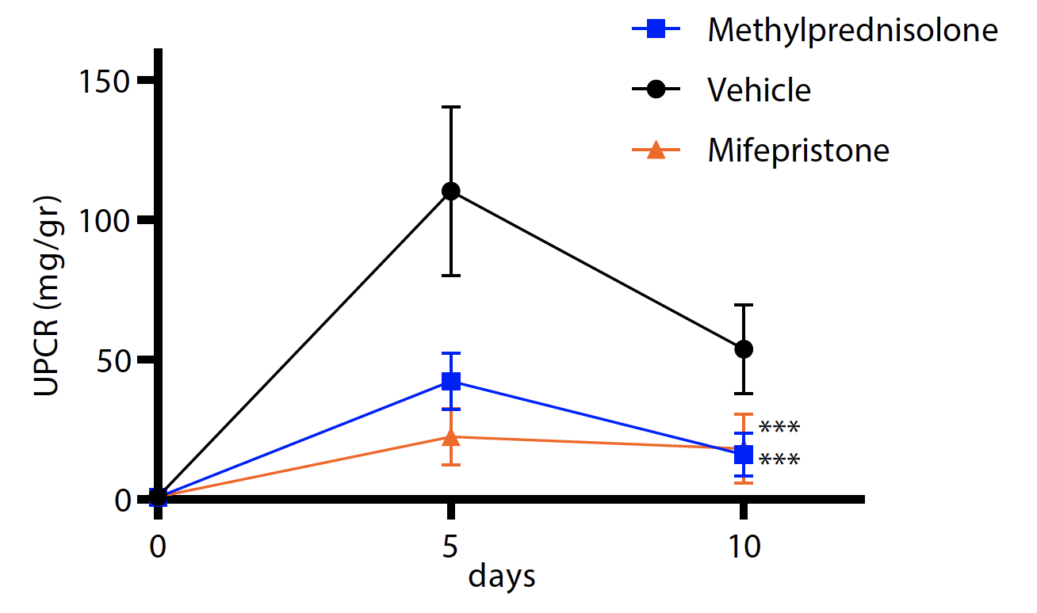
Treatment with Mifepristone
wt-mice
Rats
Zebrafish
-40%
-40%
***
***
Stamellou E. et al. NDT under Revision
Notes:
21
Next we inhibited GR pharmacologically using an antagonist of the GR, mifepristone. As you can see, this reduced proteinuria about 10x, similar to the genetic inactivation in podocytes
To validate wheter antagnosim of GR truly amelioreates proteinuria, we chose a different experimental animal and a different model for MCD: Pan nephrosis in rat. –andagain tretamnet with mifepristone reduced proteinuria as efefctively as
Okay, these are interesting results. However, rodent models for MCD are rare and still not well established. So next we used a third model and a third animal species to REALLY make sure that mifepristone reduces proteinuria: the zebra fish
In this model, administration of metronidazole causes targeted and reversible foot cell damage and edema. As seen, reduction of edema treatment with dexamethasone and mifepristone led to a proportional 40%

Slide 22
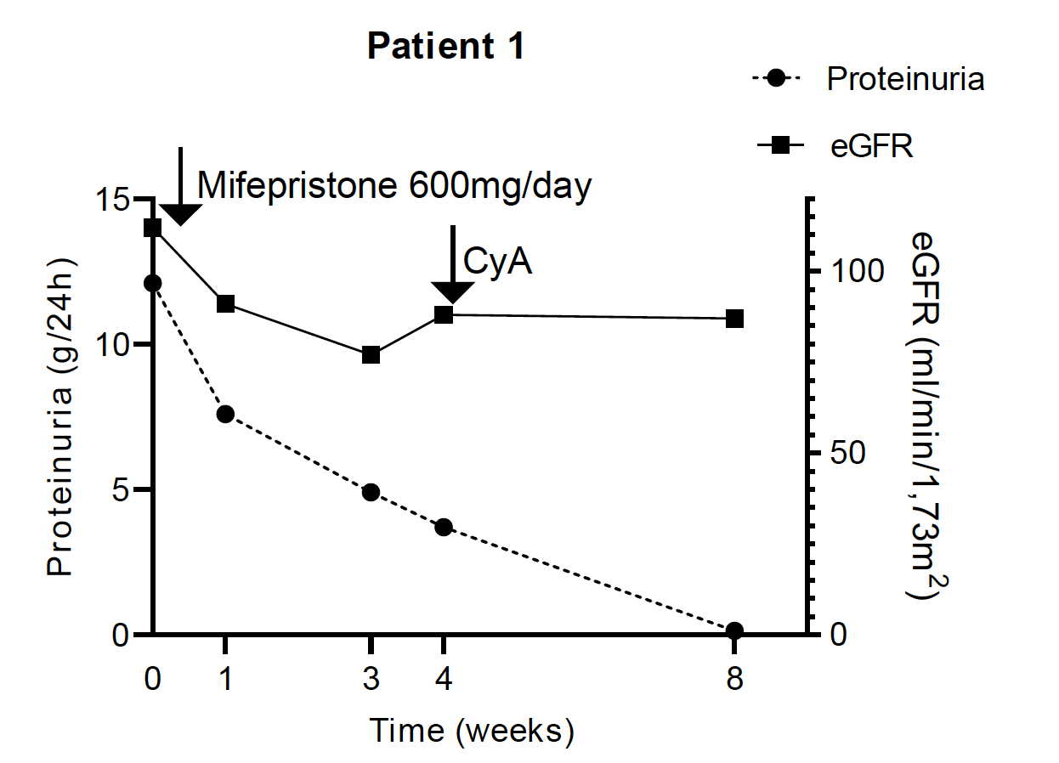
Individual patients treated with mifepristone
42-year-old man with NS , recently diagnosed with primary FSGS
BMI 38
Stamellou E. et al. NDT under Revision
Notes:
Finally, 3 individual patients from our outpatient clinic in Aachen were treated with mifepristone. Due to time constraints I will only report 1 case .
Patient 1 was a 42-year-old man with nephrotic syndrome who had recently been diagnosed with primary FSGS. Due to obesity (body mass index 38), corticosteroid therapy was not considered. After one month of mifepristone therapy, proteinuria had decreased from 12 to 4 g/day (67% reduction). At this time point, cyclosporine A (CyA) therapy was also initiated. Within one month of dual therapy with mifepristone and cyclosporine, complete remission was achieved (proteinuria <0.15 g/day)
Patient 3, a 40-year-old man diagnosed with MCD at the age of 13 years, developed relapse of nephrotic syndrome despite maintenance treatment with CyA; mifepristone was administered for approximately 6/7 weeks. Complete remission of the nephrotic syndrome was achieved within 7 weeks.
In all three patients, the drug was well tolerated and none experienced mild or severe adverse effects.

Slide 23
Patient #2
A Caucasian male, 30 years old with:
24h urine protein 6g/day
Normal total protein and serum albumin
No edema, increased BP (150/100mmHg)
Light microscopy: 18 glomeruli: 2 global sclerotic and 5 with FSGS
Electron Microscopy: partial FPE
→Primary FSGS with 40% tubulointerstitial fibrosis

Slide 24
Approach to treatment with secondary FSGS

Slide 25
Patient #2
A Caucasian male, 30 years old with:
24h urine protein 6g/day
Normal total protein and serum albumin
No edema, increased BP (150/100mmHg)
Extended medical history:
Low Birth weight 2400 gr, 48 cm
Salt consumption 18 gr/day
High energy protein drinks
Light microscopy: 18 glomeruli: 2 global sclerotic and 5 with FSGS
Electron Microscopy: partial FPE
→Primary FSGS with 40% tubulointerstitial fibrosis

Slide 26
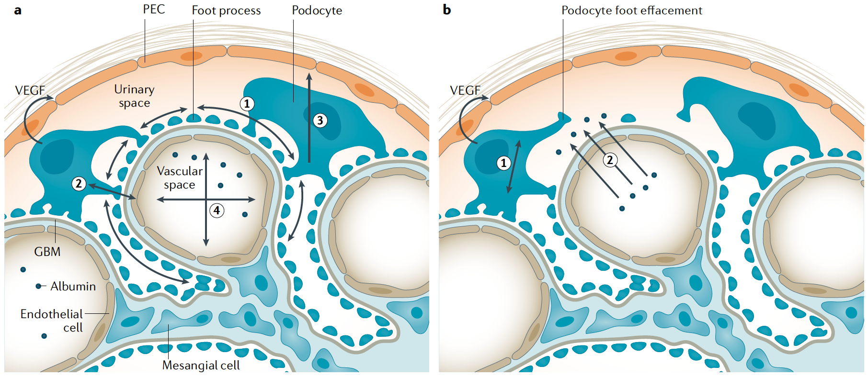
Approach to secondary/maladaptive FSGS
Correct the haemodynamic abnormalities →podocyte
shear stress → podocyte injury
NO IMMUNOSUPPRESSION
Dietary sodium restriction
Protein restriction
BP control
RAASi
SGLT2i
De Vriese AS Nat Rev Nephrol. 2021 Sep
Notes:
to correct the haemodynamic abnormalities that promote podocyte shear stress, and are expected to be primarily but not exclusively beneficial for maladaptive FSGS.
In order to decrease the hydrostatic pressure and the shear stress preventing podocytes

Slide 27


Is it possible to blow podocytes off the GBM?
Strieder... Stamellou. Cell Physiol Biochem, 2020
Notes:
Übersicht

Slide 28
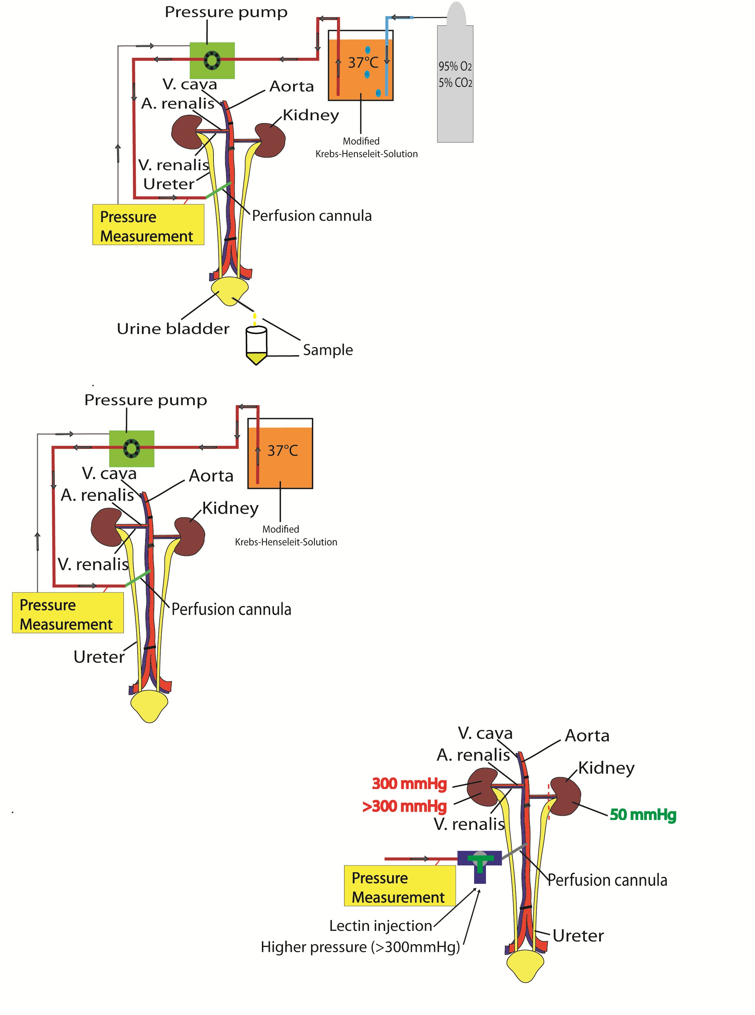
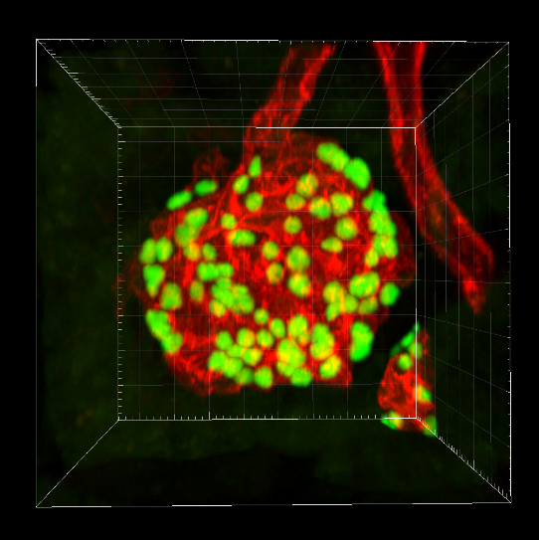
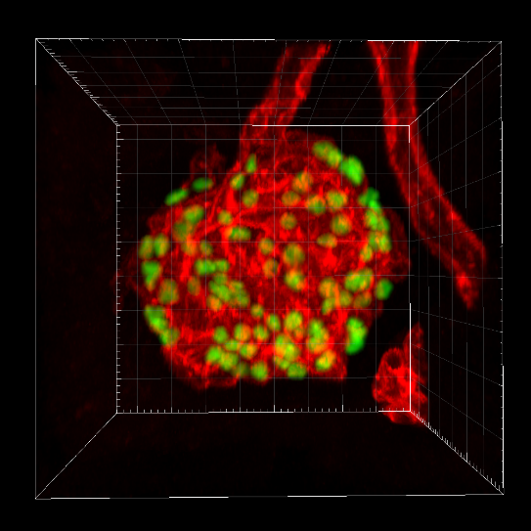
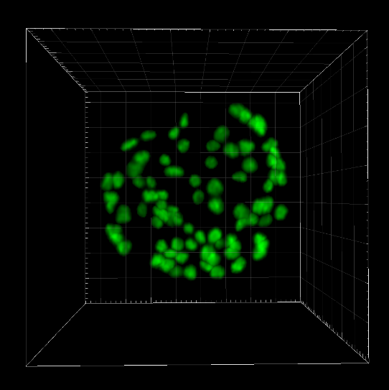
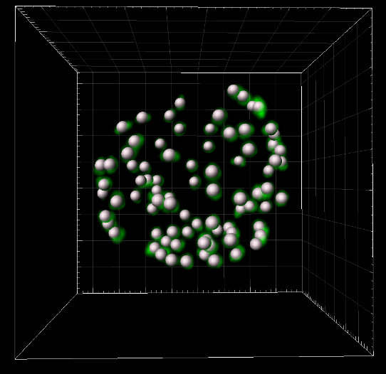
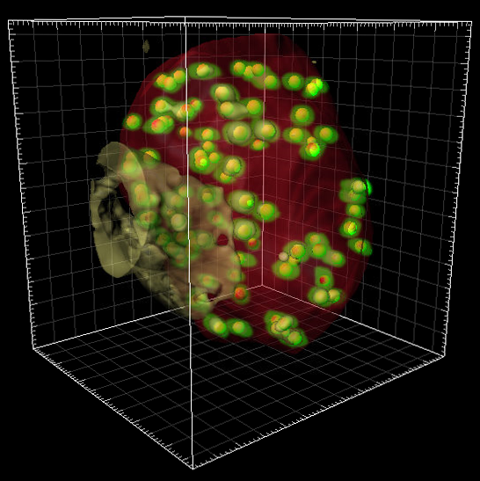
Ex-vivo hyperperfusion of the right mouse kidney
Semi-automating counting
Strieder... Stamellou, Cell Physiol Biochem, 2020
Notes:
So here you can see the experimental set up.
In adult mice we canulated the aorta and we perfused both kidneys with 50mmHg for approximately 10 minutes (allowing injections of fluorescently-labeled lectins) and after this time the left kidney was removed and served as paired control in every experiment, and then the right kidney was perfused either for additional 5 minutes at 300 mmHg or with supramaximal pressure (>>300mmHg, filtration pressures were estimated to be well above 400 mmHg), applied manually, with a total volume of 50 ml perfusion solution.
And we did semi-automatic counting, which involves 3d. acquisition and computational analysis.
count the GFP positive cells

Slide 29
It is impossible to blow off podocytes in healthy mice
Healthy mice
Strieder... Stamellou, Cell Physiol Biochem, 2020
Notes:
when we perfused at normal pressures we had as many podocytes as when we hyperperfused the kidney with 300mmHg or with the very high supraphysiological pressures→So amazingly it is not possible to blow off podocytes in healthy mice

Slide 30
Foot process effacement renders podocytes more susceptible to detachment.
Healthy mice
3 days after inject.
Strieder... Stamellou, Cell Physiol Biochem, 2020
Notes:
Then we looked at effaced podocytes, we induced podocyte effacement by injecting anti-GBM serum→
and what we saw is that this reduced the podocyte number a little bit at the first place because of the injury of the podocytes and then the higher pressures blow off an additional proportion of podocytes about a third, so effaced podocytes adhere to the GBM with less tightness and they can been blown off more easily either because they block so much surface area or because they have less adhesion.
In the present study, the acute effects of higher perfusion pressures were studied. Long term effects of pathological hyperperfusion could be more deleterious, leading to even more podocyte loss. However, our study suggests, that this chronic loss of podocytes is not driven by the shear force of filtration flow per se but much rather by the (mal-)adaptive changes in podocytes which decrease their adherence to the GBM and this points out that patients with glomerular diseases would benefit substantially from supportive therapy including antihypertensive treatment but also supportive measurements like body weight reduction to prevent (mal-)adaptive structural changes of podocytes.

Slide 31
Translational message
Acute podocyte injury with effacement, renders podocytes susceptible to detachment at increased perfusion pressures.
Supportive therapy in glomerular diseases
Notes:
31
In the present study, the acute effects of higher perfusion pressures were studied. Long term effects of pathological hyperperfusion could be more deleterious, leading to even more podocyte loss. However, our study suggests, that this chronic loss of podocytes is not driven by the shear force of filtration flow per se but much rather by the (mal-)adaptive changes in podocytes which decrease their adherence to the GBM and this points out that patients with glomerular diseases would benefit substantially from supportive therapy including antihypertensive treatment but also supportive measurements like body weight reduction to prevent (mal-)adaptive structural changes of podocytes.

Slide 32
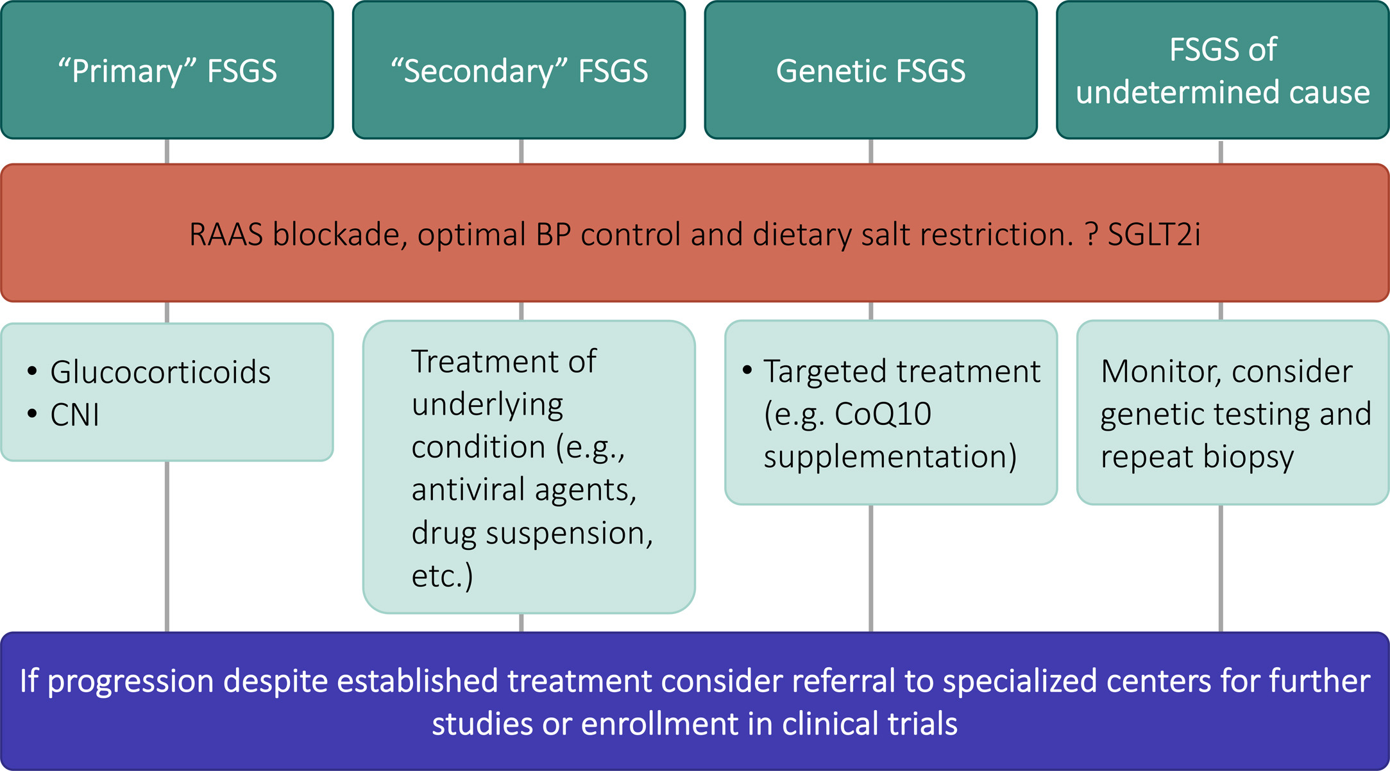
Treatment approach for FSGS
Kidney International Reports 2023 830-35DOI: (10.1016/j.ekir.2022.10.004)
Notes:
The recently updated KDIGO for the treatment of FSGS recommend supportive treatment for all patients with persistent proteinuria ……..

Slide 33
Goal of therapy in maladaptive FSGS
For patients with maladaptive and genetic forms of FSGS, a 30–40% reduction in proteinuria and preservation of eGFR seem appropriate surrogate markers and therapeutic targets.
→ Based on data from meta-analysis studies in patients with CKD
Heerspink, H. J. L. et al. Lancet Diabetes Endocrinol. 7, 128–139 (2019)
Coresh, J. et al. Diabetes Endocrinol. 7, 115–127 (2019)
Notes:
33

Slide 34
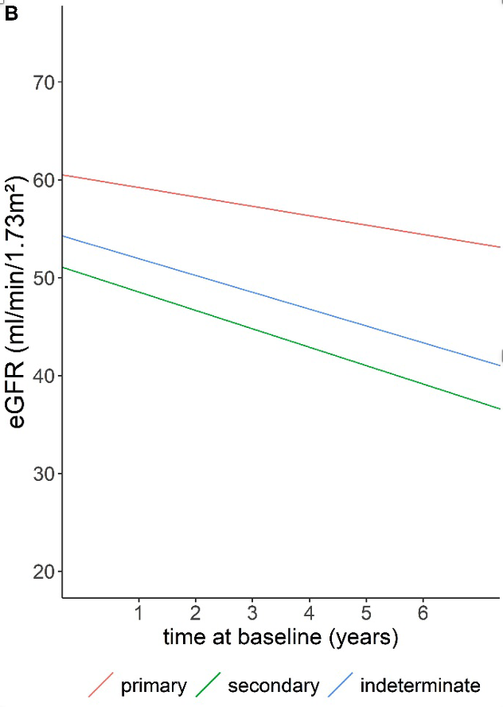
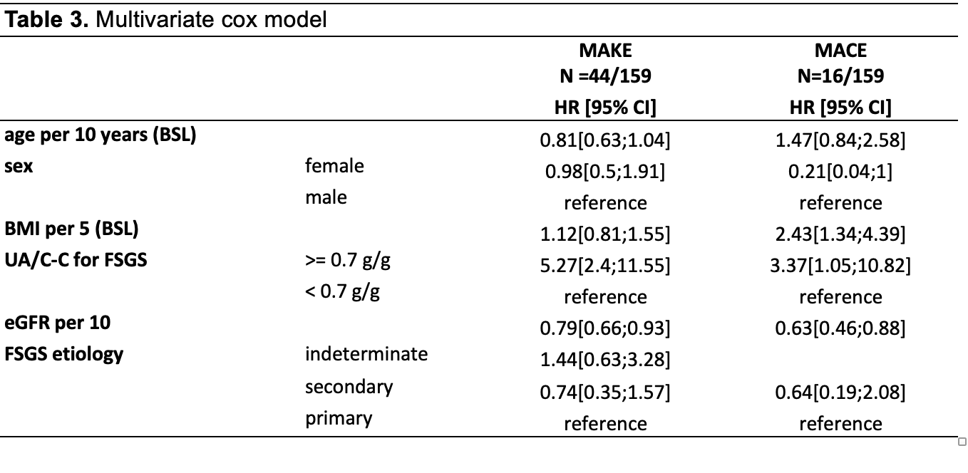
The natural history of FSGS in the German Chronic Kidney
Disease (GCKD) cohort
159 patients with biopsy-proven FSGS
Stamellou E et al. unpublished data
Notes:
34
A multivariable Cox regression analysis revealed that albuminuria > 0.7g/g was associated with adverse kidney outcomes , with a hazard ratio (HR) of 1.47 (95% CI: 1.27-1.7) compared to < 0.7g/g.
The albuminuria from baseline, treated as a categorical variable, revealed that albuminuria levels above 0.7g/g associated with poorer kidney survival and a more rapid decline in eGFR (-2.01 vs. -0.92) (Figure 2A).
Among patients with FSGS, those with secondary MALADAPTIVE FSGS exhibited a greater rate of eGFR loss compared to patients with primary FSGS (-1.87 vs. -0.95 ). (Figure 2B).
so…secondary MALADAPTIVE FSGS is not a benign from/diseasee as we believe and even thogh present with a more mild disease than primary FSGS,these patients do progress silently
And we can save them by recognize them and treting them appropriattely with bllod pressure control, sodium and protein restriction

Slide 35
Conclusions
The identification of an FSGS lesion in a kidney biopsy of a patient with proteinuria does not establish a specific diagnosis
A correct differential diagnosis between ppfFSGS, secondary and genetic FSGS in adults requires a clinicopathological approach.
Supportive treatment is the cornerstone in the treatment of all FSGS forms
Notes:
We propose that the enrolment of heterogeneous patient populations with differing underlying causes of disease has contributed to the failure of several clinical trials.
cbut until such biomarkers are available, stratification of patients based on clinico-pathological criteria is essential, not only to facilitate sound treatment decisions for individual patients but also to facilitate the rational design of therapeutic trials.
We propose a model for future trial design where identification of the target population follows categorization of the compound under study and target patient recruitment is organized subsequent to a comprehensive clinicopathological assessment of the enrolled individuals.
The identification of an FSGS lesion in a kidney biopsy of a patient with proteinuria does not establish a specific diagnosis; rather, it should prompt the clinician to pursue a thorough evaluation to determine the underlying cause of the FSGS lesion. We use a systematic approach that takes into account clinical and pathologic features of the patient to differentiate between primary, secondary, and genetic forms of FSGS

Slide 36

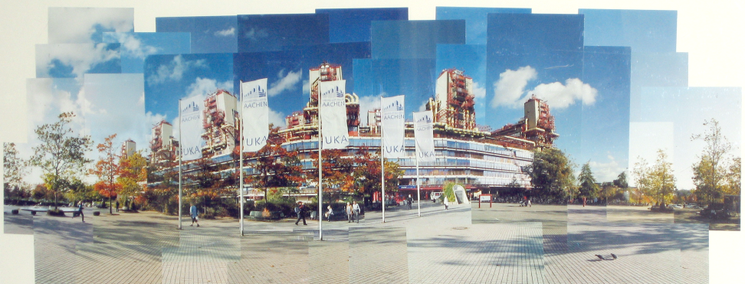
Thank you !!
University of Ioannina
© K. Zerres 2004
Notes:
36
Corticotropin may act on the melanocortin receptor in podocytes, reducing proteinuria in addition to its intrinsic glucocorticoid-releasing effect. Corticotropin therapy is approved by the US Food and Drug Administration for the edematous state in nephrotic syndrome. As with other medications used in podocytopathies, no large-scale randomized clinical trial data are available for corticotropin, which usually is reserved for refractory cases of FSGS due to its cost.

