Slide 1



the advanced treatment of chronic heart failure by peritoneal ultrafiltration
Prof Sanjin Racki
Department of Nephrology, Dialysis and Kidney Transplantation

Slide 2
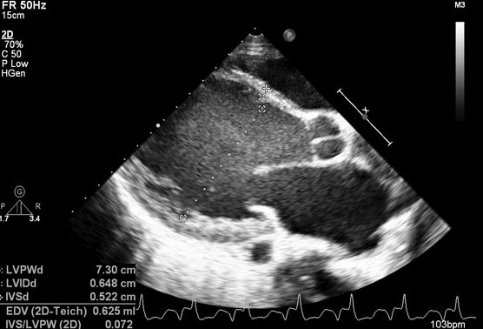

Chronic heart failure (HF)
a clinical syndrome that brings together cardiac symptoms and signs resulting from structural and/or functional abnormalities of the heart that cause increased intracardiac pressure and/or inappropriate stroke volume at rest and/or exertion
2021 ESC HF Guidelines www.escardio.org/guidelines
Notes:
HF is a complex clinical syndrome
Heart failure (HF) is a complex clinical syndrome that can result from any structural or functional cardiac disorder that impairs the ability of the ventricle to fill with or eject blood. The clinical syndrome of HF may result from disorders of the pericardium, myocardium, endocardium, or great vessels, but the majority of patients with HF have symptoms due to an impairment of left ventricular (LV) myocardial function. HF is not equivalent to cardiomyopathy or to LV dysfunction; these terms describe possible structural or functional reasons for the development of HF.
The cardinal manifestations of HF are dyspnea and fatigue, which may limit exercise capacity, and fluid retention, leading to pulmonary congestion and peripheral edema. Both abnormalities can impair the functional capacity and quality of life of affected individuals, but they do not necessarily dominate the clinical picture at the same time. Some patients have limited exercise capacity, but little evidence of fluid retention, whereas others complain primarily of edema and report few symptoms of dyspnea or fatigue.
Abbreviations
HF=heart failure; LV=left ventricular
Reference
Hunt et al. J Am Coll Cardiol 2009;53:e1–90
Key communication points
HF is a complex clinical syndrome that results from the impaired ability of the ventricle to fill with or eject blood
The cardinal manifestations of HF are dyspnea, fatigue and fluid retention
2

Slide 3



Epidemiology and natural course of HF
chronic progressive disease with poor prognosis
Kompenzirano stanje
Epizode akutne dekompenzacije
Kronična bolest
Klinički status
Kvaliteta života
Akutna dekompenzacija
Progresija bolesti
Smrt
Ahmed et al. Am Heart J 2006;151:444–50; Gheorghiade et al. Am J Cardiol 2005;96:11G–17G.

Slide 4
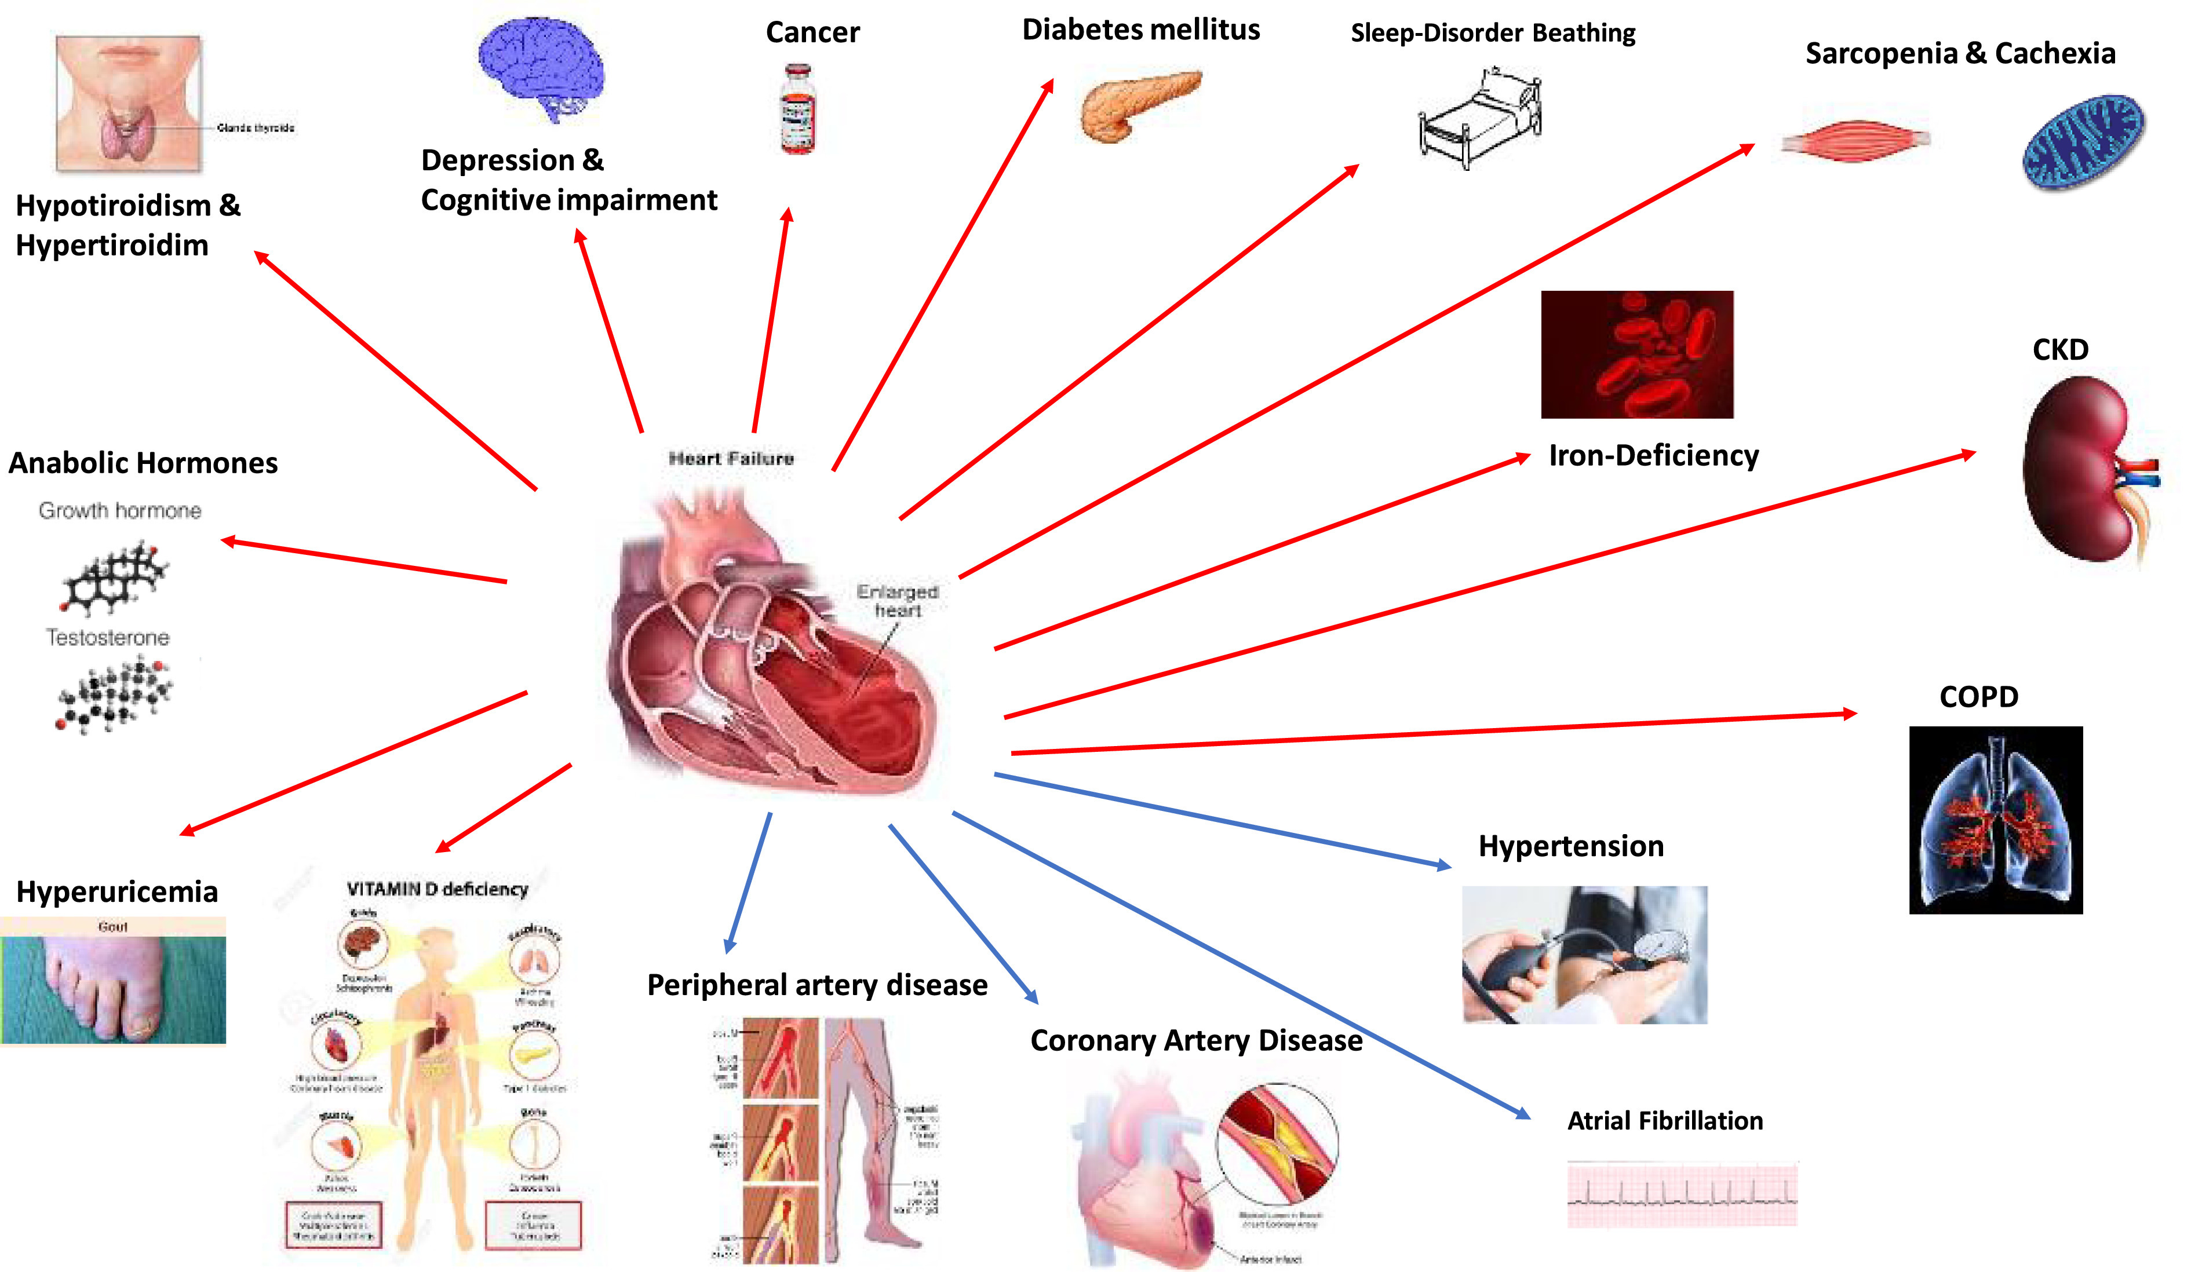
Comorbidities in patients with CHF
74% of patients whtih HF in ESC Heart Failure Pilot Study reported at least one more accompanying disease
van Deursen et al. Eur J Heart Fail 2014;16:103–111.
Correale N. et al. Eur J Int Med. 72020; 71: 23-31.
Notes:
4

Slide 5

Type of HF and severity of symptoms
2021 ESC HF Guidelines www.escardio.org/guidelines
Notes:
5

Slide 6
Medical treatment of HF
life saving therapy
disease modifying drugs
2021 ESC HF Guidelines www.escardio.org/guidelines
Notes:
6

Slide 7
Advanced forms of HF (2)
renal dysfunction and resistance to diuretics are one of the most common characteristics of patients with advanced HF
in patients who do not respond to the recommended doubling loop diuretics dose with the accompanying addition of thiazide (or metolazone), it is necessary to consider the use of continuous ultrafiltration (slow continuous ultrafiltration, SCUF), continuous methods of hemodialysis, and peritoneal ultrafiltration / dialysis (PUF/ PD) depending on the accompanying volume status, parameters of renal function and electrolyte
2021 ESC HF Guidelines www.escardio.org/guidelines
Notes:
7

Slide 8
Renal replacement therapy
extracorporeal therapy - "myocardial stunning" with a potential long-term impact on the progression of HF
potential benefits of peritoneal dialysis (PD):
minimal impact on hemodynamics and the absence of additional unfavorable neurohumoral stimulation
continuous removal of volume load and electrolyte
better tolerance of dose adjustment of medicinal therapy for HF
drainage of ascites and reduction of intra-abdominal pressure while improving renal function
absence of risk of central vascular access and hemodynamic effects of A-V fistula
psychosocial circumstances, quality of life
Francois K. et al. Blood Purif. 2015; 40: 45-52.
Notes:
8

Slide 9
PERITONEAL ultrafiltration/DIALYSIS IN END-STAGE chronic heart failure
Peritoneal ultrafiltration/dialysis (PUF/PD) appears to be a promising supportive long-term therapy of chronic heart failure (CHF) refractory to diuretics in patients with and without chronic kidney disease (CKD)
The beneficial effects of PD/PUF:
    improvement in congestive symptoms
    decrease in numbers and durations of hospitalizations
    enhanced quality of life
    decline in cost of care
    better exercise capacity
PUF/PD can be used either as palliative therapy or as bridge to transplantation

Slide 10
PD MODALITY IN PATIENTS WITH CHF
The choice of technique depends on renal function (PUF or PD)
Patients with coexisting renal failure may be treated with
  - continuous ambulatory PD (CAPD)
  - automated PD (APD)
Those without significant impairment of renal function
- a single nightly exchange (PUF) with osmotic agent
(optimally, icodextrin) is sufficient

Slide 11
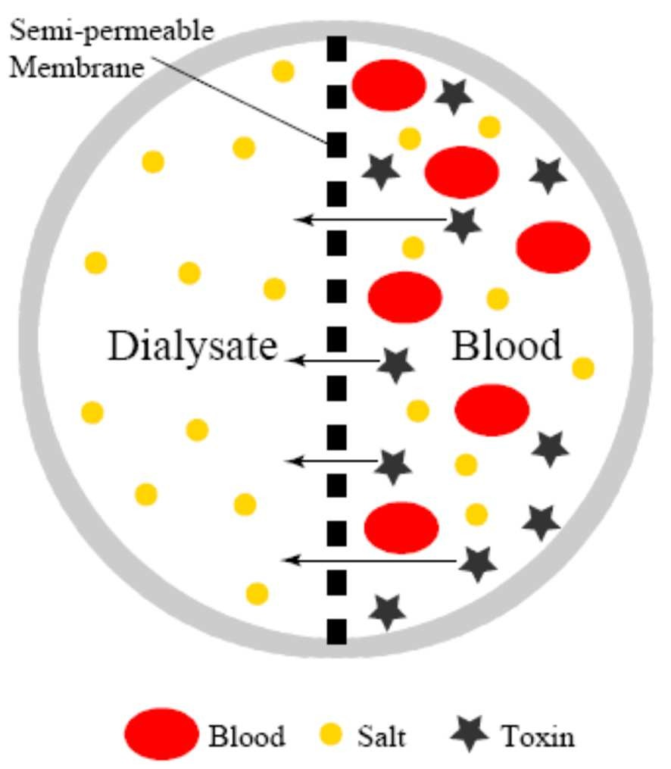
PERITONEAL MEMBRANE: SEMI-PERMEABLE
Designed to keep blood components like red blood cells, platelets and large proteins on the blood side – They cannot pass through the membrane
The membrane has pores, or openings, that are large enough to allow small molecules to pass, and others not as they are too big
Also allows water molecules to pass through

Slide 12
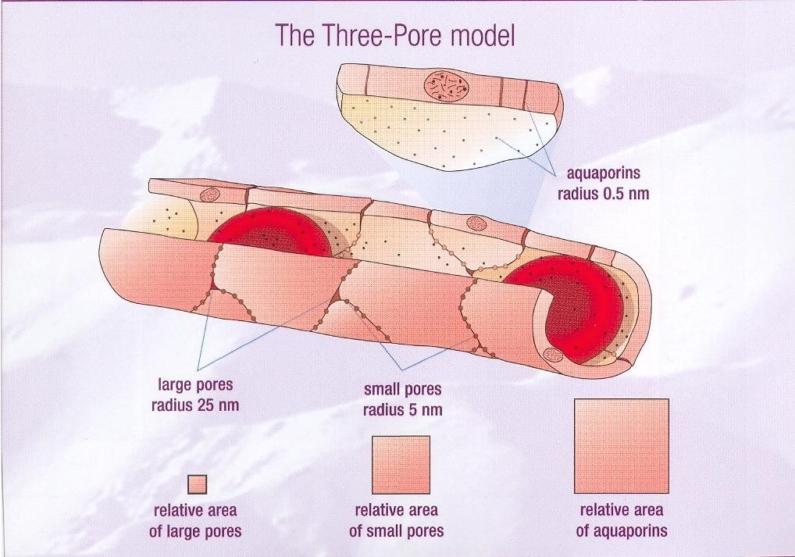
The three - pore model

Slide 13
FLUID REMOVAL – NET ULTRAFILTRATION
Key forces
BLOOD SOLUTION
Osmotic/oncotic pressure
Hydrostatic pressure (albumin)
Intra-peritoneal pressure
(volume of fluid)
Lymphatic reabsorption
Net UF

Slide 14
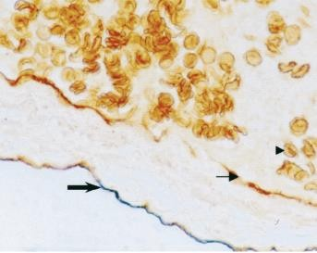

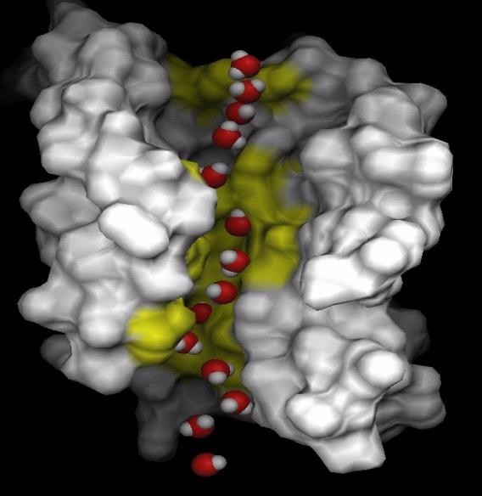
Physiology of Peritoneal Dialysis: Water Flow: Role of Aquaporins
H₂O
capillary
Brown=Aquaporin 1
Peritoneal
space
Pathways of water flow:
50% aquaporin mediated
50% intercellular pathways
Lai et al: J Am Soc Nephrol 2001:12;1036–1045

Slide 15
ROLE OF PD SOLUTIONS
Peritoneal dialysis
Balance in the internal environment
Electrolytes
Correct acidosis
Buffer
Removal of waste products
Extract water
Osmotic agent
Na
Ca
Mg
Lactate
Bicarbonate
Glucose
Amino acids
Icodextrin
Purification
Ultra filtration

Slide 16
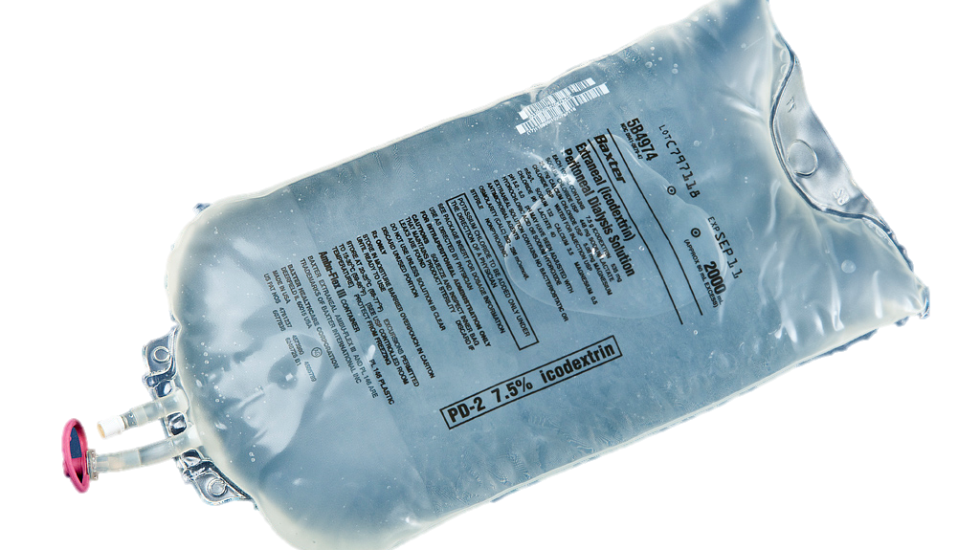
EXTRANEAL solution

Slide 17
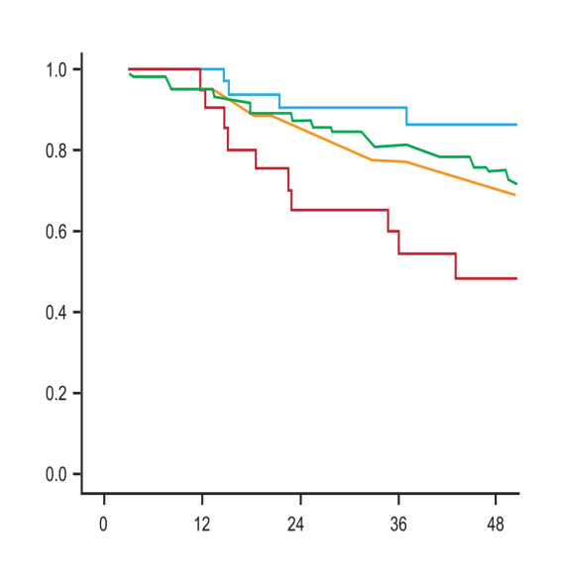
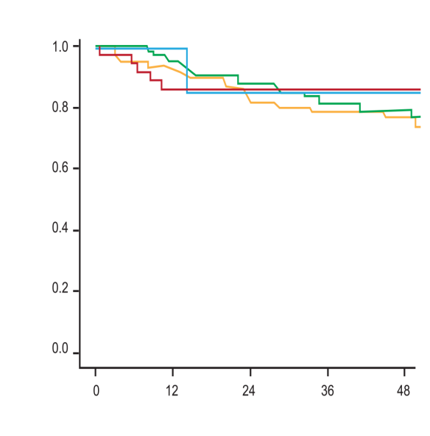
Logical PD prescribing – considering all PD therapy
The result of focusing on all parameters for all patients.
Patient survival on PD
Before the introduction of APD and Icodextrin
After the introduction of APD and Icodextrin
A
Commencing 1990 - 1997
B
Commencing 1998 - 2005
Low
Low average
High average High
Curn survival
Curn survival
Davis, 2006. Survival on PD according to transport category at the start of treatment in two cohorts commencing between (a) 1990- 1997, n=320 and (b) 1998-2005, n = 300. Low (-), Low average (-) High average (-) and High (-). In the first cohort, transport category was significantly (P=0.009) associated with survival, whereas in the second this was not the case due to an improvement in the survival of high transport patients.
Months
Months

Slide 18







Comparison of net UF during a PD dwell – sustained UF for the long dwell
2.27% Dextrose
3.86% Dextrose
7.5% Icodextrin
1000
800
600
400
200
0
-200
-400
-600
Net UF (mL)
CAPD (night)
APD (day)
0
2
4
6
8
Time (hr)
10
12
14
16
Mujais S, Vonesh E. Kidney Int 2002;62(suppl 81):S17-S22

Slide 19
7.5% Icodextrin vs 3.86% Dextrose for APD Long Dwell: High Transport Trial
*
*
600
Icodextrin
(n=47)
Long Dwell Net UF (mL)
500
400
300
3.86% Dextrose (n=45)
200
100
0
Baseline Week 1 Week 2
*P < 0.001 vs 3.86% dextrose (adjusted for baseline values).
Finkelstein F et al. J Am Soc Nephrol 2005;16:546-554

Slide 20
Benefits in reducing weight and total body water with 7.5% icodextrin
Total Body Water [kg]
(bioelectrical impedance)
1.0
0.5
0
- 0.5
- 1.0
- 1.5
- 2.0
Icodextrin
2.27% glucose
2.5
2.0
1.5
1.0
0.5
0
- 0.5
- 1.0
- 1.5
Drained Body Weight [kg]
† p<0.04
‡ p<0.008
*p<0.002
**p<0.001 Mean ± SEM
**‡
**
0 1 3 6
Months from randomisation
Davies SJ et al, J Am Soc Nephrol 14: 2338-2344, 2003

Slide 21
Icodextrin - advantages
Icodextrin solution may be associated with improved patient survival.
Han SH, et al. Nephrol Dial Transplant 2012; 27:2044–2050.
The use of icodextrin solution has been associated with a lower risk of new-onset CHF in new PD patients vs. those not using icodextrin solution.
Wang IK, et al. Pharmacoepidemiol Drug Saf 2018; 27:447–452.
Icodextrin solution may be associated with improved profiles of some lipids in some PD patient populations.
Huang YF, et al. Biomed Res Int 2015; 2015:208980.
Use of icodextrin solution helps maintain peritoneal membrane function and facilitates the achievement of fluid balance.
Paniagua R, et al. Perit Dial Int. 2009; 29:422–432.
Avoidance of excess glucose exposure can preserve peritoneal ultrafiltration and solute clearance.
Davies SJ, et al. Kidney Int 2005; 67:1609–1615.

Slide 22
PD in advanced CHF (1)
Nakayama M, et al. J Cardiol. 2010; 55: 49-54..
Notes:
Jedna od prvih studija, 12 starijih bolesnika s KBB 3-5 stupnja i refraktornim ZS (NYHA III), prosječne dobi 81+-6 liječenih PD.
22

Slide 23
PD in advanced CHF (2)
Nakayama M, et al. J Cardiol. 2010; 55: 49-54..
Notes:
Jedna od prvih studija, 12 starijih bolesnika s KBB 3-5 stupnja i refraktornim ZS (NYHA III), prosječne dobi 81+-6 liječenih PD.
23

Slide 24
PD in advanced CHF (3)
meta-analysis of 31 non-randomized studies, 1966 – 2017.
patients treated with PD had fewer symptoms, a lower rate of rehospitalization and a shorter duration of hospitalization compared to patients treated with diuretics
the comparison of PD with other forms of renal replacement therapy requires additional analyses
Chionh CY. et al. Perit Dial Inter. 2020; 40: 527-39.
Notes:
24

Slide 25
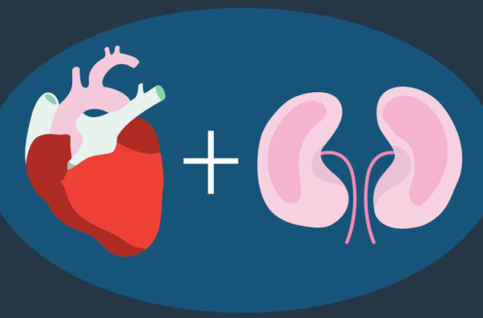
PD in advanced CHF (4)
ultrafiltration therapies, and especially PD, represent potentially useful forms of treatment for patients with severe CHF, resistant symptoms and frequent hospitalizations
an interdisciplinary approach with the cooperation of nephrologists and cardiologists seems to be crucial for the successful application of PD in CHF
Puttagunta H, Holt SG. Perit Dial Inter. 2015; 35: 645-9..
Notes:
25

Slide 26

Notes:
26

Slide 27

Clinical hospital Centre Rijeka – experience
"The Three Musketeers"

Slide 28
Multidisciplinary team
Cardiologist – indication, follow - up
Nephrologist – education, ultrafiltration prescription, follow - up
Urologist – peritoneal catether placement
Anesthesiologist – ultrasound-guided transversus abdominis plane (TAP) block anesthesia
PD nurse – education, follow - up

Slide 29
♂ i.O. 71 yrs old, NYHA class IV
Diabetic, insulin treated
2006 myocardial infarction + PCI LAD
2009 PCI LAD, LCx and RCA
9/2011 partial right nephrectomy due to renal cell carcinoma + Double J
12/2017 urosepsis + cardiac arrest with successful resuscitation
01/2018 PCI LAD
05/2018 PCI LAD and RCA

Slide 30

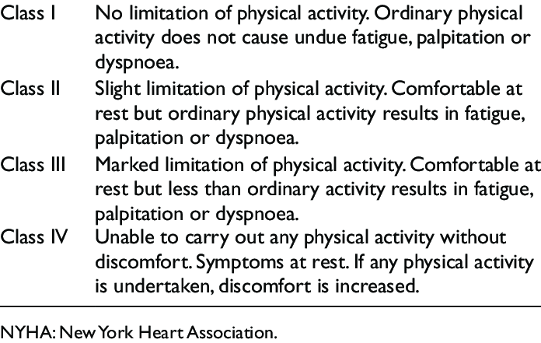
Case 1 ♂ i.O. 71 yrs old, NYHA class IV
12/2018 congestive heart failure (CHF, HFmrEF), anasarca, dyspnea
12/2018 CHF – anasarca, dyspnea, refractory to diuretics - continuous veno-venous hemodialysis (CVVHD)
01/2019 CHV – anasarca, dyspnea, refractory to diuretics - CVVHD
03/2019 CHF - anasarca, dyspnea
09/2019 CHF - anasarca, dyspnea
10/2019 CHF - anasarca, dyspnea
12/2019 CHF - anasarca, dyspnea
01/2020 CHF - anasarca, dyspnea

Slide 31
Case 1 ♂ i.O. 71 yrs. Old,
NYHA class IV
02/2020. CHF – refractory to diuretics – slow contious ultrafiltration (SCUF), body weight 100 kg
17.02.2020. peritoneal catether insertion (TAP block anesthesia)
Intermittent ultrafiltration 3 times per week duration 3 hrs, body weight 81 kg (- 19 kg )
08.03.2020. peritoneal catether surgical reposition due to malposition
23.03.2020. CAPD education
25.03.2020. The patient has fully mastered the skill to independently perform peritoneal dialysis procedures (2 days), start with icodextrin 2000 ml intraperitonelly (IP), 12 hrs night dwell
14.04.2020. central venous catether ex, body weight 77,5 kg (- 22,5 kg )
10/2020. peritonitis (E.coli) –outpatient treatment, recovered

Slide 32
Case 1 ♂ i.O. 71 yrs old, NYHA class II
date | 02/2020. | 04/2020 | 05/2020 | 06/2020 | 10/2020 | 06/2021 | 07/2021 | 08/2021 | 09/2021
NTproBNP (ng/L) | 24017 | 11214 | 16396 | 8452 | 10821 | 14402 | 17455 | 19937 | 19045
Albumin (g/l) | 35,5 | 37,7 | 36,9 | 38,9 | 42,2 | 40,1 | 38,1 | 38,4 | 40,6
eGFR CKD-EPI (ml/min/m²) | 18 | 23 | 24 | 17 | 18 | 16 | 17 | 17 | 16
24 hrs diuresis (ml) | 2500 | 1650 | 1700 | 1500 | 2000 | 2000 | 2000 | 2500 | 1500
24 hrs ultrafiltration (ml) | 0 | 500 | 700 | 700 | 600 | 650 | 600 | 550 | 800
body weight (kg) | 100 | 78,4 | 79 | 78,5 | 83 | 81,5 | 82 | 83 | 81,5
NYHA class IV → NYHA class II

Slide 33
Case 1 ♂ i.O. 71 yrs old, NYHA class Ii
15.9.2021. cardiology examination: The patient feels good. Since being treated with peritoneal ultrafiltration there are no symptoms of heart failure.
Clinical status: BP 155/90 mmHg. The action of the heart is arrhythmic, the tones are clear, no heart murmurs, auscultatory bilateral normal respiratory murmur.
No edema present.

Slide 34
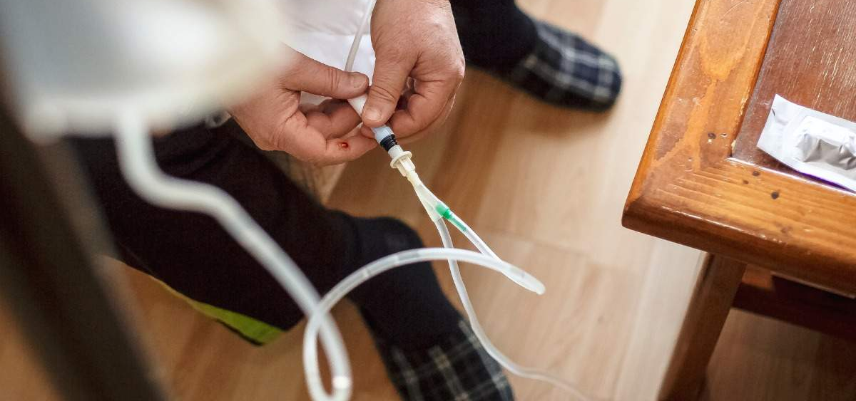


Thank you

