Slide 1
Advancing Kidney Health Worldwide. Together.

Slide 2
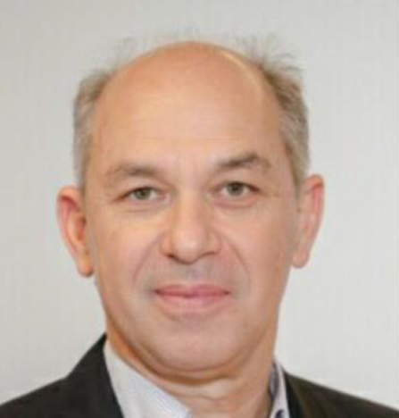
2023 ISN Pioneer Award Winner: Eastern & Central Europe Region
Goce Spasovski
(North Macedonia)

Slide 3
Biography
Prof. Goce Spasovski is from North Macedonia and an ISN member from many years ago.
His international nephrology carrier has been built with a postgraduated stay at a couple of Universities, and through COMGAN project at "Laiko" University Hospital in Athens.
After his PhD from the Universities of Antwerp and Skopje, he was involved as clinical investigator and PI latter on in more than 20 clinical trials related to progression of CKD, anaemia, CKD-MBD and bone biopsy - based studies, immunotolerance in kidney transplant recipients, and participant in a couple of COST networking actions and FP programs, publishing papers in many prestigious academic journals and being invited lecturer at Congresses, Symposia and CME courses (more than 200 presentations).
In this regard, he was promoting the scientific work and collaboration with the colleagues all over the region.

Slide 4
Biography
Prof. Goce Spasovski is affiliated member of many National and International Societies and groups.
From the affiliation with ISN, he is a board member of the ISN COMGAN and ISN GO Central & East European Committee, and the KDIGO Implementation Task Force leader for central and east Europe since 2013 (presenting KDIGO guidelines in many cities of Asia and China).
He was also a co-organizer of the KDIGO Controversies Conference on Implementation Strategies in low- and middle-income countries, Bangkok, Thailand in 2015.
In order to understand and improve thereafter the nephrology care through the ISN CEE regional board, an educative review paper has been published in KI in 2019 based on a survey and analysis from the countries involved.

Slide 5
Biography
He finished his term as an
ERA-EDTA Ordinary Council Member in 2009 and term 2016/19,
Chairman of the Committee for CME activities at ERA-EDTA up to 2013/14,
ERBP advisory board member,
Co-Chairman of the ERBP hyponatraemia group,
member of the ERBP transplant guideline and DESCARTES group.
Past President of the Balkan Association of Nephrology, Dialysis, Transplantation and Artificial Organs,
Currently
President of the Macedonian Society of Nephrology, Dialysis, Transplantation and Artificial Organs,
ISBP Board member since 2018, member of the ISN GO Central & East European Committee,
EUTox group, the KDIGO Implementation Task Force leader for central and east Europe.

Slide 6
Biography
Since creation of BANTAO Journal Prof. Goce Spasovski was a deputy and Editor in chief 2009-ongoing being always helpful for publishing papers from the regional authors.
Finally, in his rich academic opus with more than
more than 500 published articles (213 Medline cited) and book chapters
7650 google scholar citations
Hirsh index of 41
Prof Goce Spasovski is giving a bright example that science and cooperation in the region may be successful.

Slide 7
Advancing Kidney Health Worldwide. Together.
www.theisn.org
Global Operations Center
Americas Operations Center
Avenue des Arts 1-2
1210 Brussels, Belgium
340 North Avenue 3rd Floor Cranford, NJ 07016-2496, United States
+32 2 808 04 20
+1 567 248 9703
info@theisn.org
info@theisn.org
Follow us

