Slide 1


Atherosclerotic Renal Artery Stenosis: an update on treatment recommendations
Marieta Theodorakopoulou, MD, MSc
1st Department of Nephrology, Hippokration Hospital
Aristotle University of Thessaloniki, Greece
Notes:
Thank you very much for your kind introduction, I am really honored to be invited and participate in this session

Slide 2
Disclosures
Nothing to disclose

Slide 3
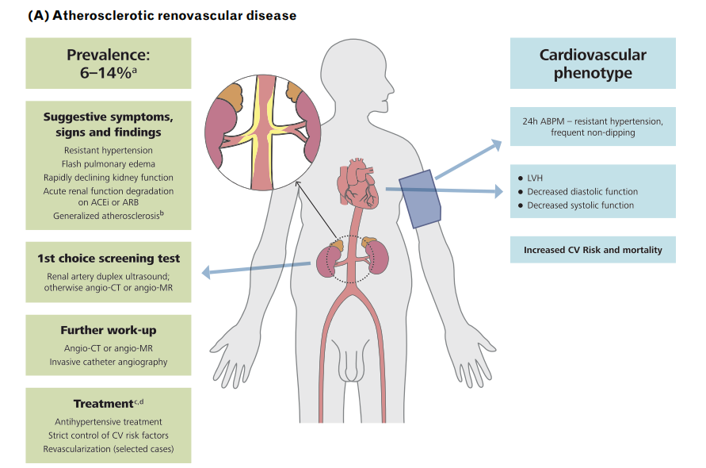

Slide 4
Renovascular hypertension: definition
A rise in arterial pressure (with or without ischemic and hypertensive renal injury) …associated with RAS … improved or eliminated by removal of the stenosis by surgical or endovascular revascularization or by removal of the kidney distal to the stenosis
When to suspect / investigate
History of hypertension in children, women <30y, age >50 y
Sudden onset or worsening of existing hypertension
Severe or resistant hypertension (inadequate BP control with > 3 drugs)
Atherosclerotic vascular disease in other circulatory beds (e.g. CAD, PAD, etc)
Smoking
Renal function decline >30% after treatment with ACEi/ARB
Heart failure of unknown etiology and/or “flash” pulmonary edema
Textor S, Greco B. Renovascular Hypertension and Ischaemic Renal Disease. In: Floege J, Johnson RJ, Feehally J (eds). Comprehensive Clinical Nephrology, 4th Edn. Mosby Elsevier, Philadelphia, PA, 2010
Kaplan NM. Kaplan’s Clinical Hypertension, 9th Edition. 2006

Slide 5
Atherosclerotic Renal Artery Stenosis
Epidemiology

Slide 6
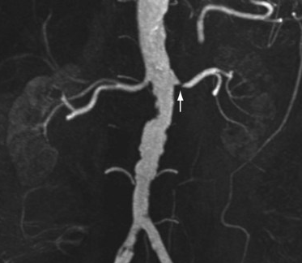
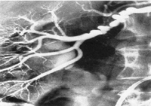
Renal artery stenosis
Atherosclerotic RAS
Fibromuscular dysplasia
5-10%
90-95%
Notes:
ARVD is the most common type of RAS, accounting for …. of patients with RAS versus 10% of cases that are due to FMD or other more rare causes
Η οποία είναι υπεύθυνη για το περιπου 90-95% των στενωσεων νεφρικης αρτηριας, με την δευτερη συχνοτερη αιτια, την ινωδη και ινωμυωματωδη νοσο να παρουσιαζει αρκετα κοινα αλλα και διαφορετικα στοιχεια σχετικα με την διαγνωση και την αντιμετωπιση όπως θα μας παρουσιασε αναλυτικα ο καθηγητη Persu στην επομενη ομιλια.
Atherosclerotic renovascular disease (ARVD) represents the most common type of renal artery stenosis (RAS) and is independently associated with various comorbidities including hypertension, chronic kidney disease (CKD), heart failure (HF), peripheral and coronary artery disease [1].

Slide 7
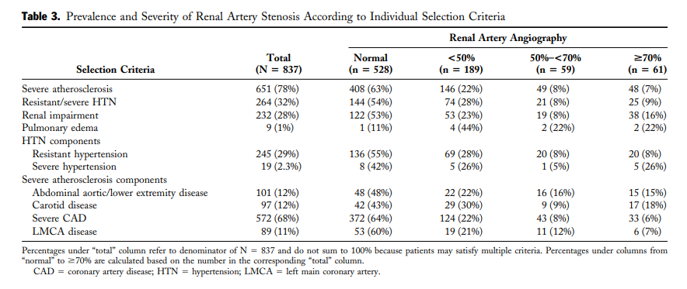
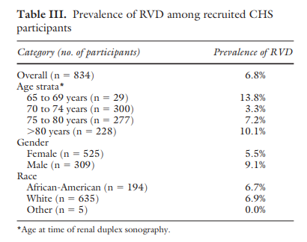

Prevalence of ARVD
N=870 patients age>65 y
Renal doppler ultrasonography
Hansen et al, J Vasc Surg 2002
Buller et al, J Am Coll Cardiol 2004
Notes:
Starting from some basic epidemiologic data, ARVD is rather common disease, accounting for almost 7% of patients with age >65 from the general population. Among hypertensives, the prevalence of ARVD is probably ≈1% in patients with mild hypertension [ 13 ], but may be as high as 14–24% in patients with severe or resistant hypertension [ 14 –16 ].
Ξεκινωντας από καποια βασικα επιδημιολογικά στοιχεια, ο επιπολασμός αυτης φτανει περιπου στο 7% του γενικου πληθυσμου >65 ετων, ενώ μεταξυ των ασθενών με υπερταση, και ένω <1% των ασθενων με ηπια υπερταση εχουν νεφραγγειακή νόσο, στους ασθενείς με σοβαρή ή και ανθεκτική υπέρταση, ο επιπολασμός αγγίζει το 30%
The prevalence of ARVD differs considerably among studied populations.
In a population-based cohort of 870 participants > 65 years of age, ARVD (defined as > 60% stenosis) was identified by renal duplex sonography in 6.8% of patients, with equal frequency among White and Black participants [ 12 ].
Among hypertensives, the prevalence of ARVD is probably ≈1% in patients with mild hypertension [ 13 ], but may be as high as 14–24% in patients with
severe or resistant hypertension [ 14 –16 ]. Of note, among patients with hypertension, ARVD is considered the second most common
cause of secondary hypertension [ 17 ].

Slide 8
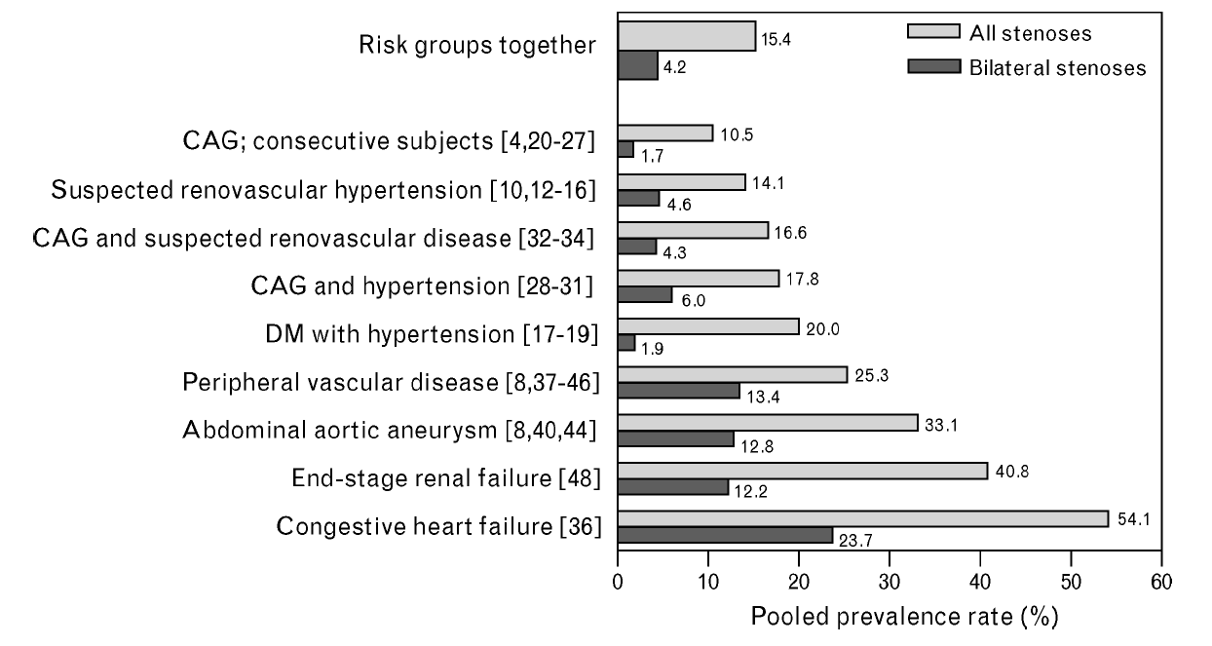
Prevalence of ARVD in high risk groups
de Mast & Beutler. J Hypertens 2009
Notes:
And this proportion is multiplied by the presennce of several comorbidities, such as …….. And most importantly, CKD and HF.
Overview of pooled prevalence rates (weighted by sample size) of renal artery stenosis in risk groups categories. CAG, coronary angiography; DM,
diabetes mellitus; RAS, renal artery stenosis.
Objective We performed a literature review and analysis to
improve the insight in the prevalence of renal artery
stenosis (RAS) in risk groups.
Methods Relevant studies were identified by a MEDLINE
and EMBASE database search (1966 to December 2007),
complemented by hand searching of reference lists. Review
was restricted to English language studies, using any form
of angiography as diagnostic method. Studies were
grouped in risk group categories sharing similar clinical
characteristics, and pooled prevalence rates were
calculated for each category.
Results Forty studies, involving a total number of 15 879
patients, were identified. The following pooled prevalence
rates (95% confidence interval; sample size risk group) of
RAS were found: suspected renovascular hypertension,
14.1% (12.7–15.8%; nU1931); hypertension and diabetes
mellitus, 20% (14.9–25.1%; nU240); coronary angiography
(CAG) in consecutive patients, 10.5% (9.8–11.2%;
nU8011); CAG in hypertensive patients, 17.8% (15.4–
20.6%; nU836); CAG and suspected renovascular disease,
16.6% (14.8–18.5%; nU1576); congestive heart failure,
54.1% (45.7–62.3%; nU135); peripheral vascular disease,
25.3% (23.6–27.0%; nU2632); abdominal aortic aneurysm,
33.1% (27.4–39.2%; nU239) and end-stage renal failure,
40.8% (27–55.8%; nU49.) In patients with an incidentally
discovered RAS, hypertension and renal failure were
present in 65.5 and 27.5%, respectively.
Conclusion RAS has a high prevalence in risk groups,
especially in those with extrarenal atherosclerosis, endstage
renal failure and heart failure. These findings are
important when screening for RAS or prescription of an
angiotensin converting enzyme inhibitor or angiotensin-II
receptor blocker is considered. J Hypertens 27:1333–1340

Slide 9
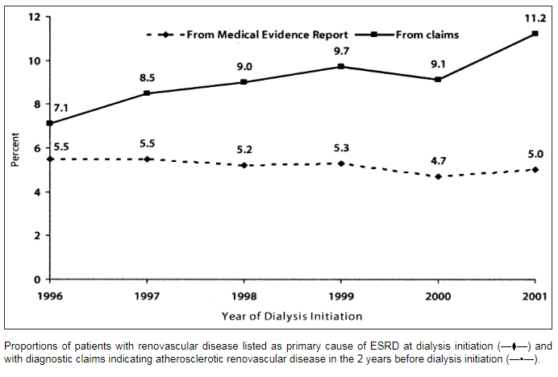
Diagnosis of ARVD in the 2-year period before dialysis initiation
Guo H, et al. Circulation 2007
Notes:
Atherosclerotic renovascular disease in older US patients starting dialysis, 1996 to 2001
Haifeng Guo ¹, Philip A Kalra, David T Gilbertson, Jiannong Liu, Shu-Cheng Chen, Allan J Collins, Robert N Foley
Affiliations expand
PMID: 17179020
DOI: 10.1161/CIRCULATIONAHA.106.637751
Free article
Abstract
Background: Temporal trends regarding the epidemiology of atherosclerotic renovascular disease (ARVD) in dialysis populations are poorly defined.
Methods and results: United States Renal Data System data were used to identify patients aged 67 years or older at dialysis inception between 1996 and 2001 (n=146,973). Medicare claims in the preceding 2 years were used to identify ARVD and revascularization procedures. Prior ARVD rose from 7.1% to 11.2% between 1996 and 2001 (adjusted odds ratio [AOR], 1.68). Other associations included hypertensive end-stage renal disease (ESRD; AOR, 2.21), ESRD network (AOR, 0.44 in network 17 versus 1.00 in network 1), peripheral vascular disease (AOR, 1.65), black race (AOR, 0.44), urologic cause of ESRD (AOR, 0.57), age >85 years (AOR, 0.58), substance dependency (AOR, 0.62), and inability to ambulate or transfer (AOR, 0.67). The proportion of ARVD patients undergoing revascularization rose from 14.6% to 16.7% between 1996 and 2001 (AOR, 1.27). Other associations included hypertension (AOR, 2.10), ESRD network (AOR, 2.07 for network 13 versus 1.00 in network 1), age >85 years (AOR, 0.53), and black race (AOR, 0.54). The rise in ARVD was not reflected in the proportion of patients with renovascular disease listed as cause of ESRD on the Medical Evidence Report at dialysis inception (5.5% in 1996, 5.0% in 2001).
Conclusions: ARVD diagnoses have become more common in older patients beginning dialysis therapy. The association of demographic factors including age, race, and geographic residence with utilization patterns suggests possible barriers to care.

Slide 10
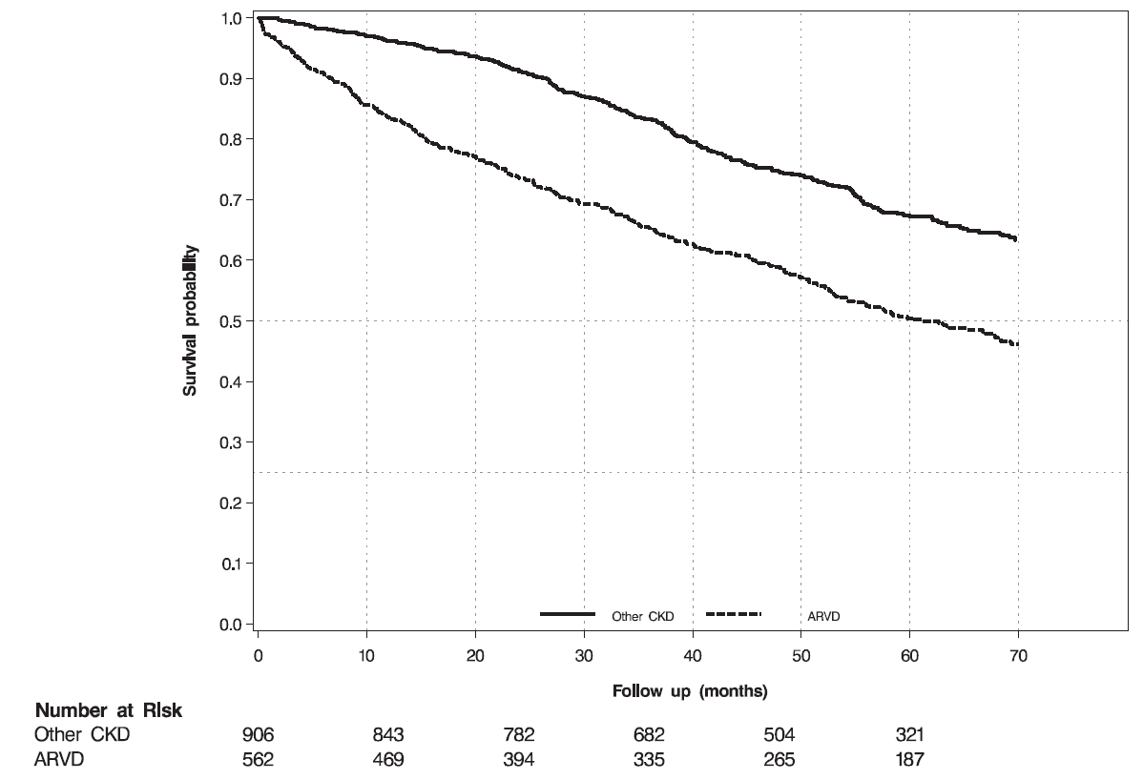
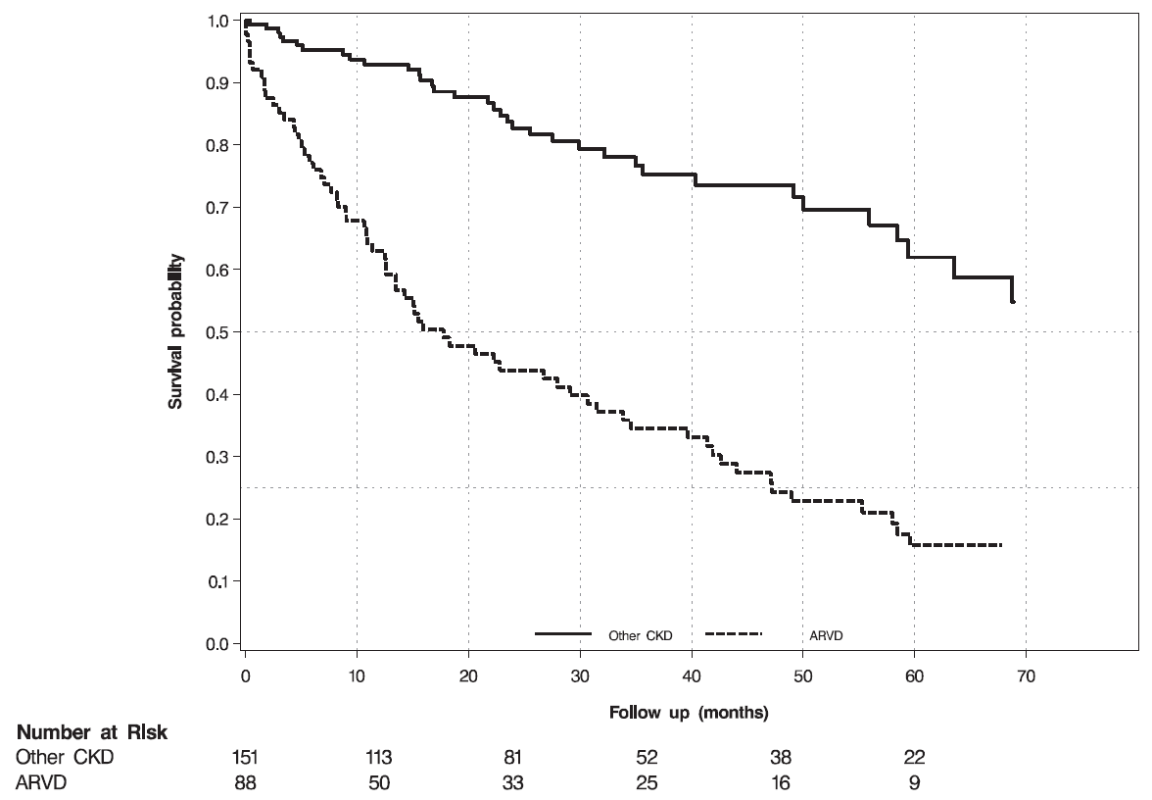
Prognosis of ARVD in CKD
The risk of death among patients with ARVD markedly exceeds the risk of progression to dialysis (44% vs 16% over a median 4 of years).
The risk of death of CKD patients with ARVD compared to other causes is 1.5 times higher in patients not receiving dialysis therapy and >3 times higher in those in dialysis.
The risk of progression to dialysis was similar between ARVD and non-ARVD patients
Hicks et al 2021 (submitted); Richie et al. Nephrology (Carlton) 2017
Notes:
The morbidity and mortality rates associated with ARVD
are high, with the risk of death markedly exceeding the
risk of progression to dialysis (44% vs 16% over a median
of 4 years).20 In patients not receiving dialysis therapy,
ARVD is associated with a 1.5 times higher mortality rate
than other causes of CKD. In dialysis patients, the mortality
rate with ARVD is more than 3 times higher than with
other primary renal diagnoses. The high burden of cardiovascular
comorbidity in patients with ARVD is likely to
be a major contributor to these outcomes20; over a 4-year
follow-up period, 33% of patients with ARVD experienced
a major cardiovascular event. Patients who present with
acute pulmonary edema have a further increased risk of
adverse outcomes compared with lower-risk ARVD phenotypes
(ie, those without flash pulmonary edema, refractory
hypertension, or rapid loss of kidney function),
with hazard ratios for death and cardiovascular events of
2.2 and 3.1, respectively.21

Slide 11
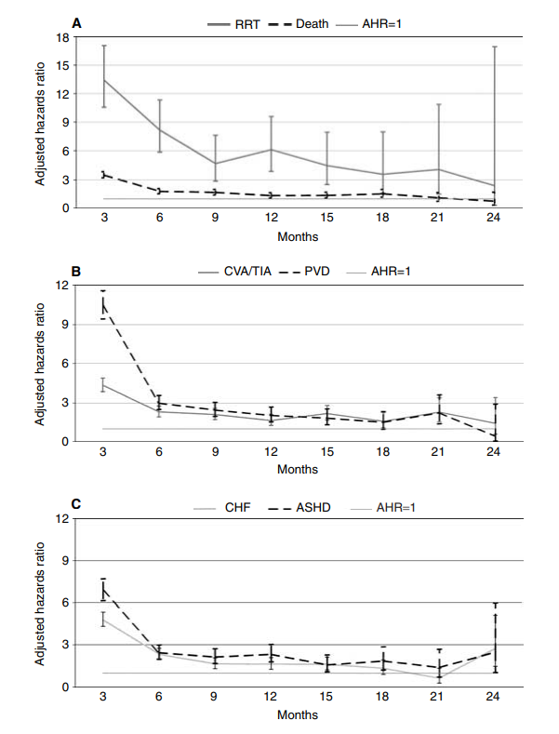
Overall prognosis of ARVD
5% random sample of the US Medicare population
Kalra et. al, Kidney Int 2005
Notes:
The overall prognosis of ARVD is poor. In an analysis of a 5% random sample of the US Medicare population, the risk for RRT, death and HHF after incident diagnosis of ARVD was markedy higher compared to the general population,
Η συνολική πρόγνωση των ασθενών με αθηροσκληρωτική νεφραγγειακή νόσο είναι πτωχή, βλέπουμε εδώ δεδομένα από την Αμερική, όπου οι ασθενείς με ARVD εμφανιζαν εξαιρετικά σημαντικό υψηλότερο ρίσκο για
The overall prognosis of ARVD is poor. In an analysis of a 5% random sample of the US Medicare population, adverse event rates after incident diagnosis of ARVD greatly exceeded those in the general population, including atherosclerotic heart disease (303.9 versus 73.5 per 1000 patient-years), PAD (258.6 versus 52.2 per 1000 patient-years), congestive HF (CHF; 194.5 versus 56.3 per 1000 patient-years); cerebrovascular accident or transient ischaemic attack (175.5 versus 52.9 per 1000 patient-years), death (166.3 versus 63.3 per 1000 patient-years) and renal replacement therapy (28.8 versus 1.3 per 1000 patient-years) [ 30 ]

Slide 12
Prognosis of ARVD in CKD
The risk of death among patients with ARVD markedly exceeds the risk of progression to dialysis (44% vs 16% over a median 4 of years).
The risk of death of CKD patients with ARVD compared to other causes is 1.5 times higher in patients not receiving dialysis therapy and >3 times higher in those in dialysis.
The risk of progression to dialysis was similar between ARVD and non-ARVD patients
nonARVD
nonARVD
ARVD
ARVD
Before dialysis ARVD vs non-ARVD had:
- increased risk for death (HR 1.5 (1.2–1.8), P < 0.001)
After dialysis ARVD vs non-ARVD had:
- increased risk for death (HR 3.3 (2.2-5.0), P < 0.001)
Richie et al. Nephrology (Carlton) 2017
Notes:
And the results are similar for patients with ARVD and CKD, with pre-dialysis CKD have 1.5 times and those on dialysis 3.3 times higher mortality risk than patients with other causes of CKD [ 31 ].

Slide 13
Prognosis of ARVD in pre-dialysis CKD
n=1472 CKD patients (563 (38%) ARVD, 909 (62%) non-ARVD)
The risk of death among patients with ARVD markedly exceeds the risk of progression to dialysis (44% vs 16% over a median 4 of years).
Before dialysis ARVD vs non-ARVD had:
- increased risk for death (HR 1.5 (1.2–1.8), P < 0.001)
- similar risk for RRT (HR 1.0 (0.7–1.4), P = 0.9)
Richie et al. Nephrology (Carlton) 2017
Notes:
Pre-dialysis ARVD X
The risk of death among patients with ARVD markedly exceeds the risk of progression to dialysis (44% vs 16% over a median 4 of years).
Original Article
Risks for mortality and renal replacement therapy in atherosclerotic renovascular disease compared with other causes of chronic kidney disease
James Ritchie,Darren Green,Helen V Alderson,Diana Chiu,Smeeta Sinha,Philip A Kalra
First published: 10 May 2015
https://doi.org/10.1111/nep.12501
Citations: 9
Conflict of interest: This research received no specific grant from any funding agency in the public, commercial or not-for-profit sectors. The authors have no conflicts of interest or financial interests to report. None of the results presented in this paper have been published previously in whole or in part, expect in abstract format.
Read the full text
PDF
TOOLS
SHARE
Abstract
Aim
Patients with atherosclerotic renovascular disease (ARVD) have an increased risk for death and likelihood of initiating renal replacement therapy (RRT) compared with the general population. No data exist to describe prognosis in ARVD compared with other causes of chronic kidney disease (CKD). We compare patient outcomes between ARVD and other causes of CKD.
Methods
Patients were selected from two prospective observational cohort studies of outcome in ARVD and CKD. Multivariate Cox regression was used to compare risk for RRT and death (both prior to and following initiation of RRT) between patients with ARVD and other causes of CKD.
Results
Of 1472 patients (563 (38%) ARVD, 909 (62%) non-ARVD), 242 (16%) progressed to RRT and 640 (44%) died over a median follow-up period of 4.1 (2.4–5.6) years. Patients with ARVD had an increased risk for death (HR 1.5 (1.2–1.8), P < 0.001) but not for RRT (HR 1.0 (0.7–1.4), P = 0.9). The largest increase in risk for death was observed relative to renal limited diseases, e.g. pyelonephritis (HR 2.4 (1.3–4.5), P = 0.004) and interstitial/infiltrative disease (HR 2.2 (1.3–4.5), P = 0.02). Following initiation of RRT, patients with ARVD had a significantly increased risk for death compared with patients without ARVD (HR 3.3 (2.2–5.0), P < 0.001).
Conclusions
Patients with ARVD as a cause of CKD have an increased risk for death both prior to and following initiation of RRT. Further work should seek to identify modifiable risk factors relevant to prognosis.

Slide 14
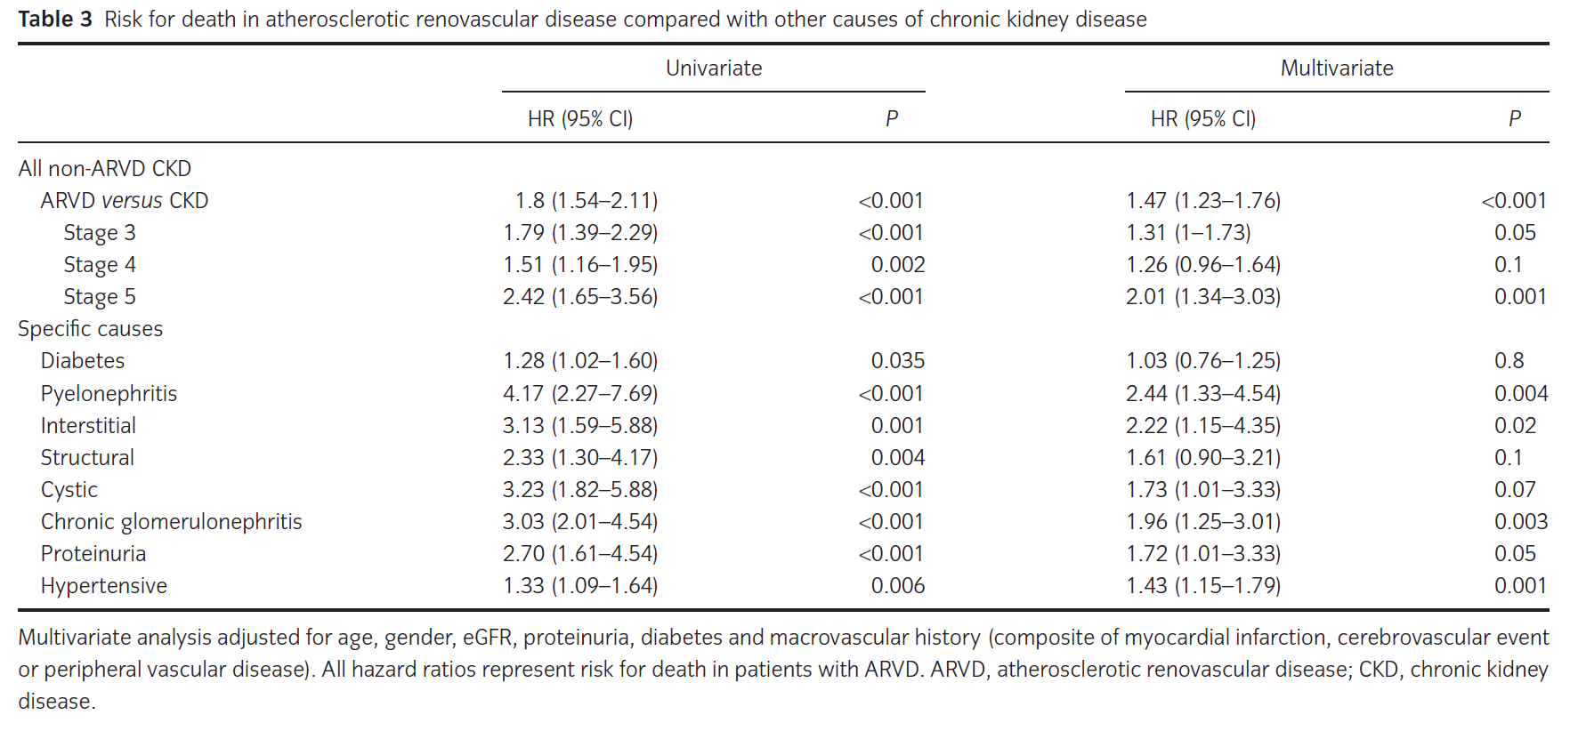
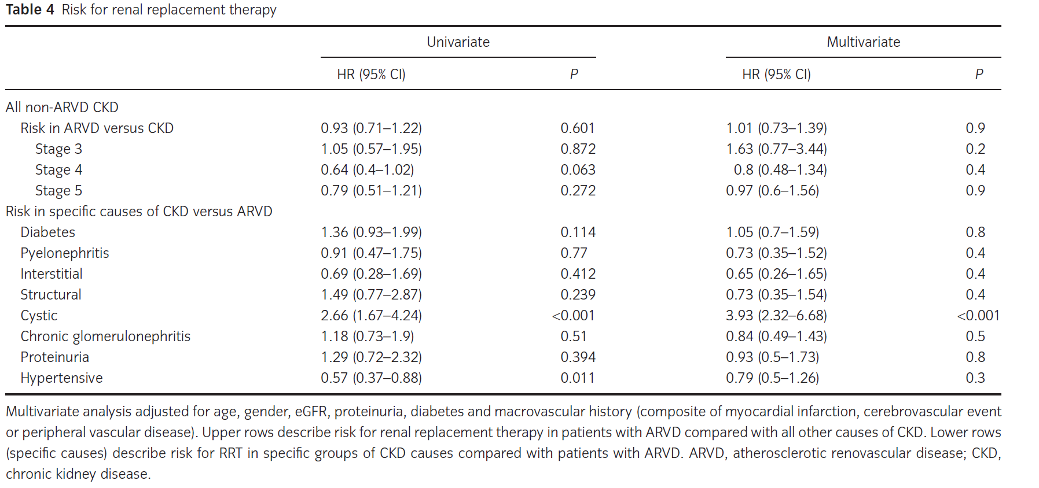
Prognosis of ARVD in CKD
n=1472 CKD patients (563 (38%) ARVD, 909 (62%) non-ARVD)
The risk of death among patients with ARVD markedly exceeds the risk of progression to dialysis (44% vs 16% over a median 4 of years).
Before dialysis ARVD vs non-ARVD had:
- increased risk for death (HR 1.5 (1.2–1.8), P < 0.001)
- similar risk for RRT (HR 1.0 (0.7–1.4), P = 0.9)
Richie et al. Nephrology (Carlton) 2017
Notes:
Pre-dialysis ARVD X
The risk of death among patients with ARVD markedly exceeds the risk of progression to dialysis (44% vs 16% over a median 4 of years).
Original Article
Risks for mortality and renal replacement therapy in atherosclerotic renovascular disease compared with other causes of chronic kidney disease
James Ritchie,Darren Green,Helen V Alderson,Diana Chiu,Smeeta Sinha,Philip A Kalra
First published: 10 May 2015
https://doi.org/10.1111/nep.12501
Citations: 9
Conflict of interest: This research received no specific grant from any funding agency in the public, commercial or not-for-profit sectors. The authors have no conflicts of interest or financial interests to report. None of the results presented in this paper have been published previously in whole or in part, expect in abstract format.
Read the full text
PDF
TOOLS
SHARE
Abstract
Aim
Patients with atherosclerotic renovascular disease (ARVD) have an increased risk for death and likelihood of initiating renal replacement therapy (RRT) compared with the general population. No data exist to describe prognosis in ARVD compared with other causes of chronic kidney disease (CKD). We compare patient outcomes between ARVD and other causes of CKD.
Methods
Patients were selected from two prospective observational cohort studies of outcome in ARVD and CKD. Multivariate Cox regression was used to compare risk for RRT and death (both prior to and following initiation of RRT) between patients with ARVD and other causes of CKD.
Results
Of 1472 patients (563 (38%) ARVD, 909 (62%) non-ARVD), 242 (16%) progressed to RRT and 640 (44%) died over a median follow-up period of 4.1 (2.4–5.6) years. Patients with ARVD had an increased risk for death (HR 1.5 (1.2–1.8), P < 0.001) but not for RRT (HR 1.0 (0.7–1.4), P = 0.9). The largest increase in risk for death was observed relative to renal limited diseases, e.g. pyelonephritis (HR 2.4 (1.3–4.5), P = 0.004) and interstitial/infiltrative disease (HR 2.2 (1.3–4.5), P = 0.02). Following initiation of RRT, patients with ARVD had a significantly increased risk for death compared with patients without ARVD (HR 3.3 (2.2–5.0), P < 0.001).
Conclusions
Patients with ARVD as a cause of CKD have an increased risk for death both prior to and following initiation of RRT. Further work should seek to identify modifiable risk factors relevant to prognosis.

Slide 15
Prognosis of ARVD in ESKD
n=1472 CKD patients (563 (38%) ARVD, 909 (62%) non-ARVD)
After dialysis ARVD vs non-ARVD had:
- increased risk for death (HR 3.3 (2.2-5.0), P < 0.001)
Richie et al. Nephrology (Carlton) 2017
Notes:
Fig. 2 Kaplan–Meier survival curves for ARVD and non-ARVD causes of CKD following initiation of renal replacement therapy. Solid line represents non-ARVD;
dashed line represents ARVD. X-axis shows time in months from recruitment; Y-axis shows survival probability. ARVD, atherosclerotic renovascular disease; CKD,
chronic kidney disease..
Original Article
Risks for mortality and renal replacement therapy in atherosclerotic renovascular disease compared with other causes of chronic kidney disease
James Ritchie,Darren Green,Helen V Alderson,Diana Chiu,Smeeta Sinha,Philip A Kalra
First published: 10 May 2015
https://doi.org/10.1111/nep.12501
Citations: 9
Conflict of interest: This research received no specific grant from any funding agency in the public, commercial or not-for-profit sectors. The authors have no conflicts of interest or financial interests to report. None of the results presented in this paper have been published previously in whole or in part, expect in abstract format.
Read the full text
PDF
TOOLS
SHARE
Abstract
Aim
Patients with atherosclerotic renovascular disease (ARVD) have an increased risk for death and likelihood of initiating renal replacement therapy (RRT) compared with the general population. No data exist to describe prognosis in ARVD compared with other causes of chronic kidney disease (CKD). We compare patient outcomes between ARVD and other causes of CKD.
Methods
Patients were selected from two prospective observational cohort studies of outcome in ARVD and CKD. Multivariate Cox regression was used to compare risk for RRT and death (both prior to and following initiation of RRT) between patients with ARVD and other causes of CKD.
Results
Of 1472 patients (563 (38%) ARVD, 909 (62%) non-ARVD), 242 (16%) progressed to RRT and 640 (44%) died over a median follow-up period of 4.1 (2.4–5.6) years. Patients with ARVD had an increased risk for death (HR 1.5 (1.2–1.8), P < 0.001) but not for RRT (HR 1.0 (0.7–1.4), P = 0.9). The largest increase in risk for death was observed relative to renal limited diseases, e.g. pyelonephritis (HR 2.4 (1.3–4.5), P = 0.004) and interstitial/infiltrative disease (HR 2.2 (1.3–4.5), P = 0.02). Following initiation of RRT, patients with ARVD had a significantly increased risk for death compared with patients without ARVD (HR 3.3 (2.2–5.0), P < 0.001).
Conclusions
Patients with ARVD as a cause of CKD have an increased risk for death both prior to and following initiation of RRT. Further work should seek to identify modifiable risk factors relevant to prognosis.

Slide 16
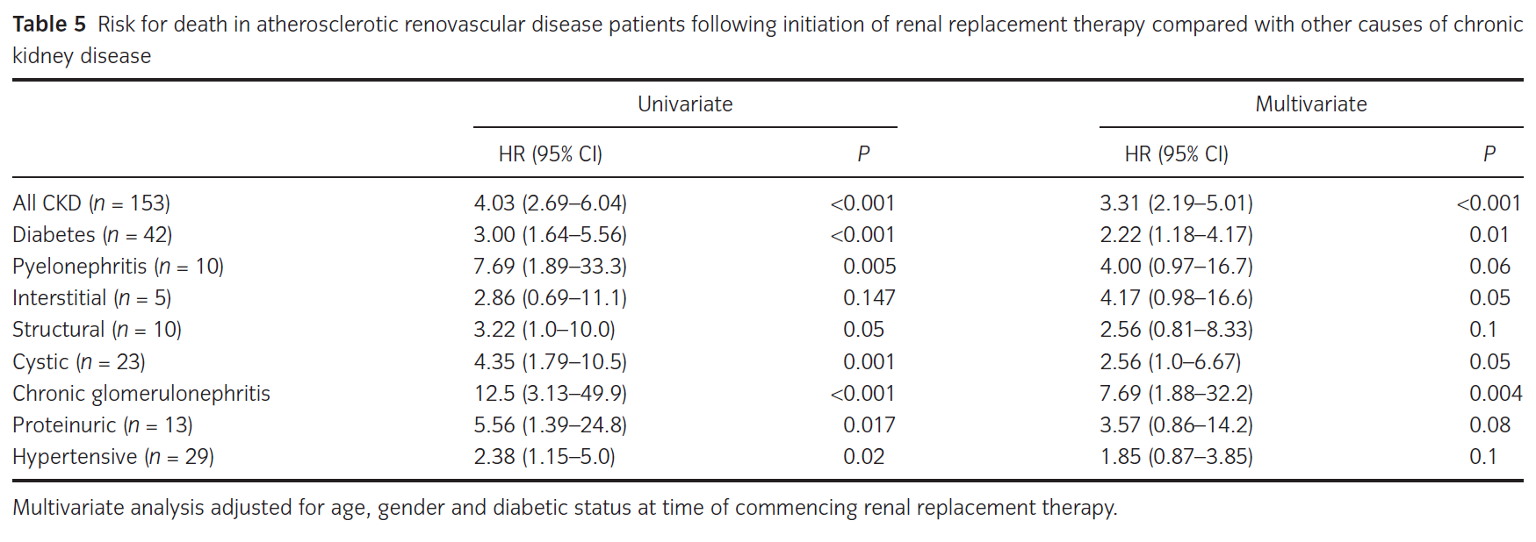
Prognosis of ARVD in CKD
n=1472 CKD patients (563 (38%) ARVD, 909 (62%) non-ARVD)
After dialysis ARVD vs non-ARVD had:
- increased risk for death (HR 3.3 (2.2-5.0), P < 0.001)
Richie et al. Nephrology (Carlton) 2017
Notes:
Fig. 2 Kaplan–Meier survival curves for ARVD and non-ARVD causes of CKD following initiation of renal replacement therapy. Solid line represents non-ARVD;
dashed line represents ARVD. X-axis shows time in months from recruitment; Y-axis shows survival probability. ARVD, atherosclerotic renovascular disease; CKD,
chronic kidney disease..
Original Article
Risks for mortality and renal replacement therapy in atherosclerotic renovascular disease compared with other causes of chronic kidney disease
James Ritchie,Darren Green,Helen V Alderson,Diana Chiu,Smeeta Sinha,Philip A Kalra
First published: 10 May 2015
https://doi.org/10.1111/nep.12501
Citations: 9
Conflict of interest: This research received no specific grant from any funding agency in the public, commercial or not-for-profit sectors. The authors have no conflicts of interest or financial interests to report. None of the results presented in this paper have been published previously in whole or in part, expect in abstract format.
Read the full text
PDF
TOOLS
SHARE
Abstract
Aim
Patients with atherosclerotic renovascular disease (ARVD) have an increased risk for death and likelihood of initiating renal replacement therapy (RRT) compared with the general population. No data exist to describe prognosis in ARVD compared with other causes of chronic kidney disease (CKD). We compare patient outcomes between ARVD and other causes of CKD.
Methods
Patients were selected from two prospective observational cohort studies of outcome in ARVD and CKD. Multivariate Cox regression was used to compare risk for RRT and death (both prior to and following initiation of RRT) between patients with ARVD and other causes of CKD.
Results
Of 1472 patients (563 (38%) ARVD, 909 (62%) non-ARVD), 242 (16%) progressed to RRT and 640 (44%) died over a median follow-up period of 4.1 (2.4–5.6) years. Patients with ARVD had an increased risk for death (HR 1.5 (1.2–1.8), P < 0.001) but not for RRT (HR 1.0 (0.7–1.4), P = 0.9). The largest increase in risk for death was observed relative to renal limited diseases, e.g. pyelonephritis (HR 2.4 (1.3–4.5), P = 0.004) and interstitial/infiltrative disease (HR 2.2 (1.3–4.5), P = 0.02). Following initiation of RRT, patients with ARVD had a significantly increased risk for death compared with patients without ARVD (HR 3.3 (2.2–5.0), P < 0.001).
Conclusions
Patients with ARVD as a cause of CKD have an increased risk for death both prior to and following initiation of RRT. Further work should seek to identify modifiable risk factors relevant to prognosis.

Slide 17
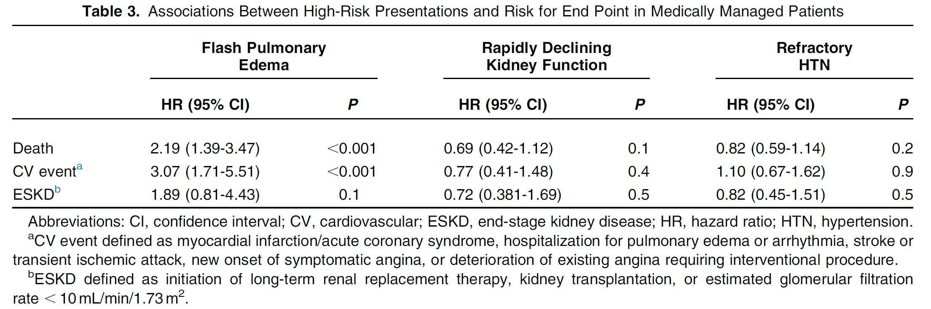
Prognosis of ARVD by clinical presentation
n= 467 patients with ARAS ≥50%,
Richie et al. Am J Kidney Dis 2014
Notes:
Of importance, RAS prognosis depends on the underlying clinical presentation and comorbid conditions, with patients that present with high risk phenotypes, such as those flash pulmonary oedema have a markedly increased risk of CV events and death {hazard ratio [HR] 2.2 [95% confidence interval (CI) 1.4–3.5]} and CV events [HR 3.1 (95% CI 1.7–5.5)] compared with patients with low-risk phenotypes
Και μαλιστα η πρόγνωση, ποικιλει αναλογα με τις κλινικές εκδηλώσεις, με τους ασθενείς με συγκεκριμένο φαινότυπο όπως ……. Να εμφανιζουν τον
RAS prognosis varies considerably depending on the underlying clinical presentation and comorbid conditions. A prospective cohort study in 467 patients with RAS > 50% showed that among patients not treated with revascularization, those that present with flash pulmonary oedema have a markedly increased risk of death {hazard ratio [HR] 2.2 [95% confidence interval (CI) 1.4–3.5]} and CV events [HR 3.1 (95% CI 1.7–5.5)] compared with patients with low-risk phenotypes (i.e. those without flash pul-monary oedema, refractory hypertension or rapid loss of kidney function) [ 32 ].
Furthermore, RAS prognosis varies considerably depending on the underlying clinical presentation and co-morbid conditions. A prospective cohort study in 467 patients with RAS>50%, showed that among patients not treated with revascularization, those that present with flash pulmonary oedema have markedly increased risk of death (HR, 2.2; 95% CI, 1.4-3.5) and CV event (HR, 3.1; 95% CI, 1.7-5.5), compared to patients with low-risk phenotypes (ie, those without flash pulmonary edema, refractory hypertension, or rapid loss of kidney function) Ritchie et al. Am J Kidney Dis. 63(2):186-197. DOI: 10.1053/j.ajkd.2013.07.020
High-Risk Clinical Presentations in Atherosclerotic
Renovascular Disease: Prognosis and Response to Renal
Artery Revascularization
James Ritchie, MB ChB,1 Darren Green, PhD,1 Constantina Chrysochou, PhD,1
Nicholas Chalmers, MB ChB,2 Robert N. Foley, MD,3 and Philip A. Kalra, MD1
Background: Current trial data may not be directly applicable to patients with the highest risk presentations
of atherosclerotic renovascular disease, including flash pulmonary edema, rapidly declining kidney function,
and refractory hypertension. We consider the prognostic implications of these presentations and response to
percutaneous revascularization.
Study Design: Single-center prospective cohort study; retrospectively analyzed.
Setting & Participants: 467 patients with renal artery stenosis $50%, managed according to clinical
presentation and physician/patient preference.
Predictors: Presentation with flash pulmonary edema (n537 [7.8%]), refractory hypertension (n5116
[24.3%]), or rapidly declining kidney function (n546 [9.7%]) compared to low-risk presentation with none of these
phenotypes (n5230 [49%]).Percutaneous revascularization (performedin32%of flashpulmonary edema,28%of
rapidly declining kidney function, and 28%of refractory hypertension patients) compared tomedicalmanagement.
Outcomes: Death, cardiovascular (CV) event, end-stage kidney disease.
Results: During a median follow-up of 3.8 (IQR, 1.8-5.8) years, 55% died, 33% had a CV event, and 18%
reached end-stage kidney disease. In medically treated patients, flash pulmonary edema was associated with
increased risk of death (HR, 2.2; 95% CI, 1.4-3.5; P , 0.001) and CV event (HR, 3.1; 95% CI, 1.7-5.5;
P , 0.001), but not end-stage kidney disease, compared to the low-risk phenotype. No increased risk for
any end point was observed in patients presenting with rapidly declining kidney function or refractory
hypertension. Compared to medical treatment, revascularization was associated with reduced risk for death
(HR, 0.4; 95% CI, 0.2-0.9; P50.01), but not CV event or end-stage kidney disease, in patients presenting
with flash pulmonary edema. Revascularization was not associated significantly with reduced risk for any
end point in rapidly declining kidney function or refractory hypertension. When these presentations were
present in combination (n531), revascularization was associated with reduced risk for death (HR, 0.15;
95% CI, 0.02-0.9; P50.04) and CV event (HR, 0.23; 95% CI, 0.1-0.6; P50.02).
Limitations: Observational study; retrospective analysis; potential treatment bias.
Conclusions: This analysis supports guidelines citing flash pulmonary edema as an indication for renal
artery revascularization in atherosclerotic renovascular disease. Patients presenting with a combination of
rapidly declining kidney function and refractory hypertension also may benefit from revascularization and may
represent a subgroup worthy of further investigation in more robust trials.
Am J Kidney Dis. 63(2):186-197.  2014 by the National Kidney Foundation, Inc. Published by Elsevier Inc. All
rights reserved.

Slide 18
Atherosclerotic Renal Artery Stenosis
Pathophysiology

Slide 19
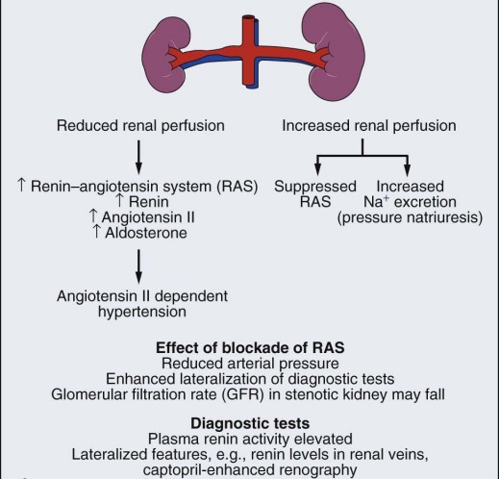
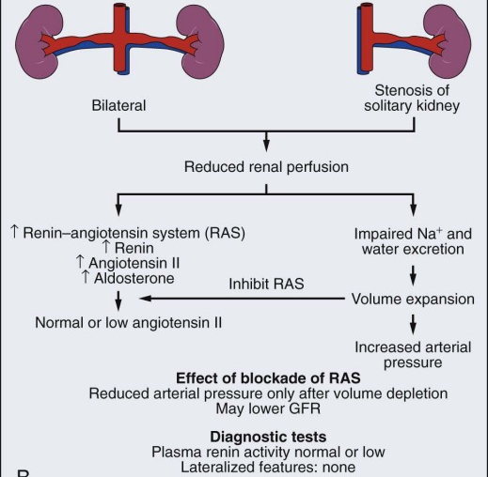
Pathophysiology
“1 clip – 2 kidney hypertension”
“1 clip – 1 kidney hypertension”
Textor S, Greco B. Renovascular Hypertension and Ischaemic Renal Disease. In: Floege J, Johnson RJ, Feehally J (eds). Comprehensive Clinical Nephrology, 4th Edn. Mosby Elsevier, Philadelphia, PA, 2010
Notes:
With regards to pathophysiology, there are two different models that have been described. In the first, one-clip two-kidney hypertension, there is unilateral RAS and the ischemic kidney secretes renin, which leads to increased ANG II formation and hence elevation of BP which is renin-dependent, as the contralateral normal kidney increases sodim excretion through pressure natriuresis. In the second, 1 clip-1 kidney hypertension, we have bilateral RAS or RAS in solitary kidney, in which reduced perfusion pressure to the stenotic kidney in the absence of a normal kidney excreting sodium leads to sodium and volume retention, and BP rise which is volume-dependent.
Σχετικα με την παθοφυσιολογια, όπως γνωριζουμε από τα πειραματα του καθηγητη coldblatt εδώ και 100 περιπου χρόνια, έχουμε δύο πρότυπα, αυτό της ετεροπλευρης στένωσης με τον άλλο νεφρό φυσιολογικό, όπου έχουμε ενεργοποιηση του ΣΡΑ και ρενινοεξαρτωμενη υπερταση, καθώς υπάρχει ο φυσιολογικός νεφρός που κανει την φυσιολογική πίεση-νατριουση,
Και το δευτερο πρότυπο – της άμφω στενωσης των νεφρικών αγγείων ή της στενωσης σε μονονεφρο, όπου η ρενινοεξαρτωμενη υπερταση μεταπιπτει πολύ γρήγορα σε ογκοεξαρτωμενη υπερταση
Two basic models have been described. In the first, In the second, one-clip one-kidney Goldblatt hypertension, the contralateral kidney is removed. In this case the pressure natriuresis can no longer occur, and sodium retention occurs. The ensuing expansion of plasma volume inhibits renin secretion, so that in this model the renin level is normal or low.
In unilateral stenosis with two kidneys, opposing forces between the stenotic kidney, which has reduced perfusion pressures, and the nonstenotic contralateral kidney, which has increased perfusion pressures, result in laboratory and clinical features of angiotensin-dependent hypertension. (B) In unilateral stenosisnwith a solitary functioning kidney or in a patient with bilateral critical renal artery stenosis,
However, the presence of a normal contralateral kidney allows pressure natriuresis to occur (see Chapter 2), in which the elevated perfusion pressure mediates natriuresis in the nonstenotic kidney. Because the nonstenotic kidney functions to eliminate the excess sodium, the level of perfusion to the stenotic side remains reduced, leading to sustained activation of the renal artery stenosis. This sequence of events producing angiotensin II (Ang II)–dependent hypertension and secondary aldosterone excess with hypokalemia is summarized in Figure 37.7.
By contrast, one-clip, one-kidney hypertension represents a model in which the entire renal mass is exposed to reduced pressures beyond a stenosis. There is no normal or nonstenotic kidney to counteract increased systemic pressures. As a result, sodium is retained and blood volume expanded, which eventually feeds back to inhibit the RAS (Fig. 37.7B). Therefore, one-clip, one-kidney hypertension is typically not angiotensin dependent unless removal of volume is achieved that reduces renal perfusion pressure and activates the RAS.

Slide 20

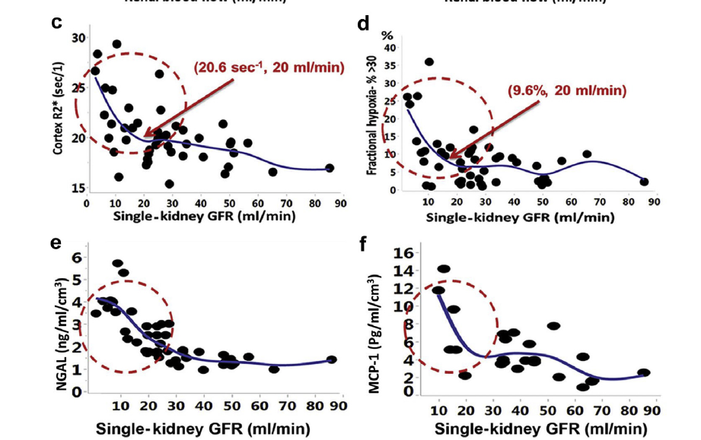
Hypoxia and inflammatory
Markers in ARVD follow
Inflection at approximately
GFR @20 ml/min
Kidney International, April 2019
Notes:
Renal vein samples obtained from kidneys. Not used in peripheral vein samples as always high so difficult to interpret
As ischemia increases and hits a threshold, other biomarkers of ischemia take off – ignition of inflammatory sequence

Slide 21
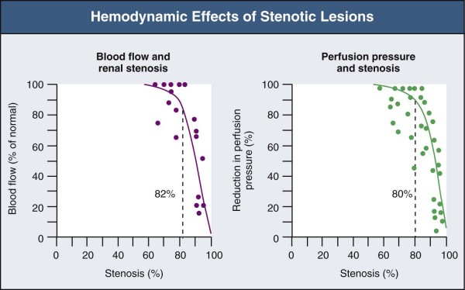
Pathophysiology: importance of stenosis grade
Textor S, Greco B. Renovascular Hypertension and Ischaemic Renal Disease. In: Floege J, Johnson RJ, Feehally J (eds). Comprehensive Clinical Nephrology, 4th Edn. Mosby Elsevier, Philadelphia, PA, 2010
Notes:
There are two points that should be highlighted. First, the importance of stenosis grade. We know from physiology that only lumen stenoses > 70-80% are functional and will cause a reduction of renal blood flow and perfusion, and stenoses of lesser degrees are suggested to have minimal haemodynamic effects due to the compensatory mechanisms of renal autoregulation
Και ένα σημειο το οποίο δεν πρεπει να ξεχναμε εινια ότι σε ένα φυσιολογικό νεφρο, για να πεσει η αιματική ροή κάτω από 50% πρέπει να υπάρχει στένωση του αυλου >80%, και αυτό συμβαινει γιατι ο νεφρος εχει πολύ καλες δυνατοτητες αυτορυθμισης κυκλοφοριας
Luminal occlusion of less than 60% (cross-sectional area) rarely produces any measurable decrements in either pressure or flow. Hence, a fall in renal perfusion pressure sufficient to initiate RVH occurs only when luminal occlusion is relatively severe, usually in the 70% to 80% cross-sectional occlusion range

Slide 22
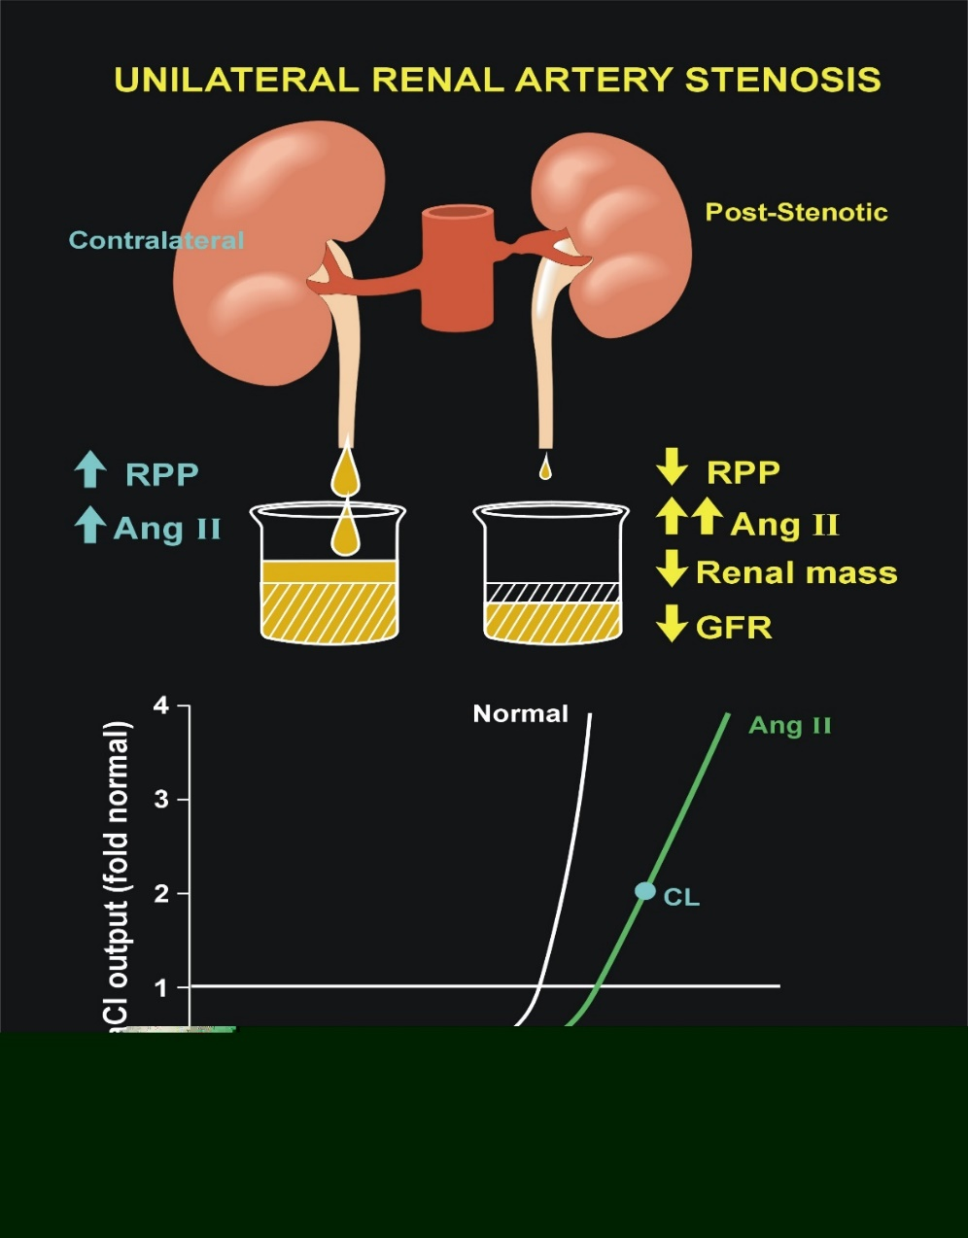
Pathophysiology of ARVD: importance of time
Irreversible parenchymal HTN:
Prolonged exposure to high BP and high levels of ATII causes widespread arteriolar damage and glomerulosclerosis in the contralateral kidney.
Corrective surgery for unilateral RVH was successful in 78% of those with HTN of less than 5 years duration but in only 25% of those with HTN of a longer duration.
Notes:
22
And the second one is the importance od time, as ……..
Ένα επίσης πολύ σημαντικό κομμάτι, σε ότι αφορα την νεφρική βλάβη, είναι η συνολική διάρκεια της λειτουργικής στένωσης καθώς όσο μεγαλύτερο το χρονικό διάστημα, τόσο ………. Και ως εκ τούτο, τόσο μικρότερη η πιθανότητα βιώσιμου νεφρικού παρεγχύματος και πτώσης της ΑΠ
Variations in the natural history of RVH complicate our understanding of primary pathogenic mechanisms. Rarely is it known exactly when critical levels of stenosis develop. In experimental models, the relative importance of pressor mechanisms, including measurable activation of the RAAS, changes with time. Levels of circulating plasma renin activity decrease, as does the responsiveness of BP to short-term blockade of the renin system. Several mechanisms have been proposed to explain such changes, including a slowly developing pressor action of Ang II, a transition to alternate pressor mechanisms, and intrinsic renal injury to the nonstenotic kidney, which ultimately sustains hypertension despite reversal of the vascular lesion. In experimental models, this translates into a time limit for reversibility of RVH.
There are several clinical correlates with this variable time course. First, it is not known how best to identify when revascularization will fail to improve BP control, although a brief duration of hyper­tension suggests a more favorable response to intervention. As a result, many of the diagnostic studies that depend on lateralization of effects have only modest predictive value when negative. As a general rule, studies are most reliable when positive, meaning that high-grade lateralization accurately predicts an improvement after revascularization. Second, coexistent intrarenal disease, such as arteriolosclerosis with glomerulosclerosis, is associated with persistent hypertension despite correction of RA stenosis, particularly for patients with ASRVD.6 In these patients, a long duration of hypertension allows the development of arteriolosclerotic lesions and renal injury in the contralateral kidney (Fig. 39-2, A). Thus, older age and a long duration of hypertension (e.g., >3 to 5 years) predict a poorer outcome of intervention in this patient population. Most elderly patients with ASRVD also have impaired renal function related to microvascular renal injury in addition to main RA stenosis.

Slide 23
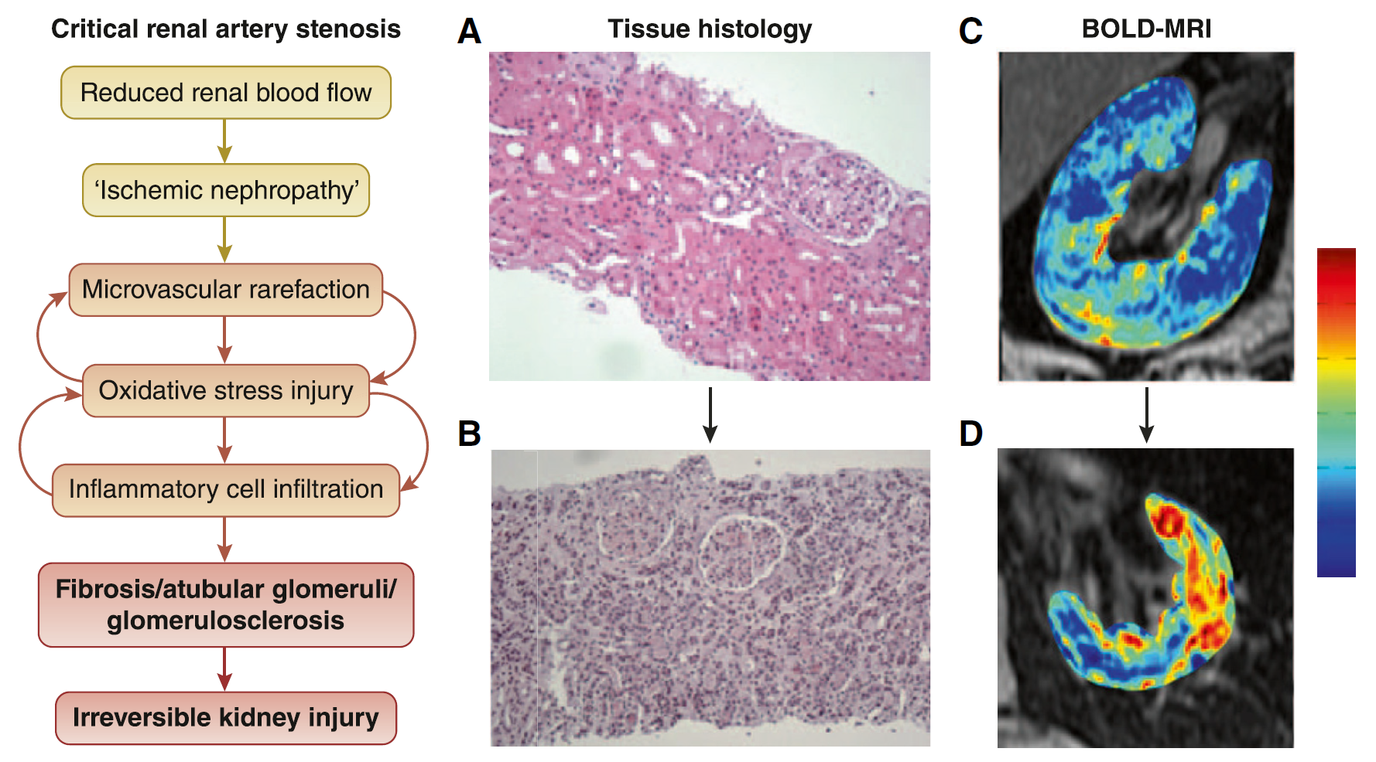
Pathways leading to kidney injury beyond “critical” levels of RAS
Hicks et al. Am J Kidney Dis 2022
Notes:
There are different mechanisms that may be responsible for this, as loss of renal perfusion leads to ………….., which in turn results in fibrosis and irreversible kidney injury.
Major pathways leading to kidney injury beyond “critical” levels of renal artery stenosis. Left column depicts sequence of
microvascular injury resulting from loss of perfusion. Histologic sections (A and B) identify reduced glomerular volume and areas
without intact tubules but with increased mononuclear inflammatory cells, consistent with irreversible kidney injury. Blood oxygen
level–dependent magnetic resonance (BOLD-MRI) images (C and D) depict levels of tissue oxygenation with moderate reductions
(30%-40%) of renal blood flow. Legend on right indicates the level of deoxyhemoglobin, which identifies the level of local tissue
hypoxia. In C, cortical levels of deoxyhemoglobin are normally low, consistent with abundant tissue oxygenation even with reduced
blood flow. As more severe and sustained reductions develop, areas of severe localized hypoxia are evident, with increased tissue
deoxyhemoglobin (D).

Slide 24
Pathways leading to heart injury beyond “critical” levels of RAS
Januszewicz et al. J Am Coll Cardiol 2022
Notes:
Major pathways leading to kidney injury beyond “critical” levels of renal artery stenosis. Left column depicts sequence of
microvascular injury resulting from loss of perfusion. Histologic sections (A and B) identify reduced glomerular volume and areas
without intact tubules but with increased mononuclear inflammatory cells, consistent with irreversible kidney injury. Blood oxygen
level–dependent magnetic resonance (BOLD-MRI) images (C and D) depict levels of tissue oxygenation with moderate reductions
(30%-40%) of renal blood flow. Legend on right indicates the level of deoxyhemoglobin, which identifies the level of local tissue
hypoxia. In C, cortical levels of deoxyhemoglobin are normally low, consistent with abundant tissue oxygenation even with reduced
blood flow. As more severe and sustained reductions develop, areas of severe localized hypoxia are evident, with increased tissue
deoxyhemoglobin (D).

Slide 25
Atherosclerotic Renal Artery Stenosis
Diagnosis

Slide 26
Clinical manifestations
Hypertension
Sudden onset or worsening of existing hypertension Grade III hypertension (especially in the presence of other CV risk factors or atherosclerotic disease in other beds) Resistant hypertension
Kidney Disease
Atrophic kidney or size difference > 1.5 cm Rapid, unexplained kidney function decline Decline in eGFR >30% after starting ACEi/ARBs Increased proteinuria due to hypertensive damage in the non-stenotic kidney in unilateral RAS
Heart Failure
Repeated hospital admissions for ADHF with preserved left ventricular function on echocardiography Sudden unexplained (“flash”) pulmonary edema
Sarafidis et al, Nephrol Dial Transplant 2023
Notes:
Patients with ARVD may present with multiple clinical manifestations, ranging from asymptomatic disease to severe presentations, including malignant hypertension, flash pulmonary oedema and rapidly progressive kidney function decline. The most common clinical presentations and changes in common laboratory tests related to ARVD that should prompt clinicians to perform further investigations for this entity
Οι κλινικές εκδηλώσεις μπορουν να ποικιλουν από ασυμπτωματική νόσο μεχρι σοβαρες εκδηλώσεις όπως κακοηθη υπερταση, πν οιδημα και ταχεια επιδεινωση της νεφρικής λειτουργιας. Γενικά, η ύπαρξη ………. Σε ασθενεις με προδιαθεσικούς παραγοντες όπως ….. Εγειρουν την υπονοια ύπαρξη νεφραγγειακής νόσου και χρήζουν περαιτέρω διερευνησης με απεικονιστικό έλεγχο
. The most common clinical presentations are resistant hypertension (defined as uncontrolled hypertension under office and ambulatory conditions despite appropriate lifestyle measures and
optimal treatment with adequate doses of three or more antihypertensive drugs of different classes, including a diuretic, or
controlled BP in the presence of adequate doses of more than four antihypertensive drugs) [ 49 , 50 ] and ischaemic nephropathy, -CKD.

Slide 27
Clinical presentations
Hypertension | Sudden onset or worsening of existing hypertension Grade III hypertension (especially in the presence of other cardiovascular risk factors or atherosclerotic disease in other circulatory beds) Resistant hypertension
Kidney Disease | Atrophic kidney or size difference > 1.5 cm between kidneys Rapid, unexplained kidney function decline Decline in kidney function (eGFR) >30% after starting treatment with ACEi/ARBs Increased albuminuria/proteinuria due to hypertensive damage in the non-stenotic kidney in unilateral RAS
Heart failure | Repeated hospital admissions for decompensated heart failure with preserved left ventricular function on echocardiography Sudden unexplained (“flash”) pulmonary edema
Sarafidis, Theodorakopoulou et al, Nephrol Dial Transplant 2023
Notes:
Patients with ARVD may present with multiple clinical manifestations, ranging from asymptomatic disease to severe presentations, including malignant hypertension, flash pulmonary oedema and rapidly progressive kidney function decline. The most common clinical presentations and changes in common laboratory tests related to ARVD that should prompt clinicians to perform further investigations for this entity

Slide 28
ARVD: Clinical Presentations
Incidental finding during arterial imaging studies
Resistant/refractory hypertension (ARVD prevalence 10-40%)
Chronic Kidney Disease
Loss of GFR during RAAS blockade initiation (>30% rise in SCr)
Unexplained rapid decline in kidney function or AKI
Acute (i.e. flash) pulmonary edema and/or acute decompensations of heart failure, particularly in patients with hypertension CKD, and renal asymmetry >1.5 cm in renal US.
Hicks et al. Am J Kidney Dis 2022; Pappacoggli et al. Hypertension 2023

Slide 29
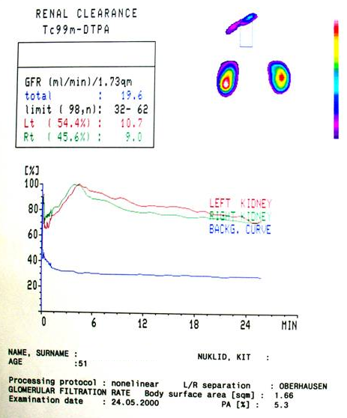
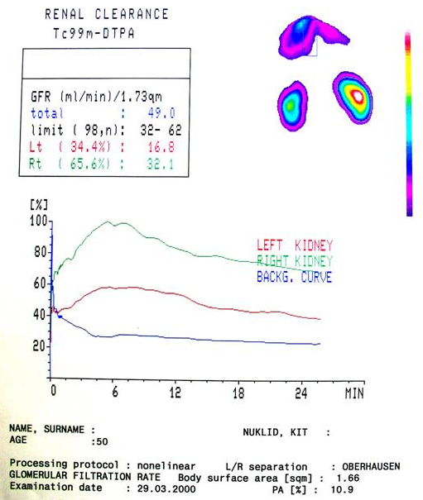
ARVD: Diagnostic Testing
Baseline Captopril test

Slide 30
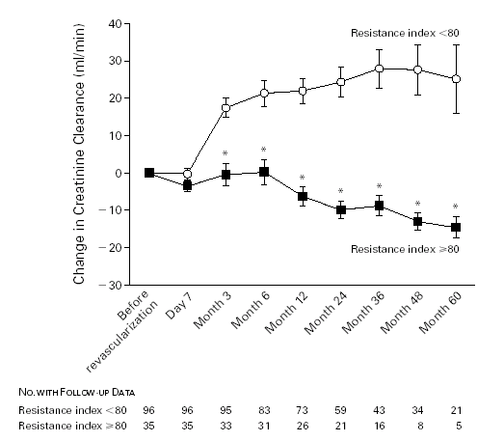
Resistance Index and response to angioplasty
* indicates p < 0.05
Radermacher et al. N Engl J Med 2001

Slide 31
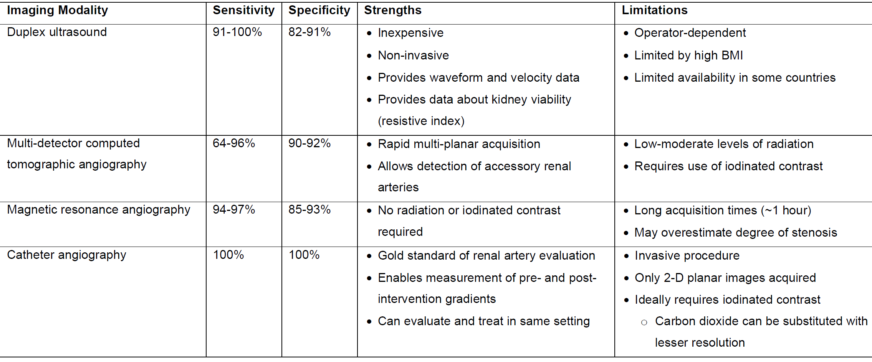
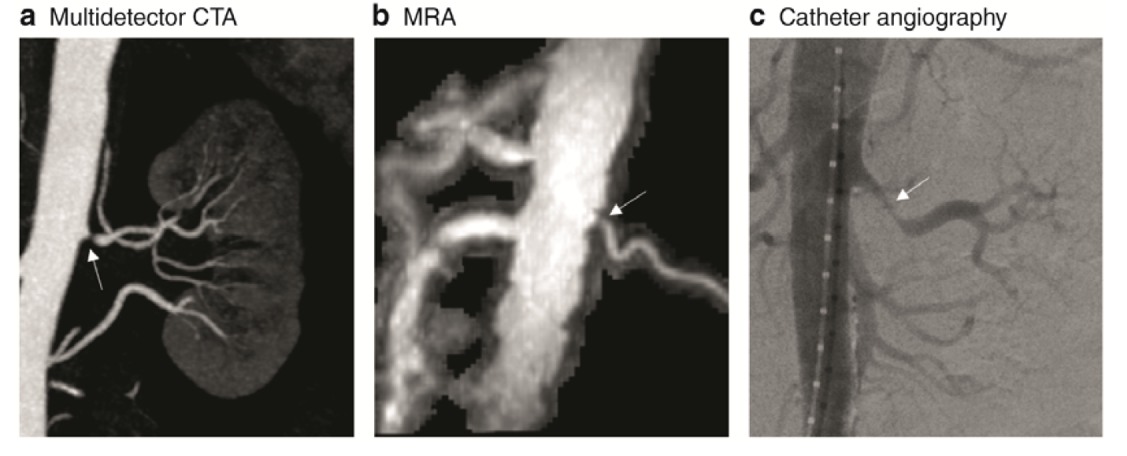
ARVD: imaging modalities
Severe/significant: RAS > 70%
Moderately severe: RAS 50–70% + confirmation of the haemodynamic severity (translesional resting/hyperemic or mean systolic gradient ≥20 or 10 mmHg, RFFR ≤0.8)
Sarafidis, Theodorakopoulou et al. Nephrol Dial Transplant 2023
Hicks et al. Am J Kidney Dis 2022
Notes:
Should prompt further examination by available imaging modalities, each with different strengths and limitations (Fig 2; Table 1). Duplex ultrasound is frequently used for screening because it is inexpensive and noninvasive.
Computed tomography angiography (CTA) or MRA are reliable methods for diagnosing RAS with their
sensitivity and specificity being significantly improved over the past years, reaching….. Despite improvements in the diagnostic accuracy of CTA and MRA, invasive catheter angiography remains the gold standard method for RAS diagnosis and evaluation and it should guide the final decision to intervene, as it enables to characterize the measurement of pre- and post-intervention pressure gradients to establish the haemodynamic severity of the stenosis
and the possibility of treatment in the same setting and time

Slide 32
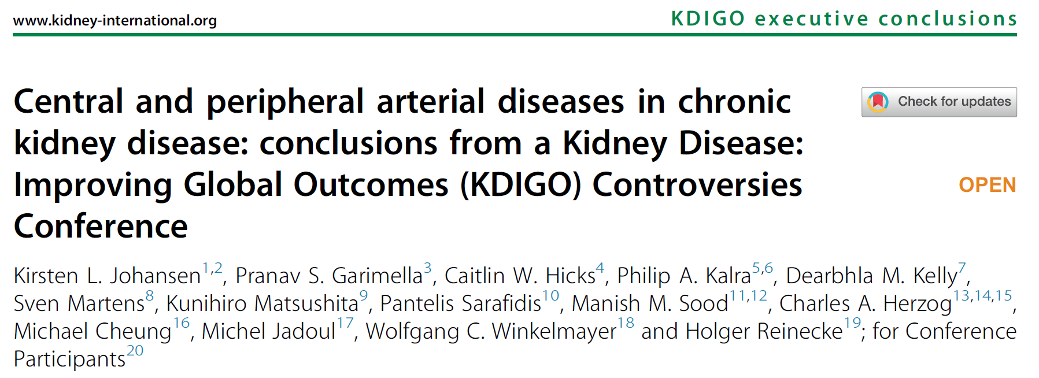

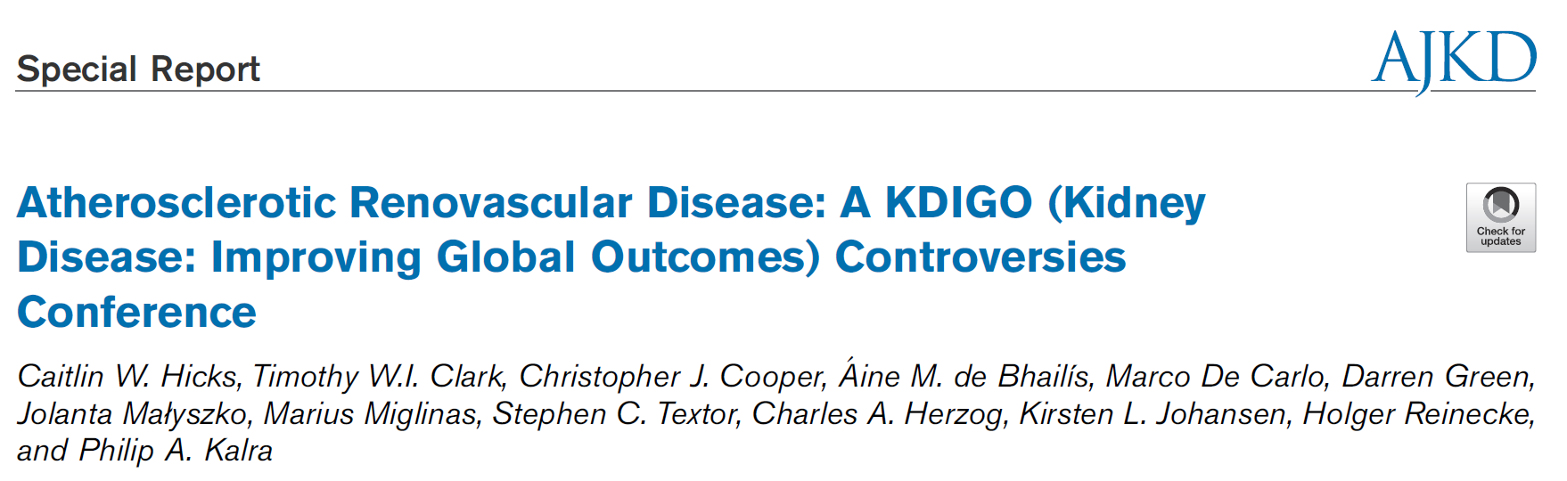
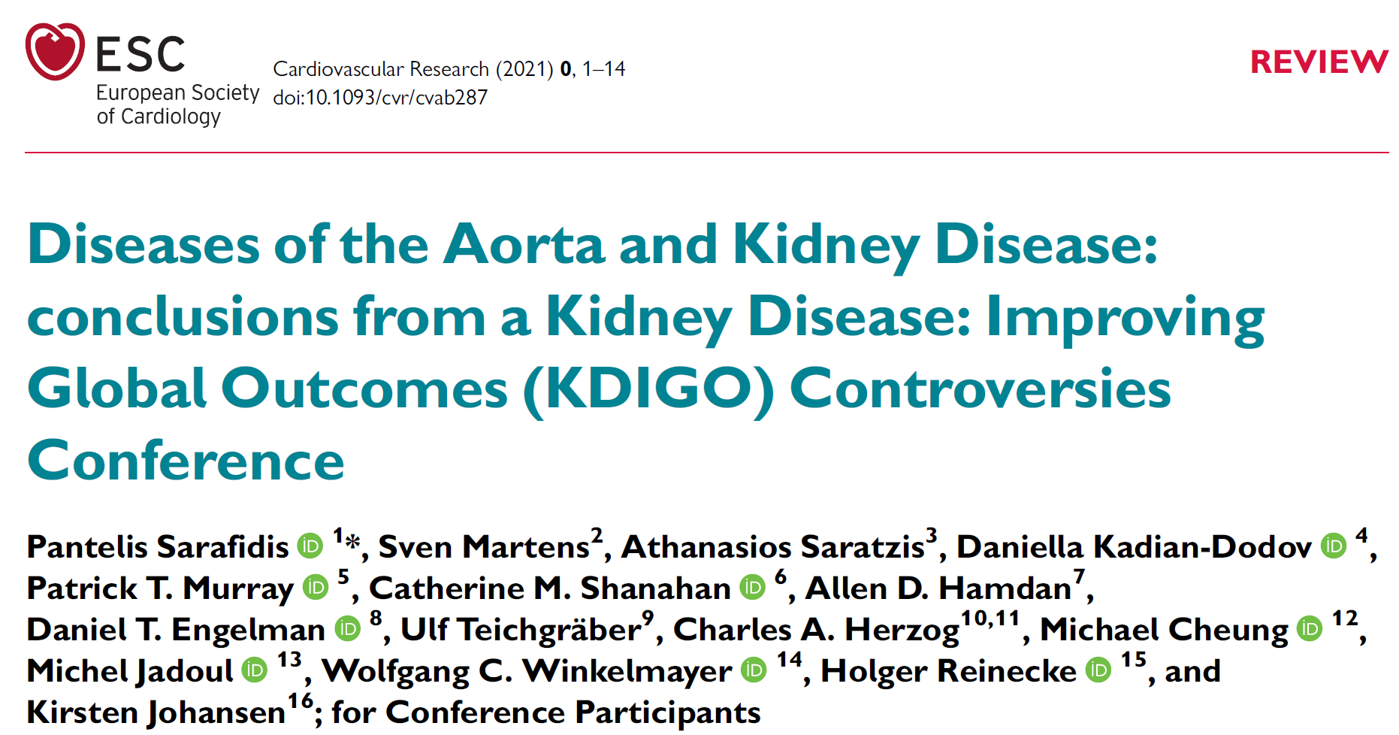

Slide 33

Assessment of kidney parenchyma viability in ARVD
 | Non-viable | Likely to be viable**
Renal length (cm) | < 7 cm | > 8* cm
Cortical thickness | Loss of cortico-medullary differentiation; no cortex | Cortex distinct eg > 0.5 cm
Proteinuria | uACR > 300 mg/g (30 mg/mmol) = uPCR > 500 mg/g | uACR < 200 mg/g (20 mg/mmol)
Renal resistive index | > 0.8 | < 0.8
*possibly consider renal length : BMI ratio
** BOLD values still research application
Johansen et al. Kidney Int 2021
Notes:
Types of Endovascular Aneurysm Repair (EVAR) depending on the anatomy of the abdominal aneurysm (infra-renal aneurysms include a proximal aortic neck that provide an adequate landing zone for EVAR; juxta-renal aneurysms are adjacent to or include the lower margin of the renal arteries; supra-renal and thoraco-abdominal aneurysms also extend above the orifice of renal arteries)

Slide 34
Atherosclerotic Renal Artery Stenosis
Management

Slide 35
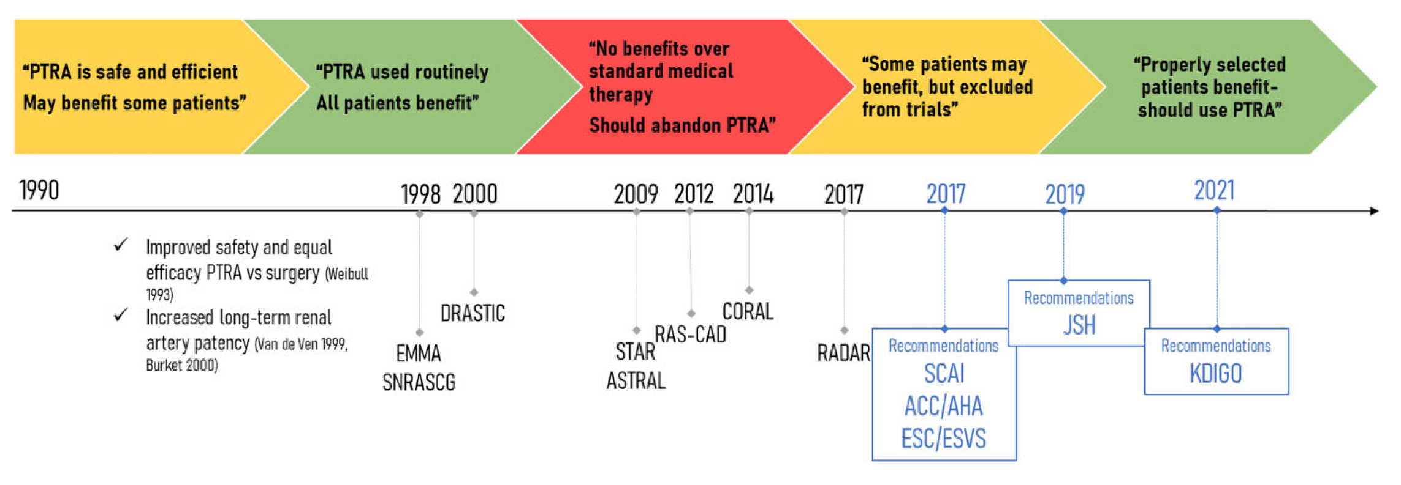
Revascularization vs Medical Therapy in ARVD
Theodorakopoulou et al. Clin Kidney J 2022
Notes:
And let’s move on to management , which remained a controversial issue for the last 20 years, you see here in this historical timeline the different practice patterns in the management of ARVD and associations with published randomized trials, with recommendations changing constantly and the medical community being divided on whether they should be medical therapy alone or revascularization.

Slide 36

Standard Medical Therapy
BP control
  Multiple drug regimens
  ACEi / ARBs :
    First choice– Reduction in mortality
    Generally well tolerated
    Stability of GFR (>30% increase = ? critical stenosis)
  Calcium Channel Blockade / Diuretic
↓ CV risk: statins, antiplatelets, smoking cessation, exercise, weight loss
Van der Niepen et al. Curr Hypertens Rep 2017;Hicks et al. Am J Kidney Dis 2022; Sarafidis et al. Nephrol Dial Transplant 2023
Notes:
Medical management of ARVD should aim to reduce CV risk and protect kidney function. Hypertension control is a prominent goal; since no clinical studies examining different BP targets have been performed in patients with RAS, the general recommendations should be followed [17]. Lipid-lowering agents are needed to achieve cholesterol targets depending on total CV risk [78]. The role of antiplatelet therapy in mitigating adverse CV outcomes in patients with ARVD is not tested in clinical trials, but its role is established in patients with atherosclerotic coronary or peripheral artery disease [79], and observational studies showed that use of low-dose aspirin was associated with reduced mortality risk in patients with ARVD [80]. Additional measures to help BP control and CV risk reduction include smoking cessation, weight loss, regular physical exercise and reduced sodium consumption [17,19,81]; for all these measures no hard evidence for RCTs in patients with ARVD is available.

Slide 37
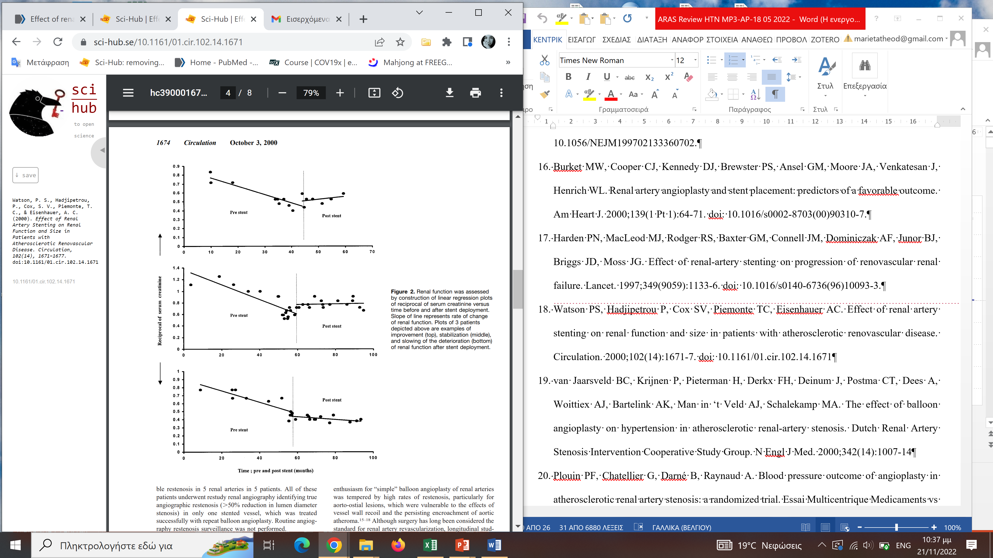
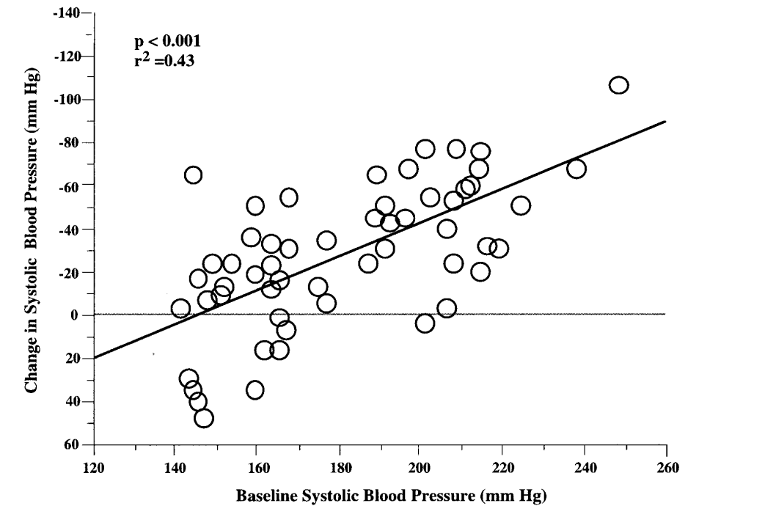
Preliminary observational studies
61 vessels in 33 patients
F-up 20 months
N=127 pts
F-up 15 months
Burket MW et al. Am Heart J. 2000
Watson PS et al. Circulation. 2000
Notes:
In fact, we have strong data that PTRA with or without stenting was effective both in terms of BP control, with systolic BP decreasing up to 20-25 mmHg [15–17], and in terms of stabilization or improvement of kidney function [16– 18].
Ετσι, και ενώ αρχικα ειχαμε ισχυρα δεδομενα από μελέτες παρατηρησης σχετικά με τα οφέλη που προσφέρει η PTRA με πτώση των επιπεδων της ΑΠ και σταθεροποιηση της νεφρικής λειτουργιας

Slide 38
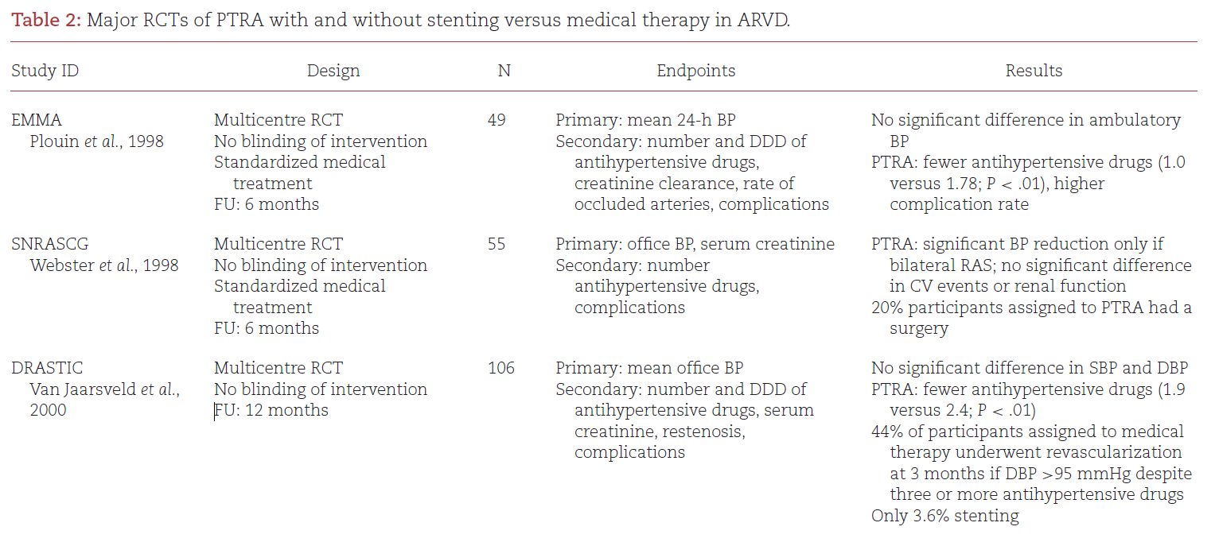

PTRA effects on BP: Evidence from RCTs
Notes:
In later years, a few RCTs attempted to properly test the su-periority of standard medical therapy plus PTRA with or without stenting compared with medical therapy alone in lowering BP lev-els or preventing adverse renal and CV outcomes in patients with ARVD. They largely showed that PTRA had no additional benefit on BP control, renal function and adverse CV or renal outcomes when compared with medical therapy alone [ 2 , 8 , 82

Slide 39
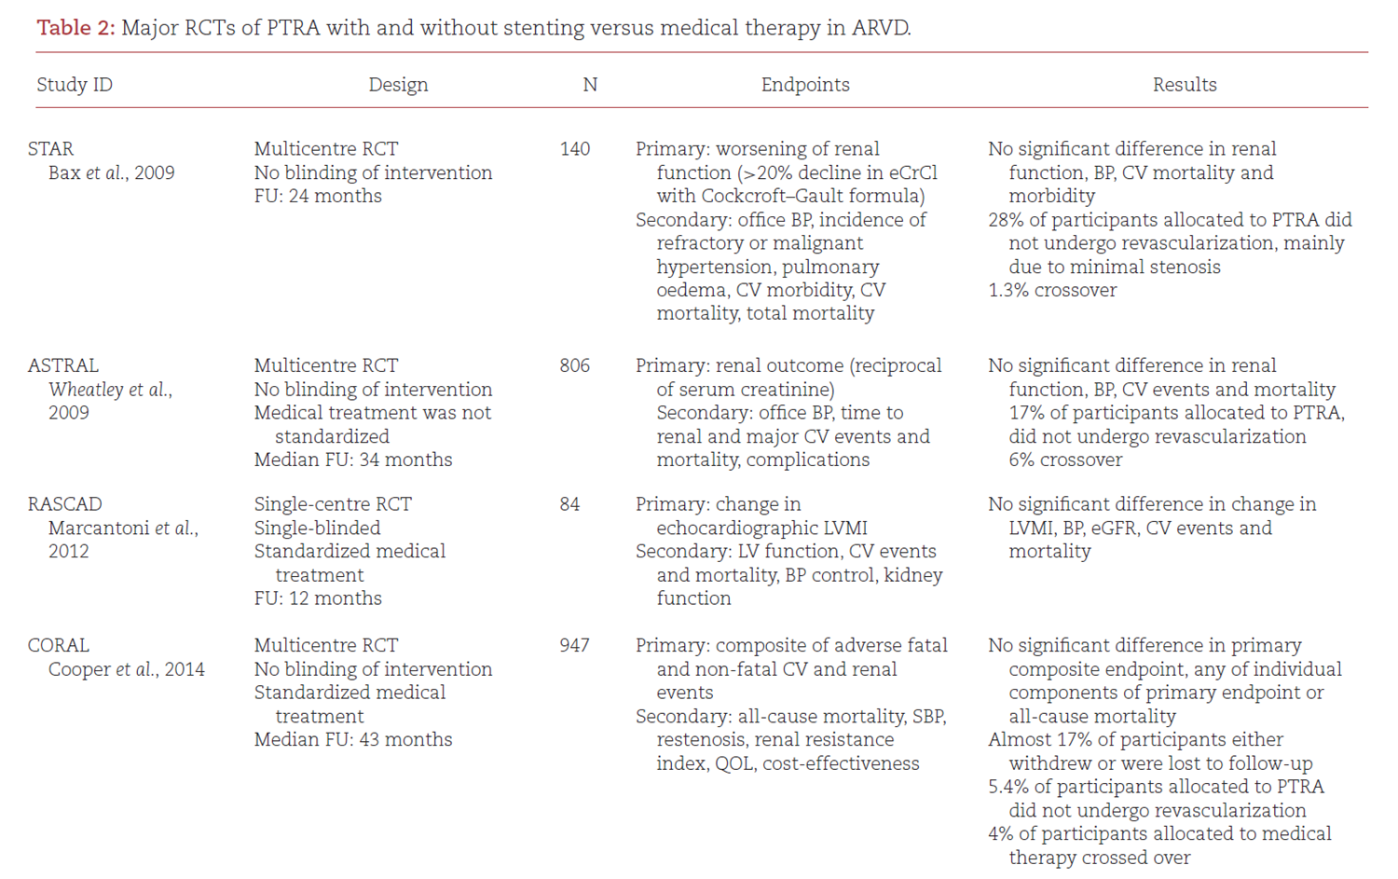
PTRA effects on renal and CV outcomes: Evidence from RCTs
Notes:
They largely showed that PTRA had no additional benefit on BP control, renal function and adverse CV or renal outcomes when compared with medical therapy alone [ 2 , 8 , 82

Slide 40
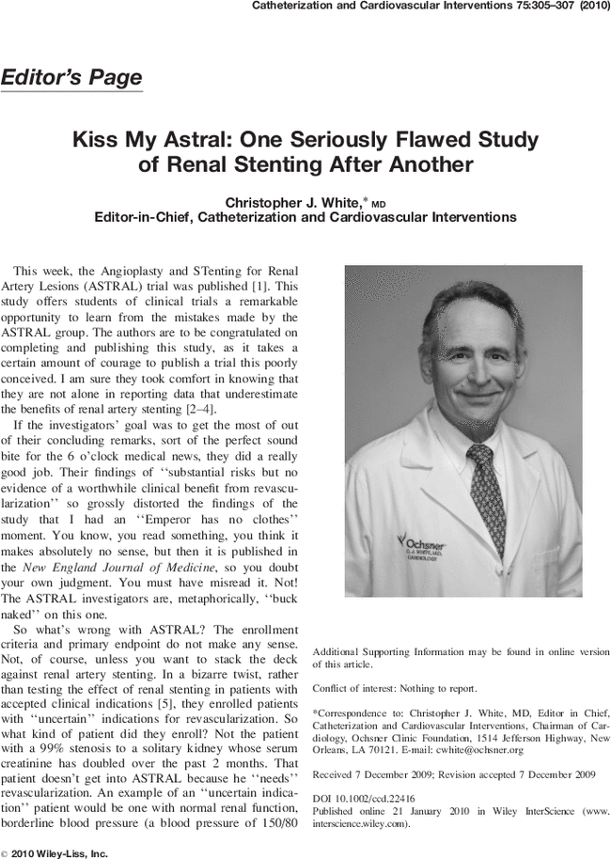
Notes:
However, these trials met severe criticism due to numerous limitations in study design, methodology and execution,

Slide 41
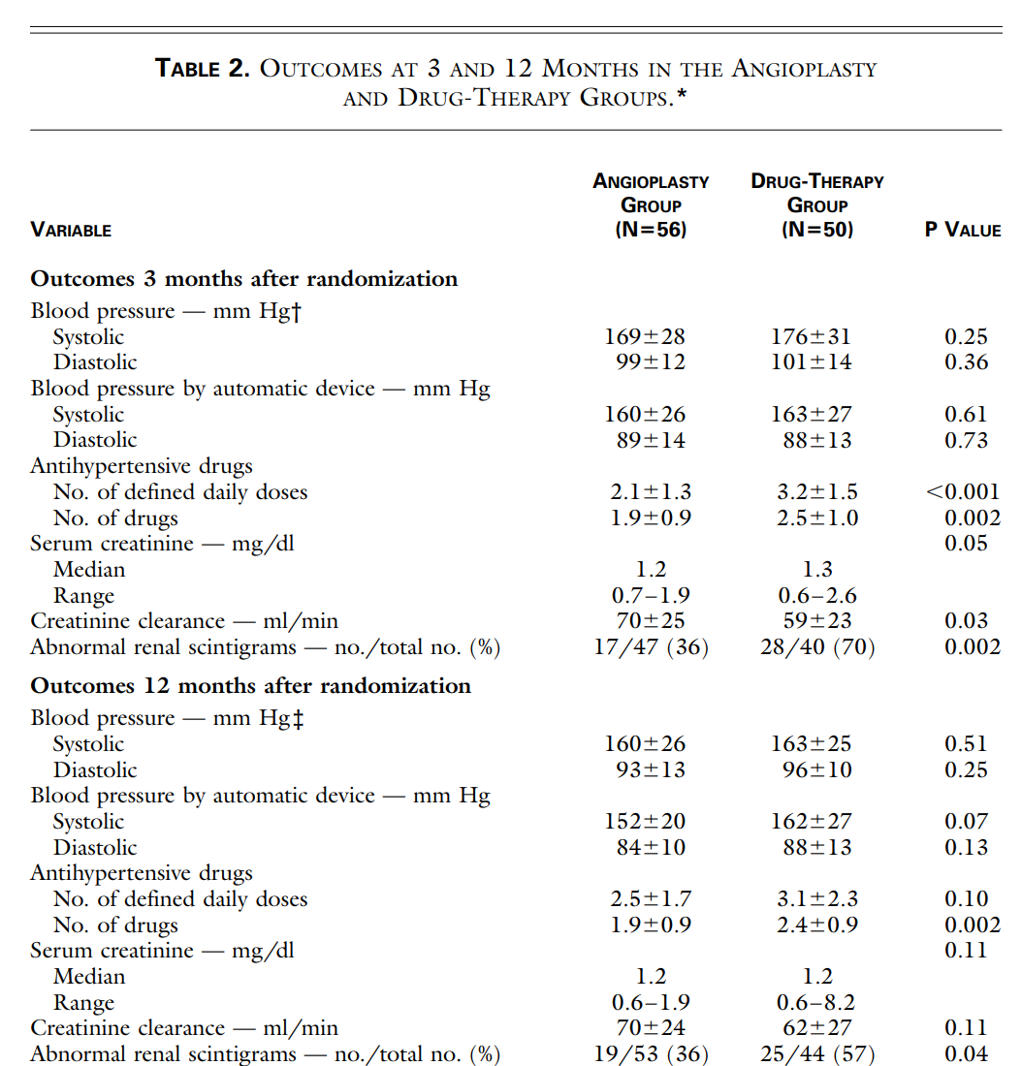
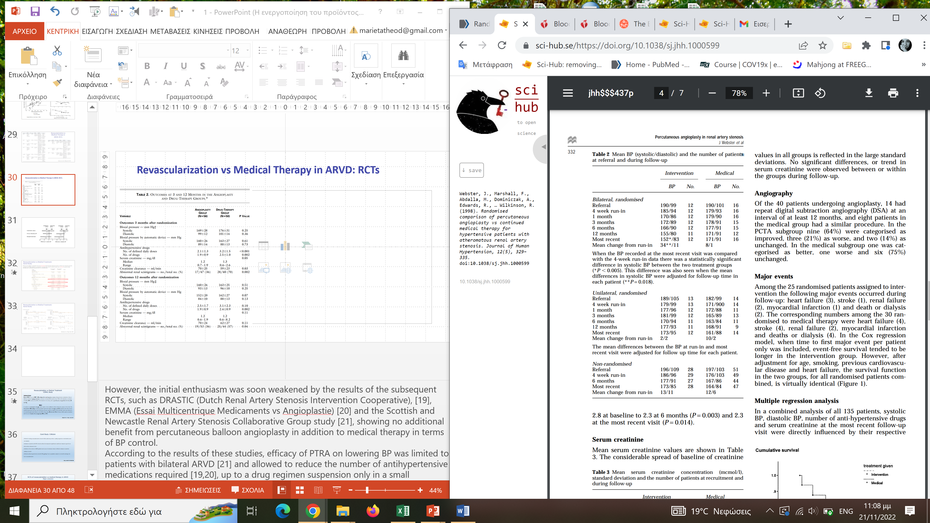
Revascularization vs Medical Therapy in ARVD: RCTs
SNRASCG
N=55 randomized pts with unilateral and bilateral RAS, 4-w f-up
DRASTIC
N=106 pts, 12 months f-up
van Jaarsveld et al., N Engl J Med 2000
Webster J, et al. J Hum Hypertens. 1998
Notes:
However, the initial enthusiasm was soon weakened by the results of the subsequent RCTs, such as DRASTIC (Dutch Renal Artery Stenosis Intervention Cooperative), [19], EMMA (Essai Multicentrique Medicaments vs Angioplastie) [20] and the Scottish and Newcastle Renal Artery Stenosis Collaborative Group study [21], showing no additional benefit from percutaneous balloon angioplasty in addition to medical therapy in terms of BP control.
According to the results of these studies, efficacy of PTRA on lowering BP was limited to patients with bilateral ARVD [21] and allowed to reduce the number of antihypertensive medications required [19,20], up to a drug regimen suspension only in a small percentage of patients [20].
At three months, the blood pressures were similar in the two groups (169±28 and 99±12 mm Hg, respectively, in the 56 patients in the angioplasty group and 176±31 and 101±14 mm Hg, respectively, in the 50 patients in the drug-therapy group; P=0.25 for the comparison of systolic pressure and P=0.36 for the comparison of diastolic pressure between the two groups); at the time, patients in the angioplasty group were taking 2.1±1.3 defined daily doses of medication and those in the drug-therapy group were taking 3.2±1.5 daily doses (P<0.001)
Blood pressure fell during the run-in period in all groups. In patients with bilateral renal artery stenosis randomised to angioplasty, a statistically significant (P<0.05) fall in BP was observed at latest follow-up (range 3-54 months). The mean fall in BP at latest follow-up in the angioplasty group, corrected for the medical group response, was 26/10 mm Hg. In patients with unilateral renal artery stenosis, no statistically significant or clinically important differences in outcome were observed between the two groups. No significant differences or trends in serum creatinine were observed between or within any group during follow-up. Webster J, Marshall F, Abdalla M, Dominiczak A, Edwards R, Isles CG, Loose H, Main J, Padfield P, Russell IT, Walker B, Watson M, Wilkinson R. Randomised comparison of percutaneous angioplasty vs continued medical therapy for hypertensive patients with atheromatous renal artery stenosis. Scottish and Newcastle Renal Artery Stenosis Collaborative Group. J Hum Hypertens. 1998

Slide 42
The effect of balloon angioplasty on hypertension in atherosclerotic RVH (DRASTIC study)
DRASTIC
N=106 pts, 12 months f-up
Group A: 56 patients assigned to angioplasty
54 underwent angioplasty
2 received a stent
Group B: 50 patients assigned to drug therapy
22 underwent angioplasty (after 3 months)
Results: angioplasty has little advantage over antihypertensive drug therapy
van Jaarsveld et al., N Engl J Med 2000
Notes:
In the drug-therapy group, 22 patients underwent balloon angioplasty after three months because of persistent hypertension despite treatment with three or more drugs or because of a deterioration in renal function.

Slide 43
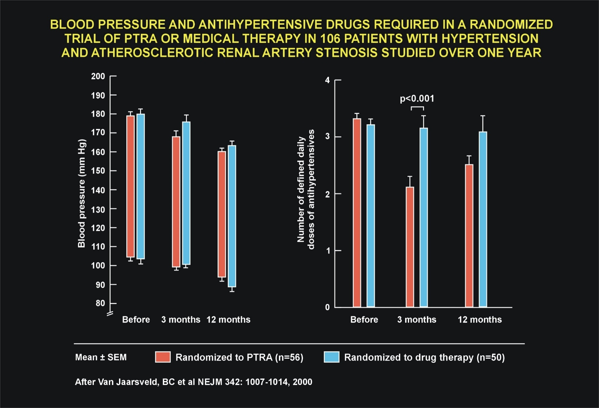

Slide 44
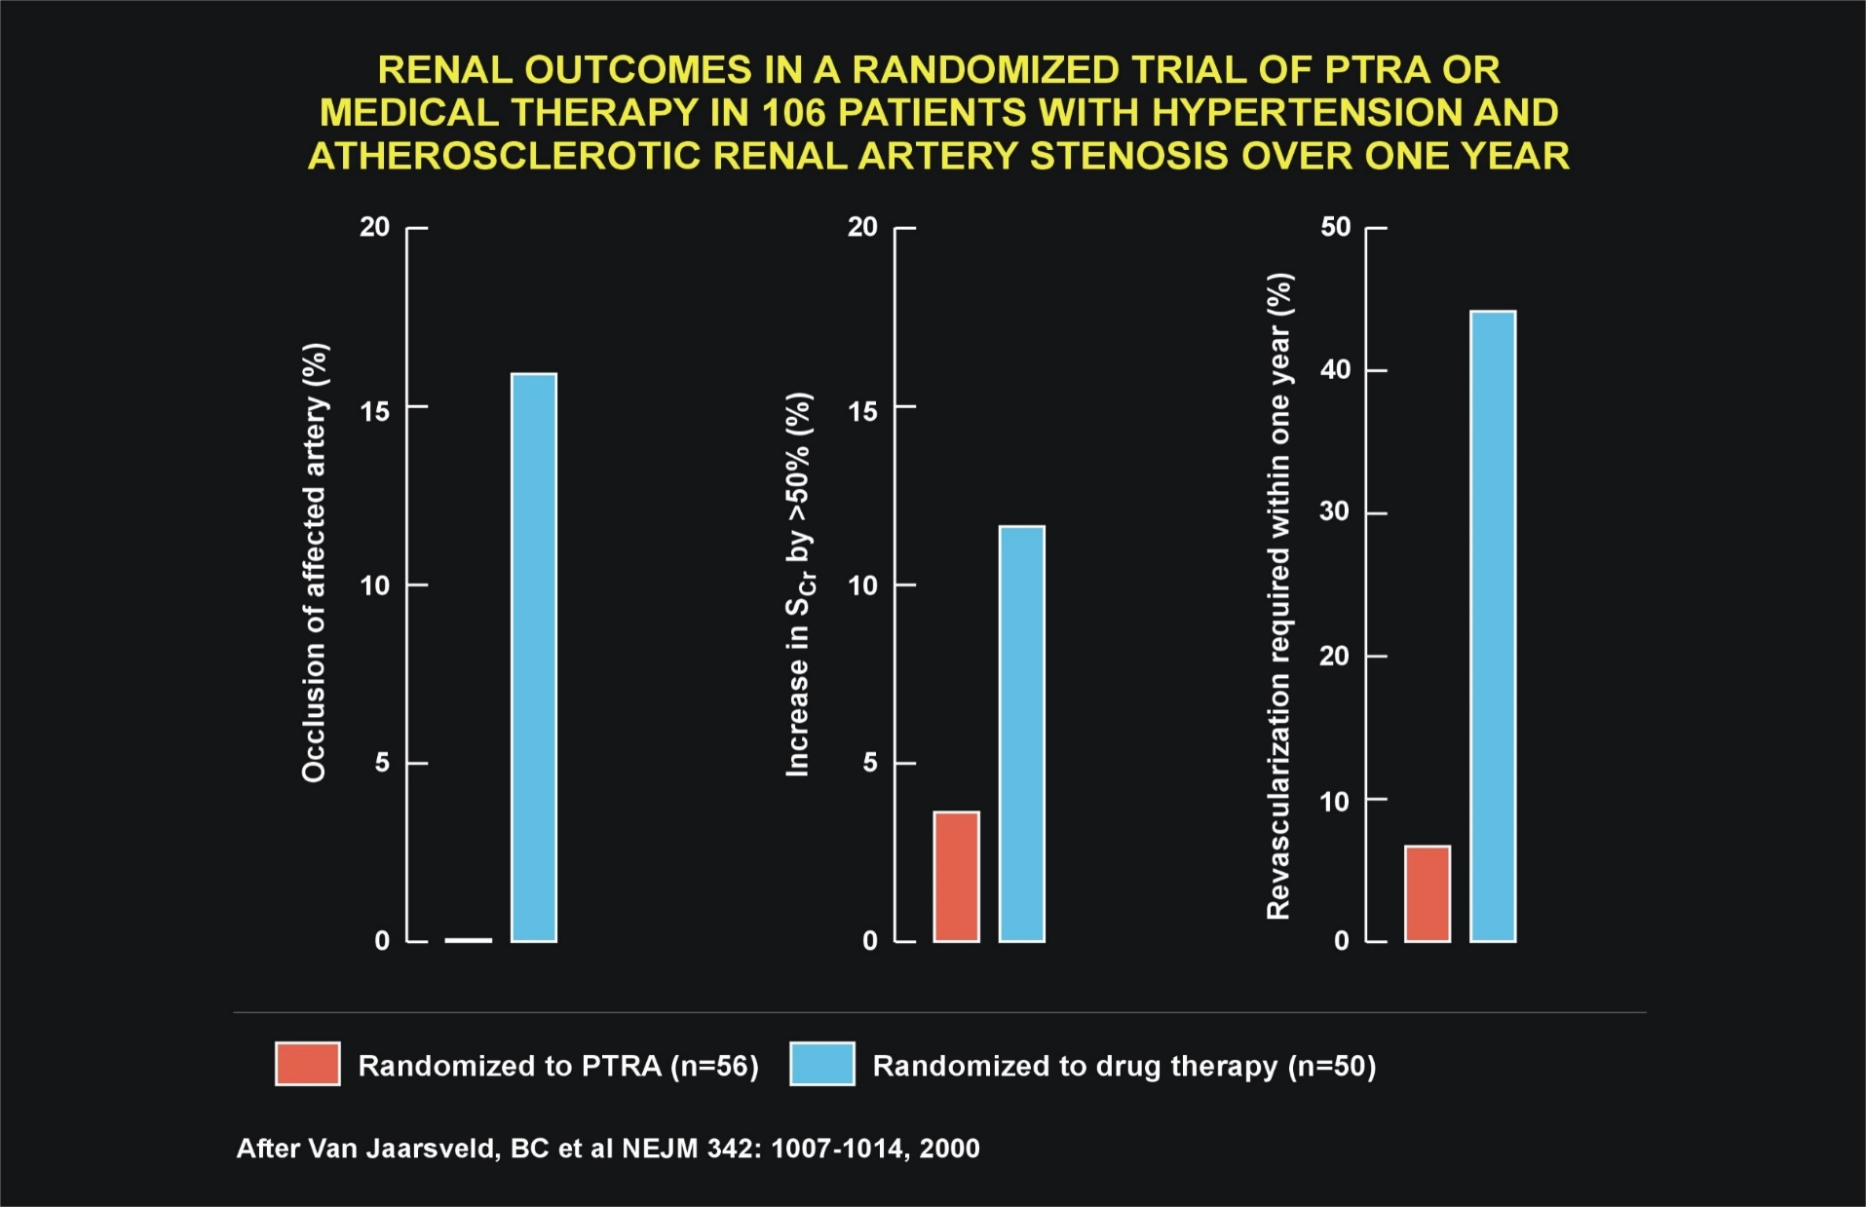

Slide 45
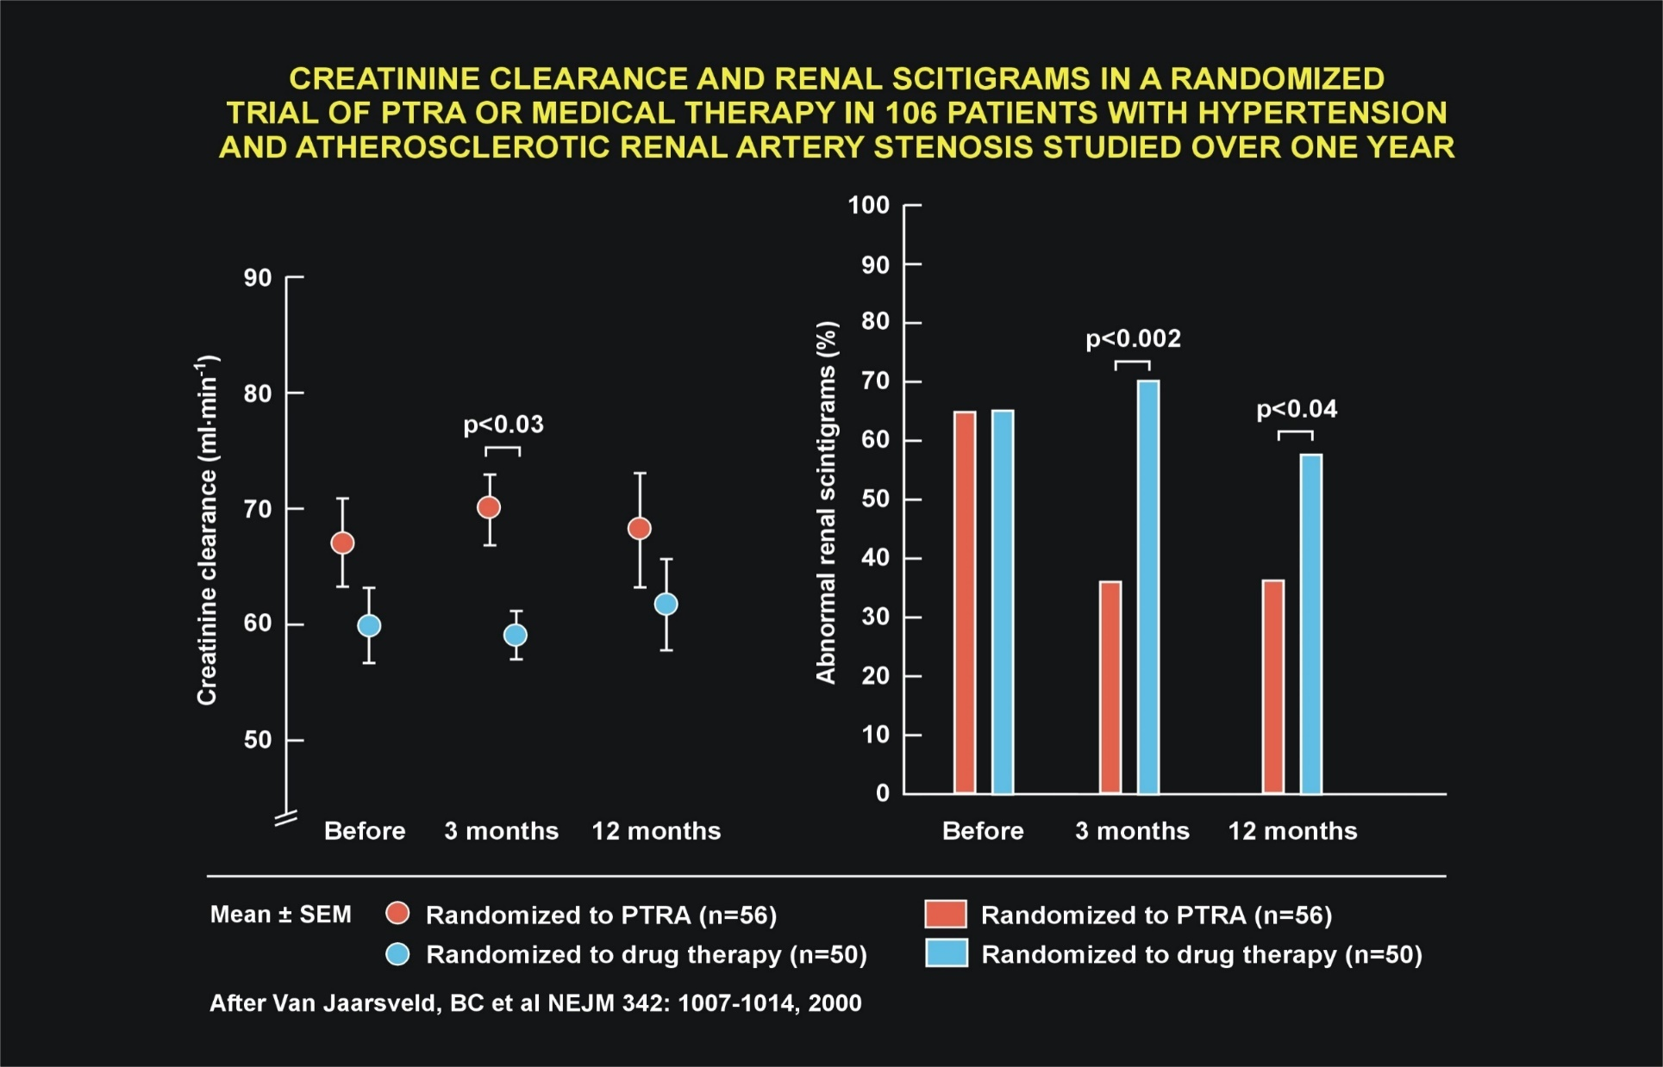

Slide 46
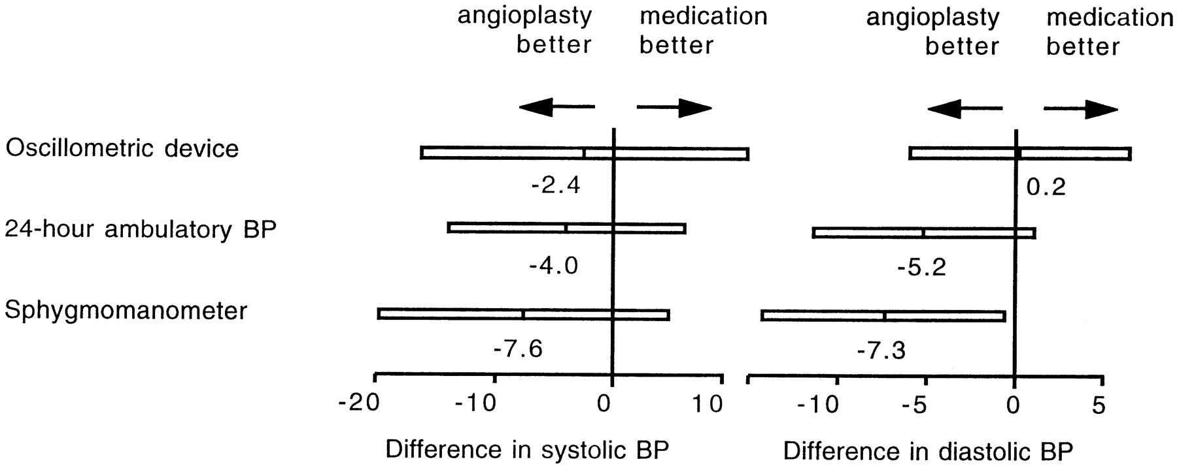
Revascularization vs Medical Therapy in ARVD: RCTs
EMMA study
N=49 pts
6 months f-up
Plouin PF, et al. Hypertension. 1998
Notes:
Data for the effects on blood pressure of renal artery balloon angioplasty are mostly from uncontrolled studies. The aim of this study was to document the efficacy and safety of angioplasty for lowering blood pressure in patients with atherosclerotic renal artery stenosis. Patients were randomly assigned antihypertensive drug treatment (control group, n=26) or angioplasty (n=23). Twenty-four-hour ambulatory blood pressure, the primary end point, was measured at baseline and at termination. Termination took place 6 months after randomization or earlier in patients who developed refractory hypertension. In those allocated angioplasty, antihypertensive treatment was discontinued after the procedure but was subsequently resumed if hypertension persisted. Secondary end points were the treatment score and the incidence of complications. Two patients in the control group and 6 in the angioplasty group suffered procedural complications (relative risk, 3.4; 95% confidence interval, 0.8 to 15.1). Early termination was required for refractory hypertension in 7 patients in the control group. Antihypertensive treatment was resumed in 17 patients in the angioplasty group. Mean ambulatory blood pressure at termination did not differ between control (141±15/84±11 mm Hg) and angioplasty (140±15/81±9 mm Hg) groups. Angioplasty reduced by 60% the probability of having a treatment score of 2 or more at termination (relative risk, 0.4; 95% confidence interval, 0.2 to 0.7). There was 1 case of dissection with segmental renal infarction and 3 of restenosis in the angioplasty group. No patient suffered renal artery thrombosis. In unilateral atherosclerotic renal artery stenosis, angioplasty is a drug-sparing procedure that involves some morbidity. Previous uncontrolled and unblinded assessments of angioplasty overestimated its potential for lowering blood pressure.

Slide 47
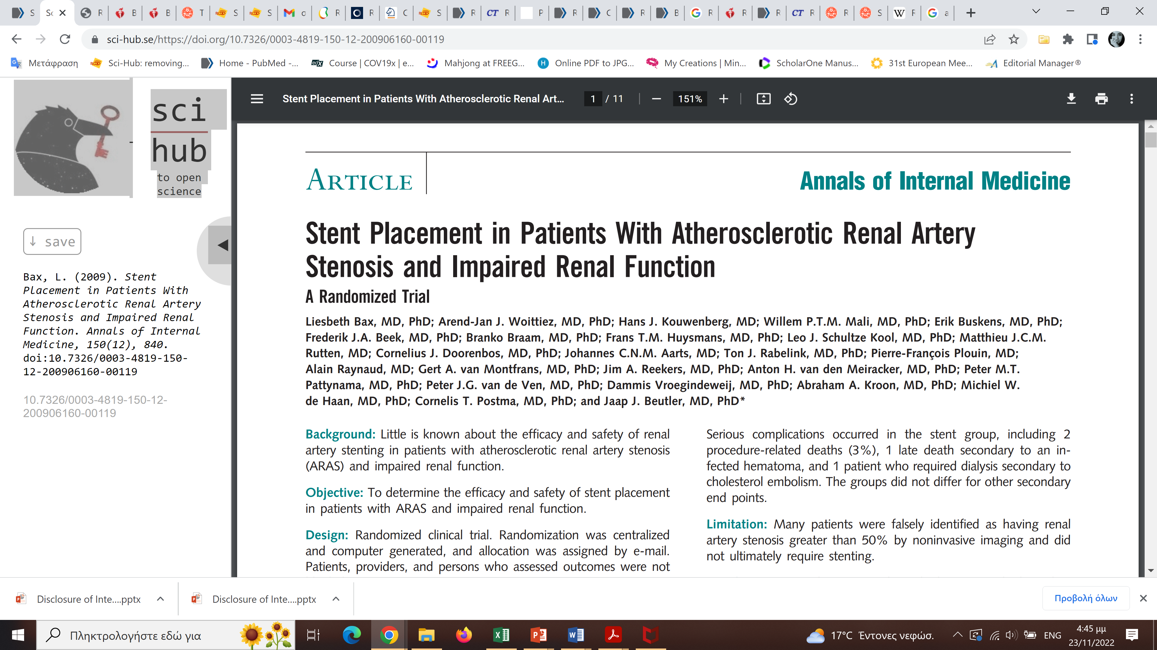
N=140 patients with eGFR<80 ml/min/1.73m2
ARAS> 50%
controlled BP on stable medication dosage (BP <140/90 mmHg)
follow-up 2 years
primary endpoint: eGFR decline>20%
Bax et al., Ann Intern Med, 2009
Notes:
BACKGROUND
Type 2 diabetes mellitus is the leading cause of kidney failure worldwide, but few effective
long-term treatments are available. In cardiovascular trials of inhibitors of sodium–
glucose cotransporter 2 (SGLT2), exploratory results have suggested that such
drugs may improve renal outcomes in patients with type 2 diabetes.
METHODS
In this double-blind, randomized trial, we assigned patients with type 2 diabetes and
albuminuric chronic kidney disease to receive canagliflozin, an oral SGLT2 inhibitor,
at a dose of 100 mg daily or placebo. All the patients had an estimated glomerular
filtration rate (GFR) of 30 to <90 ml per minute per 1.73 m2 of body-surface area
and albuminuria (ratio of albumin [mg] to creatinine [g], >300 to 5000) and were
treated with renin–angiotensin system blockade. The primary outcome was a composite
of end-stage kidney disease (dialysis, transplantation, or a sustained estimated
GFR of <15 ml per minute per 1.73 m2), a doubling of the serum creatinine level, or
death from renal or cardiovascular causes. Prespecified secondary outcomes were
tested hierarchically.
RESULTS
The trial was stopped early after a planned interim analysis on the recommendation
of the data and safety monitoring committee. At that time, 4401 patients had undergone
randomization, with a median follow-up of 2.62 years. The relative risk of
the primary outcome was 30% lower in the canagliflozin group than in the placebo
group, with event rates of 43.2 and 61.2 per 1000 patient-years, respectively (hazard
ratio, 0.70; 95% confidence interval [CI], 0.59 to 0.82; P = 0.00001). The relative
risk of the renal-specific composite of end-stage kidney disease, a doubling of the
creatinine level, or death from renal causes was lower by 34% (hazard ratio, 0.66;
95% CI, 0.53 to 0.81; P<0.001), and the relative risk of end-stage kidney disease
was lower by 32% (hazard ratio, 0.68; 95% CI, 0.54 to 0.86; P = 0.002). The canagliflozin
group also had a lower risk of cardiovascular death, myocardial infarction,
or stroke (hazard ratio, 0.80; 95% CI, 0.67 to 0.95; P = 0.01) and hospitalization for
heart failure (hazard ratio, 0.61; 95% CI, 0.47 to 0.80; P<0.001). There were no significant
differences in rates of amputation or fracture.
CONCLUSIONS
In patients with type 2 diabetes and kidney disease, the risk of kidney failure and
cardiovascular events was lower in the canagliflozin group than in the placebo group
at a median follow-up of 2.62 years. (Funded by Janssen Research and Development;
CREDENCE ClinicalTrials.gov number, NCT02065791.)

Slide 48
Revascularization vs medical treatment
STAR Study
140 patients with CrCl <80 mL/min/1.73 m²
& ARAS >50%.
Primary end-point
From patients randomized to revascularization:
12/64 patients were falsely identified as having RAS >50% by noninvasive imaging and did not ultimately had stenting
6/64 patients stenting was not performed for various reasons
22/64 patients had 50-70% stenoses (unlikely to benefit)
Primary end-point & death
Bax et al., Ann Intern Med, 2009
Notes:
48
32

Slide 49
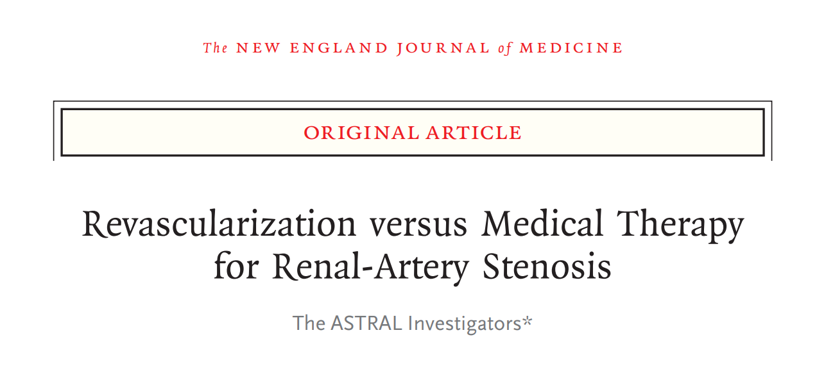
N=806 patients
“substantial” ARAS that was considered potentially suitable for endovascular revascularization
median follow-up period 34 months
primary endpoint: change in mean slope of reciprocal of Scr
Wheatley et al., N Engl J Med, 2009
Notes:
BACKGROUND
Type 2 diabetes mellitus is the leading cause of kidney failure worldwide, but few effective
long-term treatments are available. In cardiovascular trials of inhibitors of sodium–
glucose cotransporter 2 (SGLT2), exploratory results have suggested that such
drugs may improve renal outcomes in patients with type 2 diabetes.
METHODS
In this double-blind, randomized trial, we assigned patients with type 2 diabetes and
albuminuric chronic kidney disease to receive canagliflozin, an oral SGLT2 inhibitor,
at a dose of 100 mg daily or placebo. All the patients had an estimated glomerular
filtration rate (GFR) of 30 to <90 ml per minute per 1.73 m2 of body-surface area
and albuminuria (ratio of albumin [mg] to creatinine [g], >300 to 5000) and were
treated with renin–angiotensin system blockade. The primary outcome was a composite
of end-stage kidney disease (dialysis, transplantation, or a sustained estimated
GFR of <15 ml per minute per 1.73 m2), a doubling of the serum creatinine level, or
death from renal or cardiovascular causes. Prespecified secondary outcomes were
tested hierarchically.
RESULTS
The trial was stopped early after a planned interim analysis on the recommendation
of the data and safety monitoring committee. At that time, 4401 patients had undergone
randomization, with a median follow-up of 2.62 years. The relative risk of
the primary outcome was 30% lower in the canagliflozin group than in the placebo
group, with event rates of 43.2 and 61.2 per 1000 patient-years, respectively (hazard
ratio, 0.70; 95% confidence interval [CI], 0.59 to 0.82; P = 0.00001). The relative
risk of the renal-specific composite of end-stage kidney disease, a doubling of the
creatinine level, or death from renal causes was lower by 34% (hazard ratio, 0.66;
95% CI, 0.53 to 0.81; P<0.001), and the relative risk of end-stage kidney disease
was lower by 32% (hazard ratio, 0.68; 95% CI, 0.54 to 0.86; P = 0.002). The canagliflozin
group also had a lower risk of cardiovascular death, myocardial infarction,
or stroke (hazard ratio, 0.80; 95% CI, 0.67 to 0.95; P = 0.01) and hospitalization for
heart failure (hazard ratio, 0.61; 95% CI, 0.47 to 0.80; P<0.001). There were no significant
differences in rates of amputation or fracture.
CONCLUSIONS
In patients with type 2 diabetes and kidney disease, the risk of kidney failure and
cardiovascular events was lower in the canagliflozin group than in the placebo group
at a median follow-up of 2.62 years. (Funded by Janssen Research and Development;
CREDENCE ClinicalTrials.gov number, NCT02065791.)

Slide 50
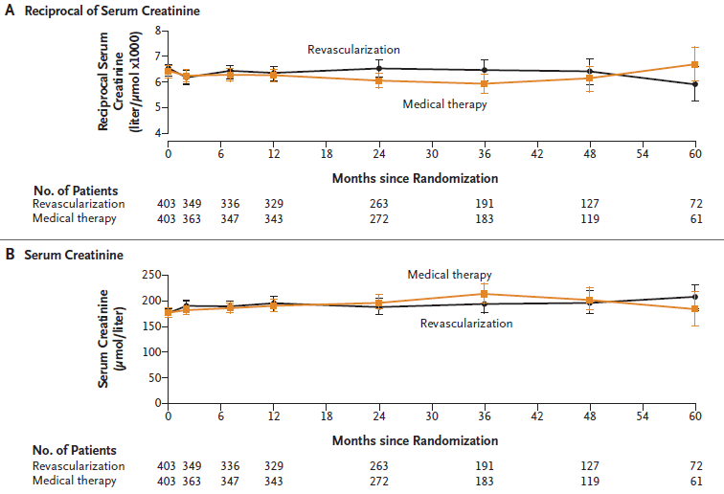
Revascularization vs Medical Treatment: ASTRAL Study
N=806 patients with “substantial ARAS”, median f-up 34 months
Wheatley et al., N Engl J Med, 2009
Notes:
Percutaneous revascularization of the renal arteries improves patency in atherosclerotic renovascular disease, yet evidence of a clinical benefit is limited.
METHODS
In a randomized, unblinded trial, we assigned 806 patients with atherosclerotic renovascular disease either to undergo revascularization in addition to receiving medical therapy or to receive medical therapy alone. The primary outcome was renal function, as measured by the reciprocal of the serum creatinine level (a measure that has a linear relationship with creatinine clearance). Secondary outcomes were blood pressure, the time to renal and major cardiovascular events, and mortality. The median follow-up was 34 months.
RESULTS
During a 5-year period, the rate of progression of renal impairment (as shown by the slope of the reciprocal of the serum creatinine level) was −0.07×10⁻³ liters per micromole per year in the revascularization group, as compared with −0.13×10⁻³ liters per micromole per year in the medical-therapy group, a difference favoring revascularization of 0.06×10⁻³ liters per micromole per year (95% confidence interval [CI], −0.002 to 0.13; P=0.06). Over the same time, the mean serum creatinine level was 1.6 μmol per liter (95% CI, −8.4 to 5.2 [0.02 mg per deciliter; 95% CI, −0.10 to 0.06]) lower in the revascularization group than in the medical-therapy group. There was no significant between-group difference in systolic blood pressure; the decrease in diastolic blood pressure was smaller in the revascularization group than in the medical-therapy group. The two study groups had similar rates of renal events (hazard ratio in the revascularization group, 0.97; 95% CI, 0.67 to 1.40; P=0.88), major cardiovascular events (hazard ratio, 0.94; 95% CI, 0.75 to 1.19; P=0.61), and death (hazard ratio, 0.90; 95% CI, 0.69 to 1.18; P=0.46). Serious complications associated with revascularization occurred in 23 patients, including 2 deaths and 3 amputations of toes or limbs.
CONCLUSIONS
We found substantial risks but no evidence of a worthwhile clinical benefit from revascularization in patients with atherosclerotic renovascular disease. (Current Controlled Trials number, ISRCTN59586944. opens in new tab.)

Slide 51
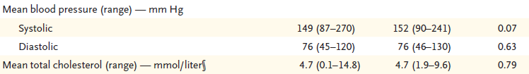
Revascularization vs medical treatment
ASTRAL Study
N=806 patients with “substantial ARAS”, median f-up 34 months
Patients were eligible to participate if:
1) they had “substantial” anatomical ARAS in at least one renal artery that was considered potentially suitable for endovascular revascularization and
2) if the patient’s doctor was “uncertain” the patient would definitely have a worthwhile clinical benefit from revascularization
Wheatley et al., N Engl J Med, 2009
Notes:
51
32

Slide 52
ASTRAL Study: Criticism
Patients needing revascularization (those with subocclusive lesions or severe disease in one or both kidneys) were not included.
Patients with either insignificant vascular lesions or advanced renal disease (kidneys 6 cm in length) were enrolled
No criterion relevant to time
Lower number of antihypertensives in the revascularization group (P=0.03)
806 patients at 57 hospitals in 7 years = 2 patients/center/year randomized, = 1 patient/center/year had revascularization
Low rate of technical success (79%) and high rate of serious complications (8%) (world average 98% and 2%, respectively)
N Engl J Med 2010; 362:762-764
Notes:
52
32

Slide 53
Revascularization vs Medical Treatment: Astral Study
Patients were eligible to participate if they had substantial anatomical atherosclerotic stenosis in at least one renal artery that was considered potentially suitable for endovascular revascularization and if the patient’s doctor was uncertain the patient would definitely have a worthwhile clinical benefit from revascularization
Wheatley et al., N Engl J Med, 2009
Notes:
53
32

Slide 54
Revascularization vs Medical Treatment: Astral Study
Wheatley et al., N Engl J Med, 2009

Slide 55

N=140 patients with eGFR<80 ml/min/1.73m2
Severe ARAS >80% but less than 100% of the diameter or ARAS>60% but less than 80% with a systolic pressure gradient >20 mm Hg
SBP >155 mmHg while receiving two or more antihypertensive medications. Severe RAS was defined angiographically as stenosis of at least 80%.
Median follow-up 43 months
Primary endpoint: CV or renal death, MI, stroke, HHF, progressive renal insufficiency, or the need for RRT
Cooper et al., N Engl J Med, 2014
Notes:
BACKGROUND
Type 2 diabetes mellitus is the leading cause of kidney failure worldwide, but few effective
long-term treatments are available. In cardiovascular trials of inhibitors of sodium–
glucose cotransporter 2 (SGLT2), exploratory results have suggested that such
drugs may improve renal outcomes in patients with type 2 diabetes.
METHODS
In this double-blind, randomized trial, we assigned patients with type 2 diabetes and
albuminuric chronic kidney disease to receive canagliflozin, an oral SGLT2 inhibitor,
at a dose of 100 mg daily or placebo. All the patients had an estimated glomerular
filtration rate (GFR) of 30 to <90 ml per minute per 1.73 m2 of body-surface area
and albuminuria (ratio of albumin [mg] to creatinine [g], >300 to 5000) and were
treated with renin–angiotensin system blockade. The primary outcome was a composite
of end-stage kidney disease (dialysis, transplantation, or a sustained estimated
GFR of <15 ml per minute per 1.73 m2), a doubling of the serum creatinine level, or
death from renal or cardiovascular causes. Prespecified secondary outcomes were
tested hierarchically.
RESULTS
The trial was stopped early after a planned interim analysis on the recommendation
of the data and safety monitoring committee. At that time, 4401 patients had undergone
randomization, with a median follow-up of 2.62 years. The relative risk of
the primary outcome was 30% lower in the canagliflozin group than in the placebo
group, with event rates of 43.2 and 61.2 per 1000 patient-years, respectively (hazard
ratio, 0.70; 95% confidence interval [CI], 0.59 to 0.82; P = 0.00001). The relative
risk of the renal-specific composite of end-stage kidney disease, a doubling of the
creatinine level, or death from renal causes was lower by 34% (hazard ratio, 0.66;
95% CI, 0.53 to 0.81; P<0.001), and the relative risk of end-stage kidney disease
was lower by 32% (hazard ratio, 0.68; 95% CI, 0.54 to 0.86; P = 0.002). The canagliflozin
group also had a lower risk of cardiovascular death, myocardial infarction,
or stroke (hazard ratio, 0.80; 95% CI, 0.67 to 0.95; P = 0.01) and hospitalization for
heart failure (hazard ratio, 0.61; 95% CI, 0.47 to 0.80; P<0.001). There were no significant
differences in rates of amputation or fracture.
CONCLUSIONS
In patients with type 2 diabetes and kidney disease, the risk of kidney failure and
cardiovascular events was lower in the canagliflozin group than in the placebo group
at a median follow-up of 2.62 years. (Funded by Janssen Research and Development;
CREDENCE ClinicalTrials.gov number, NCT02065791.)

Slide 56
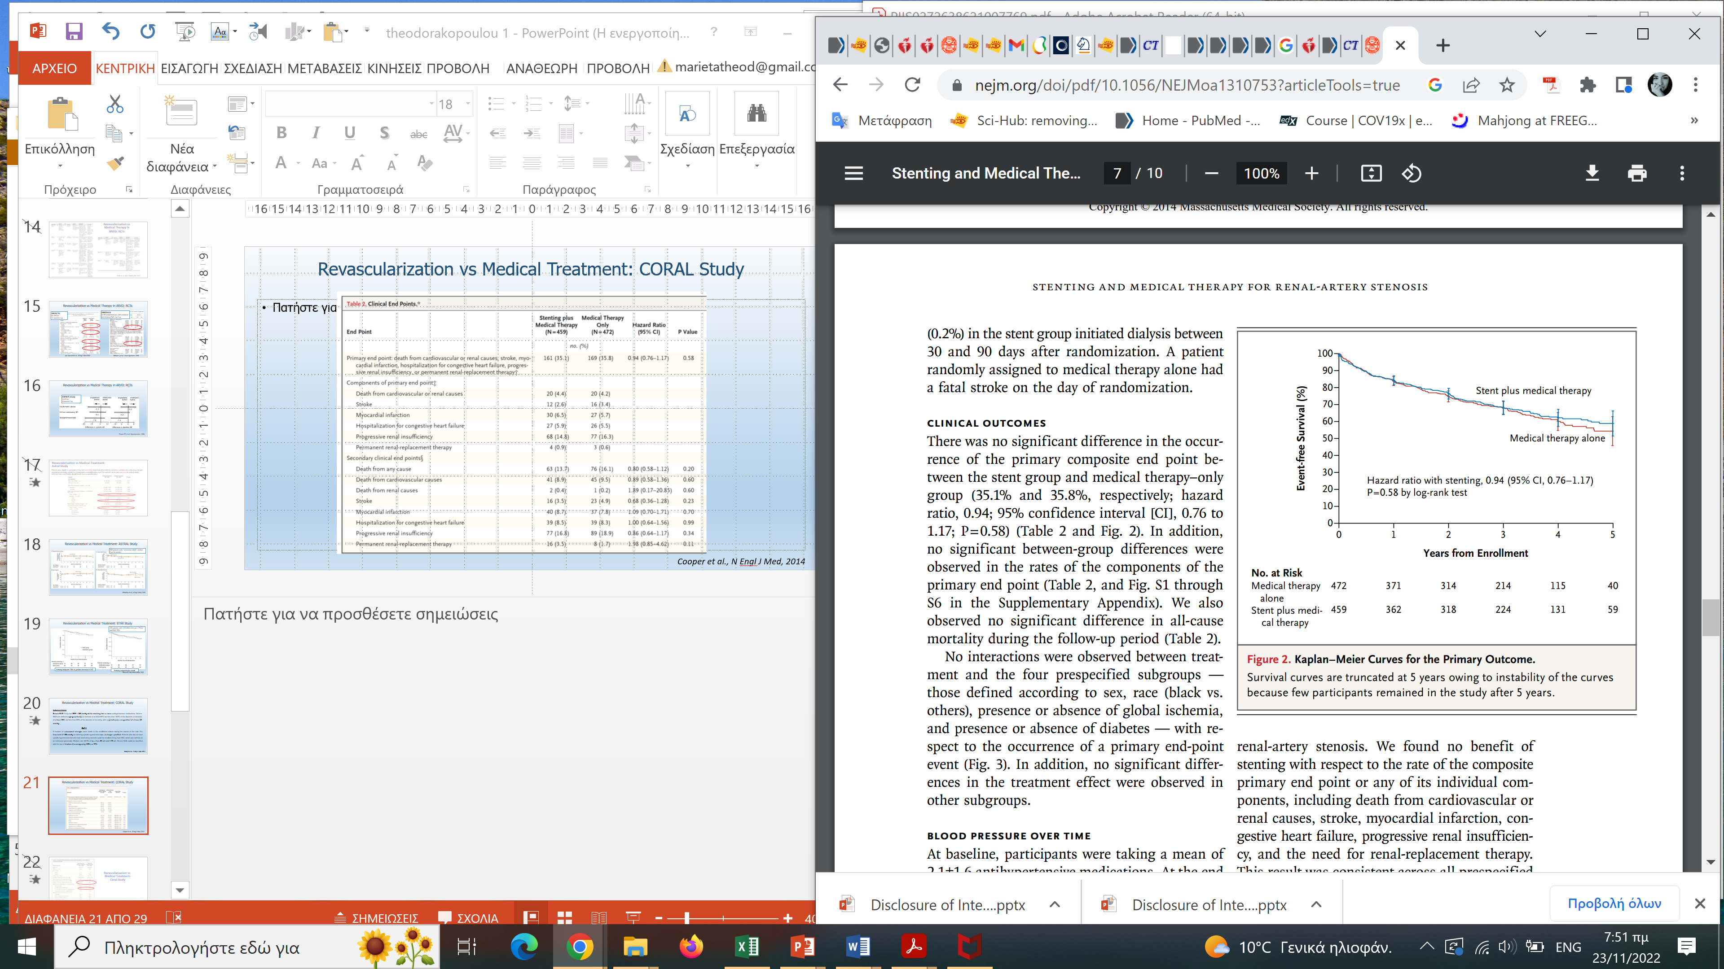
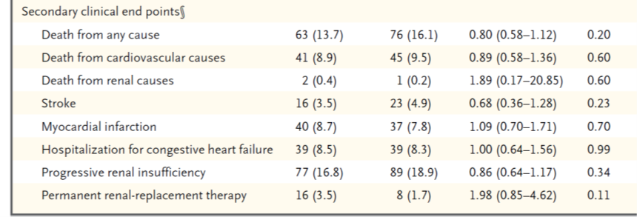
Revascularization vs Medical Treatment: CORAL Study
Cooper et al., N Engl J Med, 2014
Notes:
56
Atherosclerotic renal-artery stenosis is a common problem in the elderly. Despite two randomized trials that did not show a benefit of renal-artery stenting with respect to kidney function, the usefulness of stenting for the prevention of major adverse renal and cardiovascular events is uncertain.
METHODS
We randomly assigned 947 participants who had atherosclerotic renal-artery stenosis and either systolic hypertension while taking two or more antihypertensive drugs or chronic kidney disease to medical therapy plus renal-artery stenting or medical therapy alone. Participants were followed for the occurrence of adverse cardiovascular and renal events (a composite end point of death from cardiovascular or renal causes, myocardial infarction, stroke, hospitalization for congestive heart failure, progressive renal insufficiency, or the need for renal-replacement therapy).
RESULTS
Over a median follow-up period of 43 months (interquartile range, 31 to 55), the rate of the primary composite end point did not differ significantly between participants who underwent stenting in addition to receiving medical therapy and those who received medical therapy alone (35.1% and 35.8%, respectively; hazard ratio with stenting, 0.94; 95% confidence interval [CI], 0.76 to 1.17; P=0.58). There were also no significant differences between the treatment groups in the rates of the individual components of the primary end point or in all-cause mortality. During follow-up, there was a consistent modest difference in systolic blood pressure favoring the stent group (−2.3 mm Hg; 95% CI, −4.4 to −0.2; P=0.03).
CONCLUSIONS
Renal-artery stenting did not confer a significant benefit with respect to the prevention of clinical events when added to comprehensive, multifactorial medical therapy in people with atherosclerotic renal-artery stenosis and hypertension or chronic kidney disease. (Funded by the National Heart, Lung and Blood Institute and others; ClinicalTrials.gov number, NCT00081731. opens in new tab.)
32

Slide 57
Revascularization vs Medical Treatment:
CORAL Study
Inclusion Criteria:
Severe RAS if they had SBP >155 mmHg while receiving two or more antihypertensive medications. Severe RAS was defined angiographically as stenosis of at least 80% but less than 100% of the diameter or stenosis of at least 60% but less than 80% of the diameter of an artery, with a systolic pressure gradient of at least 20 mm Hg.
BUT !!
A number of subsequent changes were made in the enrollment criteria during the course of the trial. The threshold of 155 mmHg for defining systolic hypertension was no longer specified. Patients who did not have systolic hypertension but who had renal-artery stenosis could be enrolled if they had CKD, which was defined as an estimated glomerular filtration rate (GFR) of less than 60 ml/ min/1.73 m². Severe RAS could be identified with the use of duplex ultrasonography, MRA, or CTA.
Cooper et al., N Engl J Med, 2014
Notes:
57
Lastly, the results of the multicentre Cardiovascular Outcomes with Renal Atherosclerotic Lesions (CORAL) study [8] reinforced the arguments in favour of the absence of a clear benefit from revascularization and represented for many clinicians a point of no return in the discontinuation of PTRA. With 947 patients enrolled over 5 years of recruitment, the CORAL study not only replicated the findings of the ASTRAL and STAR trials, but also showed that stenting moderate-to-severe RAS (~ 73% of arterial diameter) had no additional benefit in preventing CV or renal events (death from cardiovascular or renal causes, stroke, myocardial infarction, congestive heart failure, progressive renal insufficiency and/or need for renal replacement therapy), when compared to medical therapy alone.
STAR και ASTRAL που έδειξαν ότι η τοποθέτηση stent σε ασθενής με στένωση νεφρικής αρτηρίας δεν υπερτερεί της φαρμακευτικής αγωγής.
BACKGROUND Atherosclerotic renal-artery stenosis is a common problem in the elderly. Despite two randomized trials that did not show a benefit of renal-artery stenting with respect to kidney function, the usefulness of stenting for the prevention of major adverse renal and cardiovascular events is uncertain.
METHODS We randomly assigned 947 participants who had atherosclerotic renal-artery stenosis and either systolic hypertension while taking two or more antihypertensive drugs or chronic kidney disease to medical therapy plus renal-artery stenting or medical therapy alone. Participants were followed for the occurrence of adverse cardiovascular and renal events (a composite end point of death from cardiovascular or renal causes, myocardial infarction, stroke, hospitalization for congestive heart failure, progressive renal insufficiency, or the need for renal-replacement therapy).
RESULTS Over a median follow-up period of 43 months (interquartile range, 31 to 55), the rate of the primary composite end point did not differ significantly between participants who underwent stenting in addition to receiving medical therapy and those who received medical therapy alone (35.1% and 35.8%, respectively; hazard ratio with stenting, 0.94; 95% confidence interval [CI], 0.76 to 1.17; P=0.58). There were also no significant differences between the treatment groups in the rates of the individual components of the primary end point or in all-cause mortality. During follow-up, there was a consistent modest difference in systolic blood pressure favoring the stent group (−2.3 mm Hg; 95% CI, −4.4 to −0.2; P = 0.03).
CONCLUSIONS Renal-artery stenting did not confer a significant benefit with respect to the prevention of clinical events when added to comprehensive, multifactorial medical therapy in people with atherosclerotic renal-artery stenosis and hypertension or chronic kidney disease.
(Funded by the National Heart, Lung and Blood Institute and others; ClinicalTrials.gov number, NCT00081731.)
32

Slide 58
Revascularization vs medical treatment
CORAL Study
Cooper et al., N Engl J Med 2014
Notes:
58
32

Slide 59
Revascularization vs Medical Treatment: Coral Study
Cooper et al., N Engl J Med, 2014
Notes:
59
32

Slide 60
ΑΓΓΕΙΟΠΛΑΣΤΙΚΗ vs ΦΑΡΜΑΚΕΥΤΙΚΗ ΑΓΩΓΗ
CORAL Study
Cooper et al., N Engl J Med, 2014
Notes:
60
32

Slide 61
ΑΓΓΕΙΟΠΛΑΣΤΙΚΗ vs ΦΑΡΜΑΚΕΥΤΙΚΗ ΑΓΩΓΗ
CORAL Study
Cooper et al., N Engl J Med, 2014
Notes:
32

Slide 62
Coral Study: Criticism
Patients needing revascularization (recurrent flash pulmonary edema, rapidly progressive renal decline) were not included.
Inclusion of patients with 60% stenosis without hemodynamic significance could have induced a type II error
No criterion relevant to time
Deletion of the criterion of SBP gradient and no use of resistance index in US led to inclusion of patients unlikely to benefit
Patients without hypertension and with CKD > Stage 3 are a population subject to no benefit and large risk from revascularization
N Engl J Med 2014; 370:1852-1855
Notes:
62
32

Slide 63
Coral Study: Criticism
Patients needing revascularization (recurrent flash pulmonary edema, rapidly progressive renal decline) were not included.
Inclusion of patients with <60% stenosis without hemodynamic significance could have induced a type II error
No criterion relevant to time
Deletion of the criterion of SBP gradient and no use of resistance index in US led to inclusion of patients unlikely to benefit
Patients without hypertension and with CKD > Stage 3 are a population subject to no benefit and large risk from revascularization
N Engl J Med 2014; 370:1852-1855
Notes:
63
32

Slide 64
RCTs of revascularization vs medical therapy in ARVD
Major criticisms
Inclusion of many patients with mild/asymptomatic RAS, mild hypertension or advanced CKD with small kidneys, i.e. individuals with no benefit from RAS revascularization
Large number of patients fulfilling the inclusion criteria who were not randomized based on the investigators’ judgement without specific justification
Almost total exclusion of patients with a presentation suggestive of critical RAS (flash pulmonary oedema, refractory hypertension or rapid loss of kidney function after ACEi/ARB use)
Great variability between and within study protocols in imaging techniques of RAS diagnosis and evaluation, often resulting in overestimation of the degree of stenosis.
Additional methodological issues: enrolment delays, protocol amendments during the trial, high crossover
rates between the arms and low event rates for major outcomes
Van der Niepen et al. Curr Hypertens Rep 2017, Theodorakopoulou et al. Clin Kidney J 2022

Slide 65
Criticism of RCTs in ARVD field
N=806 patients
1) they had “substantial” anatomical ARAS in at least one renal artery that was considered potentially suitable for endovascular revascularization and
2) if the patient’s doctor was “uncertain” the patient would definitely have a worthwhile clinical benefit from revascularization
median follow-up period 34 months
primary endpoint: change in mean slope of reciprocal of Scr
Non-standardized inclusion criteria
Van der Niepen et al. Curr Hypertens Rep 2017; Pappacoggli et al. Hypertension 2023; Sarafidis et al. Nephrol Dial Transplant 2023

Slide 66
Criticism of RCTs in ARVD field
Non-standardized inclusion criteria
Low event rates of major outcomes
No criterion relevant to time
High crossover rates between treatment arms
Group A: 56 patients assigned to angioplasty
54 underwent angioplasty
2 received a stent
Group B: 50 patients assigned to drug therapy
22 underwent angioplasty (after 3 months)
DRASTIC
N=106 pts, 12 months f-up
Van der Niepen et al. Curr Hypertens Rep 2017; Pappacoggli et al. Hypertension 2023; Sarafidis et al. Nephrol Dial Transplant 2023

Slide 67
Criticism of RCTs in ARVD field
Non-standardized inclusion criteria
Low event rates of major outcomes
No criterion relevant to time
High crossover rates between treatment arms
Enrolment delays
Protocol revisions during the trial
Van der Niepen et al. Curr Hypertens Rep 2017; Pappacoggli et al. Hypertension 2023; Sarafidis et al. Nephrol Dial Transplant 2023

Slide 68
CORAL Study
BUT !!
A number of subsequent changes were made in the enrollment criteria during the course of the trial. The threshold of 155 mmHg for defining systolic hypertension was no longer specified. Patients who did not have systolic hypertension but who had renal-artery stenosis could be enrolled if they had CKD, which was defined as an estimated glomerular filtration rate (GFR) of less than 60 ml/ min/1.73 m². Severe RAS could be identified with the use of duplex ultrasonography, MRA, or CTA.
Inclusion Criteria:
Severe RAS if they had SBP >155 mmHg while receiving two or more antihypertensive medications. Severe RAS was defined angiographically as stenosis of at least 80% but less than 100% of the diameter or stenosis of at least 60% but less than 80% of the diameter of an artery, with a systolic pressure gradient of at least 20 mm Hg.
Cooper et al., N Engl J Med, 2014
Notes:
68
Lastly, the results of the multicentre Cardiovascular Outcomes with Renal Atherosclerotic Lesions (CORAL) study [8] reinforced the arguments in favour of the absence of a clear benefit from revascularization and represented for many clinicians a point of no return in the discontinuation of PTRA. With 947 patients enrolled over 5 years of recruitment, the CORAL study not only replicated the findings of the ASTRAL and STAR trials, but also showed that stenting moderate-to-severe RAS (~ 73% of arterial diameter) had no additional benefit in preventing CV or renal events (death from cardiovascular or renal causes, stroke, myocardial infarction, congestive heart failure, progressive renal insufficiency and/or need for renal replacement therapy), when compared to medical therapy alone.
STAR και ASTRAL που έδειξαν ότι η τοποθέτηση stent σε ασθενής με στένωση νεφρικής αρτηρίας δεν υπερτερεί της φαρμακευτικής αγωγής.
BACKGROUND Atherosclerotic renal-artery stenosis is a common problem in the elderly. Despite two randomized trials that did not show a benefit of renal-artery stenting with respect to kidney function, the usefulness of stenting for the prevention of major adverse renal and cardiovascular events is uncertain.
METHODS We randomly assigned 947 participants who had atherosclerotic renal-artery stenosis and either systolic hypertension while taking two or more antihypertensive drugs or chronic kidney disease to medical therapy plus renal-artery stenting or medical therapy alone. Participants were followed for the occurrence of adverse cardiovascular and renal events (a composite end point of death from cardiovascular or renal causes, myocardial infarction, stroke, hospitalization for congestive heart failure, progressive renal insufficiency, or the need for renal-replacement therapy).
RESULTS Over a median follow-up period of 43 months (interquartile range, 31 to 55), the rate of the primary composite end point did not differ significantly between participants who underwent stenting in addition to receiving medical therapy and those who received medical therapy alone (35.1% and 35.8%, respectively; hazard ratio with stenting, 0.94; 95% confidence interval [CI], 0.76 to 1.17; P=0.58). There were also no significant differences between the treatment groups in the rates of the individual components of the primary end point or in all-cause mortality. During follow-up, there was a consistent modest difference in systolic blood pressure favoring the stent group (−2.3 mm Hg; 95% CI, −4.4 to −0.2; P = 0.03).
CONCLUSIONS Renal-artery stenting did not confer a significant benefit with respect to the prevention of clinical events when added to comprehensive, multifactorial medical therapy in people with atherosclerotic renal-artery stenosis and hypertension or chronic kidney disease.
(Funded by the National Heart, Lung and Blood Institute and others; ClinicalTrials.gov number, NCT00081731.)
32

Slide 69
Criticism of RCTs in ARVD field
Non-standardized inclusion criteria
Low event rates of major outcomes
No criterion relevant to time
High crossover rates between treatment arms
Enrolment delays
Protocol revisions during the trial
Great variability between and within study protocols in imaging techniques of RAS diagnosis and evaluation, often resulting in overestimation of the degree of stenosis
From patients randomized to revascularization:
12/64 patients were falsely identified as having RAS >50% by noninvasive imaging and did not ultimately had stenting
6/64 patients stenting was not performed for various reasons
22/64 patients had 50-70% stenoses (unlikely to benefit)
Van der Niepen et al. Curr Hypertens Rep 2017; Pappacoggli et al. Hypertension 2023; Sarafidis et al. Nephrol Dial Transplant 2023

Slide 70
N=140 patients with eGFR<80 ml/min/1.73m2
ARAS> 50%
controlled BP on stable medication dosage (BP <140/90 mmHg)
follow-up 2 years
primary endpoint: eGFR decline>20%
Bax et al., Ann Intern Med, 2009
Notes:
BACKGROUND
Type 2 diabetes mellitus is the leading cause of kidney failure worldwide, but few effective
long-term treatments are available. In cardiovascular trials of inhibitors of sodium–
glucose cotransporter 2 (SGLT2), exploratory results have suggested that such
drugs may improve renal outcomes in patients with type 2 diabetes.
METHODS
In this double-blind, randomized trial, we assigned patients with type 2 diabetes and
albuminuric chronic kidney disease to receive canagliflozin, an oral SGLT2 inhibitor,
at a dose of 100 mg daily or placebo. All the patients had an estimated glomerular
filtration rate (GFR) of 30 to <90 ml per minute per 1.73 m2 of body-surface area
and albuminuria (ratio of albumin [mg] to creatinine [g], >300 to 5000) and were
treated with renin–angiotensin system blockade. The primary outcome was a composite
of end-stage kidney disease (dialysis, transplantation, or a sustained estimated
GFR of <15 ml per minute per 1.73 m2), a doubling of the serum creatinine level, or
death from renal or cardiovascular causes. Prespecified secondary outcomes were
tested hierarchically.
RESULTS
The trial was stopped early after a planned interim analysis on the recommendation
of the data and safety monitoring committee. At that time, 4401 patients had undergone
randomization, with a median follow-up of 2.62 years. The relative risk of
the primary outcome was 30% lower in the canagliflozin group than in the placebo
group, with event rates of 43.2 and 61.2 per 1000 patient-years, respectively (hazard
ratio, 0.70; 95% confidence interval [CI], 0.59 to 0.82; P = 0.00001). The relative
risk of the renal-specific composite of end-stage kidney disease, a doubling of the
creatinine level, or death from renal causes was lower by 34% (hazard ratio, 0.66;
95% CI, 0.53 to 0.81; P<0.001), and the relative risk of end-stage kidney disease
was lower by 32% (hazard ratio, 0.68; 95% CI, 0.54 to 0.86; P = 0.002). The canagliflozin
group also had a lower risk of cardiovascular death, myocardial infarction,
or stroke (hazard ratio, 0.80; 95% CI, 0.67 to 0.95; P = 0.01) and hospitalization for
heart failure (hazard ratio, 0.61; 95% CI, 0.47 to 0.80; P<0.001). There were no significant
differences in rates of amputation or fracture.
CONCLUSIONS
In patients with type 2 diabetes and kidney disease, the risk of kidney failure and
cardiovascular events was lower in the canagliflozin group than in the placebo group
at a median follow-up of 2.62 years. (Funded by Janssen Research and Development;
CREDENCE ClinicalTrials.gov number, NCT02065791.)

Slide 71
Revascularization vs medical treatment
STAR Study
140 patients with CrCl <80 mL/min/1.73 m²
& ARAS >50%.
Primary end-point
From patients randomized to revascularization:
12/64 patients were falsely identified as having RAS >50% by noninvasive imaging and did not ultimately had stenting
6/64 patients stenting was not performed for various reasons
22/64 patients had 50-70% stenoses (unlikely to benefit)
Primary end-point & death
Bax et al., Ann Intern Med, 2009
Notes:
71
32

Slide 72
Criticism of RCTs in ARVD field
Non-standardized inclusion criteria
Low event rates of major outcomes
No criterion relevant to time
High crossover rates between treatment arms
Enrolment delays
Protocol revisions during the trial
Great variability between and within study protocols in imaging techniques of RAS diagnosis and evaluation, often resulting in overestimation of the degree of stenosis
Inclusion of patients with mild/asymptomatic RAS, mild hypertension or advanced CKD
Exclusion of patients with clinical presentation suggestive of critical RAS (recurrent flash pulmonary oedema, resistant hypertension, progressive renal function decline)
Van der Niepen et al. Curr Hypertens Rep 2017; Pappacoggli et al. Hypertension 2023; Sarafidis et al. Nephrol Dial Transplant 2023
Notes:
The most important problem arising from the aforementioned RCTs is a large misinterpretation of their results by the medical
community. As discussed, they have almost entirely excluded patients with clinical presentations highly suggestive of functionally
important RAS, such as those with flash pulmonary oedema, refractory hypertension or rapid loss of kidney function after use of
an ACEI or ARB. Although that this was a conscious and ethical choice, on the basis that the investigators truly considered these
individuals to have a clear indication for revascularization, the fact that their results cannot be extrapolated to these specific subsets
of patients with high-risk phenotypes was not properly emphasized.

Slide 73
Criticism of RCTs in ARVD field
Non-standardized inclusion criteria
Inclusion of patients with mild/asymptomatic RAS, mild hypertension or advanced CKD
Exclusion of patients with clinical presentation suggestive of critical RAS (recurrent flash pulmonary oedema, resistant hypertension, progressive renal function decline)
Great variability between and within study protocols in imaging techniques of RAS diagnosis and evaluation, often resulting in overestimation of the degree of stenosis
Enrolment delays
Protocol revisions during the trial
High crossover rates between treatment arms
Low event rates of major outcomes
No criterion relevant to time
Van der Niepen et al. Curr Hypertens Rep 2017; Pappacoggli et al. Hypertension 2023; Sarafidis et al. Nephrol Dial Transplant 2023
Notes:
73
32

Slide 74
Ongoing (?) RCTs
Study ID | Design-Intervention | N | Status | Dates | Outcome Measures
Comparison of stenting versus best medical therapy for treatment of ostial renal artery stenosis: a trial in patient with advanced atherosclerosis [NCT00711984] | RCT, Open Label Endovascular therapy with Herkulink renal stent vs Best medical therapy | 120 | Unknown | Study Start 2004 (No results available) | Change in BP Change in renal function Incidence of major CV events Progression of RAS degree in the control group Incidence of renal restenosis in the stent group
Renal Stenting With Distal Atheroembolic Protection [NCT00868972] | Double masked RCT Endovascular therapy with/without distal embolic protection | 150 | Unknown | Study Start 2009 Study Completion 2011 (No results available) | Change in renal function Incidence of acute complication Evaluation of covariates associated with a better outcome in the atheroembolic device group Change in BP
RAVE study [NCT00127738] | Single center RCT (pilot) Endovascular therapy vs Best medical therapy | 20 | Unknown | Started 2007 (No results available) | Composite endpoint, death or dialysis or doubling of Scr, CV disease, Change in BP Change in antihypertensive drugs
METRAS study [NCT01208714] | Multicenter RCT Endovascular therapy vs Best medical therapy | 60 | Unknown | Study Start 2010 | Change in eGFR as assessed by 99TcDTPA sequential renal scintiscan Change in BP Evaluation of overall renal function (including Ca2+ and PO43- metabolism) Regression of TOD
ANDORRA study [NCT02539810] | Multicenter RCT Endovascular therapy vs Best medical therapy | 140 | Terminated | Started 2015- stopped prematurely due to a lack of recruitment (No results available) | Change in diurnal 24-h BP Change in mean 24-h BP, home BP and office BP Change in antihypertensive medication CV events Renal events
Pappaccogli et al. Hypertension 2023; Sarafidis et al, Nephrol Dial Transplant 2023
Notes:
this regard, the few additional clinical trials examining possible benefits of revascularization in the field of ARVD identified in a systematic search of databases of clinical trials (Supplementary Table 2) appear to have been terminated without publishing results. As such, no major input in the field from major
trials can be anticipated in near future

Slide 75
Atherosclerotic Renal Artery Stenosis
Observational real-world evidence
Notes:
To this end, a second round of observational cohort studies examined whether PTRA would be of benefit for patients with clinical presentation highly suggestive of functionally critical ARVD, such as those with flash pulmonary oedema, refractory hypertension or rapid loss of kidney function, and helped to establish a clearer picture for current recommendations

Slide 76
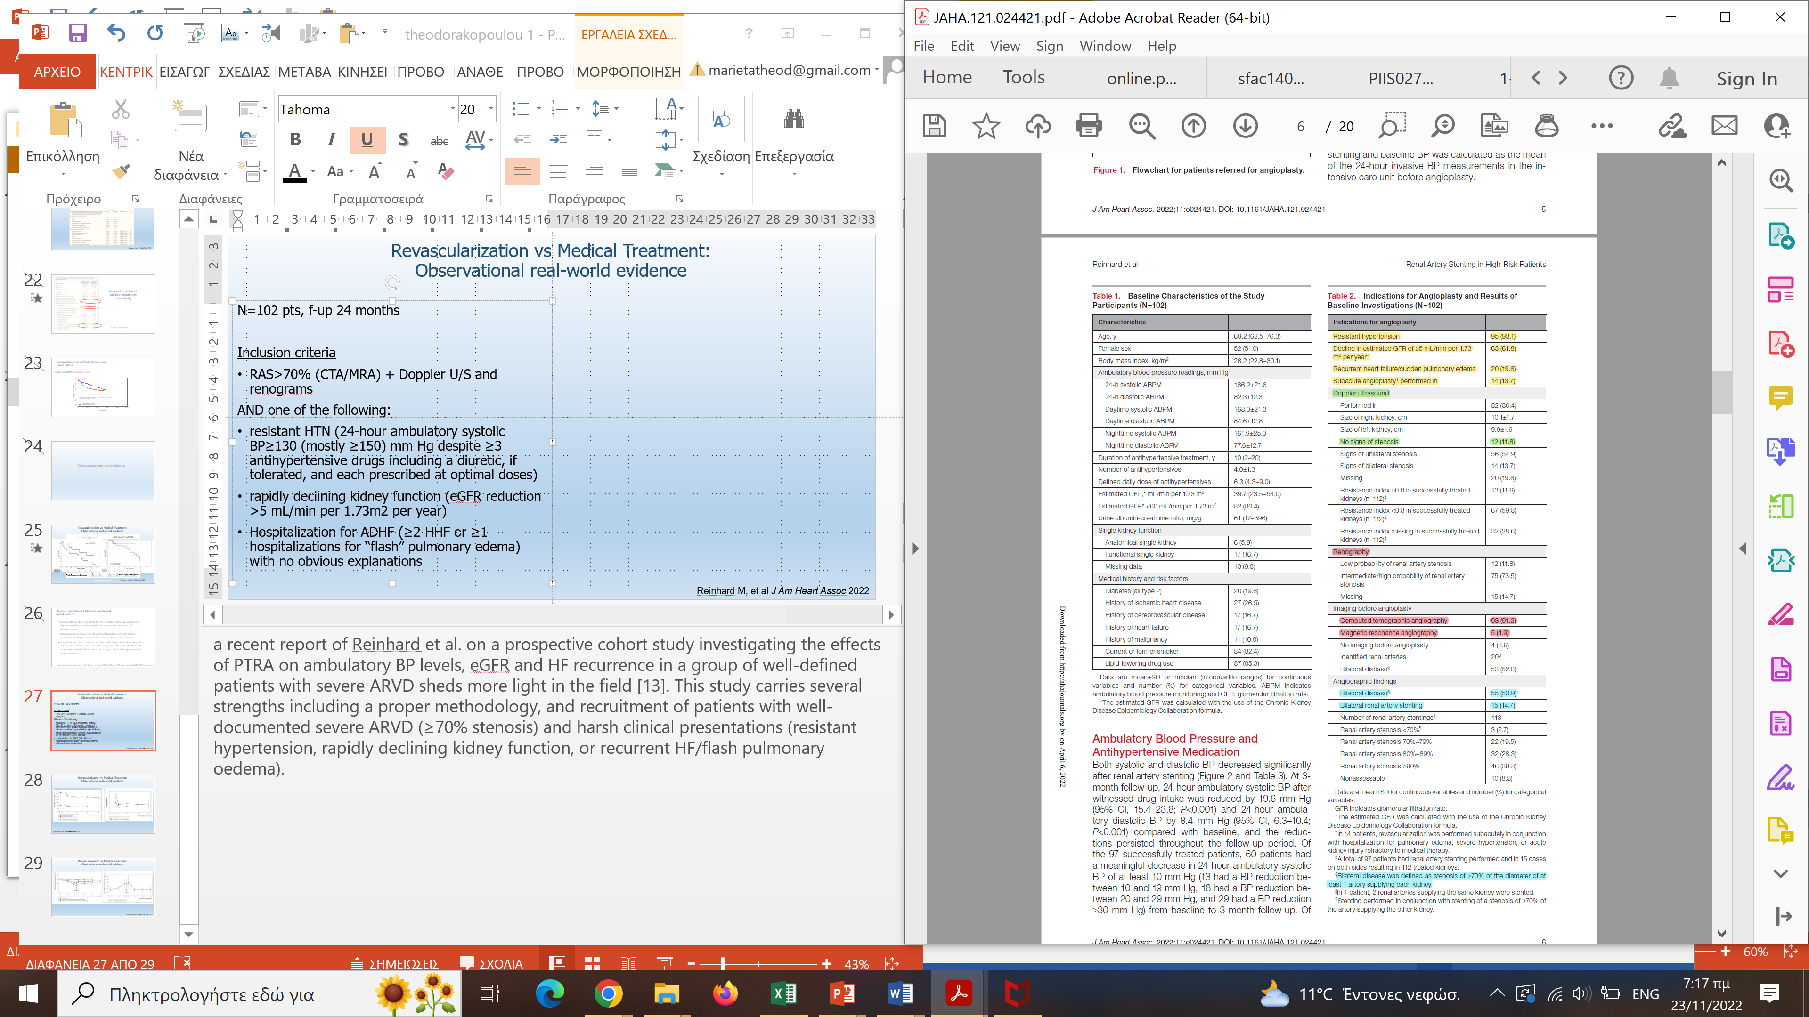
Revascularization vs Medical Treatment:
Observational real-world evidence
N=102 pts, f-up 24 months
Inclusion criteria
RAS>70% (CTA/MRA) + Doppler U/S and renograms
AND one of the following:
resistant HTN (24-h SBP≥130 (mostly ≥150) mm Hg despite ≥3 antihypertensive drugs including a diuretic, if tolerated, and each prescribed at optimal doses)
rapidly declining kidney function (eGFR reduction >5 mL/min per 1.73m2 per year)
Hospitalization for ADHF (≥2 HHF or ≥1 hospitalizations for “flash” pulmonary edema) with no obvious explanations
Reinhard M, et al J Am Heart Assoc 2022
Notes:
a recent report of Reinhard et al. on a prospective cohort study investigating the effects of PTRA on ambulatory BP levels, eGFR and HF recurrence in a group of well-defined patients with severe ARVD sheds more light in the field [13]. This study carries several strengths including a proper methodology, and recruitment of patients with well-documented severe ARVD (≥70% stenosis) and harsh clinical presentations (resistant hypertension, rapidly declining kidney function, or recurrent HF/flash pulmonary oedema).

Slide 77
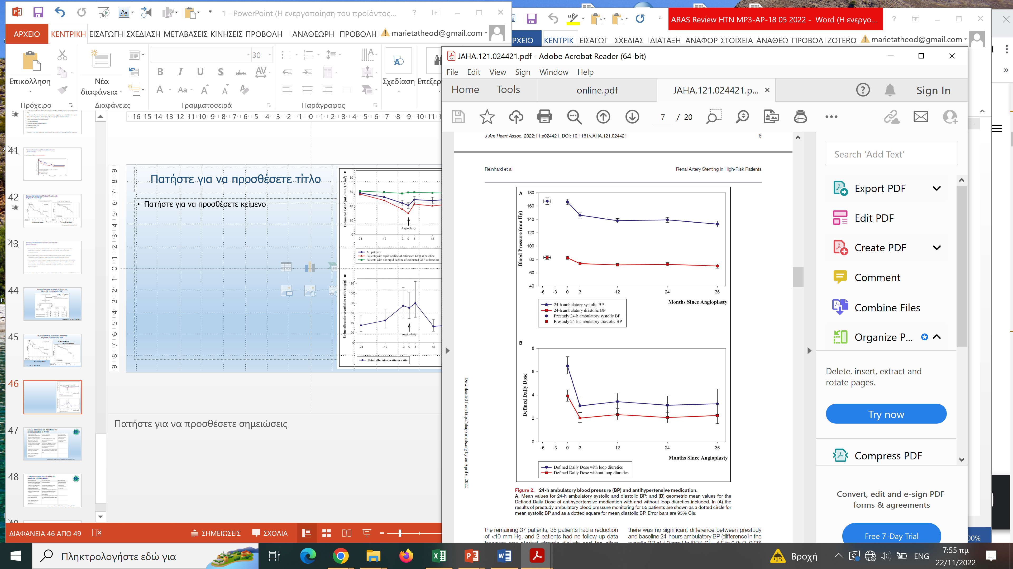
Revascularization vs Medical Treatment:
Observational real-world evidence
N=102 pts, RAS>70%, f-up 24 months
Reinhard M, et al J Am Heart Assoc 2022
Notes:
Both systolic and diastolic BP decreased significantly after renal artery stenting (Figure 2 and Table 3). At 3-month follow-up, 24-hour ambulatory systolic BP after witnessed drug intake was reduced by 19.6 mm Hg (95% CI, 15.4–23.8; P<0.001) and 24-hour Ambulatory diastolic BP by 8.4 mm Hg (95% CI, 6.3–10.4; P<0.001) compared with baseline, and the reductions persisted throughout the follow-up period
At 3-month follow-up, the defined daily dose of antihypertensive medication with loop diuretics included was reduced by 52% (95% CI, 41%–62%; P<0.001), and when loop diuretics were excluded from the analysis, the reduction was 48% (95% CI, 36%–58%;
P<0.001) compared with baseline and the reductions persisted through follow-up
(Figure 2 and Table 3)

Slide 78

Revascularization vs Medical Treatment:
Observational real-world evidence
N=102 pts, RAS>70%, f-up 24 months
Reinhard M, et al J Am Heart Assoc 2022
Notes:
At 3-month ollow-up after renal artery stenting, the mean estimated GFR had increased significantly by overall 7.8 mL/min per 1.73m2 (95% CI, 4.5–11.1; P<0.001) and in the subgroup of 63 patients with rapidly declining kidney function at baseline by 12.5 mL/
min per 1.73m2 (95% CI, 7.9–17.0; P<0.001), and the observed changes persisted throughout the follow- up period.

Slide 79
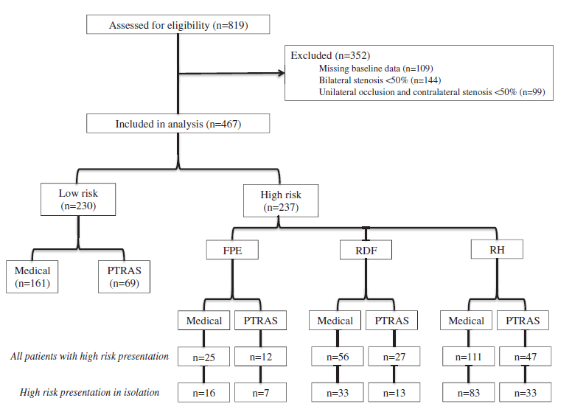
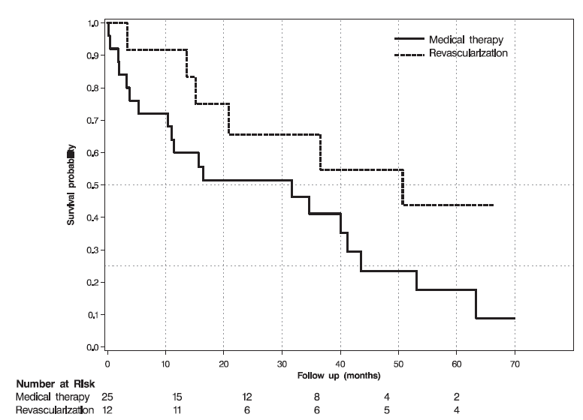
High-risk phenotypes: PTRA vs medical therapy
n=467 pts with RAS>50%
Flash pulmonary oedema
Rapid kidney function decline
Resistant HYP
Flash Pulmonary Oedema
RH or rapid GFR decline
Richie et al. Am J Kidney Dis 2014
Notes:
To this end, in the aforementioned prospective study, in patients presenting with flash pulmonary edema, refractory hypertension, or rapidly declining kidney function, revascularization compared to medical therapy was associated with major reductions in risk for death (HR, 0.15; 95% CI, 0.02-0.9) and CV events (HR, 0.23; 95% CI, 0.1-0.6); in contrast, no apparent benefit in low-risk patients without the above presentations was evident (HR 0.8 [95% CI, 0.7-1.2], and 1.0 [95% CI, 0.8-1.2], respectively), similar to major randomized trials.
Ritchie et al. Am J Kidney Dis. 63(2):186-197. DOI: 10.1053/j.ajkd.2013.07.020
Randomized Controlled Trial
Am J Kidney Dis
. 2014 Feb;63(2):186-97.
doi: 10.1053/j.ajkd.2013.07.020. Epub 2013 Sep 26.
High-risk clinical presentations in atherosclerotic renovascular disease: prognosis and response to renal artery revascularization
James Ritchie ¹, Darren Green ¹, Constantina Chrysochou ¹, Nicholas Chalmers ², Robert N Foley ³, Philip A Kalra ⁴
Affiliations expand
PMID: 24074824
DOI: 10.1053/j.ajkd.2013.07.020
Background: Current trial data may not be directly applicable to patients with the highest risk presentations
of atherosclerotic renovascular disease, including flash pulmonary edema, rapidly declining kidney function,
and refractory hypertension. We consider the prognostic implications of these presentations and response to
percutaneous revascularization.
Study Design: Single-center prospective cohort study; retrospectively analyzed.
Setting & Participants: 467 patients with renal artery stenosis $50%, managed according to clinical
presentation and physician/patient preference.
Predictors: Presentation with flash pulmonary edema (n537 [7.8%]), refractory hypertension (n5116
[24.3%]), or rapidly declining kidney function (n546 [9.7%]) compared to low-risk presentation with none of these
phenotypes (n5230 [49%]).Percutaneous revascularization (performedin32%of flashpulmonary edema,28%of
rapidly declining kidney function, and 28%of refractory hypertension patients) compared tomedicalmanagement.
Outcomes: Death, cardiovascular (CV) event, end-stage kidney disease.
Results: During a median follow-up of 3.8 (IQR, 1.8-5.8) years, 55% died, 33% had a CV event, and 18%
reached end-stage kidney disease. In medically treated patients, flash pulmonary edema was associated with
increased risk of death (HR, 2.2; 95% CI, 1.4-3.5; P , 0.001) and CV event (HR, 3.1; 95% CI, 1.7-5.5;
P , 0.001), but not end-stage kidney disease, compared to the low-risk phenotype. No increased risk for
any end point was observed in patients presenting with rapidly declining kidney function or refractory
hypertension. Compared to medical treatment, revascularization was associated with reduced risk for death
(HR, 0.4; 95% CI, 0.2-0.9; P50.01), but not CV event or end-stage kidney disease, in patients presenting
with flash pulmonary edema. Revascularization was not associated significantly with reduced risk for any
end point in rapidly declining kidney function or refractory hypertension. When these presentations were
present in combination (n531), revascularization was associated with reduced risk for death (HR, 0.15;
95% CI, 0.02-0.9; P50.04) and CV event (HR, 0.23; 95% CI, 0.1-0.6; P50.02).
Limitations: Observational study; retrospective analysis; potential treatment bias.
Conclusions: This analysis supports guidelines citing flash pulmonary edema as an indication for renal
artery revascularization in atherosclerotic renovascular disease. Patients presenting with a combination of
rapidly declining kidney function and refractory hypertension also may benefit from revascularization and may
represent a subgroup worthy of further investigation in more robust trials.

Slide 80

High-risk clinical phenotypes: Resistant hypertension
no RCT in the field included solely patients with properly defined resistant hypertension!!!
n= 72 with resistant HYP (dABP >135/85 mm Hg on 3 drugs)
Courand et al., Hypertension 2019
Notes:
In addition to these beneficial effects on prognosis, revascularization is associated with a number of benefits including,
In a retrospective uncontrolled single-center study in 72 patients with ARVD and resistant hypertension, PTRA with or without stenting significantly decreased ambulatory BP levels by 14.0±17.3/6.4±8.7 mm Hg, and the number of antihypertensive drugs (from 4.0±1.0 to 3.6±1.4) [107]. In an international registry (2001-2009) including 265 consecutive patients with ARVD (≥ 50% de novo stenosis) and at least one of the following: (1) mean SBP≥160mmHg on at least three anti-hypertensive medications including diuretic), (2) eGFR <60 mL/min/1.73 m2), (3) unexplained congestive HF or recurrent acute pulmonary edema that were treated by PTRA with stenting [91], BP was reduced from 160/86mmHg to 135/75 mmHg. Finally, in the aforementioned study of 467 patients from Ritchie et al. [32], revascularization was associated with improved survival in patients with the combination of rapidly declining renal function and refractory hypertension (HR for death 0.15 95%CI 0.02-0.9, p=0.04).

Slide 81






High-risk clinical phenotypes: Heart failure
HF was underrepresented in the large RCTs and no imaging RCTs including solely patients with HF and RAS are available
n= 152 (52 with previous APO) with RAS
n= 163 with PTRA
Green et al., Nephrology 2018
Kane et al. Nephrol Dial Transplant 2010
Notes:
Another observational analysis from the UK in 611 patients with RAS>50% (of which 152 patients with co-existing HF without previous pulmonary oedema), showed a large difference in mortality risk between PTRA and standard medical therapy for those with HF (HR=0.6; 95%CI 0.3-0.9), and non-significant reductions for those without (HR=0.8; 95%CI 0.5-1.1) [113]. Furthermore, the HR for hospital admission for HF overall in revascularised patients was 0.2 (0.0-1.1, p=0.06). In 152 patients, with HF but without previous acute pulmonary oedema, the hazard ratio for death after revascularization compared with medical therapy was 0.76 (95%CI 0.58–0.99) [114]. In another observational study in 163 patients PTRA with stenting was associated with a significant decrease in the New York Heart Association Functional Class (1.9±0.8 versus 2.6 1.0, P<0.04) and a 5-fold reduction in the number of hospitalizations compared with medical treatment [53]. These data suggest that revascularisation of RAS in HF is associated with a substantial reduction in all-cause mortality and hospital admission and call for an RCT of renal artery revascularisation versus medical therapy in patients with RAS and HF. Until such evidence is available, on the basis of existing observational data and expert opinion, recurrent hospitalizations for HF and/or pulmonary oedema with severe ARVD are considered as indications for PTRA. Of note, all this published experience preceded the introduction of several newer agents drugs that constitute the current standard of therapy for HF, such as sacubitril-valsartan or SGLT2-inhibitors [115,116]

Slide 82

High-risk clinical phenotypes: rapid kidney function decline
Notes:
Patients with a rapid deterioration of renal function and ARVD may benefit from revascularization, as has been shown by several small studies, case series and case reports [100,117–120]. Of note, participants who presented improved kidney function after PTRA with stenting have lower risk of death and multiple CV and renal complications, as recently demonstrated in a sub-group analysis of the CORAL trial [123].
Most reports of salvage of renal function apply to patients with renovascular disease affecting the total functional mass (e.g., a solitary functioning kidney or high-grade bilateral disease) [90,124]. Some patients continue to have relative preservation of renal size, despite high-grade vascular occlusion; preservation of volume may be related to the presence of collateral vessels that develop to replace a minimum level of perfusion, but most commonly indicate a stenosis that has recently become severe and functionally critical. As such, the reversibility of damage is time-dependent and regarding the patients who were receiving dialysis there is a consensus to avoid revascularization in those on dialysis for >3 months [19].

Slide 83
Revascularization vs Medical Treatment:
Heart Failure
Case reports and observational studies have reported major improvements in NYHA functional status and hospitalization rates for HF after successful revascularization .
Echocardiographic studies suggest significant reduction in LV wall thickness, concentric hypertrophy and LV diastolic function after revascularization
In a prospective cohort study of 611 patients with atherosclerotic RAS >50%, (152 with HF ) showed HRs in revascularisation compared with medical treatment of 0.6 (0.3-0.9, p=0.01) for death and 0.2 (0.0-1.1, p=0.06) for HF hospitalisation in patients with HF.
Iwashima et al. Am J Hypertens 2020; Green et al. Lancet. 2015; 385 Suppl 1:S11; Januszewicz et al JACC 2022
Notes:
Revascularisation of renal artery stenosis as a therapy for
heart failure: an observational cohort study
Darren Green, James P Ritchie, Constantina Chrysochou, Philip A Kalra
Abstract
Background Heart failure contributes to 5% of all hospital admissions, and mortality is more than 50% at 4 years.
54% of patients with a left ventricular ejection fraction of less than 40% have renal artery stenosis. The potential
benefi t of revascularisation for heart failure is not established. We aimed to compare clinical outcomes for renal
artery revascularisation with medical therapy for renal artery stenosis associated with heart failure as the fi rst step
towards validating revascularisation as a therapeutic option in heart failure.
Methods In a prospective, longitudinal observational study at a single UK nephrology centre, we recruited patients
with atherosclerotic renal artery stenosis (>50% as judged by CT, MR, or direct angiography). Endpoints were all-cause
mortality and hospital admission for heart failure. Survival analyses were performed with Cox proportional hazard
model adjusted for age, estimated glomerular fi ltration rate (eGFR), and cardiovascular comorbidities. Ethics approval
was granted by South Manchester Research Ethics Committe.
Findings 611 patients (152 [25%] with and 459 [75%] without heart failure) were recruited. Mean age was 70 years (SD 9),
348 (57%) were men, 183 (30%) had diabetes, and mean eGFR was 33 mL/min per 1・73 m2 (SD 19). Patients with and
without heart failure were similar with to sex, diabetes, and eGFR. 367 participants (60%) died over a follow-up of a
mean of 4・3 years (SD 3・6). 87 patients without heart failure (19%) underwent revascularisation compared with 47 with
heart failure (31%). The adjusted hazard ratio (HR) for death in heart failure compared with no heart failure was 1・9
(95% CI 1・5–2・5, p<0・0001). For patients without heart failure, the adjusted HR for death in revascularisation compared
with receiving medical therapy was 0・8 (0・5–1・1, p=0・16). For heart failure, the HR was 0・6 (0・3–0・9, p=0・01). The HR
for hospital admission for heart failure in revascularised patients was 0・2 (0・0–1・1, p=0・06).
Interpretation Revascularisation of renal artery stenosis in heart failure is associated with a substantial reduction
in all-cause mortality and hospital admission, although such observational data might be complicated by hidden
confounders. These fi ndings are encouraging for the development of a randomised trial of renal artery revascularisation
versus medical therapy in heart failure, and suggest that investigation for renal artery stenosis should be considered
more frequently in heart failure clinics.

Slide 84
Revascularization vs Medical Treatment:
Heart Failure
Results from CORAL (unpublished results)
Notes:
This is unpublished data - remove

Slide 85

Ongoing observational studies
Title/NCT Number | Population | Intervention | Status | Dates | Outcome Measures
ETRAS-China [NCT03080519] | N=5000 Age $≥$14 Sex: all | Single Group Assignment Open Label Endovascular therapy | Not yet recruiting | Study Start 2017 Study Completion 2024 | Change in BP Change in eGFR Device or procedure related acute adverse events Incidence of major adverse events Incidence of renal restenosis (>50%)
DAN-PTRA [NCT02770066] | N=30 Child, Adult, Older Sex: all | Observational Prospective Endovascular therapy | Recruiting | Study Start 2015 Study Completion 2030 | Change in 24-h ABPM BP Change in antihypertensive treatment Change in eGFR Incidence of death and major adverse events Early safety composite outcome
Pappaccogli et al. Hypertension 2023 (in press)

Slide 86
Atherosclerotic Renal Artery Stenosis
Changes in recommendations

Slide 87


Slide 88
Revascularization vs Medical Therapy in ARVD
Theodorakopoulou et al. Clin Kidney J 2022

Slide 89
Indications for PTRA in existing clinical recommendations
SCAI (2017) | Appropriate Cardiac Disturbance Syndromes (Flash Pulmonary Oedema or ACS with hypertension and moderate RAS with a resting translesional mean gradient of >=10mmHg and/or several RAS (AUC 9) CKD stage 4 and bilateral moderate RAS with a resting translesional mean gradient of >=10mmHg with kidney size>7 cm (pole-pole length) (AUC 8) CKD stage 4 and bilateral severe RAS or unilateral severe RAS with a solitary kidney (AUC 7) Resistant hypertension and bilateral or solitary severe RAS (AUC 7) May be appropriate Resistant hypertension and unilateral severe RAS (AUC 6) CKD stage 4 and unilateral moderate RAS with a resting translesional mean gradient of >=10 mmHg without other explanation (AUC 6) Recurrent CHF with unilateral moderate RAS with a resting translesional mean gradient of >=10 mmHg (AUC 5) CKD stage 2 with bilateral severe RAS (AUC 5) CKD stage 3 stable for 1 year with bilateral severe RAS (AUC 5) Resistant hypertension with severe unilateral RAS and anatomically challenging or high risk lesion (AUC 4)
Theodorakopoulou et al. Clin Kidney J 2022

Slide 90
Indications for PTRA in existing clinical recommendations
ACC/AHA (2017) | In adults with RAS for whom medical management has failed (refractory hypertension, worsening renal function, and/or intractable HF) and those with nonatherosclerotic disease, including fibromuscular dysplasia, it may be reasonable to refer the patient for consideration of revascularization (percutaneous renal artery angioplasty and/or stent placement). (Class: IIb/LOE: C)
ESC/ESVS (2017) | Routine revascularization is not recommended in RAS secondary to atherosclerosis (Class: III/ LOE: A) In cases of hypertension and/or signs of renal impairment related to FMD, balloon angioplasty without bailout stenting should be considered (Class: IIa/LOE: B) Balloon angioplasty with or without stenting may be considered in selected patients with RAS and unexplained recurrent CHF or sudden pulmonary oedema (Class: IIb/LOE: C)
JSH (2019) | PTRA for renovascular hypertension could be considered in patients with hemodynamically significant stenosis of the renal artery and one of the following conditions: 1) FMD, 2) resistant hypertension, 3) exacerbating/malignant hypertension, 4) unexplained or repeated pulmonary edema/HF, or 5) bilateral renal artery stenosis or renal artery stenosis in solitary kidney
Theodorakopoulou et al. Clin Kidney J 2022

Slide 91






Slide 92

KDIGO consensus on indications for revascularization in ARVD
Johansen et al. Kidney Int 2021; Hicks et al. Am J Kidney Dis 2022
Notes:
Medical management of ARVD is fundamentally targeted both to reducing coexisting
cardiovascular risk in other vascular territories and to protecting the viability of the
kidney. Intensive management of arterial hypertension is the single most important and
modifiable risk element, with recent target blood pressure goals of <130/80 mm Hg, or
<140/90 in older subjects as per AHA/ACC 7 and ESC 6 guidelines. Initial antihypertensive
therapy often includes multiple drugs, but agents that block the RAAS are preferred. Prior to
the introduction of ACE inhibitors, and later ARBs, renovascular hypertension often
manifested as intractable or malignant-phase hypertension 43. As reduced renal perfusion
pressure triggers activation of the RAAS, these agents are physiologically rational agents to
treat renovascular hypertension and have made the disorder more manageable 44. Several
observational series suggest that individuals with ARVD managed with RAAS blockade have
reduced mortality 45-47. Hence, RAAS blockade is considered an optimal measure for treating
hypertension in the setting of ARVD.
RAAS blockade also has a potential disadvantage, however. Glomerular filtration
depends upon the action of angiotensin II under some conditions, specifically those with
marginal renal perfusion pressure and/or sodium depletion 48, 49. As a result, many clinicians
are wary of observing a decrement in GFR (manifest as rising serum creatinine) in patients
with ARVD and/or CKD. A marked rise in creatinine can serve as a marker of impending
“critical” ARVD with marginal flows and filtration dependent on angiotensin II. Removal of
the stenosis with successful revascularization has been associated with removal of
angiotensin dependence and stable kidney function despite re-introduction of RAAS
blockade. Importantly, abundant registry data and experience in prospective trials in which
RAAS blockade was universally applied indicate that RAAS blockade is well-tolerated in
most individuals both with unilateral and/or bilateral ARVD. It should be emphasized that the
11
presence of a high-grade RAS renders the kidney susceptible to further reductions in blood
flow and loss of function with any form of systemic antihypertensive drug therapy 50. In any
case, drug therapy in patients with ARVD requires careful supervision and a willingness to
evaluate the cause of unexplained loss of GFR.
Other medications are also important in the management of ARVD. Statin class agents to
reduce cholesterol and lower cardiovascular risk are strongly recommended at doses appropriate
to the level of estimated risk; by definition, ARVD represents a clinical manifestation of
atherosclerotic disease and should be considered high risk. Antiplatelet therapy with at least a
low dose of aspirin is also considered standard of care. Additional measures to manage ARVD
risk include tobacco cessation and intensive efforts to optimize diabetic control. Application of
standardized treatment programs for both hypertension and diabetes were fundamental to the
success of “optimized” medical therapy in the CORAL trial 51.

Slide 93

Ενδείξεις επαναγγείωσης

Slide 94
Revascularization indications
Strong indications
High-grade (>70%) renal artery stenosis in association with one of the following criteria:
Resistant hypertension
New-onset or recently uncontrolled hypertension
Acute pulmonary oedema or acute decompensated HF
Rapid decline of eGFR (bilateral stenosis or solitary kidney)
ACEi or ARB intolerance (≥30% eGFR reduction)
replacement treatment (with possibly viable renal parenchyma) if stenosis detected <3 months of renal replacement treatment or if uncontrolled hypertension with multiple (≥5) antihypertensive agents is present
AKI due to acute renal artery occlusion or high-grade stenosis
Kidney transplant with renal artery stenosis
Moderately strong indications
High-grade (>70%) renal artery stenosis in association with one of the following criteria:
Chronic HF
Asymptomatic but either bilateral or supplying a solitary kidney with viable renal parenchyma (non-atrophic kidney, distinct renal cortex)
Sarafidis, Theodorakopoulou et al, Nephrol Dial Transplant 2023
Notes:
Suggest a personalized approach to select patients who will benefit from revascularization based on the strong and moderately strong indications described

Slide 95
2023 ESH Guidelines
….. Thus, the current consensus is to offer revascularization on top of medical therapy in patients with documented secondary hypertension because of atherosclerotic renal vascular disease or high-risk clinical profiles and documented high-grade stenosis (> 70%) [1418,1422,1423].
Medical therapy alone could be used for individuals with asymptomatic atherosclerotic renal vascular disease with <70% stenosis, patients with mild or moderate hypertension that is easily controlled with antihypertensive drugs and low-grade stenosis, or patients with nonviable kidney parenchyma, where revascularization has little to offer. In the medically treated patients, if treatment initiation with an ACEi or an ARB results in eGFR reduction of 30%, careful reevaluation of the patient is warranted.
Mancia, Kreutz et al, J Hypertens. 2023

Slide 96


Evaluation of possible kidney viability
Sarafidis, Theodorakopoulou et al, Nephrol Dial Transplant 2023
Notes:
It should be highlighted that in addition to the indications, we should also perform a careful evaluation of the degree of the stenosis and the viability of the renal parenchyma of the stenotic kidney in candidates for revascularization in order to detect those that are likely to benefit, i.e. ……..

Slide 97
Assessment of kidney parenchyma viability in ARVD
 | Likely non-viable | Likely to be viable**
Renal length (cm) | < 7 cm | > 8* cm
Cortical thickness | Loss of cortico-medullary differentiation; no cortex | Cortex distinct eg > 0.5 cm
Proteinuria | uACR > 300 mg/g (30 mg/mmol) = uPCR > 500 mg/g | uACR < 200 mg/g (20 mg/mmol)
Renal resistive index | > 0.8 | < 0.8
a) Possibly consider kidney length-to-BMI ratio.
b) Proteinuria may be arising from an atrophic kidney.
Johansen et al. Kidney Int 2021
Notes:
Types of Endovascular Aneurysm Repair (EVAR) depending on the anatomy of the abdominal aneurysm (infra-renal aneurysms include a proximal aortic neck that provide an adequate landing zone for EVAR; juxta-renal aneurysms are adjacent to or include the lower margin of the renal arteries; supra-renal and thoraco-abdominal aneurysms also extend above the orifice of renal arteries)

Slide 98

Algorithm for revascularization in atherosclerotic renal vascular disease
Pappaccogli et al. Hypertension 2023 (in press)

Slide 99

Ongoing studies
No results posted
Recruitment Status : Unknown
Stopped prematurely due to a lack of recruitment
Van der Niepen et al. Curr Hypertens Rep 2017

Slide 100

ARVD & CKD: Gaps in knowledge and research recommendations
Johansen et al. Kidney Int 2021
Notes:
Types of Endovascular Aneurysm Repair (EVAR) depending on the anatomy of the abdominal aneurysm (infra-renal aneurysms include a proximal aortic neck that provide an adequate landing zone for EVAR; juxta-renal aneurysms are adjacent to or include the lower margin of the renal arteries; supra-renal and thoraco-abdominal aneurysms also extend above the orifice of renal arteries)

Slide 101
ARVD & CKD: Gaps in knowledge and research recommendations
Johansen et al. Kidney Int 2021
Notes:
Types of Endovascular Aneurysm Repair (EVAR) depending on the anatomy of the abdominal aneurysm (infra-renal aneurysms include a proximal aortic neck that provide an adequate landing zone for EVAR; juxta-renal aneurysms are adjacent to or include the lower margin of the renal arteries; supra-renal and thoraco-abdominal aneurysms also extend above the orifice of renal arteries)

Slide 102
Conclusions
ARVD is a common clinical problem with presentations relevant to many medical specialties and important prognostic associations
Major RCTs included patients with ARVD of various degrees and not patients with high-risk clinical presentations and/or critical stenoses
Several pieces of observational data show that PTRA is associated with future renal and cardiovascular benefits in patients presenting high-risk ARVD phenotypes
Such evidence resulted in a progressive shift in relevant recommendations, with most recent not-graded suggestions supporting that revascularization should be offered in selected patients with these phenotypes, after careful evaluation

Slide 103
Areas for further clinical research in the field of ARVD
RCTs enrolling patients with hemodynamically significant ARVD and high-risk clinical presentations, with true renovascular hypertension rather than patients with primary hypertension and incidental RAS through a wider and more systematic use of the translesional pressure gradient studies testing the impact of functional non-invasive imaging, such as BOLD-MRI, to identify patients more likely to benefit from revascularization studies examining the efficacy of PTRA on moderate vs advanced CKD studies establishing the optimal timeline of revascularization to avoid delay-related ineffectiveness studies identifying predictors of PTRA benefit studies evaluating the efficacy of PTRA in combination with novel therapeutic strategies (e.g., targeting inflammation-related pathways, mesenchymal stem cells or angiogenic/growth factors)
Sarafidis et al, Nephrol Dial Transplant 2023

Slide 104
Thank you!

Slide 105
Ευχαριστώ

