Slide 1
Anemia in CKD
Kantartzi Konstantia
Ass. Prof. of Nephrology D.U.TH.
Notes:
First of all, I would like to thank the president and the organizing committee for inviting me to participate in this round table
Anemia is a common complication in chronic kidney disease (CKD), and is associated with:

Slide 2
Reduced quality of life
van Haalen et al. BMC Nephrology 2020

Slide 3
Worse renal survival

Slide 4
Increase in morbidity and mortality
Lamerato et al. BMC Nephrology 2022

Slide 5
Higher costs
J Manag Care Spec Pharm. 2021

Slide 6
Anemia in CKD
Notes:
Anemia is more prevalent and severe as the estimated glomerular filtration rate (eGFR) declines and starts to develop when the eGFR drops below 60 ml/min

Slide 7
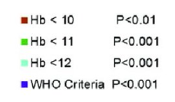
The prevalence of anemia raises with the progression of CKD
Several studies report the prevalence of anemia in non-dialysis dependent (NDD) CKD up to 60%
Clinical Kidney Journal., 2017
Notes:
The prevalence of anemia raised with the progression of CKD and there is a strong correlation of glomerular filtration rate (GFR) with reduction in Hb concentration, which is more pronounced in individuals with advanced CKD
Anemia is a well-known and frequent consequence of CKD,

Slide 8
Diagnosis and evaluation of anemia in CKD
KDIGO 2012
Notes:
anemia is defined as an Hb concentration below
And the investigation of anemia must include

Slide 9
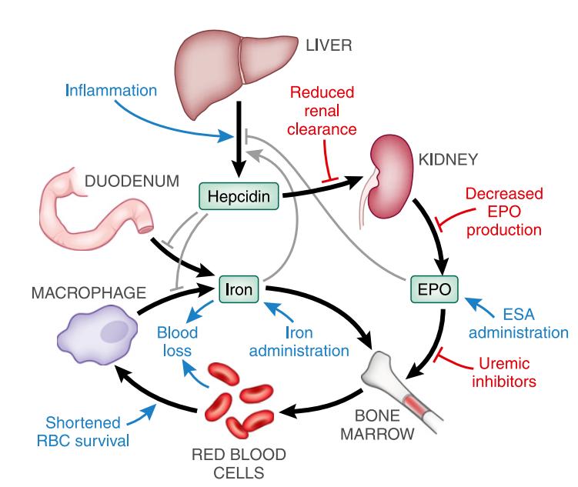
Pathophysiology of anemia in CKD
Progressive reduction of endogenous erythropoietin (EPO) levels has classically been considered to play a preeminent role
Absolute iron deficiency due to blood losses or an impaired iron absorption
Ineffective use of iron stores due to increased hepcidin levels
Systemic inflammation due to CKD and associated comorbidities
Reduced bone marrow response to EPO due to uremic toxins
Reduced red cell life span
Vitamin B12 or folic acid deficiencies
KDIGO Anemia Working Group. KDIGO clinical practice guideline for anemia in chronic kidney disease. Kidney Int. 2012
Notes:
The mechanisms of anemia in CKD are multifactorial:
However, other factors have also been described to contribute to anemia in CKD patients, such as an

Slide 10
Erythropoietin (EPO), a glycoprotein hormone, is the master regulator of erythropoiesis
Fibroblast-like interstitial peritubular cells of the kidneys
In CKD:
Decrease in the EPO production due to fibrosis
Errors in EPO-sensing
Sato et al., Frontiers in Genetics, 2019

Slide 11
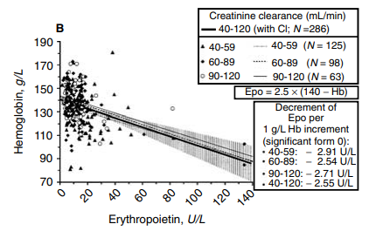
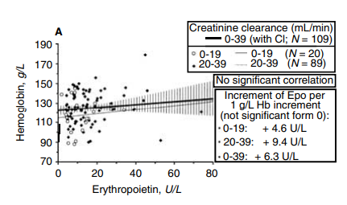
In CKD patients, EPO levels are inadequately low with respect to the degree of anemia
Fehr et al., Kidney International 2004
Notes:
Studies have shown

Slide 12
Tissue oxygenation
Renal blood flow
Erythroid Progenitor Cells
Arterial O2 tension
Red blood cells
Survival
Proliferation
Differentiation
Notes:
Erythropoietin synthesis is determined by tissue oxygenation rather than by renal blood flow; production increases as the hemoglobin concentration drops and the arterial oxygen tension decreases
EPO binds to its receptor on the surface of erythroid progenitor cells mainly in the bone marrow, and serves as a key stimulus for red cell survival, proliferation and differentiation
Iron is necessary for red blood cell production
And all this process is orchestrated by hypoxia inducible factor

Slide 13
Prolyl-Hydroxylase-Domain:
Hypoxia Inducible Factor 1
HIF-1
EPO, EPOR, VEGF, GLUT1, TRFR
Notes:
HIF-1 is a transcription factor that mediates between the oxygenation state and the cell's response to it. It is a heterodimer consisting of an α-subunit with a short half-life in the presence of O2 and a β-subunit that is continuously expressed regardless of O2 levels. The "oxygen sensor" is a polyhydroxylase, which in the presence of O2 (21% O2) hydroxylates the α-subunits of the HIF-1 factor. Hydroxylated HIF-1α subunits accept ubiquitin molecules from the von Hippel-Lindau (vHL) protein, resulting in their proteasomal degradation. In hypoxic conditions the α-subunits remain intact and accumulate, forming heterodimers with HIF-1β subunits. Heterodimers activate a number of hypoxia response genes, such as genes encoding EPO and EPOR, enzymes of the glycolytic pathway, the transferrin receptor, and angiogenic factor

Slide 14
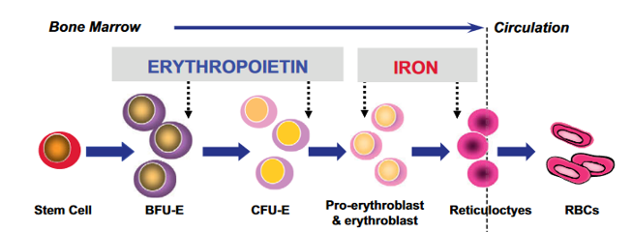
Iron is essential for adequate erythropoietic response to EPO
Kalantar-Zadeh et al., Advances in Chronic Kidney Disease 2009
Notes:
As we said before iron is essential

Slide 15
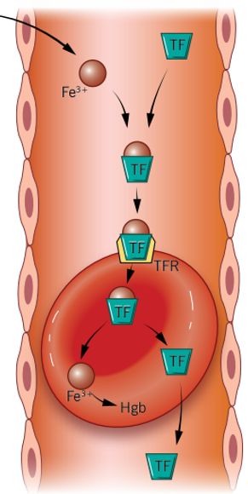
Notes:
Generally Iron (Fe) is provided mainly by reticuloendothelial macrophages that recycle iron from senescent red blood cells (RBCs), with a lesser contribution from dietary absorption and other body stores. Iron circulates in the plasma, predominantly bound to transferrin (TF), and is stored in cells in the form of ferritin.
The liver hormone hepcidin controls systemic iron homeostasis by inducing degradation of the iron exporter ferroportin (FPN) to reduce iron entry into plasma from dietary sources and body stores. Iron deficiency and erythropoiesis drive suppress hepcidin production to provide adequate iron for erythropoiesis and other essential functions. Iron and inflammation induce hepcidin to prevent iron overload and limit iron availability to pathogens

Slide 16
Iron deficiency is common in CKD Depending on its cause, iron deficiency can be categorized as absolute or functional
Notes:
Both forms are common in CKD

Slide 17
CKD correlates with impaired iron availability, due to uremic toxins, inflammatory cytokines, hepsidin, malnutrition, malabsorption or blood losses
Kalantar-Zadeh et al., Advances in Chronic Kidney Disease 2009

Slide 18
Anemia treatment in CKD
First oral iron supplements introduced in 1830s
The use of red blood cell transfusions along the 20th century
The appearance of the first rhuEPO use in late 1980s followed by longacting ESAs
The widespread use of intravenous iron supplements in recent years
The use of Hypoxia Inducible Factor Prolyl Hydroxylase Inhibitors (HIF-PHIs) the last few years
Notes:
in accordance with the pathophysiology
Has evolved dramatically from the

Slide 19
Treatment of anemia varies
Notes:
But the actual management of anemia in patients with CKD varies among different countries and medical units

Slide 20
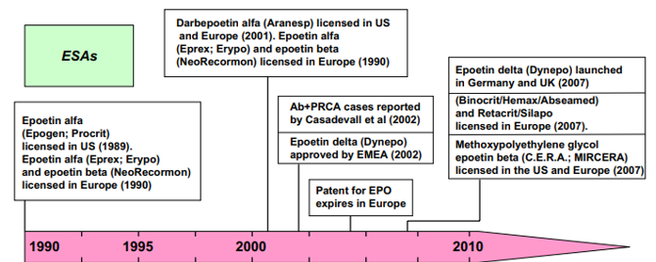
Erythropoiesis-Stimulating Agents (ESAs)
Mainstay of treatment
Macdougall and Ashenden., Advances in Chronic Kidney Disease, 2009
Notes:
Nowadays, ESA are an established treatment of anemia in CKD patients. Epoetin alfa and beta were the two first recombinant human erythropoietins entering into clinical practice nearly 30 years ago; some years later, darbepoetin alfa and methoxy polyethylene glycol-epoetin beta were developed

Slide 21
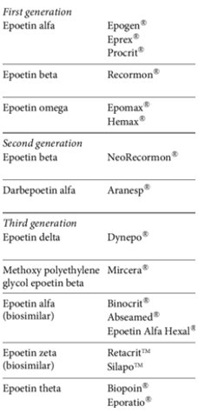
Not all ESAs are the same
They have different pharmacokinetic and pharmacodynamic properties, such as different half-lives and EPO receptor affinity
Erythropoiesis-Stimulating Agents (ESAs)

Slide 22
Administration convenience, CKD phase, administration route, and costs
Notes:
Remains unclear whether different forms of epoetin drugs are better or safer
The choice of ESA is based on administration convenience, CKD phase, administration route, and costs.

Slide 23
Effective agents in increasing and maintaining adequate Hb levels in a substantial proportion of CKD patients
with a relatively acceptable safety profile
Notes:
During these years of clinical use, ESA have been shown as effective agents in increasing and maintaining adequate hemoglobin (Hb) levels in a substantial proportion of CKD patients with a relatively acceptable safety profile

Slide 24
Target Hb concentration
?
At the very beginning, the rationale for their use was quite simple …..
The target Hb concentration during ESA therapy is still controversial
Aapro et al., Frontiers in Pharmacology 2019
Notes:
At the very beginning, the rationale for their use was quite simple: there was one symptom, anemia; there was a new effective drug to cure it, recombinant human erythropoietin; therefore, it was administered to increase Hb levels. Despite this apparent simplicity, a longstanding controversy took hold over the optimal Hb target when using ESAs
The target Hb concentration during ESA therapy is still controversial

Slide 25
Therapeutic goals
Study | ESA | Target Hb | Clinical outcomes
“Normal Hematocrit Trial” 1998 | Epoetin alfa | Hct: 42% vs 30% | Halted early, due to a higher number of deaths and acute myocardial infarction in the group randomized to the higher hematocrit group
CHOIR 2006 | Epoetin alfa | 13.5g/dl vs 11.3g/dl | Increased risk of a composite of death, myocardial infarction, hospitalization for congestive heart failure and stroke, and no incremental improvement in the quality of life
CREATE 2006 | Epoetin alfa | Early therapy 13-15g/dl vs ‘salvage’ 10.5-11.5g/dl | Increase the necessity of dialysis, more hypertensive episodes, improved QoL in 13-15g/dl
TREAT 2009 | Darbepoetin alfa | 13g/dl vs placebo rescue (below 9g/dl) | Did not reduce the risk of either of the two primary composite outcomes (either death or a cardiovascular event or death or a renal event), and was associated with an increased risk of stroke
X
X
X
X
Notes:
Studies early after the use of ESAs demonstrated its efficacy in reducing the need for blood transfusions, the symptoms related to anemia and an improved quality of life.
But a complete correction of anemia did not bring substantial benefits or could be even harmful

Slide 26
Target Hb concentration
Correcting Hb levels if they are below 10 g/dL
Avoiding exceeding Hb 13 g/dl
The Hb target appears to be somewhere in between 10 and 12 g/dl
It is advisable individualizing the Hb target relative to the patient’s basal conditions, preferences and risks:
Cancer
Diabetes
Symptomatic limb arteriopathy
Stroke
Non-symptomatic ischemic heart disease
JL Babitt et al.: Optimal anemia management: a KDIGO conference report., Kidney International 2021
Notes:
Altogether, this evidence led to the current clinical practice of ESA use, with a broad consensus on

Slide 27
Iron Supplementation for Anemia in CKD
Macdougall and Ashenden., Advances in Chronic Kidney Disease, 2009
Notes:
Furthermore, iron supplementation has a key role for the treatment of anemia in CKD,
This was well known almost before the first use of erythropoietin, since iron is essential for an adequate erythropoesis.
In the nephrology community, the use of iron has been almost exclusively adopted as supportive therapy for anemia control. Guidelines recommend iron use as a first-line strategy if we seek an increase of Hb or a decrease in ESA dose

Slide 28
Evidence for clinical benefits of iron administration
Several large studies have reported that correction of iron deficiency may be related with a reduction of congestive heart failure
JL Babitt et al., Kidney International 2021
Notes:
There are several evidence for clinical benefits of iron administration
Several large studies have reported that correction of iron deficiency may be related with a reduction of congestive heart failure

Slide 29
Concerns about iron supplementation
IV Fe
Oral Fe
Enhanced oxidative stress
Endothelial dysfunction
Potential role in favoring infection
IV iron administration has been associated with an increased risk of hypotension, headaches or hypersensitivity reactions
Gastrointestinal intolerance
Constipation
effect on gut microbiota
Increases uremic toxins production ????
Increases inflammation in CKD ???????
Notes:
However, there some concerns about the use of iron supplementation,

Slide 30
Iron types
Severity of iron deficiency
Availability of venous access
Response to prior oral iron therapy
Side effects with prior oral or IV iron therapy
Patient compliance and cost
KDIGO 2012
Notes:
There are many types and routes for iron administration with pros and cons and the decision of the treatment may based on

Slide 31
Iron guideline KDIGO
KDIGO 2012
Notes:
guideline suggests the treatment of anemia with iron supplementation in adults with CKD stage 3-5 when TSAT < 30% and ferritin < 500μg/ml regardless of ESA administration

Slide 32
Prolyl hydroxylase domain (PHD) inhibitors
Prolyl hydroxylase domain (PHD) inhibitors are a new class of drugs for the treatment of anemia
They differentiate from ESAs, since they do not directly activate the erythropoietin receptor, but rather stimulate the production of endogenous erythropoietin from the kidneys
Induce the expression of genes related to iron transport
They are administered orally
Notes:
Prolyl hydroxylase domain (PHD) inhibitors are a new class of drugs for the treatment of anemia. They differentiate from ESAs, since they do not directly activate the erythropoietin receptor, but rather stimulate the production of endogenous erythropoietin from the kidneys and to a lesser extent from the liver. Moreover, they are administered orally and not parenterally

Slide 33
Forest plots for the efficacy of Hb response
Chen et al., Frontiers in Pharmacology 2023
Notes:
According to data from phase-II and III studies, compared with placebo or ESA, PHD inhibitors are effective in increasing and maintaining Hb levels in both ND and dialysis dependent CKD patients

Slide 34
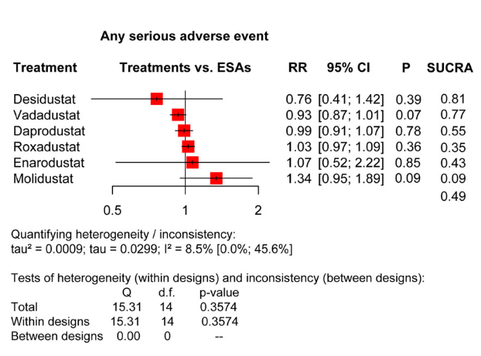
Forest plots for the safety of the treatment-emergent adverse events
Chen et al., Frontiers in Pharmacology 2023
Notes:
with a satisfactory safety profile in terms of adverse events and serious adverse events

Slide 35
Forest plots for the safety of the treatment-emergent adverse events
Chen et al., Frontiers in Pharmacology 2023
Notes:
And specific adverse events such as

Slide 36
Pleiotropic effects of PHDi
Activation of multiple genes regulating:
Erythropoiesis
Iron metabolism
Angiogenesis
Lipid and glucose metabolism
Glycolysis
Mitochondrial function
Inflammation and immunity
Cell growth and survival
Vasodilation
Cell migration
Nava Yugavathy., et al., Curr. Issues Mol. Biol. 2023
Notes:
PHDi have pleiotropic effects
As the HIF system controls a wide array of pathways, some of them still unknown, this may open the way to new positive effects, but also to unwanted adverse events

Slide 37
Anemia in CKD is a significant and frequent complication with multifactorial pathophysiology
Anemia guidelines are old
Does not include recent studies assessing the:
Efficacy and safety of IV iron
Different strategies of iron repletion
Current and upcoming erythropoiesis stimulating agents
Notes:
concluding

Slide 38
Kidney International 2021
Revise anemia guideline
With optimal thresholds and targets
Individualized diagnosis and therapy
There are many areas where more research is needed
Notes:
We still have a lot to learn

Slide 41
6H syndrome
High Fibroblast Growth Factor 23
Hyperphosphaturia
Hypophosphatemia
Hypovitaminosis D
Hypocalcemia
Hyperparathyroidism secondary
Reported clinical manifestations of the 6H syndrome include:
Osteomalacia
Bone fractures
Muscular weakness and
Respiratory failure
Jonathan W. Bazeley., Jay B. Wish., AJKD 2022
Notes:
Another clinically relevant and increasingly recognized side-effect of certain intravenous iron formulations is 6H syndrome 6H syndrome (high fibroblast growth factor 23 [FGF-23], hypophosphatemia, hyperphosphaturia, hypovitaminosis D, hypocalcemia, and secondary hyperparathyroidism). In the setting of iron deficiency, FGF-23 transcription is increased. Normally, this has no substantial adverse consequences because FGF-23 is cleaved proportionally to synthesis to the inactive form. However, higher levels of intact FGF-23 develop in the presence of certain IV iron formulations. It is speculated that the carbohydrate moieties of the iron formulations inhibit the cleavage of FGF-23.

