Slide 1


Clinical significance of genetic tests in ADPKD
A. Duni
Nephrologist, University Hospital of Ioannina

Slide 2
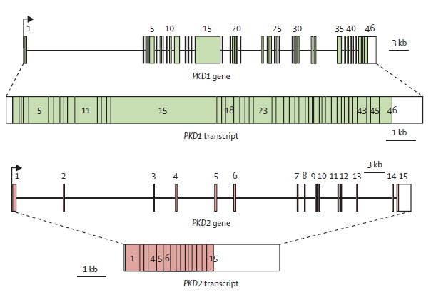
The identification of PKD1 in 1995 and PKD2 in 1996 facilitated the development of DNA sequence–based molecular diagnostics.
ADPKD is genetically heterogeneous
PKD1 and PKD2 genes and transcripts
46 exons
PKD1
Chr. 16.p13.3; approximately 78% of families
50 kb genomic region
producing a 12 909 bp mRNA transcript
15exons
PKD2​
4q21; approximately 15% of families
producing a 2907 bp mRNA transcript
Hughes et al, Nat Genet 1995
Mochizuki et al, Science 1996
Torres et al, Lancet. 2007
Notes:
The coding regions are shaded; 50 and 30 untranslated regions are not shaded

Slide 3
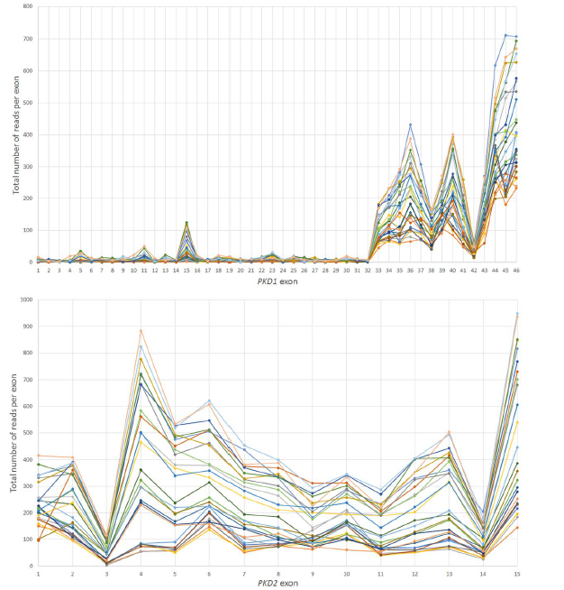
PKD1 mutation screening has been challenging
Large size
High guanine–cytosine (GC) content
Complexity
first 33 exons duplicated in 6 pseudogenes
with ≈ 98% DNA sequence identity
Genetic analysis of PKD2 is relatively easy
Song et al, Expert Rev Mol Diagn 2017
Ali et al, Sci Rep 2019
Notes:
The high level of DNA
sequence identity with the pseudogenes creates the possibility
for both false positive and negative genotype calls
because a pseudogene mutation can be incorrectly called
as present in PKD1, and a PKD1 mutation can be missed if
the signal is overwhelmed by the normal sequence in
the pseudogenes when DNA capture assay is used
Mutation-based molecular diagnostics of ADPKD is complicated by the presence of six PKD1 pseudogenes with high DNA sequence identify.

Slide 4


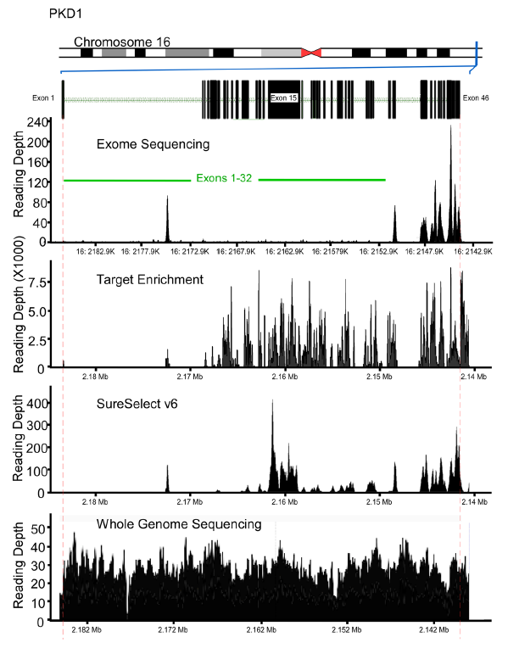
Gold standard
Long range PCR
Sanger sequencing
Large gene rearrangements account for 4% of mutations and are missed by Sanger sequencing
labor-intensive + costly
Next Generation Sequencing (NGS) technology
whole exome sequencing (WES)
whole genome sequencing (WGS)
targeted enrichment methodologies
Ali et al, Sci Rep 2019
Notes:
Gonidiaki anadiataksi Με τη μέθοδο αλληλούχισης DNA νέας γενεάς NGS
ΑΡΧΙΚΗ
ΠΟΙΟΙ ΕΙΜΑΣΤΕ
ΓΟΝΙΔΙΑΚΟΙ ΕΛΕΓΧΟΙ
ΕΠΙΚΟΙΝΩΝΙΑ
Μητροπόλεως 39, Θεσσαλονίκη, 546 23 (3ος όροφος)
+30 2314 000 487
Ανάλυση όλου του γονιδιώματος WES και WGS
Home
Ανάλυση όλου του γονιδιώματος WES και WGS
WES και WGS μέσω NGS – Η Αλληλούχιση Επόμενης Γενιάς για την Διάγνωση Σπάνιων Κληρονομούμενων Νοσημάτων
Η αλληλούχιση επόμενης γενιάς (NGS) μπορεί να χρησιμοποιηθεί σε διάφορα επίπεδα πολυπλοκότητας. Αυτά περιλαμβάνουν αλληλούχιση επιλεγμένων γονιδίων (πάνελ) που σχετίζονται με κάποια ασθένεια (Disease-targeted gene panel), αλληλούχιση των εξονίων όλων των γονιδίων του γονιδιώματος και κλινική ανάλυση 100 X (Clinical Whole Exome Sequencing-WES 100 X) και αλληλούχιση όλου του γονιδιώματος (Whole Genome Sequencing-WGS).
Με τη μέθοδο αλληλούχισης DNA νέας γενεάς NGS, και συγκεκριμένα με την κλινική αλληλούχιση όλων των εξονίων του γονιδιώματος (Clinical Grade Whole Exome Sequencing, WES), είναι δυνατόν να μελετηθούν με ακρίβεια τα σημεία θραύσης των γενετικών ανωμαλιών. Συγκεκριμένα, με τη μέθοδο αυτή έχουν ανακαλυφθεί επιπρόσθετες χρωμοσωμικές πολυπλοκότητες που δεν μπορούσαν να ανιχνευτούν με τις παραδοσιακές κυτταρογενετικές μεθόδους. Χρωμοσωμικές ανωμαλίες ορίζονται ως oι οποιεσδήποτε αλλαγές στον αριθμό (αριθμητικές χρωμοσωμικές ανωμαλίες) ή τη δομή των χρωμοσωμάτων (δομικές χρωμοσωμικές ανωμαλίες). Οι αριθμητικές χρωμοσωμικές ανωμαλίες κατατάσσονται σε ανευπλοειδίες, όπως το σύνδρομο Down (Τρισωμία 21), και πολυπλοειδίες, όπως τριπλοειδίες, και τετραπλοειδίες. Οι δομικές χρωμοσωμικές ανωμαλίες χωρίζονται σε 2 κατηγορίες, τις ισοζυγισμένες και τις μη ισοζυγισμένες. Στις μη ισοζυγισμένες περιλαμβάνονται οι αναδιατάξεις που οδηγούν σε αλλαγή στην ποσότητα του γενετικού υλικού όπως για παράδειγμα οι ελλείψεις και οι διπλασιασμοί και έχουν συνήθως επιπτώσεις στο φαινότυπο. Οι ισοζυγισμένες περιλαμβάνουν αναδιατάξεις που δεν προκαλούν προσθήκη ή απώλεια γενετικού υλικού. Παραδείγματα ισοζυγισμένων αναδιατάξεων είναι οι αναστροφές κατά τις οποίες ένα τμήμα του χρωμοσώματος αλλάζει φορά 180o και οι μετατοπίσεις όπου σημεία θραύσης σε χρωμοσώματα δημιουργούν τμήματα που μετατοπίζονται σε άλλα ομόλογα ή μη ομόλογα χρωμοσώματα. Η πιο συχνή κατηγορία ισοζυγισμένων αναδιατάξεων είναι οι μετατοπίσεις. Το μεγαλύτερο ποσοστό φορέων με φαινομενικά ισοζυγισμένες μετατοπίσεις είναι φαινοτυπικά υγιείς. Ωστόσο συχνά συναντώνται και ανώμαλα φαινοτυπικά χαρακτηριστικά όπως νοητική υστέρηση, πολλαπλές συγγενείς ανωμαλίες και άλλες αναπτυξιακές ανωμαλίες. Επίσης, ισοζυγισμένες μετατοπίσεις μπορούν να μεταβιβαστούν στους απογόνους φορέων σε μη ισορροπημένη μορφή με αποτέλεσμα να γίνεται σύλληψη εμβρύων με ελλείμματα ή περίσσεια γενετικού υλικού ή να προκαλούνται πολλαπλές αποβολές

Slide 5
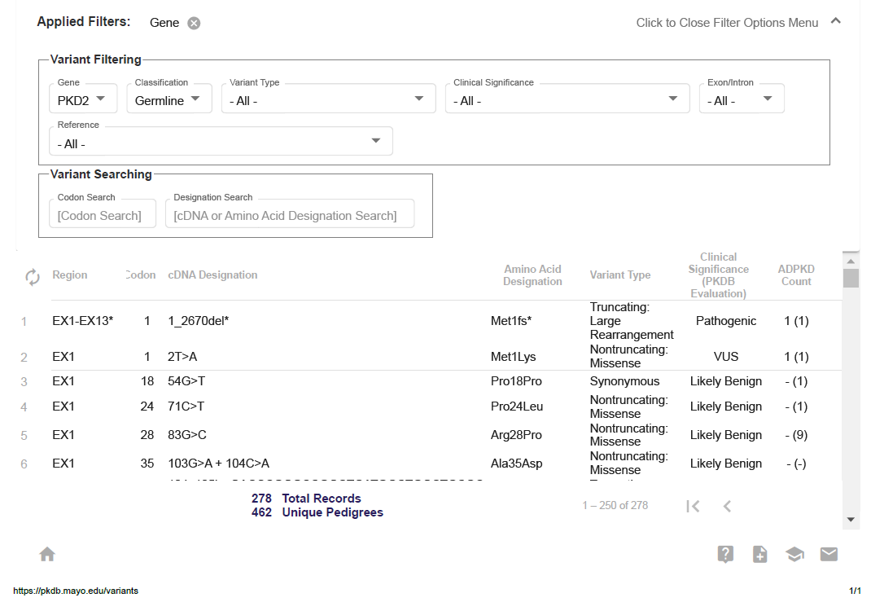
Variant type
- Any Truncating -
- Any Nontruncating -
3'-UTR
5'-UTR
Nontruncating: Deletion/Insertion
Truncating: Deletion/Insertion
IVS Silent
IVS Unknown
Truncating: Large Rearrangement
Nontruncating: Nonstop
Truncating: Nonsense
Truncating: Splice
Nontruncating: Splice
Nontruncating: Missense
Synonymous
Clinical significance
Pathogenic
Likely Pathogenic
Benign
Likely Benign
Variant of Uncertain Significance (VUS)
https://pkdb.mayo.edu/variants
NO single mutation accounts for >2% of cases
HIGH degree of allelic heterogeneity
GENE | GERMLINE | SOMATIC
PKD1 | 2322 Total Records 2077 Unique Pedigrees | 9 Total Records 33 Unique Pedigrees
PKD2 | 278 Total Records 462 Unique Pedigrees | 27 Total Records 43 Unique Pedigrees

Slide 6
Genetic studies in ADPK
Epidemiologic information
Disease mechanisms
Providing prognostic value
Broadening of the phenotypic spectrum of cystic kidney diseases
Genetic Causes of PKD beyond PKD1 and PKD2
Improving diagnostics

Slide 7
Estimating the prevalence of ADPKD has been challenging
variable age-dependent penetrance
incomplete clinical ascertainment in the general population
Prevalence estimates can have important implications for drug development, with orphan diseases defined by a prevalence of <1 per 2000
Epidemiologic studies of clinically ascertained cases of ADPKD reported a point prevalence of 2.4–9.0 per 10,000.
Joly et al, Kidney Int 2015
Cornec-Le Gall Am J Kidney Dis 2017
Willey, Nephrol Dial Transplant 2017
Notes:
Dieisdytikotita
Metablitis, mi statheris
eksakribwsi

Slide 8
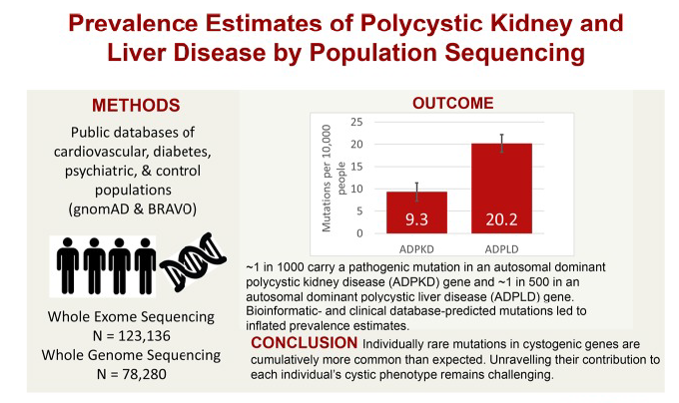
Lanktree et al, J Am Soc Nephrol. 2018

Slide 9
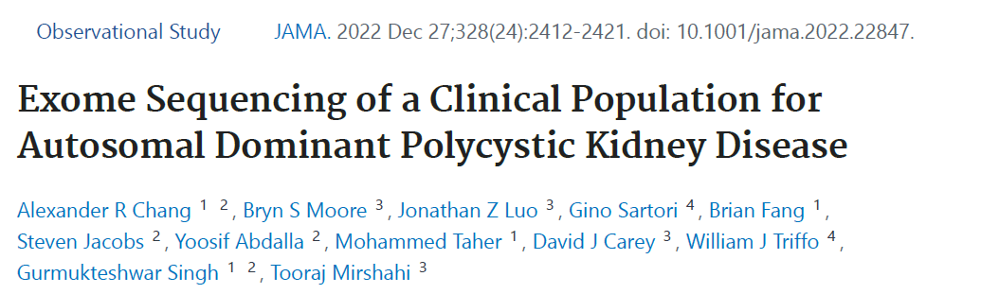
Retrospective observational study using an unselected health system–based cohort with exome sequencing enrolled from 2004 to 2020 and electronic health record data
Of 174 172 patients 303 patients had ADPKD diagnosis codes
1.74:1000

Slide 10
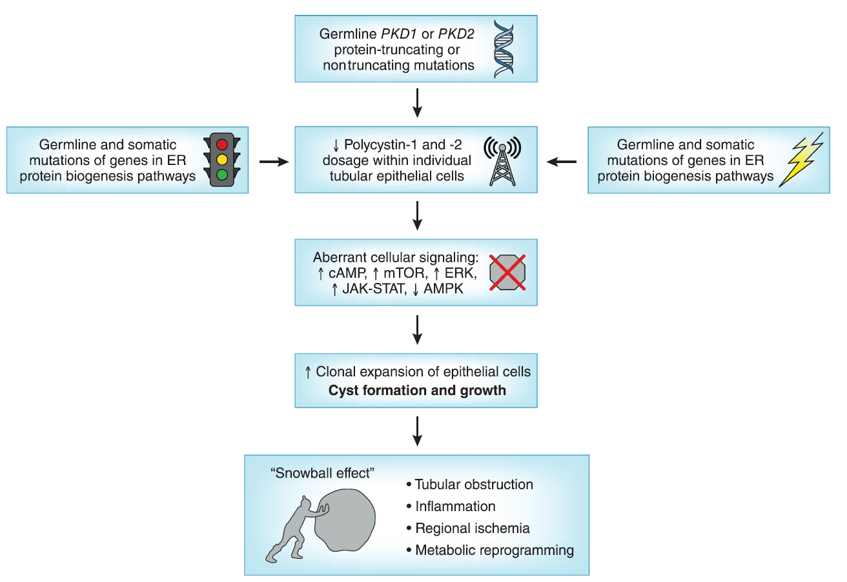
Insights into pathobiology of ADPKD from human and animal genetic studies
Germline mutation
Second-hit
Somatic mutation
Threshold effect
Third-hit model
Gene mutations in endoplasmic reticulum proteins
Lanktree et al, CJASN 2021

Slide 11
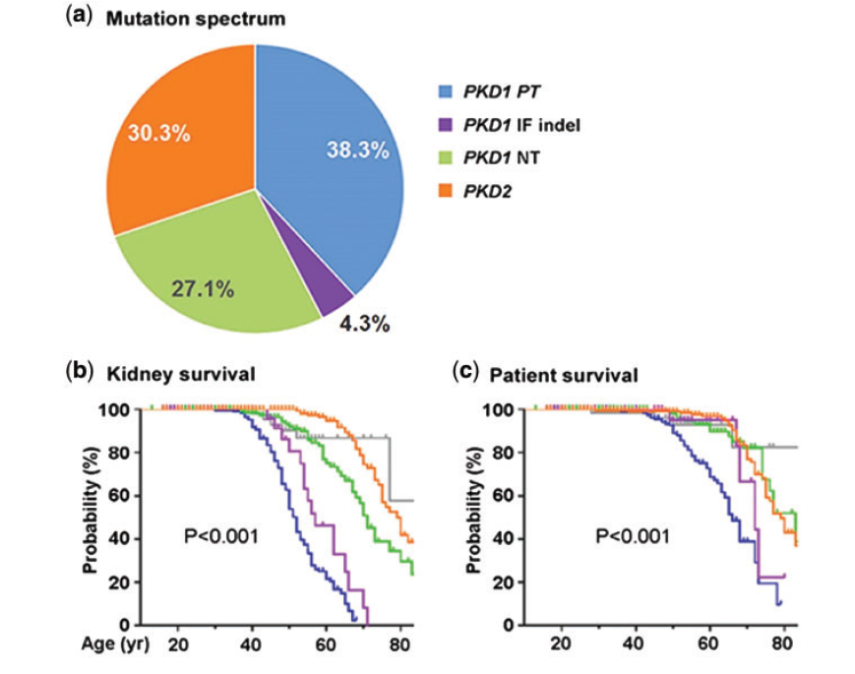
Mutation class predicts disease variability
Cornec-Le Gall, J Am Soc Nephrol 2013
Heyer et al, J Am Soc Nephrol 2016
Hwang et al, J Am Soc Nephrol 2016
Cornec-Le Gall et al, J Am Soc Nephrol 2018
Protein-truncating PKD1 mutations
frameshift, nonsense, canonical splice site and large deletions
Nontruncating PKD1mutations
Missense, in-frame insertions/deletions
PKD2 mutations
Notes:
Antikatastasi, apaloifi, enthesi, antistrofi, diplasiasmos

Slide 12
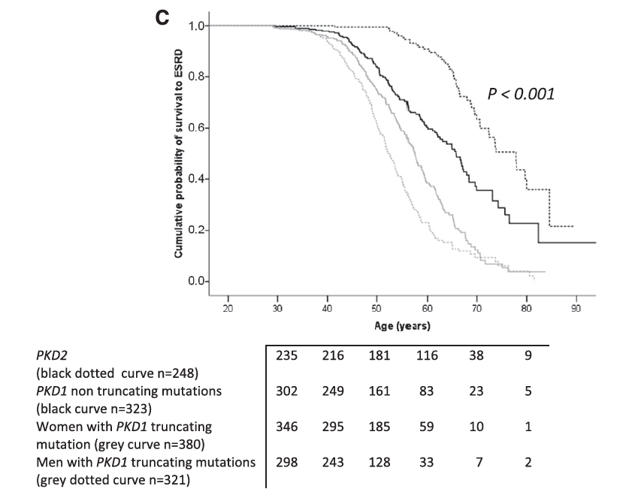
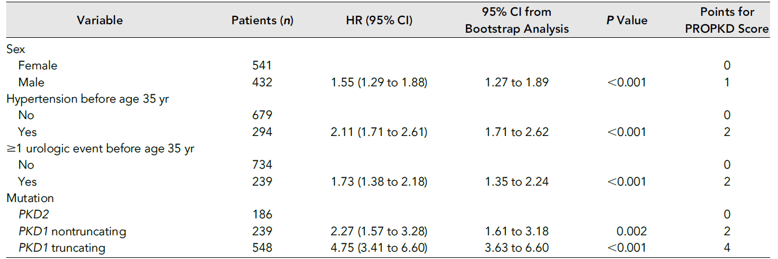
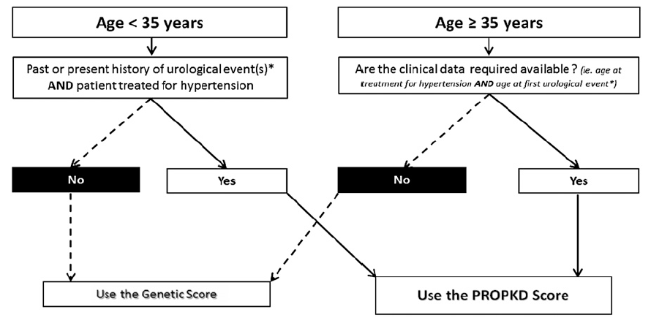
Incorporation of clinical risk factors with genetic results may further improve risk stratification in ADPKD as exemplified by the use of PROPKD (predicting renal outcome in ADPKD) scores.
Cross sectional study
1341 patients from the Genkyst cohort
Influence of clinical and genetic factors on renal survival
GENETIC SCORE
PRO-PKD SCORE
Cornec Le-Gall J Am Soc Nephrol 2016
Notes:
Predicting renal outcomes is, more than ever before, a key
question for the patient and the physician in ADPKD. As
targeted therapies approach, nephrologists should expect to
more patients with milder forms of ADPKD referred to them.
Theywill have the responsibility of determiningwhich patients
should be treated, who can benefit from regular monitoring,
and who should be reassured. We believe that the PROPKD
score will be valuable in assisting with this difficult task. As
illustrated in this study, combining clinical and genetic data to
predict a disease’s evolution aligns perfectly with the entry in
the era of personalized medicine.Age at hypertension onset, age at first urologic complication and the causative mutation all influence renal survival. (A)
Significant difference in renal survival between patients treated for hypertension before 35 years of age (dotted curve, n=357) and
patients who did not receive treatment for hypertension before 35 years of age (black curve, n=788). (B) Significant difference in renal
survival between patients presenting with their first urologic event (gross hematuria, flank pain, or cyst infection) before 35 years of age
(n=294, dotted curve) and patients without any urologic events before that age (n=824, black curve). (C) Significant differences in renal
survival between the PKD2 mutation carriers (genetic group 1, n=248, black dotted curve), PKD1 nontruncating mutation carriers
(genetic group 2, n=322, black curve), women with truncating PKD1 mutations (genetic group 3, n=380, gray curve), and men with
truncating PKD1 mutations (genetic group 4, n=321, gray dotted curve).
0–3, 4–6, and 7–9 points
patients with PKD2 mutations: 1 point; patients with nontruncating
PKD1 mutations: 2 points; women with truncating
PKD1 mutations: 3 points; and men with truncating PKD1
mutations: 4 points (Figure 1D). A genetic score $2 points,
which incorporates the presence of a truncating PKD1 mutation,
predicted ESRD onset before age 65 years with a sensitivity
of 73.8%, a specificity of 74.3%, a PPVof 80.4%, and an
NPV of 66.6%.
The courseof autosomal dominant polycystic kidney disease (ADPKD)variesamongindividuals,with somereaching
ESRD before 40 years of age and others never requiring RRT. In this study, we developed a prognostic model to
predict renal outcomes in patients with ADPKD on the basis of genetic and clinical data. We conducted a crosssectional
study of 1341 patients from theGenkyst cohort and evaluated the influence of clinical and genetic factors
on renal survival. Multivariate survival analysis identified four variables that were significantly associated with age at
ESRDonset,andascoringsystemfrom0to9wasdevelopedas follows:beingmale:1 point; hypertensionbefore 35
years of age: 2 points; first urologic event before 35 years of age: 2 points; PKD2 mutation: 0 points; nontruncating
PKD1 mutation: 2 points; and truncating PKD1 mutation: 4 points. Three risk categories were subsequently defined
as low risk (0–3 points), intermediate risk (4–6 points), and high risk (7–9 points) of progression to ESRD, with
correspondingmedian ages for ESRDonset of 70.6, 56.9, and 49 years, respectively. Whereas a score#3 eliminates
evolution toESRDbefore60years ofagewith anegative predictive valueof81.4%, a score.6forecastsESRDonset
before 60 years of agewith a positive predictive value of 90.9%. This newprognostic score accurately predicts renal
outcomes in patients with ADPKD and may enable the personalization of therapeutic management of ADPKD.

Slide 13
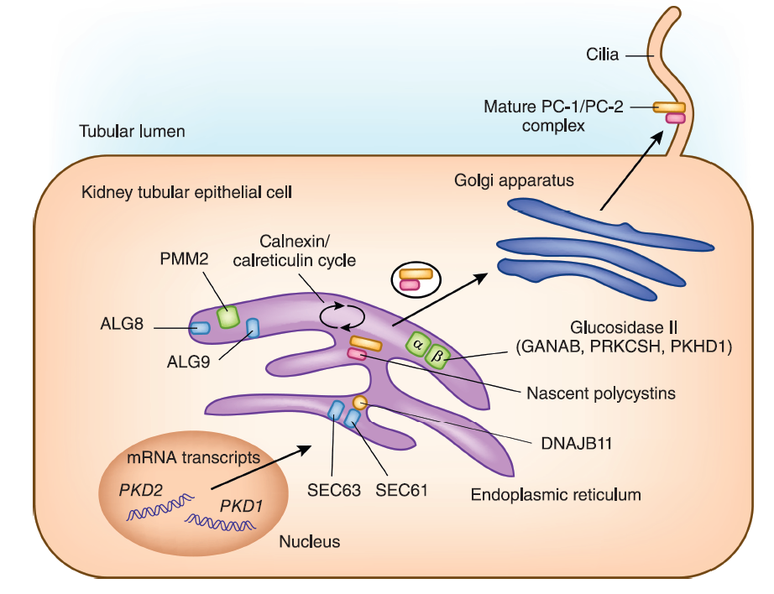
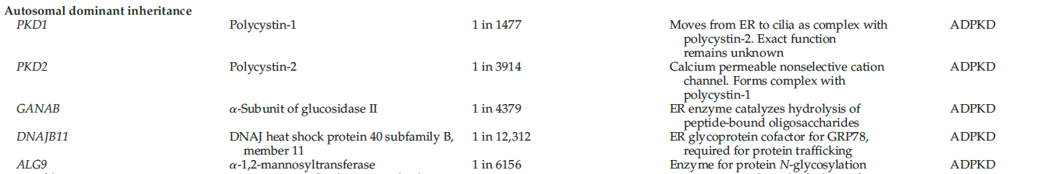
Genetic Causes of PKD beyond PKD1 and PKD2
Whole-exome sequencing identified mutations in rare cystic disease genes in patients who were originally labeled as “no mutation detected”
Poroth et al, Am J Hum Genet 2016
Besse et al, J Am Soc Nephrol 2019
Cornec Le-Gall et al, Am J Hum Genet 2018

Slide 14
Scenarios where genetic testing is clinically indicated
Suspected ADPKD with no apparent family history
Suspected ADPKD with equivocal kidney imaging findings
ADPKD exclusion in young (e.g., ,25 yr old) at-risk subjects
Living related kidney donation evaluation​
Obtaining life or disability insurance​
Prenatal and preimplantation genetic diagnosis
Notes:
Progenitiki
προεμφυτευτική γενετική διάγνωση

Slide 15
ADPKD DIAGNOSIS
positive family history
plus
Ultrasonography
or
MRI in equivocal cases or young at-risk subjects
validated age-dependent diagnostic criteria
No apparent family history in up to 28% of patients suspected to have ADPKD
unavailability of parental medical records
mild PKD unrecognized in an affected parent
genetic and nongenetic causes of renal cystic diseases​
de novo disease​
somatic and germline mosaicism ​
Iliuta et al, J Am Soc Nephrol 2017

Slide 16
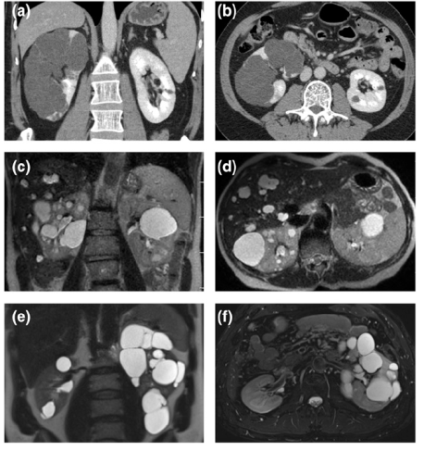
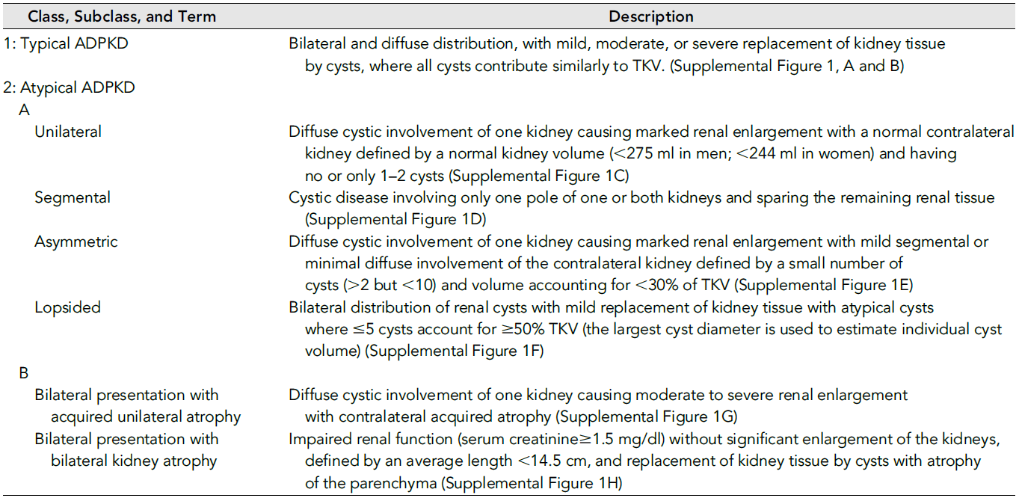
Atypical Kidney Imaging
Present in up to 16% of patients suspected to have ADPKD
Nontruncating PKD1 or PKD2 mutations if positive family history and mild cystic disease
Second kidney disease in patients with moderate to advanced CKD but mild cystic disease without kidney enlargement
Somatic mosaicism if no family history of ADPKD and unilateral, asymmetric, segmental, or lopsided cystic disease
Irazabal et al, J Am Soc Nephrol 2015
Iliutal et al, J Am Soc Nephrol 2017

Slide 17
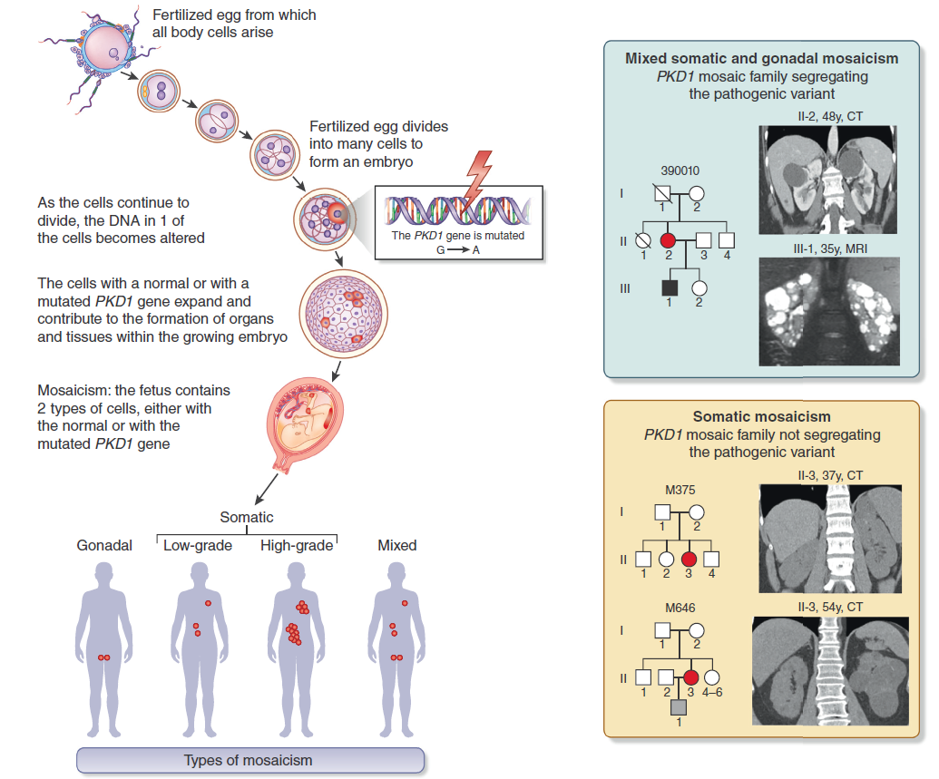
Mosaicism
presence of 2 genetically distinct cell populations within 1 individual resulting from a somatic mutation during embryogenesis
Mosaicism in ADPKD
Readily detectable mosaicism by NGS
1% of typical ADPKD population
10% of genetically unresolved PKD cases
Hopp et al, Kidney Int 2020
Devuyst et al, Kidney Int 2020
Notes:
Mosaicism is defined as the presence of 2 genetically different populations of cells in a single organism, resulting from a mutation during early embryogenesis.

Slide 18
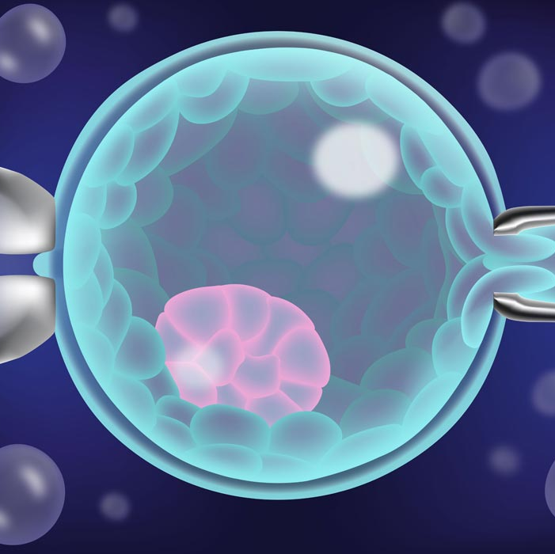
PGD involves extraction, amplification, and analysis of DNA removed from the blastomere or trophectoderm of embryos created using IVF
Affected individuals have a 50% chance of passing the mutation to each of their offspring.
Assisted reproductive technology using preimplantation genetic diagnosis (PGD) allows individuals with PKD to reduce risk to 1% - 2%.
Notes:
Η βιοψία των εμβρύων για PGD συνήθως γίνεται την 3η ημέρα της επώασης όταν τα έμβρυα βρίσκονται μεταξύ 6 και 8 κυττάρων και αρχίζει να εκφράζεται το πατρικό (ανδρικό) γονιδίωμα. Από κάθε έμβρυο απομονώνεται 1-2 κύτταρα και αναλύονται στο γενετικό εργαστήριο. Όσο διαρκεί η ανάλυση των βλαστομεριδίων τα έμβρυα επωάζονται και με βάση το αποτέλεσμα της γενετικής ανάλυσης η εμβρυομεταφορά των υγιών εμβρύων συνήθως πραγματοποιείται την 5η ημέρα επώασης των εμβρύων (δηλαδή στο στάδιο της βλαστοκύστης).
Είναι τεχνική που πρόσφατα άρχισε να εφαρμόζεται. Πλεονέκτημα της βιοψίας βλαστοκύστης είναι η παρουσία και η δυνατότητα αφαίρεσης περισσοτέρων κυττάρων(συνήθως έως 10) και η μικρότερη πιθανότητα τραυματισμού του εμβρύου. Επιπλέον, επειδή τα έμβρυα έχουν την τάση της αυτοδιόρθωσης το αποτέλεσμα από τη λήψη κυττάρων της βλαστοκύστης είναι πιο αντιπροσωπευτικό για την ποιότητα του ίδιου του εμβρύου.

Slide 19
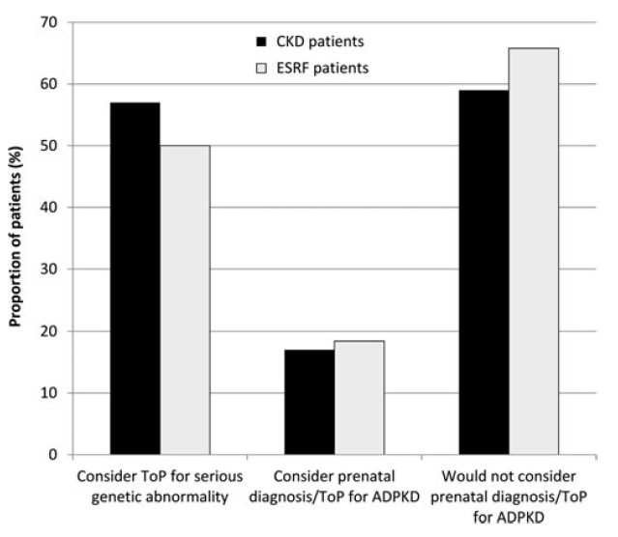
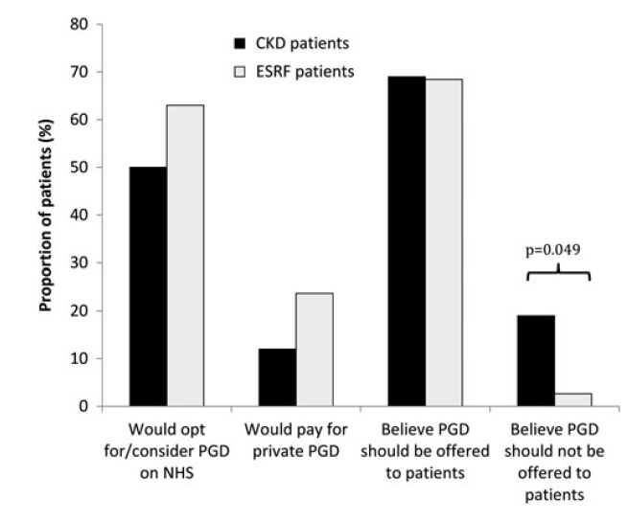
Greater acceptability for diagnostic methods that occur before embryo implantation
Attitudes to prenatal diagnosis and termination of pregnancy in ADPKD patients
Attitudes to PGD in ADPKD patients
Swift et al, Genet Test Mol Biomarkers. 2016

Slide 20
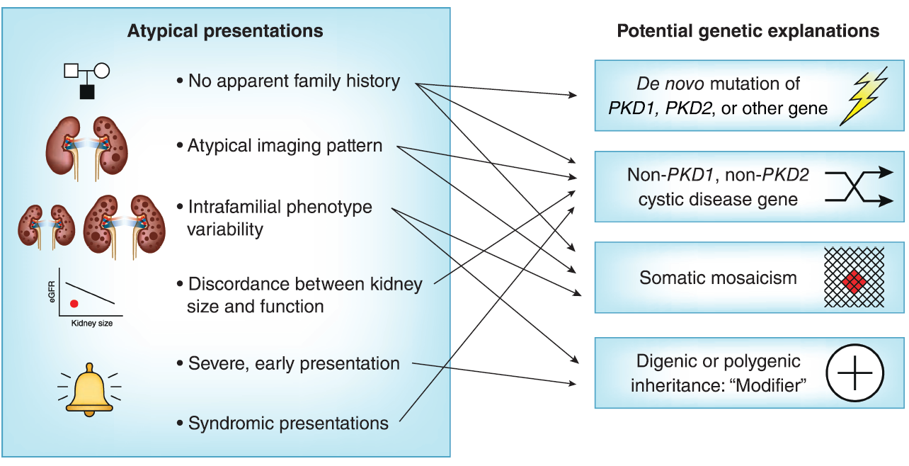
Scenarios with evolving indication for genetic testing
Delineating the cause of atypical clinical presentation
Early and severe disease
Marked intrafamilial disease discordance
Syndromic forms of polycystic kidney disease
Identifying “high-risk” patients for novel disease modifier therapy or clinical trial

Slide 21
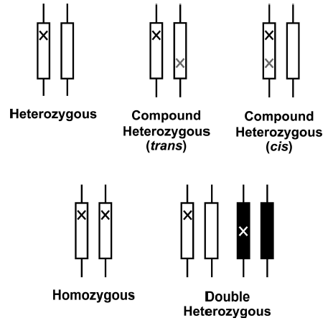
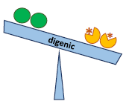
Severe PKD with bilateral kidney enlargement presenting in utero or early childhood can result in ESRD by teenage years or young adulthood
COMPOUND HETEROZYGOSITY
one protein-truncating PKD1 mutation in trans with a second nontruncating PKD1 mutation
DIGENIC DISEASE
one PKD1 mutation and a second mutation in another cystic disease gene, such as PKD2, COL4A1, or HNF1B
Biallelism of fully inactivating PKD1 or PKD2 mutations is not compatible with life
Paterson et al, Am J Hum Genet. 2001
Lanktree et al, CJASN 2021
Notes:
Mutations located on the same chromosome are described as being in the cis position; if they occur one on each homologue they are in the trans position.

Slide 22
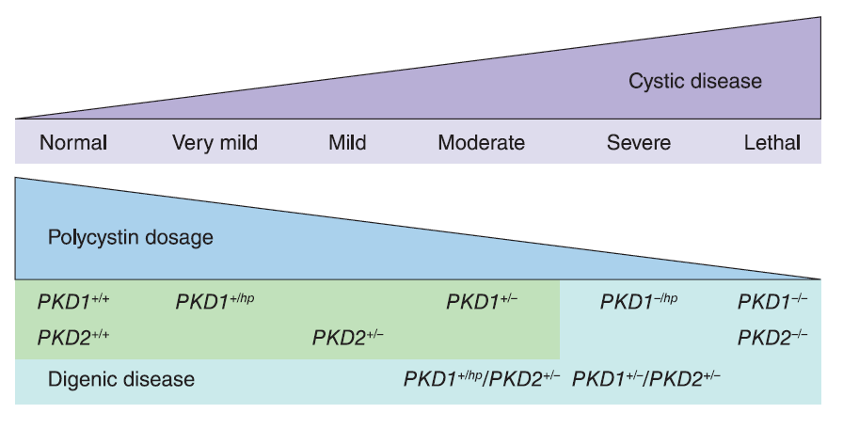
Identification of families with bilineal ADPKD has important implications for genetic counseling
Bilineal disease is predicted to occur in ≈ 1 in 250,000–1,000,000 marriages in the general population
one affected parent may have a mild form of ADPKD due to a nontruncating PKD1 or PKD2 mutation
marked kidney disease discordance between family members
high disease segregation ratio affecting ≈ 75% of children in large pedigrees
Notes:
Asimfonia kai diaxorismos

Slide 23
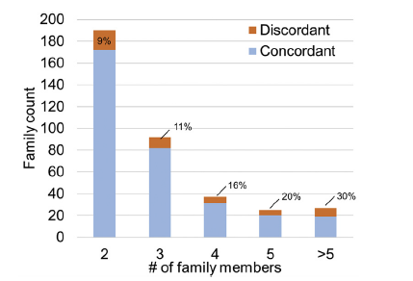
Extreme kidney disease discordance is present in at least 12% of families with ADPKD, regardless of the underlying mutated gene or mutation class.
the extended Toronto Genetic Epidemiology Study of Polycystic Kidney Disease (eTGESP) cohort
1390 patients and 612 unrelated families with ADPKD
Families were defined as discordant if they had at least 1 affected member with mild kidney disease and 1 member with severe kidney disease
Lanktree et al, Kidney Int Rep 2019

Slide 24
Marked intrafamilial disease variability by total kidney volume or eGFR adjusted for age
the presence of an unusual genetic underpinning
somatic mosaicism or digenic disease
coincidence of a second kidney disease
diabetes or glomerulonephritis
comorbidities
hypertension and obesity
environmental factors
smoking and water intake

Slide 25

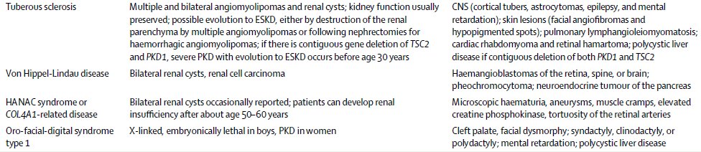
Syndromic forms of PKD

Slide 26
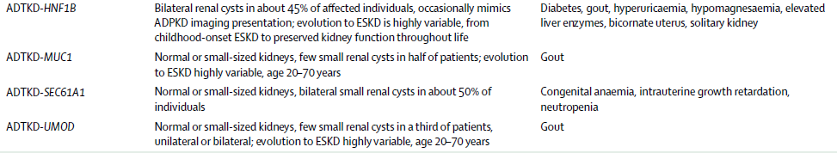
ADTKD-associated genes

Slide 27
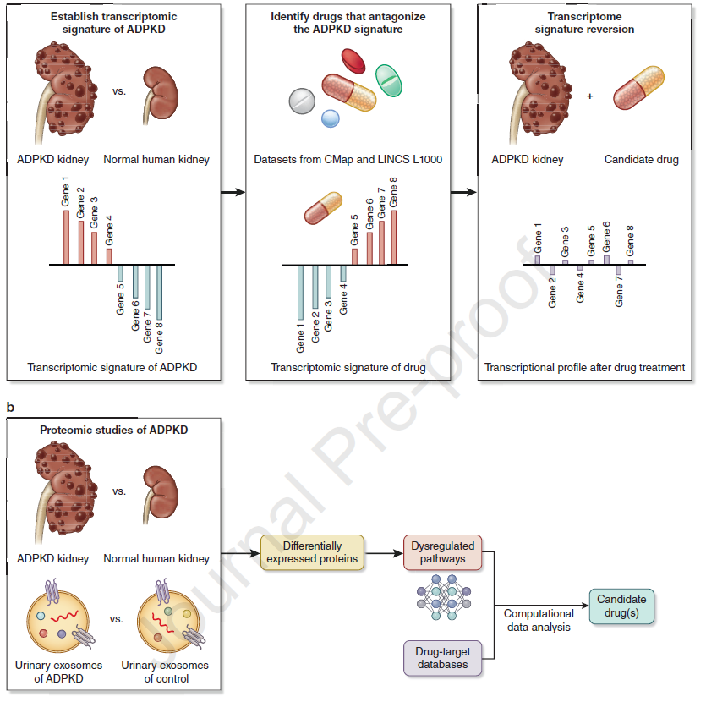
Drug repurposing in ADPKD
GWAS
Transcriptional gene profiling
Investigation of the genomic data and integrating GWAS with other “omics” datasets might assist to identify compounds for repurposing in ADPKD
Xou et al, Kidney Int 2023

Slide 28

Patient Voice
What will I do with the information once I have it?​
Will it prevent me from obtaining medical or life insurance?​
Am I better off knowing or not knowing?​
Can I financially afford the test?
Lifestyle and Medication Intervention
Family Planning
Living donation
Increased Knowledge About ADPKD
Legal Protection​
Insurance​
Emotional support

Slide 29
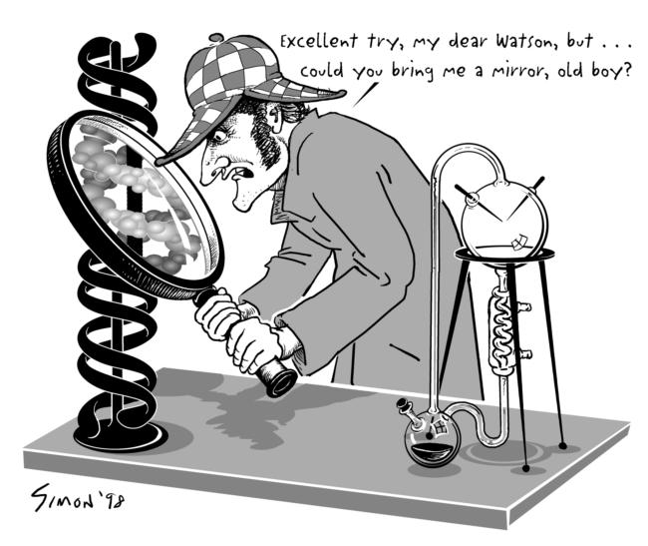

Slide 30
All patients with ADPKD who might consider having children in the future should be counseled about family planning and reproductive options.
The decision to pursue or decline assisted reproductive technology or prenatal diagnosis of ADPKD is a personal choice based on patient beliefs, experience, and preferences.
High risk disease factors may lead to patient interest in PGD.
Murphy et al, Am J Kidney Dis 2018

Slide 31
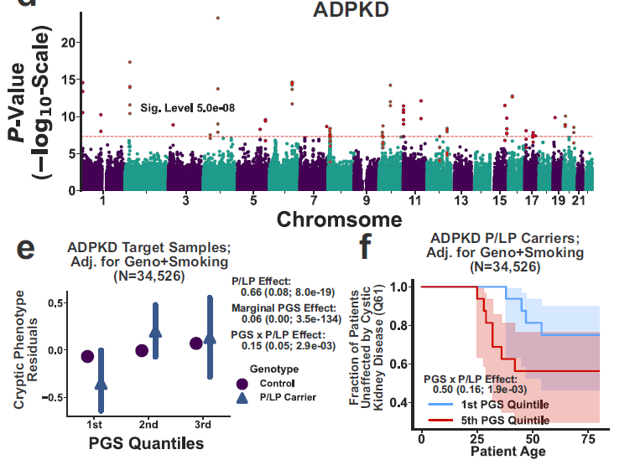
Cryptic phenotype analysis uses statistical modeling to infer quantitative traits that summarize disease-related phenotypic variability.
These traits are estimated using symptoms documented in the electronic medical record.
GWAS analyses for cryptic phenotypes, uncover common variation that is predictive of Mendelian disease-related diagnoses and outcomes.
GWAS for ADPKD uncovered 30 loci, most associated with blood pressure regulation.
The cryptic phenotype polygenic scores (PGS) based on the associated loci was associated with the progression but not the diagnosis of ADPKD
Blair et al, Nat Commun 2022
Notes:
Cryptic phenotype analysis (CPA) uses statistical modeling to infer quantitative traits that summarize disease-related phenotypic variability (metavlitotita). These traits are estimated using symptoms documented in the electronic medical record (EMRNa symperanei, na synagei – to infer

Slide 32
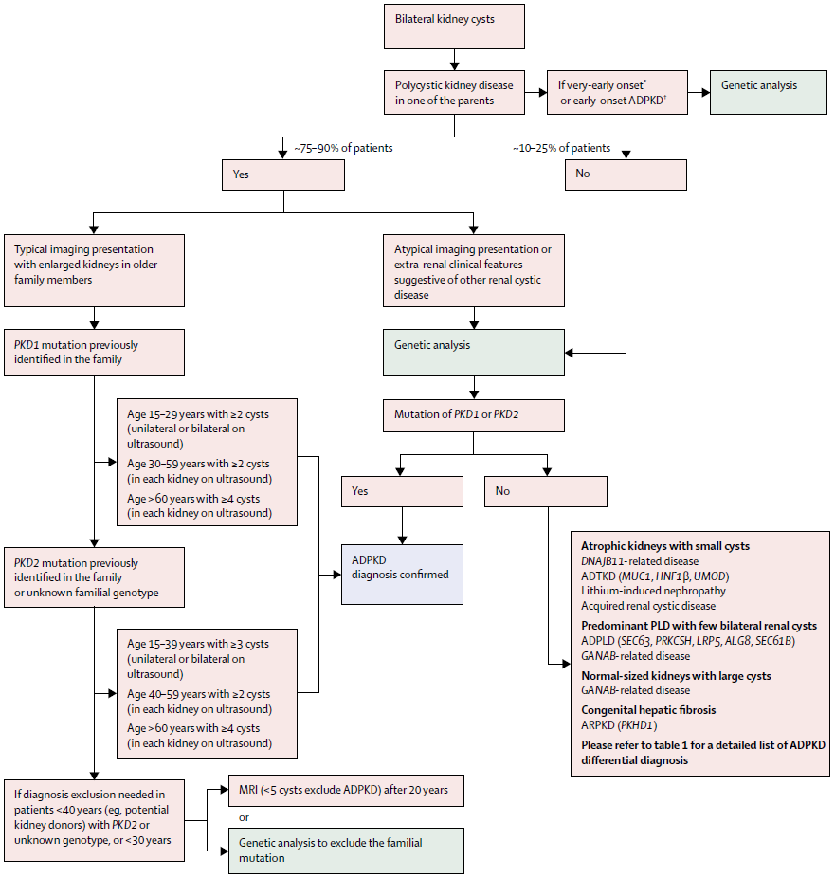
Cornec-Le Gall et al, Lancet 2019

Slide 33
disease-modifying treatments in the pediatric population are
lacking and obtaining a diagnosis in a presymptomatic state can
be associated with emotional and psychological stress, we do
not encourage screening beyond blood pressure measurement
in pediatric cases. All subjects interested in undergoing genetic
testing for ADPKD should be informed of the potential for genetic
discrimination or protection from genetic discrimination,
which varies fromcountry to country

Slide 34
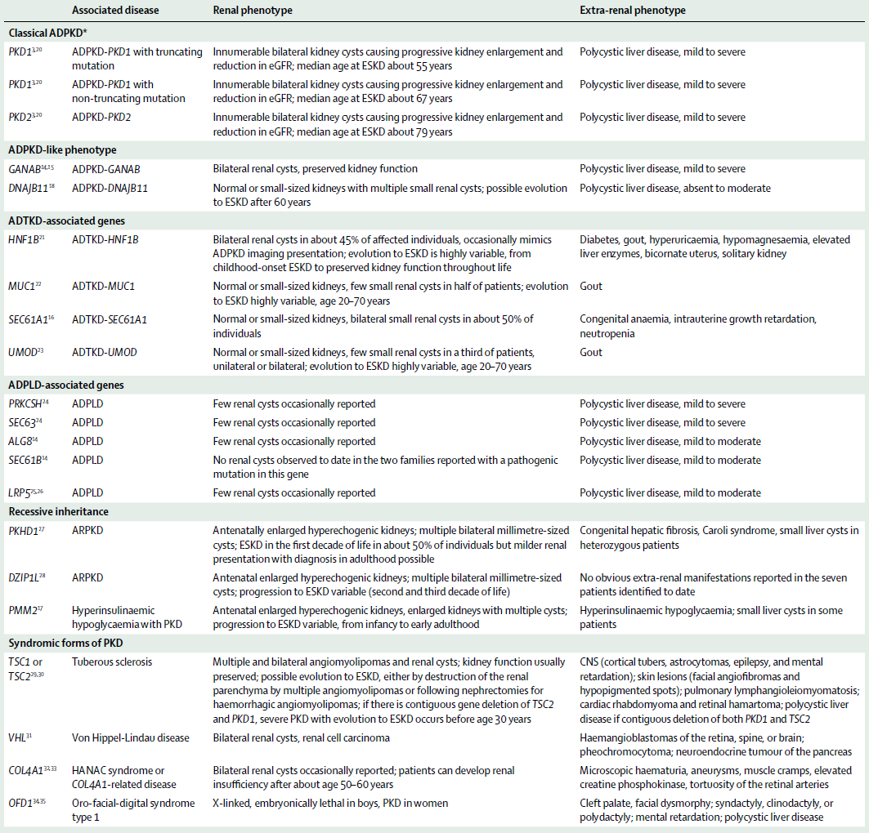
Differential diagnosis in ADPKD genotypes

Slide 35
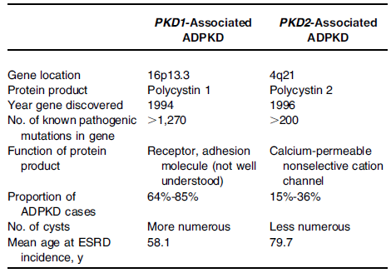
The identification of PKD1 in 1995 and PKD2 in 1996 facilitated the development of DNA sequence–based molecular diagnostics.
Driven by advancements in sequencing technology, our understanding of the complexities of the genetic basis of cystic kidney disease has evolved.
PKD1 and PKD2 genes and transcripts
46 exons
15exons
Hughes et al, Nat Genet 1995
Mochizuki et al, Science 1996
Torres et al, Lancet. 2007
Notes:
The coding regions are shaded; 50 and 30 untranslated regions are not shaded

Slide 36
Evolution of Mutation Screening Technologies in ADPKD
Future improvement of NGS-based molecular diagnostic for ADPKD will need to address several key issues including adequacy of target sequence coverage and read depth (especially in GC-rich regions), accuracy of mapping of raw sequence reads and variant calls to the duplicated region of PKD1 versus its pseudogene(s), and better identification of indels and CNVs.
The use of WGS for molecular genetic diagnosis in ADPKD is promising but needs to be vigorously tested and validated
Song et al, Expert Rev Mol Diagn 2017

Slide 37
Genetic studies in ADPK
Epidemiologic information
Pathobiology mechanisms information
Not all patients with multiple kidney cysts have ADPKD

Slide 38
improving diagnostics
providing prognostic value
broadening the phenotypic spectrum of many kidney diseases

Slide 39
Endoplasmic reticulum maturation and N-glycosylation of nascent polycystin-1 (PC-1) and polycystin-2 (PC-2)
Lanktree et al, CJASN 2021

Slide 40
ADPKD
78% are due to mutations in PKD1
15% of cases are due to mutations in PKD2
0.3% are due to mutations in GANAB
no mutation detected in the remaining cases

Slide 41
Gene linkage testing and direct mutation analysis/DNA sequencing
can determine if you have PKD with a 99 percent probability in those with family history. Linkage testing is not a direct analysis of the DNA sequence of the PKD1 and PKD2 genes. Instead, it relies on the identification of certain “markers” in the DNA of several members of a family in which PKD has been diagnosed. For linkage analysis, blood samples must be obtained from the person being tested as well as several (typically three or more) family members including those affected and unaffected by PKD. A detailed family history is also required. The results are typically reported to all family members that provided blood samples for the analysis
direct DNA sequencing requires only a single sample from you (the person being tested). This method is a direct analysis of the DNA sequences of the PKD1 and PKD2 genes. It is private, and the results are only reported to you and your doctor.
Using very specialized scientific equipment, each of the nearly 17,000 “bases” of DNA are analyzed and the entire sequence is thus determined.
This method is capable of identifying those changes in the sequence that cause PKD.

Slide 42
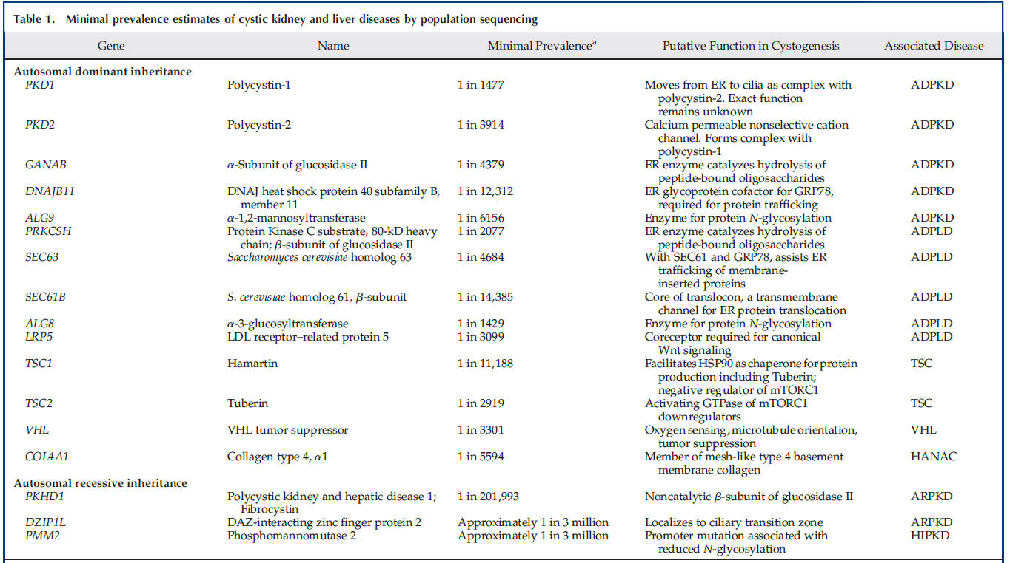

Slide 43
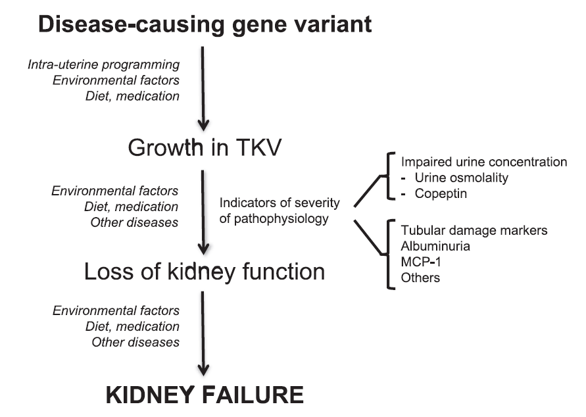
Markers of disease progression and factors contributing to the information contained in these markers
Müller et al, Nephrol Dial Transplant 2022

Slide 44
Mosaicism in ADPKD
Readily detectable mosaicism by NGS
1% of typical ADPKD population
10% of genetically unresolved PKD cases
Clinical findings highly suspicious of
somatic mosaicism
de novo PKD
Mild PKD
Asymmetric PKD
unilateral PKD
Hopp et al, Kidney Int 2020
Devuyst et al, Kidney Int 2020
Notes:
Mosaicism is defined as the presence of 2 genetically different populations of cells in a single organism, resulting from a mutation during early embryogenesis.

Slide 45
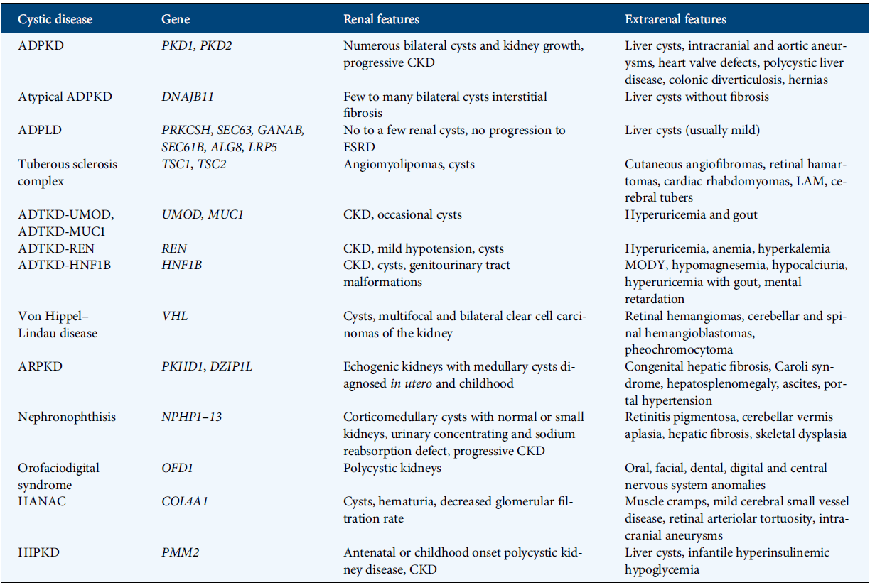
Syndromic Presentation
Differential diagnosis of cystic kidney diseases
Lanktree et al, Nephrol Dial Transplant 2019

Slide 46
The genotype-phenotype relationship in ADPKD is not completely understood
identity of the affected locus (PKD1 vs PKD2 mutation)
allelic variant (truncating, nontruncating, or hypomorphic)
timing of gene inactivation
mosaicism
genetic background

Slide 47
Syndromic Presentation

Slide 48
Marked intrafamilial disease discordance

Slide 49
Early and severe disease

Slide 50
PGD involves extraction, amplification, and analysis of DNA removed from the blastomere or trophectoderm of embryos created using IVF
The accuracy of PGD is highest when DNA analysis includes both direc mutation testing and linkage analysis of polymorphic markers closely linked to the gene of interest to ensure that there is no allelic drop out
Identification of the pathogenic mutation is a prerequisite for PGD. If direct mutation analysis fails to identify a single pathogenic mutation, either because multiple potential pathogenic variants are identified or no mutation is detected, the use of family-based linkage analysis may be required to determine the locus of the pathogenic PKD mutation.
The patient must have a large enough family to support linkage to PKD1 or PKD2.
Murphy et al, Am J Kidney Dis 2018

Slide 51
No Apparent Family History

Slide 52
Scenarios with evolving indication for genetic testing
Identifying “high-risk” patients for novel disease modifier therapy or clinical trial
Delineating the cause of atypical clinical presentation
Early and severe disease
Discrepancy between imaging findings and decrease in kidney function
Asymmetric, unilateral, segmental, or lopsided cystic kidneys
Marked intrafamilial disease discordance
Suspected somatic mosaicism
Syndromic forms of polycystic kidney disease

Slide 53
Atypical kidney imaging

Slide 54
All patients with ADPKD who might consider having children in the future should be counseled about family planning and reproductive options, including PGD and available genetic sservices.
• The decision to pursue or decline assisted reproductive technology or prenatal diagnosis of ADPKD is a personal choice based on patient beliefs, experience, and preferences; either decision should be fully supported.
• Genotype, early-onset hypertension, and large htTKV predict high risk for clinical progression to ESRD.
• Other factors that may lead to patient interest in PGD include family history of aggressive disease manifestations such as intracranial aneurysm rupture or complications of hepatic cysts.
• Initial genetic testing consists of identifying the disease causing mutation. In a minority of patients, no mutation may be identified.
• DNA from additional affected family members may be required to determine the pathogenicity of a PKD gene variant and to increase the accuracy of PGD.
Murphy et al, Am J Kidney Dis 2018

Slide 55
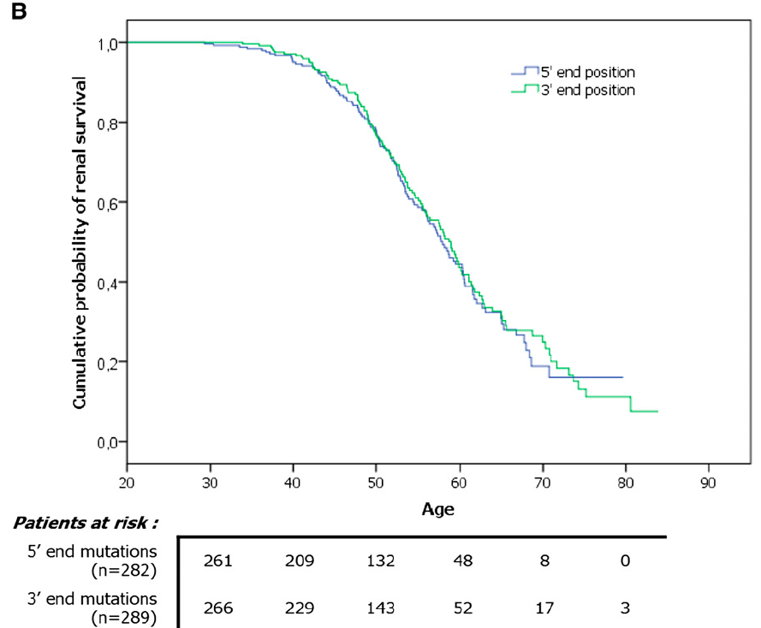
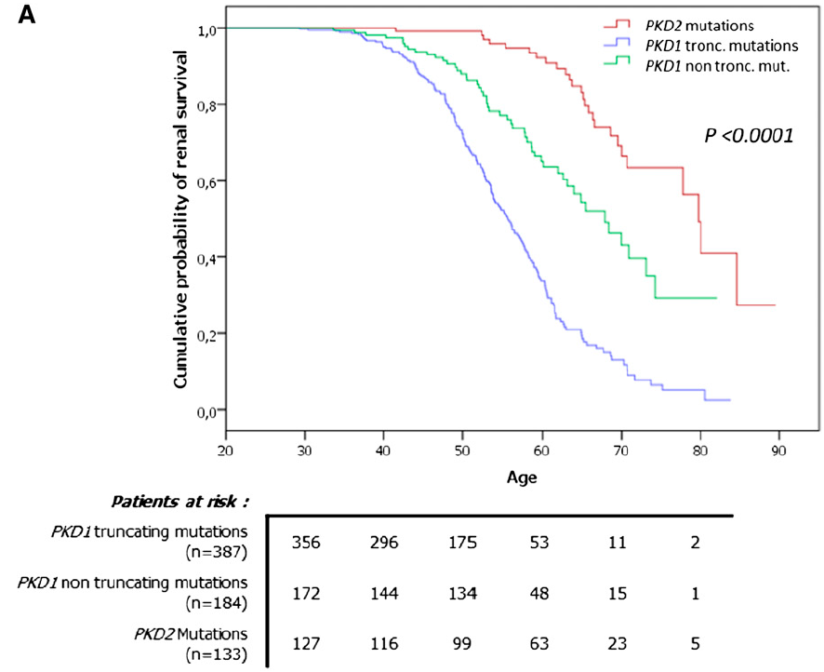
PKD1 mutation type, but not its location, influences renal survival
Patients carrying a truncating PKD1 mutation were 2.74 times more likely to develop ESRD than those carrying a nontruncating PKD1 mutation
Cornec-Le Gall, J Am Soc Nephrol 2013

Slide 56
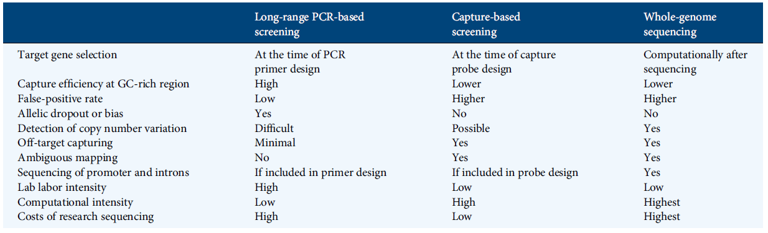
Comparison of NGS methods for PKD mutation screening
Song et al, Expert Rev Mol Diagn 2017
Lanktree et al, Nephrol Dial Transplant 2017
Notes:
Future improvement of NGS-based molecular diagnostic for ADPKD will need to address several key issues including adequacy of target sequence coverage and read depth (especially in GC-rich regions), accuracy of mapping of raw sequence reads and variant calls to the duplicated region of PKD1 versus its pseudogene(s), and better identification of indels and CNVs.
The use of WGS for molecular genetic diagnosis in ADPKD is promising but needs to be vigorously tested and validated

Slide 57
Incomplete penetrance of many nontruncating PKD1 alleles has shown potential prognostic value.
not fully inactivating the protein
associated with milder kidney disease
30%–35% of PKD1 pathogenic alleles are nontruncating, it is a challenge to differentiate pathogenic from neutral changes, and their degree of penetrance.

Slide 58
Atypical Kidney Imaging
Present in up to 16% of patients suspected to have ADPKD
Nontruncating PKD1 or PKD2 mutations if positive family history and mild cystic disease
Second kidney disease in patients with moderate to advanced CKD but mild cystic disease without kidney enlargement
Somatic mosaicism if no family history of ADPKD and unilateral, asymmetric, segmental, or lopsided cystic disease
Irazabal et al, J Am Soc Nephrol 2015
Iliutal et al, J Am Soc Nephrol 2017

Slide 59
de novo PKD with atypical kidney imaging patterns
suspect somatic mosaicism

Slide 60
The diagnosis of mosaicism is challenging due to variable involvement of the affected cells resulting in a low mutation signal-to-noise ratio, and it is frequently missed by Sanger sequencing.
Future studies using “molecular bar coding” of template DNA from different tissues (e.g., buccal mucosa and urinary epithelia) may improve the detection rate of mosaic cases with even lower variant allele fractions (<2% of reads).

Slide 61
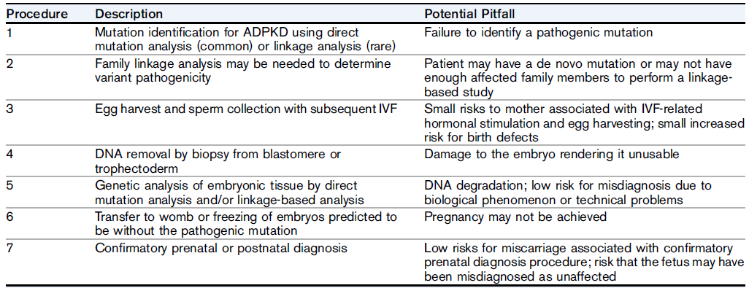
Procedures and Potential Pitfalls of IVF With PGD
Murphy et al, Am J Kidney Dis 2018

Slide 62
Autosomal dominant polycystic kidney disease (ADPKD) is the most common monogenic hereditary kidney disease worldwide affecting all racial groups.
Compex genetic mechanisms underlie the variable clinical presentation.

Slide 63
Effects of digenic disease on functional polycystin dosage and cystic disease severity
“two-hit” model
"threshhold effect"
Lanktree et al, CJASN 2021

Slide 64
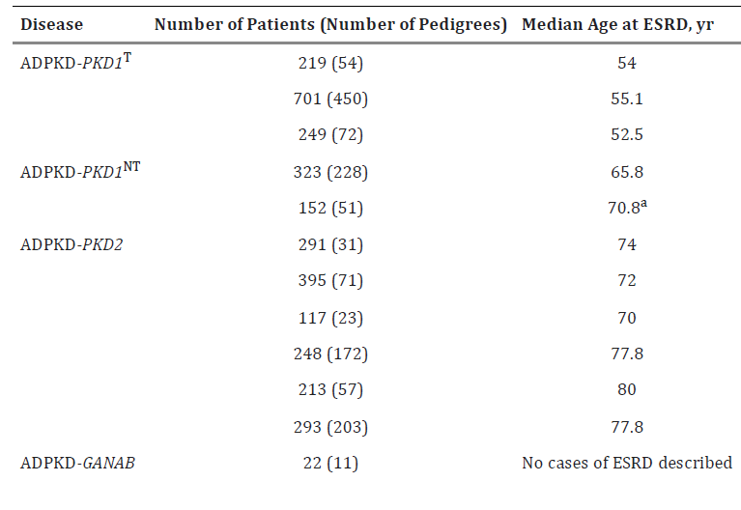
Patients carrying a truncating PKD1 mutation were 2.74 times more likely to develop ESRD than those carrying a nontruncating PKD1 mutation
Cornec-Le Gall, J Am Soc Nephrol 2013
Heyer et al, J Am Soc Nephrol 2016
Hwang et al, J Am Soc Nephrol 2016
Cornec-Le Gall et al, J Am Soc Nephrol 2018
Notes:
The importance of mutation type was confirmed in aCanadian cohort, where ADPKD-
PKD1
patients had larger htTKV, and in the HALT PKD clinical trial, where this group had a lowereGFR.
The reason for this phenotypic effect is that some ADPKD-
PKD1
mutations have residual functional PC1

Slide 65
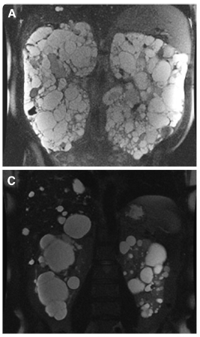
Mutation class predicts disease variability
Protein-truncating PKD1 mutations
frameshift, nonsense, and canonical splice site mutations and large deletions
Nontruncating PKD1mutations
missense and in-frame insertions/deletions
PKD2 mutations
Notes:
Antikatastasi, apaloifi, enthesi, antistrofi, diplasiasmos

Slide 66
The high level of DNA​ sequence identity with the pseudogenes creates the possibility​ or both false positive and negative genotype calls​
a pseudogene mutation can be incorrectly called​ as present in PKD1
a PKD1 mutation can be missed if​ the signal is overwhelmed by the normal sequence in​ the pseudogenes when DNA capture assay is used

Slide 67
Mutation screening of patients with ADPKD with high-risk clinical features for progression
75% carried PKD1 mutations
15% carried PKD2 mutations
at least 10% had no mutation detected
Rossetti et al, J Am Soc Nephrol 2013
Cornec Le-Gall J Am Soc Nephrol 2016
CRISP COHORT
GENKYST COHORT
No identifiable PKD1 or PKD2 mutation 6–11% of patients with PKD despite comprehensive screening.
Mutation screening of patients with normal or near-normal kidney function​
60% carried PKD1 mutations​
25% carried PKD2 mutations​
15% had no mutation detected
Hwang et al, J Am Soc Nephrol 2016
TGESP COHORT

Slide 68
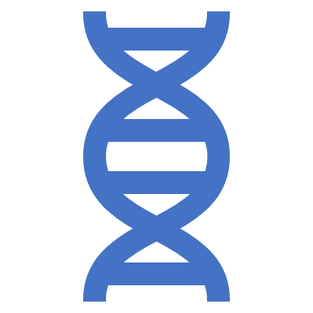
Integrated results of NGS-based PKD genetic screen has the potential
to provide highly accurate risk stratification
to advance personalized precision medicine for ADPKD in the era of mechanism-based therapeutics

Slide 69

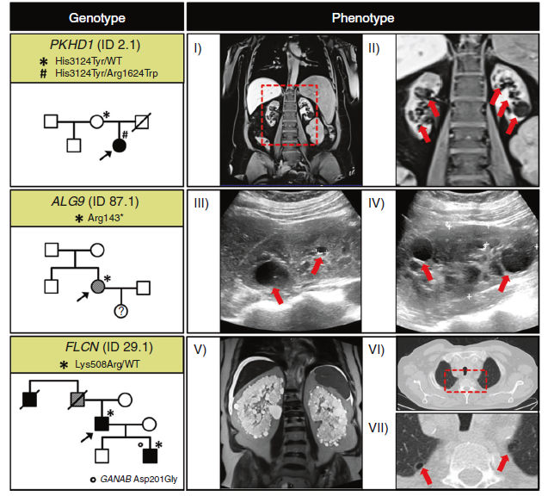
Genetic analysis enables detection of ADPKD phenocopies and excludes PKD1/2-negative patients from potentially harmful treatment.
Patients suffering from conditions such as TSC may need mTOR inhibitor treatment which were not shown to be beneficial in ADPKD.
As TSC and BHDS represent tumor syndromes, disease recognition is crucial for affected families, prompting intrafamilial screening for malignancies.
Schönauer et al, Genetics in Medicine 2020

Slide 70
Clinical scenarios of atypical ADPKD presentations and potential genetic explanations
Lanktree et al, CJASN 2021
Notes:
Poikilia, metablitotita

