Slide 1

Hypertension in ESRD
Vaios Vasileios, MD, PhD
Nephrologist,
2nd Department of Nephrology, School of Medicine, Aristotle University of Thessaloniki, Thessaloniki, Greece

Slide 2

1) Epidemiology

Slide 3
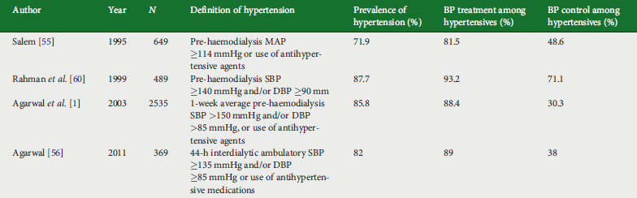
Prevalence, treatment and control of hypertension in HD patients
Sarafidis PA, et al. Nephrol Dial Transplant 2017;32:620-640.

Slide 4
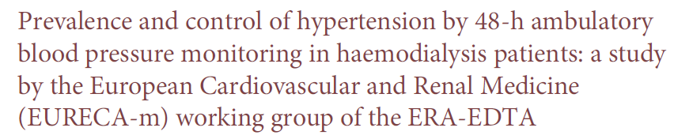
Sarafidis PA, et al. Nephrol Dial Transplant 2019; 34: 1542-48.

Slide 5
Mallamaci F, et al. J Hypertens 2020; 38: 1849-56.

Slide 6
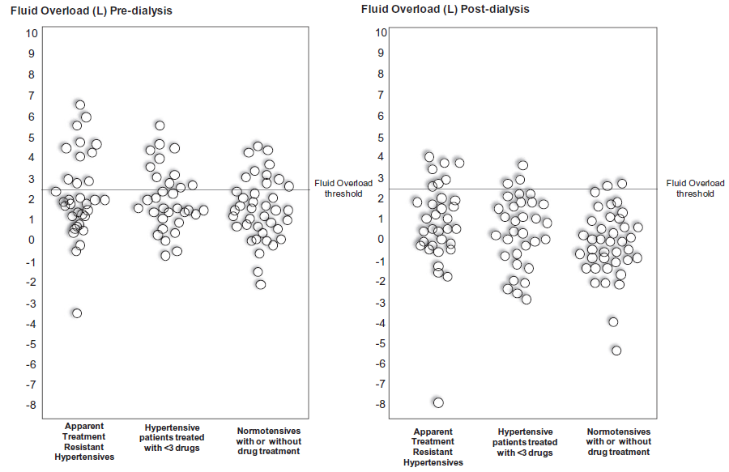
Mallamaci F, et al. J Hypertens 2020; 38: 1849-56.

Slide 7
Vareta G, Georgianos P, Vaios V, Liakopoulos V. Am J Nephrol.2022;53(2-3):139-147

Slide 8
Vareta G, Georgianos P, Vaios V, Liakopoulos V. Am J Nephrol.2022;53(2-3):139-147

Slide 9

2) Diagnosis

Slide 10
Agarwal R, et al. Clin J Am Soc Nephrol 2006;1(3):389-98.

Slide 11

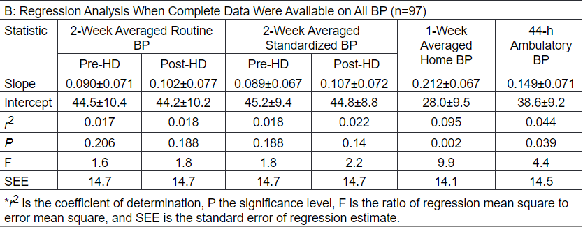
Agarwal R et al. Hypertension. 2006 Jan;47(1):62-8

Slide 12
Agarwal R, et al. Clin J Am Soc Nephrol 2008;3:1364-1372

Slide 13
Agarwal R, et al. Kidney Int 2006; 69(5):900-6.

Slide 14
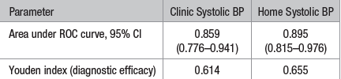
Vaios V, Georgianos PI, Vareta G, Liakopoulos V et al. Hypertension 2019; 74: 998-1004

Slide 15
HBPM in RCTs in HD patients
Georgianos PI & Agarwal R. Am J Kidney Dis 2021; 77:4-6.

Slide 16

3) Blood pressure targets

Slide 17
BP targets in ESRD-Guidelines
2005 K/DOQI guideline:
predialysis and postdialysis BP goals should be <140/90 mmHg and <130/80 mmHg, respectively. (Level C)
2012 KDIGO BP guideline: No recommendation.
2017 AHA/ACG guideline: No recommendation.
2018 ESH/ESC guideline: No recommendation.
2019 K/DOQI commentary on 2017 AHA/ACG guideline: No recommendation.
2021 KDIGO BP guideline: No recommendation.
2023 ESH guideline: No recommendation.

Slide 18
Association of hypertension with mortality in ESRD
Han Yu-Chen, et al. J Hum Hypertens 2019;33:41-49

Slide 19

Alborzi P, et al. Clin J Am Soc Nephrol 2007;2(6):1228-34.

Slide 20
Georgianos PI, Vaios V, Liakopoulos V. J Clin Med 2021; 10(11):2232

Slide 21
CV protection with antihypertensive agents in ESRD (1)
Lambers-Heerspink H, et al. Lancet 2009; 373: 1009–15.

Slide 22
CV protection with antihypertensive agents in ESRD (2)
Agarwal R. & Sinha AJ. Hypertension 2009;53(5):860-6.

Slide 23
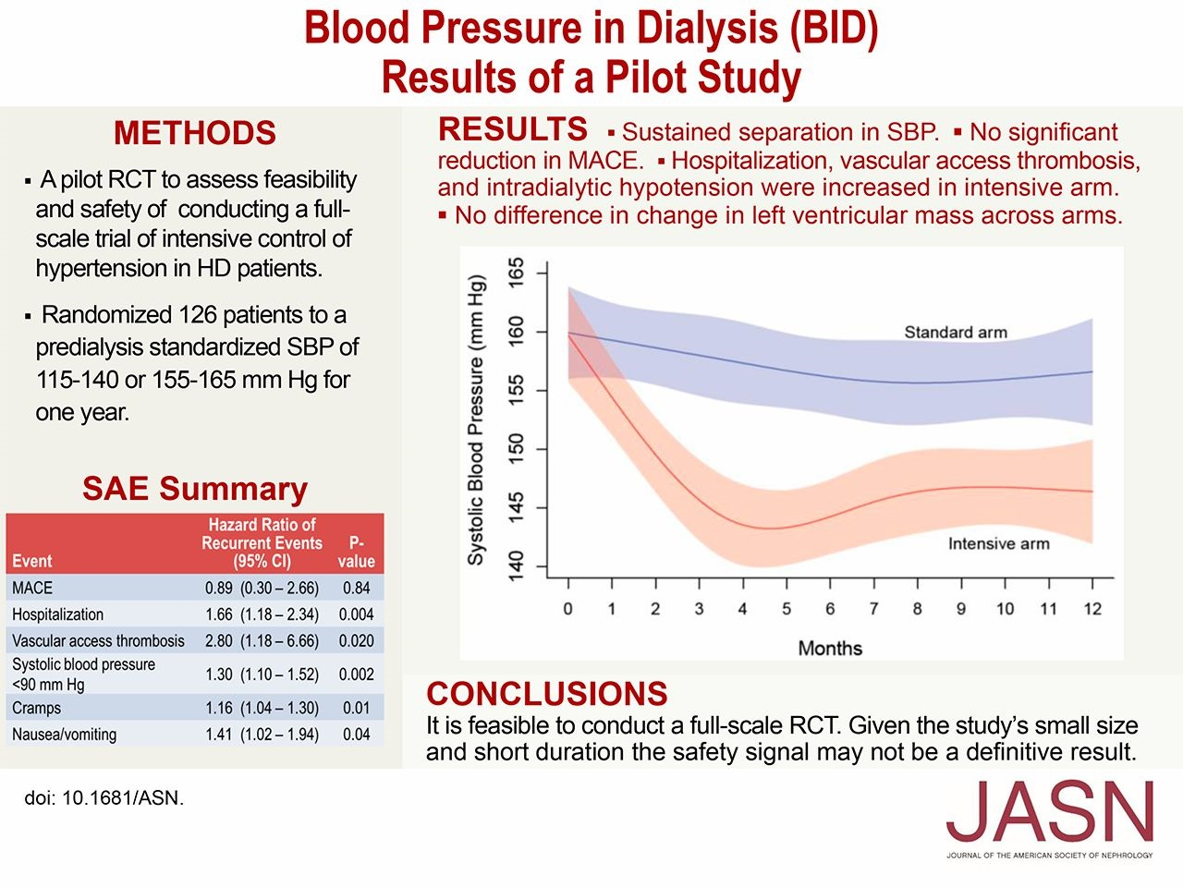
BP targets in dialysis: BID trial
Miskulin D, et al. J Am Soc Nephrol 2018; 29(2):571-578.

Slide 24
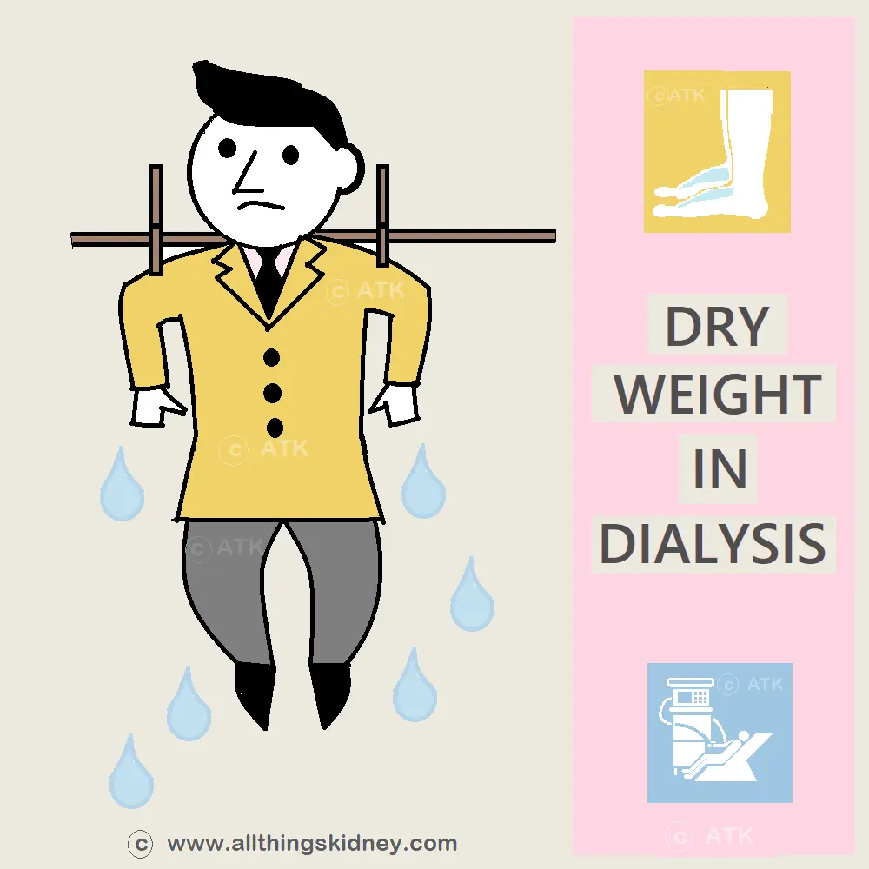
4) Treatment of HTN in ESRD
Non-pharmacological interventions

Slide 25
Volume management strategies
First-line management of hypertension in patients on dialysis should focus on:
achieving dry weight
lowering dietary Na⁺
individualizing dialysate Na⁺ concentrations
ensuring dialysis sessions are of adequate duration
Georgianos PI & Agarwal R. Nat Rev Nephrol 2016;12(10):636-47.

Slide 26
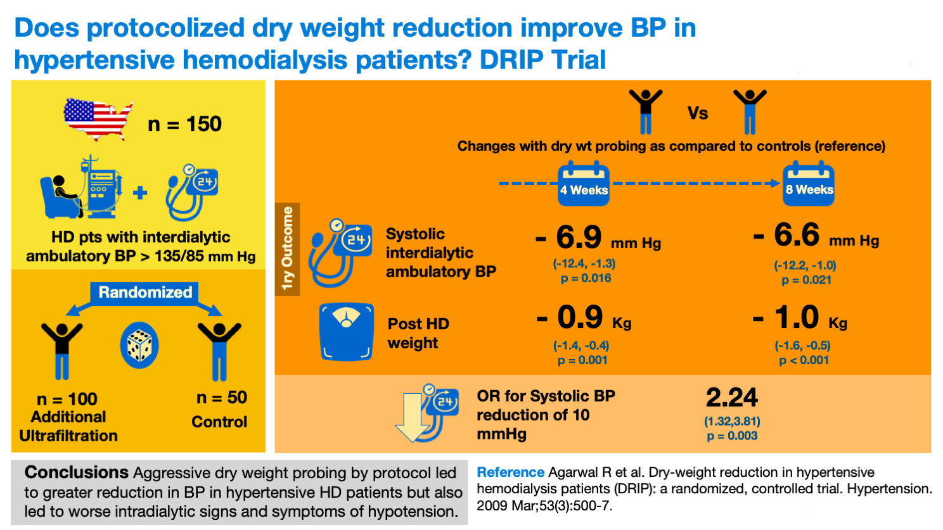
Agarwal R, et al. Hypertension 2009;53(3):500-7.

Slide 27
Cole N, et al. J Hum Hypertens 2019; 33:319-326.

Slide 28
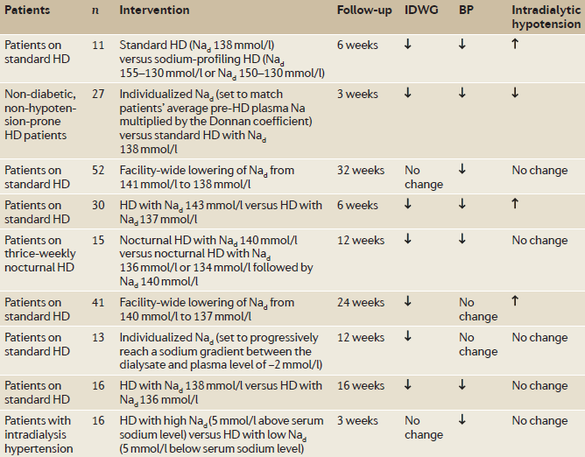
Prescription of dialysate Na⁺ concentration
Georgianos PI & Agarwal R. Nat Rev Nephrol 2016;12(10):636-47.

Slide 29
Tandon T, et al. Nephrol Dial Transplant 2013;28(6):1562-8.

Slide 30

5) Pharmacotherapy

Slide 31
Pharmacotherapy for HTN in ESRD: clinical trial evidence
Georgianos PI & Agarwal R. Nat Rev Nephrol 2016;12(10):636-47.

Slide 32
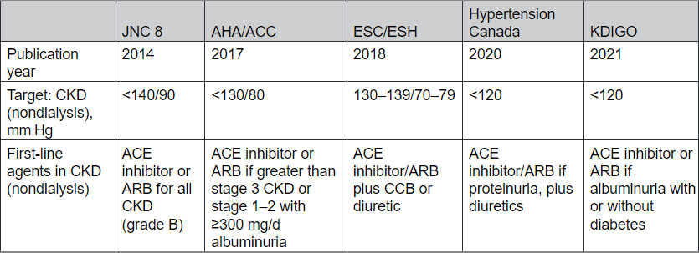
Recommendations for the pharmacotherapy of HTN in predialysis CKD
Bansal N et al. Hypertension. 2023 Jun;80(6):e112-e122.

Slide 33
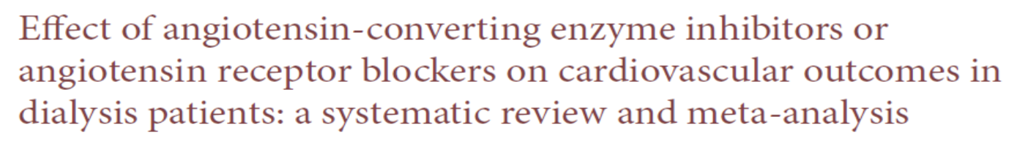
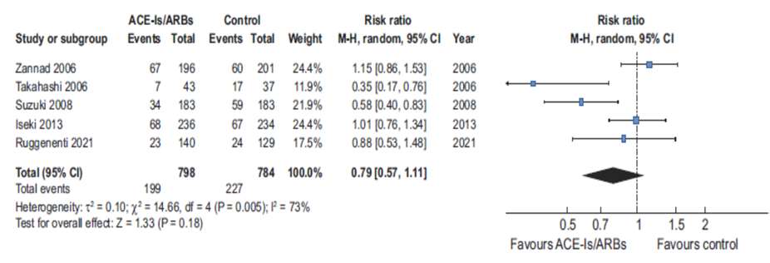
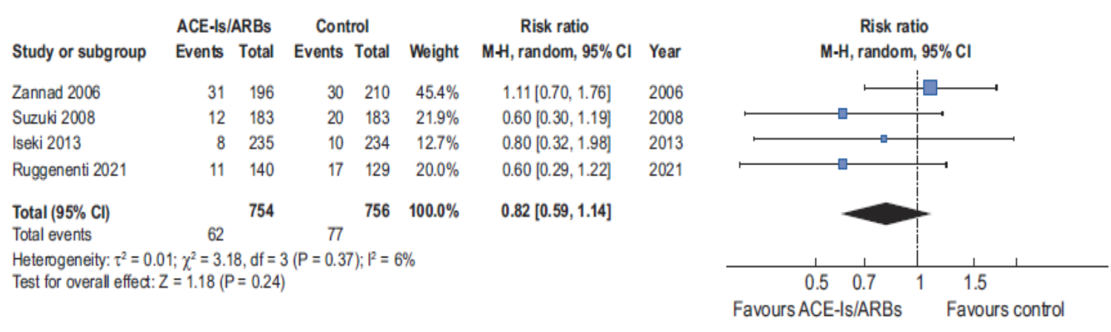
Fatal/non-fatal CV events
CV mortality
Georgianos PI, et al. Nephrol Dial Transplant 2023; 38: 203-211

Slide 34
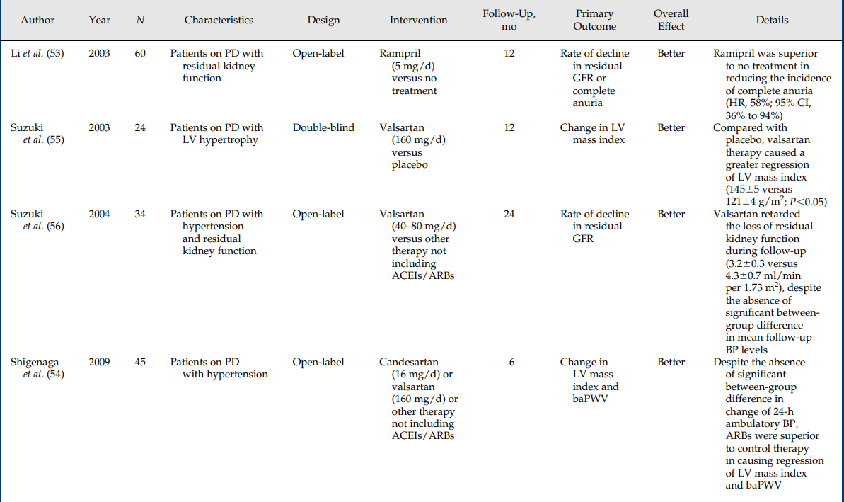
RCTs with ACEIs or ARBs in PD
Vaios V, et al. Clin J Am Soc Nephrol 2019; 14:297-305

Slide 35
Atenolol vs Lisinopril in HD: the HDPAL trial
100: Atenolol TIW
200 HD patients
100: Lisinopril TIW
12-month period
BP monitoring: HBPM (monthly) and 44h interdialytic ABPM (every 3 months)
Primary outcome: between group differences in change from baseline (CFB) to 12 months in LVMI
Agarwal R, et al. Nephrol Dial Transplant 2014; 29: 672-681.

Slide 36
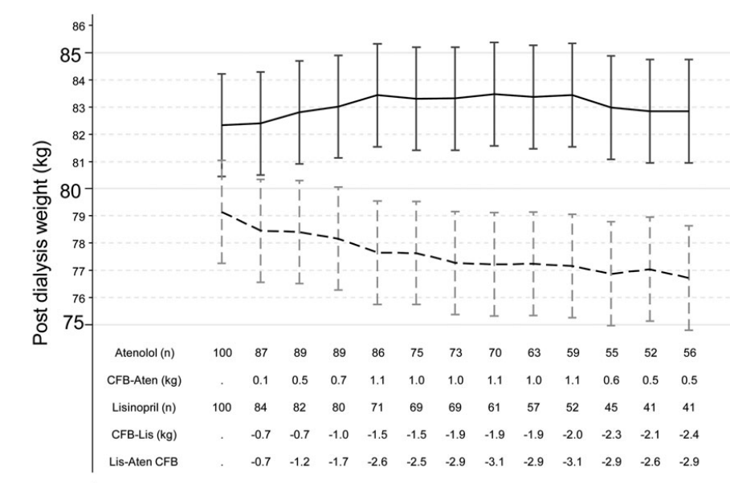
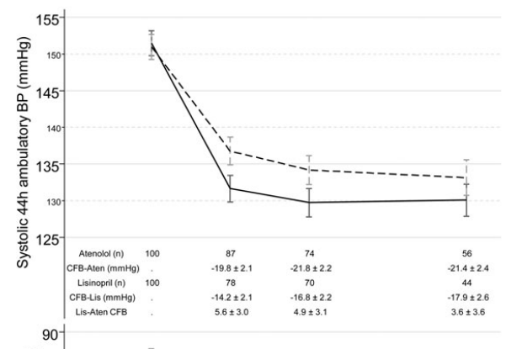
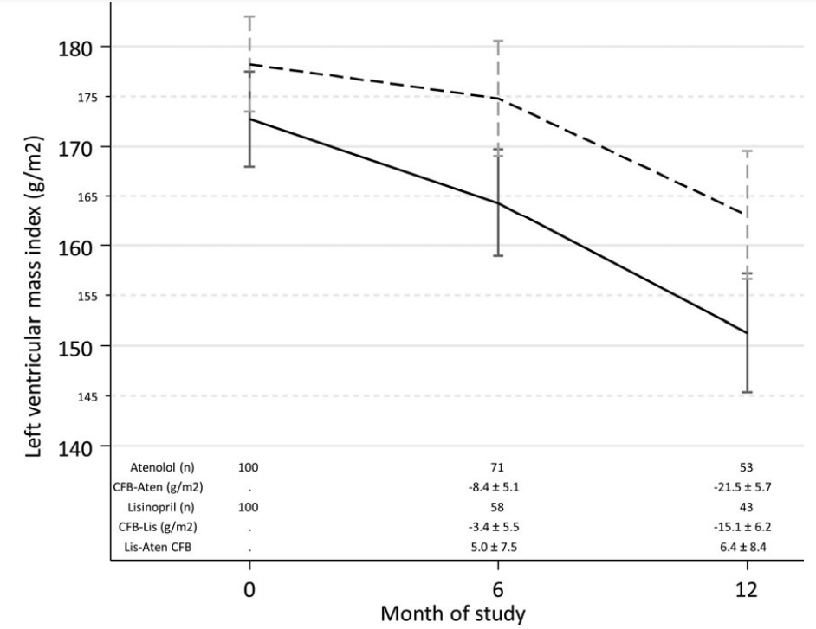
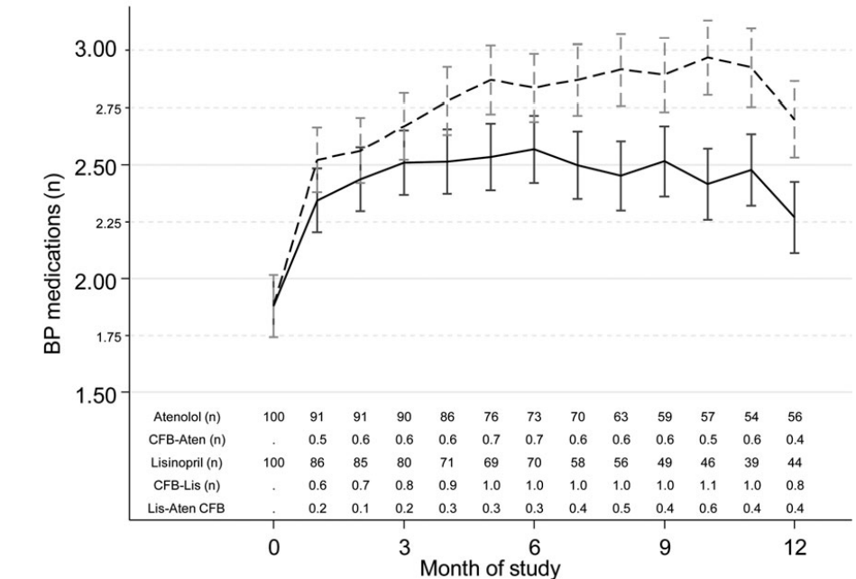

Slide 37
Agarwal R, et al. Nephrol Dial Transplant 2014; 29: 672-681.

Slide 38
Effect of MRAs on CV mortality
Quach K, et al. Am J Kidney Dis 2016; 68: 591-98.

Slide 39
Effect of MRAs on hyperkalemia
Quach K, et al. Am J Kidney Dis 2016; 68: 591-98.

Slide 40
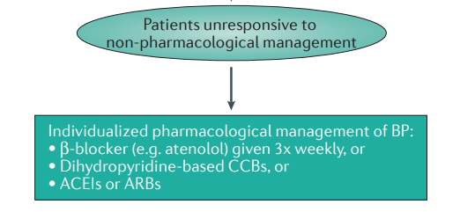
Pharmacotherapy for HTN in ESRD
Georgianos PI & Agarwal R. Nat Rev Nephrol 2016;12(10):636-47.

Slide 41


