Slide 1



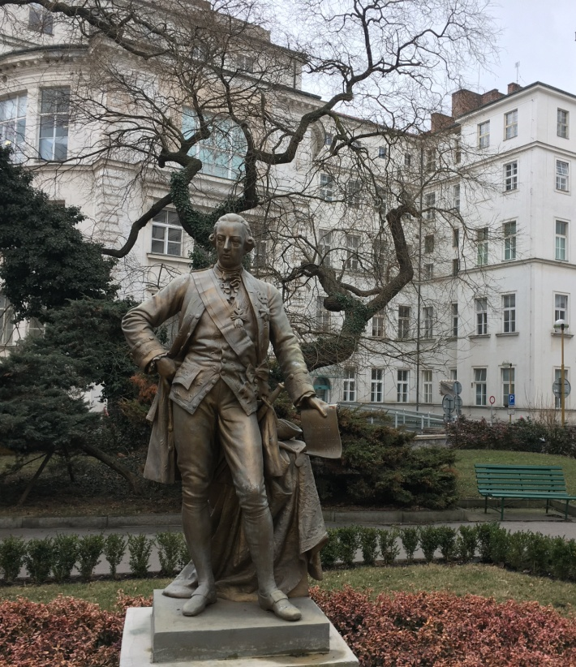

Recent progress in the treatment of lupus nephritis
Vladimir Tesar
Department of Nephrology,
Charles University, Prague

Slide 2

Disclosure of Interests
AstraZeneca,
Bayer,
Boehringer-Ingelheim,
Calliditas
Novartis,
Omeros,
Otsuka
Travere
(consultancy, advisory board)
Notes:
Please disclose financial relationships with any companies (within last 3 years) whose products or services may be broadly related to the topical content of this presentation.
If you have nothing to disclose, state "No relevant disclosures."

Slide 3
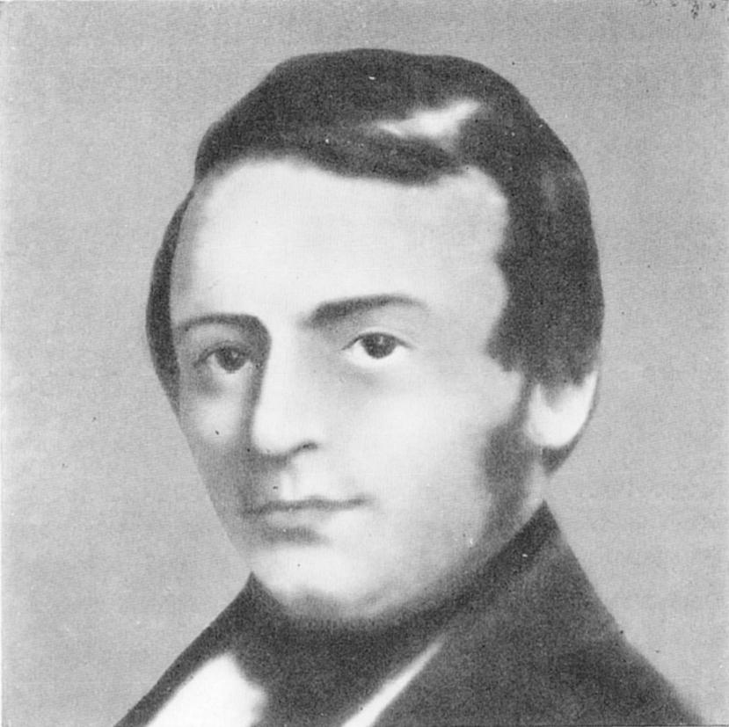
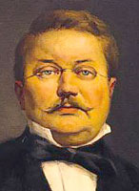
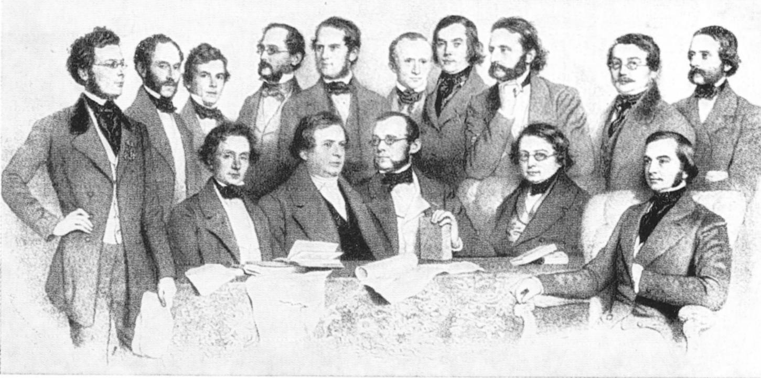
Ferdinand, Ritter von Hebra (1816-1880)
among his colleagues in the University of Vienna
description of lupus vulgaris and erythematosus by Hebra (1856)

Slide 4
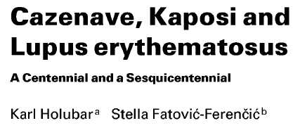

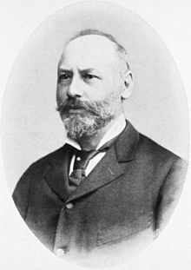
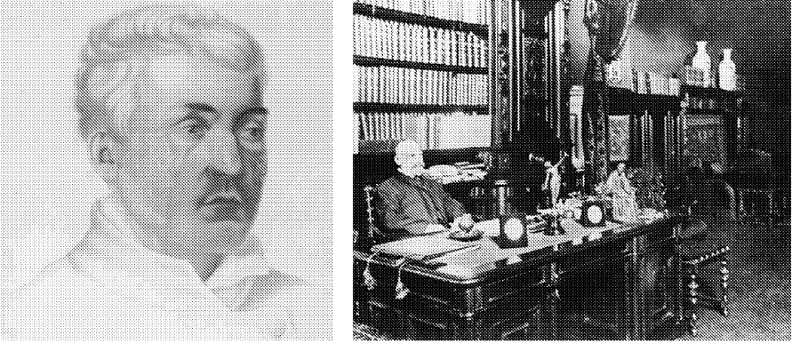
Louis-Alphée Cazenave (1795-1867)
used the term SLE for the first time in 1851
Moritz Kaposi (1837 – 1901)
provided detailed description of organ involvement in SLE

Slide 5
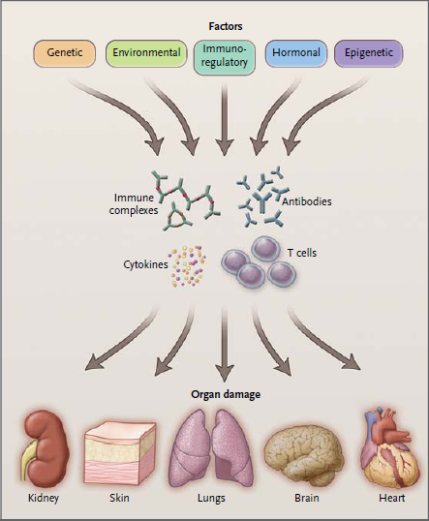


Slide 6
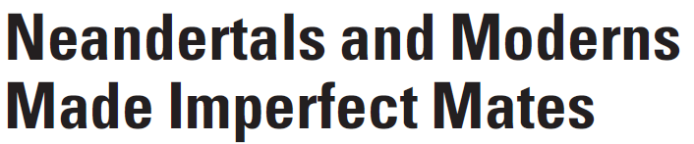

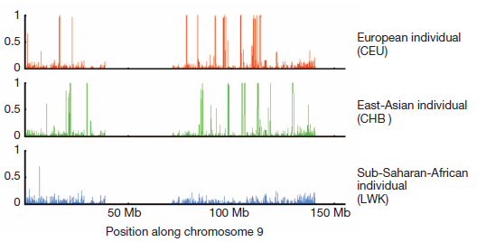
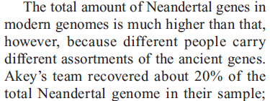


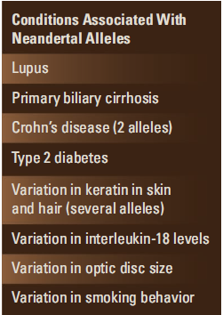


IRF5 –
G allele
enriched
in European
population

Slide 7
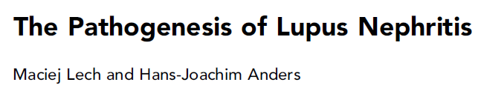
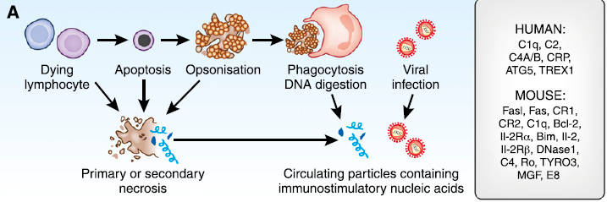
Cell death with incomplete chromatin digestion resulting
in the exposure of nuclear particles to the immune system

Slide 8
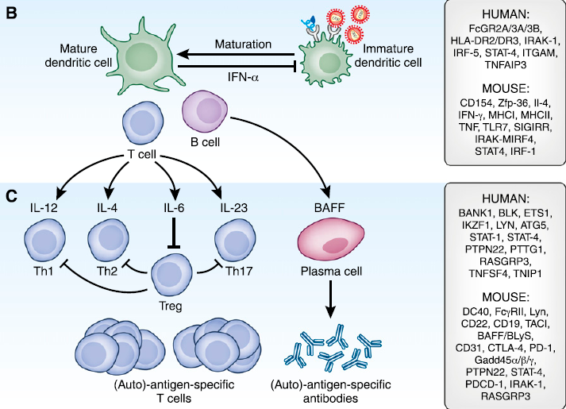
Pseudo-viral particles activate TLRs and antigen presentingresulting in polyclonal expansion of T and B cells

Slide 9

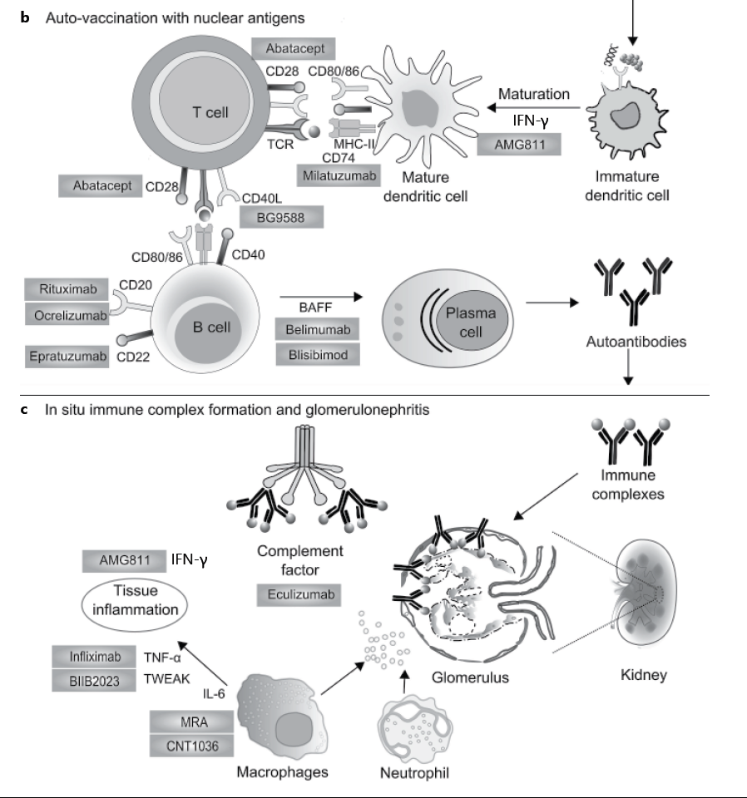

Slide 10
Lupus nephritis – ISN/RPS classification
Weening et al.: Kidney Int., 2004, 65: 521-30
1. type I – II – mesangiopathy
2. type III – IV – proliferative LN
3. type V – membranous LN
4. type VI – sclerosing lesions

Slide 11
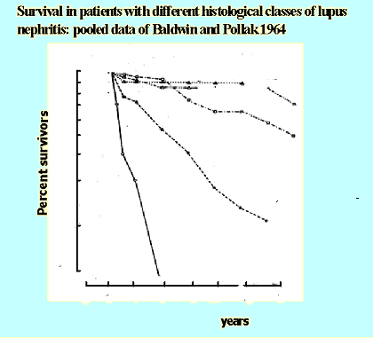
5-year survival in lupus nephritis in 1964
100
90
Type III 65%
Type IV 25%
Type V 90%
80
70
Normals (10 pts)
60
50
Membranous GN
(22 pts )
40
30
Focal GN
(46 pts)
20
Diffuse GN
(10 pts)
Low steroid
Diffuse GN
(50 pts)
High steroid
10
0
1
2
3
4
5
6
7

Slide 12
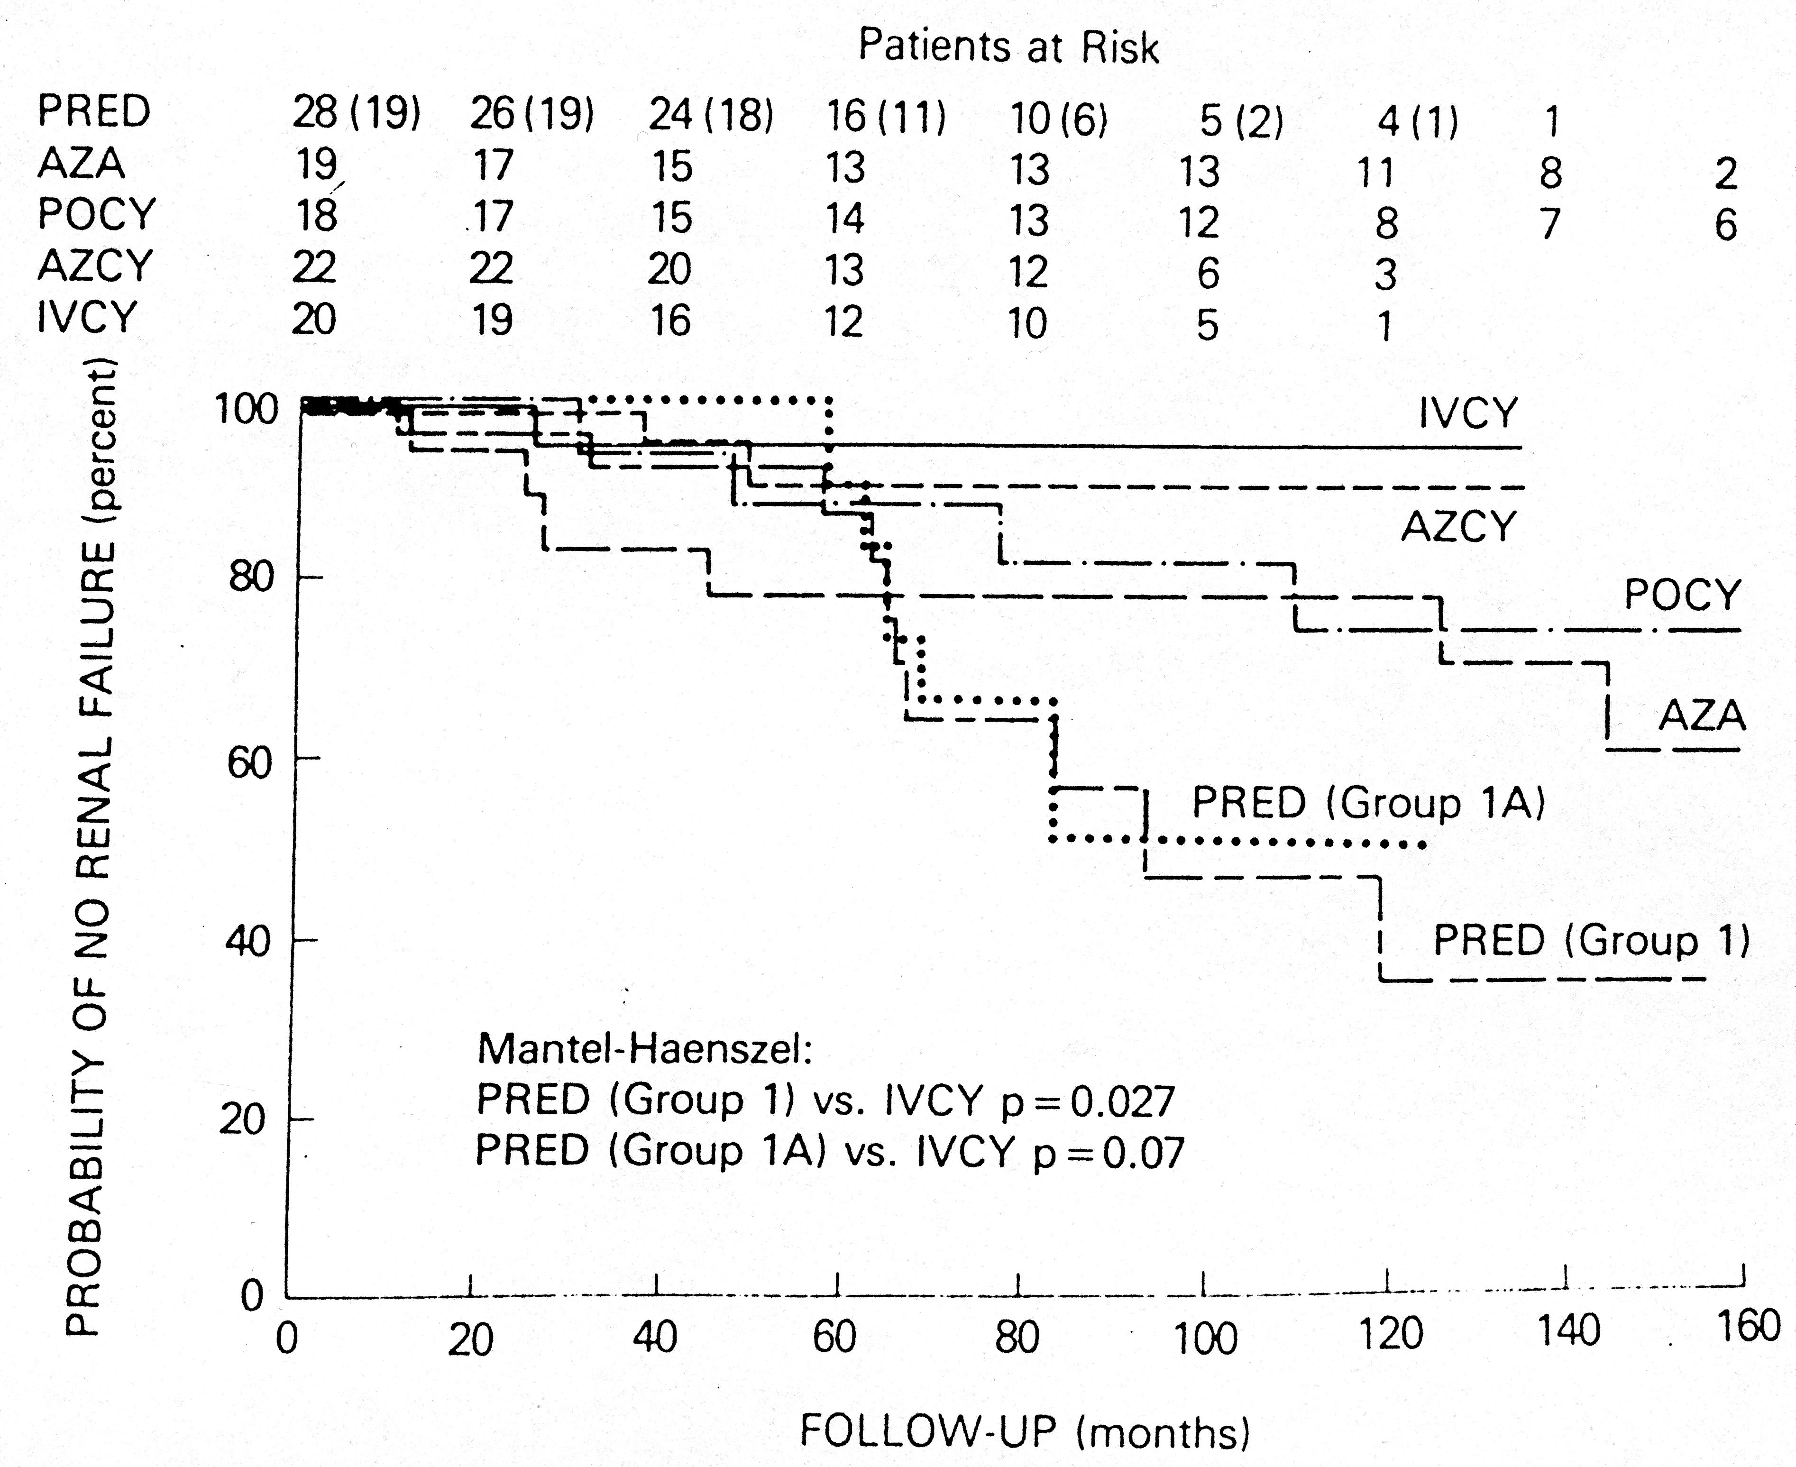
Survival without renal failure
Austin, et al. N Engl J Med 314, 614,1986

Slide 13
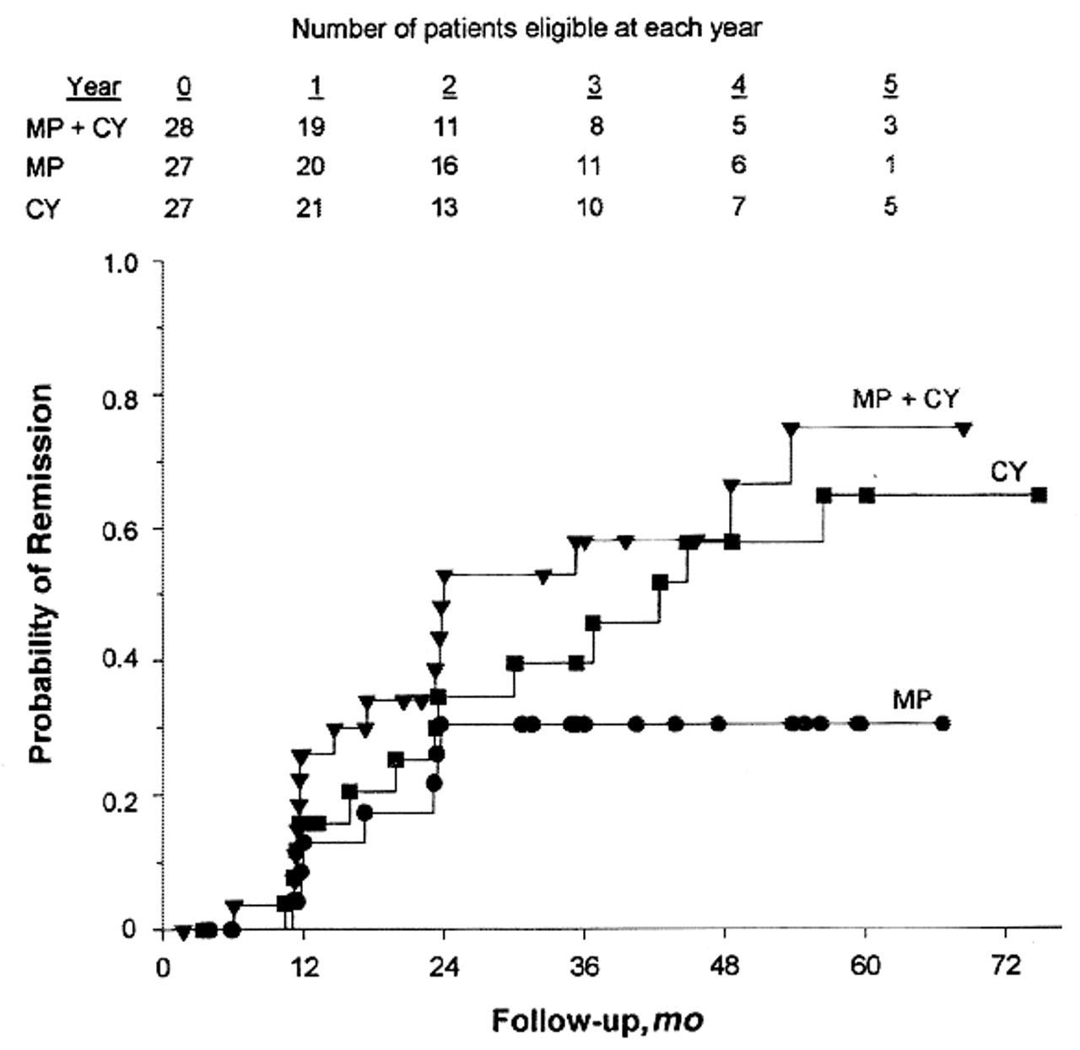
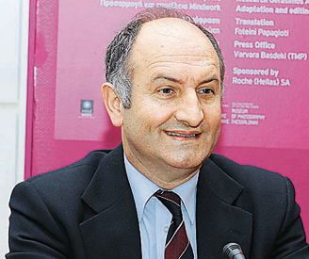

CPH increased the remission rate
Dimitrios Boumpas
Gourley, M. F. et. al. Ann Intern Med 1996;125:549-557

Slide 14
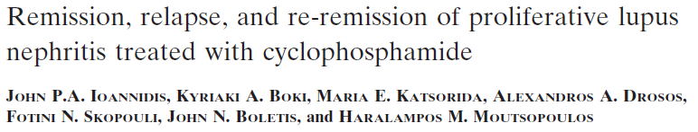
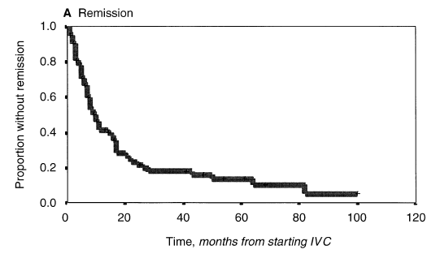
In 85 Greek patients with class III (33 pts) and IV (52 pts) LN
median time to remission was 10 months
0.5
10

Slide 15
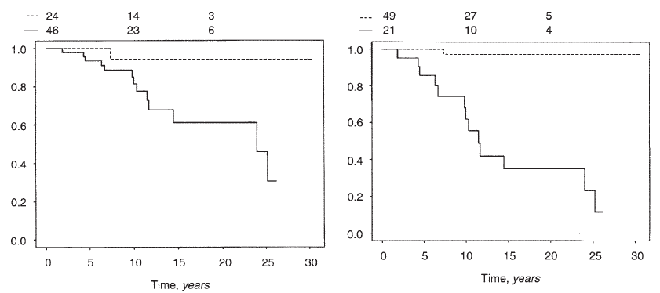
In non- relapsing patients survival without DSC
much better than with („nephritic“) relapses
0.9
0.95

Slide 16

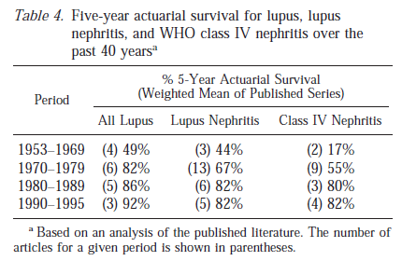
Outcome of pts with SLE and (proliferative) lupus nephritis dramatically improved

Slide 17
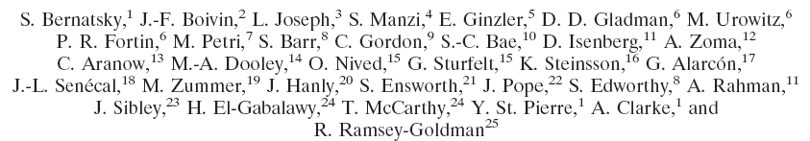

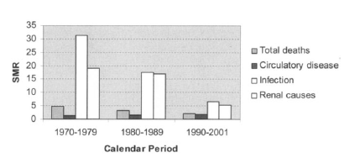
SMR dramatically decreased (infection, renal)

Slide 18
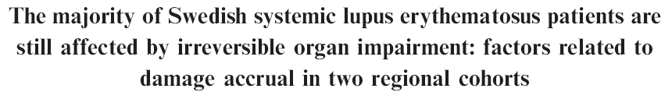
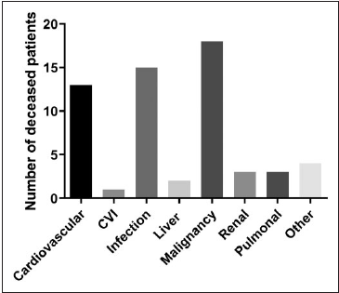
Most frequent causes
of mortality:
CV disease,
infection
malignancy

Slide 20
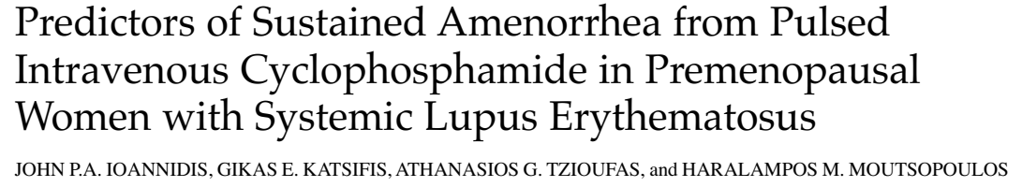
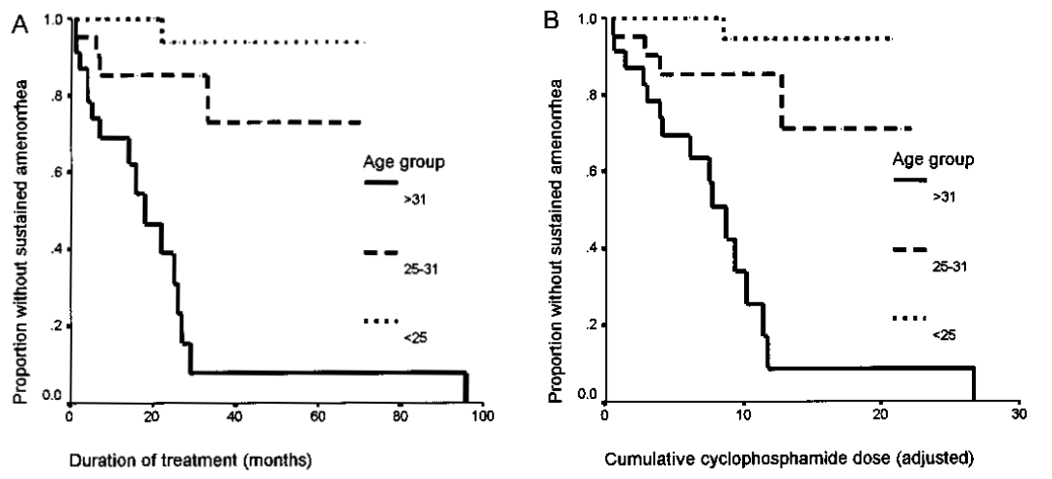
Predictors of sustained amenorrhea in 67 pts with SLE (59 out of them with LN)
age, cumulative dose of CPH and duration of treatment

Slide 21
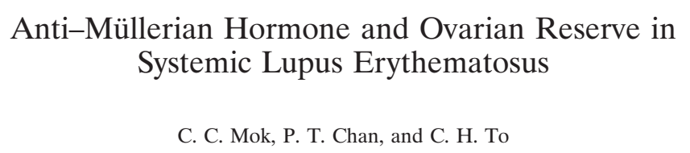

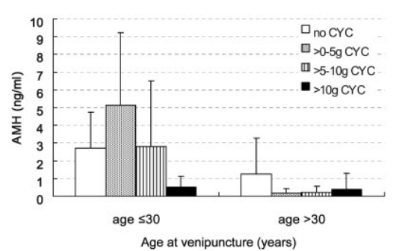
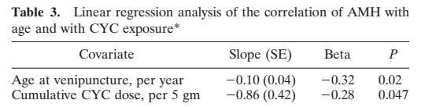
AMH measured in 216 premenopausal SLE pts
divided based on age and CPH use

Slide 22
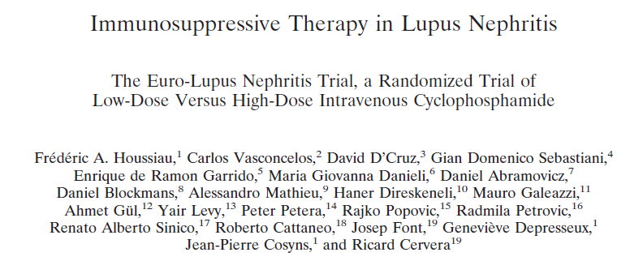

Euro-Lupus study
compared low-dose (3 g) versus high dose CPH (almost 9g)
Treatment failure
Renal remission

Slide 23
LD HD
Death 11% 4%
DSC 14% 11%
ESKD 5% 9%
Severe infection 11% 22%

Slide 24
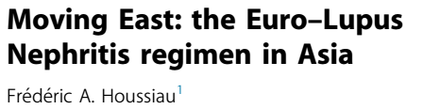
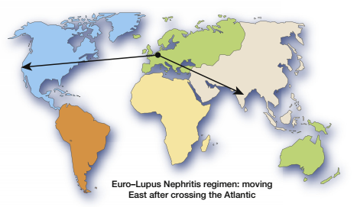

Slide 25
In the ALMS study (358 pts with LN)
MMF better than CPH only in „other“ (mostly black) pts

Slide 26
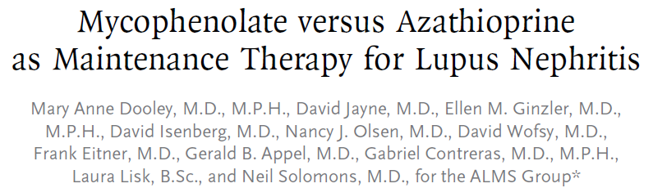
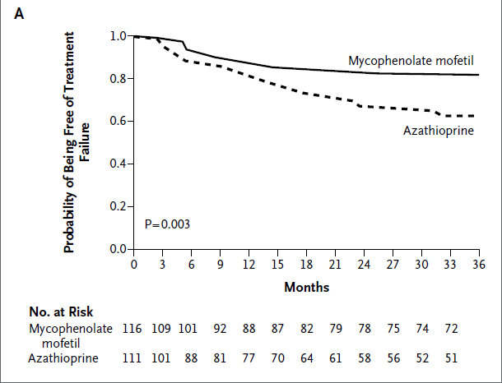
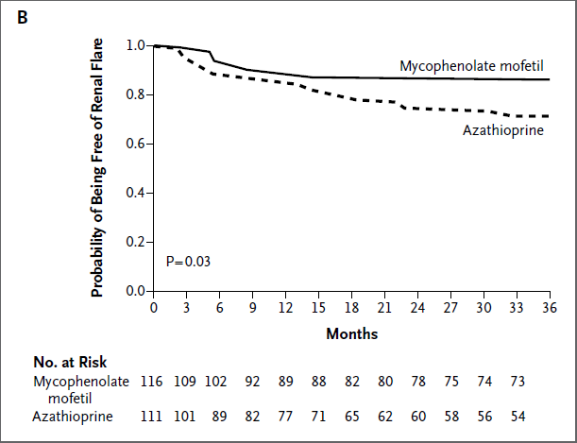
In 227 pts in ALMS study compared maintenance treatment with MMF and AZA (2mg/kg)
MMF - lower risk of treatment failure and lower risk of relapses
ALMS study
ALMS study

Slide 27
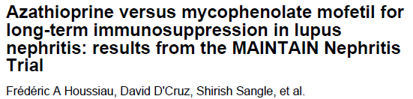
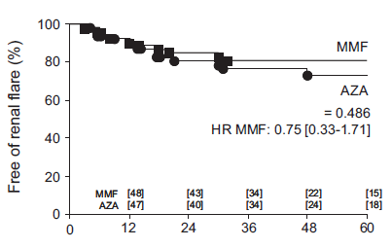
In 105 mostly Caucasian pts with LN III-IV treated with Euro-lupus-like induction MMF compared with AZA
No difference in relapse rate and time to relapse
MAINTAIN trial

Slide 28
No difference in mortality and all AE, different drug specific AE

Slide 29
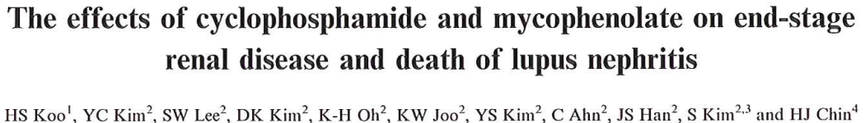
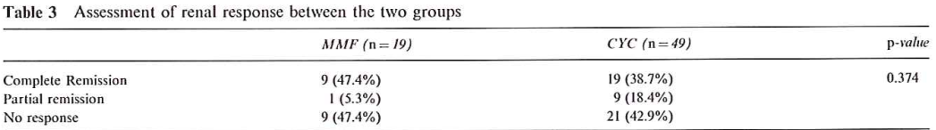
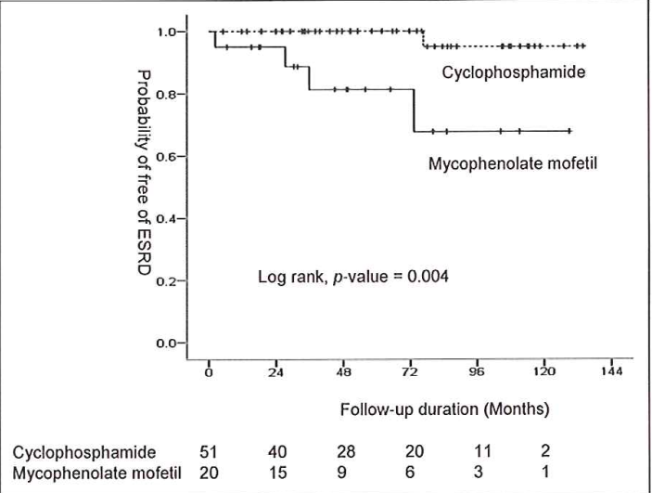
Despite the same short-term response to MMF and CPH,
higher risk of ESRD in MMF treated pts

Slide 30
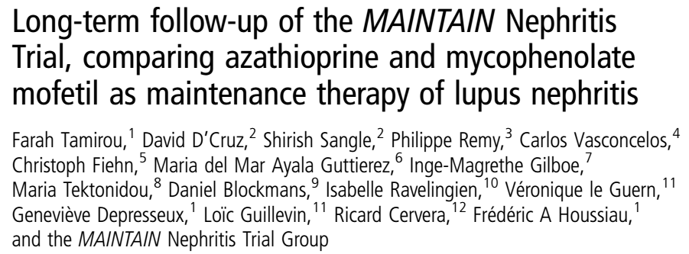

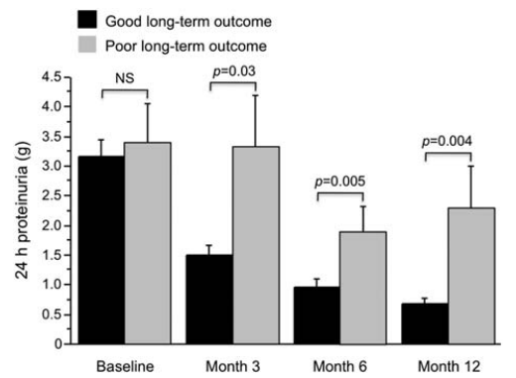
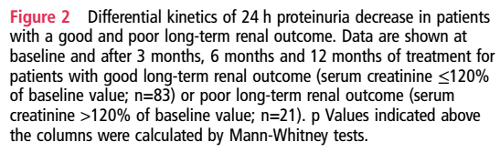
10-yr FU of 87 pts from MAINTAIN study
Predictive role of early decrease of proteinuria

Slide 31
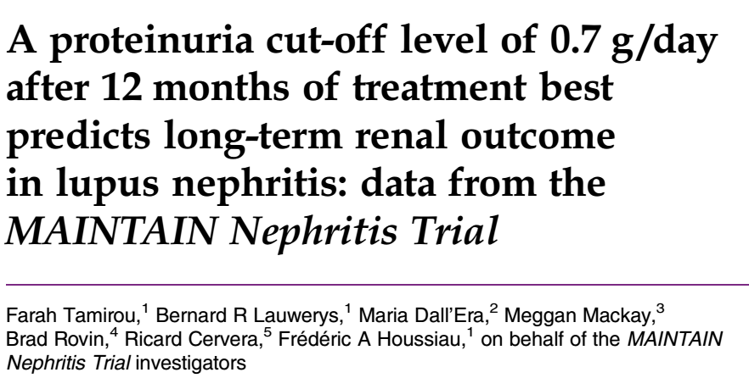
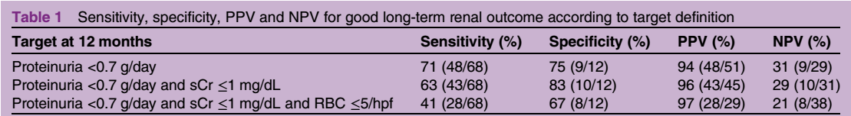
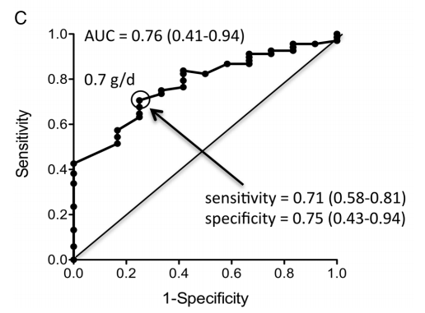

Proteinuria 0.7 g/day at 12 mo and longterm outcome of LN

Slide 32



Slide 33
Calcineurin inhibitors in the treatment of lupus nephritis
Cyclosporine
Combination of tacrolimus and MMF
Voclosporin

Slide 34


In 40 Caucasian pts with LN III-IV cyclosporine similarly effective compared to iv CPH pulses

Slide 35


Extended FU (7.7 years) available in 38 pts,
without significant difference between both limbs

Slide 36



Multitarget therapy more effective compared to iv CPH,
complete remission at 24 weeks (45.9 vs. 25.6%, p < 0.001)

Slide 37

Voclosporin – a new CNI with more predictable relation
between its plasma levels and calcineurin inhibition
Voclosporin
Cyclosporin

Slide 38


265 pts randomized to either to 23.7 mg or 39.5 mg of voclosporin twice daily, or placebo
as an add-on to the standard care with MMF and CS (forced taper to 5 mg by week 8)
Complete renal remission more common in voclosporin-treated pts
AURA-LV trial
Complete renal remission
Durability of complete renal remission

Slide 39
In the phase 3 trial (AURORA 1) 357 pts with LN III-V randomized to either 23.7 mg of voclosporin twice daily, or placebo
as an add-on to the standard care with MMF and CS (forced taper to 5 mg by week 8)
Complete and partial response more common in voclosporin-treated pts

Slide 40


In the phase 3 trial (AURORA 1) 357 pts with LN III-V randomized to either 23.7 mg of voclosporin twice daily, or placebo
as an add-on to the standard care with MMF and CS (forced taper to 5 mg by week 8)
Complete and partial response more common in voclosporin-treated pts
Complete response
Partial response

Slide 41

Recommended treatment targets achieved more frequently in voclosporin-treated patients

Slide 42

Reduction of CS more successful in voclosporin-treated patients

Slide 43

Efficacy of voclosporin similar in recent onset and later onset lupus nephritis

Slide 44
Longterm renal outcome of voclosporin-treated patients better

Slide 45
eGFR during the course of AURORA 1 and AURORA 2 study

Slide 46
Slope of eGFR during the course of AURORA 2 clinical trial
-5.4 vs. – 0.2 ml/min/yr in favour of voclosporine

Slide 47

In the phase 3 trial (AURORA 1) adverse events similarly frequent in voclosporin and placebo limb, respectively

Slide 48
Biologic treatment for lupus nephritis
Rituximab
Belimumab
Obinutuzumab
Anifrolumab

Slide 49




Slide 50

144 pts with LN III-IV on CS and MMF randomized to RTX,
or placebo with a FU of 52 weeks
No significant difference in remission rate and renal response rate…

Slide 51


Only 78% of pts reached complete peripheral depletion
Complete response achieved 47% of pts with and in only 13% of pts without complete B cell depletion (p = 0.03)
Complete response associated with time to B cell depletion and its duration

Slide 53


Similar efficacy of belimumab in BLISS-52 study
Response
Flare
Severe flare
PGA
CS dose reduction
C4
Anti-ds-DNA

Slide 54







Belimumab approved by FDA and then by EMA in 2011 for an add-on therapy in adult patients with active autoantibody-positive SLE, with a high degree of disease activity (e.g. positive anti-dsDNA and low C3) despite standard therapy

Slide 55
In a subanalysis of 267 (out of 1684) pts from BLISS-76 and BLISS-52 studies
with renal involvement belimumab decreased proteinuria
p< 0.05
p< 0.01

Slide 56
Post-hoc analysis of BLISS-LN study – sustained 30% and 40% decline in eGFR by the end of study

Slide 57
Post-hoc analysis of BLISS-LN study – time to first LN flare from week 24

Slide 58
Open-label 28 mo extension of BLISS-LN study –
Probabillity of experiencing PERR

Slide 59
Pseudo-viral particles activate TLRs and antigen presentingresulting in polyclonal expansion of T and B cells

Slide 60
NOBILITY study
-

Slide 61
TULIP 2 – phase 3 study
– 373 pts with SLE, anifrolumab vs placebo
Primary endpoint - decrease of BICLA at 52 weeks reached
TULIP LN – phase 2 study
– 147 pts with SLE, anifrolumab vs placebo
Primary endpoint - decrease of BICLA at 52 weeks reached

Slide 62
147 pts with LN III-IV randomized to basic or intensified anifrolumab regimen, or placebo,
Anifrolumab significantly suppressed „interferon signature“

Slide 63
Anifrolumab in LN – second-year extension of randomised phase II trial – SLEDAI-2K score

Slide 64
Anifrolumab in LN – second-year extension of randomised phase II trial – % of pts with CRR

Slide 65
Curative options in SLE need to eliminate both plasmablasts and long-lived plasma cells

Slide 66
2023 update of 2021 KDIGO guidelines
and EULAR 2023 guidelines

Slide 67




Recommended initial first-line treatment of proliferative LN according to 2012 KDIGO guidelines
Notes:
These are patients positive be ELISA and IIF

Slide 68

Recommended approach for initial therapy of active class III-IV LN according to 2021 KDIGO guidelines
Lupus nephritis
Notes:
These are patients positive be ELISA and IIF

Slide 69
Recommended approach for initial therapy of active class III-IV±V LN according to 2023 KDIGO LN guidelines

Slide 73
Conclusions
1. Better understanding of the pathogenesis of SLE and LN resulted in the identification of new therapeutic targets
2. New modes of treatment should be at least similarly effective, but less toxic
3. Current treatment can induce longterm remission, but the risk of relapses after withdrawal still remains high
3. None of recommended modes of treatment is curative

Slide 74
Thank you for your attention and your questions

