Slide 1
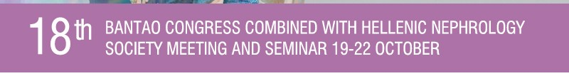
Changing the therapeutic landscape in IgA nephropathy.
The value of targeted release budesonide
Maria Stangou
Associate Professor in Nephrology,
Aristotle University of Thessaloniki,
1st Department of Nephrology,
Hippokration Hospital Thessaloniki, Greece

Slide 2
Immune abnormalities in IgA nephropathy
IgA1 mucosal surfaces
systemic circulation
IgA2 mucosal surfaces
Differences IgA1/IgA2
1. Numbers of N-linked carbohydrates
in the heavy chain
2. Hinge Region (HR)
9 serine and threonine
3-6 O-linked glycans
[GalNac +β1,3-linked galactose +sialic acid]
Clinical Kidney Journal, 2023
Notes:
Pathogenetic pathway in IgAN begins with deficient glycosylation of IgA molecule
IgA is the predominant antibody subtype in external secretions and plays a very important role in mucosal immunity.
In humans and higher primates, IgA exists in two subclasses: IgA1 which is found in both mucosal surfaces and systemic circulation,
and IgA2 which is mostly limited to the mucosal surfaces.
IgA1 contains a unique HR characterized by nine serine and threonine residues, and about 3-6 of them, are attached to O-linked glycans.
Variations in the O-glycosylation have a direct impact in biological functions
IgA molecule can be fount as dimeric or polymeric

Slide 3
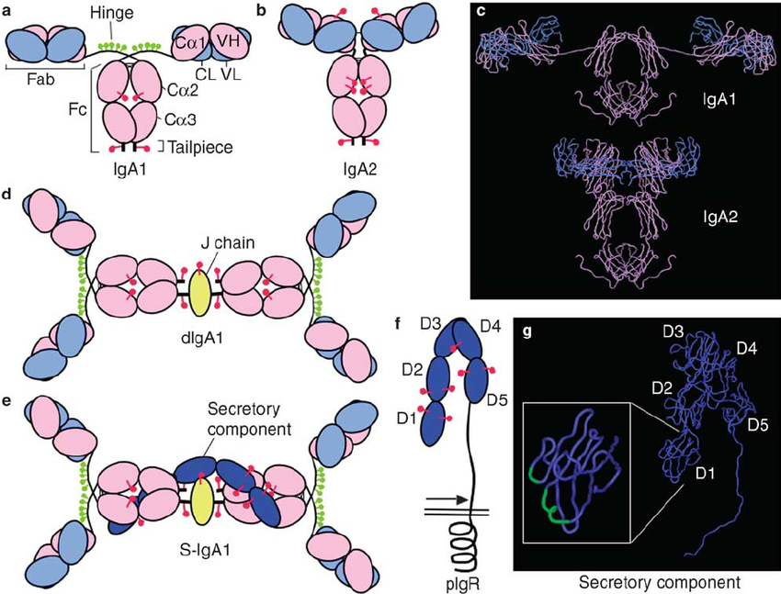
Secretory IgA N- and O-Glycans Provide a Link between the
Innate and Adaptive Immune Systems
Schematic representations of human dimeric IgA1 and secretory IgA1
J Chain:
Two IgA monomers are depicted tail-to-tail, with a
J chain covalently linking together the heavy chain
tails from each monomer.
The Secretory Component:
five immunoglobulin-like domains
covalently linked to domain V and domain C2, C3,
domain I and the J chain.
SIgA2 has one more N-glycan on the C2 domain and one or two more on the C1 domain than SIgA1.
SIgA1 has four of the five possible sites are shown on the hinge region occupied by O-glycans.
There are no O-glycans on the hinge region of SIgA2.
Notes:
We can see here the structure of human dimeric secretory IgA1 and IgA2.
Two IgA monomers are depicted tail-to-tail, with a J chain covalently linking together the two heavy chains.
The SC consists of five immunoglobulin-like domains covalently linked to heavy chains, SC and J chain.

Slide 4
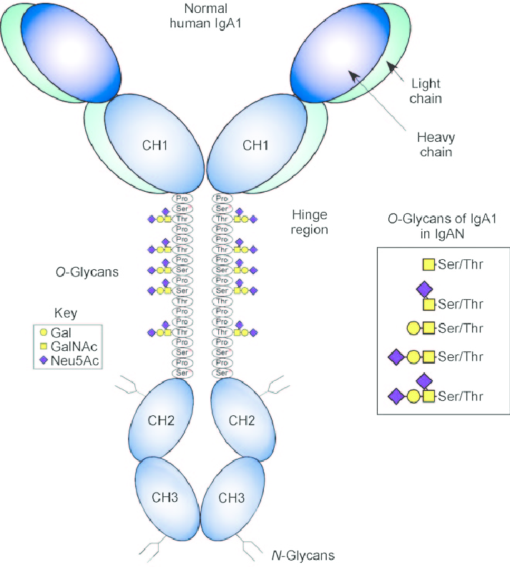
Secretory IgA N- and O-Glycans Provide a Link between the
Innate and Adaptive Immune Systems
Innate immunity
Adaptive immunity
interaction with bacterials
Fab antibody-binding sites interaction with Ags
Molecular model of SIgA1 with N- and O-glycans
J chain
Secretory component
O-glycans (on the hinge region)
N-glycans on the H chains
N-glycans on the SC and J chain
Notes:
Again the structure of dimeric IgA
IgA molecules are depicted as green and blue, J chain is this pink molecule and SC the purple one
The glycans are these red - O-glycans, yellow and orange molecules, the N glycans.
This model illustrates that most of the molecule is covered with O- and N-glycans, leaving free just small parts of the immunoglobulin which can take part both in innate and adaptive immunity
In IgA nephropathy, IgA1 molecule lacks O-glycans

Slide 5
Immune abnormalities in IgA nephropathy
IgA1 mucosal surfaces
systemic circulation
IgA2 mucosal surfaces
↑Circulating levels of Gd-IgA1
Antiglycan autoantibodies against Gd-IgA1
Circulating immune complexes contain Gd-IgA
The Gd-IgA1-antiglycan IgG immune complexes
deposit in the mesangium
Clinical Kidney Journal, 2023
Notes:
The presence of Gd-IgA molecule is not enough to cause IgAN, this is just the first hit, the second one is the production of autoantibodies against gD-IgA1, the third is the formation of immune complexes and the last step is the deposition of circulating immune complexes in glomeruli

Slide 6
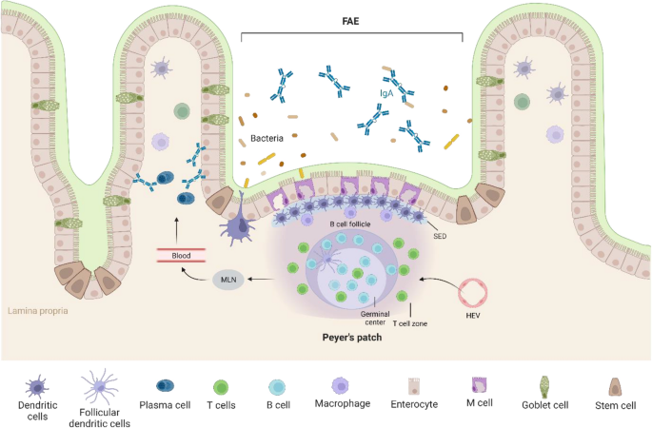
Where does the responsible IgA come from?
The site of gd-IgA1 production is still unclear,
evidence on the involvement of Peyer’s patches
and mesenteric lymph nodes
↑Serum levels of gd-IgA1 directed against mucosal pathogens
Is Gd-IgA molecule pathogenic?
↑Circulating levels of SIgA
Positive correlation between SIgA and
disease activity
3. Mesangial deposits of Gd-IgA
Peyer’s patches (PPs) follicles are enclosed by
follicle-associated endothelium (FAE)
Expansion and differentiation of B cells is stimulated by interactions between B cells and T cells at FAE
Tissue Eng Reg Med 2023
Notes:
Two crucial questions have arised after these findings
Where does the Gd-IgA molecule come from, where is it produced? There are not enough data yet, but there is strong evidence that the Peyers patches and mesenteric lymph nodes are involved
Is circulating Gd-IgA pathogenic? It seems so, as their serum levels are increased in IgAN compared to HC, and they seem to correlate with disese activity

Slide 7
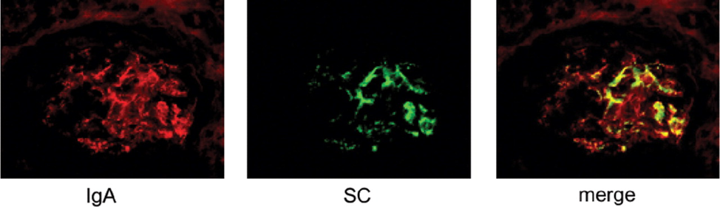
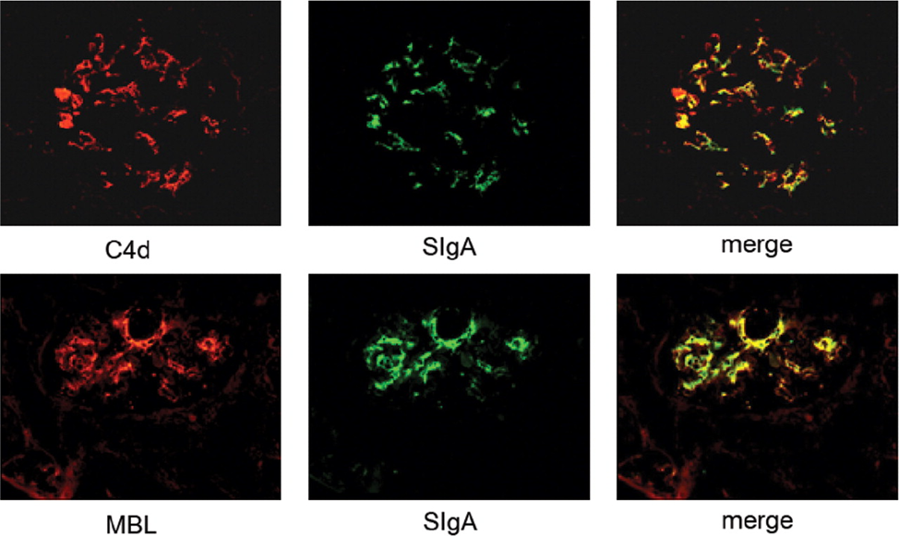
Where does the responsible IgA come from?
Nephrol Dial Transplant (2007) 22: 3191–3195
The site of gd-IgA1 production is still unclear,
evidence on the involvement of Peyer’s patches
and mesenteric lymph nodes
↑Serum levels of Gd-IgA1 directed against mucosal pathogens in IgAN patients
Is Gd-IgA molecule pathogenic?
↑Circulating levels of SIgA
Positive correlation between SIgA and
disease activity
3. Mesangial deposits of Gd-IgA
Kidney Blood Press Res 2021;46:286–297
Notes:
Also, Gd-IgA was found in the mesangium which colocalize with C4 complement compounds

Slide 8
SIgA binds to Mesangial and Tubulointerstitial cells and causes increased production of TNF-α, TGF-β1, MCP-1
Cytokine deposition is positively correlated with the degree of tubulointerstitial injury
Where does the responsible IgA come from?
Binding rate of SIgA to mesangial cells (HRMC) and proximal tubule epithelial cells (HK-2)
Kidney Blood Press Res 2021;46:286–297
Notes:
Additionally, Gd-IgA molecules can directly stimulate proliferation of mesangial and tubular epithelial cells, and also production of cytokines, such as TNF, TGF and MCP.
Expression and production of the above cytokines positively correlate with the degree of tubulointerstitial damage

Slide 9
IgA Nephropathy – from pathogenesis to histology
Notes:
So, here we go, from pathogenesis, production of Gd-IgA with the four hit process, to histological lesions

Slide 10
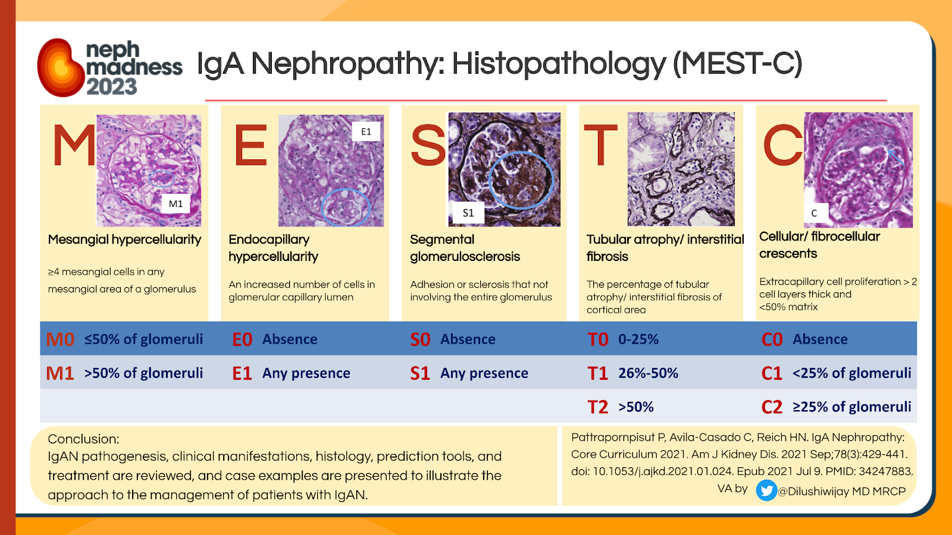
Notes:
We are all aware of the Oxford classification system, taking into account mesangial hypercellularity, endothelia hyperplasia, segmental sclerosis tubular atrophy and crescent formation

Slide 11
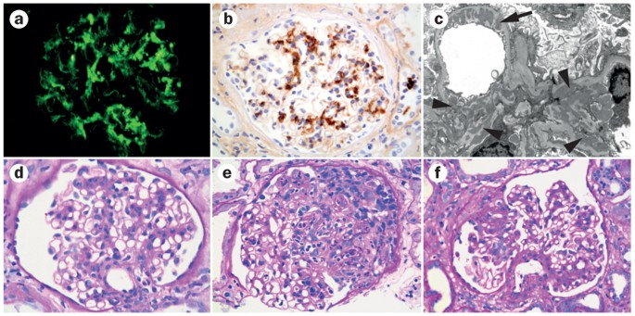
IgA Nephropathy – from pathogenesis to histology
Notes:
And there are two options when treating IgAN (as all diseases). Either you aim to the result, the apparent histological lesions, or you aim to the initial pathogenic factors.

Slide 12
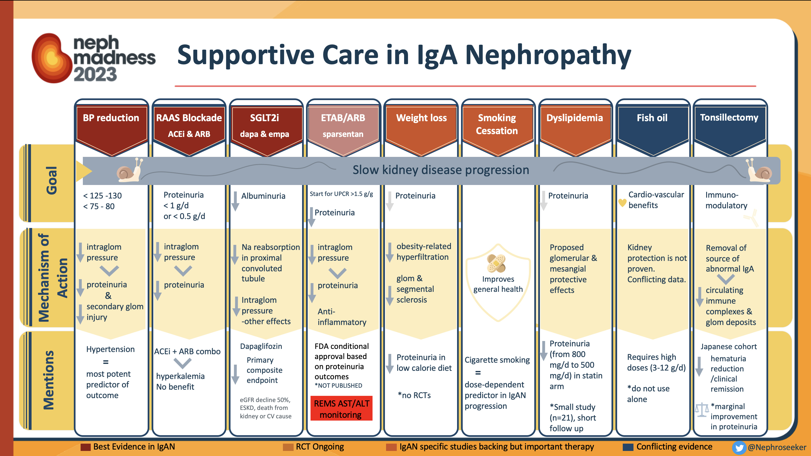
Notes:
Supportive treatment including bp control, acei or arb inhibitors, sglt2 inhibitors, sparsentan, studies with endothelin inhibitors are ongoing.
weight loss, control of dyslipidemia are prerequisites and should be applied in all IgAN patients, before any other treatment approach. But there are not enough, as they just have a mechanical effect in glomeruli, not adequate to regulate immune pathways involved

Slide 13
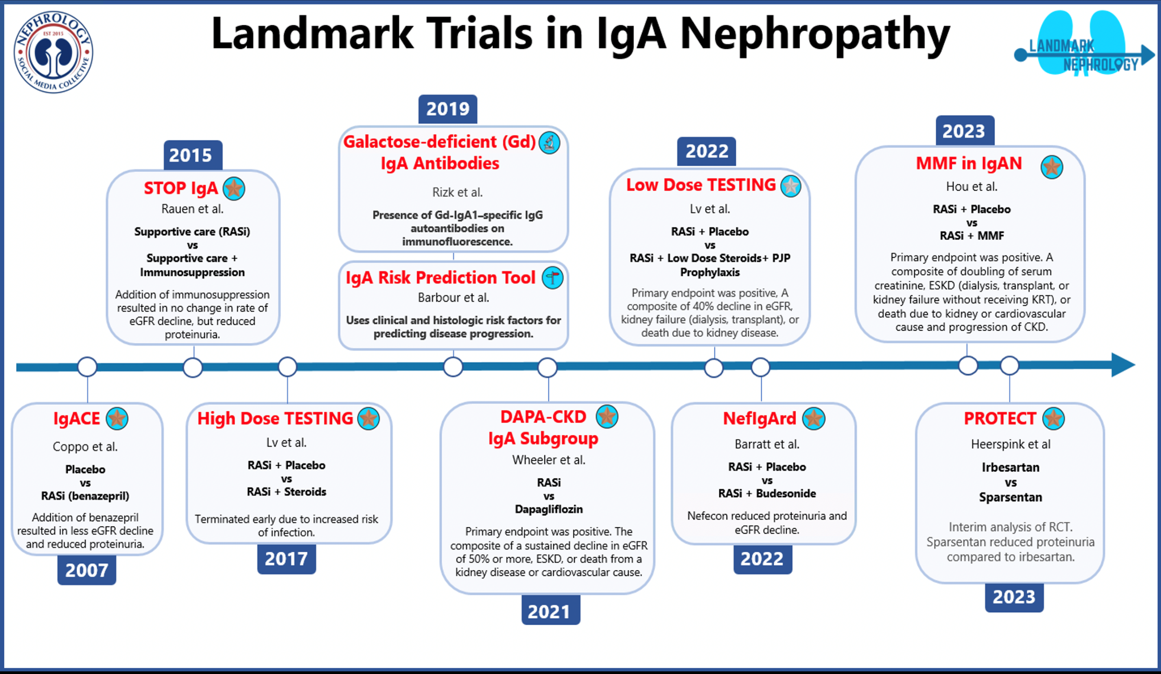
1999
Pozzi
Supportive care
vs
IV + po methylprednisolone
MP reduced proteinuria during 6 months
Notes:
What about steroids? Steroids are extensively studied in IgAN, starting for 1999 with applying the Pozzi regime for 6 months treatment with gradualy reduction. We consequently had the stop IgA, again the Pozzi regime plus immunosuppression, and few years ago the testing and re-testing trials. Testing trial was early terminated due to incresed risk of infections.

Slide 14
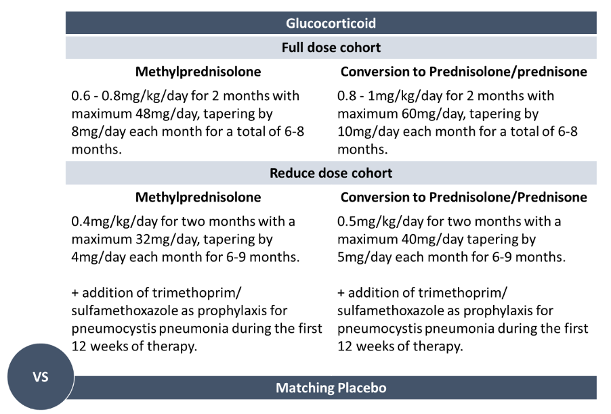
Notes:
Something which was not surprising, conserving the huge amounts of steroids, almost 1mg/Kg for 2 months, - we never had patient who could tolerate such a huge dose of steroids for so long. This was the reason, the investigators had to reduce the dose to half, and also add antibiotic prophylaxis for pneumocystis carrini

Slide 15
Issues arise from treatment with Systemic Steroids
Steroids reduce glomerular inflammation but do not act in the disease pathogenesis
no change in Gd-IgA1 circulating levels
temporary beneficial effect – relapse of proteinuria early after withdrawal
need to repeat steroid course
2. Steroid toxicity (reported only in newer clinical studies)
infections (Pneumocystis jirovecii, Nocardia and Cryptococcus) – need for Pneumocystis prophylaxis
diabetes melitus
death due to sepsis
Notes:
As we can see here, the main issues with steroids in IgAN, 1. there are not enough, as they can reduce inflammation, but showed no change in Gd-IgA1 levels, they had a temporary beneficial effect, with increased rates of relapse, and lots of patients end up having repeated steroid courses
Adverse effects is the second issue, common as the doses used are high

Slide 16
IgA Nephropathy – from pathogenesis to histology
Therapies that target Gd-IgA1
Targeted-release budesonide
B cell and plasma cell targeted treatment
Notes:
So, what about treatment approach based on the pathogenesis? We have the targeted-release budesonide treatment and the B cell and plasma cell targeted treatments, aiming the to the reduction of Gd-IgA1 production

Slide 17
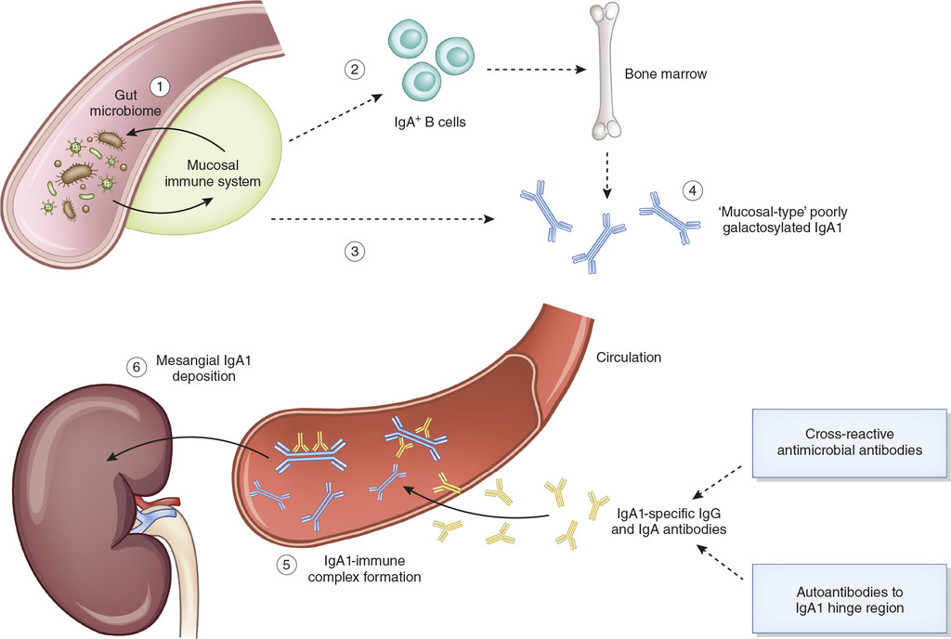
Nefecon: Targeted-Release Budesonide
pH dependent and time delayed release
Nefecon is designed to achieve a high dose delivery of budesonide to the distal ileum where Peyer’s patches are highly concentrated.
Approximately 46% of all Peyer’s patches are located in the final 25cm segment of the distal ileum
90% first pass effect reduces systemic exposure and the risk of AEs typically associated with the systemic administration of corticosteroids.

Slide 18
Nefecon: Targeted-Release Budesonide
Trials overview
Phase 2A Pilot Study
NDT 2011
N=16 IgAN
↓Uprot 23%
NEFIGAN
Phase 2B Study
Lancet 2017
NEFIGARD
Phase 3A
Kidney Int 2022
Phase 3B
Lancet 2023
Phase 3 OLE
Last patient out: Q1 2024
Publication
Notes:
Here we can see the 4 clinical trials with targeted release budesonide in IgAN. The first one, the pilot study does back to 2005, with 16 IgAN patients showing reduction in proteinuria and improvement of renal function after treated with budesonide. Results from this study were published in NDT
The second one, initiated in 2012 and results were published in Lancet 2017

Slide 19
Targeted-release budesonide versus placebo in patients with IgA nephropathy (NEFIGAN): a double-blind, randomised, placebo-controlled phase 2b trial
NEFIGAN
Phase 2B Study
Double-blind, placebo-controlled phase 2b trial, 6-month run-in,
9-month treatment,
3-month follow-up (62 nephrology clinics across 10 European countries)
Randomised 1:1:1 ratio to 16 mg/day TRF-budesonide, 8 mg/day TRF-budesonide, or placebo
Inclusion criteria
GFR (eGFR) ≥ 45 mL/min/1.73m²
UPCR≥0.5 g/g or Uprot ≥ 0.75 g/day
Target blood pressure <130/80mmHg (ACEIs or ARBs to a maximum recommended dose or maximum tolerated dose)
Lancet 2017
Notes:
This was a double-blind, phase 2b trial, comprised of 9-month treatment, and 3-month follow-up
Inclusion criteria eGFR should be more than 45 and Uprot>750mg/24hr
Of course, maximal tolerated acei to achieve a BP of <130

Slide 20
Lancet 2017
Notes:
153 patients were randomized to take …

Slide 21
Outcomes
Primary outcome
9-months: Mean change in UPCR
Secondary outcomes
12 months: Mean changes from baseline in
eGFR, UPCR, Uprot (g/24hr), UACR, Ualb (g/24hr)
Lancet 2017
Notes:
Primary Outcome: At 8reduction of Upr mainly in those randomized to 16mg

Slide 22
Outcomes
Primary outcome
9-months: Mean change in UPCR
Secondary outcomes
12 months: Mean changes from baseline in
eGFR, UPCR, Uprot (g/24hr), UACR, Ualb (g/24hr)
Lancet 2017
Notes:
Secondary outcomes: At 12 months improvement of renal function, happened during the 9 months treat and remained

Slide 23

NefIgArd: Study Design
NEFIGARD
Phase 3A
Phase 3B
Efficacy and safety of Nefecon in patients with primary IgA Nephropathy
INCLUSION CRITERIA:
eGFR: >35 mL/min
UPCR: >0.8 g/g
Part A, n=199**
Part B, n=364
9 months on medication
3 months off
medication
incl. 2 weeks
tapering
12 months off medication
Verification of optimized* and stable RAS-blockade for ≥3 months
16 mg Nefecon
Placebo
RANDOMIZATION
Stable and optimized* RAS-blockade
Kidney Int 2022
Notes:
And the latest phase 3 studies, the pahse 3A, publishes in KI 2022

Slide 24
NEFIGARD
Phase 3A
Results from part A of the multi-center, double-blind, randomized, placebo-controlled NefIgArd trial, which evaluated targeted-release formulation of budesonide for the treatment of primary immunoglobulin A nephropathy
Inclusion criteria
Persistent proteinuria (UPCR >0.8 g/g or Uprot >1 g/24 h)
eGFR 35 - 90 ml/min/1.73 m2 using CKD-EPI.
Maximum tolerated or maximum allowed of an RAASinhibitors for at least 3 months
Patients with type 1 or type 2 diabetes were eligible provided their diabetes was adequately controlled,
Exclusion criteria
All secondary forms of IgAN or any non-IgAN glomerulonephritis
Inadequately controlled BP>140/90 mm Hg,
Kidney transplant,
Treatment with systemic glucocorticoids or immunosuppressants in the 12 months
Notes:
Inclusion criteria, almost the same, eGFR 35-90 and Uprit>1gr/24hr

Slide 25
Notes:
199 patients were randomized to either nefecon 16mg or palcebo

Slide 26
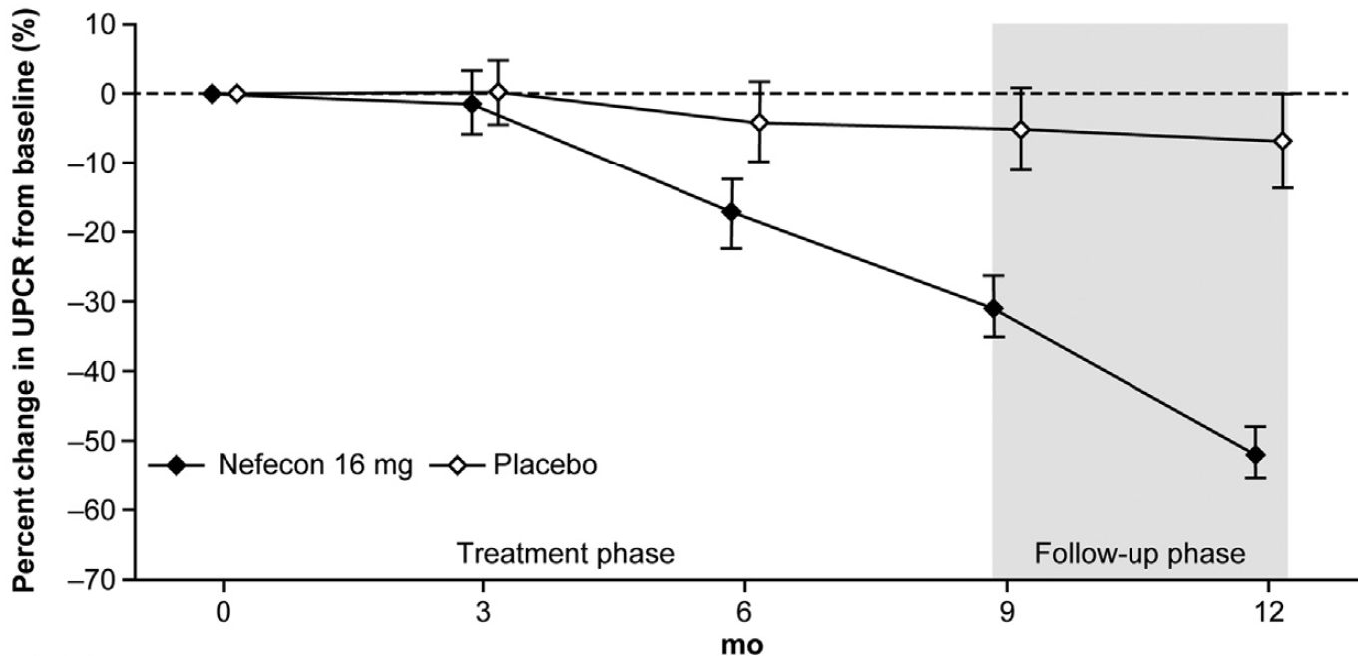
NefIgArd Part A: Results
NEFIGARD
Phase 3A
Change in UPCR at 9 and 12 months vs. baseline
Primary endpoint: change in UPCR from baseline at 9 months
Change in UPCR from baseline
over 12 months
-5%
-31%
Placebo
Nefecon 16 mg
P=0.0003
Barratt J et al. (2023) Kidney Int. 103(2):391-402
Notes:
We can see the significant reduction of proteinuria during the 9 months treatment

Slide 27
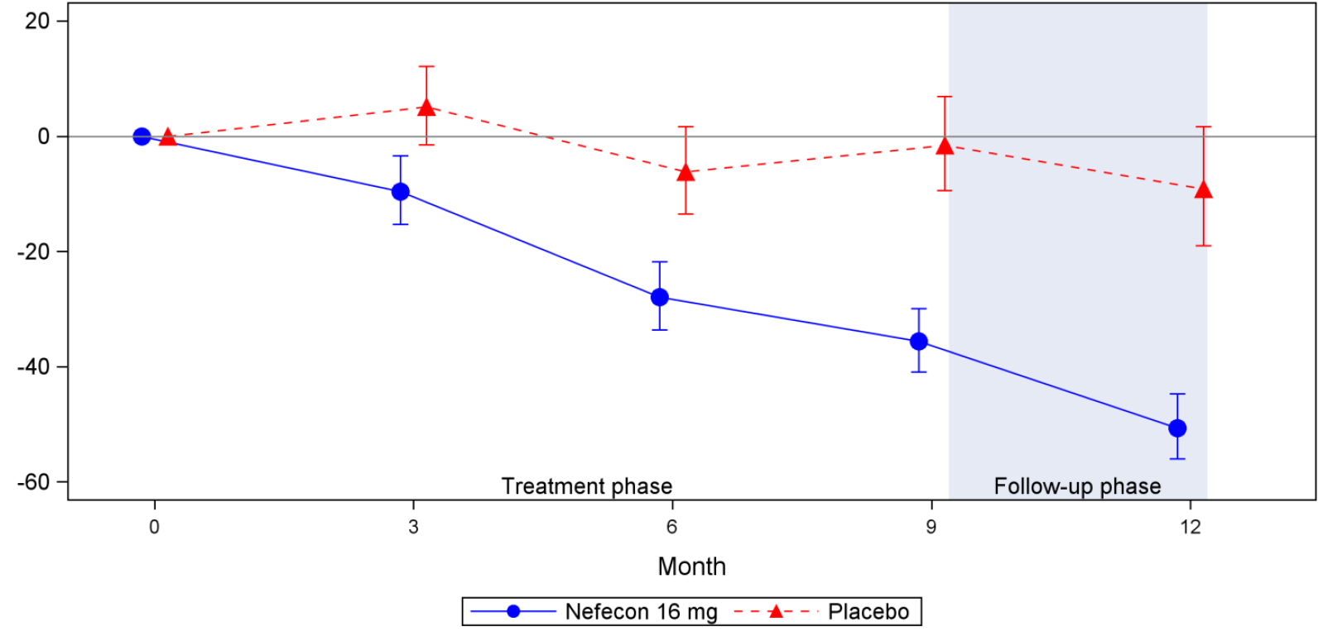
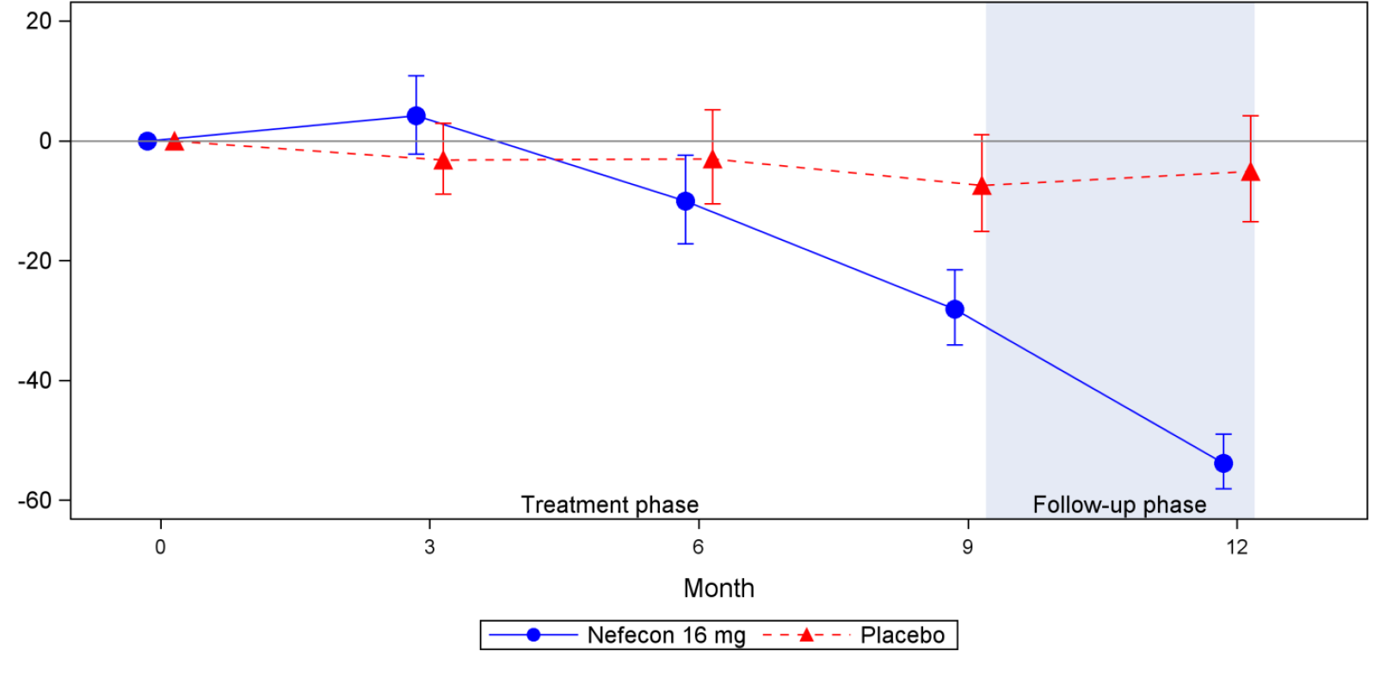
NefIgArd Part A: Results
NEFIGARD
Phase 3A
Subgroup analysis: UPCR change in patients based on baseline UPCR
Baseline UPCR subgroup ≥1.5 g/g
Baseline UPCR subgroup <1.5 g/g
Percent change of UPCR from Baseline (%)
Percent change of UPCR from Baseline (%)
Notes:
Differences in subgroups of patients with more or less Uprot

Slide 28
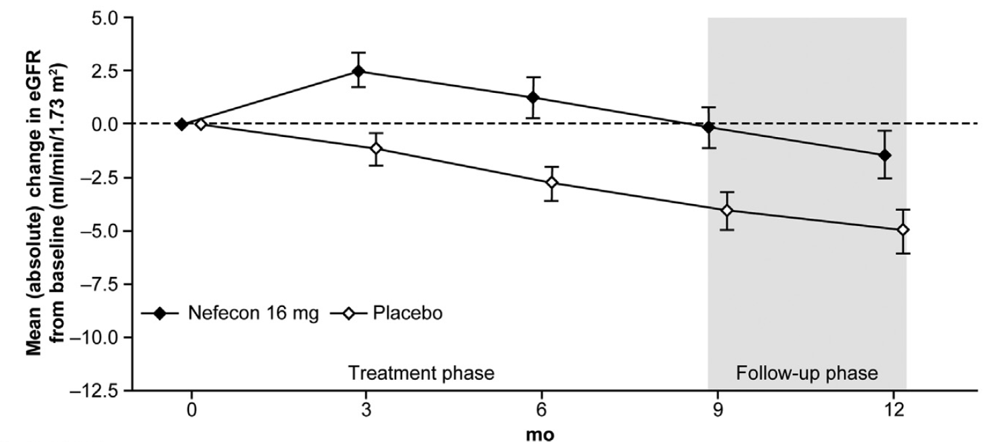
NefIgArd Part A: Results
NEFIGARD
Phase 3A
Change in eGFR at 9 months vs. baseline
Secondary endpoint: change in eGFR from baseline at 9 months
Change in eGFR from baseline
over 12 months
0%
-5%
-7%
Placebo
Nefecon 16 mg
P=0.0029
Barratt J et al. (2023) Kidney Int. 103(2):391-402; eGFR: estimated glomerular filtration rate
Notes:
And improvement of renal function

Slide 29
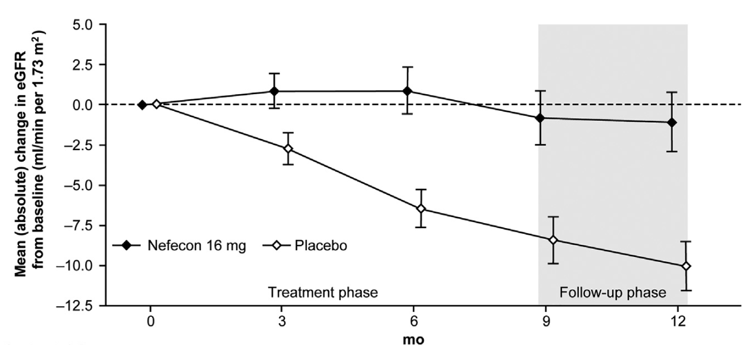
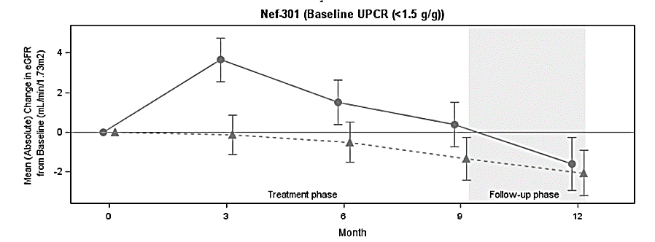
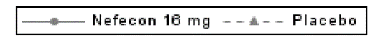
NefIgArd Part A: Results
NEFIGARD
Phase 3A
Subgroup analysis: eGFR change in patients based on baseline UPCR
Baseline UPCR subgroup ≥1.5 g/g
Baseline UPCR subgroup <1.5 g/g
4
2
0
-2
0
3
6
9
12
mo
Barratt J et al. (2023) Kidney Int. 103(2):391-402; UPCR: urine protein-creatinine ratio; eGFR: estimated glomerular filtration rate
Notes:
Again differences in subgroup analysis

Slide 30
Nefecon: Targeted-Release Budesonide
Trials overview
Phase 2A Pilot Study
NDT 2011
NEFIGAN
Phase 2B Study
Lancet 2017
NEFIGARD
Phase 3A
Kidney Int 2022
Phase 3B
Analysis of full trial population of 364 patients
Safety and efficacy of Nefecon over 2 years
Phase 3B
Lancet 2023
Phase 3 OLE
Last patient out: Q1 2024
Notes:
And finaly the last Phase 3B study, just released in Lancet

Slide 31
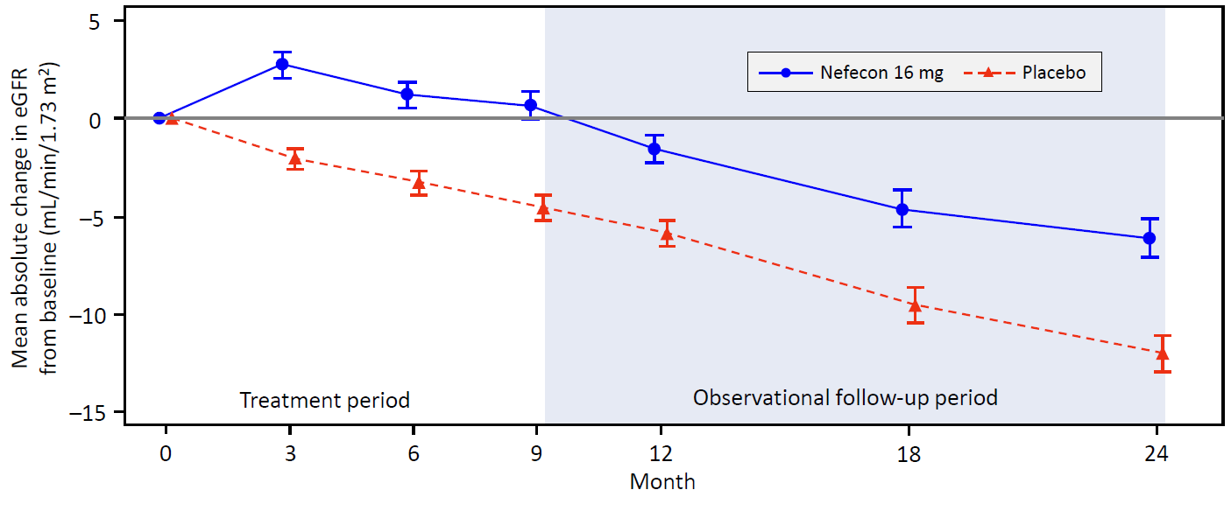
NefIgArd Part B: Results
Phase 3B
Time-weighted average of eGFR over 2 years
Mean absolute change in eGFR from baseline to 24 months in the overall study population
Primary endpoint: time-weighted average of eGFR over 2 years showed a statistically significant benefit with Nefecon vs. Placebo of 5.05 mL/min/1.73 m² (p<0.0001).
The eGFR benefit at the end of the 9-month treatment period with Nefecon was maintained during the 15-month of observational follow-up.
Notes:
Patients entered phase 3A, were prospectively followed up for 2 years
What we saw here, eGFR was maintained at 24monts with significant differsnes compared to controls,

Slide 32
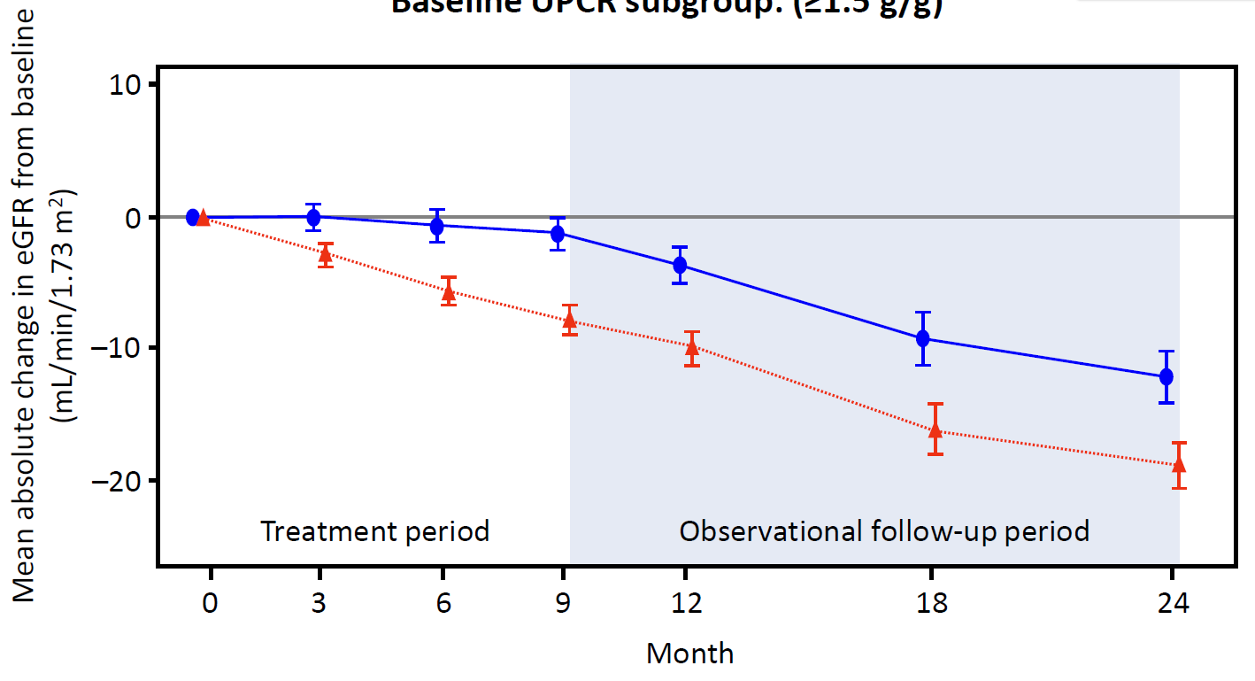
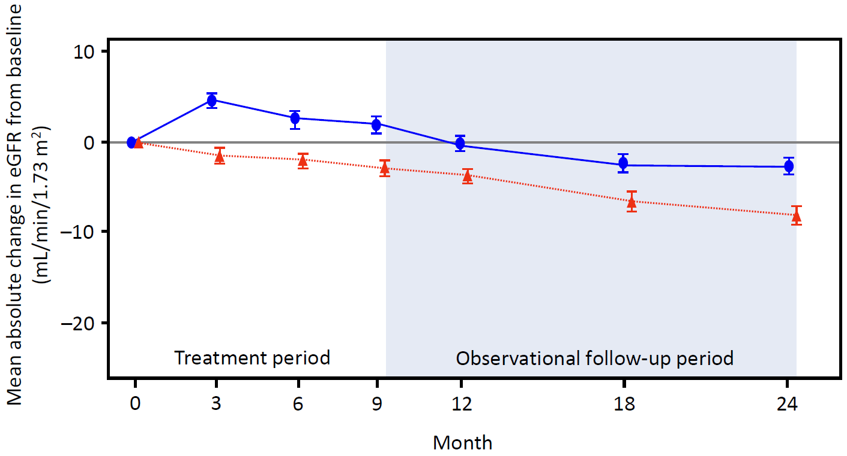
NefIgArd Part B: Results
Phase 3B
Subgroup analysis: eGFR change in patients based on baseline UPCR
Baseline UPCR subgroup ≥1.5 g/g
Baseline UPCR subgroup <1.5 g/g
Richard Lafayette, presented at ERA-EDTA 2023 in Milano; https://www.calliditas.se/en/wp-content/uploads/sites/2/2023/06/Presentation-European-Renal-Association-ERA-Congress-2023.pdf; UPCR: urine protein-creatinine ratio; eGFR: estimated glomerular filtration rate
Notes:
Slightly better for patients with lower proteinuria levels,

Slide 33
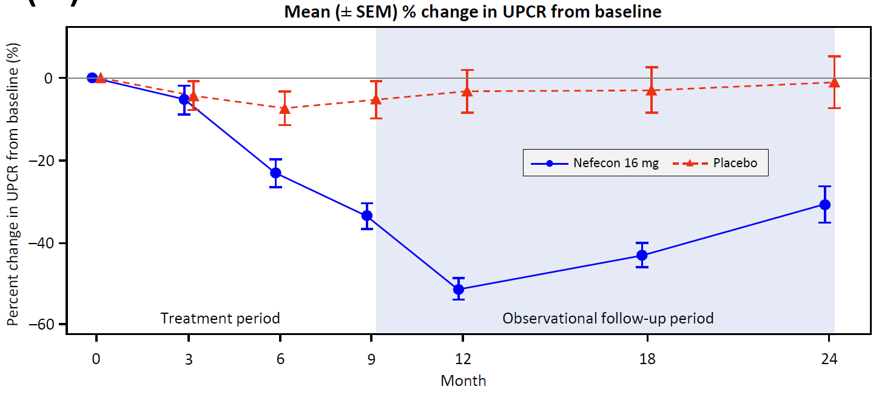
NefIgArd Part B: Results
Phase 3B
UPCR change over 24 months
Mean relative change in UPCR from baseline to 24 months in the overall study population
Mean relative change in UPCR at 24 months was -30.7% with Nefecon vs. -1.0 % with Placebo
At 24 months, the percentage reduction in UPCR in the Nefecon vs placebo arm was similar to the end of the 9-month treatment period
Notes:
And also reduction of proteinuria which was stable after stopping treatment

Slide 34
NefIgArd Part B
Phase 3B
Summary
The NefIgArd study met its 2-year primary endpoint, demonstrating that 9 months of treatment with Nefecon on top of optimized standard of care provided a statistically significant and clinically relevant preservation of eGFR compared with optimized standard of care alone.
The size of the eGFR benefit was maintained over the 15-month off-drug observational follow-up period.
The observed eGFR benefit was independent of baseline UPCR.
Nefecon 16 mg was generally well tolerated, and the AE profile was consistent with that reported in the previous interim analysis.
Notes:
In summary, nefecon was well tolerated at 16mg/d, proved efficient to reduce proteinuria and improve renal function during 9 months treat and stabilese results for the next 15mo of observation

Slide 35
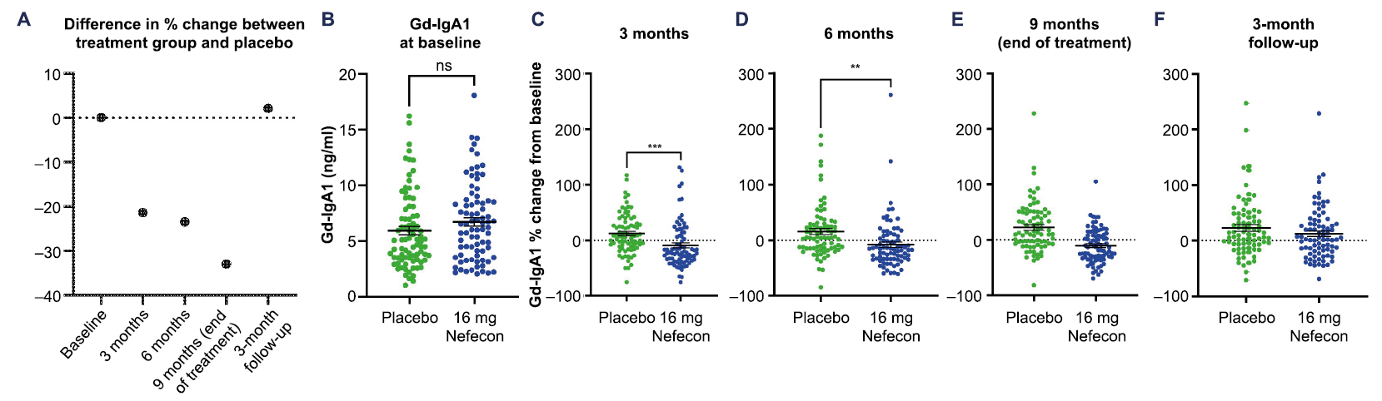
Treatment with Nefecon reduces circulating levels of gd-IgA1
 | 3 months | 6 months | 9 months
Mean reduction in gd-IgA1 vs. placebo | -21.4% | -23.5% | -34%
P-value | <0.0005 | <0.0017 | <0.0001
Molyneux et al., ASN 2022 Orlando, poster SA-PO654
Notes:
Here is a poster that showed that nefecon can reduce Gd-IgA levels

Slide 36

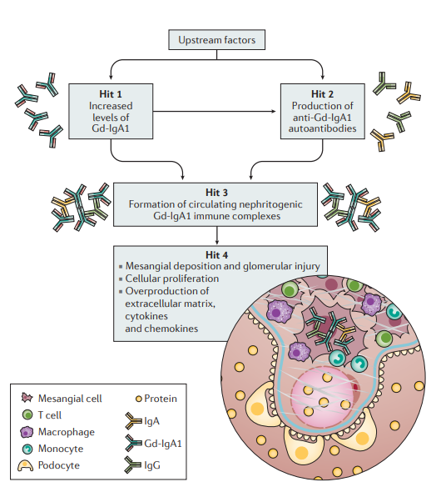
Serum Gd-IgA1 and proteomic analysis of plasma and urine in patients with IgAN, schedule of the study evaluating changes after deactivating intestinal-renal axis
Christodoulos Keskinis^{1,2}, Eleni Moysidou^{1,3}, Jerome Zoidakis⁴, Vasileios Vaios^{1,5}, Eleni Kapsia⁶, Maria Trivyza⁷, Panagiotis Pateinakis², Marios Papasotiriou⁷, Smaragdi Marinaki⁶, Pantelis Sarafidis^{1,3}, Vassilios Liakopoulos^{1,5}, Vladimir Tesar⁸, Maria Stangou^{1,3}
¹School of Medicinie, Aristotle University of Thessaloniki (AUTH), Greece
²Department of Nephrology, Papageorgiou Hospital, Thessaloniki, Greece
³1st Department of Nephrology AUTH, Hippokration Hospital, Thessaloniki, Greece
⁴Center of Systems Biology, Biomedical Research Foundation of the Academy of Athens, Greece
⁵2nd Department of Nephrology AUTH, AHEPA Hospital, Thessaloniki, Greece
⁶National and Kapodistrian University of Athens, Medical School, Nephrology Department and Renal Transplantation Unit, Laiko Hospital Athens, Athens, Greece
⁷Department of Nephrology and Renal Transplantation, University Hospital of Patras, Patras, Greece
⁸Department of Nephrology, 1st Faculty of Medicine, Charles University, Prague, Czech
Results
Between 05/2023 and 09/2023 N=24, M/F:17/7,
Mean age: 47.21±13.4years
Started on budesonide treatment.
At time of diagnosis,
41.46 ±37.79 months ago,
Mean age 43.29±14.48years, eGFR 68.7±25.3ml/min/1.73 m2 Uprot 2.993±2.07gr/24hrs.
At time of inclusion,
10/24 patients had already received steroids and 1/24 cyclophosphamide.
At time starting budesonide treatment,
eGFR58.82±25.83ml/min/1.73m² Uprot= 2.821±2.08gr/24hrs.
Conclusion
Introduction
Material & Methods
Adult patients,
eGFR>30ml/min/1.73m² Uprotein>750mg/24hr
Renal biopsies will be revaluated, and classified according to MEST-C score. Serum levels of Gd-IgA1 and plasma and urine proteomics will be estimated and analyzed by performing machine learning algorithms at the beginning of treatment (T0), and accordingly at 3, 6, 9 and 12months
Levels of Gd-IgA1 and disease biomarkers at time of disease activity and during follow up will give important information about disease pathogenesis and also, reveal predictive markers of disease activity and outcome.
Aim of the study will be to evaluate Gd-IgA1 serum levels and inflammatory mediators in plasma and urine of patients with IgAN during deactivation of intestinal-renal axis.
Notes:
And here is our poster which describes our prospective multicenter study. We are going to evaluate clicia al laboratory parameters together with biomarkers during treatment

Slide 37
IgAN patients after 3 months treatment with budesonide
IgAN patient at diagnosis
Notes:
Reduction of follicular Th17 cells after treatment

Slide 38
Conclusions
The gut-kidney axis is implicated in the pathogenesis and progression of IgAN
Increased levels of Gd-IgA1 lead to immune-complex formation and deposition into the mesangium leading to active and chronic renal lesions
Steroid treatment reduces inflammation, but it is not specific and followed by frequent relapses and side-effects
Budesonide aims to reduce production of Gd-IgA1
It is proved safe and efficient to reduce proteinuria and improve renal function
Time has come to change the aspect of our therapeutic approach
– from symptomatic treatment to precise medicine

Slide 39
Thank you for your attention!

