Slide 1



HELLENIC SOCIETY OF NEPHROLOGY MEETING & SEMINAR COMBINED WITH 18th BANTAO CONGRESS 19-22/10/23, GREECE
Challenges in diagnosis and management
of Fabry nephropathy
Elena RUSU
Nephrology Clinic, University of Medicine and Pharmacy “Carol Davila”, Bucharest, Romania
Expert Center for Rare Diseases of Reno-Urinary System, “Fundeni” Clinical Institute, Bucharest

Slide 2
Dr Elena RUSU
Disclosures
Speaker’s honoraria from Sanofi-Genzyme, Genesis Pharma (Cyprus) Ltd, Genesis
Biopharma Romania, Takeda, AstraZeneca Pharma SRL
Advisory board for Genesis Pharma (Cyprus) Ltd, Genesis Biopharma Romania, Fresenius
Kabi Deutschland, Sanofi-Genzyme, Takeda, Alnylam Pharmaceutical.

Slide 3
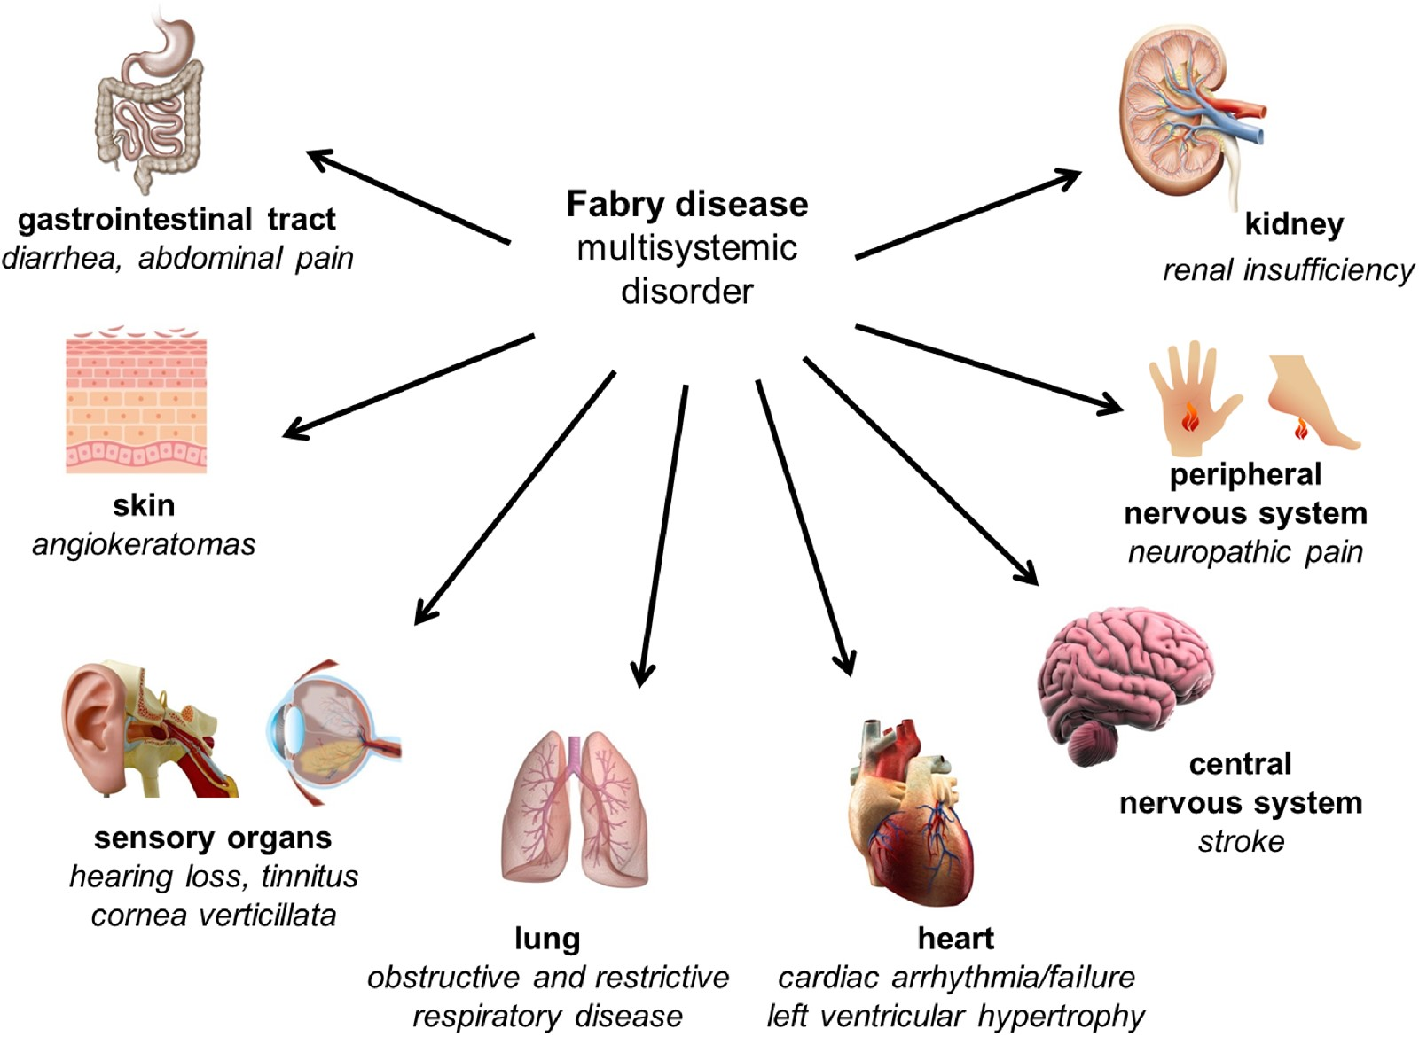
Fabry disease is a multisystemic disorder
Fabry disease (FD) is an X-linked lysosomal storage disorder, caused by the deficiency of α-galactosidase A (α-Gal A), which leads to a progressive accumulation of the globotriaosylceramide (GL-3) and its derivatives, e.g., globotriaosylsphingosine (lyso-GL-3) in various tissues.
Timeline of Fabry Disease manifestations
in hemizygous male patients*
Stroke
Proteinuria, renal failure
Cardiomyopathy
Angiokeratomas, hypohydrosis
Gastrointestinal symthoms
Pain, acroparesthesia
Age
0
10
20
30
40
50
Malte Lenders and Eva Brands. Nephrol Dial Transplant 2021; 36: ii14-ii23
*Adapted from Metha et al. Eur J Clin Invest 2004
Malte Lenders and Eva Brands. Nephrol Dial Transplant 2021; 36: ii14-ii23

Slide 4
Kidney involvement in Fabry disease
Microalbuminuria and proteinuria ^{1,2}
Chronic kidney disease³
Decreased GFR and progressive kidney failure^{1,3}
Podocyte foot process effacement¹
Substrate accumulation in glomerular endothelial, mesangial, tubular and interstitial cells¹
Glomerular sclerosis, tubular atrophy, and interstitial tissue damage (leading to kidney failure)³
Kidney biopsy demonstrating renal damage^{1,2}
1. Germain DP. Orphanet J Rare Dis. 2010;5:30. 2. Mehta A, et al. QJM. 2010;103(9):641-659. 3. Eng CM, et al. Genet Med. 2006;8(9):539-548.

Slide 5

Challenges in diagnosis and management
of Fabry disease
Reduce the time to diagnosis
Biomarkers of kidney involvement
Tools to determine when to start the treatment
Understanding the correlations between genotype and phenotype
To establish the predictors of clinical response
Improve treatment

Slide 6
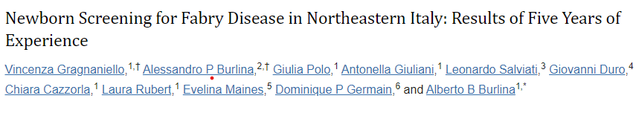
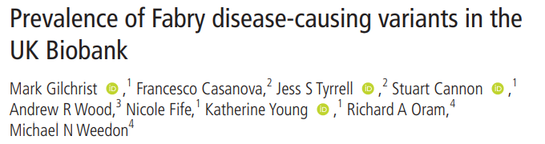
Epidemiology of Fabry disease
The prevalence of FD has been estimated between 1:40.000 and 1:170.000 individuals.
Biegstraaten M, et al. Orphanet J Rare Dis 2015;10:36.
Newborn screenings
A recent newborn screening study from Italy revealed the overall incidence of 1:7879 newborns (1 in 4068 males), and pathogenic variants incidence 1:13.334 (1 in 6883 males).
173,342 newborns (89,485 males) in 5.5 years
α-galactosidase A activity and lyso-Gb₃ assays in DBS
Biomolecules. 2021 Jul; 11(7): 951
The overall prevalence of Fabry disease causing variants in the UK Biobank is 1 in 5573 with the majority being those associated with a late-onset phenotype.
J Med Genet 2023;60:391–396.

Slide 7
Types of screening for Fabry disease
Clinical
Screening
High Risk
Screening
Family
Screening
Mass
Screening
Awareness,
Education
+ Testing
Kidney disease
Heart disease
Early stroke

Slide 8

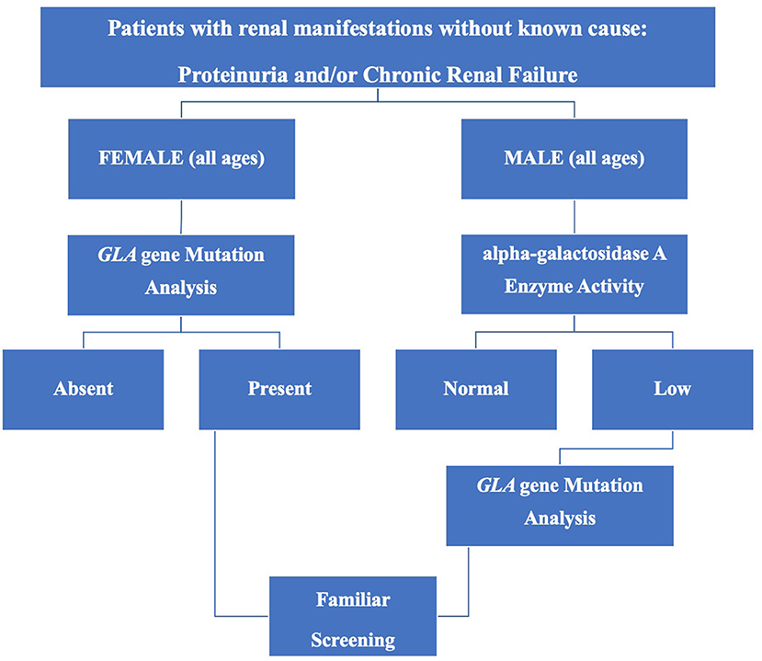
Investigation of renal signs and symptoms
could be key to prompt diagnosis and
appropriate interventions for Fabry disease
Red flags for Fabry nephropathy:¹
  Unexplained CKD, especially if presents proteinuria,
  without hypertension or mild hypertension in
  males < 50 year-old, and female, any age
  Family history of nephropathy
  Characteristic findings on kidney biopsy (zebra bodies)
Non-renal red flags:
  Unexplained left ventricular hypertrophy
  Stroke in young patient, neuropathic pain, impaired sweating
  Angiokeratomas
Flow-chart for screening for FD in CKD patients²
1. Linthorst GE. Et al. J Med Genet, 2010
2. Battaglia Y. et al. Front. Med., 2021

Slide 9
Screening for Fabry disease
High risk groups screening
Doheny et al reported prevalence of GLA variants in renal, cardiac and stroke clinics 1995-2017. Analysis included 63 studies and 51363 patients.
 | Male | Female
Hemodialysis | 0.21% | 0.15%
Renal transplant | 0.25% | 0%
Cardiac | 0.94% | 0.9%
Stroke | 0.13% | 0.14%
Family screening
For an index case with FD approximately five family members are identified.
The efficacy of screening programs depends on careful selection of an appropriate patient with multi-organ morbidity and a positive family history.
Doheny et al. J Med Genet, 2018; Battaglia Y et al. Front Med, 2021, Vardarly Y et al. Ther Clin Risk Manag. 2020, Laney et al. J Genet Couns, 2013

Slide 10
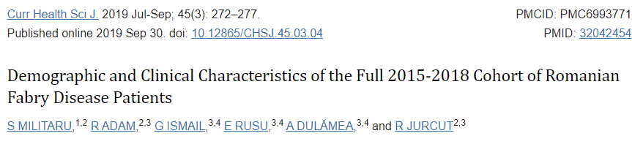
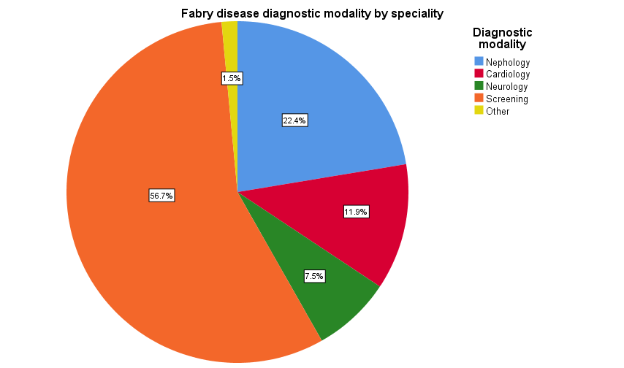
Fundeni Expert Center for Rare
Diseases of Reno-Urinary System
Between 2015-2018, a cohort of 42 Romanian patients with FD
Underdiagnosed - based on a prevalence of FD 1:100000 of approximately, in Romania should be about 200 patients diagnosed.
Between 2015 – Sep 2023, in Fundeni Expert Center for
Rare Diseases of Reno-Urinary System were evaluated
67 patients with Fabry Disease, 29 males and 38 females.
15 index cases were diagnosed by nephrologists*:
- 5 patients were diagnosed by kidney biopsy,
- 10 patients by performing enzymatic and genetic test: 5 dialyzed
patients, 1 patient with RTx, 3 with CKD 4, 1 patient CKD 3.
*Experience of Fundeni Expert Center for Rare Diseases of the Reno-Urinary System.
Notes:
Efforts of family screening and awareness

Slide 11
Key considerations for kidney biomarkers
Microalbuminuria is an early marker of Fabry nephropathy and a criterion for the diagnosis of CKD. Albuminuria should be expressed as a ratio to urinary creatinine or per 24 h.¹
Albuminuria and eGFR slopes are current gold-standard biomarkers for monitoring FD-related nephropathy.
Loss of podocytes is an early marker of Fabry disease, likely preceding proteinuria
and GFR decline, and is central to progression of Fabry nephropathy.^{2,3} Podocyturia could potentially support the diagnosis of FD and guide treatment strategies.⁴ The existing methods to assess podocyturia are not suitable for wide application in clinical settings.⁵
Use of cystatin-C provide a muscle-mass-independent criterion for early stage FD nephropathy and guide timely initiation of disease specific treatment.⁴
D.P. Germain, G. Altarescu, et al. Mol Genet Metab 2022; 137: 49–614.
Trimarchi H, et al. J Nephrol. 2016;29(6):791-797.
Najafian B, et al. Kidney Int. 2011;79(6):663-670.
Burlina A, et al. Mol Genet Metab 2023; 139, 107585
5. B. Vujkovac et al. Clinical Kidney Journal, 2022

Slide 12
Kidney biopsy – diagnostic biomarker for
Fabry nephropathy
Indications for kidney biopsy (KB) in FD nephropathy^{1,2}
To assess the degree of glomerulosclerosis and interstitial damage
In patients with 30- to 300-mg/g albumin-to-creatinine ratio and normal kidney function, the biopsy can determine whether there are GL-3 deposits and quantify them.
In women without evidence of FD nephropathy, the presence of significant renal deposits may serve as an indicator for the start of specific therapy.
Exclusion of coexistent kidney disease
Assessment of response to current therapy when a switch of therapy is being considered
Kidney biopsy findings A: Light microscopy image of a semi-thin plastic section showing a glomerulus with many lamellar inclusion bodies in podocytes (toluidine blue stain, 200x); B: Light microscopy image of a semi-thin plastic section showing renal medulla with tubular epithelial cells and vascular smooth muscle cells having their cytoplasm filled with inclusion bodies (toluidine blue stain, 200x); C: Electron microscopy image showing electron dense, lamellate inclusions (typical “zebra bodies” ) in the cytoplasm of podocytes (5700x). D: Electron microscopy image showing the densely packed lamellate membranes contained into a lysosome (24000x). Rusu, E.E. et al. Biomedicines 2022, 10,1520. https://doi.org/10.3390/ biomedicines10071520
1. Germain DP, Altarescu G. et al. Mol. Genet. Metab 2022; 137: 49-61
2. Silva C.A.B. et al. , Can. J. Kidney Health Dis., 8 (2021)
Notes:
Since renal biopsy assesses
the degree of glomerulosclerosis and interstitial damage, it can be performed in adult patients with classic FD with signs of renal involvement
in specific situations. For example, if the biopsy result could change
treatment decision-making, such as exclusion of coexistent kidney disease, initiation of therapy, or even assessment of response to current
therapy when a switch of therapy is being considered.

Slide 13
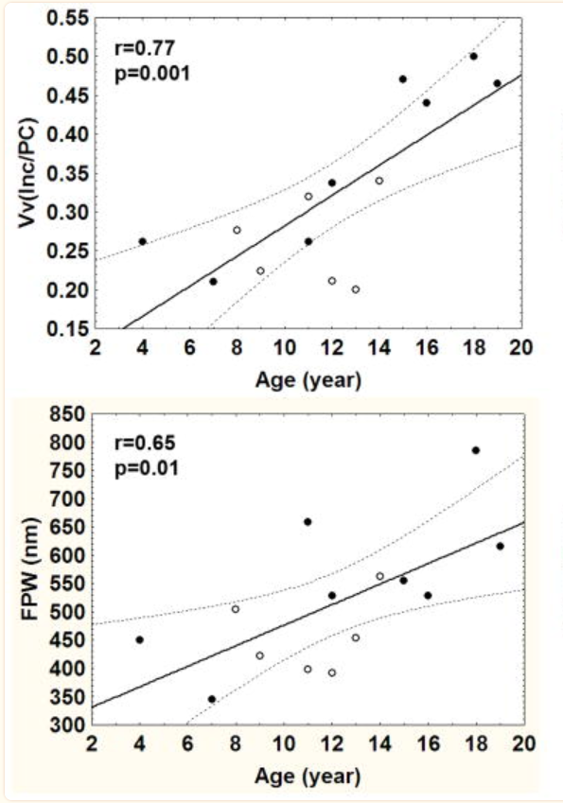
Renal histologic changes begin before
microalbuminuria is present
Renal biopsies from 14 (M/F=8/6)
therapy naive Fabry patients
(median age 12 years, range 4-19)
Relationship between age and podocyte [Vv(Inc/PC)] GL-3 fractional volume of inclusions per cytoplasm.
Direct relationship between volume fraction of GL-3 per podocyte and foot process width (FPW), an indicator of podocyte injury
Increase in foot process width (FPW), in normoalbuminuric young Fabry patients in the present study suggests that albuminuria/proteinuria is not sensitive enough to detect early kidney injury in Fabry nephropathy
Relationship between age and foot process width (FPW) in Fabry patients.
Najafian B. et al. Kidney Int. 2011; 79(6): 663–670.

Slide 14
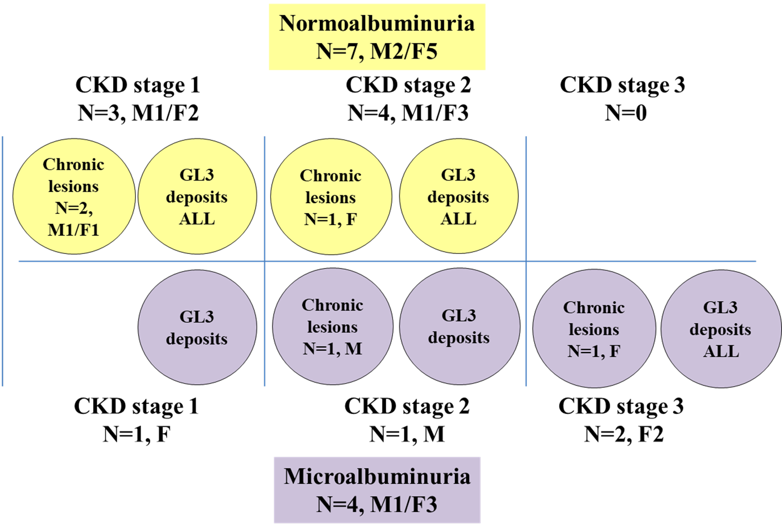
Renal histologic changes begin before
microalbuminuria is present*
Rusu E et al. poster, The 3rd International Conference on Lysosomal Diseases, London 2023
11 patients who had normoalbuminuria
or microalbuminuria (without FD specific
therapy) were evaluated by KB.
FD specific histological findings and
nonspecific chronic lesions were observed
even in normoalbuminuric patients,
demonstrating that albuminuria is not
sufficiently sensitive biomarker to diagnose
early kidney involvement in Fabry disease.
These results indicate that evaluation by
KB of FD patients can help to identify the
early kidney injury, to establish the risk of
progression, and can potentially be used to
guide clinical decisions for FD specific
therapy initiation.
*Experience of Fundeni Expert Center for Rare Diseases of the Reno-Urinary System.

Slide 15
The PRoposing Early Disease Indicators for Clinical
Tracking in Fabry Disease (PREDICT-FD)¹ -
Renal indicators for disease progression
In the international PREDICT-FD expert consensus, the early indicators of clinical kidney damage included microalbuminuria, glomerular hyperfiltration and podocyte GL3 inclusions in the presence of other renal lesions, such as signs of glomerulosclerosis or vasculopathy, which may occur even in patients without microalbuminuria.
Early
Establishedª
Late
Histology
Podocyte inclusions ^{b}
Other renal lesions
GFR
> 130
ml/min/1.73m²
< 90
ml/min/1.73m²
< 60
ml/min/1.73m²
Elevated serum cystatin C*
Albuminuria
ACR < 150 mg/g
Microalbuminuria ^{c}
ACR 150 - 300 mg/g
Microalbuminuria
ACR > 300 mg/g
Albuminuria
a = indicators that currently would be likely to trigger FD-specific treatment initiation.; b = in isolation, probably insufficient justification for FD-specific therapy initiation.
* indicator tested for, but not achieving consensus in round 3.
c = Microalbuminuria could be a trigger for further investigations, such as confirmatory biopsy, and subsequent initiation of disease-specific treatment.
ACR = Albumin : creatinine ratio
1 Hughes DA et al. BMJ Open 2020; 10:e035182

Slide 16
What are the indications for starting FD specific therapy?
 | Manifestations | Enzyme activity (in males) | Plasma lyso-GL
Classic Fabry disease | Early-onset and characteristic | Absent or deficient | High
Later-onset Fabry disease | Attenuated and non-specific | Residual | Moderately high
The European Fabry working group consensus document recommendations for enzyme replacement therapy¹
Classical FD males: 16 years or older, even if they have no symptoms or clinical signs of organ involvement | Class IIB recommendation
Classical FD males and females: as soon as there are early signs of FD organ involvement (kidney, heart, and/or CNS signs) and not fully explained by other pathology | Class I recommendation
Non-classical FD males: as soon as there are early signs of FD organ involvement (kidney, heart, and/or CNS signs and not fully explained by other pathology | Class I recommendation
Non-classical FD females: early clinical signs consistent with FD | Class IIB recommendation
1 Biegstraaten M et al. Orphanet J Rare Dis 2015; 10:36

Slide 17
Initiation of Fabry specific therapy in females:
How early is early enough?
Treatment recommendations suggest that females should start therapy only if incipient Fabry disease typical organ damage becomes apparent ⁽¹⁾
Early treatment in females with a classical phenotype might be more effective before significant end-organ damage occurs ^{(2,3)}
In an asymptomatic woman with a classic Fabry mutation, initiation of FD-specific treatment should be considered if there is laboratory, histologic, or imaging evidence of renal, cardiac, or central nervous system damage ⁽²⁾
1. Biegstraaten M et al. Orphanet J Rare Dis 2015; 10:36
2. Lenders M and Brand E. Nephrol Dial Transplant 2021; 36: ii14-ii23
3. Waldek and Feriozzi BMC Nephrology 2014; 15:72

Slide 18
Kidney biopsy findings from Fabry FEMALE patients
Rusu E et al. Nephrol Dialysis Transplant, 37, Suppl. 3, 2022 https://doi.org/10.1093/ndt/gfac062.009
No | Age at KB | ERT duration (years) | eGFR (ml/min /1.73m) | Urine ACR (mg/g) | Proteinuria (g/24h) | Global sclerosis | Segmental sclerosis | Interstitial fibrosis | Arterial sclerosis | Podocyte GL3 deposits | Tubular GL3 deposits | Endothelial GL3 deposits
1 | 55 | naive | 61 | 819 | 1.8 | + | + | + | + | + | + | +
2 | 61* | naive | 85.3 | 20 | 0 | - | - | + | + | + | + | +
3 | 35 | naive | 40 | 900 | 4.5 | + | + | - | - | + | + | +
4 | 57* | 2 | 88 | 150 | 0.2 | - | + | + | - | + | + | +
5 | 49* | naive | 104 | 100 | 0.2 | - | - | + | - | + | + | +
6 | 50 | naive | 56 | 100 | 0.4 | + | + | + | + | + | + | +
7 | 30* | naive | 88 | 10 | 0.2 | - | - | - | - | + | + | +
8 | 46* | naive | 96 | 10 | 0.1 | - | - | - | - | + | + | +
9 | 35* | naive | 81 | 20 | 0.3 | - | - | - | - | + | + | +
10 | 62 | naive | 53 | 10 | 0.1 | - | - | - | + | + | + | -
11 | 63 | naive | 59 | 30 | 0.2 | - | - | - | - | + | + | -
*Without renal criteria for initiation of enzyme replacement therapy, according to Romanian national protocol

Slide 19
Kidney biopsy in females with Fabry Disease is an important tool to establish the indication to start Fabry therapy
Rusu E et al. Nephrol Dialysis Transplant, 37, Suppl. 3, 2022 https://doi.org/10.1093/ndt/gfac062.009
Considering Romanian national criteria for initiation of enzyme replacement therapy
(eGFR < 80 ml/min/1.73m² and/or proteinuria > 300 mg/day), 6 patients with KB evaluation
did not fulfill the renal criteria, but kidney biopsy showed FD specific lesions in all cases
      3 out of 6 patients presented criteria due to other organs involvement,
      while 3 patients (mean age 37.7 years) did not fulfill any criteria for treatment initiation. These 3 patients were monitored at 6 months and 2 patients started FD-specific treatment after about 2 years.
  Our experience suggest that a revision of the Romanian national protocol is necessary, by adoption of early indicators of kidney involvement in order to promote earlier specific treatment in FD females.

Slide 20
Single center, cohort study evaluated the impact of Fabry nephropathy diagnosed by kidney biopsy on the management of patients
and long-term outcomes
Rusu, E.E. et al. Biomedicines 2022, 10,1520. https://doi.org/10.3390/ biomedicines10071520
*Previously enzyme replacement therapy treated patients; Plus (+) sign represent the presence and minus (-) sign represent the absence; M - male, F - female; NA - not applicable; GL3 - globotrioasylceramide

Slide 21
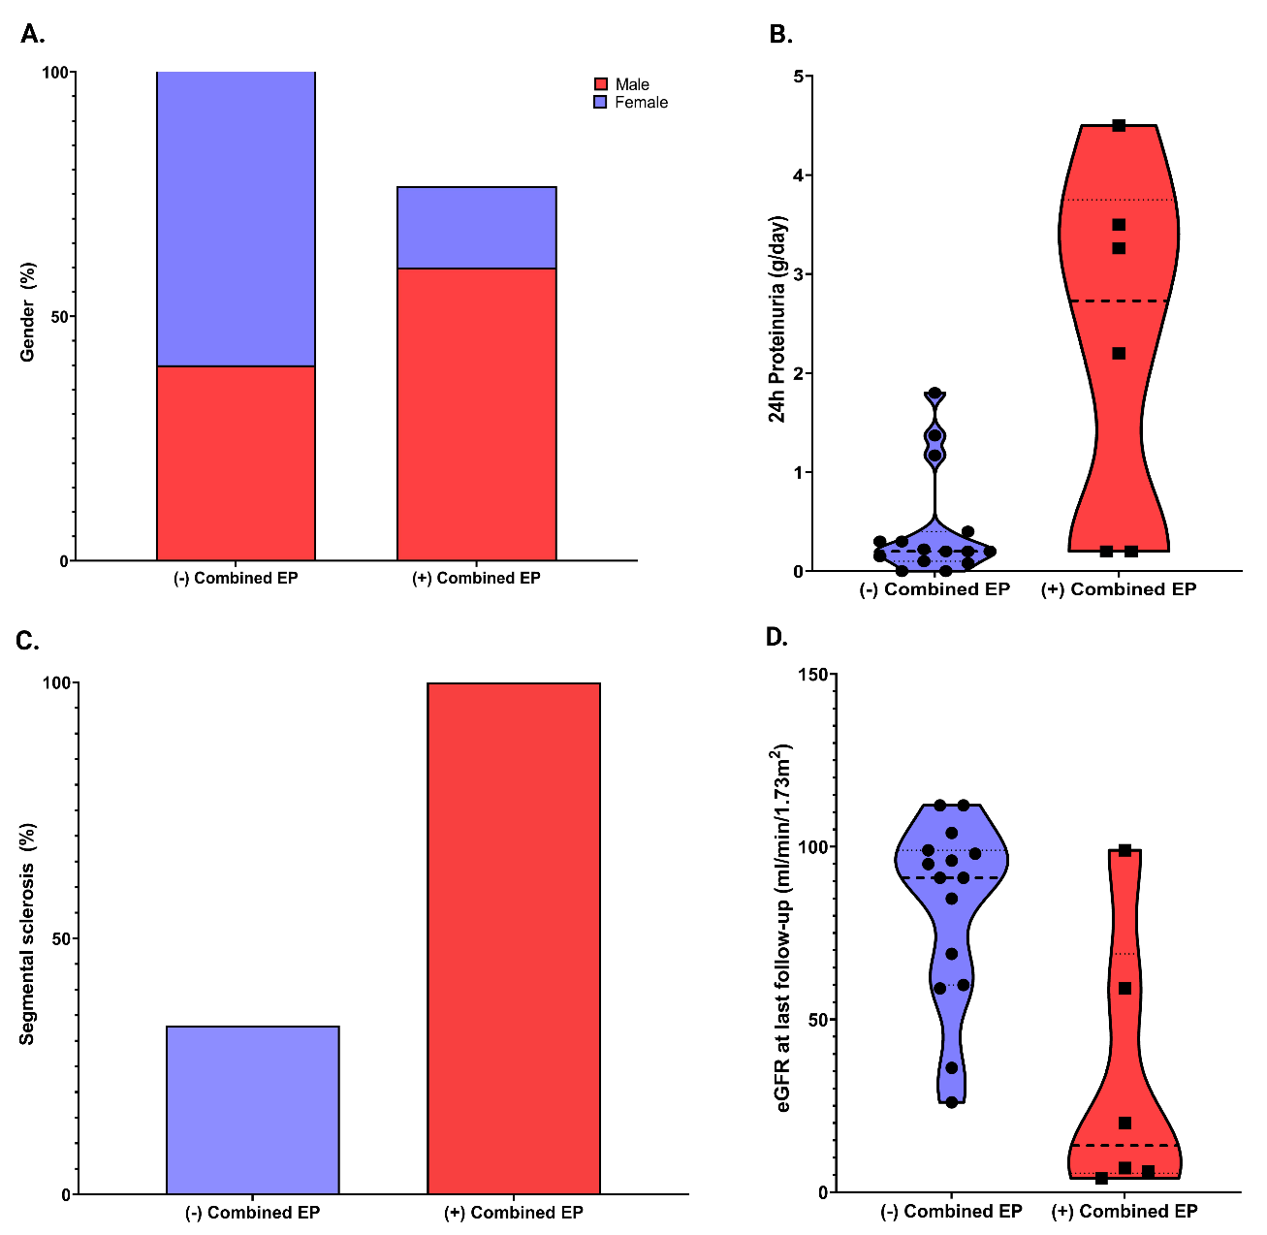
The impact of kidney biopsy for Fabry nephropathy evaluation on
patients' management and long-term outcomes: experience of a single center
Rusu, E.E. et al. Biomedicines 2022, 10,1520. https://doi.org/10.3390/ biomedicines10071520
The mean follow-up period was 47.7 ± 19.1 months
and a mandatory condition for monitoring for at
least 12 months.
Variables associated with combined endpoint (50% decrease of eGFR from baseline, reaching end-stage kidney disease and mortality):
A. Gender (p=0.06)
B. Baseline 24h proteinuria (p = 0.02)
C. Segmental sclerosis (p = 0.009)
D. eGFR at last follow-up (p=0.003).

Slide 22
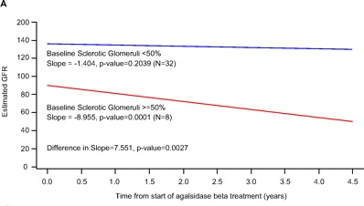
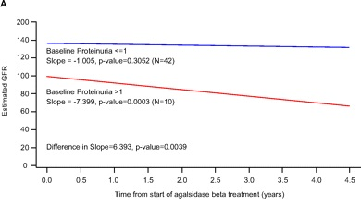
Changes in eGFR and proteinuria in individual patients
under Agalsidase beta
Subgroup analyses of patients in the “as treated” population show that those with pre-treatment glomerulosclerosis (≥50% sclerotic glomeruli) and high (>1 g/24 h) baseline proteinuria is associated with higher rate of eGFR decline and increased probability of renal events.
Germain, D.P. et al. Sustained, Long-Term Renal Stabilization After 54 Months of Agalsidase Beta Therapy in Patients with Fabry Disease. J Am Soc Nephrol 2007; 18(5):1547-1557.

Slide 23
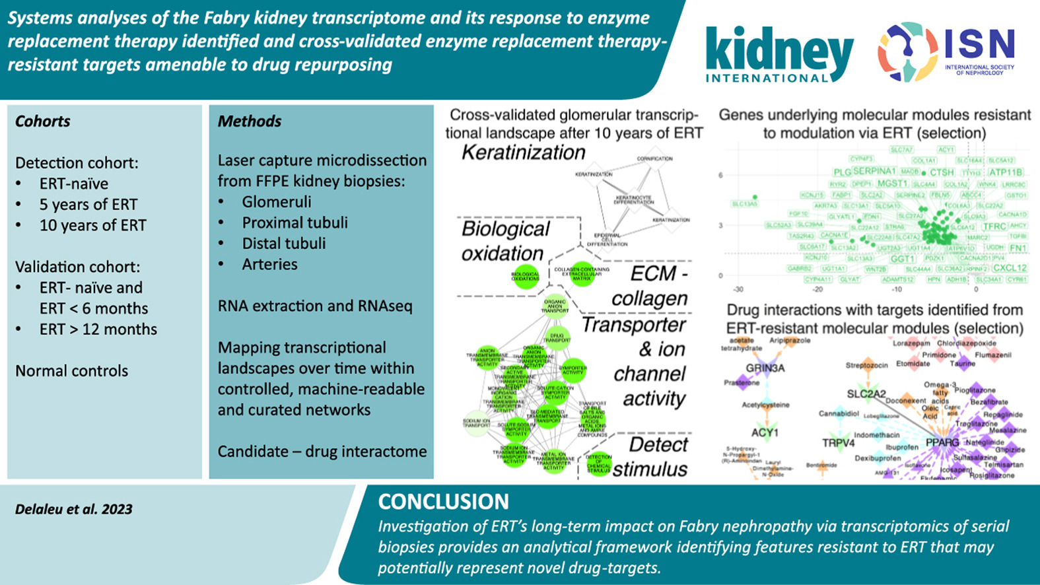
Systems analyses of the Fabry kidney transcriptome and its response to
enzyme replacement therapy identified and cross-validated enzyme
replacement therapy-resistant targets amenable to drug repurposing
Delaleu N, Marti HP, Strauss P, Sekulic M, Osman T, Tøndel C, Skrunes R, Leh S, Svarstad E, Nowak A,
Gaspert A, Rusu E, Kwee I, Rinaldi A, Flatberg A, Eikrem O
Kidney International, Volume 104 Issue 4 Pages 803-819 (October 2023)

Slide 24
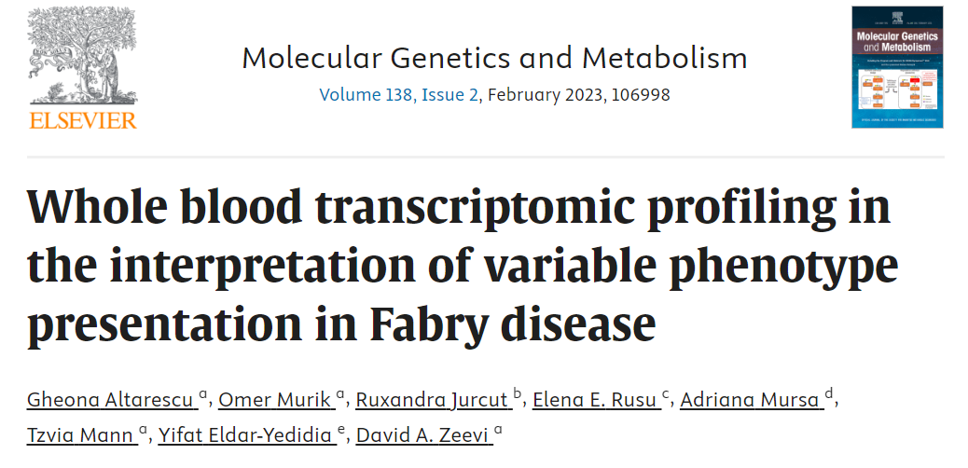
Transcriptome has potential to be an adjuvant tool for elucidating the variability of phenotypes in the same family
Cardiac hypertrophy
Stroke
?
“Conclusion: We show here that the expression profiles of FD patients are distinguished from healthy controls for a subset of over 100 genes, some of which are associated with the biological and clinical manifestations of FD. We propose to use transcriptomic profiling in order to gain a better understanding of the biological consequences of FD and in order to improve the interpretation of variable phenotypes in Fabry disease patients bearing the same GLA gene genotype.
?////
Kidney failure
?
Kidney failure
Kidney failure

Slide 25
Pedigree of the first family evaluated in
“Fundeni” Center
2006 Screening by enzymatic tests, (genetic test not available) | Index case | Male, age 25: acroparesthesias, angiokeratomas, impaired sweating, cardiac hypertrophy, proteinuria =1.8 g/24h, eGFR=98ml/min/1.73m² - α-Gal A enzyme activity = 0.01 µmol/L/h - ERT (Agalsidase beta) treatment started in 2007.
 | Family screening by enzymatic test | I-1 – uncle, age 44: acroparesthesias, angiokeratomas, impaired sweating, CKD stage 4, cardiac hypertrophy, stroke, α-Gal A enzyme activity = 0.009 µmol/L/h, ERT treatment started in 2007 I-2 – mother, age 46: acroparesthesias, depression, impaired sweating, α-Gal A enzyme activity = 0.3 µmol/L/h II-1 – age 13, carrier, negative phenotype, not tested II-2 – age 15, carrier, negative phenotype, not tested II-3 – sister, age 26, normal activity of α-Gal A (not exclude Fabry disease), microalbuminuria, normal neurological and cardiac assessment. Monitoring was recommended.
Kidney failure
?
13 yo
15 yo
26 yo
Heterozygous female with FD
Male with FD
*Represents a FD family evaluated in Fundeni Nephrology Clinic

Slide 26
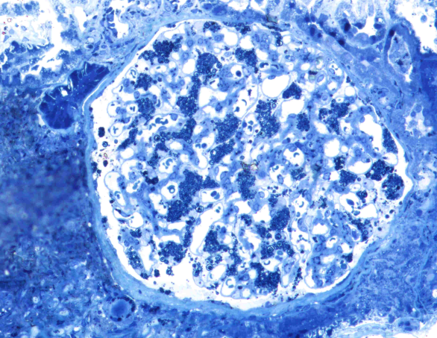
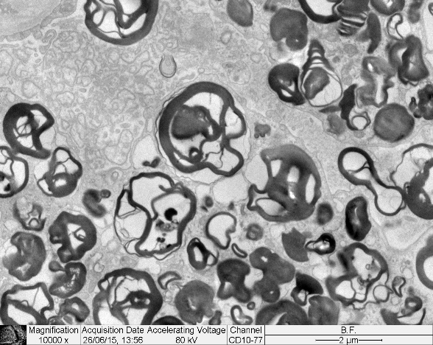
Case report – 35 yo female with Fabry disease*
2006-2015 | lost nephrology follow-up 2014 - hypertension
2015, 35 yo | genetic test: pathogenic mutation c.486 G>A
Clinical assessment (2015) | 2015
Kidney | - hypertension, CKD stage G3bA3 (eGFR=40 ml/min/1.73 m², proteinuria 4.5 g/day) - Kidney biopsy: 30% global glomerular sclerosis, numerous GL-3 deposits in podocytes, tubes, and arterioles. Another etiology for CKD was excluded.
Cardiac | - normal ECG and echocardiography, without arrythmia
Cerebrovascular | - Normal MRI
Dermatological | - upper limbs fingers angiokeratoma
Ophthalmological | - Cornea verticillata
Hemodialysis, stroke
35 yo
Heterozygous female with FD
2015 | Started ERT
2022 | ESKD, Jan 2022 started hemodialysis, Sep 2022 RTx. ERT therapy was continued.
*Represents a FD patient evaluated in Fundeni Nephrology Expert Center
Male with FD

Slide 27
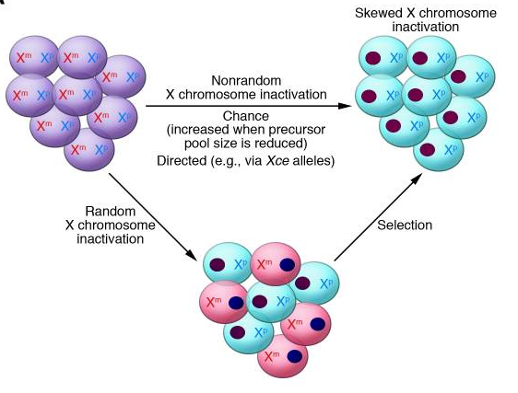
X Chromosome Inactivation
X chromosomes inactivation (XCI) involves a random choice to silence either maternal or paternal X chromosome early in mammalian female development.
Therefore, females are generally mosaics, having a mixture of cells with one or the other paternal X active. The most females the number of cells with either X being active is roughly equal. However, skewing of X chromosome inactivation is observed in a percentage of women.
Thus, women can vary from asymptomatic, mildly symptomatic, to severely symptomatic but with a later onset of symptoms.
Minks J et al. J Clin Invest. 2008 Jan 2; 118(1): 20–23.
Maier EM et. Acta Paediatr Suppl. 2006;95(451):30-8.
Echevarria L et al. Clin Genet. 2016;89(1):44-54.

Slide 28
Multidisciplinary approach
Pathogenicity of mutation Enzyme activity level Personal medical history Family history, pedigree, family screening Sign & symptoms Questionnaires (SF36, Pain-Q, FD-PRO)
Organ manifestations Biological evaluation Biomarkers: Lyso-GL3
“Fundeni” Expert Center for Rare Diseases of Reno-Urinary System:
- Clinic of Nephrology
- Clinic of Pediatric Nephrology
- Renal Transplant
The Expert Center for Rare Genetic Cardiovascular Diseases
Clinic of Neurology
Radiology and Medical Imaging
Nephrological evaluation: eGFR, UACR, 24h proteinuria, Cystatin-C, 25-OH Vit D Echo, ABPM, Guided Kidney Biopsy
Cardiac: echo, ECG, ECG Holter, LE-MRI Biomarkers: BNP, NTproBNP, troponin
Neurological, cerebral evaluation: Sudotest, EMG, Brain-MRI
Others target organ involvement
National protocol for Fabry disease treatment and Fundeni Nephrology Clinic Protocol

Slide 29
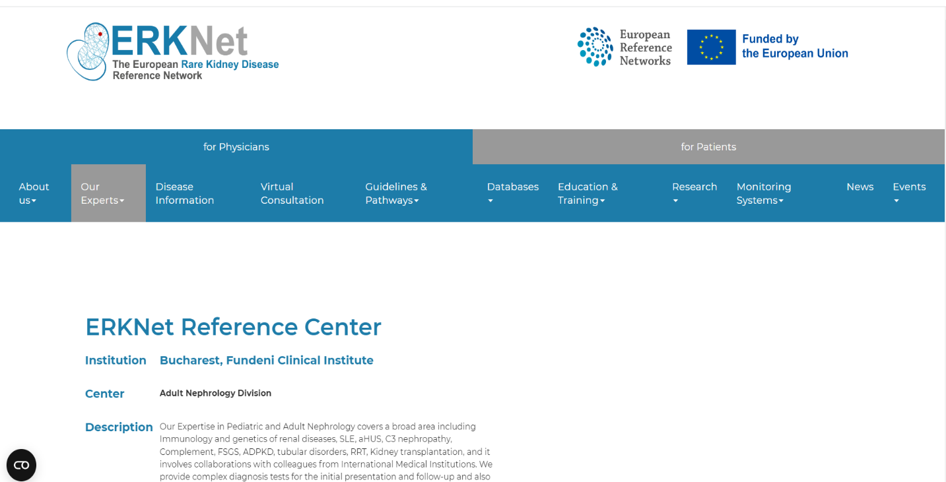
“Fundeni” Expert Center for Rare
Diseases of Reno-Urinary System
2006 – Romanian Association for the Study of Hereditary Kidney Diseases
2016 – Expert Center for Rare Diseases of Reno-Urinary System
2021 – full member of the European Rare Kidney Disease Reference Network (ERKNet)
www.nephroered.ro, www.erknet.org

Slide 30
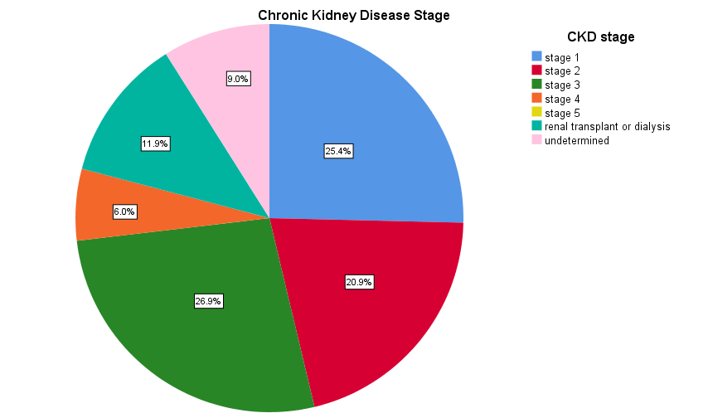
Experience of “Fundeni” Expert Center
for Rare Diseases of Reno-Urinary System
Between 2015 – Sep 2023, in our center were evaluated 67 patients with Fabry Disease:
29 males and 38 females
Mean age: 40.6 ± 16.3 (3-75) years
No of adult: 62
No of children: 5
No of families: 27

Slide 31
Experience of “Fundeni” Expert Center
for Rare Diseases of Reno-Urinary System
Baseline characteristics of Fabry adult patients
 |  | Male (n= 27) | Female (n=35)
General features and cardiovascular risk factors* | Mean age at baseline, years | 39 | 46
 | Mean age of diagnosis | 35 | 44
 | Mean age at symptoms | 20 | 33
 | Hypertension | 11 | 13
 | Dyslipidemia | 10 | 13
 | Diabetes | 0 | 2
 | Smoking | 11 | 15
*The cohort of patients evaluated in Fundeni Expert Center for Rare Diseases of the Reno-Urinary System.

Slide 32
Experience of “Fundeni” Expert Center
for Rare Diseases of Reno-Urinary System
Kidney symptoms |  | Male* (n= 24) | Female* (n=31)
CKD stage at baseline | Subclinic/no CKD | 0 | 3
 | G1 | 7 | 10
 | G2 | 3 | 9
 | G3a | 5 | 9
 | G3b | 2 | 2
 | G4 | 3 | 1
 | G5/Dialysis | 2 | 1
 | Kidney transplant | 5 | 0
Proteinuria level | Without albuminuria | 4 | 14
 | Microalbuminuria | 8 | 9
 | Proteinuria | 12 | 8
Kidney biopsy | 26 adult patients | 11 | 15
Baseline characteristics of our Fabry adult patients
*Patients evaluated in Fundeni Expert Center for Rare Diseases of the Reno-Urinary System.

Slide 33
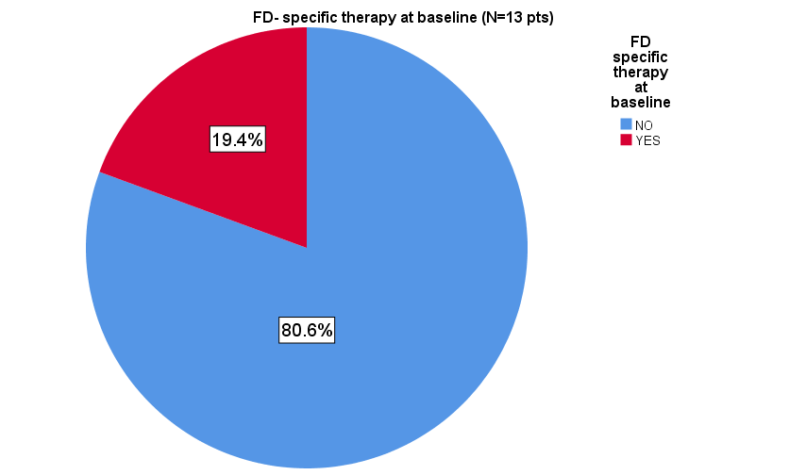
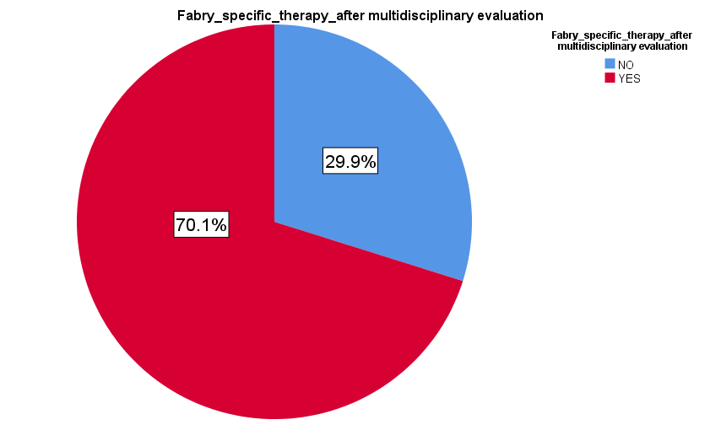
Experience of “Fundeni” Expert Center
for Rare Diseases of Reno-Urinary System
FD-specific therapy at baseline = 13 pts | FD-specific therapy after multidisciplinary evaluation = 48 pts
26 patients with kidney biopsy in our cohort of patients
*The cohort of patients evaluated in Fundeni Expert Center for Rare Diseases of the Reno-Urinary System.

Slide 34
Experience of “Fundeni” Expert Center
for Rare Diseases of Reno-Urinary System
 |  | Male (n=27) | Female (n=35)
Fabry features in adult patients at baseline* | Hypertrophic cardiomyopathy, n (%) | 22 (81.5) | 13 (37.1)
 | Pacemaker, n (%) | 2 (7.4) | 6 (17.1)
 | Acroparesthesias, n (%) | 26 (96.3) | 29 (82.8)
 | Stroke, n (%) | 2 (7.4) | 5 (14.3)
 | TIA, n (%) | 2 (7.4) | 0
 | Hypohydrosis, n (%) | 20 (74) | 12 (34.3)
 | Angiokeratomas, n (%) | 21 (77.7) | 9 (25.7)
 | ENT involvement, n (%) | 9 (33.3) | 8 (22.8)
 | Cornea verticillata, n (%) | 18 (66.6) | 14 (40)
4 | α-GLA activity, nmol/h/mg, median | 0.57 | 1.36
 | Lyso-GL3 at baseline, ng/ml | 60.06 | 6.34
*The cohort of patients evaluated in Fundeni Expert Center for Rare Diseases of the Reno-Urinary System.

Slide 35
Treatment of Fabry nephropathy
The following therapeutic
goals should be aimed:
reduction of complaints
delaying/preventing the progression of organ manifestations
improvement of quality
of life
improvement/ normalization of life expectancy
Symptom-based
Interventions
Disease-specific
Therapy
Optimal care involves both disease-specific and supportive treatment and regular follow up with a multidisciplinary team experienced in the management of Fabry disease
¹Eng et al. Genet Med 2006;8:539-48
²Schaefer et al. Drugs 2009;69:2179-205
Treatment Basics
Lenders M and Brand E. Nephrol Dial Transplant 2021; 36: ii14-ii23

Slide 36
Therapeutic renal goals for patients with Fabry disease
Patient subgroup | Therapeutic goals
Mild kidney involvement, eGFR at normal levels or hyperfiltration (eGFR > 90 mL/min/1.73m²) | eGFR should be maintained in an age-appropriate normal range
Mild-to-moderate kidney function impairment, mild eGFR decreases (eGFR 60–90 mL/min/1.73m²) | Prevent progression of eGFR loss and stabilize eGFR level
Moderate-to-severe kidney function impairment, mild-to-moderate eGFR decreases (eGFR 45–59 mL/min/1.73m²) | Prevent progression of eGFR loss to delay/avoid ESKD
Moderate-to-severe eGFR decreases (eGFR 30–44 mL/min/1.73m²) | Prevent progression of eGFR loss to delay/avoid ESKD
Severe eGFR decreases (eGFR 15–29 mL/min/1.73m²) | Decrease the slope of eGFR as much as possible; delay the progression to ESKD
ESKD | Provide optimal RRT by dialysis or RTx (first choice therapy), maintain ERT to avoid damage to heart, CNS Suggest and encourage RTx before dialysis to prevent impact on other organs
Patient subgroup | Therapeutic goals
Mild-to-moderate kidney function impairment; albuminuria levels: <30 mg/g (< 3 mg/mmol) | Normalize/stabilize albuminuria
Albuminuria levels: 30–300 mg/g (3–30 mg/mmol) | Normalize/stabilize albuminuria
Albuminuria levels: >300 mg/g (> 30 mg/mmol) | Reduce levels to <300 mg/g (<30 mg/mmol)
Moderate-to-severe kidney function impairment | Slow progression of albuminuria
Wanner C. et al. Molecular Genetics and Metabolism 2018; 189-203

Slide 37
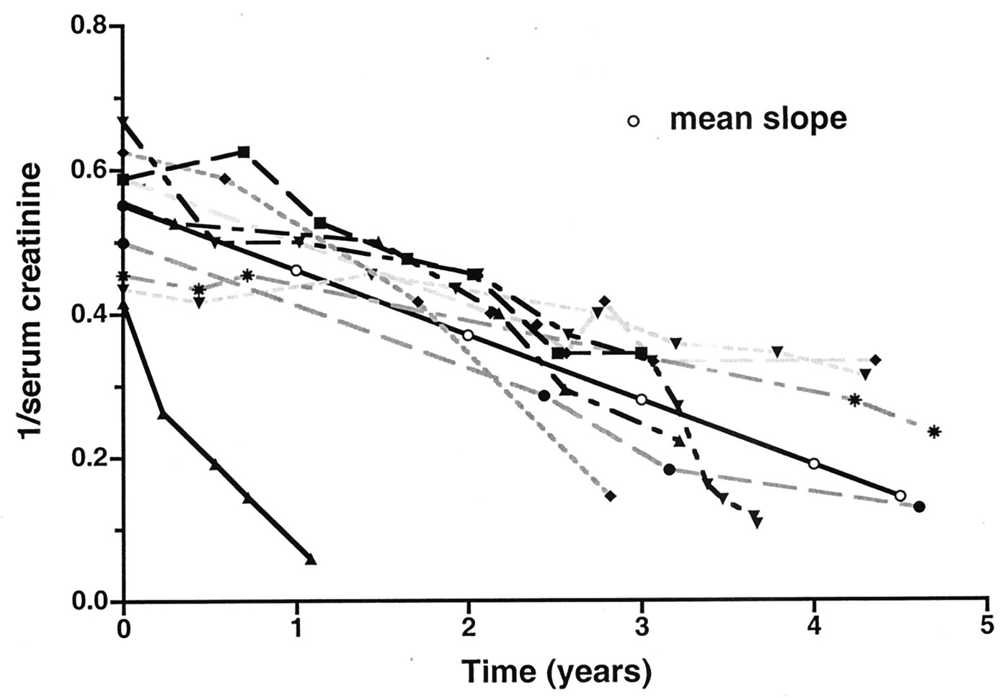
Natural course of Fabry nephropathy
Mean GFR decline = 12,2 ml/min/year
A loss of up to 1 ml/min/1.73m²/year is considered normal.
Stabilization of renal function is achieved if a patient has a GFR slope loss ≤ 1-3 ml/min/1.73m²/year.
Progression of renal disease is demonstrated by an annual decrease in GFR > 3 ml/min/1.73m².
Rapid progression is considered when GFR decrease is > 5 ml/min/1.73m²/year.
KDIGO clinical practice guideline for the evaluation and management of CKD. Kidney Int 2013
Kantola IM. Nephrol Dial Transplant 2019
Branton M et al. JASN 2002;13:S139-S143

Slide 38
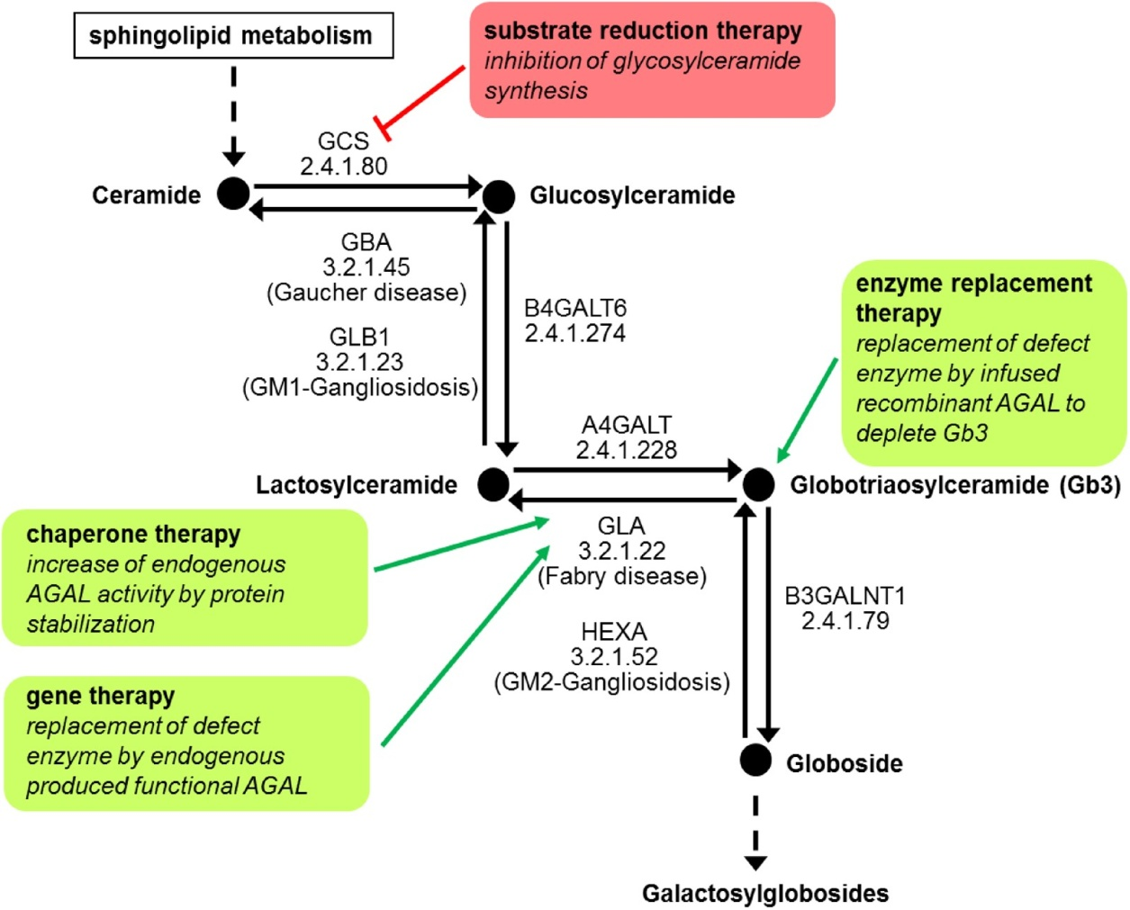
Fabry disease specific treatment
Drug Name |  | Mechanism of Action | Route of Administration
Enzyme replacement therapy | Agalsidase-beta | Recombinant α-GAL | iv., every 2 weeks
 | Agalsidase-alpha | Recombinant α-GAL | iv., every 2 weeks
 | New approved ERT - Pegunigalsidase alfa | Plant derived α-GAL | iv., every 2 weeks
Chaperone | Migalastat | Binds reversibly to the active site of the amenable mutant of α-GAL | Oral, every other day
Investigational drugs | Substrate reduction therapy: lucerastat, venglustat | Glucosylceramide synthase inhibitor | Oral, daily
 | Gene therapy
Malte Lenders and Eva Brands. Nephrol Dial Transplant 2021; 36: ii14-ii23
Umer M et al. Pharmaceuticals 2023, 16(2), 320

Slide 39
Supportive therapy for Fabry nephropathy
RAAS blocker (ACEI or ARB)
General management of CKD regarding anemia treatment, statin indication,
and CKD-MBD prevention and management according to guidelines
SGLT2 inhibitors might be of future interest due to the general cardiovascular
and kidney protection in non-diabetic patients.
Malte Lenders and Eva Brands. Nephrol Dial Transplant 2021; 36: ii14-ii23
Battaglia Y et al. J Clin Med 2023

Slide 40
Experience of “Fundeni” Expert Center
for Rare Diseases of Reno-Urinary System
Since 2006 – Enzyme replacement therapy with Agalsidase beta has been started as a compassionate program
Since 2008 - Romanian National Program for Rare Diseases, which provides the source of funding of the
treatment for rare diseases, including treatment with Agalsidase beta for Fabry disease
Since 2019 - Migalastat treatment has been approved in Romania
Since 2021 - Agalsidase alpha has been approved
Patients with Fabry disease * | Total N | Treated N (%) | Type of treatment
 | 67 | 48 (71.6%) | Agalsidase beta | Migalastat | Agalsidase alfa
Males | 27 | 26 (96.3%) | 21 | 4 | 1
Females | 35 | 21 (60%) | 15 | 6 | -
Children | 5 | 1 (20%) (10 yo boy) | 1 | - | -
*The cohort of patients evaluated in Fundeni Expert Center for Rare Diseases of the Reno-Urinary System.

Slide 41
Evolution of proteinuria for 19 patients treated with Fabry specific therapy during follow-up period*
Evolution of proteinuria for 19 patients treated with Fabry specific therapy during
follow-up period (between 12 months and 60 months).
Patients
24 h proteinuria (g/24 h)
*Experience of Fundeni Expert Center for Rare Diseases of the Reno-Urinary System.

Slide 42
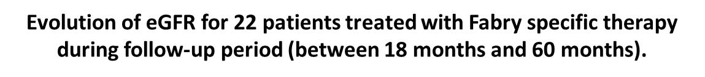
Treatment effect on GFR slope can predict
clinical benefit*
*Experience of Fundeni Expert Center for Rare Diseases of the Reno-Urinary System

Slide 43
Long-term outcome of
the “Fundeni” Expert Center cohort
 | Before the initiation of Fabry disease specific treatment | After the initiation of Fabry disease specific treatment
Cardiovascular event (Arrhythmia, congestive heart failure, myocardial infarction, significant cardiac procedure, complete heart block) | 3 (1M,2F) | 6 (4M/2F)
Age at cardiovascular event | 53.4±8.2 (range 45-62)
Cerebrovascular event (TIA, stroke) | 9 (4M/5F) | 5 (4M/1F)
Age at cerebrovascular event | 45.3±12.1 (range 26-65)
Renal event (reaching ESKD, dialysis or kidney transplant) | 7 (6M,1F) | 4 (3M/1F)
Age at renal event | 37.27±14.8 (range 18-64)
Death | 2 (1M/1F) | 6 (5M/1F)
Age at death | 52.3± 11.7 (range 33-66)
*Experience of Fundeni Expert Center for Rare Diseases of the Reno-Urinary System. Not published data.

Slide 44
KEY TAKEAWAYS
Fabry disease is heterogeneous, with classical and non-classical presentations
Screening and testing is important to identify new patients
Kidney biopsies increase knowledge about histological lesions and could be used for identifying
new treatment targets in Fabry disease
Factors influencing GFR and GFR slope in FD patients are: age, gender, baseline CKD stage,
baseline proteinuria, and the presence of glomerular sclerosis on kidney histology
Updated recommendations underline the importance of early treatment initiation in both males
and females, and stress the importance of patient-specific care and a multidisciplinary approach to
disease management.

Slide 45
Thank you!

