Slide 1


The important interaction between science and advocacy at influencing European politics
BANTAO Meeting Thessaloniki
October 20, 2023
Raymond Vanholder, EKHA President

Slide 2


Agenda
Introduction to the European Institutions
Introduction on EKHA and its advocacy endeavours.
How the activities of EKHA and ERA complement each other.
Call to action: support the EKHA manifesto that will be launched ahead of the European elections in spring 2024

Slide 3
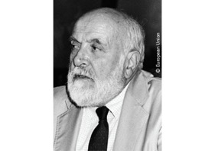
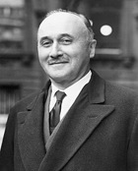

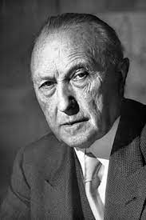
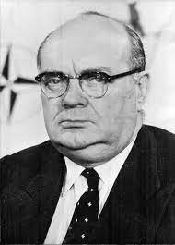
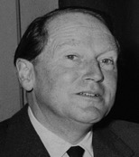
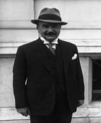
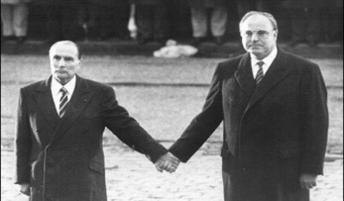
EU History
A Spinelli
J. Monnet R. Schumann K. Adenauer PH. Spaak JW. Beyen J. Beck
European Coal and Steel Community – 1951
European Economic Community – 1957
European Union – 1973
F Mittérand – H Kohl

Slide 4
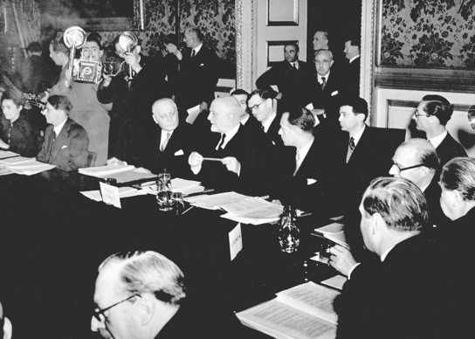
EU History
YEAR | COUNTRIES
1951 | Belgium, France, Germany, Italy, Luxembourg, the Netherlands
1973 | Denmark, Ireland, UK
1981 | Greece
1986 | Portugal, Spain
1995 | Austria, Sweden
2004 | Czechia, Cyprus, Estonia, Latvia, Lithuania, Hungary, Malta, Poland, Slovenia, Slovakia
2007 | Bulgaria, Romania
2013 | Croatia
2020 | Brexit
4

Slide 5
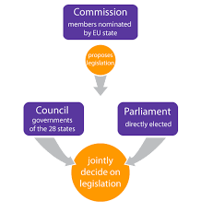
EU basic structure
Controlling organs
  European Central Bank
  European Court of Justice
  European Court of Auditors

Slide 6
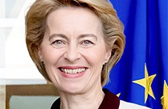
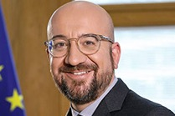
EUROPEAN COMMISSION
COUNCIL
LEADERS OF EU27

Slide 7
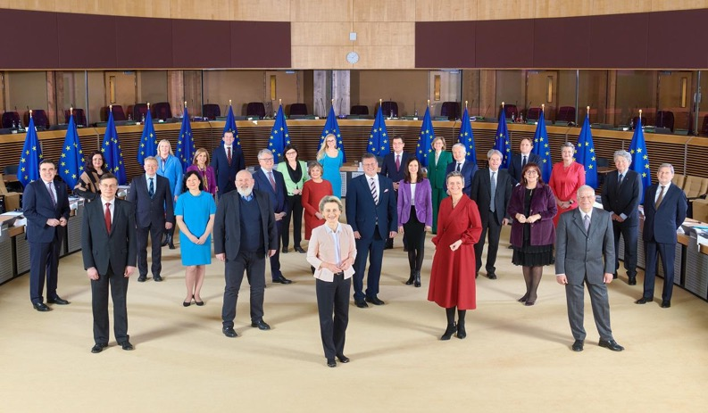
European Commission
1 President
8 Vice-Presidents
18 Commissioners
Appointed by their countries
2019-2024

Slide 8
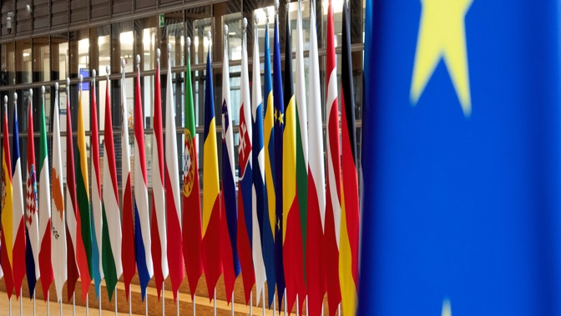
Share
Twitter
Facebook
LinkedIn
Presidency of the council of the European union
Rotational basis per semester
  2022 France, Czechia
  2023 Sweden, Spain
  2024 Belgium, Hungary

Slide 9
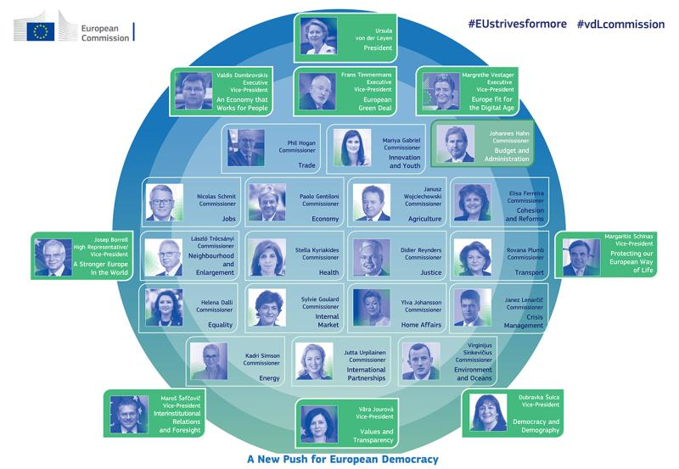
General directorates
33 General Directorates
  Health and food safety (SANTE)
  Research and innovation (RID)
  Health and consumer protection (SANCO)
  Informatics (DIGIT)
  Environment (ENV)
  Humanitarian aid and civil protection (ECHO)
  Education and culture (EAC)
11 Services

Slide 10
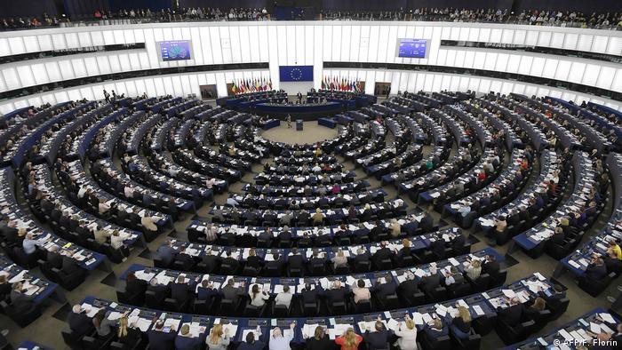
EUROPEAN PARLIAMENT
705 Members of European Parliament
7 Fractions
  The Left 5.5%
  Socials & Democrats 20.7%
  Greens 10.4%
  Renew 13.9%
  European Popular Party 25.4%
  European Conservatives and Reformists 8.9%
  Identity and Democracy
Committees
  ENVI: environment, health & food safety
Notes:
ECR = NVA, ID = 10.1

Slide 11
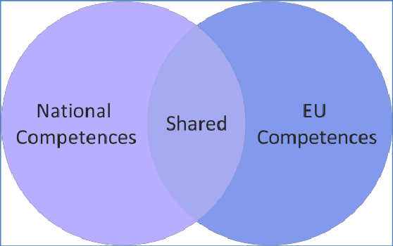
Eu competences vs member states
EXCLUSIVE | SHARED | SUPPORTING
Customs | Internal market | Health
Competition | Agriculture | Industry
Monetary (Euro) | Environment | Culture
Fishery | Transport | Tourism
Commerce | Energy | Education
International agreements | Justice | Disaster prevention
 | Safety | Administration
 | Foreign affairs
 | Humanitarian aid

Slide 12
Eu competences vs member states
EXCLUSIVE | SHARED | SUPPORTING
Customs | Internal market | Health
Competition | Agriculture | Industry
Monetary (Euro) | Environment | Culture
Fishery | Transport | Tourism
Commerce | Energy | Education
International agreements | Justice | Disaster prevention
 | Safety | Administration
 | Foreign affairs
 | Humanitarian aid
 | Public health

Slide 13
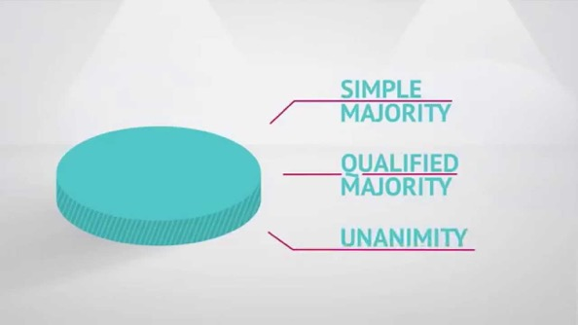
Voting procedure
Simple majority
  14 Council members pro
  Procedural matters
Qualified majority
  55% (15) [72%] of members states pro, representing 65% of EU population
  Proposal by Commission (80% of legislation)
Blocking minority
  4 member states contra representing 35% of EU population
  Proposal returns to Commission
Unanimity
  For “sensitive” matters
  Foreign affairs, security, EU finances, EU membership, some legal matters

Slide 14








Strengthening the work of our network by means of advocacy
EKHA is a non-profit organisation whose aim is to propose solutions for the challenges of Chronic Kidney Disease in Europe through EU-level advocacy.
EKHA works on the principle that the issue of kidney health and disease must be considered at European level and that both the European Commission and European Parliament have vital roles to play in assisting national governments with these challenges.
EKHA advocates for more effective prevention and a more efficient care pathway intended to facilitate the provision of high-quality care and affordable treatment to all Europeans equally.
is the European Nephrology advocacy platform in which a broad scope of organisations and individuals work together for healthy kidneys and the benefit of people with kidney diseases.
The EKHA platform connects the following groups of the Nephrology world:
Physicians
Nurses
Patients
Foundations
Commercial partners
Individuals
Members of European Parliament (22)
14

Slide 15












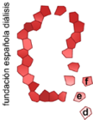
































EKHA members in 2023
5 FULL MEMBERS:
31 AFFILIATE MEMBERS:
10 SUPPORTERS:
Swedish Society of Nephrology
EKHA is a member of
and
EKHA is supported in their advocacy by the 22 members of the MEP Group for kidney health
15
15

Slide 16
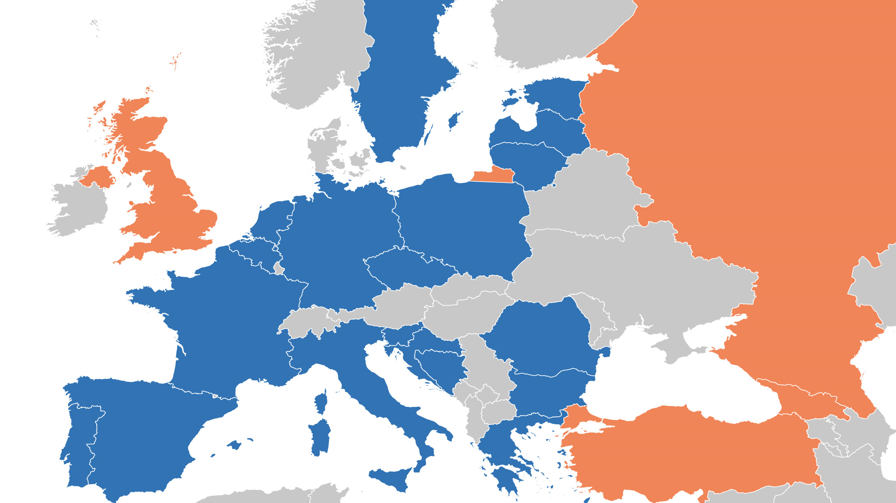

Slide 17
Where science meets advocacy – EKHA projects 2023
PREVENTCKD: to enhance CKD screening, data on prevalence and incidende, best practises and the creation of a CKD prevention code.
The project is funded by the EC and supported by AstraZeneca, in collaboration with members of EKHA working group 1 and the following consortium partners:
  EKPF –– EUTOX – IMEC – ISN – RENALOO
Collaboration with other major NCD societies
  International Diabetes Federation Europe (IDF)
  European Association for Cardiac Health (EACH)
Facilitate Home Haemodialysis care for chronic dialysis patients in Europe (funded by Mozarc) in collaboration of a working group constructed of experts in the nephrology field (nephrologist, nurses and patient).
Establishment of an international consortium for ground breaking innovation in collaboration with:
  Patient organisations EKPF and AAKP;
  The co-chairs of the MEP Group For Kidney Health and (Hilde Vautmans and Ondrej Knotek)
  the Co-Chairs of the USA bi-partisan Congressional Kidney Caucus Congressman Larry Bucshon and Congresswoman Suzan DelBene,
  Members of EKHA working group 3

Slide 18

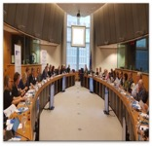
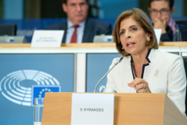



Where science meets advocacy – a snapshot of activities
EKHA Recommendations on CKD prevention, treatment and care to inform EU policies and initiatives
Annual European Kidney Forum in the European Parliament hosted by the MEP Group for Kidney Health
Regular meetings with policy makers from the European Parliament, European Commission and Member-States
Annual EU policy-focused campaign on World Kidney Day
Peer-reviewed articles on CKD with a policy angle (34)
Active posting on EKHA social media (X and LinkedIn)

Slide 19

Scientific papers on issues concerning CKD in 2023
In 2023 EKHA published 11 scientific articles on CKD. The latest are
Vanholder et al, A policy call to address rare kidney disease in health care plans. Clin. J. Am. Soc. Nephrol. Available from: Doi: 10.2215/CJN.0000000000000220
Vanholder et al, Inequities in kidney health and kidney care. Nat. Rev. Nephrol. Available from: 10.1038/s41581-023-00745-6
Also EKHA working group members publish scientific articles:
Wieringa et al, Coordinating efforts to optimize next-generation kidney replacement therapies: the European Kidney Health Alliance work group ‘Breakthrough innovation. Clin. Kidney J., 16, 885-890, 2023
Science meets advocacy
Announcement of the European Kidney Forum Vanholder et al in J Nephrol. 36, 1225-1227, 2023
Article in Health Quarterly Issue 25: Improving care and awareness of CKD, written by Raymond Vanholder and Eveline Scheres

Slide 20


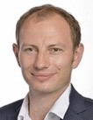

Campaigns and events with strong ambassadors (2023)
World Kidney Day
Awareness-raising campaign ‘Show Your Kidneys Love’ with Tina Turner
Online campaign: written conversation on the vulnerability of kidney patients during disastrous events
Celebrating 80 years of dialysis: Time again for science fiction
Successful event in the European Parliament,
hosted by MEP Knotek (Czechia), commemorating the invention of dialysis & reminding the urgency of innovation.
The event was organized in close collaboration with
Fokko Wieringa, Phd (chair EKHA of working group 3 on ground-breaking innovation) who created a short movie on the inspiring live of Dr. William Kollf
20

Slide 21
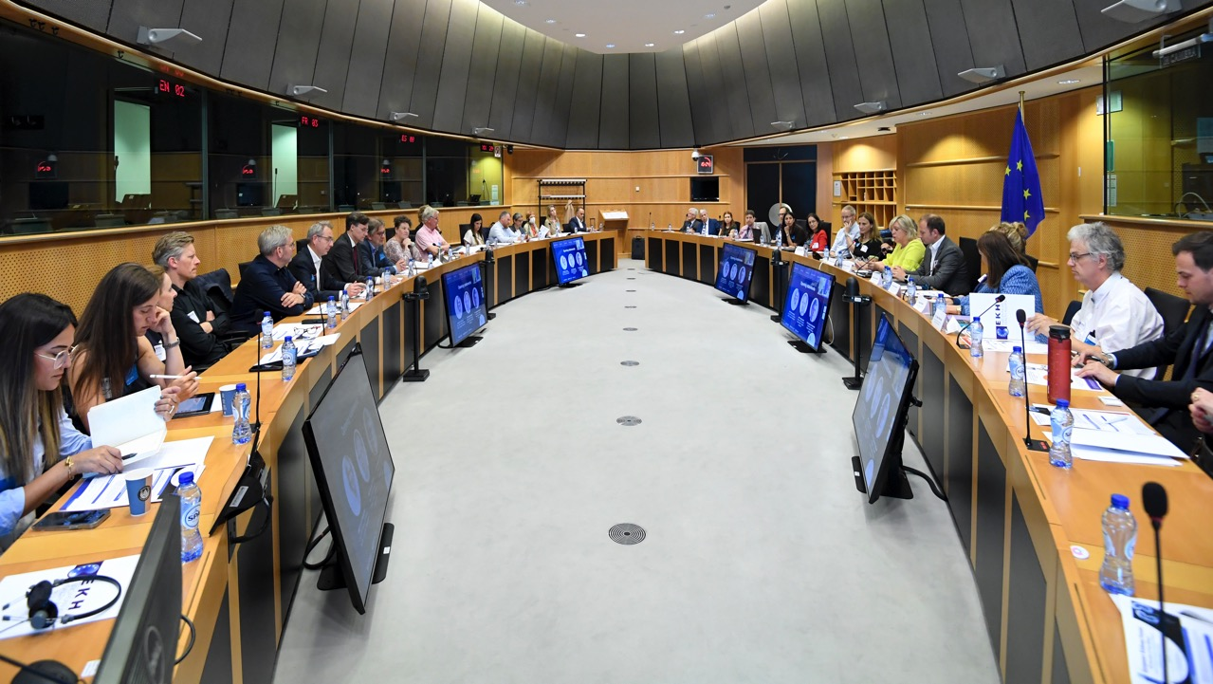
Welcome to our Forum!

Slide 22

2023 European Kidney Forum
Annual policy event in the European Parliament

Slide 23






EKHA advocacy achievements
CKD mentioned in high-level parliamentary debates
EU funding secured for CKD prevention and early diagnosis
CKD included in key EU reports, initiatives and policies
The CKD community represented annually in the European Parliament
EKHA seen as a go-to partner for any EU initiatives on kidney disease
Strong network of EU policy makers established to support efforts on CKD

Slide 24
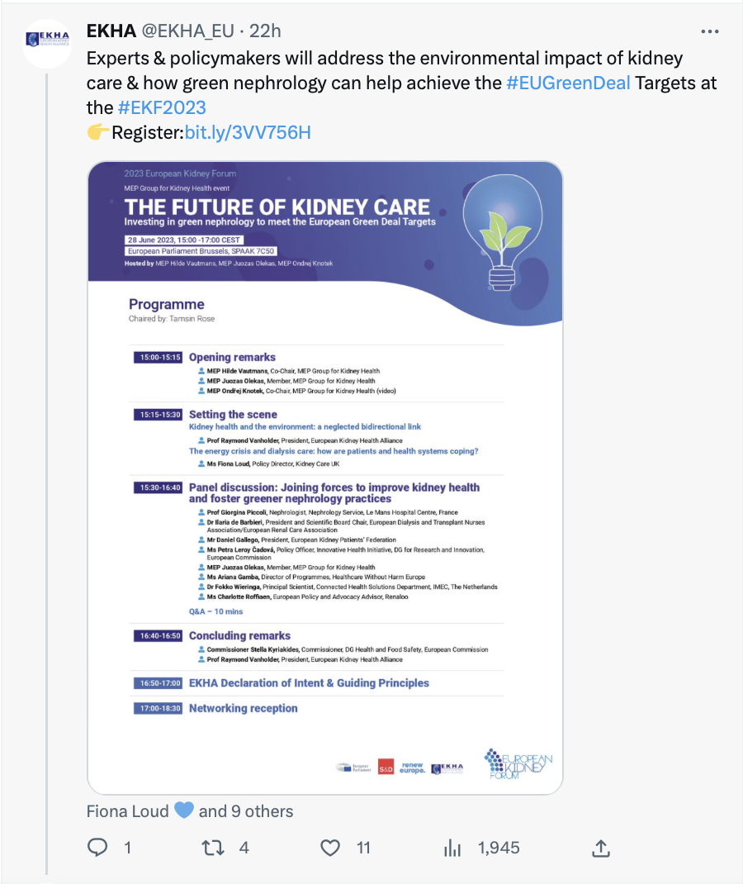


EKHA communication achievements
Growing network on social channels
Help us in spreading the message and follow us on “X” and Linked-in!
1026 followers on linked-in
957 followers on twitter

Slide 25


ERA versus EKHA
Collaboration to strengthen mutual goals

Slide 26
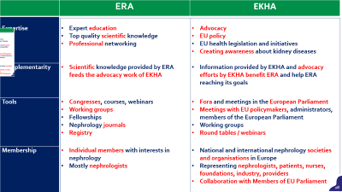

 | ERA | EKHA
Expertise | Expert education Top quality scientific knowledge Professional networking | Advocacy EU policy EU health legislation and initiatives Creating awareness about kidney diseases
Complementarity | Scientific knowledge provided by ERA feeds the advocacy work of EKHA | Information provided by EKHA and advocacy efforts by EKHA benefit ERA and help ERA reaching its goals
Tools | Congresses, courses, webinars Working groups Fellowships Nephrology journals Registry | Fora and meetings in the European Parliament Meetings with EU policymakers, administrators, members of the European Parliament Working groups Round tables / webinars
Membership | Individual members with interests in nephrology Mostly nephrologists | National and international nephrology societies and organisations in Europe Representing nephrologists, patients, nurses, foundations, industry, providers Collaboration with Members of EU Parliament

Slide 27
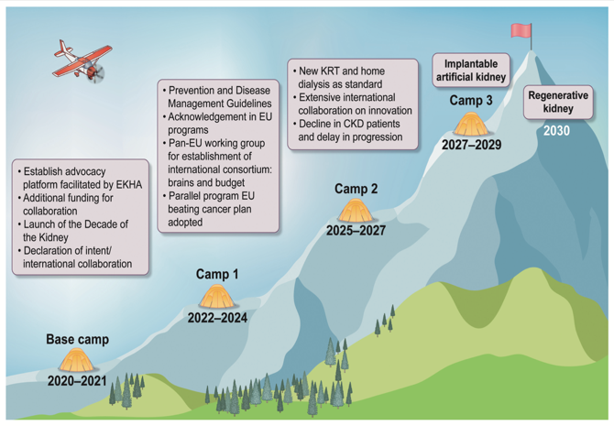
Shared goals of ERA and EKHA
ERA’ GOALS
Promoting kidney health for all
Prevent people from developing kidney disease
Develop a global vision about kidney health beyond borders
Improving kidney care for patients
Promote equity of access to kidney diagnosis and treatment across Europe
Generate respect for the patient voice
Strengthening the kidney community
Foster a stronger sense of identity and community among members
Reconsider the role of the modern nephrology professional specialist to inspire the next generation
Address the pressing issues of nephrology workforce shortage and promote personnel recruitment and continuity
EKHA’S MISSION STRATEGY

Slide 28
Advocacy Priorities ahead of 2024 European Parliament Elections
European elections
EKHA key recommendations, short- and long-term objectives, concrete asks
Foster innovation in kidney disease treatments
Call on the EU to stimulate research, development, and green innovation of therapeutic alternatives for CKD, preferably in a international consortium
Organ donation and transplantation
Call on the EU to address the long-standing challenges in organ donation and transplantation
Potential ask: A 2nd EU action plan
Kidney Manifesto

Slide 29
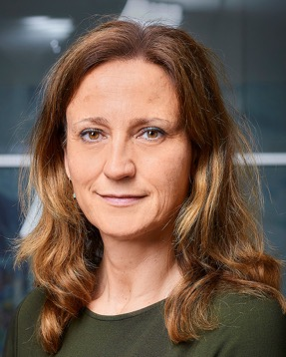

For more information, membership and support:
Eveline Scheres
General Manager
For all your questions on:
Organisation
Membership possiblities
Public affairs
Support
Sponsorship
eveline.scheres@ekha.eu
+31 6 32278149
If you would like to stay tuned to EKHA activities or support our election manifesto, please contact Eveline Scheres or myself (raymond.vanholder@ugent.be)
29

Slide 30



Slide 31
Back-ups

Slide 32

EKHA ambitions, goals and instruments
STRATEGIC GOALS
INSTRUMENTS
EKHA MISSION
Less people to develop CKD, slow down progression of CKD and better quality of life for CKD patients.
Prevent people from getting kidney disease.
Advocacy expertise
Improve disease management by educating politicians, care givers (GP’s, Specialists) and scientists on the impact of unhealthy kidneys.
Scientific Content
EKHA working groups
Patient engagement
EKHA VISION
Engage EU politicians to change EU policy to lower the socio-economic burden of CKD by creating awareness & urgency on CKD being a neglected disease in all stages.
Push for innovative green therapies for kidney patient accessibly to all European patients and for fair prices
Communication
Include CKD as a research priority of the European Commission.
Collaboration
32
32

Slide 33




EKHA Working groups
In 2021 EKHA starting with 3 working groups. The groups exist of people of EKHA member organisations and people from the nephrology world who contribute with their expertise on nephrology. They carry out tasks and actions to achieve, amongst other, the 3 strategic goals of EKHA. In 2021 they started with the following tasks:
WG1: Prevention & screening
Research via a survey to:
analyse existing screening programs in primary care in Europe;
to understand the general attitude to – and use of – CKD detection/screening in GP practises;
to evaluate the feasibility of screening for kidney disease.
  WG 2: Disease Management
  Research for need and use of a Disease Management Toolbox, to provide kidney patients with a practical tool to better manage kidney disease in all stages.
  This tool should also be helpful to nurses, nephrologists, general practitioners and other specialists in supporting patients tackling their disease.
WG 3: Ground Breaking Innovation
Collaboration to push for an international framework for new innovative and affordable Kidney Replacement Therapies (KRT’s) in response to Horizon Europe’s Strategic Orientations for Research and Innovation and the Advancing American Kidney Health (AAKH) Executive Order
Aside from the working groups, EKHA installed an ambassador group that exists of people living with kidney disease. Their tasks are to reflect on the output of the working groups, represent the patient voice in political meetings and provide patients insights on EKHA’s strategic goals. These Ambassadors are therefor incorporated in the one of working groups.
33

Slide 34
Decade of the KidneyTM mission strategy

