Slide 1
CKD – Mineral and Bone Disorder
Marios Papasotiriou
mpapasotiriou@yahoo.com
mpapasotir@upatras.gr

Slide 2
CKD – Mineral and Bone Disorder
Pathophysiology and classification
Diagnosis of CKD–MBD
Therapeutic principles
Bone disease in the kidney transplant

Slide 3
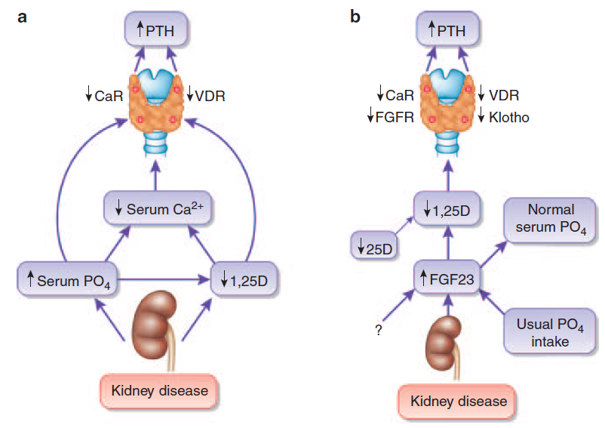
Pathophysiology of MBD
Traditional (a) and updated (b) view, emphasizing the central role of FGF23, of the mechanisms that maintain secondary hyperparathyroidism in advanced chronic kidney disease.
Isakova T et al. Kidney Int. (2010) 78, 947 – 949.

Slide 4
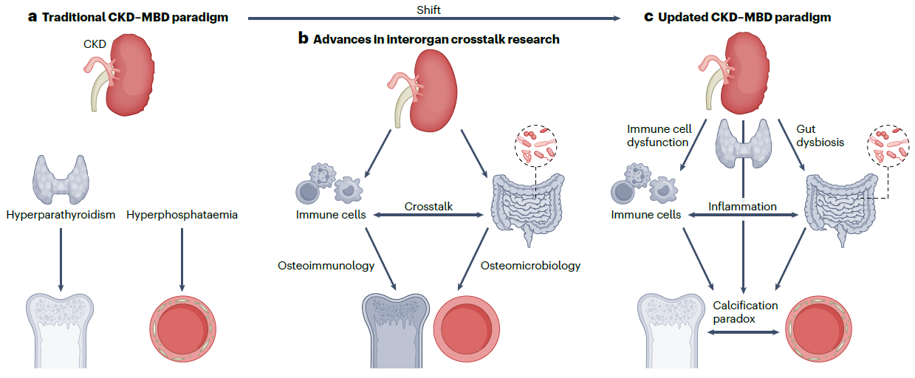
Pathophysiology of MBD
In CKD, gut dysbiosis, immune cell dysfunction, inflammation and oxidative stress are increasingly recognized as important factors that contribute to the bone loss and vascular calcification that characterize CKD–MBD.
Evenepoel P et al. Nature Reviews Nephrology, 19, 646–657 (2023)

Slide 5
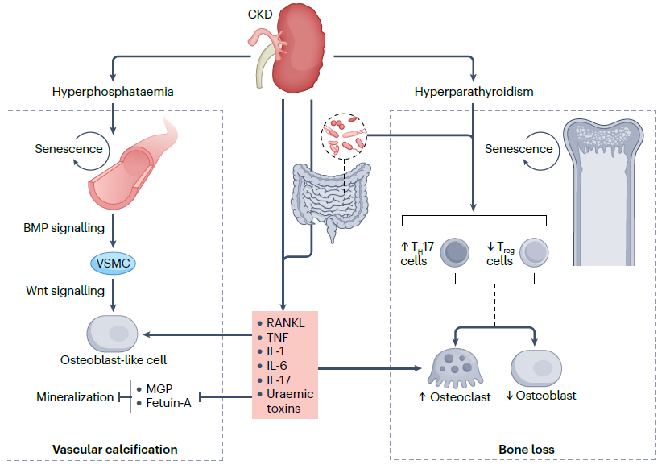
Pathophysiology of MBD
The detrimental effects of hyperparathyroidism on bone are mediated in part by the enhanced trafficking of intestinal T helper 17 (TH17) cells to the bone marrow, where they release IL-17 and trigger a cascade of events that culminates in bone loss.
Evenepoel P et al. Nature Reviews Nephrology, 19, 646–657 (2023)

Slide 6
Classification of CKD-MBD

Slide 7
CKD – Mineral and Bone Disorder
Pathophysiology and epidemiology
Diagnosis of CKD–MBD
Therapeutic principles
Bone disease in the kidney transplant

Slide 8
Diagnosis of CKD-MBD: Bone
Bone components
Bone is composed of two components:
inorganic mineralized bone and
organic matrix, or osteoid.
Both components are remodeled approximately within a three-month cycle through the recruitment and activation of osteoblasts and osteoclasts.
Resorption of bone is a function of osteoclasts; formation of new bone is a task of osteoblasts, and osteocytes control both processes.
To have complete information on a patient’s bone health, we should aim to have histomorphometric evaluation of both static and dynamic parameters. To evaluate the rate of bone formation and rate of mineral deposition (dynamic parameters), a label technique (with tetracycline) is used.
Ferreira AC et al. Calcified Tissue International (2021) 108:528–538.

Slide 9
Diagnosis of CKD-MBD: Bone
Tetracycline labeling technique
In our institutions, tetracycline hydrochloride 500 mg, 12/12 h is prescribed
for 3 days, 1 month, and 1 week or
for 2 days beginning at 14 and 4 days before the bone biopsy and the biopsy is scheduled in line with this prescription.
Ferreira AC et al. Calcified Tissue International (2021) 108:528–538.

Slide 10
Diagnosis of CKD-MBD: Bone
Bone turnover
In CKD, bone turnover can either be
Low,
Normal, or
High.
The extremes have been associated with extra-osseous calcifications and high mortality.
This is thought to result from an increased efflux of calcium/phosphate from high bone turnover.
From impaired calcium apatite incorporation into the bone in low bone turnover cases.
Both situations result in increased deposition of the mineral content from skeletal system in the vessel wall.
Ferreira AC et al. Calcified Tissue International (2021) 108:528–538.

Slide 11
Diagnosis of CKD-MBD: Bone
High Bone turnover
In the case of high bone turnover, the most typical bone findings in static histomorphometry are a significant increase in osteoblast and osteoclast number, which can be accompanied by an increased cancellous bone volume and a decrease in cortical bone volume in terms of cortical thinning and increased cortical porosity.
The inter-trabecular fibrosis can be massive if secondary hyperparathyroidism is severe that can even compromise erythropoiesis.
Usually, bone mineralization is normal, even though osteoid surface and even volume may be slightly increased, due to the accelerated bone formation process along with a delay in bone mineralization.
Ferreira AC et al. Calcified Tissue International (2021) 108:528–538.

Slide 12
Diagnosis of CKD-MBD: Bone
Low Bone turnover
Typical bone findings in static histomorphometry include no osteoclasts and few osteoblast numbers, no osteoid formation, and, in extreme cases, features of an acellular bone.
This low bone remodeling aspect, with low dynamic parameters when associated with low volume, is termed adynamic bone disease.
Ferreira AC et al. Calcified Tissue International (2021) 108:528–538.

Slide 13
Diagnosis of CKD-MBD: Bone
Bone mineralization
Mineralization can be normal or compromised in CKD.
Mineralization defects might be associated with low vitamin D, mineral deficiency (e.g., low phosphate levels), acidosis, and aluminum toxicity.
Symptoms are very similar to those of hyperparathyroidism and no imaging technique or noninvasive biomarker is capable of ensuring the diagnosis of delayed mineralization.
Ferreira AC et al. Calcified Tissue International (2021) 108:528–538.

Slide 14
Diagnosis of CKD-MBD: Biochemical indices
Monitoring of serum levels of calcium, phosphorus, PTH, and alkaline phosphatase activity should begin in CKD stage 3 (1C). In children, we suggest such monitoring beginning in CKD stage 2 (2D).
In patients with CKD stages 3–5D, 25(OH)D (calcidiol) levels might be measured, and repeated testing determined by baseline values and therapeutic interventions (2C). We suggest that vitamin D deficiency and insufficiency be corrected using treatment strategies recommended for the general population (2C).
In patients with CKD stages 3–5D, therapeutic decisions should be based on trends rather than on a single laboratory value, taking into account all available CKD–MBD assessments (1C).
In patients with CKD stages 3–5D, we suggest that individual values of serum calcium and phosphorus, evaluated together, be used to guide clinical practice rather than the mathematical construct of calcium– phosphorus product (CaP) (2D).

Slide 15
Diagnosis of CKD-MBD: Bone
In patients with CKD G3a–G5D with evidence of CKD-MBD and/or risk factors for osteoporosis, we suggest Bone Mineral Density testing to assess fracture risk if results will impact treatment decisions (2B).
Dual-energy X-ray absorptiometry (DXA) measures of bone mineral density (BMD) to estimate fracture risk in CKD predicted fractures across the spectrum from CKD G3a to G5D.

Slide 16
Diagnosis of CKD-MBD: Bone
Dual-energy X-ray absorptiometry (DXA)
Various imaging tools are available to evaluate bone volume in CKD patients. Bone density is a measure of mineralized bone mass or quantity and is measured by dual-energy X-ray absorptiometry (DXA).
The limitations of DXA are :
it does not discriminate between cortical and trabecular bone
it does not give any direct information on bone quality, namely, microarchitecture and microdamage, fibrosis, or collagen organization
is also unable to determine bone turnover and, at most, it can indirectly provide information on the long-term effect of a low or high bone turnover on the bone quantity
is also unable to evaluate bone mineralization defects, which is a major limitation.

Slide 17
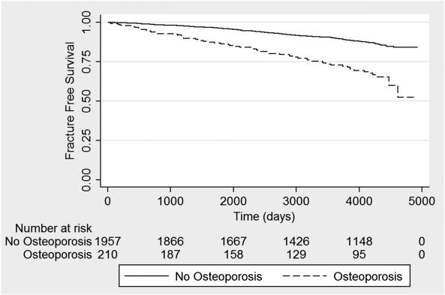
Diagnosis of CKD-MBD: Bone
DXA in patients with CKD stage 3 to 5
Lower FN-BMD is associated with greater fracture, regardless of CKD status.
Yenchek RH et al. Clin J Am Soc Nephrol. 2012; 7(7): 1130–1136.

Slide 18
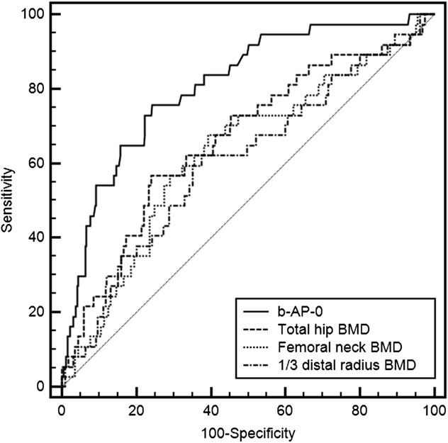
Diagnosis of CKD-MBD: Bone
DXA in patients with ESKD
In adjusted Cox proportional analyses, lower baseline femoral neck and total hip BMD predicted a greater risk of fracture; for example, the hazard ratio (HR) was 0.65 (95% confidence interval [CI]: 0.47–0.90) for each standard deviation (SD) higher femoral neck BMD.
Iimori S et al. Nephrol Dial Transplant (2012) 27: 345–351.

Slide 19
Diagnosis of CKD-MBD: bone
In patients with ESKD
In summary, the aforementioned 4 prospective studies evaluating BMD testing in adults with CKD represent a substantial advance since the original guideline from 2009. Despite the fact that they were conducted across a spectrum of CKD severity, the finding that hip BMD predicted fractures was consistent across studies, and 2 studies demonstrated associations comparable to those seen in the absence of CKD
Iimori S et al. 345–351.

Slide 20
Diagnosis of CKD-MBD: Bone
Bone biopsy
In patients with CKD G3a–G5D, it is reasonable to perform a bone biopsy if knowledge of the type of renal osteodystrophy will impact treatment decisions.
Renal osteodystrophy is defined as abnormal bone histology and is 1 component of the bone abnormalities of CKD-MBD. Bone biopsy is the gold standard for the diagnosis and classification for renal osteodystrophy.

Slide 21
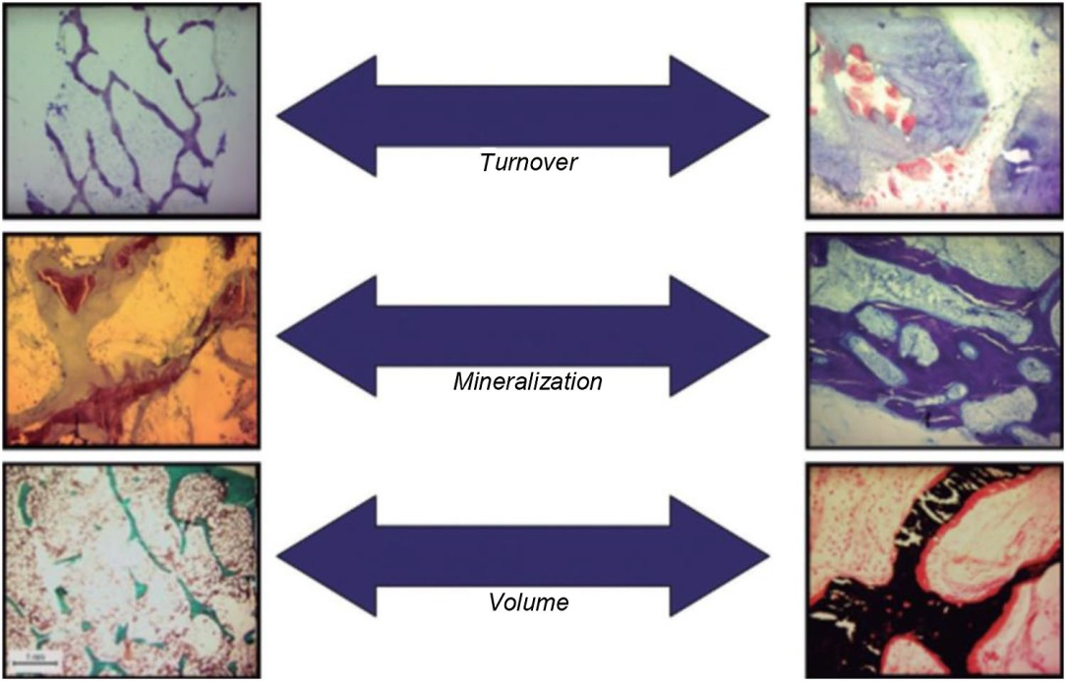
Diagnosis of CKD-MBD: Bone
Bone biopsy
This technique remains the gold standard for ROD diagnosis since it
allows analysis of both cortical and trabecular bone,
gives information on static and dynamic parameters of bone turnover, and
is the only method able to assess mineralization.
The TMV classification (Turnover, Mineralization, Volume) described in 2006 [1] aimed to designate the quantity (volume) and the quality (turnover and mineralization) of the bone.
Ferreira AC et al. Calcified Tissue International (2021) 108:528–538.

Slide 22
Diagnosis of CKD-MBD: Bone
When to bone biopsy
A bone biopsy should be considered in patients with unexplained fractures, refractory hypercalcemia, suspicion of osteomalacia, an atypical response to standard therapies for elevated PTH, or progressive decreases in BMD despite standard therapy.
The goal of a bone biopsy would be to:
rule out atypical or unexpected bone pathology;
determine whether the patient has high- or low-turnover disease, which may alter the dose of medications to treat renal osteodystrophy (e.g., initiate or discontinue calcimimetics, calcitriol, or vitamin D analogs); or
identify a mineralization defect that would alter treatment (e.g., stop intake of aluminum, or aggressively treat hypophosphatemia or vitamin D deficiency).

Slide 23
Diagnosis of CKD-MBD: Bone
Measurements of markers (PTH – bsALP)
In patients with CKD G3a–G5D, measurements of serum PTH or bone-specific alkaline phosphatase can be used to evaluate bone disease because markedly high or low values predict underlying bone turnover (2B).
Use of trends in PTH rather than absolute “target” values when making decisions as to whether to start or stop treatments to lower PTH. When trends in PTH are inconsistent, a bone biopsy should be considered.
In patients with CKD G3a–G5D, we suggest not to routinely measure bone-derived turnover markers of collagen synthesis (such as procollagen type I C-terminal propeptide) and breakdown (such as type I collagen cross-linked telopeptide, cross-laps, pyridinoline, or deoxypyridinoline) (2C).

Slide 24
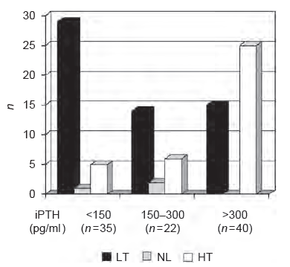
PTH levels and Bone turnover
Intact PTH levels <150 pg/ml presented a 50% sensitivity, an 85% specificity, and an 83% positive predictive value for the diagnosis of low bone turnover.
iPTH levels >300 pg/ml presented a 69% sensitivity, a 75% specificity, and a 62% positive predictive value for the diagnosis of high bone turnover.

Slide 25
Diagnosis of CKD-MBD
Vascular calcification
In patients with CKD G3a–G5D, a lateral abdominal radiograph can be used to detect the presence or absence of vascular calcification, and an echocardiogram can be used to detect the presence or absence of valvular calcification, as reasonable alternatives to computed tomography-based imaging (2C).
We suggest that patients with CKD G3a–G5D with known vascular or valvular calcification be considered at highest cardiovascular risk (2A). It is reasonable to use this information to guide the management of CKD-MBD (Not Graded).

Slide 26
CKD – Mineral and Bone Disorder
Pathophysiology and epidemiology
Diagnosis of CKD–MBD
Therapeutic principles
Bone disease in the kidney transplant

Slide 27
Treatment of CKD-MBD
Lowering high serum phosphate and maintaining serum calcium
In patients with CKD G3a–G5D, treatments of CKD-MBD should be based on serial assessments of phosphate, calcium, and PTH levels, considered together.
Most studies showed increasing risk of all-cause mortality with increasing levels of serum phosphate in a consistent and direct fashion, with moderate risk of bias and low quality of evidence.
In patients with CKD G3a–G5D, we suggest lowering elevated phosphate levels toward the normal range (2C).
However, trial data demonstrating that treatments that lower serum phosphate will improve patient-centered outcomes are still lacking, and therefore the strength of this recommendation remains weak.

Slide 28
Treatment of CKD-MBD
Lowering high serum phosphate and maintaining serum calcium
Methods to prevent the development of hyperphosphatemia essentially include
dietary modification,
the use of phosphate-lowering therapy,
and intensified dialysis schedules for those with CKD G5D.
In patients with CKD G3a–G5D, we suggest limiting dietary phosphate intake in the treatment of hyperphosphatemia alone or in combination with other treatments (2D). It is reasonable to consider phosphate source (e.g., animal, vegetable, additives) in making dietary recommendations.
In patients with CKD G3a-G5D, decisions about phosphate-lowering treatment should be based on progressively or persistently elevated serum phosphate.

Slide 29
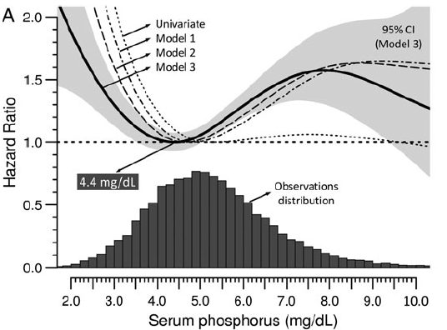
Treatment of CKD-MBD
Lowering high serum phosphate and maintaining serum calcium
The prospective observational COSMOS study cohort of HD patients the best patient survival was observed with serum phosphate close to 4.4 mg/dl (1.42 mmol/l).
The majority of studies have found phosphate to be consistently associated with excess mortality at levels above and below the limits of normal, but not in the normal range.
There is a U-shaped relation of phosphate with mortality risk in dialysis patients.
Fernandez-Martin JL et al. Nephrol Dial Transplant. 2015;30(9):1542-51.

Slide 30
Treatment of CKD-MBD
Lowering high serum phosphate and maintaining serum calcium
a recent trial comparing placebo with active phosphate-binder therapy in predialysis patients (CKD G3b–G4) with a mean baseline phosphate concentration of 4.2 mg/dl (1.36 mmol/l), found a minimal decline in serum phosphate, no effect on FGF23, and increases in coronary calcification scores for the active treatment group59—calling into question the efficacy and safety of phosphate binding in this population, with normal phosphate concentration prior to initiation of binder treatment
Although the data suggested that the observed increase in coronary artery calcification (CAC) was mainly driven by the group treated with calcium containing phosphate binders, those treated with calcium free binders had no advantage over placebo in terms of progression of CAC. In addition, a well-executed mineral balance study in pre-dialysis patients using calcium-containing phosphate binders demonstrated the absence of any effect on phosphate balance (while showing in the short term a positive calcium balance).
Iimori S et al. 345–351.

Slide 31
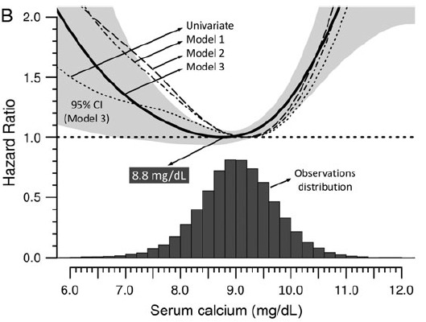
Treatment of CKD-MBD
Lowering high serum phosphate and maintaining serum calcium
In adult patients with CKD G3a–G5D, we suggest avoiding hypercalcemia (2C). In children with CKD G3a–G5D, we suggest maintaining serum calcium in the age-appropriate normal range (2C).
As is the case for phosphate, epidemiological evidence link higher calcium concentrations to increased mortality in adults with CKD.
Fernandez-Martin JL et al. Nephrol Dial Transplant. 2015;30(9):1542-51.

Slide 32
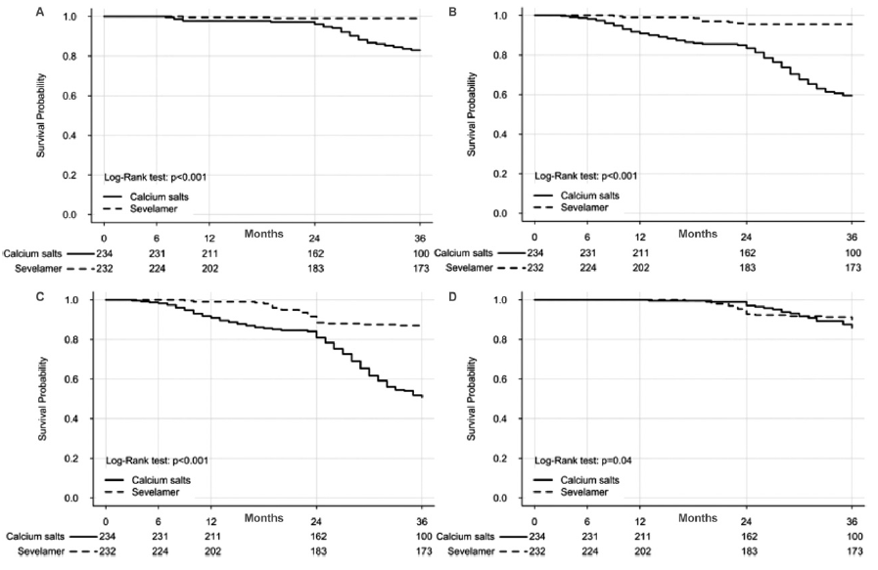
Treatment of CKD-MBD
Lowering high serum phosphate and maintaining serum calcium
Evidence from RCTs supports a more general recommendation to restrict calcium-based phosphate binders in hyperphosphatemic patients across all severities of CKD.
Di Iorio B et al. Am J Kidney Dis. 2013;62(4):771-778

Slide 33
Treatment of CKD-MBD
Lowering high serum phosphate and maintaining serum calcium
In patients with CKD G5D, we suggest using a dialysate calcium concentration between 1.25 and 1.50 mmol/l (2.5 and 3.0 mEq/l) (2C).
In adult patients with CKD G3a–G5D receiving phosphate-lowering treatment, we suggest restricting the dose of calcium-based phosphate binders (2B). In children with CKD G3a–G5D, it is reasonable to base the choice of phosphate-lowering treatment on serum calcium levels.

Slide 34
Treatment of abnormal PTH levels
Patients with CKD G3a–G5 not on dialysis
In patients with CKD G3a–G5 not on dialysis, the optimal PTH level is not known. However, patients with levels of intact PTH progressively rising or persistently above the upper normal limit for the assay be evaluated for modifiable factors, including hyperphosphatemia, hypocalcemia, high phosphate intake, and vitamin D deficiency (2C).
Calcitriol and vitamin D analogs should not be routinely used (2C). It is reasonable to reserve the use of calcitriol and vitamin D analogs for patients with CKD G4–G5 with severe and progressive hyperparathyroidism.

Slide 35
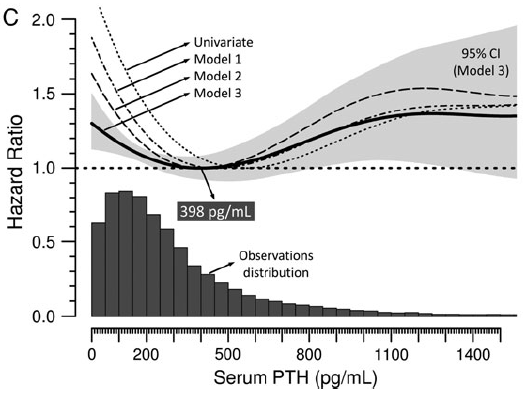
Treatment of abnormal PTH levels
Patients with CKD G5D
In patients with CKD stage 5D, we suggest maintaining iPTH levels in the range of approximately two to nine times the upper normal limit for the assay (2C).
We suggest that marked changes in PTH levels in either direction within this range prompt an initiation or change in therapy to avoid progression to levels outside of this range (2C).
In patients with CKD G5D requiring PTH-lowering therapy, we suggest calcimimetics, calcitriol, or vitamin D analogs, or a combination of calcimimetics with calcitriol or vitamin D analogs (2B).

Slide 36
Treatment of abnormal PTH levels
Patients with CKD G5D – Cinacalcet
The EVOLVE trial evaluated the effect of cinacalcet versus placebo on patient-level outcomes in 3883 HD patients using a composite endpoint of all-cause mortality, nonfatal myocardial infarction, hospitalization for unstable angina and congestive heart failure.
The unadjusted primary composite endpoint showed a non-significant reduction (HR: 0.93; P = 0.112) with cinacalcet use. However, analyses adjusted for imbalances in baseline characteristics demonstrated a nominally significant reduction in the primary composite endpoint (HR: 0.88; P= 0.008).
Approximately one-third of the EVOLVE participants were under the age of 55, and pre-specified analyses that evaluated subjects above or below age 65 demonstrated a significant reduction in risk associated with use of cinacalcet for both the primary endpoint (HR: 0.74; P ≤ 0.001) and all cause mortality (HR: 0.73; P ≤ 0.001) for those aged above 65.
EVOLVE trial investigators. N Engl J Med 2012; 367:2482-2494

Slide 37
Treatment of abnormal PTH levels
Patients with CKD G5D – Other options
The individual choice should continue to be guided by considerations about concomitant therapies and the present calcium and phosphate levels. In addition, the choice of dialysate calcium concentrations will impact on serum PTH levels.
It should be pointed out that parathyroidectomy remains a valid treatment option especially in cases when PTH-lowering therapies fail.
In patients with CKD G3a–G5D with severe hyperparathyroidism who fail to respond to medical or pharmacological therapy, we suggest parathyroidectomy (2B).

Slide 38
Treatment with osteoporosis medications
Osteoporosis and/or high risk of fracture
In patients with CKD G1–G2 with osteoporosis and/or high risk of fracture, as identified by World Health Organization criteria, we recommend management as for the general population (1A).
In patients with CKD G3a–G3b with PTH in the normal range and osteoporosis and/or high risk of fracture, as identified by World Health Organization criteria, we suggest treatment as for the general population (2B).
In patients with CKD G3a–G5D with biochemical abnormalities of CKD-MBD and low BMD and/or fragility fractures, we suggest that treatment choices take into account the magnitude and reversibility of the biochemical abnormalities and the progression of CKD, with consideration of a bone biopsy (2D).

Slide 39
Treatment with osteoporosis medications
Treatment side effects
When such treatment choices are considered, their specific side effects must also be taken into account
antiresorptives will exacerbate low bone turnover,
denosumab may induce significant hypocalcemia
The risk of their administration must be weighed against the accuracy of the diagnosis of the underlying bone phenotype.

Slide 40
CKD – Mineral and Bone Disorder
Pathophysiology and epidemiology
Diagnosis of CKD–MBD
Therapeutic principles
Bone disease in the kidney transplant

Slide 41
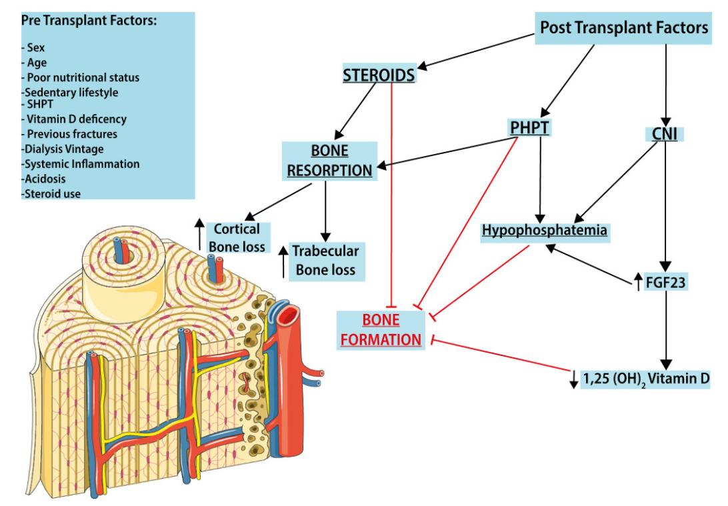
Kidney transplant bone disease
Pathophysiology
In KTRs, the progression of bone disease results from the evolution of pre-existing CKD-MBD with several risk factors already present in the pre-transplantation period.
Cianciolo G et al. Clin Kid Journal. 2022, 15(8), 1459–1474.

Slide 42
Kidney transplant bone disease
Risk of fracture
One quarter of recipients will fracture within the first 5 years of transplantation. Hip fracture risk is 34% higher than for patients on dialysis, and hip and spine fracture risks are more than 4- and 23-fold higher, respectively, than for the general population.
After hip fracture, mortality risk is 60% higher than in other kidney transplant recipients without fracture.
Iyer SP et al. J Am Soc Nephrol 25: 1331–1341, 2014.

Slide 43
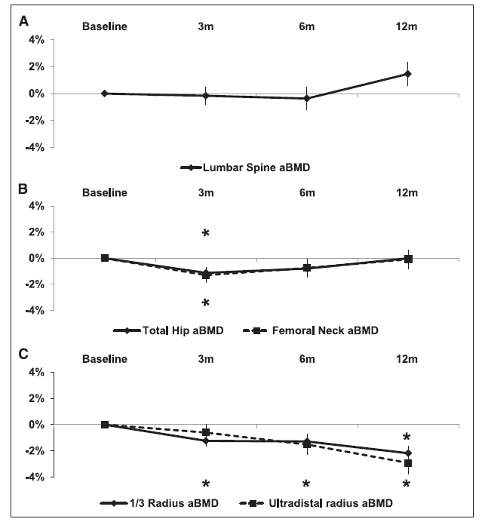
Kidney transplant bone disease
Loss of BMD after kidney transplantation
More recent cohort studies have shown minimal BMD losses in the early post-transplant period, which seem to be restricted to sites rich in cortical bone such as the distal radius and can be attributed to low cumulative steroid exposure.
Iyer SP et al. J Am Soc Nephrol 25: 1331–1341, 2014.

Slide 44
Kidney transplant bone disease
Bone disease and hyperparathyroidism
There is no consensus about the safe level of PTH, the PTH cut-off level that identifies persistent HPT or the ‘ideal’ timing of PTH assessment after transplantation.
Most nephrologists wait up to 12months after transplantation for PTH to normalize. Beyond 12 months, a PTH level >100 pg/mL or 70 pg/mL is consistent with persistent HPT.
The KDIGO guidelines recommend that KTRs should have the same therapeutic approach for CKD-MBD abnormalities, including PTH, as for patients with CKD stages 3–5.
Cianciolo G et al. Clin Kid Journal. 2022, 15(8), 1459–1474.

Slide 45
Kidney transplant bone disease
Ca and phosphate measurements
In patients in the immediate post–kidney transplant period, we recommend measuring serum calcium and phosphate at least weekly, until stable (1B).
In patients after the immediate post–kidney transplant period, it is reasonable to base the frequency of monitoring serum calcium, phosphate, and PTH on the presence and magnitude of abnormalities, and the rate of progression of CKD.

Slide 46
Kidney transplant bone disease
Calcidiol (25-OH-VitD)
In patients with CKD G1T–G5T, we suggest that 25(OH)D (calcidiol) levels might be measured, and repeated testing determined by baseline values and interventions (2C).
In patients with CKD G1T–G5T, we suggest that vitamin D deficiency and insufficiency be corrected using treatment strategies recommended for the general population (2C).

Slide 47
Kidney transplant bone disease
Fracture risk assessment
In patients with CKD G1T–G5T with risk factors for osteoporosis, we suggest that BMD testing (DXA) be used to assess fracture risk if results will alter therapy (2C).

Slide 48
Kidney transplant bone disease
Treatment plan
In patients in the first 12 months after kidney transplant with an eGFR greater than approximately 30 ml/min/1.73 m² and low BMD, we suggest that treatment with vitamin D, calcitriol/alfacalcidol, and/or antiresorptive agents be considered (2D).
Treatment choices should be influenced by the presence of CKD-MBD, as indicated by abnormal levels of calcium, phosphate, PTH, alkaline phosphatases, and 25(OH)D (2C).
It is reasonable to consider a bone biopsy to guide treatment.
There are insufficient data to guide treatment after the first 12 months.

Slide 49
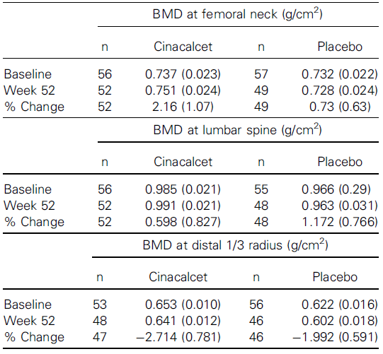
Kidney transplant bone disease
Cinacalcet
Cinacalcet is not approved for the treatment of hyperparathyroidism in kidney transplant recipients; however, it is clinically used, in patients with significant hypercalcemia.
While efficiently correcting hypercalcemia, cinacalcet so far has failed to show a beneficial impact on bone mineralization in the transplant population.
Mean (SE) percent change in BMD at the femoral neck measured from baseline to week 52 by treatment group was 2.16% (1.07%) in the cinacalcet group compared to 0.73% (0.63%) in the placebo group.
Evenepoel P et al. Am J of Transpl 2014; 14: 2545–2555.

Slide 50
Kidney transplant bone disease
Parathyroidectomy
Randomization
N=15
Parathyroidectomy
N=15
Cinacalcet
Variable | Subtotal Parathyroidectomy | Cinacalcet | P Value
BMD baseline, g/cm²
Femoral neck | 0.819±0.164 | 0.723±0.089 | 0.12
Lumbar spine | 0.993±0.227 | 0.904±0.106 | 0.25
Distal 1/3 radius | 0.613±0.097 | 0.661±0.116 | 0.30
BMD month 12, g/cm² |  | Article I.
Femoral neck | 0.846±0.149 | 0.700±0.081 | 0.01
Lumbar spine | 1.015±0.213 | 0.896±0.109 | 0.11
Distal 1/3 radius | 0.630±0.086 | 0.658±0.114 | 0.52
Change at month 12, %
Femoral neck | +3.8±6.1 | −3.0±5.1 | 0.01
Lumbar spine | +2.7±7.8 | −0.9±4.7 | 0.21
Distal 1/3 radius | +3.3±6.6 | −0.4±2.6 | 0.10
Subtotal parathyroidectomy induced greater reduction of iPTH and associated with a significant increase in femoral neck BMD.
Cruzado JM et al. J Am Soc Nephrol. 2016; 27(8): 2487–2494.

Slide 51
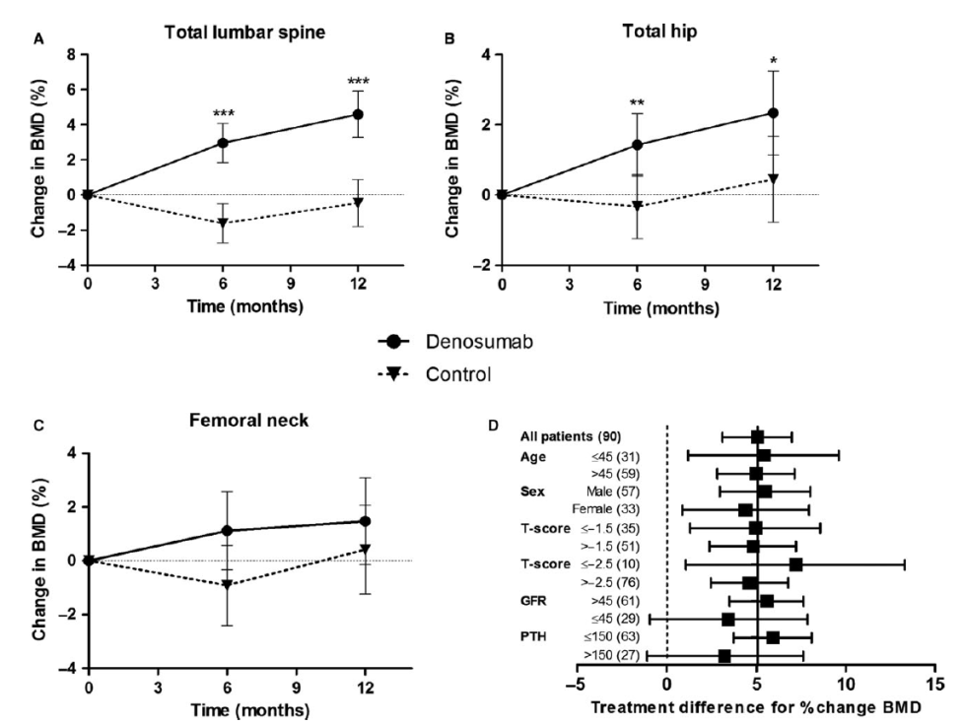
Kidney transplant bone disease
Denosumab
Randomization
N=46
Denosumab
N=44
Control – no treatment
Denosumab has been shown to effectively increase BMD in de novo kidney transplant recipients. However, an increased rate of UTIs was observed.
Bonani M et al. Am J Transplant 2016; 16: 1882–1891.

Slide 52
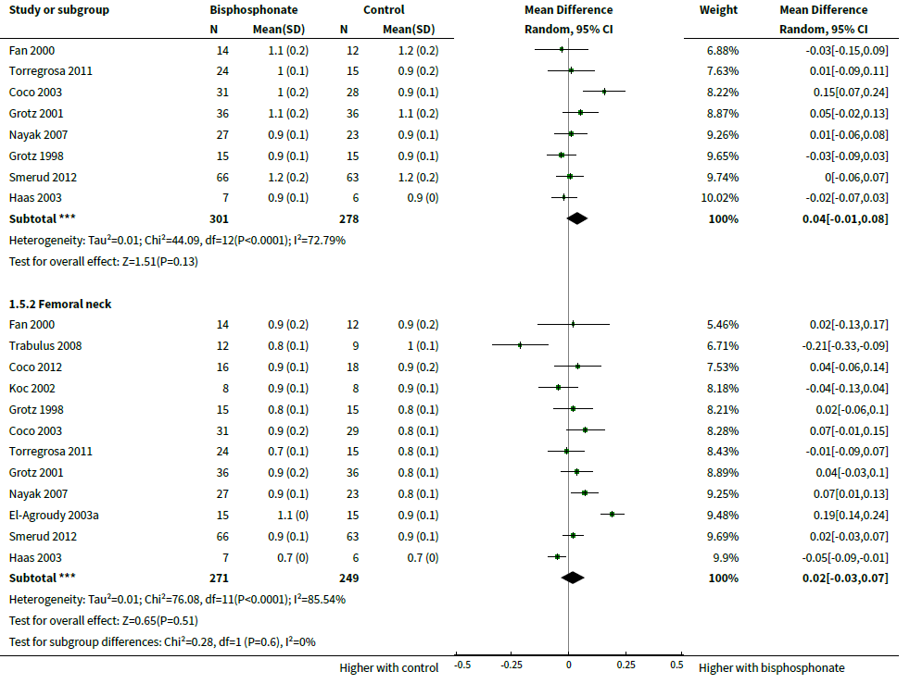
Kidney transplant bone disease
Bisphosphonates – BMD
Compared to placebo, bisphosphonate therapy administered over 12 months in transplant recipients may increase vertebral and femoral BMD (low certainty evidence).
Palmer SC et al. Cochrane Database Syst Rev. 2019, 22;10(10).

Slide 53
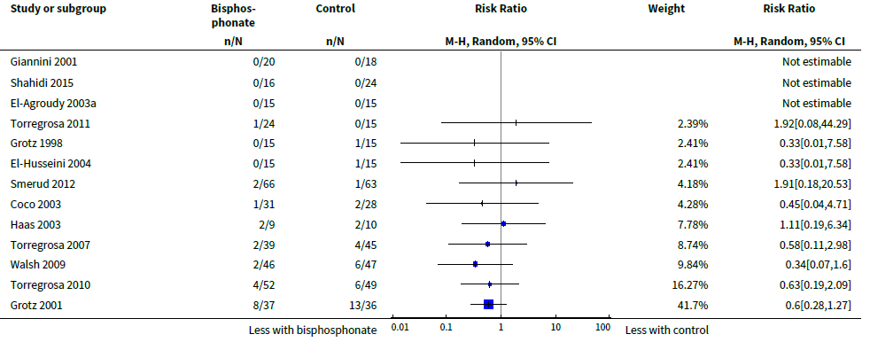
Kidney transplant bone disease
Bisphosphonates – Risk of fracture
Compared to placebo, bisphosphonate therapy administered over 12 months in transplant recipients may prevent fracture (RR 0.62, 95% CI 0.38 to 1.01; low certainty evidence).
Palmer SC et al. Cochrane Database Syst Rev. 2019, 22;10(10).

Slide 54
Conclusion
MBD in CKD is a systemic disorder of mineral and bone metabolism due to CKD manifested by abnormalities of calcium, phosphorus, PTH, or vitamin D metabolism that promotes bone loss, vascular calcification and increases cardiovascular risk.
Diagnosis should be established by serial measurements of calcium, phosphorus and PTH while the use of DEXA and bone biopsy can help the assessment of fracture risk and determine bone turn-over that can impact treatment decisions.
Treatment should aim at normal phosphorus and calcium levels with restricting the dose of calcium-based phosphate binders and vitamin D analogs.

