Slide 1
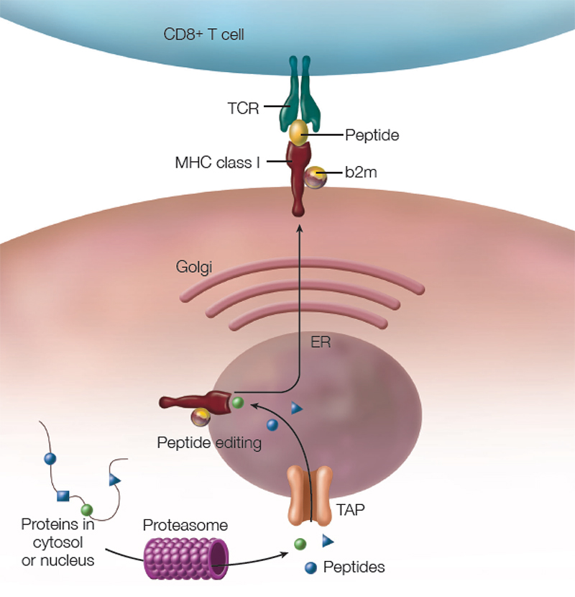



Immunologically high-risk kidney transplantation - the role of desensitization protocols
Milica Kravljaca
Clinic of Nephrology University Clinical Center of Serbia
Faculty of Medicine University of Belgrade

Slide 2
What are the key challenges in kidney transplantation today?
Shortage of organs worldwide
Improving long-term graft survival
Searching for the most appropriate graft for each recipient
Optimizing the ischemia time
Minimizing the impact of surgery and subsequent immunosuppressive therapy
Transplantation of highly sensitized patients
Vázquez-Martul D et al. Archivos Españoles de Urología 2021;74(10): 1058-1065

Slide 3

Definition of sensitization
HLA antibodies are termed donor-specific (DSA) if they recognize HLA proteins found in the allograft, or non-DSA if the HLA antigens are not present on the transplanted organ
Development of antibodies to the human leukocyte antigens (HLA) - HLA antibodies (prior to or after transplantation)
- associated with transplant rejection, graft dysfunction and poor overall survival
- HLA sensitization can result from any exposure to HLA (previous blood transfusions,
pregnancies or transplants)
The strongest connection is with a history of prior transplantation (43 of 75 candidates for re-transplantation (57%) were sensitized) *
.
Abbes S et al. Ther Apher Dial. 2017; 21(5): 441–450.
* Duquesnoy RJ, et al. Transplant immunology. 2008;18(4):352.

Slide 4
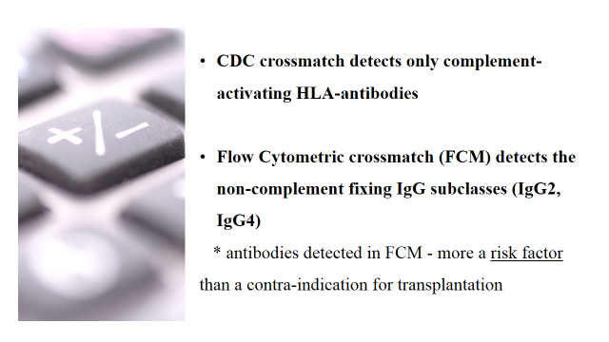
Detection of HLA antibodies – measurement the degree of sensitization
HLA incompatible transplantation (HLAi) is defined by a positive CDC or FCM crossmatch.
percentage of panel reactive antibodies (%PRA) measured by complement-dependent cytotoxicity (CDC)
PRA > 85% - a highly sensitized patient

Slide 5

Single antigen beads (SAB) - Luminex
More sensitive than CDC and FCM for detecting HLA antibodies and DSA
The degree of antibody is expressed as mean fluorescence intensity (MFI)
Significant MFI of 1,000–1,500 (there is no general agreement on this value)
vPRA (virtual PRA) cPRA (calculated PRA) cRF (calculated reaction frequency)
estimate the chance that a patient has HLA antibodies reactive with a donor from the actual organ donor population
Pandey P, et al. J Immunoassay Immunochemistry.2021;42:300–13.
Huber L, et al. Transpl Int. 2015;28:710–9.
Cecka JM.. Am J Transpl.2010;10:26–9.

Slide 6

Improvement in transplantation and technology
The improvement of techniques to detect anti-HLA antibodies in recipients waiting for kidney transplantation has allowed us to detect a larger number of sensitized patients.
In Spain in a period 2010-2015 number of recipients waiting for kidney with PRA >75% increased from 20% to 50%.
With the growing number of candidates for retransplantation, 35% of patients awaiting a renal transplant are sensitized.
Heidt S, et al. Kidney Int. 2018;93:491–500.
UNOS. United Network for Organ Sharing. http://www.unos.org. Updated 2017.

Slide 7
Algorithm of options for a highly sensitized transplant candidate
European Society of Organ Transplantation (ESOT) working group, Transplant International 2022.

Slide 8
United Network of Organ Sharing (UNOS)
implemented a new deceased donor kidney allocation system (KAS) in 2014 in the United States
increased the allocation priority for sensitized candidates on waiting list
patients with a cPRA 80-84% received 2.5 allocation points
patients with a cPRA ≥ 99.5% received 202 allocation points
Reports have shown that it has been very effective for highly sensitized patients (≥99.5% cPRA), but very highly sensitized patients (ex. >99.9%) continue to be transplanted at a low rate.
Zhou S, Massie AB, Luo X, et al. Am J Transplant. 2018;18:1415-1423.
Stewart DE, et al.Am J Transplant. 2016;16:1834-1847.
Schinstock CA, et al. Clin Transpl. 2019; 33:e13751

Slide 9
USA, Waiting list on June 1, 2016.
Sensitized candidates (cPRA ≥ 80%) were younger, more likely female, more likely to be on dialysis, on dialysis for a longer period of time, and more likely to have had a prior transplant than candidates with a cPRA < 80% (p < 0.001).
Outcomes of the “100%” cPRA candidate
5.5% (3233) candidates on the active list had a cPRA of 100%
- 16.3% received a transplant during 1-year follow-up
- 6.6% were removed from the waitlist
- 4.3% died
- 17.1% were made temporarily inactive
Schinstock CA, et al. Clin Transpl. 2019; 33:e13751

Slide 10

Are the desensitization protocols needed today (in the era of kidney exchange programs)?
Despite having a high priority on waiting list, highly sensitized patients rarely receive a kidney transplant against which they do not have DSAs and consequently require transplantation across the HLA barrier.
Studies’ suggest that:
Outcomes of DSA-positive transplants are comparable to DSA negative patients
Patients who receive an HLA incompatible kidney transplant after desensitization have an improved survival compared with comparable candidates who remain on dialysis
Heidt S, et al. Transpl Immunol 2015; 33:51.
Orandi BJ, et al. Am J Transplant. 2014;14:1573-1580.
Schinstock CA, et al. Transplantation. 2017;101:2429-2439.
Orandi BJ, et al. N Engl J Med. 2016;375:288-289.

Slide 11
Are the desensitization protocols needed today (in the era of kidney exchange programs)?
candidates with a cPRA > 99.9% may benefit from desensitization, take into account
- blood type (B or O)
- wait-list mortality
- potential removal from the list
- candidate age
candidates with an approved HLA incompatible living donor, desensitization is a reasonable because it offers
- the benefits of getting a living donor transplant
- an avoidance of wait-list morbidity and mortality
- dialysis can be avoided
Schinstock CA, et al. Clin Transpl. 2019; 33:e13751

Slide 12
The most efficacious desensitization strategy is to start with rounds of plasma exchanges/immunoadsorption together with IVIG or B-cell depletion with anti-CD20 monoclonal antibodies (1C).

Slide 13
Desensitization protocols
STANDARD OF CARE
plasmapheresis or immunoadsorption,
followed by IVIg (low- dose, 100 mg/kg, or high- dose, 2 g/kg)
Montgomery, R. A. & Zachary, A. Pediatr. Transplant. 2004; 8, 535–542.
Bohmig, G. A. et al. Am. J. Transplant.. 2007; 7, 117–121.

Slide 14
Desensitization protocols
anti-CD20 antibodies (Rituximab) and high-dose IVIgs (2 g/kg over 2–4 days)
*anti- CD20 alone does not have proven efficacy for reducing DSA
*new anti-CD20 monoclonal antibodies (such as ocrelizumab or obinutuzumab) may be more efficient
Vo AA, Lukovsky M,, et al. N Engl J Med. 2008; 359:242–51.
proteasome inhibitors (decrease the synthesis of proteins (DSAs)) – bortezomib, carfilzomib, ixazomib
*monotherapy is ineffective, in combination with standard of-care antibody reduction therapy
*bortezomib is indicated for multiple myeloma, the mechanism of action of these drugs is the disruption of
the normal intracellular protein degradation process
Woodle ES, et al. Am J Transpl. 2015; 15:101–18.
Everly, M. J. et al. Transplantation. 2008; 86, 1754–1761.

Slide 15
Desensitization protocols
anti-C5 monoclonal antibody (Eculizumab)
* DSAs not fixing the complement
Marks WH, et al. Am J Transpl. 2019; 19:2876–88.
C1-inhibitor
- subject of clinical trials (theoretical advantage compared with eculizumab is that C1-inhibitor blocks the complement pathway more proximally and therefore prevents the formation of anaphylatoxins and activation of innate immunity)
Berger M, et al. Transplantation. 2019; 103:1763–75.

Slide 16
Desensitization protocols
cysteine protease (IG endopeptidase, Ides, Imlifidase and Idefirix®)
*Imlifidase is currently the only approved therapy for use in the EU for desensitization treatment of highly sensitized adult kidney transplant patients with a positive crossmatch against an available deceased donor. It cleaves all IgGs without regard to their specificity, with an immediate action that lasts around 5–7 days; this drug cannot be re-dosed due to immunogenicity
Kjellman C, et al. Am J Transpl. 2021; 21:3907–18.
anti-IL6 receptor monoclonal antibody (Tocilizumab)
*has been successfully used in combination with high- dose IVIg and anti- CD20 to desensitize patients who failed standard of-care desensitization therapy
Belimumab (anti BAFF)
Choi J, et al. Am J Transpl. 2017; 17:2381–9.
Banham GD, et al. The Lancet. 2018; 391: 2619–30.

Slide 17
Summarized
Targeting different cells or functions
Salvadori M. Transplantology 2023; 4(3), 139-150

Slide 18
Timing of Desensitization
Living donation - an early pre-transplant desensitization is preferred (until negative CDC or Flow crossmatch)
Deceased donors - two strategies may be applied
the immediate pre-transplant desensitization
the post-transplant desensitization
used in Austria
immunoadsorption followed with ATG and/or Rituximab
graft survival rates at 3 years are similar in CDCXM-positive and negative patients
used at the Necker Hospital in Paris (started in 2002)
induction therapy (ATG), followed by high-dose IVIg that is repeated every 3 weeks for a total of four courses; 5-10 plasmapheresis; at the end of plasmapheresis, 1 or 2 Rituximab
95 patients, MFI > 3000, 7-year allograft survival rate was 78%
Schwaiger, E et al.Nephrol. Dial. Transplant. 2016; 31, 1342–1351.
Amrouche, L et al. Transplantation 2017; 101, 2440–2448.

Slide 19
Candidates for Desensitization
Study suggests that even a mild reduction in cPRA would markedly increase the rate of transplantation.
clarify who would have the most benefit from desensitization
who should be included in future desensitization studies
Schinstock CA, et al. Clin Transpl. 2019; 33:e13751

Slide 20

A major advance in the field of kidney transplantation will be a method for permanent reduction of HLA antibodies!
THANK YOU FOR THE ATTENTION!

