Slide 1
Iga Nephropathy (IgAN)
Myrto Giannopoulou MD, PhD
Consultant Nephrologist
Renal Department, Evangeslimos Hospital, Athens
Notes:
Dear colleagues. First of all, I would like to thank the scientific comittee and Professor Liakopoulos
for kindly inviting me to talk about IgA updates
regarding current issues and emerging therapeutic options for the management of the disease

Slide 2
Disclosures
I have previously received honoraria from Amgen, Astellas, Astra Zeneca, Faran, Genesis, GSK
Notes:
These are my disclosoures.

Slide 3
Outline
Epidemiology and Pathophysiology of IgAN (gut-kidney axis)
Risk stratification for disease progression
Supportive care/new agents
Immunosuppressive therapy in high-risk patients
Other investigational agents
  Inhibition of Immune Complex-Activated Complement Activity
  Inhibition of BAFF/APRIL Signaling
  Plasma Cell and B Cell Depletion
  Inhibition of Endothelin A Receptor and Angiotensin II Subtype 1 Receptor
Conclusions
Notes:
In the next 20 minutes I will try to summarize the latest data regarding vrious aspects of IgAN

Slide 4

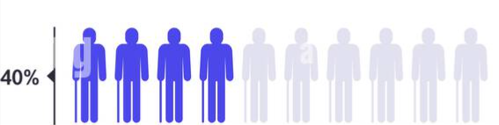
IgA Nephropathy (IgAN)
45% of all GN (most common)
2.5/100,000 Global incidence (screening policies, threshold for biopsies )
Asians > Caucasians > Black patients
Male:Female = 2:1 (in Asia→ 1:1)
Heterogenous clinical presentation (from asymptomatic to RPGN)
Mucosal surfaces play a key role
Up to 40% progress to ESRD within 20 years of diagnosis
Until now, SOC has been the use of supportive measure
ESRD
Int J Immunogenet 2022;49:8-21
Int J Nephrol Renovasc Dis 2018;11:137-148
Notes:
IgA is the most common, serious and progressive glomerulonephritis.
Now we have the knowledge that it is not considered anymore a benign condition
as in 40% of the cases it progresses to ESRD within 20 yrs..

Slide 5
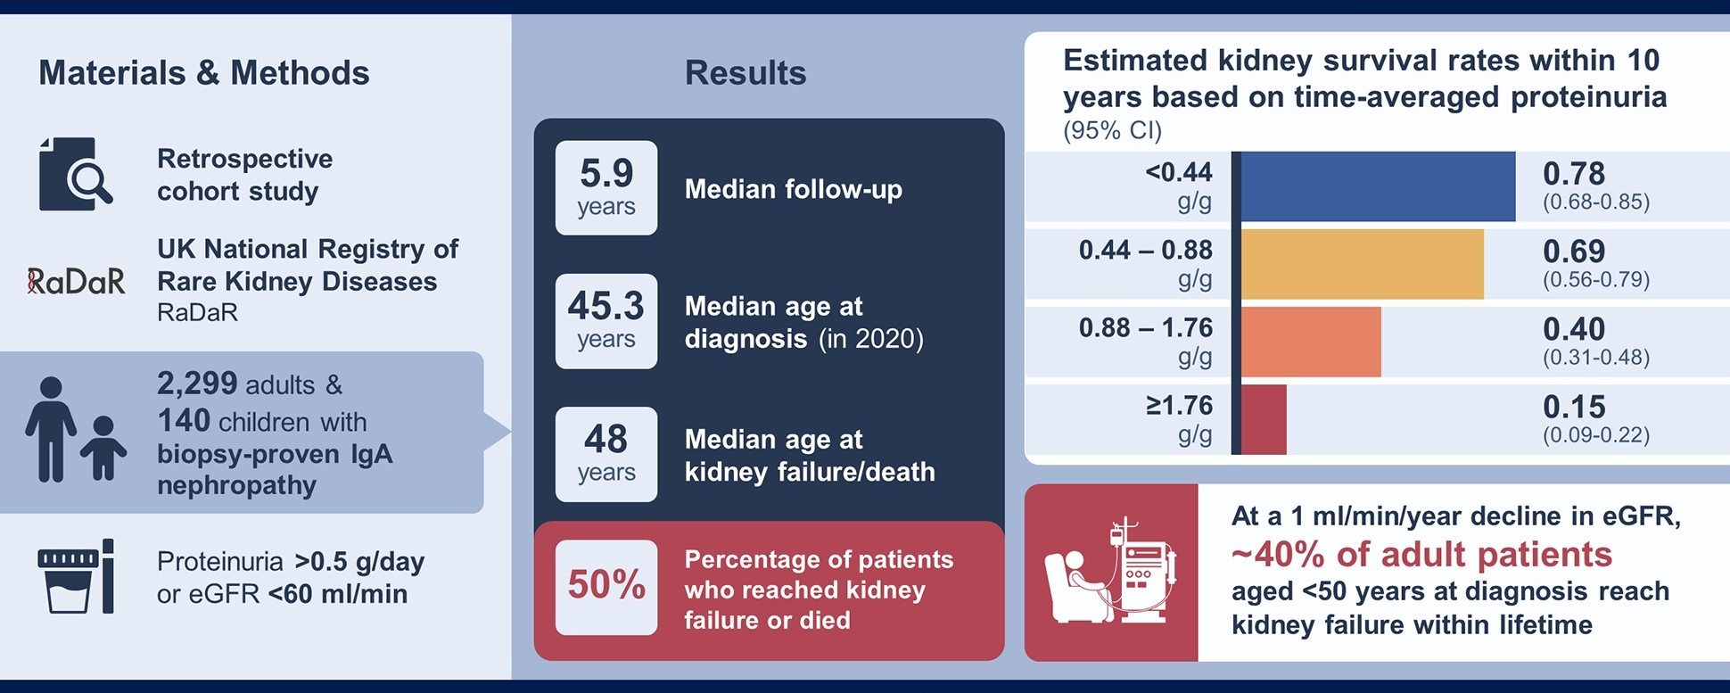
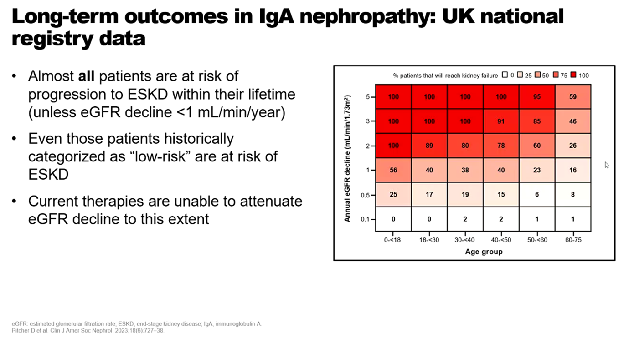
Long term risk of kidney failure in IgAN (RaDaR cohort)
Almost all patients are at risk of progression to ESRD within their lifetime, unless eGFR declines <1ml/min/year
Even patients traditionally regarded as being “low risk”, with proteinuria <880 mg/mg,
also had high rates of kidney failure within 10yrs
Clin J Amer Soc Nephrol 2023;18(6) 727-38
Notes:
Indeed, as it is shown in a UK registry, almost all are at risk for progression to ESRD within their lifetime unless the eGFR decline is <1 ml/min/year.
Even patients that were traditionally considered low risk due to their proteinuria of < 1 gr/gr,
had also high rates of kidney failure within 10 years

Slide 6

Genome wide association studies (GWAS)
Identification of several genetic variants associated with increase risk for disease development
Chromosome 22q12
LIF and OSM genes encode two
cytokines important for mucosal
immunity and inflammation
Two additional loci encoding genes
related to mucosal immunity were
identified in Chinese cohorts
CARD9 locus
Variant associated with ↑ risk for IBD
Clin J Am Soc Nephrol. 2021;16:458-466
Notes:
Regarding the new data that we have for the pathophysiology of IgAN, there are findings that confirm the link between IgA-gut axis, with the help of Genome wide association studies we have identified several genetic variants such as GARD 9 locus and genes that encode cytokines important for mucosal immunity.

Slide 7
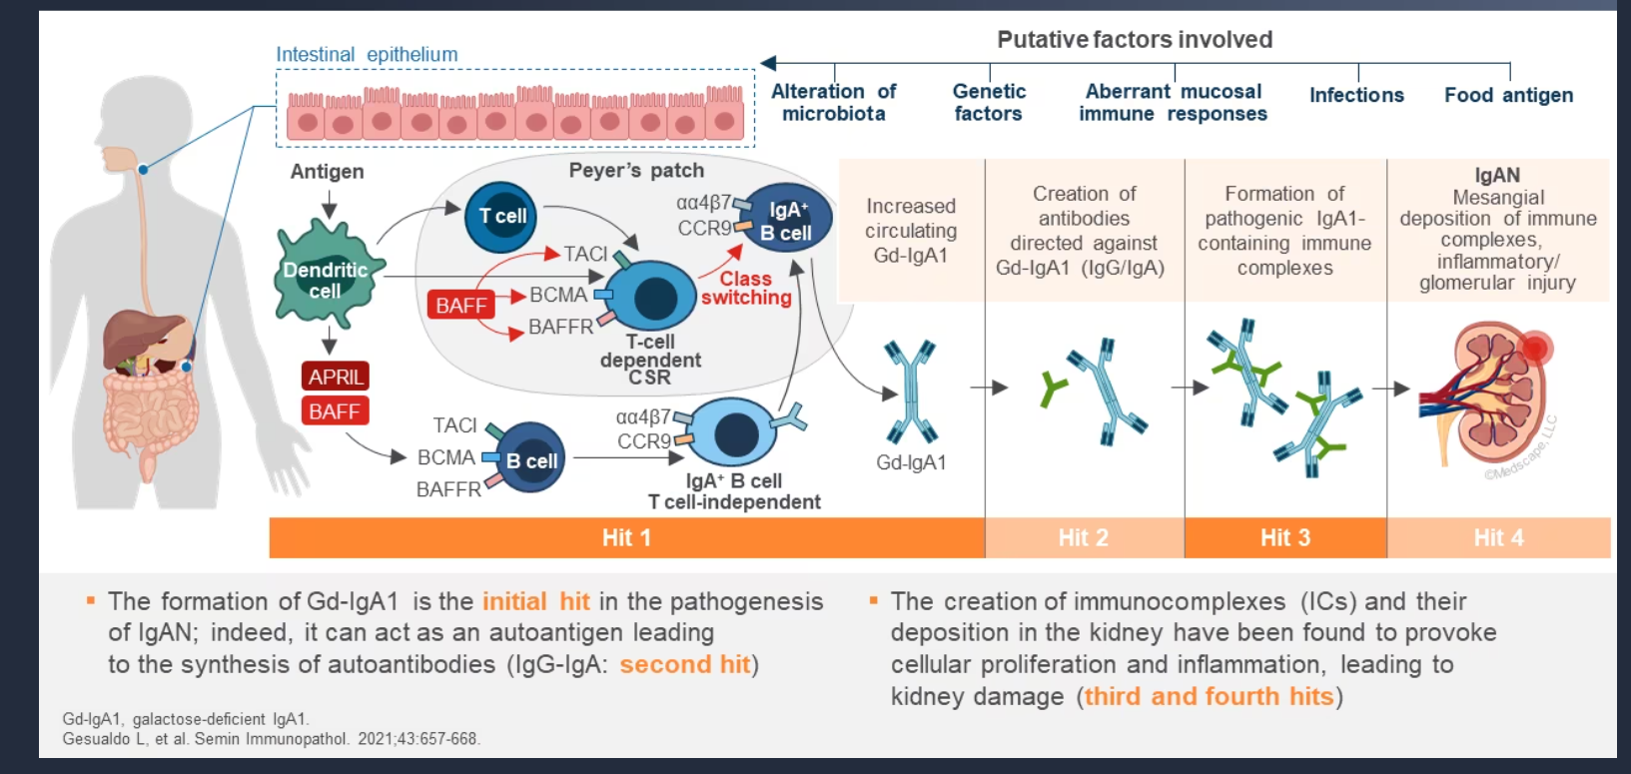
IgA and Gut-kidney axis: the “multi-hit” theory
Semin Immunopathol 2021; 43:657-668
J Am Soc Nephrol. 2022 May;33(5):873-875
Notes:
IgA is protecting our mucosal surfaces from invasion by viruses bacteria fungi.
So in patients with genetic predisposition their mucosal system gets stimulated from epigenetic stimuli in a temporary or more persistent manner which results in vigorous inflammatory response with an increased mucosal IgA which is lactose decicient IgA1.
After that first hit that lactose deficient IgA1 enters the systemic circulation and then the innate immune system “sees” these IgA1 as foreign and forms increased amounts of IgG and IgA against the lactose deficient IgA1 and form complexes which are trapped to mesangium

Slide 8
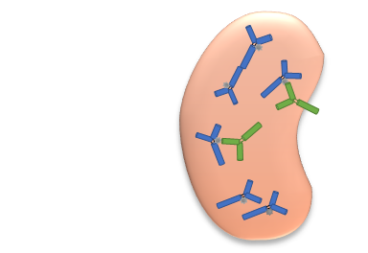
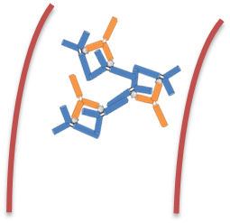
4. Deposition of immune complexes in the kidney
3. Immune complexes form in the circulation
1. Increased circulating levels of Galactose deficient-IgA1
• Genetic predisposition
• Epigenetics
• Enzymatic variants
• Mis-trafficking of B cells from mucosal
to systemic sites
2. Production of Anti-IgA1 autoantibodies (IgA or IgG)
5. Immune complexes in the mesangium cause local immune activation & injury
→ Worse prognosis
• Genetic predisposition, HLA haplotype
• Germline mutations
• Molecular mimicry
• Viral infection
• Streptococcal antigens
• Complement activation
• Cytokine/chemokine release
• Monocyte recruitment
• Matrix production
• Mesangial proliferation
• Glomerular sclerosis
• Interstitial fibrosis
“the 5th element “
Notes:
The new interest is the 5th hit which is the hyperactivation of the complement system after the deposition of the immune complexes,

Slide 9
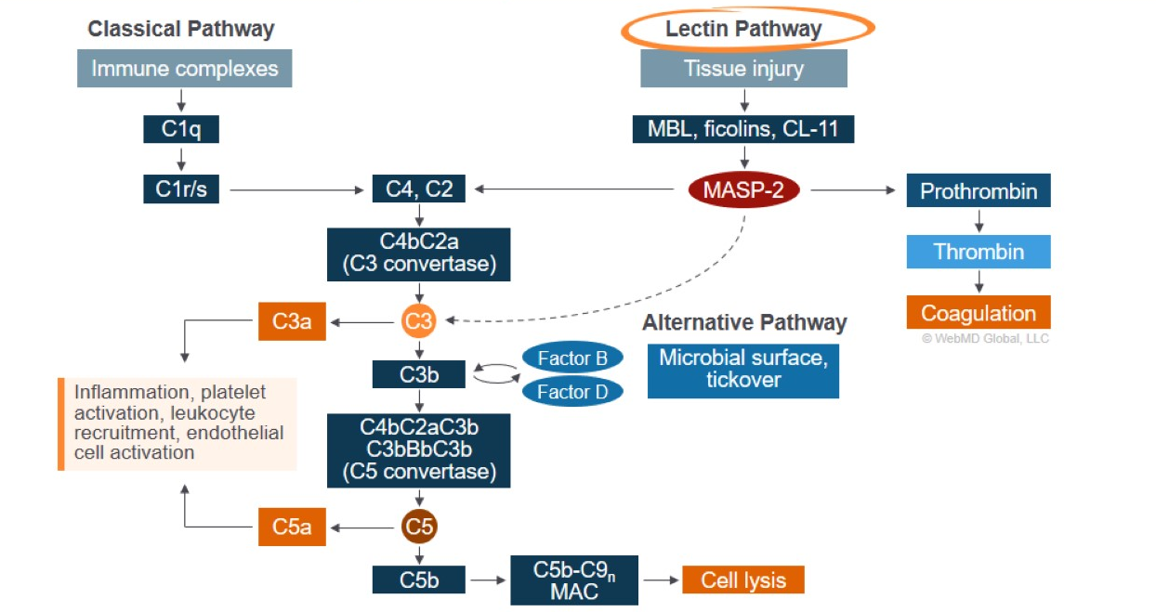
Complement Activation in Glomerular Disease
Complement Activation in Glomerular Disease
Classical Pathway Lectin Pathway
Exp Hematol Oncol. 2021;10:57
Notes:
….which leads to formation of end products of compliment such as anaphylatoxin C5a and MAC complex and augmented inflammation

Slide 10
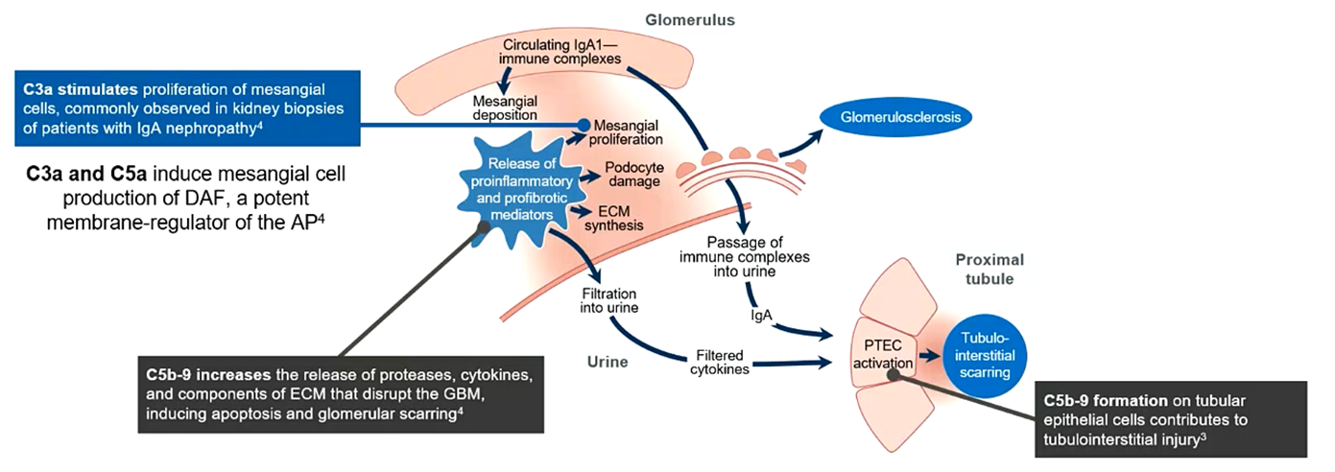
Hit 5: IgA immune complex deposition
leads to overactivation of the alternative pathway in IgAN
IgA immune complex deposition→
Activation of the alternative pathway of the complement trigger inflammation (proteinuria and hematuria)
Leads to tubulointerstitial and glomerular scarrinng and eventually to CKD
Front Immunol 2019; 10:504
Am J Nephrol 2018; 47:43-52
Notes:
….which as we can understand a potential therapeutic target with agents that can block this activation and prevent the inflammation and the progression to tissue damage and eventual fibrosis.

Slide 11
Outline
Epidemiology and Pathophysiology of IgAN (gut-kidney axis)
Risk stratification for disease progression
Supportive care/new agents
Immunosuppressive therapy in high-risk patients
Other investigational agents
  Inhibition of Immune Complex-Activated Complement Activity
  Inhibition of BAFF/APRIL Signaling
  Plasma Cell and B Cell Depletion
  Inhibition of Endothelin A Receptor and Angiotensin II Subtype 1 Receptor
Conclusions
Notes:
But how can we detect the patients with the highest risk for progrssion?

Slide 12
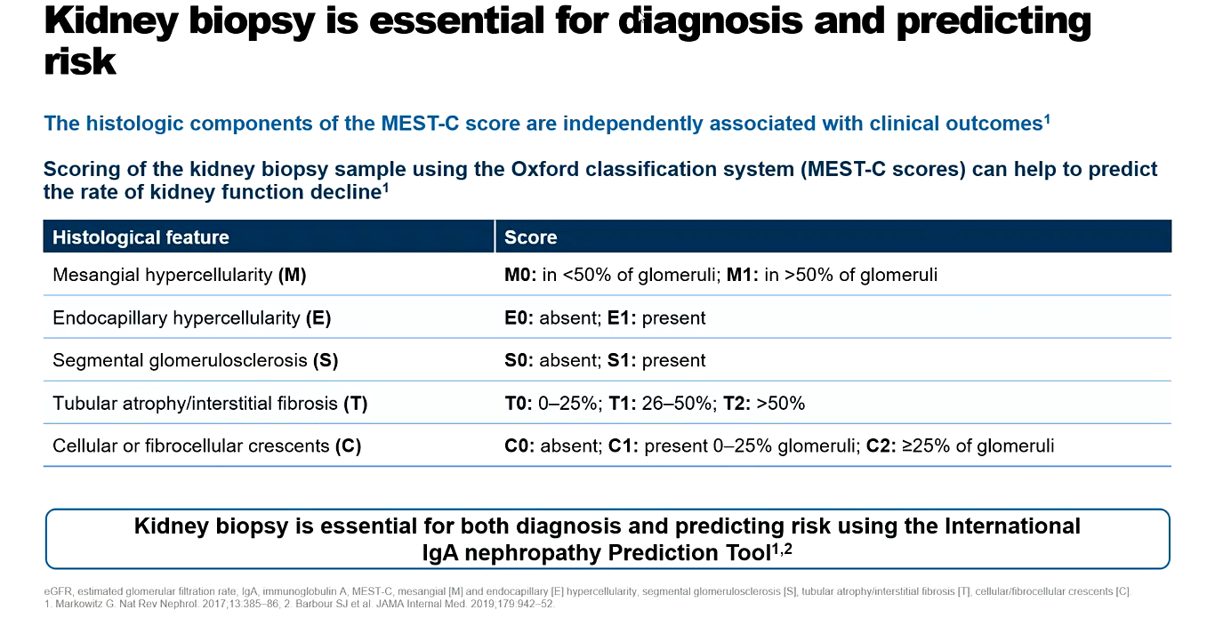
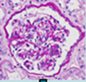
The histologic components of Oxford classification (MEST-C score)
are independently associated with clinical outcomes
Kidney biopsy is essential for both diagnosis and predicting risk using the international IgAN prediction tool
The score predicted outcomes independently of BP, proteinuria and eGFR
Nat Rev Nephrol 2017;13:385-86
JAMA Internal Med. 2019;179:942-52
Notes:
Histologic findings on kidney biopsy have been identified as strong risk factors for disease progression. They include crescent formation, mesangial depositions, or cellularity of capillary loops, as well as markers of chronic fibrotic damage
and they are all described in the Oxford classification MEST-C Score.

Slide 13
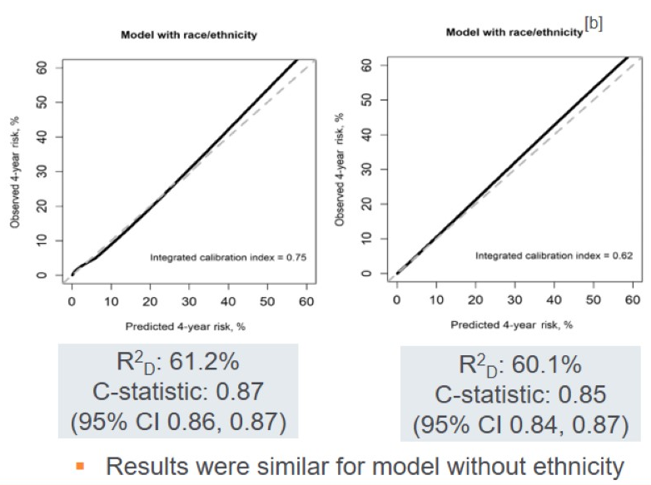
International IgAN Prediction Tool at Biopsy
Determining Prognosis
International IgAN Prediction Tool at Biopsy
Determining risk of 50% decline in eGFR or progression to ESRD in 5 yrs from biopsy
Parameters
Estimated GFR at biopsy
SBP at biopsy
DBP pressure
Proteinuria at biopsy
Age at biopsy
Race
Use of ACEi or ArB at the time of biopsy
MEST score
Immunosuppression use at or prior to biopsy
Validated
prognostic
biomarkers
for IgAN
The updated International IgAN Prediction Tool
can be used for accurate risk stratification 1-2 years post biopsy
Mobile app: https://qxcalc.app.link/igarisk
Kidney Int 2022; 102:160-172
Notes:
The graded components of this score will be used in the International IgA prediction tool that has been validated to determine the risk of 50% decline of eGFR or progression to ESRD in 5 yrs from biopsy. The original International tool could be used only close to biopsy.
However the updated tool has been shown that can be used for accurate risk stratification even 1-2 yrs post biopsy. So it validated and continues to assess risk progression at 1 or yrs.
It cannot, however, determine the likely impact of any treatment regimen.

Slide 14
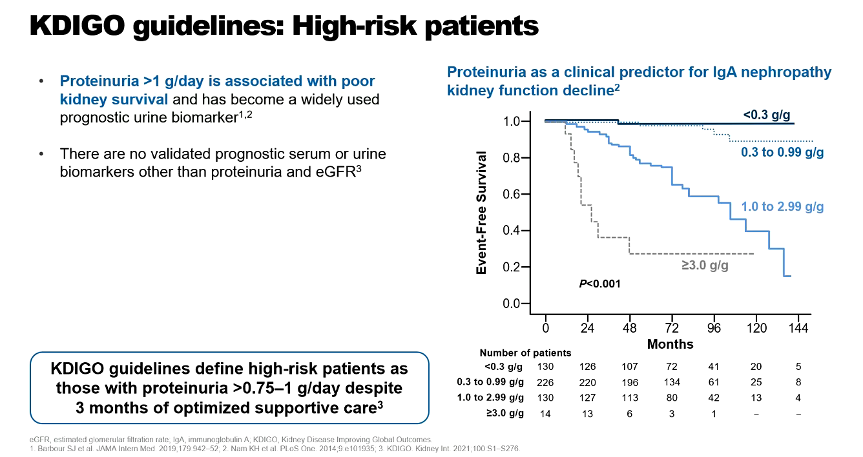
KDIGO guidelines: high-risk patients
Proteinuria of > 1g/d → 9.4 fold increased risk of ESRD
JAMA Intern Med 2019; 179: 942-52
Kidney Int. 2021;100:S1-S276
Notes:
According to KDIGO guidelines we focus in proteinuria as a major modifiable risk factor for progression

Slide 15
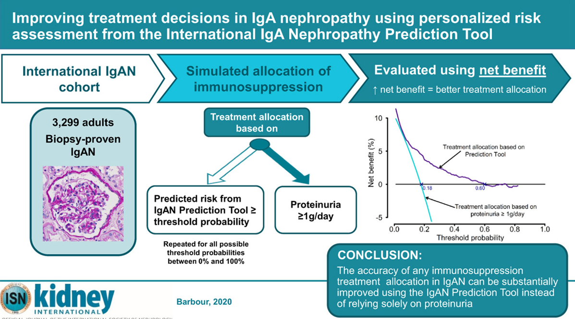
Improving treatment decisions in IgAN using personalized risk
assessment from the International IgAN Prediction Tool
larger net benefit up to 23.4%
larger net ↓ in treatment up to 35.1%
CONCLUSION:
The accuracy of any immunosuppression
treatment allocation in IgAN can be substantially improved using the IgAN Prediction Tool instead of relying solely on proteinuria
Kidney Int. 2020 Oct;98(4):1009-1019
Notes:
There is a need to clarify the risk and benefit of using these agents.
A study from the International cohort in 3299 adults with biopsy proven IgAN,
showed that treatment allocation using the Prediction Tool vs proteinuria>1g/day,
had a larger net benefit up to 23.4% and a larger net reduction in treatment up to 35.1%.

Slide 16
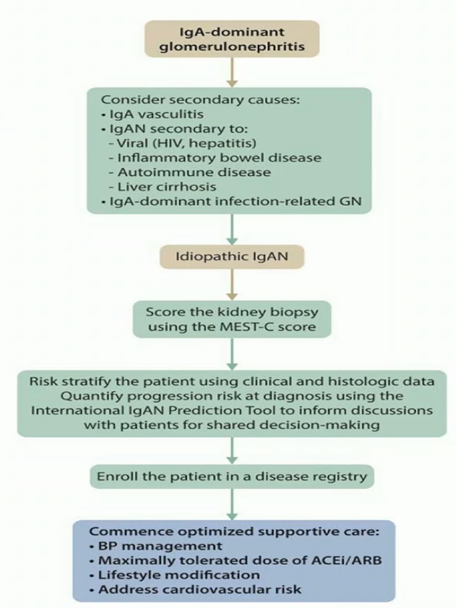
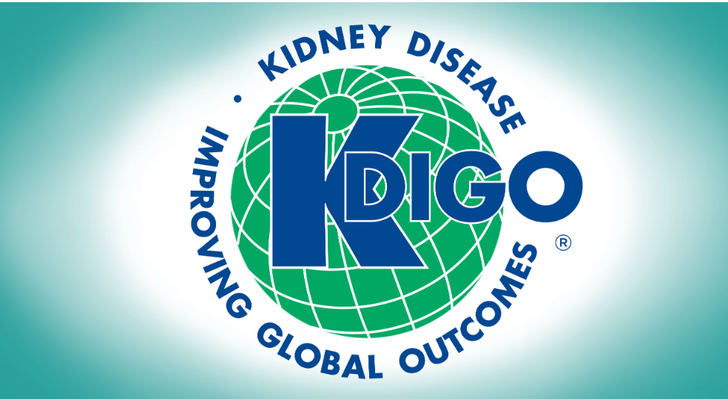
2021 update
Kidney Int. 2021 Oct;100(4S):S1-S276
Notes:
The most recent KDIGO update uses an algorithm that after ruling out secondary causes of IgAN and quantifying the progression risk by using both histologic and clinical data in the International prediction tool,
concludes that the backbone of the initial treatment for primary IgAN is supportive care, including maximally tolerated doses of RAS inhibition

Slide 17
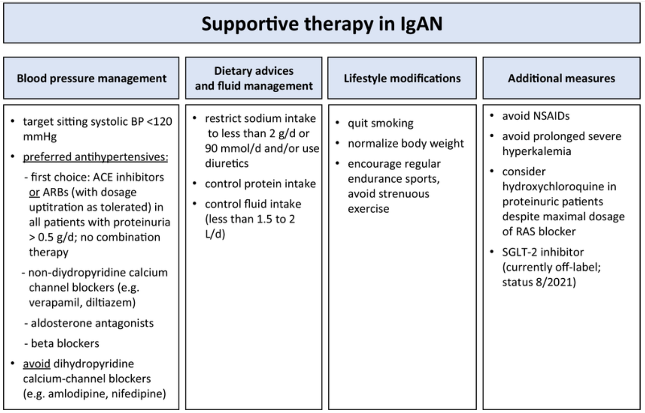
2021 KDIGO Guidelines
(at least for 3 months)
Kidney International 2021 100, 753-779

Slide 18
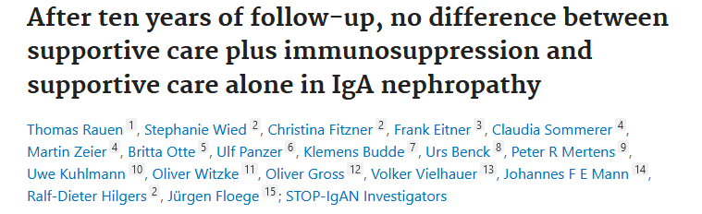
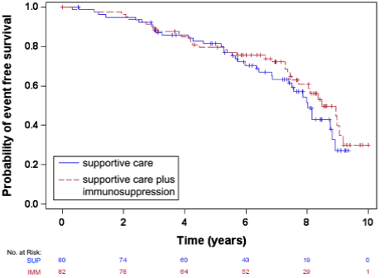
Entire STOP IgA cohort
50% of patients in the stop IgA trial
on maximal supportive care reached ESRD
Kidney Int. 2020 Oct;98(4):1044-1052
Notes:
However 50% of patients who were on maximal supportive care in the stop IgA trial reached ESRD at 8 years.
This is similarly true in the placebo groups of other recent RCTs in full supportive care where they will still have an annual loss of 5ml/min in GFR.
So there is a need to improve the supportive care in IgA nephropathy

Slide 19
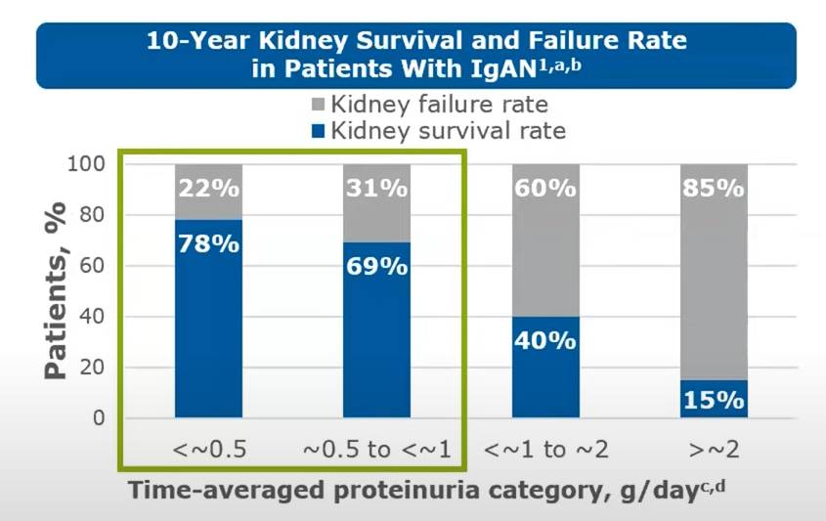
RaDaR database
There may be an unmet need for disease management
in “low risk” patients with proteinuria < 1g/d
JAMA Intern Med 2019; 179: 942-52
Kidney Int. 2021;100:S1-S276
Notes:
Indeed based on the cohort from the RADAR study we see that still even in patients with proteinuria between 0.5 and 1g/day there is still a 31% of risk for ESTD in 10 yrs…there is an unmet need for disease management in the presumably “low risk” patients with proteinuria of <1 g/d

Slide 20
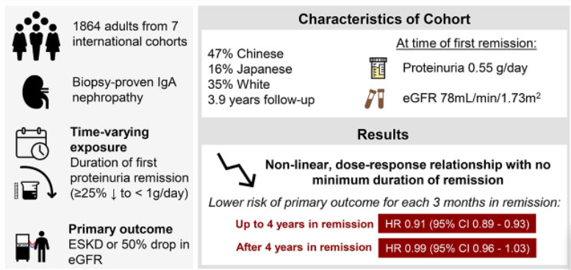
There is no minimum duration of proteinuria remission
that is associated with improved outcomes in IgAN
There is a strong dose-response relationship between the longer duration of
proteinuria remission and a lower risk of disease progression in IgAN
J Am Soc Nephrol. 2021 Feb;32(2):436-447
Notes:
As shown in this cohort where the 1mary outcome was ESKD or 50% drop in eGFR, there a non linear dose response relationship with no minimum duration of remission

Slide 21
Outline
Epidemiology and Pathophysiology of IgAN (gut-kidney axis)
Risk stratification for disease progression
Supportive care/new agents
Immunosuppressive therapy in high-risk patients
Other investigational agents
  Inhibition of Immune Complex-Activated Complement Activity
  Inhibition of BAFF/APRIL Signaling
  Plasma Cell and B Cell Depletion
  Inhibition of Endothelin A Receptor and Angiotensin II Subtype 1 Receptor
Conclusions
Notes:
Lets see what improvements we can have in the supportive care
based on supportive evidence

Slide 22
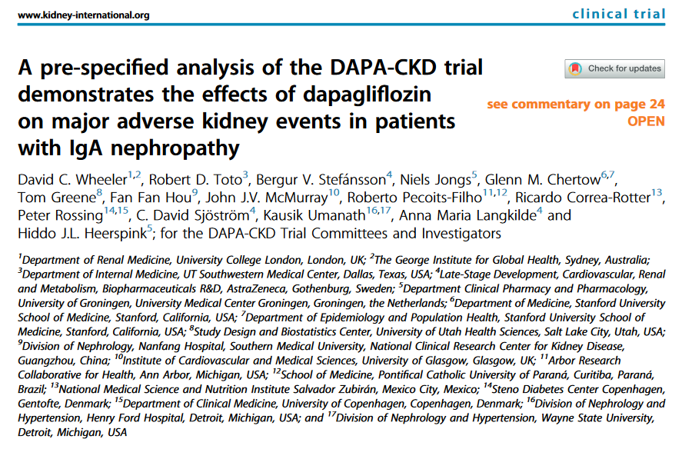
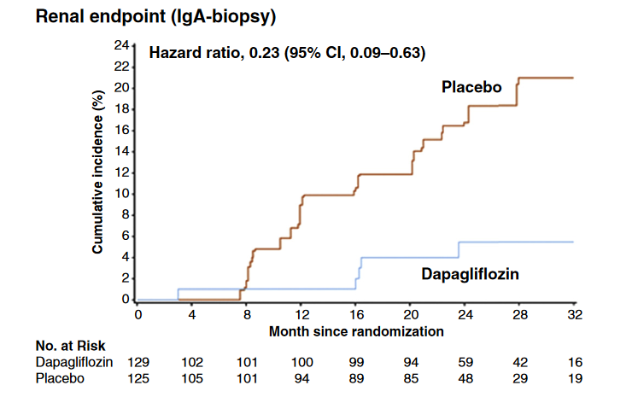
270 pnts with biopsy proven IgA nephropathy
Addition of dapagliflozin to RAAS inhibitors
led to reduction of the risk of progression
(>50% eGFR reduction or ESRD)
Renal endpoint: HR 0.23
Reduction of UACR by 26%
Good safety profile
Conclusion: In pnts with IgAN, dapagliflozin added
to ACE/ARB therapy, significantly reduced the risk
of CKD progression
Approval of dapagliflozin in USA and Europe in CKD
Kidney Int. 2021 Jul;100(1):215-224
Notes:
SGLT2 inhibitors have been new to the treatment landscape to most proteinuric diseases in Nephrology, both in the diabetic but also in the non diabetic population
A pre-specified analysis of the DAPA CKD trial for dapagliflozin showed in a subgroup analysis in 270 pnts with IgA nephropathy that
SGLT2 inhibitors were able to reduce the risk of decline in kidney function with a reduction in proteinuria which led to a fast track approval of dapagliflozin in USA and Europe for CKD patients

Slide 23
Deposition of IgA-immune complexes in the mesangium increases ET-1 and AngII production which contribute to:
inflammation
fibrosis
changes to the shape of podocytes, podocyte loss, mesangial cell proliferation
increased permeability of the glomerular filtration barrier
Vasoconstriction
Increased glomerular pressure
Kidney Dis. 2020, 6, 22–34
Kidney Int. 2014, 86, 896–904
Notes:
More striking results are coming from the dual blockage of endothelin 1 and Angiotensin II which is known that their production is induced after the immune complex deposition in the mesangium and contribute to….

Slide 24
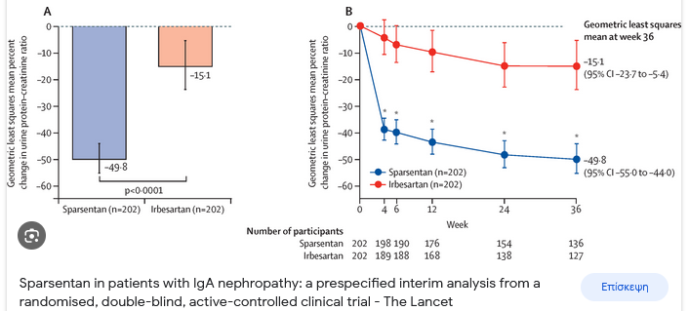
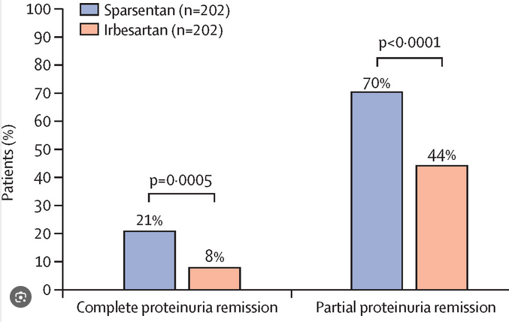

Sparsentan in patients with IgA nephropathy: a prespecified interim analysis from a randomised, double-blind, active-controlled clinical trial
Interim analysis at 36 weeks
Hiddo J L Heerspink 1 , Jai Radhakrishnan 2 , Charles E Alpers 3 , Jonathan Barratt 4 , Stewart Bieler 5 , Ulysses Diva 6 , Jula Inrig 6 , Radko Komers 6 , Alex Mercer 7 , Irene L Noronha 8 , Michelle N Rheault 9 , William Rote 6 , Brad Rovin 10 , Howard Trachtman 11 , Hernán Trimarchi 12 , Muh Geot Wong 13 , Vlado Perkovic 14 ; PROTECT Investigators
PROTECT trial: international, double-blind, active-controlled RCT
Compared 400 mg Sparsentan vs 300mg Irbesartan
404 pnts with IgAN
eGFR >30 ml/min/1.73m²
Proteinuria > 1g/day
Duration: 270 wks
Sparsentan= Dual Endothelin Angiotensin Receptor Antagonist (DEARA)
Lancet. 2023 May 13;401(10388):1584-1594.
Notes:
This is PROTECT trial which compared 400 mg sparsentan (a dual endothelin Angiotensin receptor antagonist) vs 300 irbesartan in 400 patients with IgA nephropathy.
In the prespecified intrim analysis at 36 weeks,
in the sparsertan group an impressive reduction of 50% of UPCR was noted,
compared to an much less decrease of 15% in the irbesartan group.
In the pipeline there are trials with combination of sparsentan with SGLT2i, but this will be awaited in the near future

Slide 25
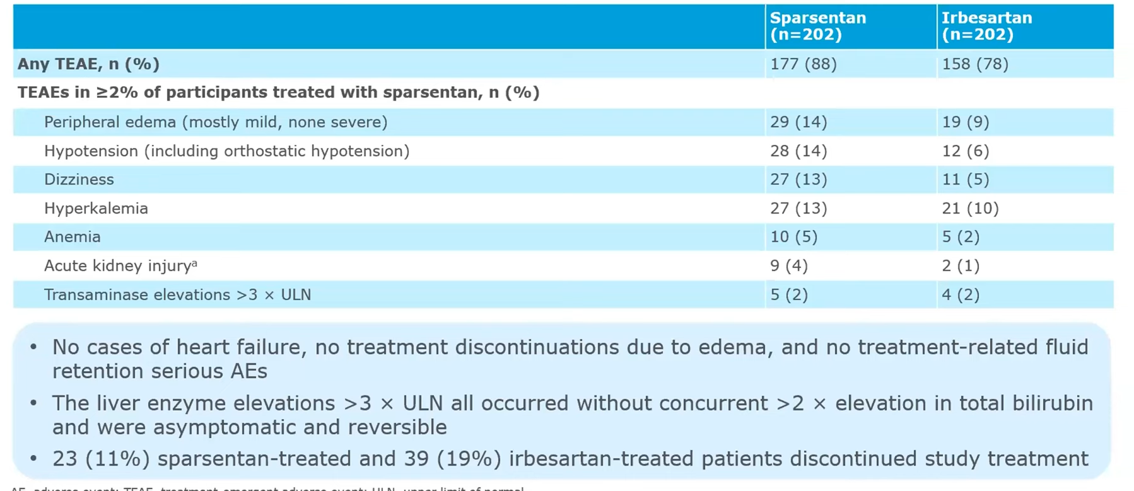
TREATMENT- EMERGENT ADVERSE EVENTS
Sparsertan (Filspari): accelerated FDA approval in pnts with IgAN
and risk of rapid kidney function decline (e.g UPCR ≥1.5g/g or ≥2g/day)
Lancet. 2023 May 13;401(10388):1584-1594.
Notes:
The safety profile was rather satisfactory with only some peripheral oedema, hypotension and dizziness
but no severe oedema, heart failure, or hepatotoxicity were noted.
That was why sparsentan got an accelerated FDA approval in pnts with IgAN when proteinuria was > than 2 g/day

Slide 26
Outline
Epidemiology and Pathophysiology of IgAN (gut-kidney axis)
Risk stratification for disease progression
Supportive care/new agents
Corticosteroids in high-risk patients
Other investigational agents
  Inhibition of Immune Complex-Activated Complement Activity
  Inhibition of BAFF/APRIL Signaling
  Plasma Cell and B Cell Depletion
  Inhibition of Endothelin A Receptor and Angiotensin II Subtype 1 Receptor
Conclusions
Notes:
But how can we detect the patients with the highest risk for progrssion?

Slide 27
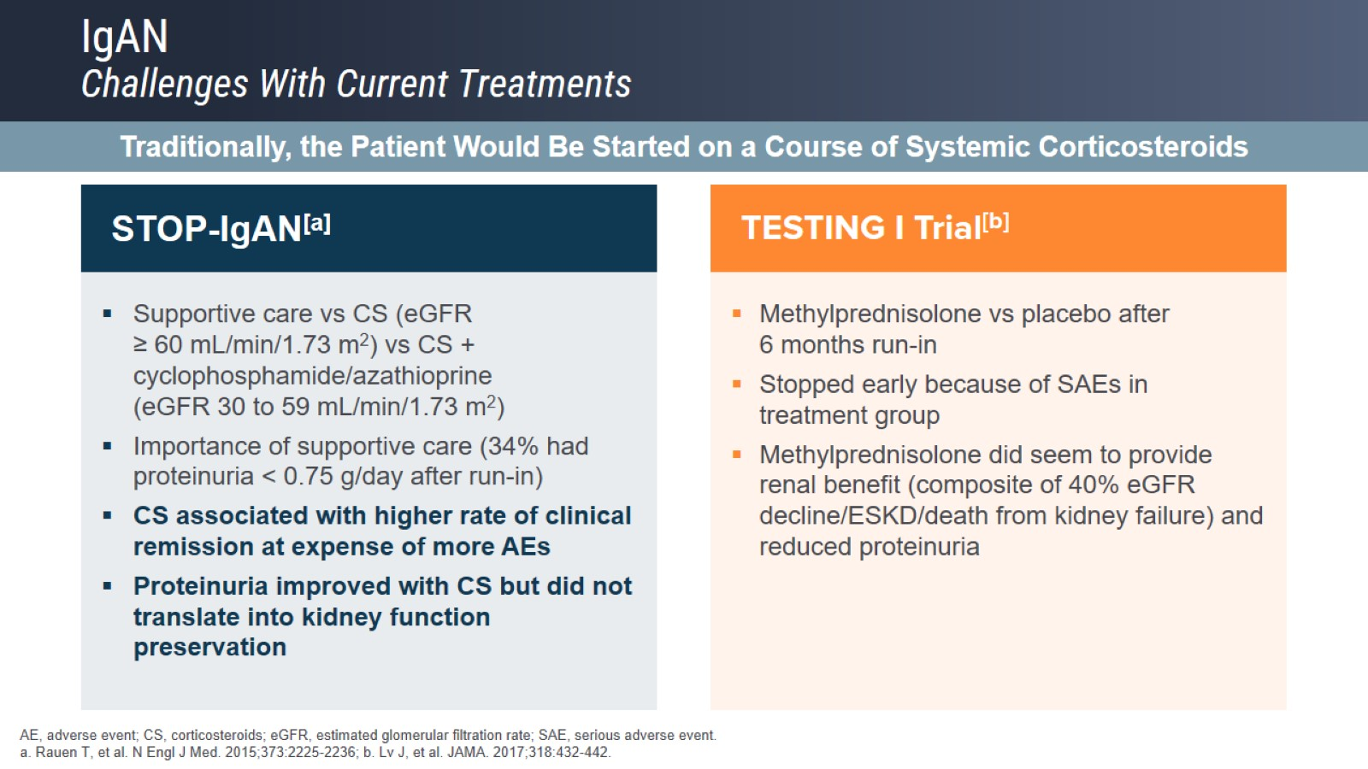
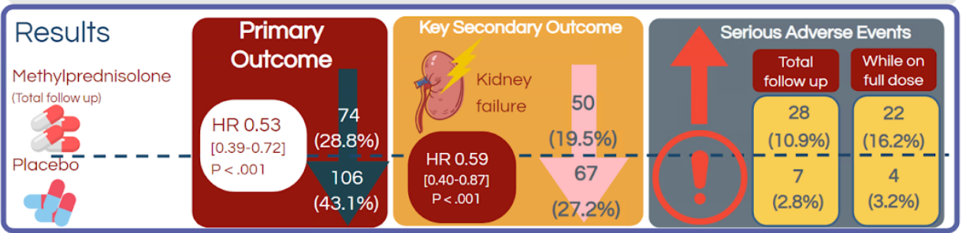
IgAN
Challenges With Current Treatments
Systemic Steroids Treatment
STOP-IgAN
TESTING I Trial
Multi-center, double blind RCT, N=503 IgA
0.6-0.8mg/Kg/d vs placebo (6months)
FU=4.2 yrs
1mary outcome: 40%↓eGFR, ESRD, renal death
503 high risk pnts with IgA
14.4 vs 3.2
(Mainly of Chinese origin)
NEJM 2015;373:2225-2236
JAMA 2017;318:432-442
Notes:
IgA is an inflammatory disease, so steroids have been introduced as a therapeutic approach in the high risk patients
But oral steroids ended up being out of favor
after the publication of STOP-IgAN in 2015 in NEJM
that showed no difference between the treatment and the placebo arms regarding renal outcomes
and the TESTING trial.

Slide 28
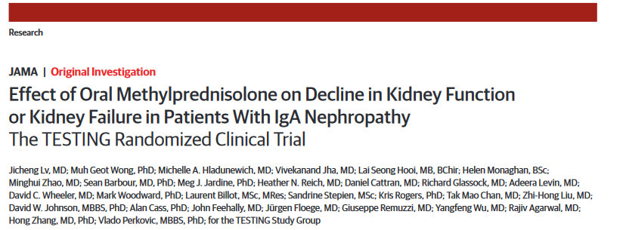
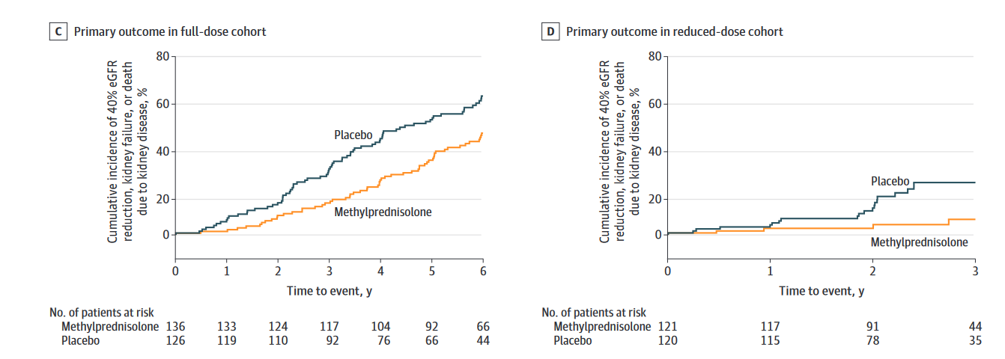
Reduced corticosteroid dose:
From 0.6-0.8mg/Kg/d to 0.4mg/Kg/d for 2 mo
with 6-8 mo tapering
Total 503 pnts (1:1, high:low dose)
Median follow up 4.6 yrs
1mary outcome in full dose
1mary outcome in reduced dose
76% Chinese ethnicity
35 yrs median age
Initiation of therapy since biopsy: in 5 mo
Median proteinuria 2g/d
The benefit of methylprednisolone was evident on the 1mary outcome of 40% reduction in GFR and was independent of the dose as it was both on full and in reduced dose
JAMA. 2022 May 17;327(19):1888-1898
Notes:
Recently the results of the final report of the TESTING trial. It was tried a reduced dose of the corticosteroids from 0.6-0.8 mg/Kg/day in the first two months to 0.4mg/Kg/day.
The benefit of methylprednisolone was evident on the 1mary outcome of 40% reduction in GFR and was independent of the dose as it was both on full and in reduced dose

Slide 29
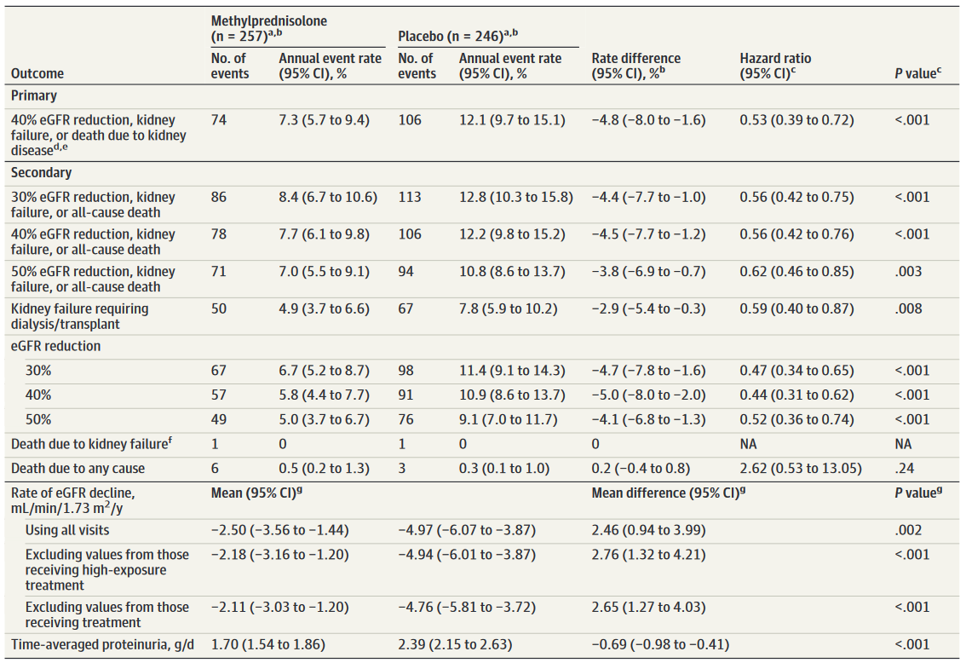
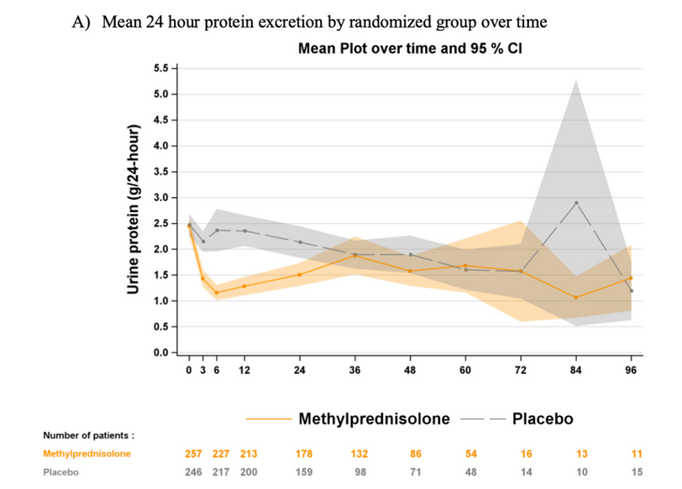
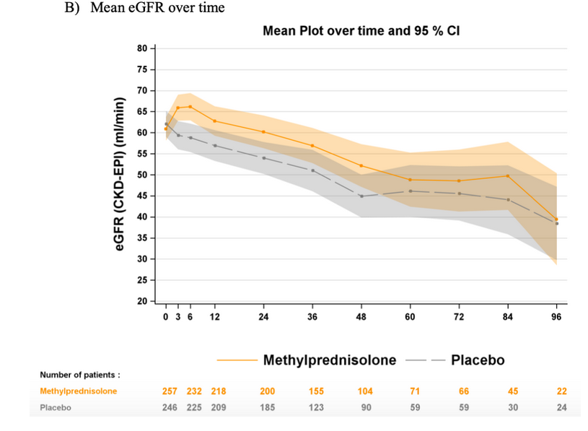
Maximal proteinuria reduction at 6mo (-1.4g/day)
Proteinuria reduction was lost at 3yrs
eGFR increased at 6mo
Benefit was lost at 5yrs
JAMA. 2022 May 17;327(19):1888-1898
http://www.nephjc.com/news/2022/6/5/re-testing
Notes:
1mary and 2ndary outcomes were significantly met
and if we look at the yearly decline in GFR in the placebo group was about 5ml/min/year
whereas in the methylprednisolone was only 2.5ml/min/year at 2.4 years

Slide 30
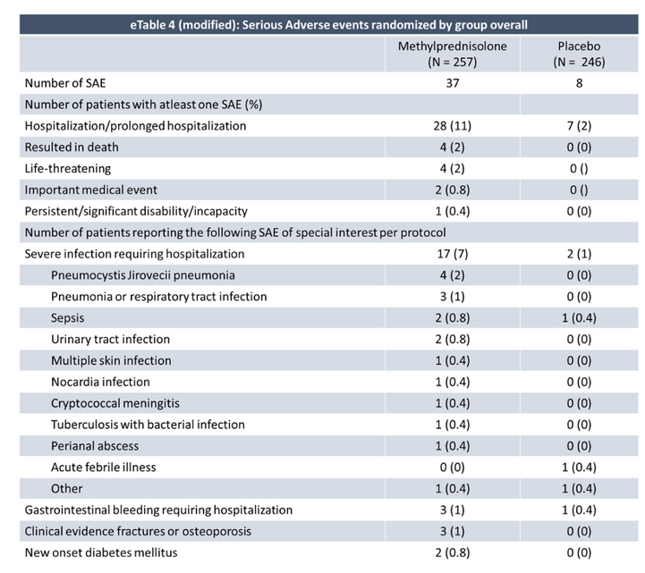
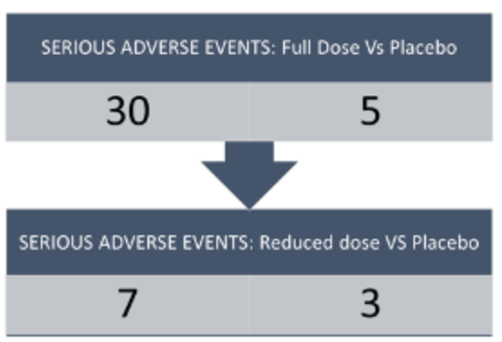
Re-TESTING Steroids for IgA Nephropathy
TESTING trial: Serious adverse events
Discontinuation of trial due to ASE
JAMA. 2022 May 17;327(19):1888-1898
Curr Opin Nephrol Hypertens. 2023 May
Notes:
However in the lower dose of steroids SE particularly the infections were reduced but still were double in comparison to the placebo group

Slide 31
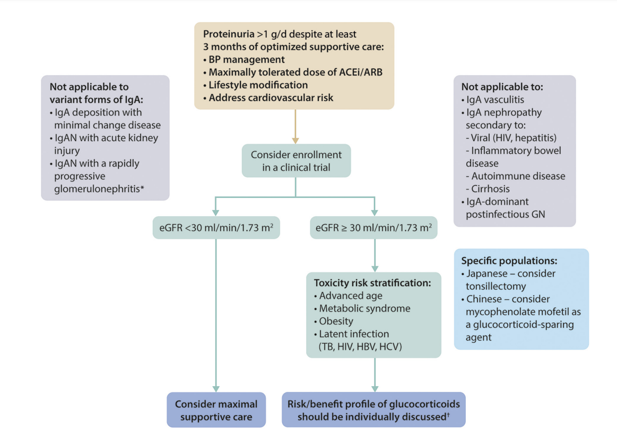
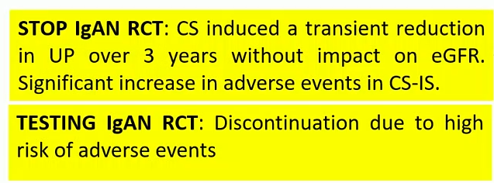
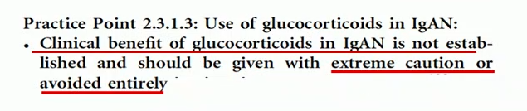
High risk patients
2021 update
Kidney Int. 2021 Oct;100(4S):S1-S276
Notes:
Indeed KDIGO update in 2021 concluded from the 2 big trials that (*) from STOP IgA …. and from TESTING IgAN ….. So in conclusion the clinical benefit of glucocorticosteroids is not established and should be used with caution or not at all.

Slide 32
Systemic vs topical glucocorticosteroids
Notes:
So another approach has been tested in order to descrease the side effects of the treatment yet get the benefit of it
which would be the local administration of glucocorticosteroids acting at the terminal ileum where the IgA1 are produced

Slide 33
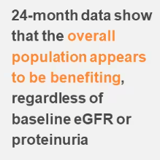
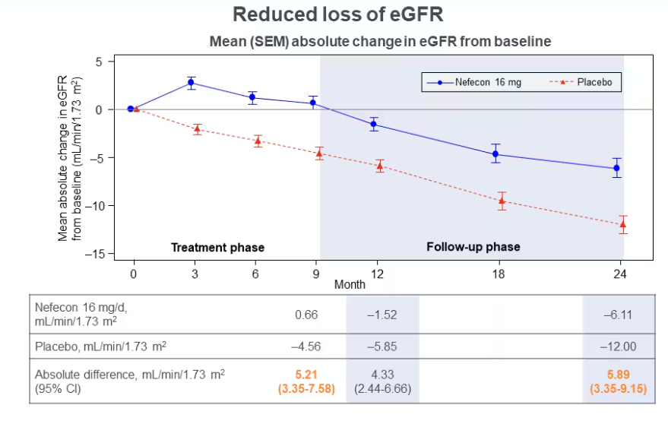
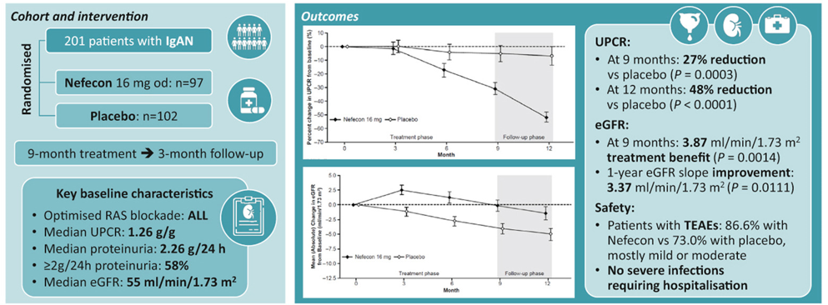
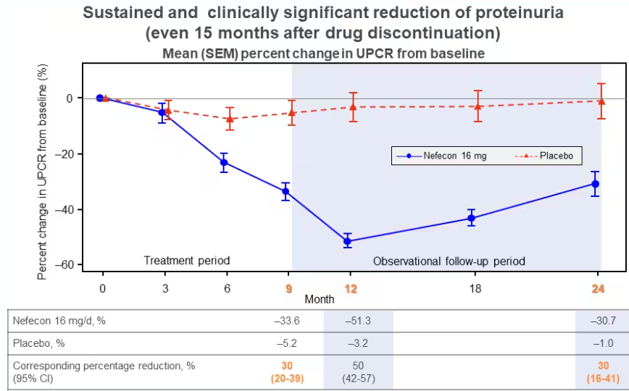
NefIgArd phase III trial (Part A)
Long term efficacy in Part B → 360 pnts
Nefecon: Oral Targeted release formulation (TRF) budesonide
5.05ml/min/1.73m² benefit vs placebo in 2 yrs (p<0.0001)
-27%
-48%
Kidney International (2023) 103, 391–402
Lafayette et al. Presented at 60th annual ERA congress; June 15-18 2023; Milan
Notes:
So the NefIgArd trial tested the benefit of Nefecon in IgAN which is an oral targeted release formulation of budesonide that delivers steroid exactly at the level of the ileum where galactose deficient IgA1 is produced.
They included 200 high risk patients that had biopsy proven IgA preserved eGFR and persistent proteinuria despite maximally tolerated RAAS blockage
And they gave 16mg/day Nefecon for 9 months vs placebo for 9 months.

Slide 34
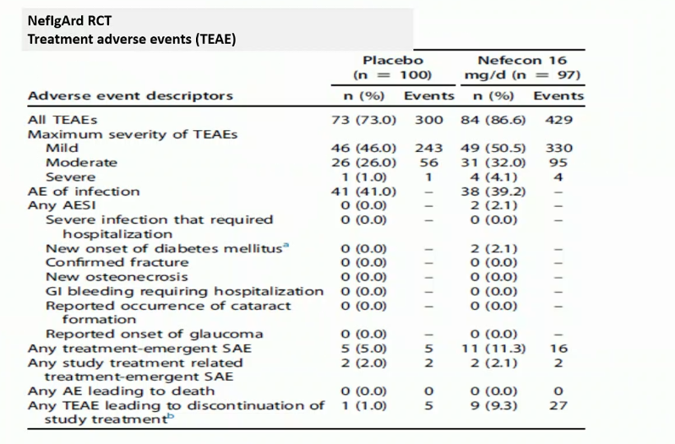
NefIgArd adverse events: 86.6% with Nefecon vs 73% with placebo
No severe infections requiring hospitalisation
Kidney International (2023) 103, 391–402
Notes:
The side effects were only mild and 9% had a discontinuation due to the drug

Slide 35
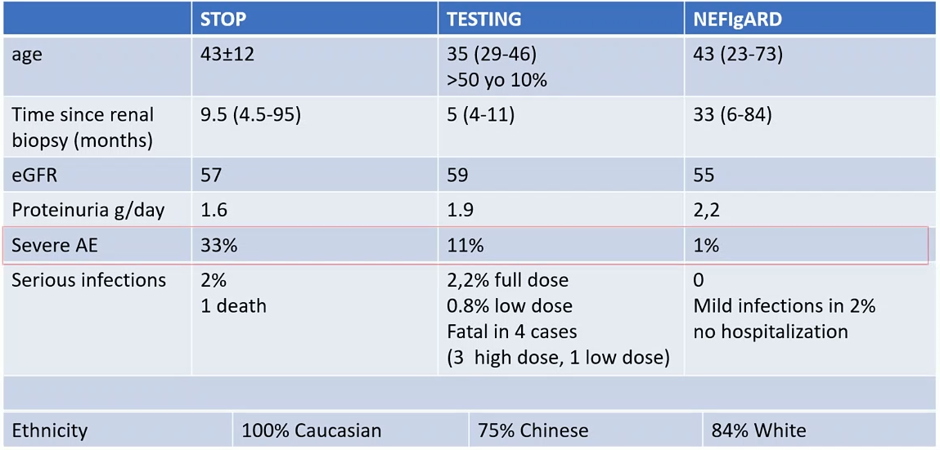
Increased frequency of peripheral edema, acne, hypertension (11-15% of the treated cases)→ some systemic CS exposure
→ Treatment up to 9 montns
Notes:
…but if compare STOP and TESTING and NEFIgARD adverse events you can see that the rate of serious adverse events are really low with only 2% of mild infections not requiring hospitalization. However, there is increased frequency of peripheral edema, hypertension and facial acne suggesting some systemic exposure to corticosteroids and the reserchers discourages treatment longer than 9 months

Slide 36
FDA approved in December 2021 in pnts with IgAN and risk of progression (UPCR ≥ 1.5g/g)
Systemic
Glucocorticosteroids
Delayed released
budesonide
Rapid anti-inflammatory action
May vanish over 1-3 years at the low doses
Validation awaited in all ethnicities
4mg of methylprednisolone
More SE
90% cleared by 1st liver passage → less systemic SE
2nd generation synthetic GS
Slow decrease in proteinuria (decrease in Gd-IgA)
Possible benefits last longer
Validation awaited in all ethnicities
Awaiting results of Part B Nefigard
Equivalent is 0.375mg of budesonide
vs
Who will have a significant benefit from the treatment?
2021 update:
Insufficient evidence supporting use of Oxford classification MEST-C score
to determine whether GS shoud be used in the treatment
https://www.fda.gov/drugs/fda-approves-first-drug-decrease-urine-protein-iga-nephropathy-rare-kidney-disease
Notes:
This drug is thought to be safe because 90% of the drug is cleared from the circulation after the 1st liver passage with only 10 % remaining in the circulation. We still need to monitor cumulative systemic toxic effects.
So when we compare the two formulations systemic corticosteroids seem to have a rapid antinflammatory effect, it may vanish over 1-3 years but validation is awaited in all ethnicities. In contrast the delayed released budesonide seem to lead to slower decrease in proteinuria, but possibly the benefits last longer. This may be confirmed with the results that we will obtain from the full part B report from the Nefigard trial.
But who exactly will be benefi tfrom the use of corticosteroids? The KDIGO 2021 emphasized that there in benefit to use the Oxford classification MEST-C score for this purpose. From the VALIGA study

Slide 37
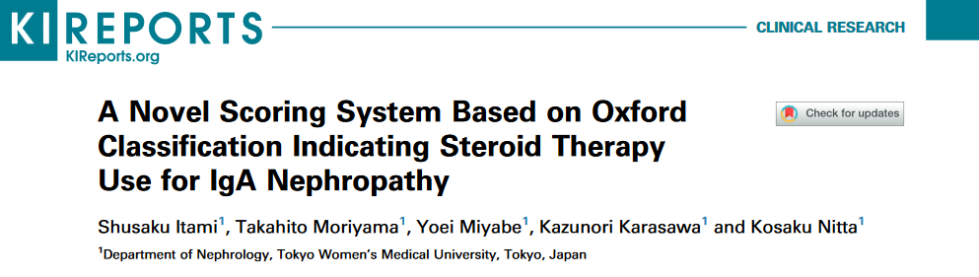

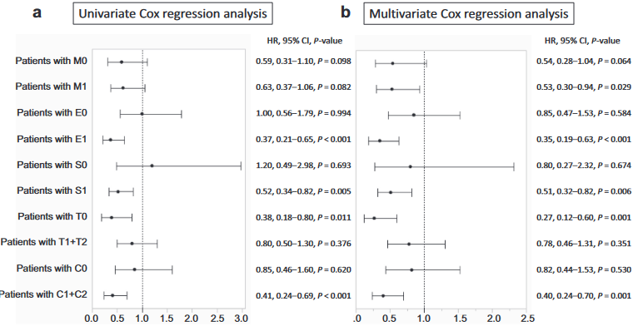
858 pnts with IgAN
GS benefit with MEST-C score 2-4
Pnts with M1, E1, S1, and C1+2 scores responded to GS
Pnts with T1+2 scores did not respond to GS
Kidney Int Rep. 2021 Oct 14;7(1):99-107
Notes:
Recently in this publication from Japan in over 800 patients with IgAN showed that steroids improved prognosis in patients with active 2-4 MEST-C score and there was no benefit with tupulointerstitial lesions T1+T2

Slide 38
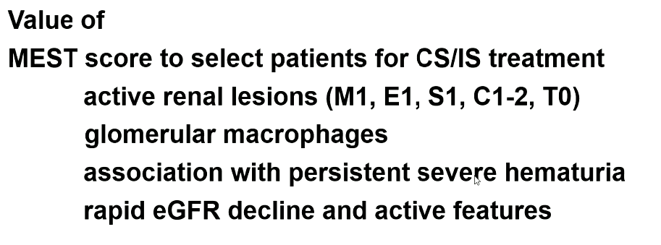
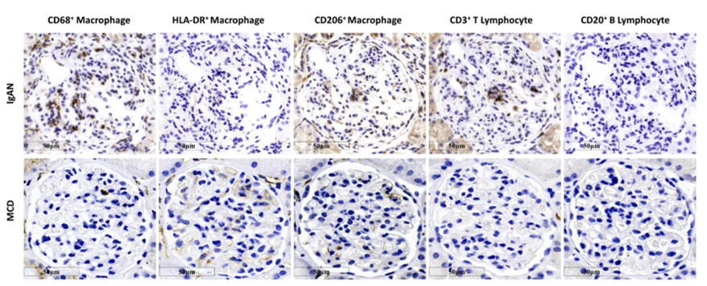
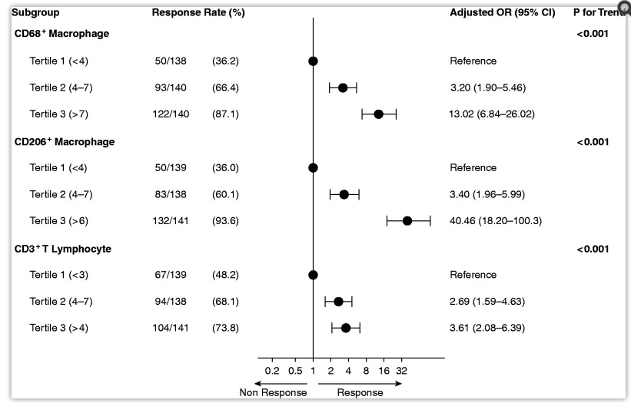
Intensity of macrophage infiltration in the glomerulus predicts
the response to immunosuppressive therapy in IgAN
621 Chinese pnts and IgAN and proteinuria ≥ 1g/g
Treated with MMF and GS for median of 18 mo
Levels of glomerular CD68 and CD206 of MΦ
Having higher levels of glomerular infiltrates, significantly associated with an increased probability of response to immunosuppression in adjusted analysis compared with having lower levels
Outcome of stable UP and stable eGFR after 1 year
J Am Soc Nephrol. 2021 Dec 1;32(12):3187-3196
Notes:
The intensity of Macrophage infiltration in glomeruli predicts the response to immunosuppression therapy with IgAN. Here we see the findings from a Chinese cohort in 621 patients with high risk treated with steroids and MMF for 6 months and looked at the remission of proteinuria and stable GFR. The macrophage infiltration (particularly with these two markers: CD 68 and CD206) was associated with increased response to steroids.

Slide 39
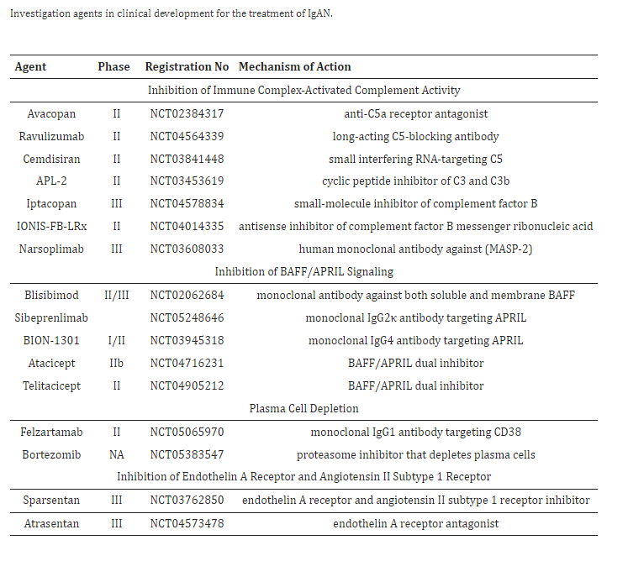
Inhibition of Immune Complex Activated Complement Activity
APPLAUSE-IgAN trial
ARTEMIS trial
Inhibition of BAFF/APRIL Signaling (Prevent Gd-IgA1 production)
Emerging targeted therapies
JANUS trial
Plasma Cell Depletion
Pilot trial
Inhibition of Endothelin A Receptor and Angiotensin II subtype 1 receptor inhibitor
ALIGN trial
Notes:
We will soon have new emerging therapies based data from trials in investigational agents

Slide 40
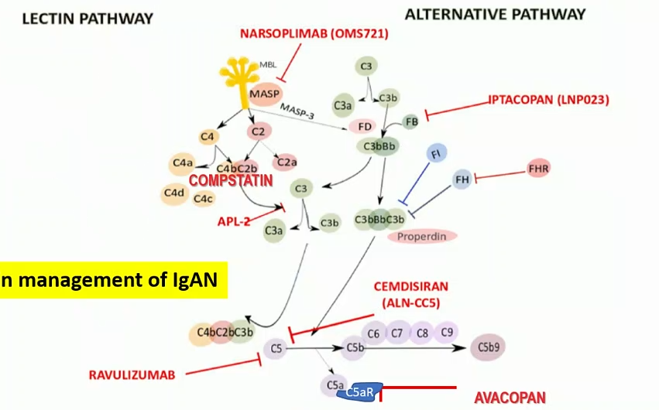
PATHWAY-SPECIFIC COMPLEMENT INHIBITORS IN IGAN: ONGOING STUDIES
Evidence for complement activation
Clinical
Genetic
Histopathological
Biochemical
Compliment activation associates with
more severe disease prognosis
TERMINAL PATHWAY
Notes:
There is evidence of complement activation in IgAN in particular the lectin and the alternative pathways as well as the terminal pathway

Slide 41

Targeting the alternative complement pathway with iptacoban to treat IgAN:
APPLAUSE-IgAN study (NCT04578834)
Iptacoban: is a proximal compliment inhibitor that specifically binds to factor B
APPLAUSE-IgAN will evaluate the benefits and safety of iptacoban in reducing complement mediated kidney damage
and thus slowing or preventing disease progression
Notes:
Iptacoban: is a proximal compliment inhibitor that specifically binds to factor B and is being evaluated in the ongoing PHASE III trial trial

Slide 42

mannan-binding lectin-associated serine protease-2 (MASP-2)
This interim analysis suggests that narsoplimab treatment is safe, is well tolerated, and may result in clinically meaningful reductions in proteinuria and stability of eGFR in high-risk patients with advanced IgAN.
ARTEMIS-IGAN trial
Kidney Int Rep. 2020 Nov; 5(11): 2032–2041.

Slide 43

C5a receptor inhibitor avacopan in immunoglobulin A nephropathy:
an open-label pilot study
improvement in the slope of the UPCR, with ∼50% improvement in three of seven patients with IgAN. Longer avacopan treatment duration may be indicated for maximal benefit.
Clin Kidney J. 2022 May; 15(5): 922–928.

Slide 44
Inhibition of Immune Complex Activated Complement Activity
APPLAUSE-IgAN trial
ARTEMIS trial
Inhibition of BAFF/APRIL Signaling (Prevent Gd-IgA1 production)
Emerging targeted therapies
JANUS trial
Plasma Cell Depletion
Pilot trial
Inhibition of Endothelin A Receptor and Angiotensin II subtype 1 receptor inhibitor
ALIGN trial
Notes:
We will soon have new emerging therapies based data from trials in investigational agents

Slide 45


JANUS RCT: Atacicept binds and inhibits B lymphocyte stimulator (BLyS) and A proliferation inducing ligand (APRIL)→
Kidney Int Rep. 2022 Aug; 7(8): 1831–1841.

Slide 46
…. What does the future hold?
Earlier identification/ diagnosis/ enrollment in clinical trials
Better risk stratification with novel biomarkers (e.g G-IgA1, autoantibodies)
Personalize the best therapy
  Different treatments at different stages
  Concomitant or sequential therapies?
Better assessment of treatment response (repeat biopsy?)
Pediatric population? Tx population?
IgAVN?
...ΑΙ → pathomis=automated morphometry and comprehensive quantitative data→
prediction who will respond to CS

Slide 47

“This is an awesome time to be a Nephrologist!
We are at the entry level of an explosion in new therapies
that show very little safety concern and yet are providing
us the mechanism to move in a direction hopefully of both
early and precise treatment for individual patients”

Slide 49
https://vmx.m-anage.com/era/era23/en-GB/presentation/496667
https://cme.healio.com/nephrology/20230320/pathogenesis-and-management-of-iga/content
https://www.thelancet.com/journals/lancet/article/PIIS0140-6736(23)01554-4/fulltext
https://www.youtube.com/watch?app=desktop&v=LV3PCkEgjFU

Slide 52

What about presence of crescents
regarding the decision of treatment?
J. Clin. Med. 2022, 11, 356
Notes:
Shall the presence of crecents guide the treatment in patients with IgAN?

Slide 53


Multivariable Cox regression analysis for the risk of
reaching the combined renal endpoint of 50% decline in eGFR or kidney failure
*after 7 yrs follow up crescents maintain a negative predictive value
Nephrol Dial Transplant (2020) 35: 1002–1009
Notes:
In the follow up of the VALIGA study crescents were independent predictors in patients that had not yet been treated with immunosuppressants

Slide 54

Barratt et al.
Patients traditionally regarded as being low risk, with proteinuria <0.88 g/g (<100 mg/mmol), had high rates ESRD within 10 years
Clin J Am Soc Nephrol. 2023 Jun 1;18(6):727-738
Notes:
Barratt et al. recently published the results of their IgA nephropathy UK cohort, including individuals with IgAN plus proteinuria >0.5 g/day or eGFR < 60 mL/min/1.73 m2 with a median follow-up of 5.9 years. Unfortunately, 50% of patients reached kidney failure or died in the study period, indicating that outcomes are generally poor with few patients expected to avoid kidney failure in their lifetime. Significantly, patients traditionally regarded as being “low risk”, with proteinuria <10 mg/mmol, still have high rates of kidney failure within 10 years [20].
Outcomes in this large IgA nephropathy cohort are generally poor with few patients expected to avoid kidney failure in their lifetime. Significantly, patients traditionally regarded as being low risk, with proteinuria <0.88 g/g (<100 mg/mmol), had high rates of kidney failure within 10 years.

Slide 55


16 pnts (1:1:1), placebo:atacicept 25mg: atacicept 75mg
Once weekly, SC
72 weeks
24 weeks follow up
Dose dependent reduction in Gd-IgA1 from week 24-72
Median percentage change from baseline in Gd-IgA1 to week 72
Kidney Int Rep. 2022 May 26;7(8):1831-1841

Slide 56


Slide 57



Slide 58


Slide 59

Kidney Int Rep (2017) 2, 318–331

Slide 60

Seminars in Immunopathology (2021) 43:717–728

Slide 61


Seminars in Immunopathology (2021) 43:717–728

Slide 62


Slide 63

Glucocorticoid regimens used in clinical trials of IgAN
Antibodies (Basel). 2023 Jun 19;12(2):40
Notes:
The treatment regimens used in IgAN are summarized

Slide 64


Slide 65


Slide 66


Slide 67


Slide 68


Slide 69


Slide 70

Treatment of primary IgAN
(adapted from KDIGO 2021 CLINICAL PRACTICE GUIDELINE FOR THE MANAGEMENT OF GLOMERULAR DISEASES
Seminars in Immunopathology (2021) 43:717–728

Slide 71


Slide 72


Slide 73

The innate and adaptive immune mechanisms
that drive protective mucosal immunity against pathogens
Gut associated lymphoid tissue (GALT) and IgAN
Genetic
Epigenetic
Microbiota
Food antigens
Infections
Kidney Int Rep (2017) 2, 318–331
Notes:
During infection, the host initiates innate and adaptive immune responses to defend against pathogens. In 1 context, on pathogen recognition through toll-like receptors (TLRs), dendritic cells in the mucosa produce proinflammatory cytokines such as interleukin (IL)-23. T helper 17 (Th17) cells, nature killer (NK) cells, and innate lymphoid cells (ILCs) express the IL-23 receptor. The combination of IL-23 and its receptor triggers production of the downstream cytokines IL-17 and IL-22, which then induce production of antimicrobial peptides such as defensins. In addition, IL-22 induces epithelial-cell production of CXC chemokines, which recruit neutrophils to the infection site. In another context, immune component-primed B cells migrate to the mucosal lamina propria, where they mature into IgA-secreting plasma cells. The release of thymic stromal lymphopoietin (TSLP) after “sensing” bacteria through TLRs could increase the production of the tumor necrosis factor ligand superfamily member 13 (APRIL), the tumor necrosis factor ligand superfamily member 13B (BAFF), and the transforming growth factor β (TGF-β) by dendritic cells, which result in increasing IgA1 production through IgA class switching recombination (CSR).

Slide 74
The innate and adaptive immune mechanisms
that drive protective mucosal immunity against pathogens
Gut associated lymphoid tissue (GALT) and IgAN
Genetic
Epigenetic
Microbiota
Food antigens
Infections
Kidney Int Rep (2017) 2, 318–331
Notes:
The gut renal connection is well known: genetic and epigenetic factors such as microbiota, food components and infectious antigens, trigger an immunological response after the antigen presentation in the GI mucosa in the Peyer’s patches near the ileoceaccal junction were B cells are primed to produce IgA1 which is deficient in galactose

Slide 75

2021 KDIGO Guidelines
Kidney International 2021 100, 753-779
Notes:
If patients despite the supportive care remain proteinuric despite the maximal supportive care for at least 3 months then should be considered in enrollement in a clinical trial and notice that they went to clinical trial first before considering steroid therapy. If the GFR is < 30 you may consider only maximal supportive care. If GFR is relatively preserved and they don’t want to be in a clinical trial then you could consider a trial of steroids

Slide 76

APRIL/BAFF
NEW DRUGS IN IGAN: ONGOING STUDIES

Slide 77
ATACICEPT
Binds and inhibits B lymphocyte stimulator (BLyS) and A proliferation inducing ligand (APRIL)→ interferes with B call maturation, function and survival
Blocks the BLyS and APRIL-mediated Ig isotope class switching and reduces IgG and IgA levels in patients with IgAN

Slide 78

The mucosal immune system plays a key role in the production of GdIgA1 in IgA nephropathy
Agent | Target | Modality | Mechanism of action | Desired effect
Tarpeyo | Glucocorticoid receptors | Corticosteroid | Depletes B cells and plasma cells in the small intestine | Reduced GD-IgA1 synthesis in the GALT
Ataticept and Telitacicept | BAFF and APRIL | Fusion protein/antibody | Inhibits maturation and activation of B cells and plasma cell survival
BION-1301 and Sibeprenlimab | APRIL | Monoclonal antibody | Inhibits maturation and activation of B cells | Reduced GD-IgA1 and IgG autoantibodies
Bortezomib | Proteasome | Peptide | Inhibits proteasome activity in plasma cells | Reduced Ig synthesis
Felzartamab | CD38 | Monoclonal antibody | Depletes CD38+ plasma cells | Depletes long-living plasma cells
MALT
Mucosal innate immunity
Adaptive immunity
Complement activation
JASN 33(5):p 873-875, 2022
Notes:
Antigens are taken up by intestinal mucosal (M ) cells and, subsequently, by dendritic cells (DC). After priming by DC, naive CD4+ T cells differentiate into T helper cells. T follicular helper (Tfh) cells interact with naive B cells, which undergo class switching to form IgA+ B cells. T cell–independent class switching also occurs through interaction of DC with naive B cells. These processes are promoted by factors including B-cell activating factor (BAFF) and APRIL. IgA+ cells then leave the MALT and enter into the lymphatic system and circulation, on their way to effector sites. Zachova et al.2 demonstrate increased levels of GdIgA1+λ+ B cells in the circulation that express gut (CCR9) or respiratory tract (CCR10) homing receptors in patients with IgAN. GdIgA1+λ+ B cells may then traffic to these sites where IgA is secreted. In IgAN, increased levels of circulating GdIgA1 are found, which may be produced by spillover, from mucosal sites or from B cells that have mishomed to systemic sites, such as the bone marrow. This leads to the formation of IgA1 immune complexes, which subsequently deposit within the glomerular mesangium. Dotted lines represent putative pathways.

Slide 79


Alexandra Cambier, Stéphan Troyanov, Vladimir Tesar, Rosanna Coppo; Validation Study of Oxford Classification (VALIGA) Group
Nephrol Dial Transplant. 2022 May 25;37(6):1195-1197
Notes:
From the VALIGA study in the absence of tubular damage but with moderate active lesions M1-2 had benefits from steroids

