Slide 1
Role of Damage associated-molecular patterns in chronic renal injury associated inflammation
Gordana Kocic
Medical Faculty University Nis, Serbia
Financed by Science Fund of the Republic of Serbia (IDEAS), project number: 7750154 (NPATPETTMPCB)

Slide 2
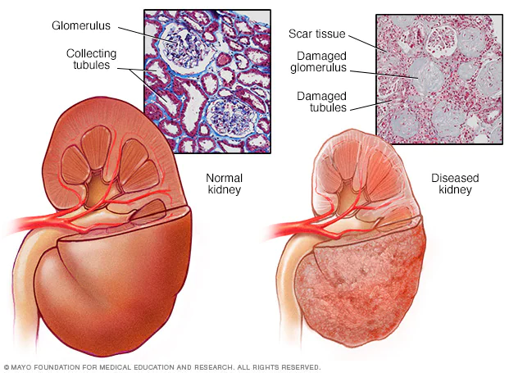

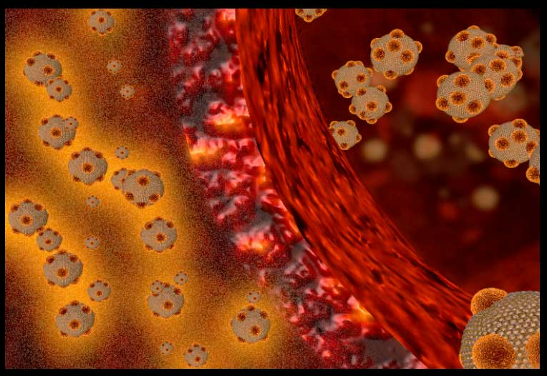
Chronic renal failure
Worldwide public health problem
now recognized as a common condition associated with an increased risk of cardiovascular complications due to atherosclerotic changes

Slide 3
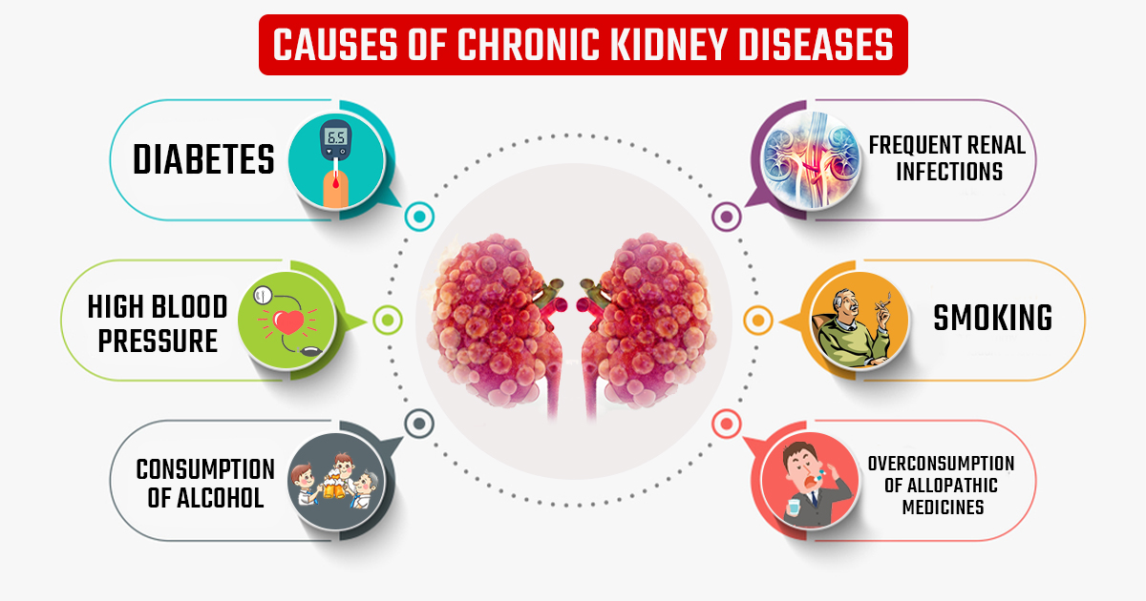
Main causes of CKD
Diabetes and hypertension
Autoimmune disorders, generally designated by Glomerulonephritis (GN)
(IgA nephropathy
renal vasculitis
transplant rejection
lupus nephritis
postinfectious glomerulonephritis)

Slide 4
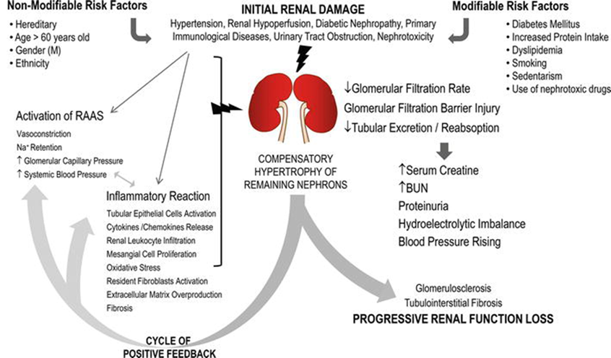
CKD
Upon injury or pathogen invasion, the innate immune system acts as an immediate defense mechanism, to provide cytoprotective mechanisms for tissue healing.
Activated immune-inflammatory cascade is one of the most important triggering factor
Persistent or excessive immune system activation is harmful and results in permanent organ structural and function alterations.

Slide 5
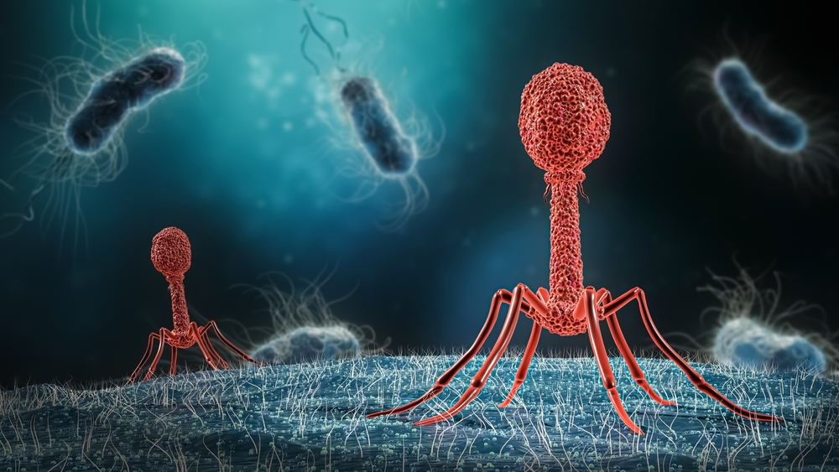
Pathogen-Associated
Molecular Patterns (PAMPs)
PAMPs are different structures shared by large groups of microorganisms, absolutely essential for the microbe's survival:
LPS: common component of gram-negative bacteria
teichoic acids: common component of gram-positive bacteria
double-stranded RNA: a structural signature of several groups of RNA viruses
bacterial DNA (unmethylated CpG sequences)

Slide 6

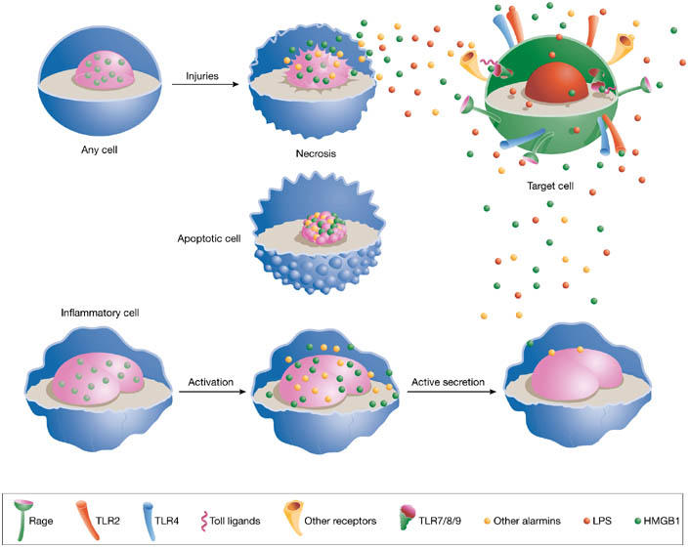
DAMP molecules, alarmins, endokines
Their family includes different molecules
The term DAMP denotes structurally diverse multifunctional host molecules that are rapidly released during infection or tissue damage with activating effects on receptor-expressing cells engaged in host defence and tissue repair.

Slide 7
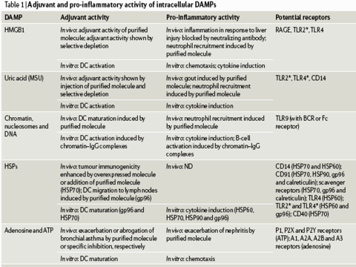
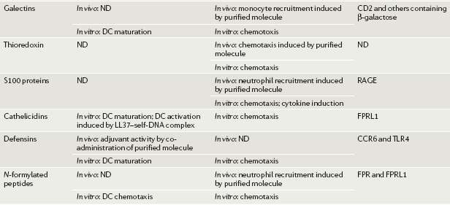
Damage-Associated Molecular Patterns (DAMPs)
DAMPs can be actively secreted by inflammatory cells and passively released by necrotic cells.

Slide 8

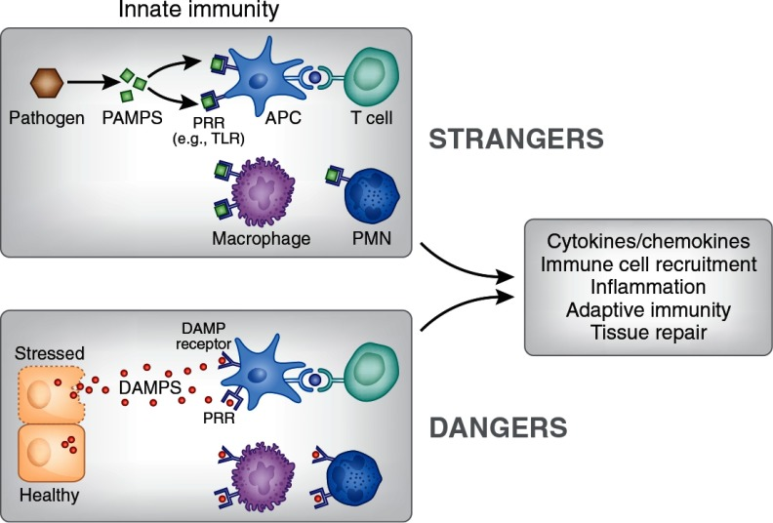
Strangers vs Dangers
“Danger hypothesis” postulates that the immune system is evolved to respond not only to the infective agents, but also to “non-physiological” cell death, damage or stress

Slide 9
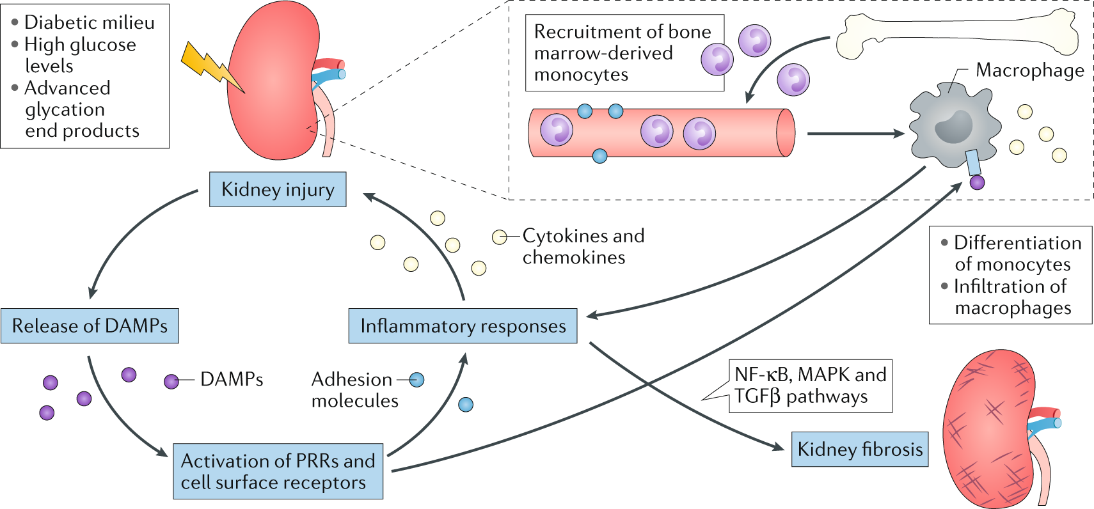
Strangers vs Dangers
Like PAMPs, DAMPs derived molecules may initiate strong inflammatory response, via the activation of antigen presenting cells (APC)
DAMP induce production of pro-inflammatory cytokines (IL-1, TNF-α, IL-6, IL-8) and the upregulated expression of cell adhesion molecules (ICAM-1, VCAM-1)

Slide 10
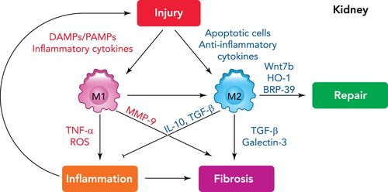
Inflammation in CKD
Macrophages are found in normal kidney
In increased numbers in diseased kidney, act as key players in renal injury, inflammation, and fibrosis.
The recruitment and differentiation of macrophages are crucial to all phases of renal injury, from triggering tissue injury to tissue repair.
Activated macrophages (M1)
Alternatively activated macrophages (M2), produced by Th2 cytokines such as IL-4 and IL-10

Slide 11
DAMP bimodal phenomenon
DAMPs not only in the proinflammatory response, but also in the resolution of injury by influencing the process of tissue remodeling
Extracellular CNA and cell-derived DNA lead to platelet activation, platelet-granulocyte interaction, and neutrophil extracellular trap formation, resulting in renal inflammation and an increase in renal injury

Slide 12
The criteria for establishing a candidate molecule as DAMP
DAMP should be active as a highly purified molecule.
Its biological activity is not owing to contamination with microbial molecules (PAMPs)
The DAMP should be active at concentrations that are actually present in pathophysiological situations.
Selectively eliminating or inactivating the DAMP — for example, with antibodies, specific enzymes
Mutations or RNA interference (RNAi) — should ideally inhibit the biological activity in vitro and in vivo

Slide 13
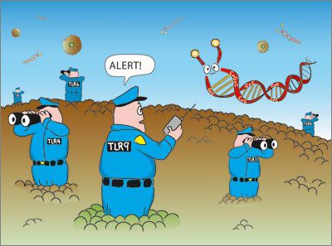
What recognizes PAMP and DAMP?

Slide 14
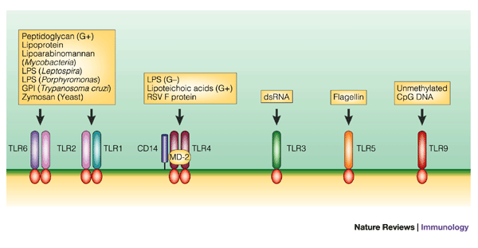
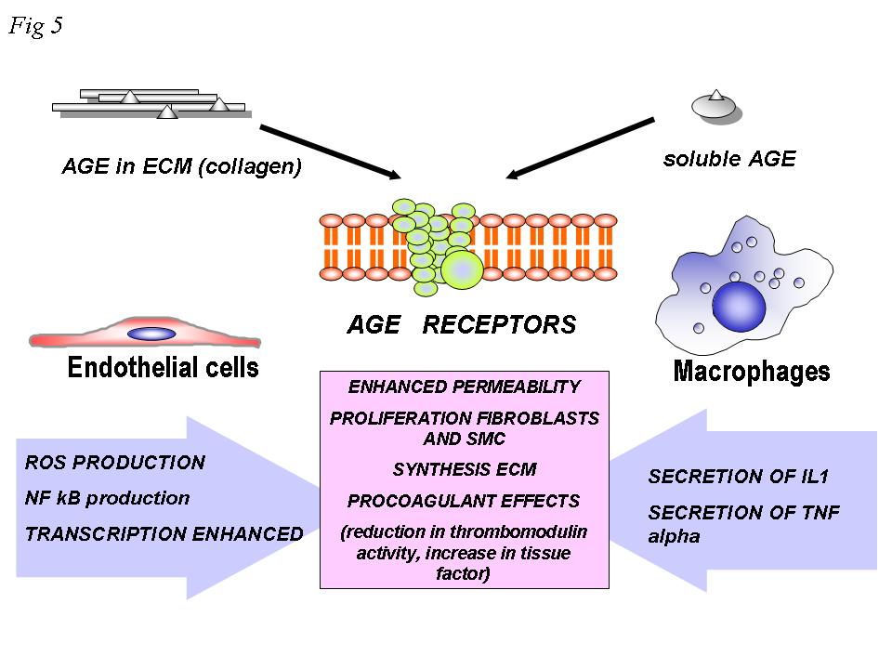
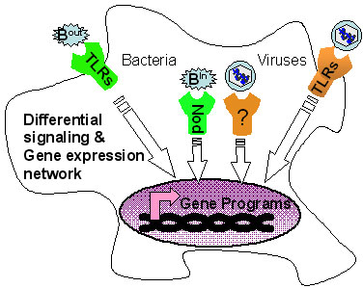
TLRs
Toll-like receptors (TLRs)
Nod like
RAGE
Danger signals mediate inflammatory responses through the Toll-like receptors (TLRs), the receptor for advanced glycation end-products (RAGE), and the NOD like receptors, after release from activated, damaged or necrotic cells.

Slide 15
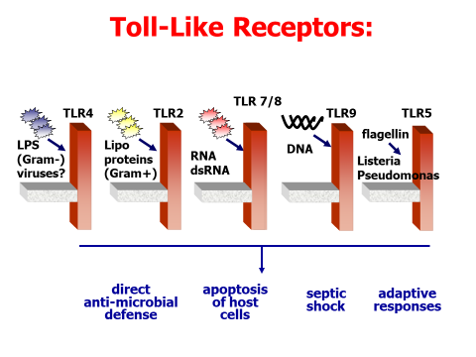
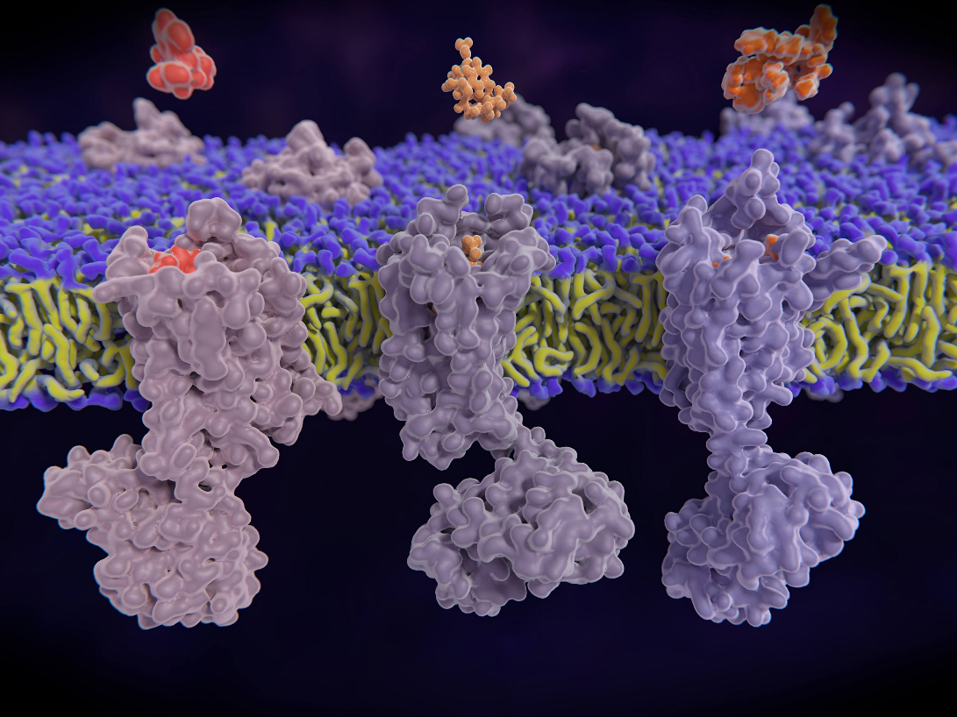
Toll-like receptors
The innate immune response is built on a class of pattern recognition receptors called Toll-like receptors (TLRs)
The expression of TLRs are not restricted to immune tissues but distributed in all tissues including the kidney
TLR activation leads to the release of various inflammatory cytokines
Excessive TLR activation disrupts the immune homeostasis by sustained pro-inflammatory cytokines and chemokine production and consequently contributes to the development and progression of many diseases
Sadik et al. 2015
Komurcu et al., 2016

Slide 16

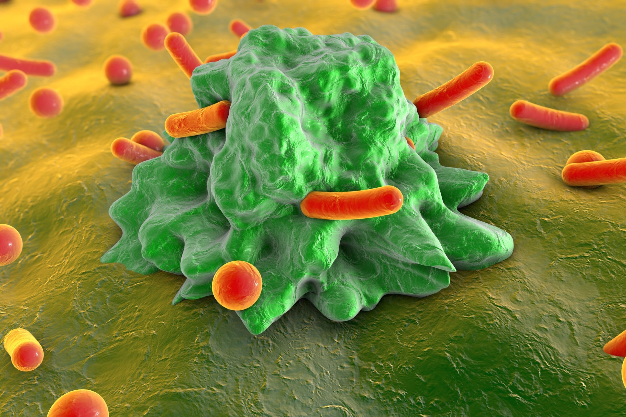
Macrophages
Neutrophils
PAMP
MD-2
LBP
TLR
mCD14
Myd88
Costimulation:
CD80
CD86
COX-2
activation
Cell adhesion:
LFA-1 (CD11a/CD18)
Mac-1 (CD11b/CD18)
VLA-4
PGs
Cytokines:
TNF-α
IL-1
IL-6
IL-10
IL-12
IL-23
IL-18
TGF-β
Chemokines:
RANTES
MIP-1α
MIP-1β
MCP-1
IL-8

Slide 17
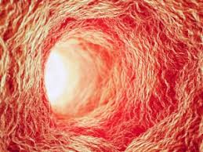
Endothelium
PAMP
MD-2
LBP
sCD14
TLR
Cell adhesion:
ICAM-1
ICAM-2
ICAM-2
V-CAM1
E-selectin
OX40L
Cytokines:
GM-CSF
IL-1
IL-6
IL-18
TGF
Chemokines:
RANTES
MCP-1
IL-8

Slide 18
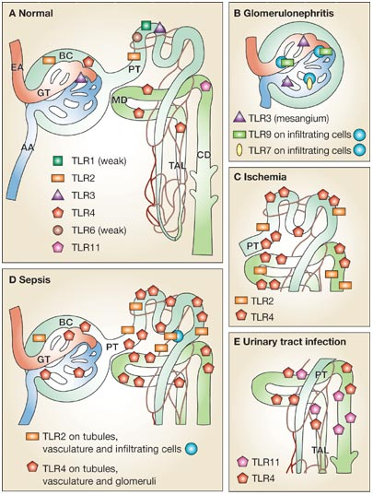
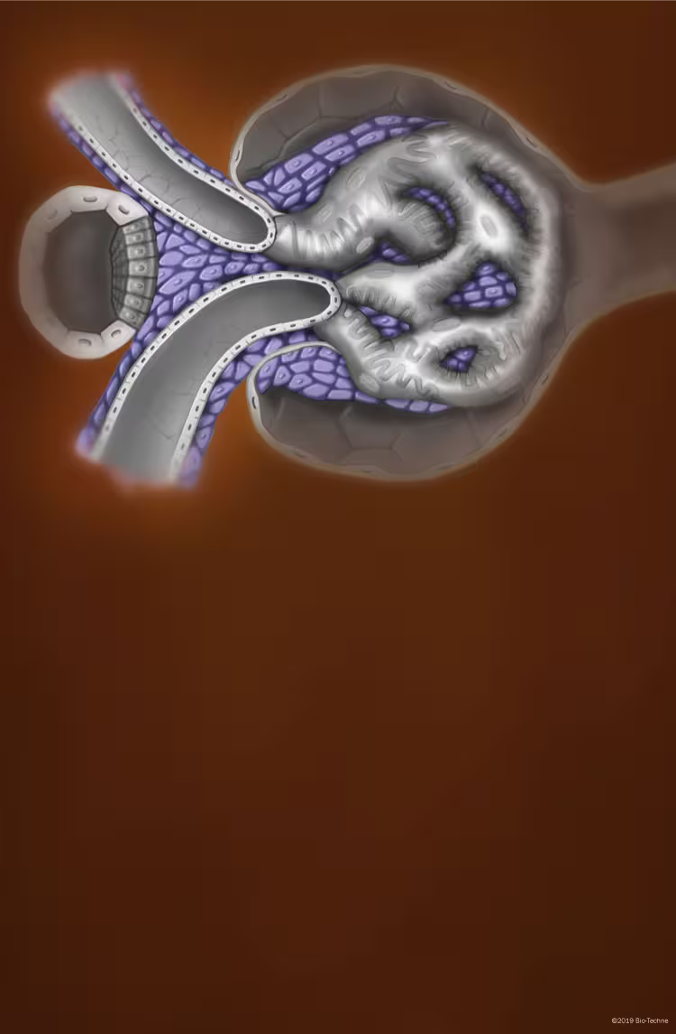
Mesangium
In mesangial cells and intrarenal macrophages, at least two TLR signaling pathways can be activated capable of inducing multiple proinflammatory events, regulated by the transcription factors AP-1 and NF-kB.

Slide 19
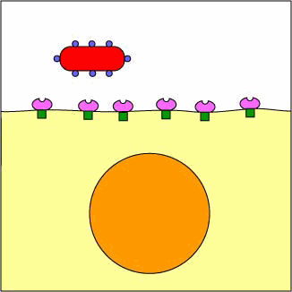
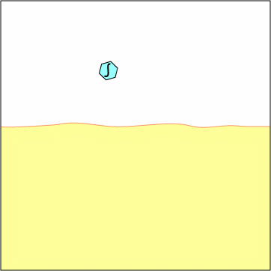
The systemic inflammatory response initiated by PAMP exerts many similarities with the DAMP-induced systemic response.

Slide 20
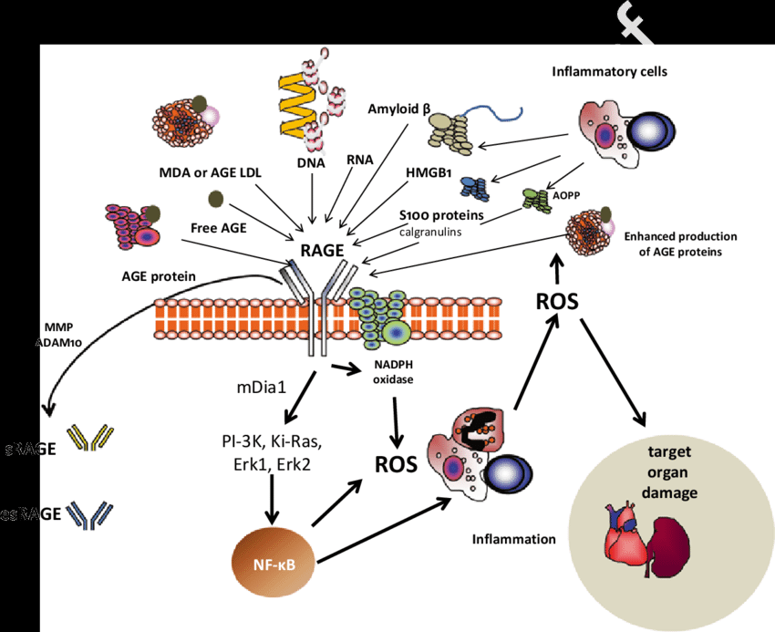
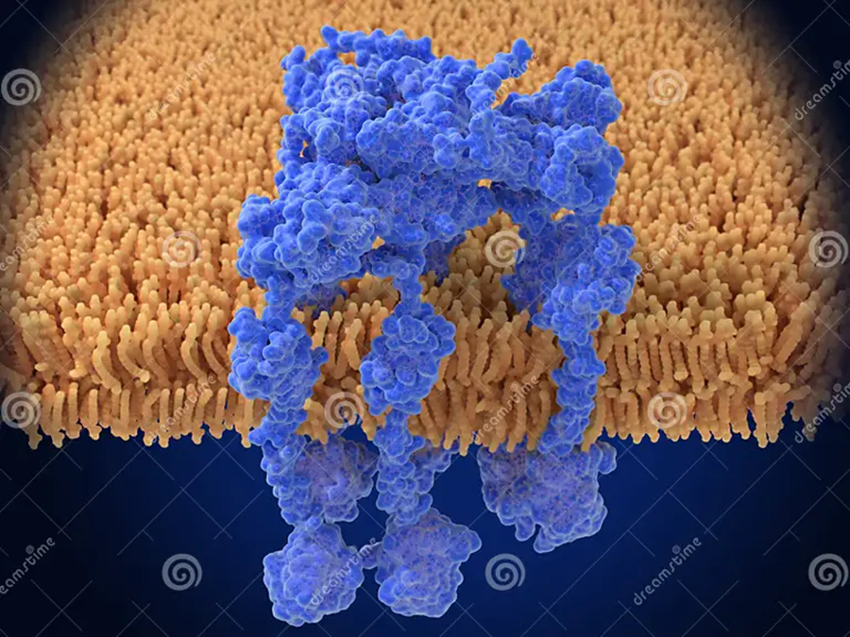
DAMP ligands of RAGE
AGE proteins
DNA, RNA
HMGB1
AOPP
AGE-LDL
S100 proteins
Amyloid B
HSPs (intracellular protein chaperones)

Slide 21
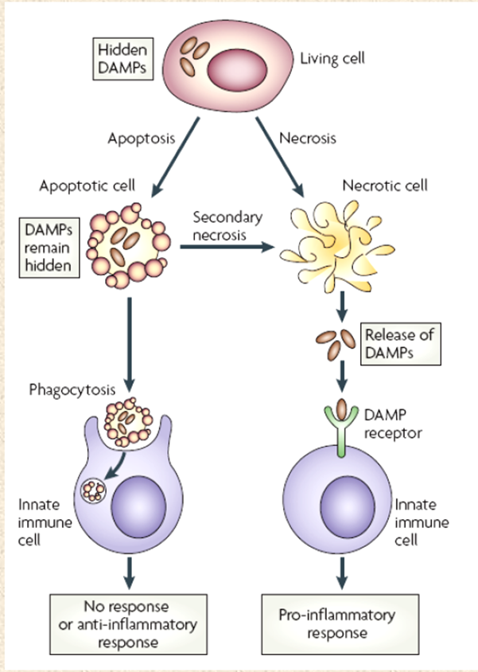
Renal DAMP-induced sterile inflammation
DAMPs induce the production of chemokines, which attract neutrophils and monocytes into the tissue
These newly recruited cells produce ROS
They also induce microvasculature congestion, which ultimately impairs renal blood flow, creating sustained ischemia, and further contributes to increasing kidney damage
Blockade of this very 1st step in the inflammatory cascade, thus, offers strong therapeutic potential

Slide 22
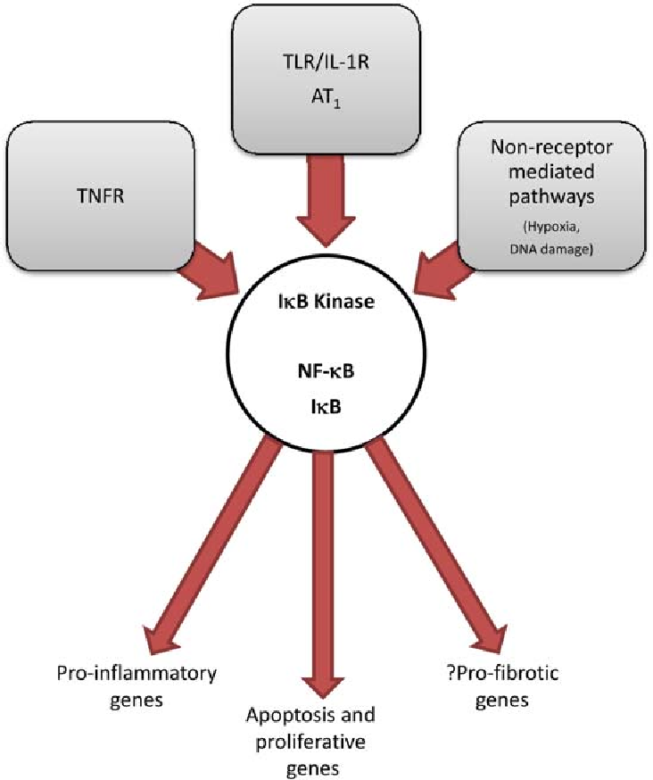
NF-κB in CKD
The activation of the nuclear factor-κB (NF-κB) pathway plays a central role in the initiation and progression of inflammation, which contributes to the pathogenesis and progression of CKD
The NF-κB family consists of five members: p50/NF-κB1, p52/NF-κB2, p65/RelA, RelB, and c-Rel, which can form a variety of homo- and hetero-dimers combinations.

Slide 23
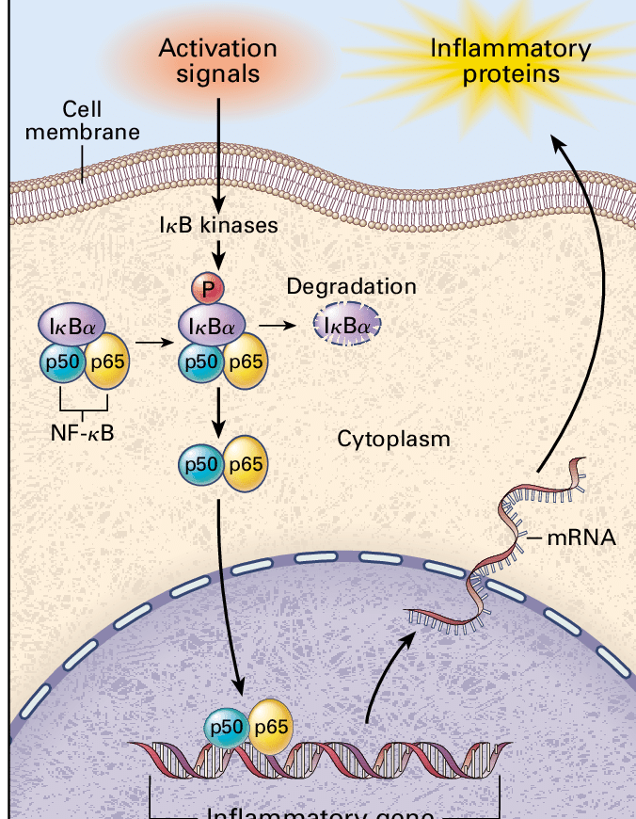
DAMP and PAMP in NF-kB activation
Under non-inflammatory conditions, NF-κB is bound by inhibitor of kappa B (IκB) proteins in the cytoplasm.
NF-κB is activated only under certain conditions, which include infection and injury.
NF-κB1 (p50), NF-κB2 (p52), RelA (p65), RelB, and c-Rel are all members of the NF-κB family which allows NF-κB proteins to form dimers p50/p65 with transcriptional activity (Liu et al. 2017).

Slide 24
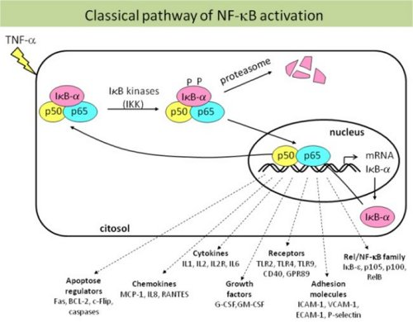
NF-kB activation
NF-kB dimer p65 and p50 present in the cytosol linked to an inhibitory protein IkB, its degradation is through the proteasome.
This allows NF-kB translocation into the nucleus. NF-kB is a key regulator of the inflammatory process, innate and adaptive immunity.

Slide 25
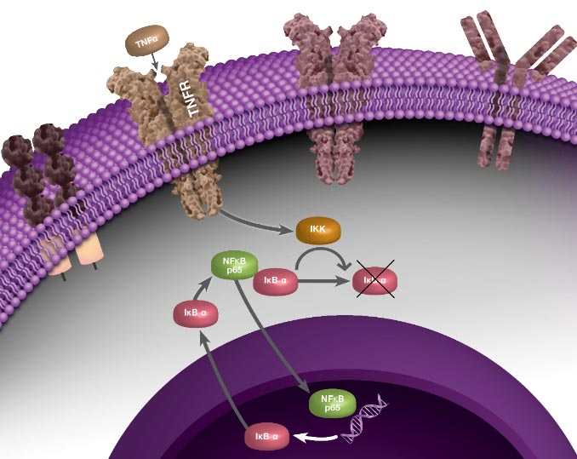
NF-kB activation
TLR ligands
TLR
Inhibition of NF-κB signaling is often a therapeutic goal (Gupta et al. 2010).

Slide 26
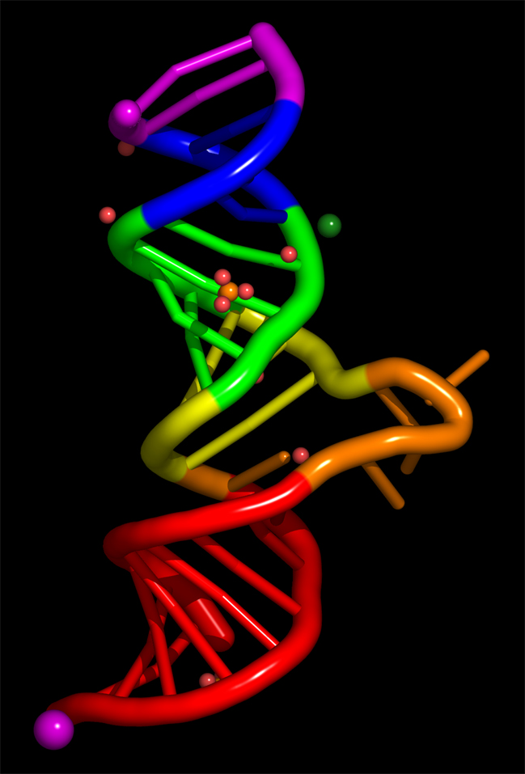
Circulating nucleic acids (CNA)
Immunomodulatory functions recognized by a set of pattern-recognition receptors that initiate and modulate immune responses in the host
Nucleic acids, single and double stranded, their analogs and specific “danger motifs”, represent strong TLR ligands and inducers.
Ligands for TLR7/8 ssRNAs
Ligands TLR3 dsRNAs
Ligands TLR9 unmethylated CpG.

Slide 27
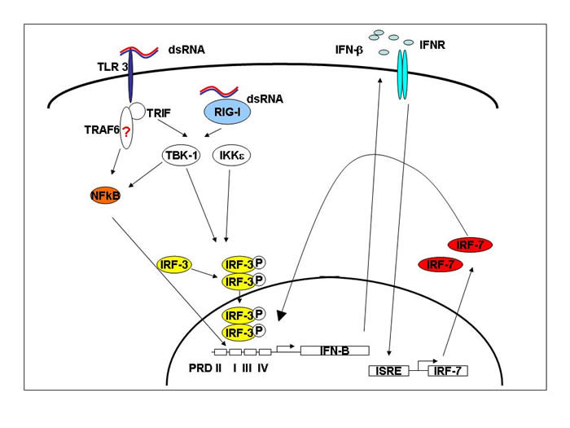
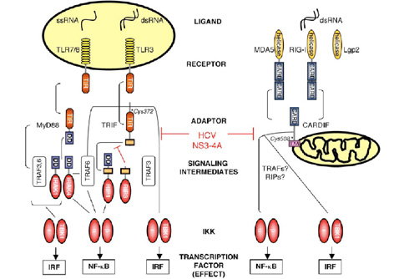
Circulating RNA species, including different-sized dsRNAs and ssRNAs may represent critical determinants for the activation of the innate immune system, whenever they are egzogenic or endogenously generated
Introduction of double stranded (ds)RNA fragments into the cytoplasm may drive normal cells to become antigen-presenting (APC)

Slide 28
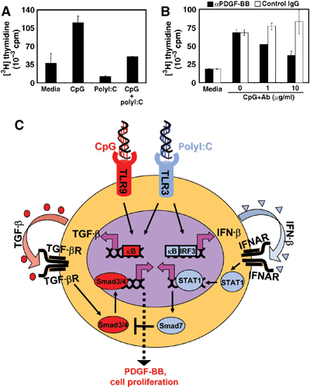
Mesangial cells do not express TLR7/8 and TLR9.
But injected dsRNA or CpG may be distributed to the glomerulus and then taken up by mesangial cells into intracellular endosomes in mice with experimental glomerulonephritis.
Cultured human mesangial cells actively produce IL-6, IL-1β, IL-8, ICAM, M-CSF, and other proinflammatory factors after dsRNA uptake

Slide 29
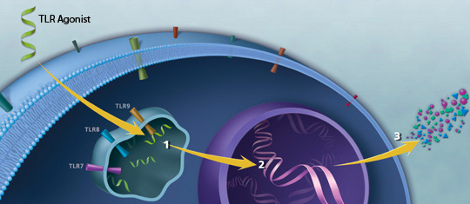
Since the TLR 3,7,8-9 are capable of recognizing diffrent-sized nucleic acids or oligonucleotides, it may allow them to sense and initiate innate and adaptive immune response in the case of nucleic acids endogenous appearance

Slide 30
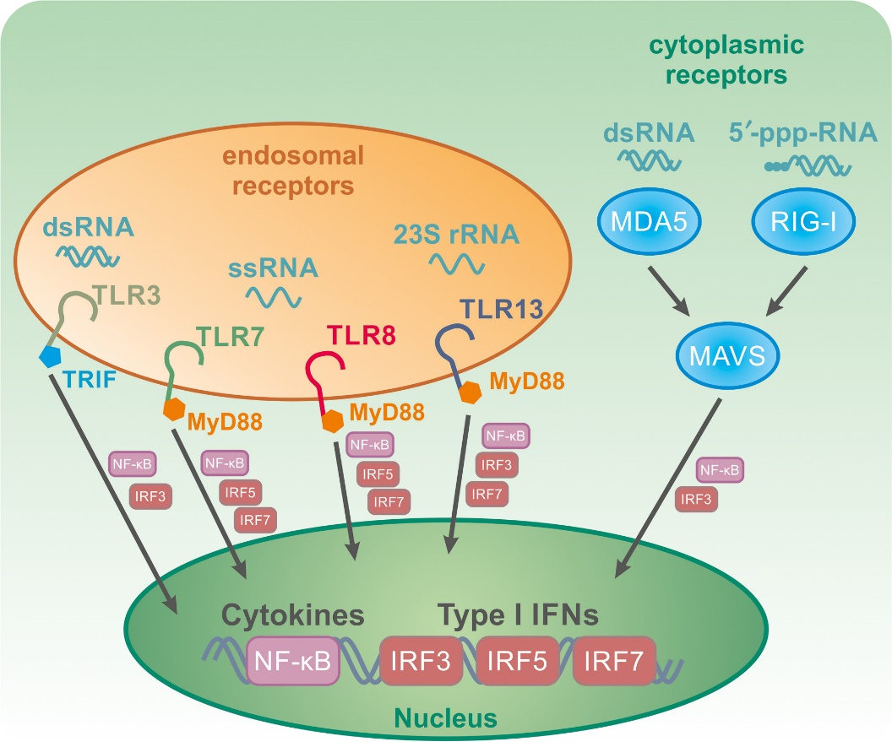
RNA/DNA in the cytosol can activate innate immune pathways via cytosolic nucleic acid sensors.
The ligand interaction of NA TLR activates downstream signaling cascade NF-kB, IRF3, IRF7, IRF5 and induces TNF-α, IL-6, IL-1β, IL-8, IL-12, IL-18 and chemokines
RIG-I and MDA5 lead to enhanced IFN response

Slide 31

A family of extracellular RNases and DNases are involved in degradation of all CNA or oligonucleotide derivatives.
In the presence of extracellular nucleases, CNA can hardly reach APC
gatekeepers

Slide 32


Our study
We hypothesized that the available CNA, acting as DAMPs, may be a possible pathogenetic mechanism capable of modulating immune-inflammatory reaction in patients with CRF

Slide 33
PAMP and DAMP
Determination:
NF-κBp65 (C-20)
P38
MDA-5
IRF-3
IRF-7
purchased from Santa Cruz Biotechnology (CA, USA)
MDA5
IRF-7
IRF-3

Slide 34
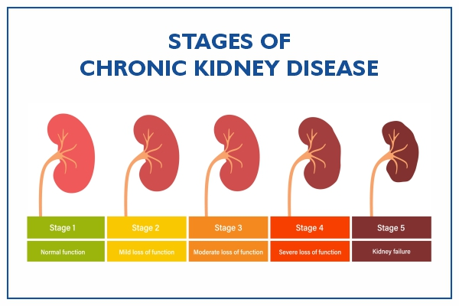
Patients and control subjects:
Patients with the different stages of chronic kidney disease were selected according to the National Kidney Foundation (NKF) criteria, recruited from the Clinic for Nephrology and hemodialysis Medical Faculty, University of Nis:
Stage 1: Kidney damage with normal or increased GFR
Stage 2: Mild reduction in GFR
Stage 3: Moderate reduction in GFR
Stage 4: Severe reduction in GFR
Stage 5: Kidney failure, patient on dialysis program
Transplanted patients

Slide 35
Isolation of nucleic acids and oligonucleotide samples
For the isolation of RNA from plasma samples, the commercial RNA isolation reagent set TRI Reagent BD (T3809) for the simultaneous isolation of RNA, DNA and proteins from plasma was used, purchased from Sigma (Saint Louis, USA).
The concentration of circulating nucleic acids was calculated by using corresponding standard of RNA. The UV spectra obtained in our study are in a close agreement with recent revised UV extinction coefficients of RNA and related nucleotides

Slide 36
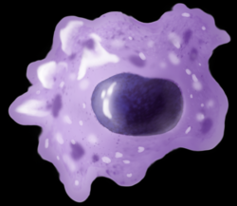
Culture of residental macrophages
The passaged residential macrophages were obtained from the Department of Microbiology, Biochemistry, and Biotechnology, University of Maribor (Slovenia).
PBMCs were isolated from buffy coats of healthy blood donors after Ficoll centrifugation, allowed to differentiate into monocyte-derived macrophages.
DMEM, supplemented with 100 μg/mL streptomycin, 100 U/mL penicillin, 10% heat-inactivated FCS , and 1 mM glutamine, was used for cultivation.
Residential macrophages, obtained after 64th passage, cultured in 24-well plates, allocated into different groups:
I the cells exposed to media supplemented with 100 μL of physiological saline solution;
II the cells exposed to media supplemented with 100 μL of RNAs purified from plasma of control healthy subjects;
III the cells exposed to media supplemented with 100 μL of RNAs purified from different groups of patients (1-5 stages of CRF, dyalysis and tarnsplanted pat)
The number of samples of each group corresponded to the number of circulating nucleic acid samples, except that untreated group of cells exposed to media and physiological saline solution consisted of 10 samples.

Slide 37
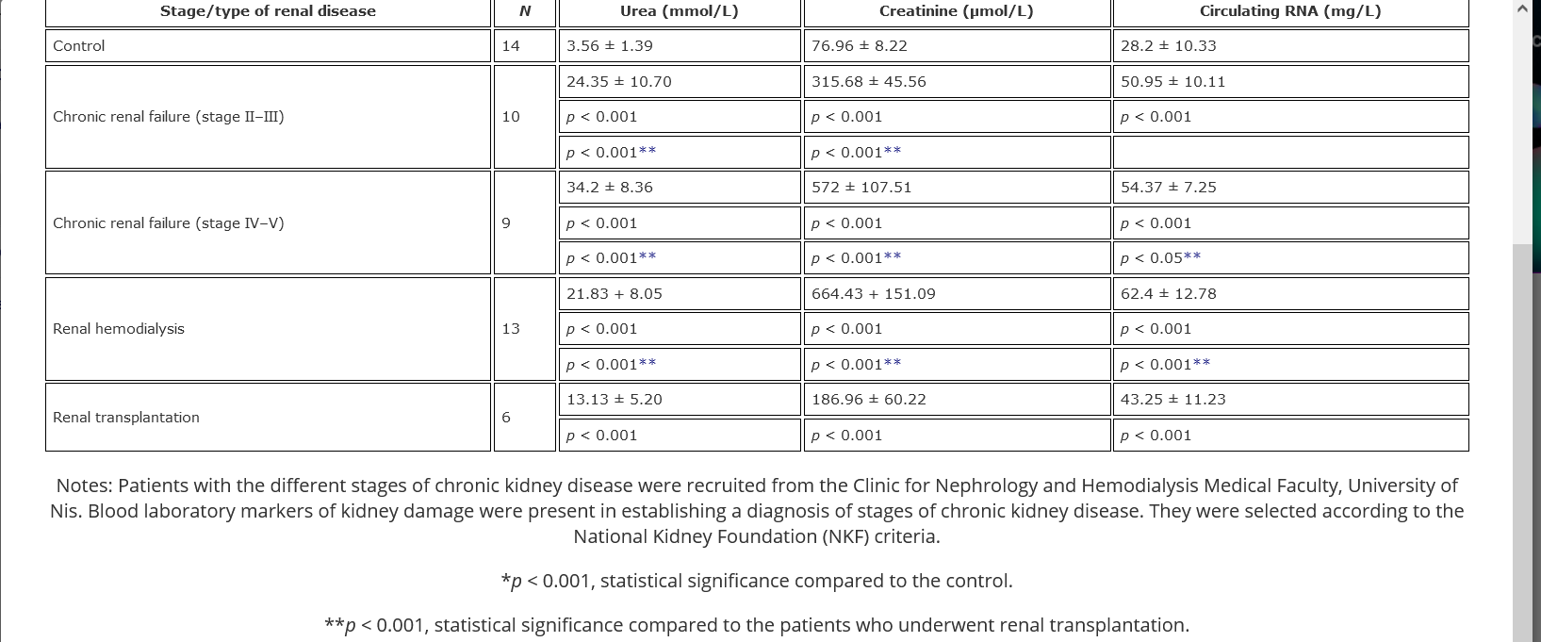
Kocić G et al. Circulating nucleic acids as possible damage-associated molecular patterns in different stages of renal failure. Ren Fail. 2010;32(4):486-92.

Slide 38
mg/L
P<0.001
*P<0.001
P<0.001
*P<0.05
P<0.001
P<0.001
Control CRF II-III CRF IV-V Hemod. Transpl.
Circulating nucleic acids concentration in groups of patients

Slide 39
Abs
CRF III, IV, V
Dialysis
Control samples
240 245 250 255 260 265 270 275 280 285 290 295 300 305 310
Figure 2. Spectrophotometric scan analysis of plasma nucleic acids

Slide 40

2000
1500
1000
500
Figure 3. Spectrophotometric scan analysis of corresponding standards

Slide 41
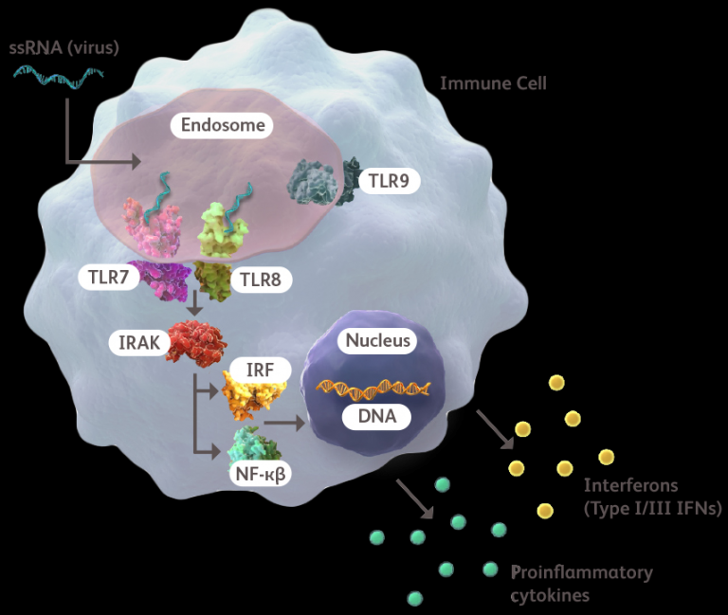
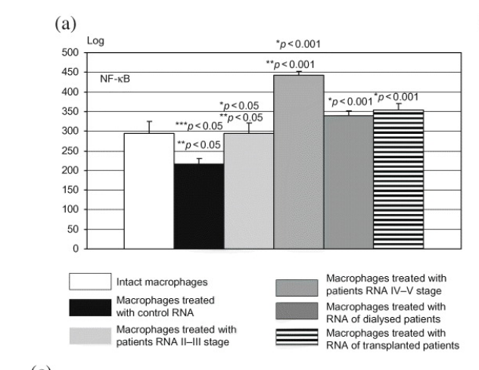

Slide 42
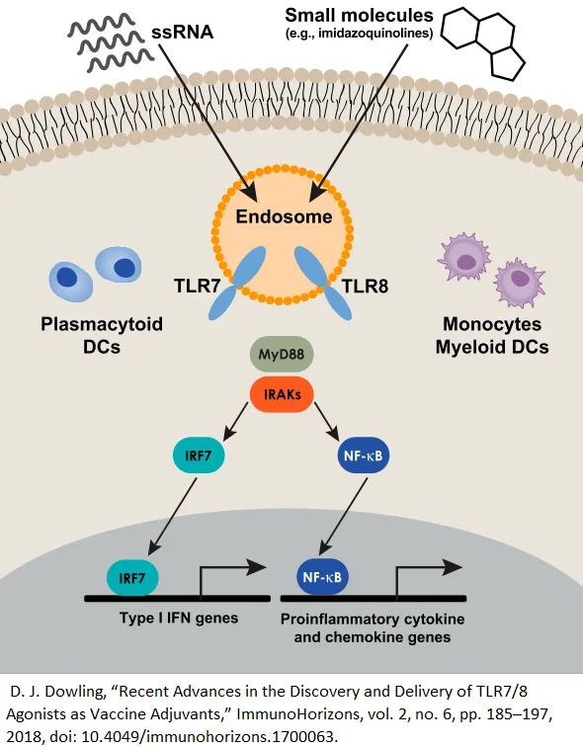
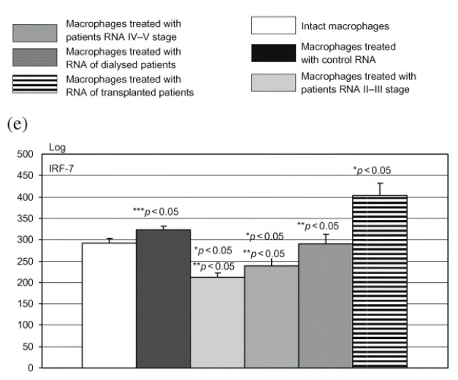
Use of interferon in kidney transplant is not advised, since it increases the chance of episodes of acute humoral rejection (15-64%) three to six months after beginning treatment (Fabrizi et al Aliment Pharmacol Ther 2006;24(10):1413-22)

Slide 43
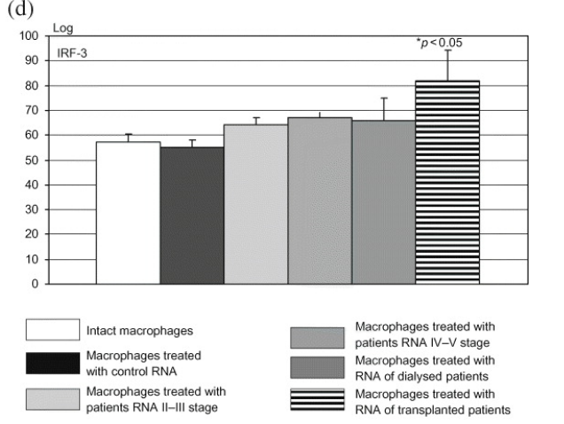
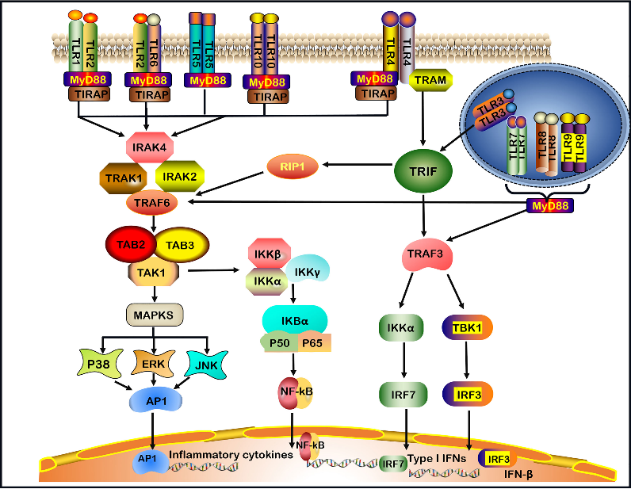
Lichtnekert J etal. Trif is not required for immune
complex glomerulonephritis: dying cells activate mesangial cells via Tlr2/Myd88 rather than Tlr3/Trif. Am J Physiol Renal Physiol 2009; 296: F867–F874.

Slide 44
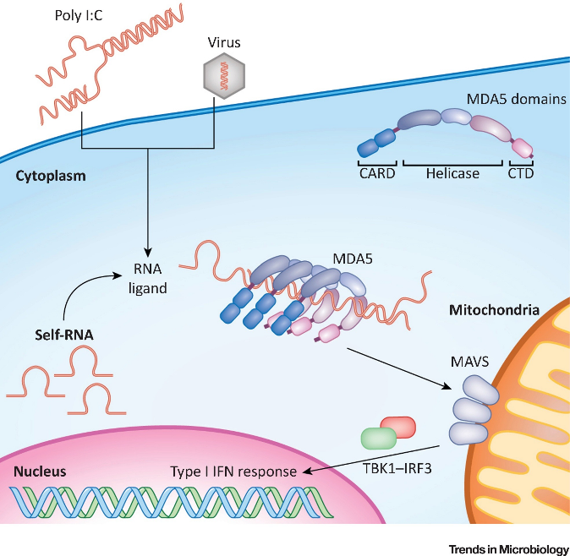
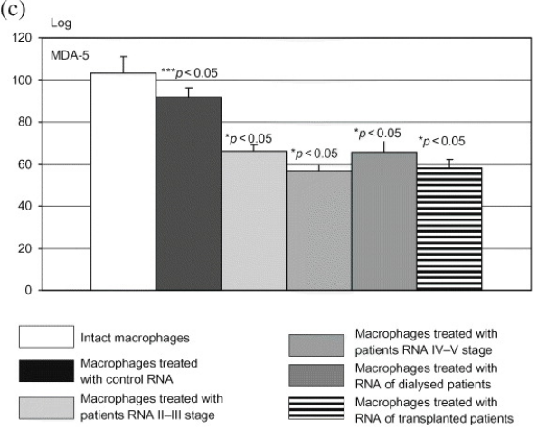

Slide 45
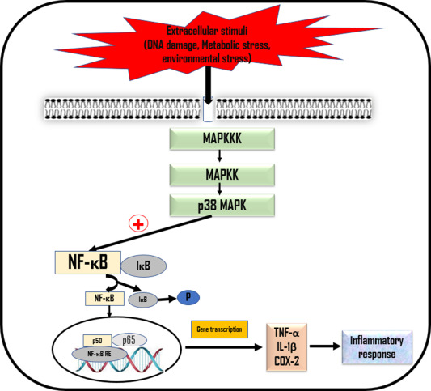
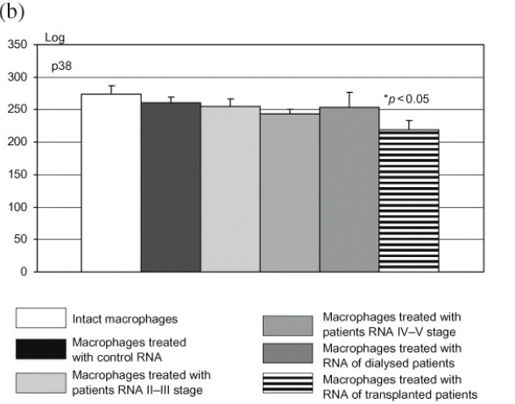

Slide 46
NFκB in CRF
In patients with immune-mediated glomerular injury, the activation of NFκB has been shown by immunohistochemistry.
NFκB is overexpressed in IgA nephropathy, especially in patients with high proteinuria and reduced renal function
All these morphological examinations in human biopsy describe the correlation of NFκB expression and clinical outcome parameters in these patients
Enhanced glomerular NF-κB activity in human chronic kidney disease lead to increased risk of lupus-related GN
Kassan M et al. Enhanced NF-kappaB activity impairs vascular function through PARP-1-, SP-1-, and COX-2-dependent mechanisms in type 2 diabetes. Diabetes. (2013) 62:2078–87.
Herrington FD, Carmody RJ, Goodyear CS. Modulation of NF-kappaB signaling as a therapeutic target in autoimmunity. J Biomol Screen. (2016) 21:223–42.
López-Franco O et al. Nuclear factor-kappa B inhibitors as potential novel anti-inflammatory agents for the treatment of immune glomerulonephritis. Am J Pathol. 2002 Oct;161(4):1497-505.

Slide 47
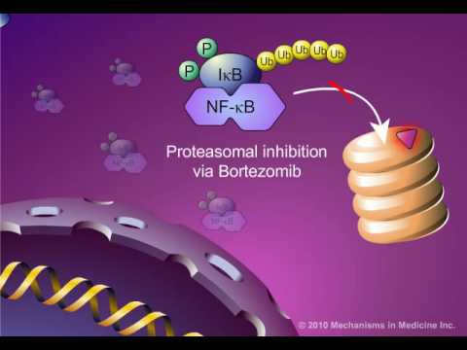

Chemical structures of NF-kB inhibitors. (A) Ectinascidin 743; (B) Bortezomib; (C) Chromomycin A3; (D) Emetine; (E) Daunorubicinum; (F) Lestaurtinib.
Biochem Pharmacol. 2010 May 1; 79(9): 1272–1280.
Qayum A, Aleem A, Al Diab AR, Niaz F, Al Momen AK. Rapid improvement in renal function in patients with multiple myeloma and renal failure treated with bortezomib. Saudi J Kidney Dis Transpl. 2010;21(1):63-8.

Slide 48

Experimental models
It has been shown that NF-κB inhibitors attenuate the induction of renal inflammation and injury in animal models
A role of celastrol, an NFκB inhibitor, on insulin resistance and renal function has been demonstrated in diabetic db/db mice, where celastrol treatment reduced the creatinine levels, albuminuria, glomerular matrix expansion
Peritoneal injection of miR-451 improved renal function in diabetic nephropathy, and the effect was accomplished by the suppression of the LMP7/NFκB pathway-mediated proinflammatory molecule expression
Downregulation of NFκB can ameliorate kidney injury through the reduction of the glomerular NLRP3 inflammasome in diabetic nephropathy
Wang Y et al. Mechanism of dioscin ameliorating renal fibrosis through NF‑κB signaling pathway‑mediated inflammatory response. Mol Med Rep. 2023 Apr;27(4):93.
Kim JE et al. Celastrol, an NF-kappaB inhibitor, improves insulin resistance and attenuates renal injury in db/db mice. PLoS ONE. (2013) 8:e62068doi: 10.1371/journal.pone.0062068

Slide 49

Conclusion
Obtained results may suggest that CNA may act as the DAMPs, probably bridging the kidney damage and immune cells activation via NF-kB activation
No response has been documented for IRF3 and IRF7 for CKD, except for Transplanted patients
p38

