Slide 1
GWAS in Nephrology
Reconstructing CKD

Slide 2
CKD “storm”
850.000.000 patients with CKD
10-13% of the general population
Diabetes, hypertension, cardiovascular disease, obesity
Diabetic kidney disease, hypertensive kidney disease

Slide 3
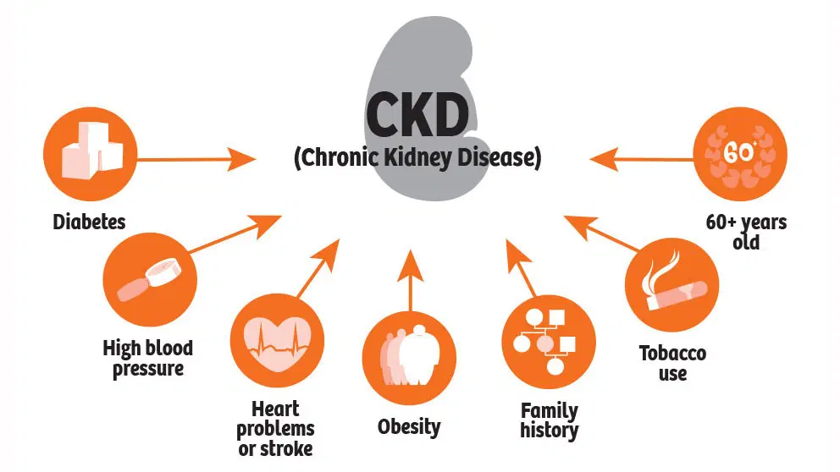

Slide 4
1. Hypertensive kidney disease

Slide 5
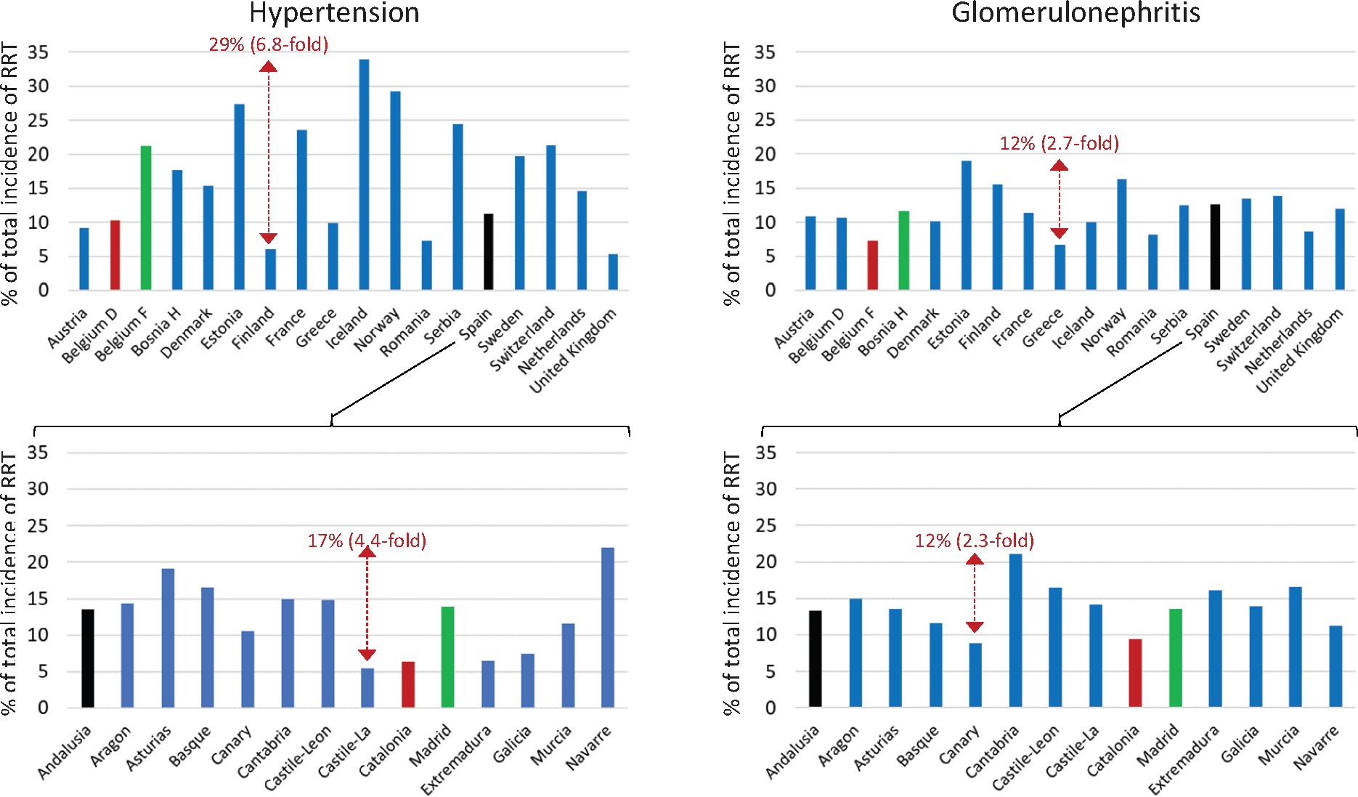

Slide 6
most hypertensive patients do not develop kidney disease
countries with a higher percentage of hypertensive patients has a lower impact of hypertensive nephropathy on RRT registries
lack of clear benefit of intensive SBP lowering on incidence and progression of CKD
familial aggregation of CKD independent of major risk factors such as diabetes and hypertension

Slide 7
2. CKD of unknown etiology

Slide 8
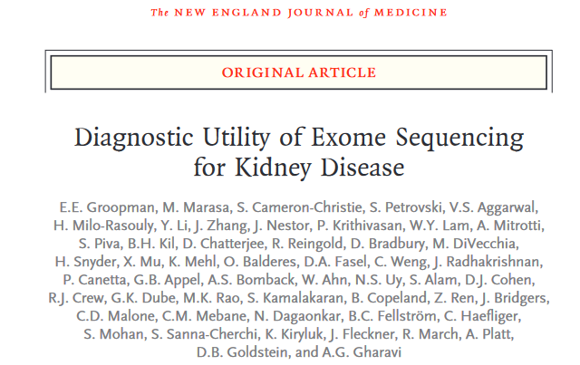
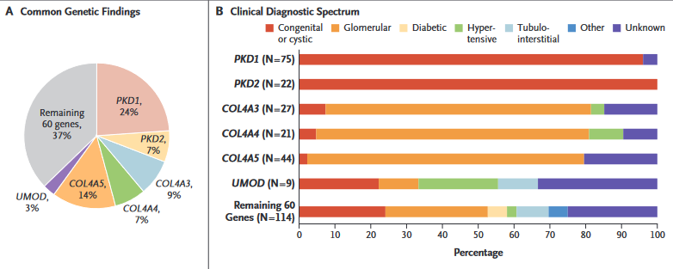

Slide 10
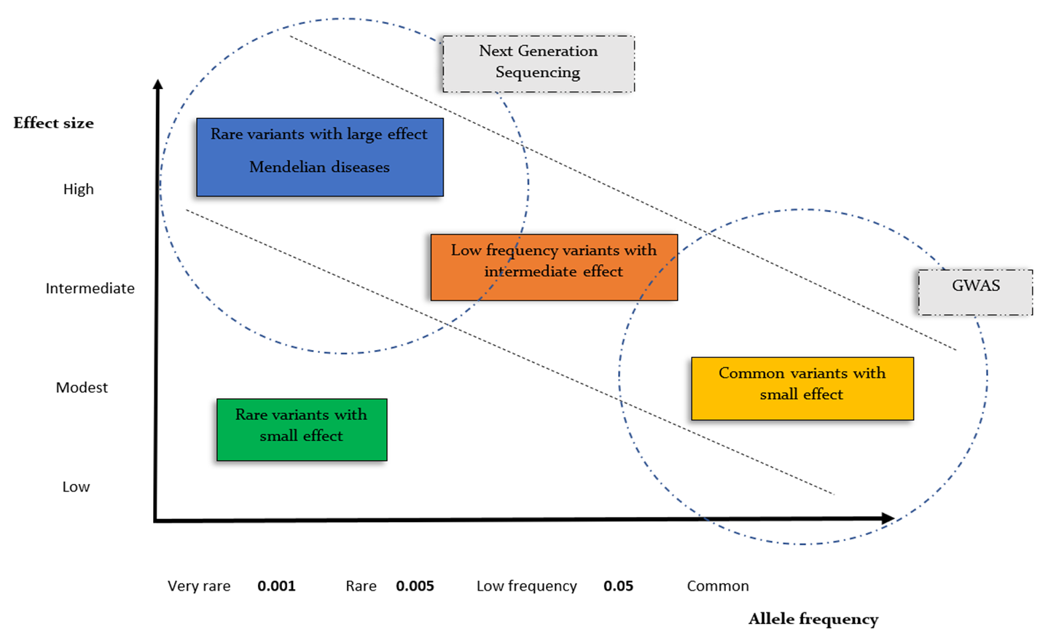
genetic architecture of CKD

Slide 12
Genome-wide association studies
mapping methods that identify genetic variants associated with an outcome across the genome in an unbiased manner
do not focus on specific genes but screen entire genome
try to find a statistical association between a genotype, typically an SNP, and an outcome, typically a kidney marker or disease
finding a SNP in a patient group that shows a significantly different frequency from that in the control group identifies a candidate genetic locus that is likely associated with a kidney phenotype

Slide 13
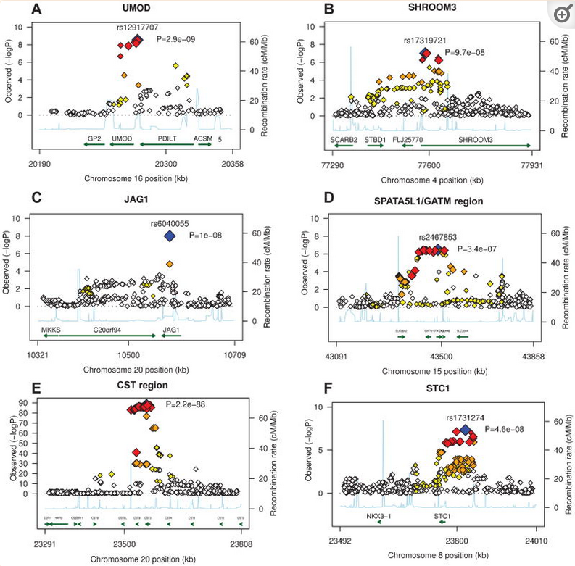
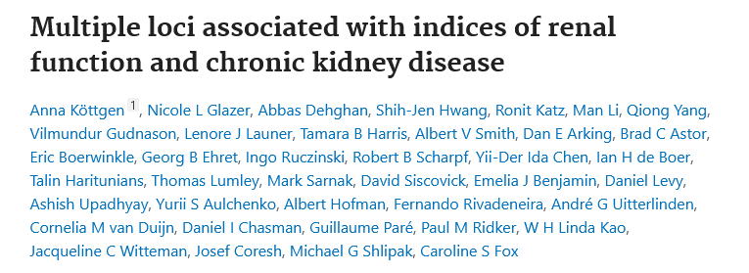

Slide 14
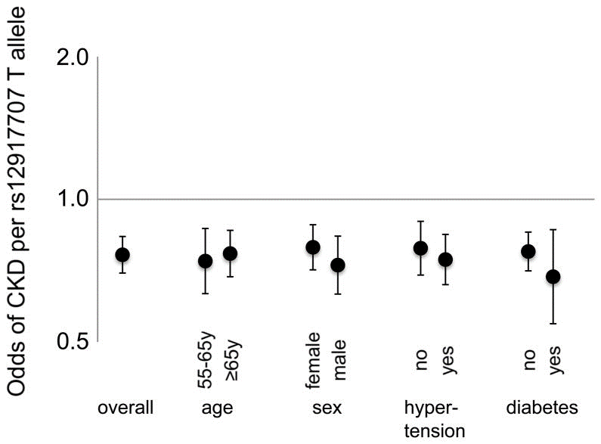
UMOD → SNP rs12917707 → minor T allele was associated with 20% reduced risk of CKD

Slide 15
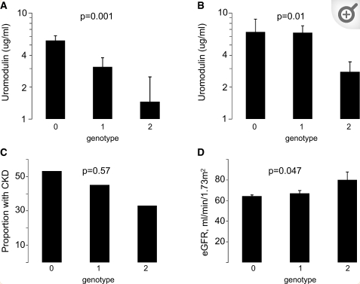
UMOD → SNP rs4293393 → minor C allele was associated with lower urine uromodulin levels, higher GFR and reduced risk of CKD

Slide 16
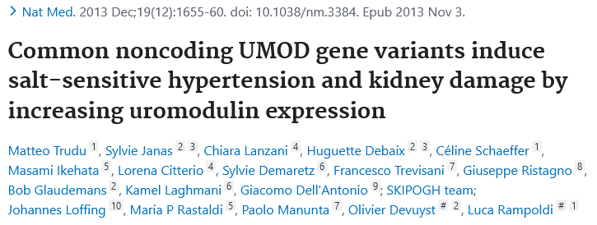

Slide 17
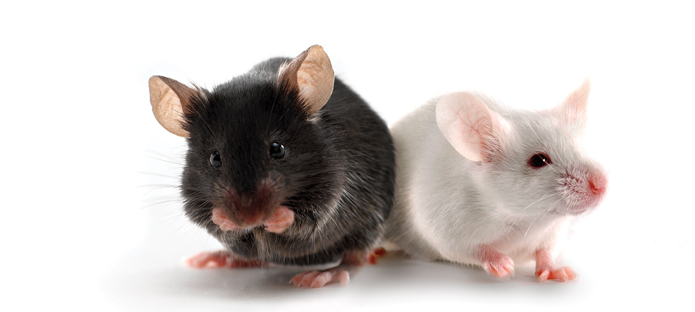
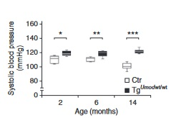
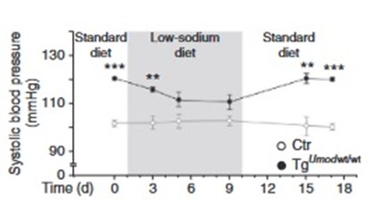
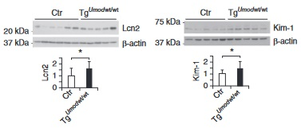
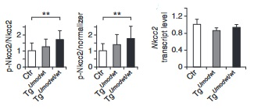
What;
How;

Slide 18
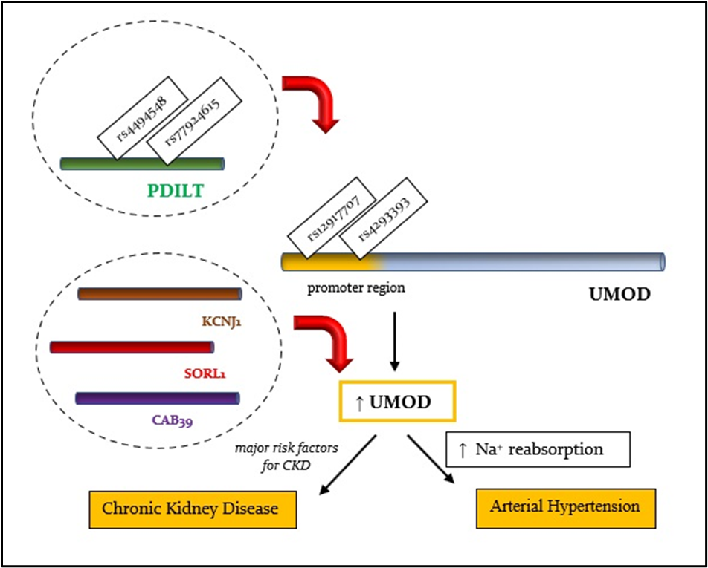

Slide 19
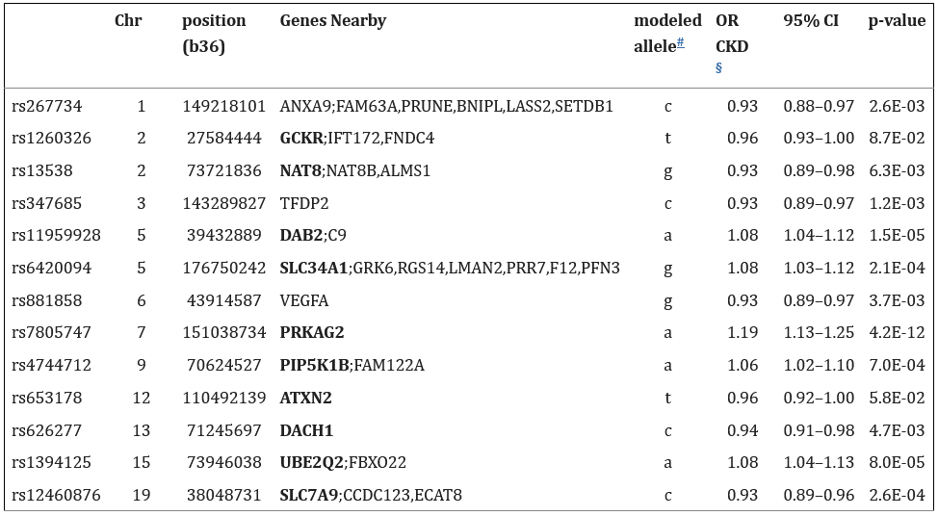
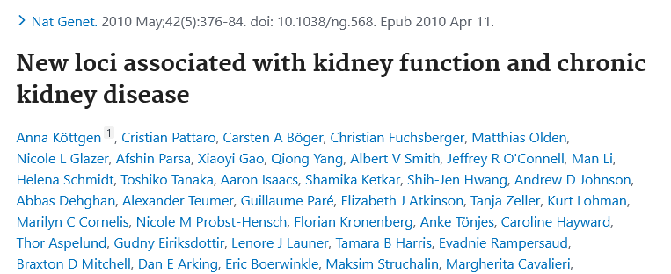

Slide 20
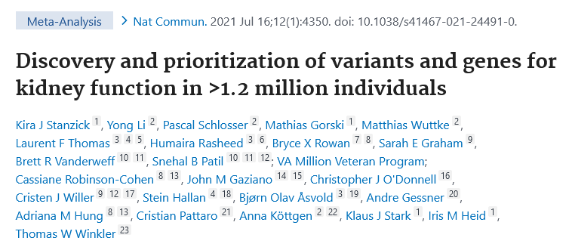
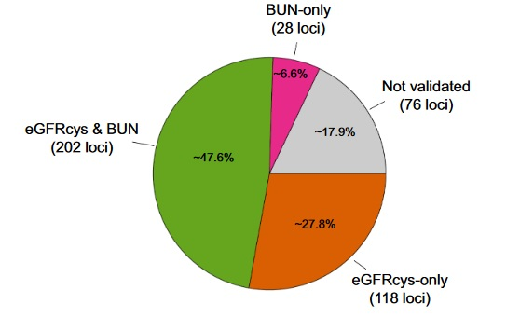
associations of eGFRcre with 424 lead variants
348 loci were validated by association with at least one alternative biomarker and thus classified as likely relevant for kidney function

Slide 21
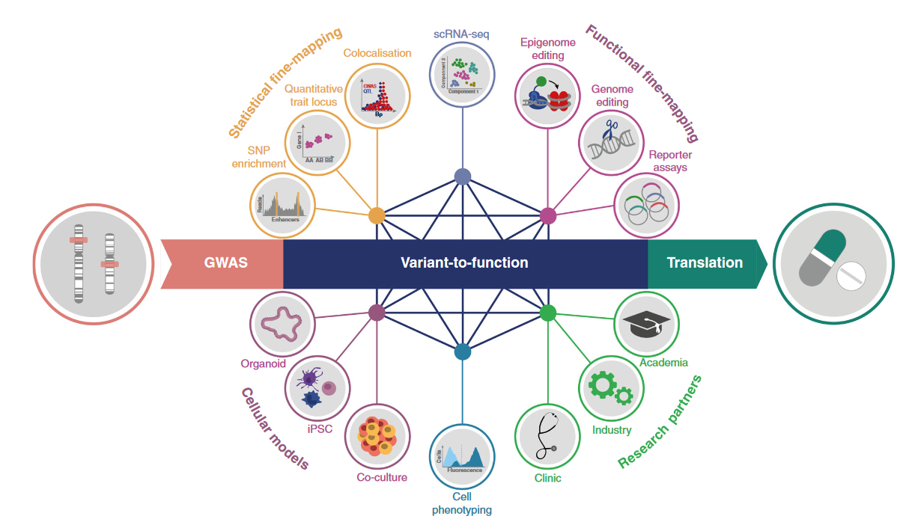

Slide 22
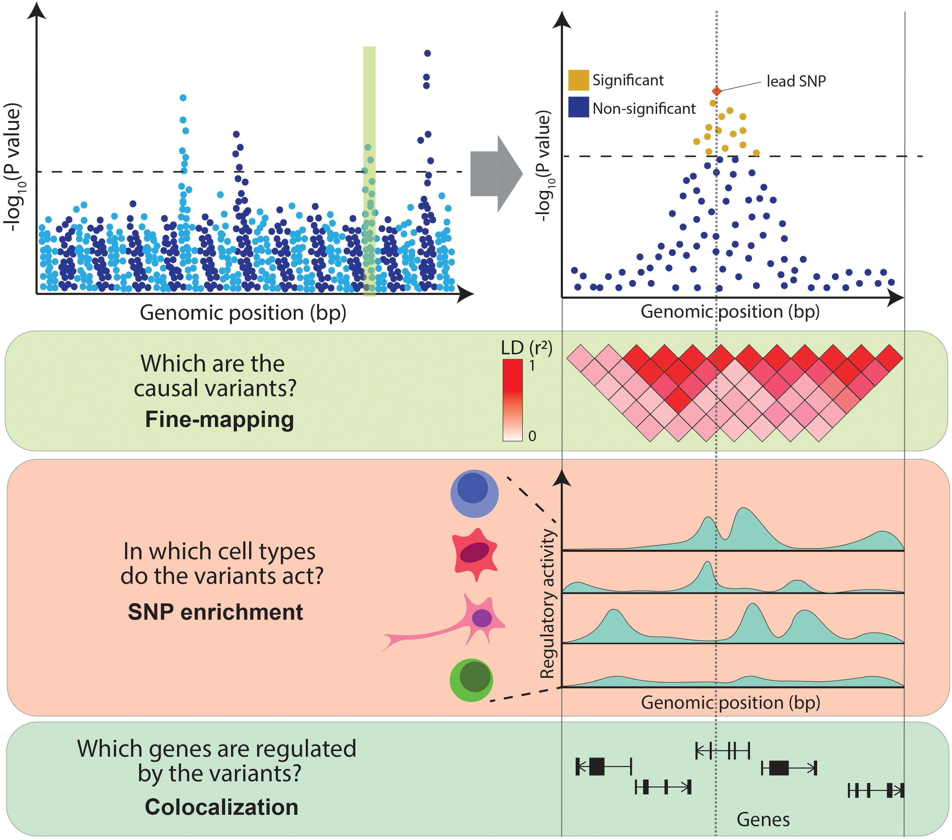

Slide 23
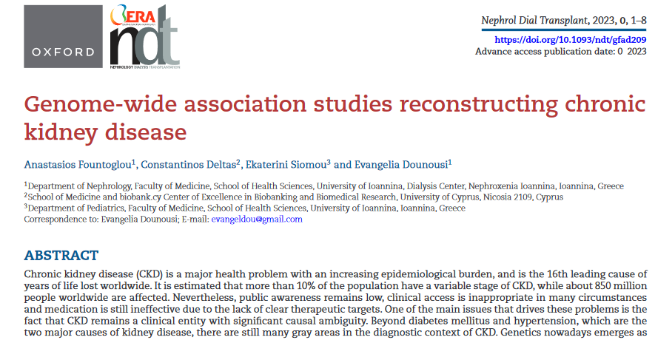

Slide 24
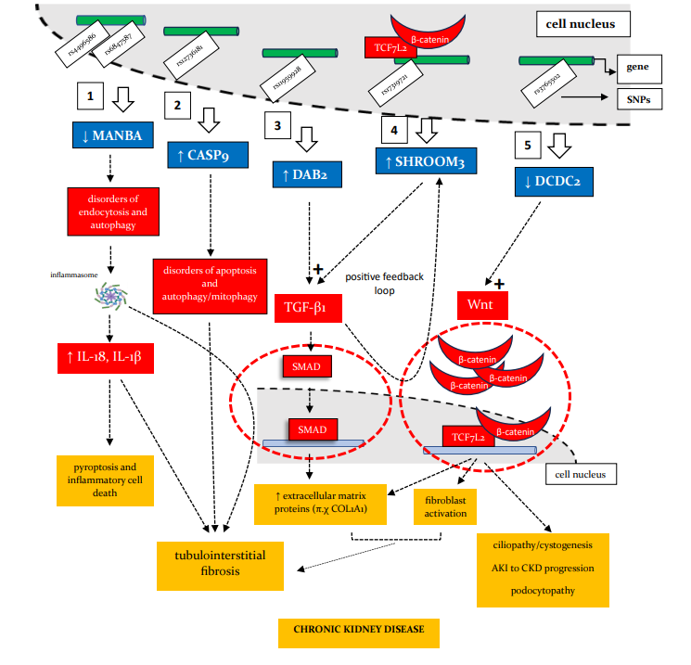
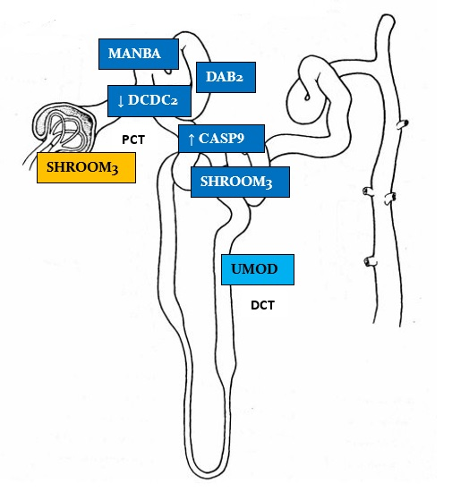

Slide 25
what we have learned so far;
genetic risk variants are not associated with the occurrence of major risk factors for CKD such as diabetes and hypertension
kidney damage appears to be mediated through a possible increase in the vulnerability of the renal parenchyma to the action of these nephrotoxic risk factors
multiple “small” damage hits to the structural and functional integrity of kidney make the latter particularly vulnerable to the major stress from the action of major CKD risk factors
the majority of the genes that are implicated in this vulnerability are expressed at tubulointerstitial level of the kidney (tubulo-centric view of CKD)

Slide 26
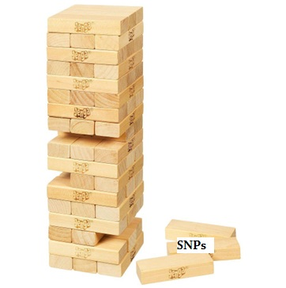
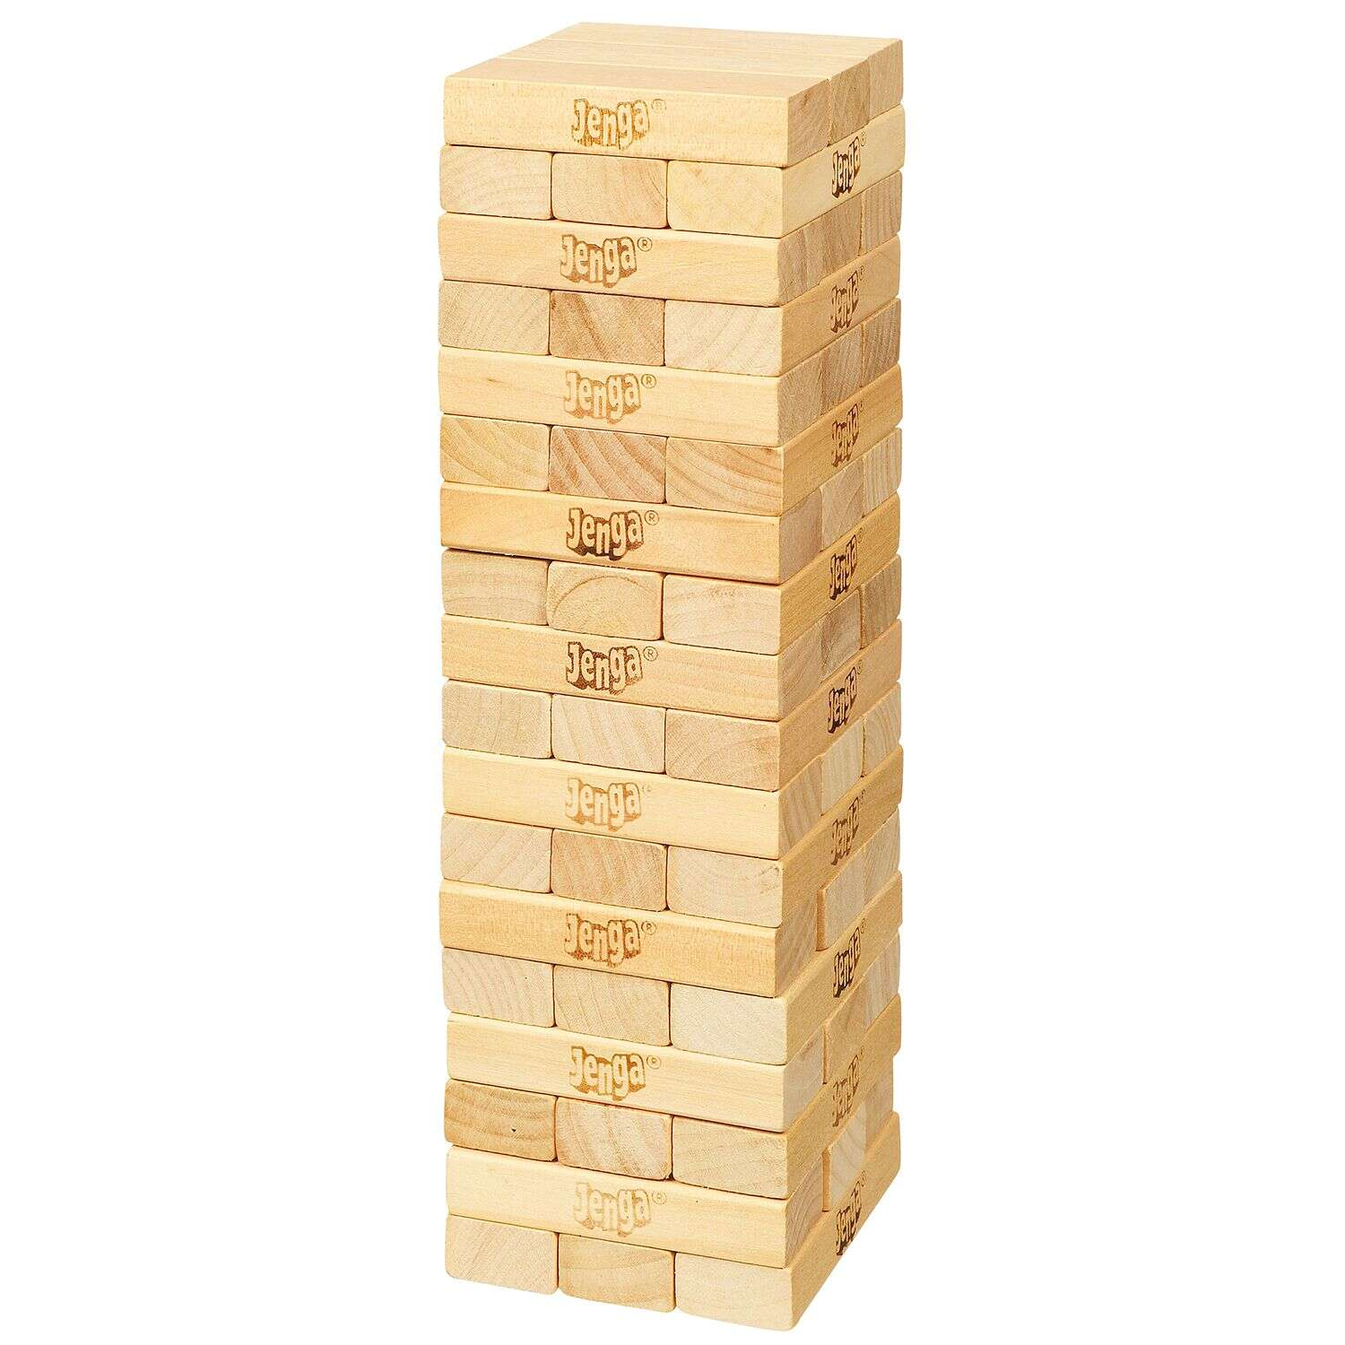
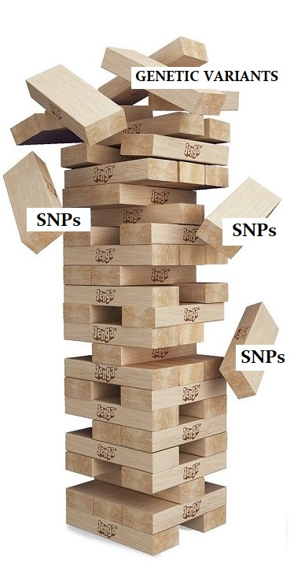
Jenga theory of CKD
Kidney with risk SNPs and
genetic predisposition of CKD
Normal kidney
Major risk factor
Chronic kidney disease
Genetic predisposition and/or
a dominant genetic variant

