Slide 1

Could incremental haemodialysis be a new standard of care?
Carlo Basile
Associazione Nefrologica Gabriella Sebastio
Martina Franca, Italy
Chair of EuDial (European Dialysis) Working Group of ERA (European Renal Association)

Slide 2
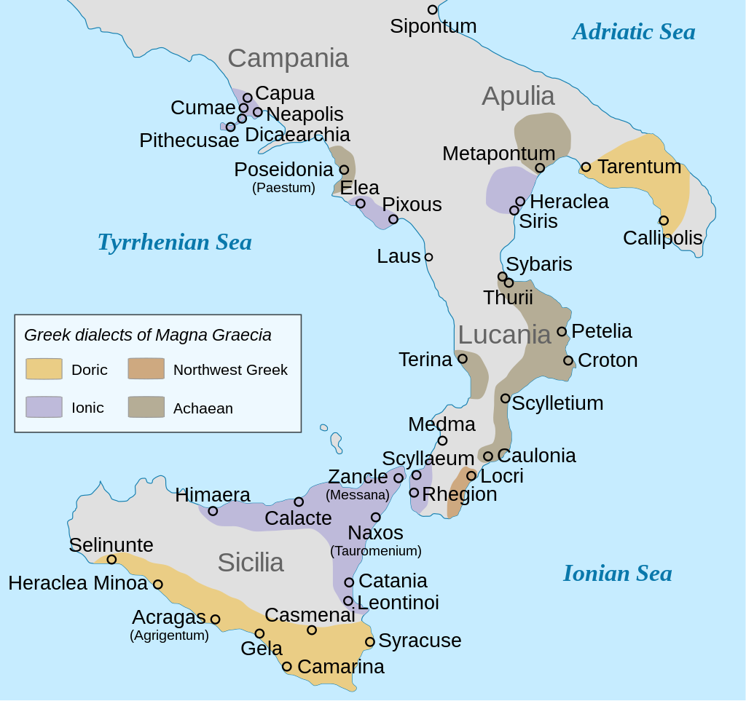

Ancient Greek colonies and their dialect groupings in Southern Italy (Magna Graecia)

Slide 3
Taranto
Founded by Spartans in the 8th century BC
They called the city Taras (Τάρᾱς) after the mythical hero Taras
Taranto was among the most important poleis in Magna Graecia, becoming a cultural, economic and military power
By 500 BC, the city was among the largest in the world, with a population estimated up to 300,000 people

Slide 4
Most people who make the transition to maintenance dialysis therapy are treated with a fixed dose of thrice-weekly haemodialysis (3HD/wk) regimen without considering their residual kidney function (RKF).
Although the regulatory agencies might consider the 3HD/wk regimen as “standard of care” and “adequate requirement”, it is by no means perfect.
The 3HD/wk regimen has been assumed, until recently, almost as a dogma in the dialysis community. Incredibly, it has been widely accepted worldwide without never undergoing any randomized controlled trial (RCT) to examine whether less frequent HD treatments would be inadequate or harmful.

Slide 5
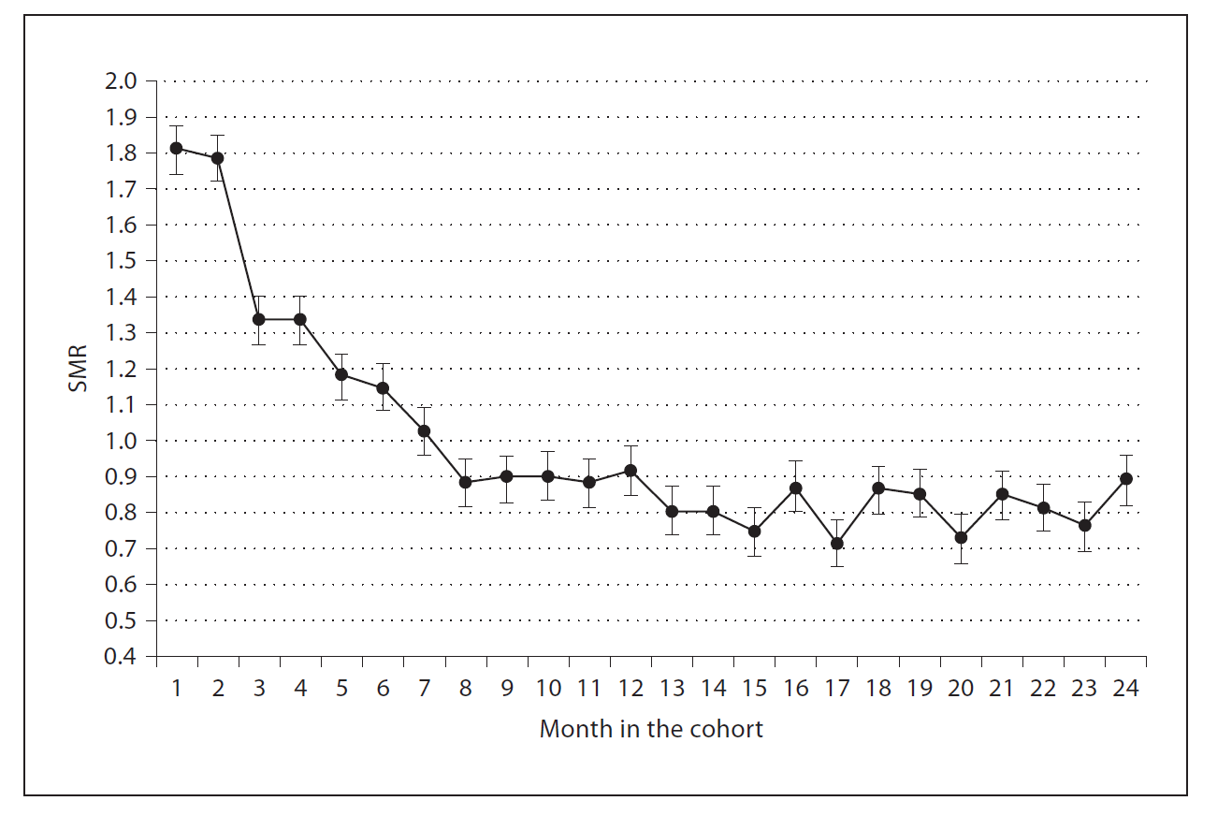
Early mortality is elevated in the first 6-12 months after initiating dialysis
Standardised mortality, n=18707 incident patients
Reference group for comparison: 57456 HD patients (Da Vita cohort, US)
Possible causes:
Patient selection ?
Dialysis “shock” ?
Excessive ultrafiltration /cardiovascular events ?
Lukowsky et al, American Journal of Nephrology 2012

Slide 6
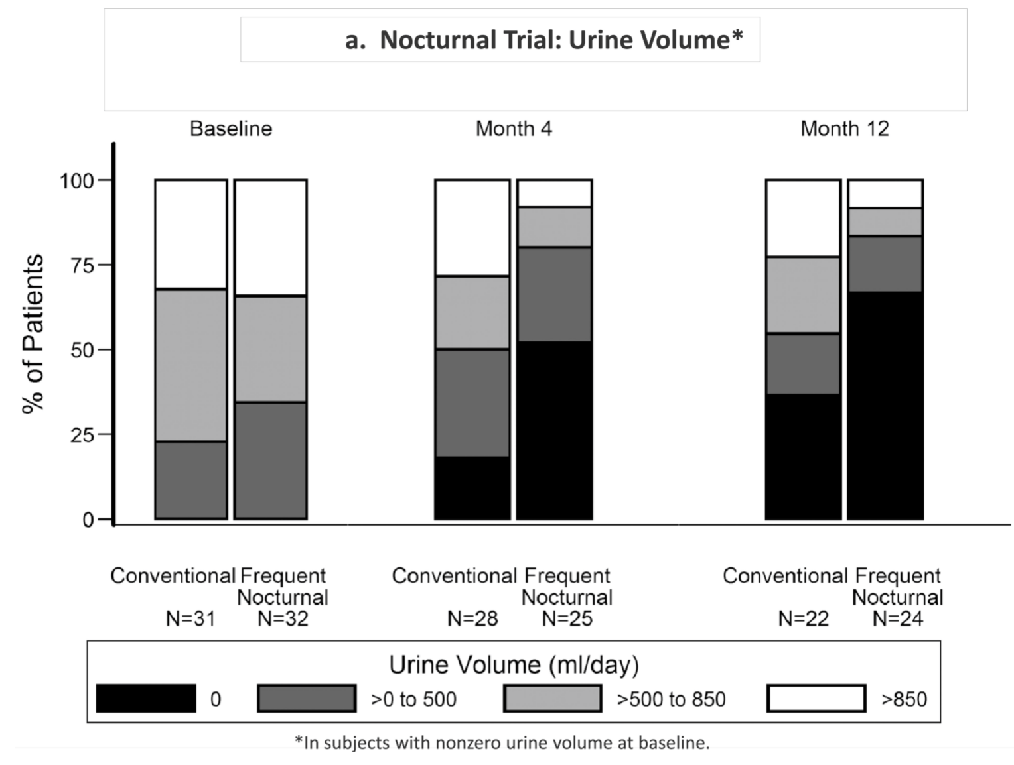
Frequent HD regimes may result in loss of residual kidney function (RKF)
Loss of RKF in nocturnal HD:
Data from the Frequent Haemodialysis Network:
In the frequent dialysis group, urine volume had
declined to zero in 52% and 67% of patients at
months 4 and 12, respectively, compared with
18% and 36% in controls
Daugirdas et al, Kidney Int. 2013 May ; 83(5): 949–958

Slide 7
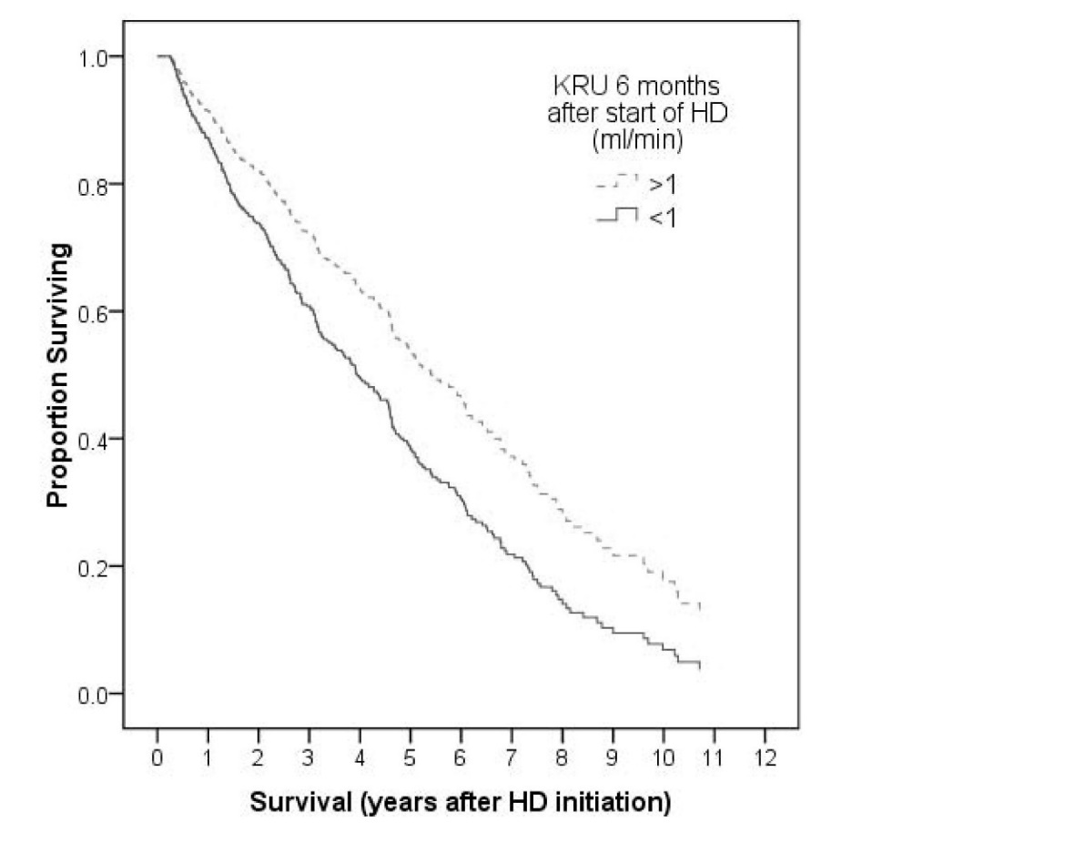
Residual kidney function: a key predictor of outcomes in HD
 | Sig (p) | Hazard ratio
6 month KRU≥1ml/min | 0.01 | 0.693
Diabetic status | 0.306 | 1.210
Age | <0.001 | 1.029
Albumin | 0.002 | 0.959
HDF use | <0.001 | 0.523
Malignancy | 0.001 | 1.814
Ischaemic heart disease | 0.620 | 0.931
Peripheral vascular disease | 0.543 | 1.107
Vilar et al, Residual kidney function improves outcomes… NDT 2009
Notes:
Just 1ml/min makes a great difference to survival

Slide 8
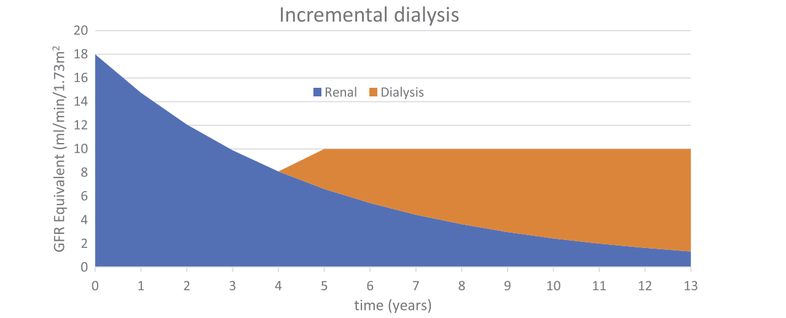
What is incremental dialysis ?
Aims to provide the required amount of dialysis at the right time, based on RKF
Based on step-wise or incremental increase in dialysis as RKF falls
Based on the premise that a gradual increase in dialysis dose may preserve RKF
Aims to reduce the “shock” of starting dialysis and reduce exposure to the harmful effects of dialysis

Slide 9
Possible benefits of incremental HD
Less exposure to harmful effects of haemodialysis
Less usage of vascular access, less complications
Gentle start of dialysis in the early period in which mortality is high
Dialysis-free time
Reducing dialysis frequency can allow to dialyse others more frequently
Quality of life
Less burden of treatment
Less exposure to aggressive attempts at ultrafiltration
Lower therapy cost

Slide 10
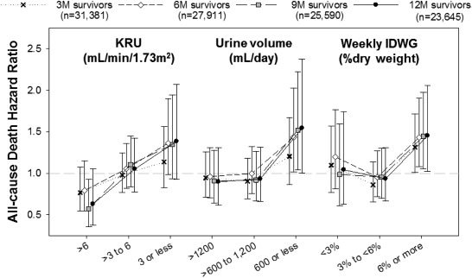
Who is safe for incremental HD?
Literature supports twice-weekly dialysis likely to be safe if kidney urea clearance (KRU) above 3mL/min/1.73m² BSA
N=23645
DaVita US cohort
Initiated HD 2007-2010
Incremental HD showed similar mortality if KRU >3mL/min/1.73m²
Higher mortality below this
Obi, Kalantar-Zadeh et al, AJKD 2016

Slide 11
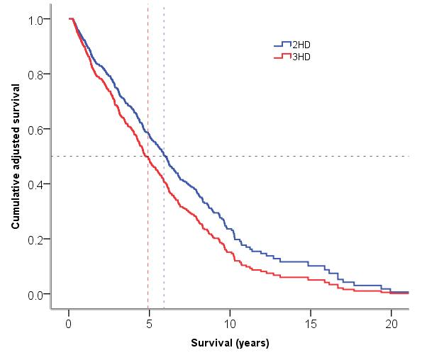
Safety of incremental HD for patients with KRU >3ml/min/1.73m² BSA
Retrospective, single centre UK study
n=154 2x weekly patients
n=411 3x weekly patients
>5 year follow up
Baseline KRU ≥3ml/min
Multivariate analysis: hazard ratio for death 0.76 in incremental HD compared to 3x weekly
Kaja Kamal, Vilar et al, NDT 2019 Jun 1;34(6):1017-1025

Slide 12
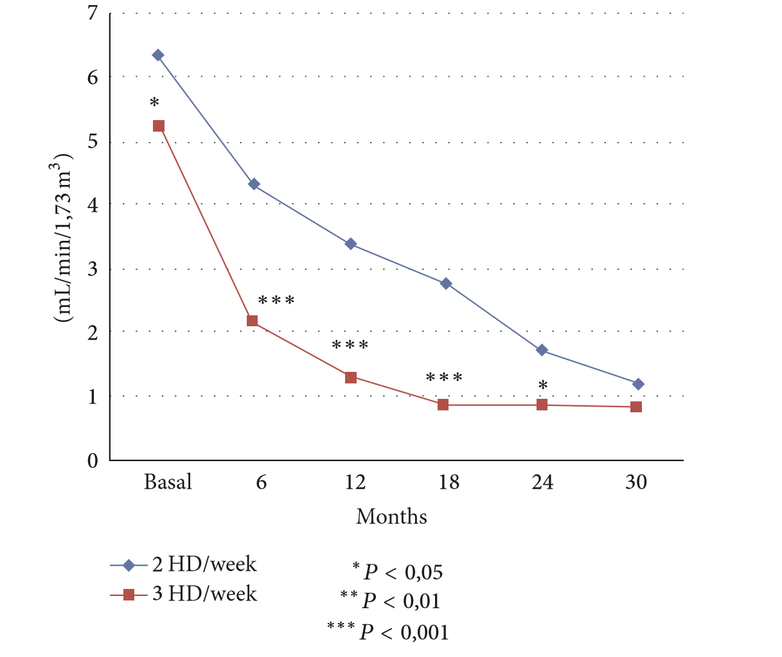
Slower loss of kidney function in twice-weekly HD: data from Spain
M Lucas, C Quereda et al, Advances in Nephrology 2014

Slide 13
Loss of RKF in an observational cohort in Taiwan: twice-weekly vs. thrice-weekly HD
 |  | 2x weekly | 3x weekly | p
Urine Volume | Start | 1072 ± 700 | 1048 ± 703 | 0.901
 | End | 1551±1094 | 660± 1106 | 0.005
 | Changes per month | 160 ± 442 | -20 ± 102 | 0.022
Mean follow up 18 months
N=23 2x weekly v 51 3x weekly
Lin, Wu et al Nephrology 14(1):59-64 2009

Slide 14
Main demographic, clinical and laboratory data of the 202 patients enrolled into the study
Age (years) | 66 ± 15
Gender (male/female) | 120/82
Body weight (kg) | 63.2 ± 13.3
Blood urea nitrogen (mg/dl) | 99 ± 33
Serum creatinine (mg/dl) | 8.0 ± 3.1
Kru (ml/min/1.73 m²) | 4.5 ± 1.6
CrCl (ml/min/1.73 m²) | 8.0 ± 2.9
Urine Output (ml/day) | 1800 ± 700
Group 1 (G1): start on 1HD/wk | 117 (57.9%)
Group 2 (G2): start on 2HD/wk | 46 (22.8%)
Group 3 (G3): start on 3HD/wk | 39 (19.3%)
Charlson comorbidity index | 6.9 ± 2.6

Slide 15
Duration of dialysis treatments in the three groups of patients
 | G1 (N=117) | G2 (N=46) | G3 (N=39)
Months on 1HD/wk | 11.9 ± 14.8 | 0 | 0
Months on 2HD/wk | 13.0 ± 20.3 | 16.7 ± 23.2 | 0
Months on 3HD/wk | 37.4 ± 46.5 | 34.7 ± 38.6 | 56.3 ± 55.3
Months of follow-up | 62.6 ± 48.8 | 51.4 ± 40.8 | 56.3 ± 55.3

Slide 16
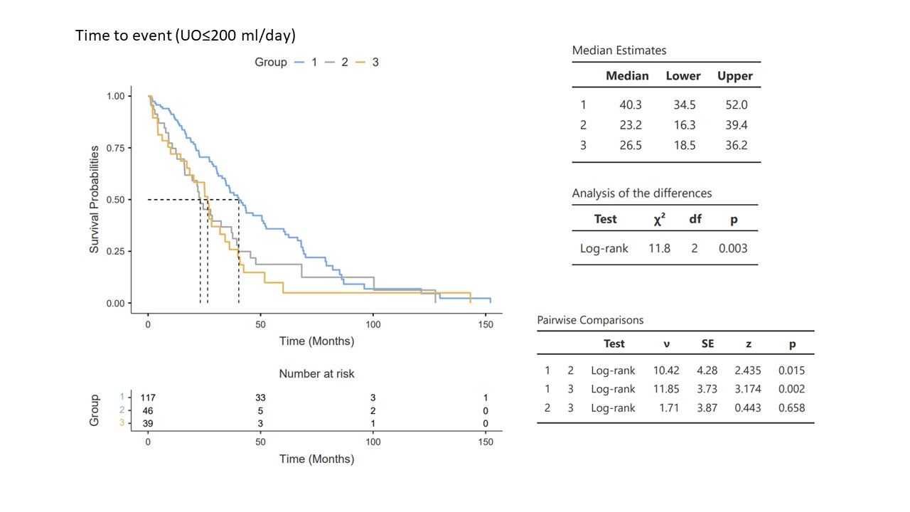

Slide 17
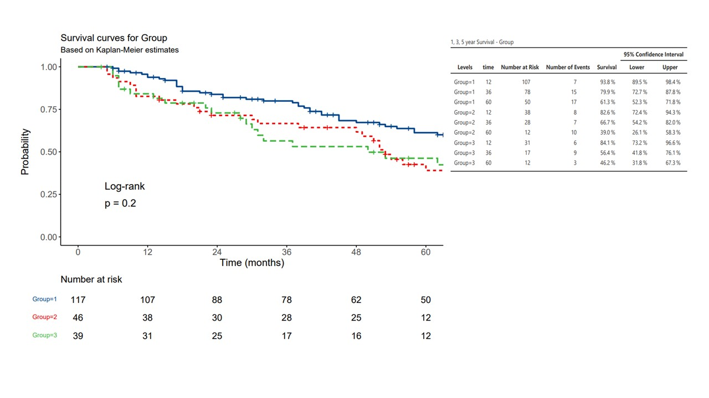

Slide 18
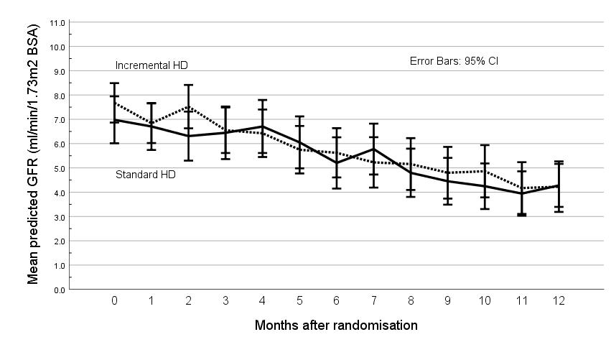
UK Incremental HD
Multicenter feasibility RCT to assess the impact of incremental versus conventional initiation of hemodialysis on RKF
Trend towards slower decline in RKF(not significant though)
Vilar et al, Kidney Int 2022;101:615–25

Slide 19
Twice-weekly hemodialysis with adjuvant pharmacotherapy and transition to thrice-weekly hemodialysis: a pilot study
Murea et al, Am J Kidney Dis 2022;80:227–40
The TWOPLUS Study
Hospitalizations

Slide 21
“The quest for a reliable dialysis adequacy index/criteria has been a constant feature through the decades in dialysis. While agreeing that evaluating dialysis adequacy should not rely on a single index, we would like to point out the need to keep urea kinetic model (UKM) as the gold standard, as it is the only established tool for assessing and prescribing dialysis.”
Its reference solute is urea
National Kidney Foundation. KDOQI clinical practice guidelines for hemodialysis adequacy: 2015 update. Am J Kidney Dis 2015; 66: 884-930
European Best Practice Guidelines. II.3 Haemodialysis dose and residual renal function (Kr). Nephrol Dial Transplant 2002; 17 (Suppl 7): 24

Slide 22
Common methods of performing calculations for incremental HD (1)
  Standard Kt/V
Std Kt/VTOTAL = StdKt/V RENAL + StdKt/V DIALYSIS
Gotch / Daugirdas

Slide 23
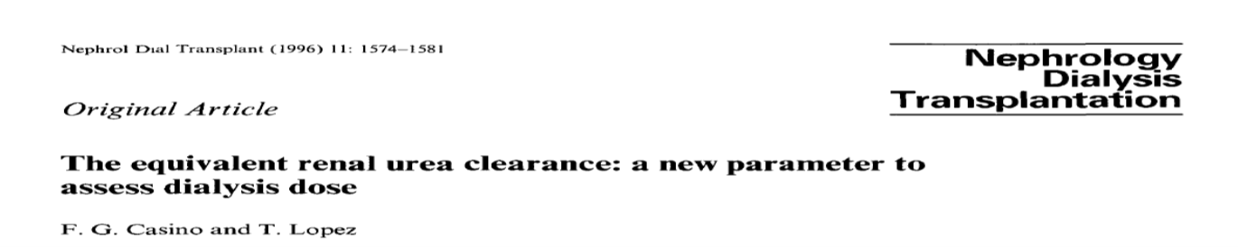
Common methods of performing calculations for incremental HD (2)
Casino-Lopez Equivalent Continuous Clearance
Convert intermittent dialysis clearance (Kt/V) to an equivalent dialytic urea clearance (EKRd) and add to native kidney urea clearance (Kru)
total EKR = EKRd + Kru

Slide 24
European Best Practice Guidelines. II.3 Haemodialysis dose and residual renal function (Kr). Nephrol Dial Transplant 2002; 17 (Suppl 7): 24
Guideline II.3
A. In the case of significant residual renal function (Kr), the amount of therapy to be delivered with HD may be estimated with the aid of the equivalent renal urea clearance (EKR).
(Evidence level: B)

Slide 26
The prescription graph shows that treatment frequency depends essentially on KRUn

Slide 27
To our knowledge, these are the ongoing RCTs on incremental dialysis
The recently started RCT in Australia-NZ-Canada not listed
Upcoming Veterans INCHVETS not listed
Investigator(s), study, N=planned enrollment/arm | Intervention arm | Control arm | Key enrollment criteria | Primary Outcome | Country, start date | Trial Registry
Deira et al. Incremental HD in Incident Patients (IHDIP), N=75 | 1x/wk HD, then to be increased to 2 and 3 x/wk per criteria | 3x/wk HD | • CKD stage 5 • KrU ≥ 4 ml/min | Patient survival | Spain/Italy, 8/2017 | NCT03239808
Fernández & Teruel Incremental HD, N=42 | 2x/wk HD | 3x/wk HD | • Kru ≥ to 2.5 ml/min • UOP: non-anuric | Change in RKF | Spain, 10/2017 | NCT03302546
Casino et al Incremental HD, N=190 | 1x/wk HD, then to be increased to 2 and 3 x/wk per criteria | 3x/wk HD | • CKD stage 5 • KrU ≥ 4 ml/min | Time to anuria | EuDial WG 07/2022 | NCT04360694
White, Less Frequently In The Elderly (D-LITE), N=20 | Twice-weekly HD | 3x/wk HD | • Age ≥70 yr • Incident HD ≥7 wk | Feasibility | Canada, 12/2018 | NCT03787719
Sirich, Efficacy of Twice Weekly HD in Patients With RKF, N = 25 | Twice-weekly HD for 4 wk, cross-over design | 3x/wk HD for 4 weeks | • Kru ≥ 2.5 ml/min (cross-over design after 4 weeks) | KD-QoL | California, USA, 3/2019 | NCT03874117

Slide 28
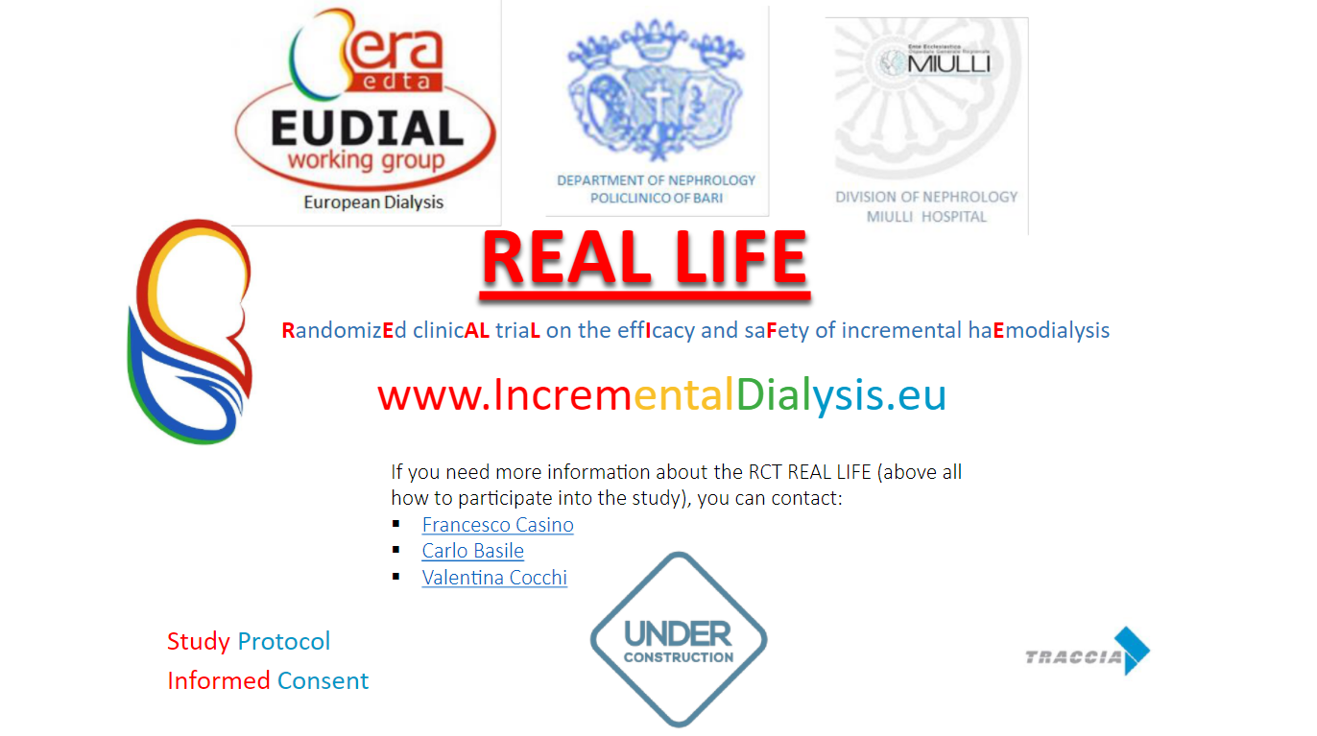

Slide 29
Prescription of weekly dialysis sessions in the intervention arm of REAL LIFE RCT
The frequency varies as a function of kidney urea clearance
Fixed Dialysis Dose: spKt/V = 1.2
7
6
5
1 HD/wk
Kidney Urea Clearance ml/min/35 l
4
3.0
2 HD/wk
3
2
1.5
3 HD/wk
1
0
Time (months)

Slide 30
Educational aspects of incremental HD
Requires patients to have education in importance of the individualised therapy and an acceptance that dialysis intensity may have to be increased in future
Patient education in accurate measurement of RKF
Investment of time needed in pre-dialysis education stage
Requires staff education: clear and consistent messaging
Requires investment of staff time in measurement of RKF and dialysis dose

Slide 31
Summary (1)
Growing interest in incremental haemodialysis which was previously a minority sport
SARS-CoV-2 pandemic has drawn attention to benefits of less frequent dialysis regimes
In HD, there are complexities with combining dialysis dose with RKF but tools have been developed to facilitate this

Slide 32
Summary (2)
Retrospective data suggest RKF may be lost less quickly if dialysis is initiated less frequently than 3 times a week
Prospective data from RCTs do not indicate any signal of harm and may indicate incremental HD has a protective effect for RKF
Definitive data from RCTs are required to define the benefits of incremental HD
Patient and staff education are a key aspect of a successful incremental dialysis programme

Slide 33


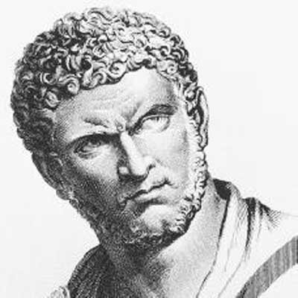
The real voyage of discovery consists not in seeking new lands, but in having new eyes
Marcus Valerius Martialis (40? AD - 104? AD)
Roman poet
Marcel Proust

