Slide 1
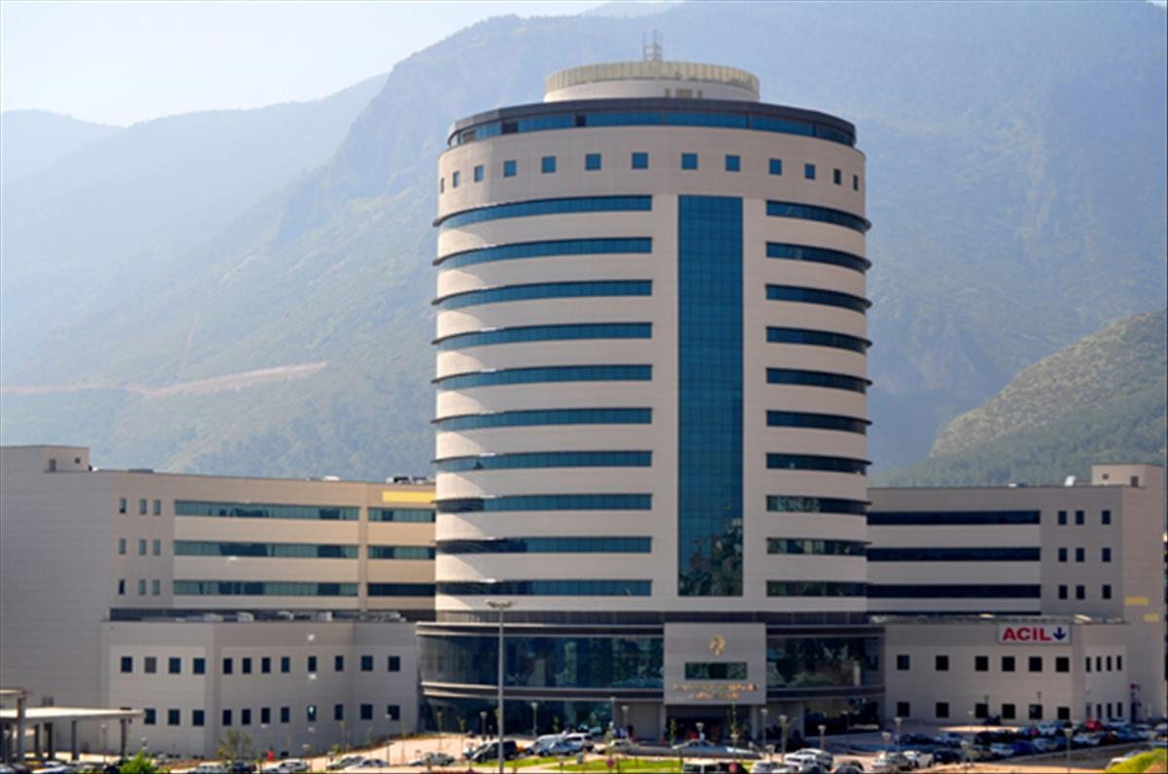
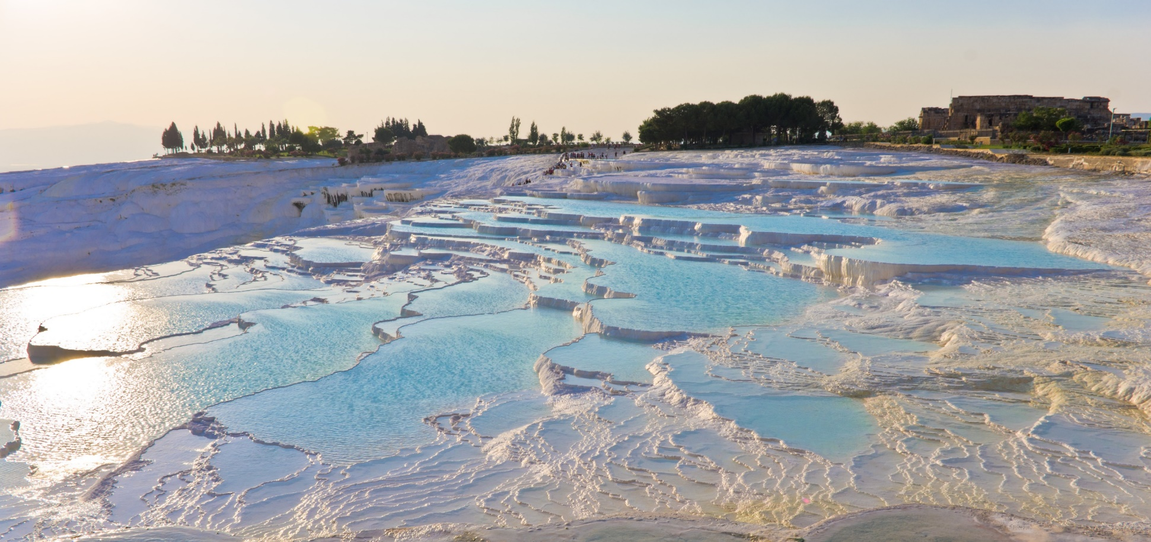
Inflammation and Complement System in AKI
Prof. Dr. Belda DURSUN
Pamukkale University, Medical School
Department of Medicine, Division of Nephrology
Denizli - Türkiye

Slide 2
Outline
Inflammatory pathways in AKI
Complement system in AKI
Maladaptive repair and AKI-CKD transition
AKI biomarkers and therapeutic options on the horizon

Slide 3
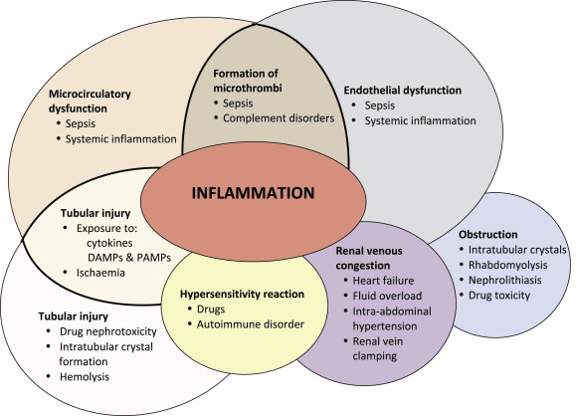
Acute Kidney Injury (AKI)
Etiology and Prognosis
Most AKI is intrinsic in nature, associated with ischemia, sepsis or nephrotoxins and complicated with high morbidity/mortality.
Ischemia/reperfusion (I/R) is a common cause of AKI after kidney transplantation, cardiac surgery.
The pathogenesis of intrinsic AKI involves a cross talking between renal system and the innate and adaptive immunity.
If the immunopathologic processes in AKI continue, this can lead to renal fibrosis, CKD/ESRD, cardiovascular disease and mortality.
Marlies Ostermann M. Best Practice & Research Clinical Anaesthesiology 2017

Slide 4
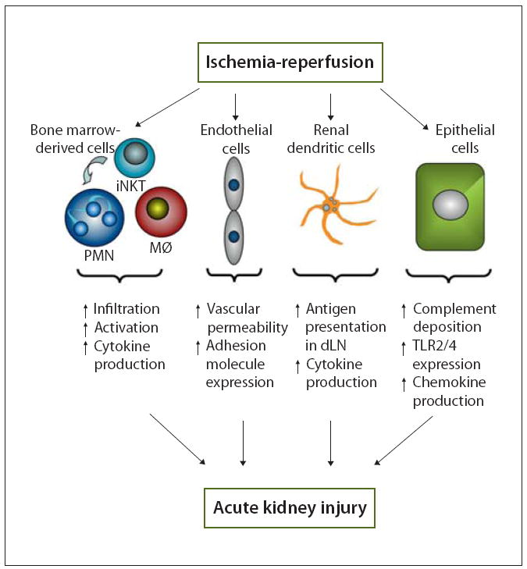
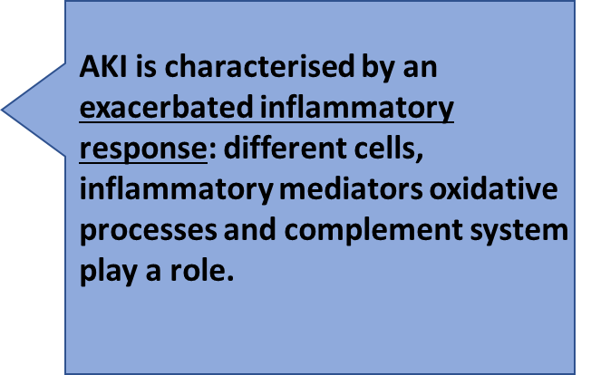
Gilbert R. Kinsey, Li Li, and Mark D. Okusa
Nephron Exp Nephrol. 2008.

Slide 5
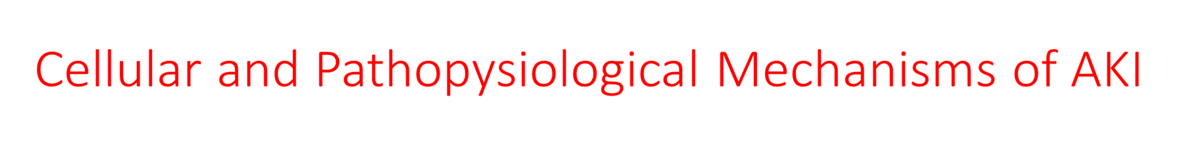
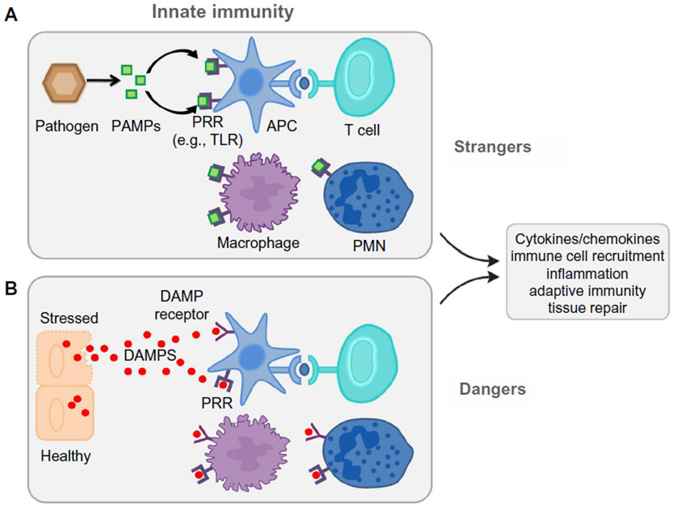
Primary insult to the kidney
PAMPS
DAMPS

Slide 6
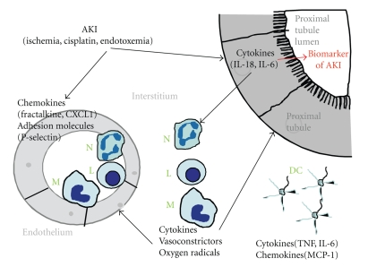
:
Proximal RTE is most sensitive to the injury:
Victim or Foe?
Endothelial cells and tubular epithelial cells undergo morphological/ functional changes and produce cytokines.
Leukocytes (N, M, NK) and lymphocytes infiltrate kidney and become activated for pro-inflammatory cytokine production
( TNF-α, IFN-γ, TGF-β, IL-1, etc)
AKI results in the upregulation of chemokines like fractalkine and CXCL1 and adhesion molecules like P-selectin in the endothelium of blood vessels in the kidney. Upregulation of chemokines and adhesion molecules in the endothelium results in the infiltration of inflammatory cells like neutrophils (N), lymphocytes (L), and macrophages (M) from the blood vessels into the interstitium of the kidney. Proximal tubular epithelial cells produce cytokines like IL-18 and IL-6. IL-18 and IL-6 produced by the proximal tubule enter the interstitium and result in activation and/or proliferation of neutrophils (N), lymphocytes (L), and macrophages (M). IL-18 and IL-6 are also released from the proximal tubular cells into the tubular lumen Inflammatory cells produce vasoconstrictors (prostaglandins, leukotrienes, and thromboxanes) that may affect vascular injury and oxygen radicals that may worsen tubular and vascular injury. Resident dendritic cells (DCs) form a contiguous network throughout the entire kidney. The role of DCs in AKI is not well understood. Following kidney ischemia-perfusion, resident dentritic cells release cytokines like TNF and IL-6 and chemokines like MCP-1.
Edelstein CL. Mediators Inflamm. 2009; 2009: 137072.

Slide 7
Immune regulation of cytokines in AKI
Proinflammatory cytokines and chemokines:
  (TNF-α, IL-6, IL-18, IFN-γ, IL-20, Caspase -1 induced IL-1B and IL-18, MCP-1, CX3CL1)
Antinflammatory inhibitors and antagonists:
  (IL-10, IL-4, IL-13, CSF and GM-CSF)
Dysregulated mechanism and excessive cytokines is responsible for AKI immunopathogenesis.

Slide 8
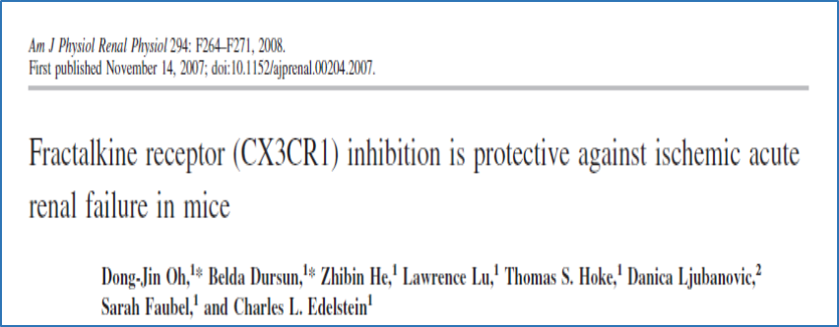
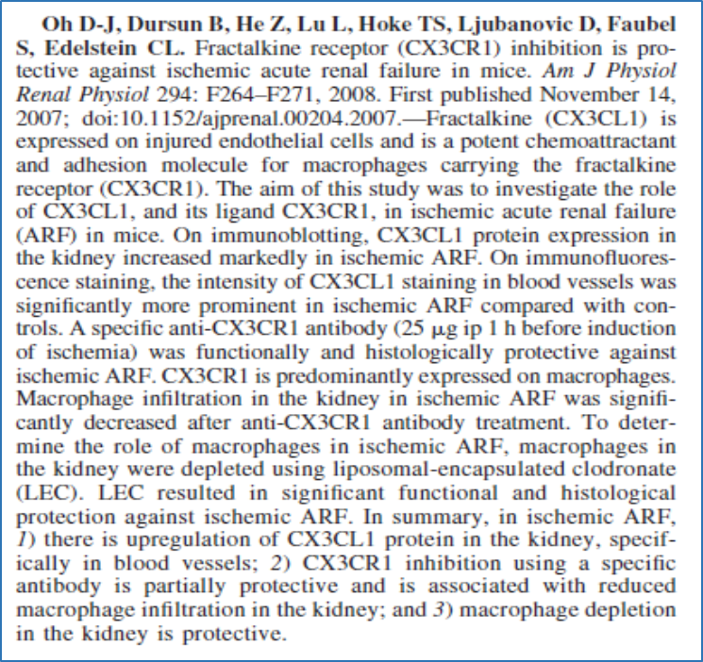
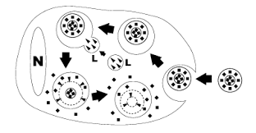
Fractalkine (CX3CL1) is expressed on injured endothelial cells and is a potent chemoattractant and adhesion molecule for macrophages carrying the fractalkine receptor (CX3CR1).
The aim of this study was to investigate:
  The role of CX3CL1, and its ligand CX3CR1, in ischemic acute renal failure (ARF) in mice.
  Whether macrophage depletion is protective
Macrophage depletion by liposome encapsulated clodronate (LEC)

Slide 9
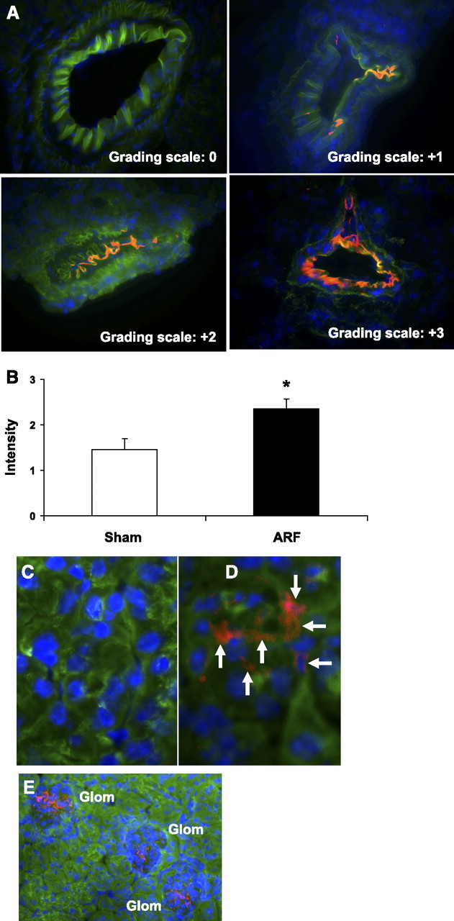
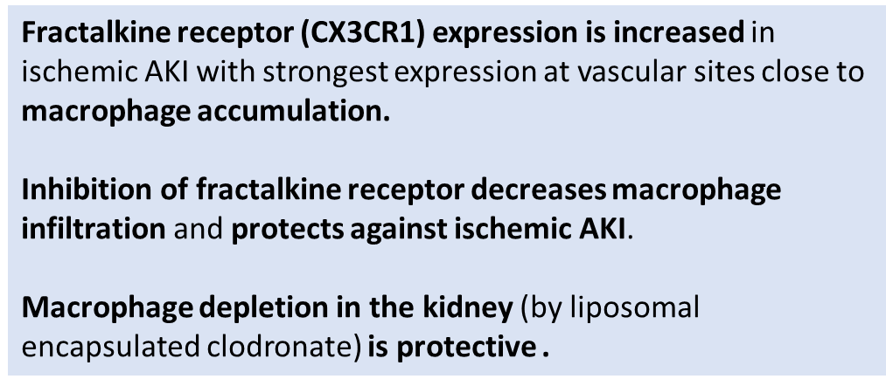
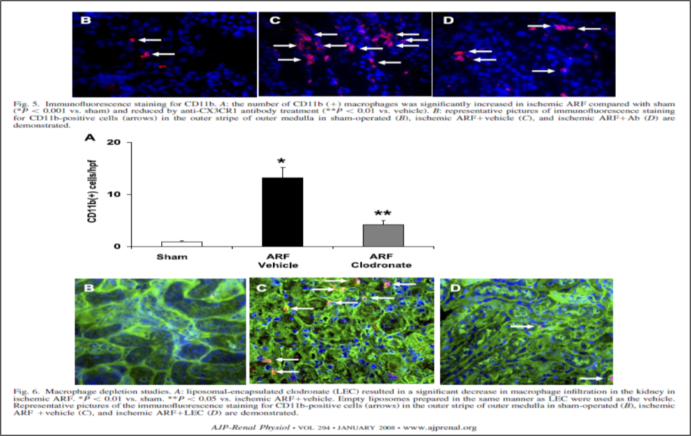
( specfic ab)
CX3CL1 immunofluorescence staining. A: intensity of endothelial staining of CX3CL1 in arteries was graded from 0 to 3+. The red/orange color indicates positive staining for CX3CL1. Blue staining represents nuclei. Representative pictures of the grading scale are demonstrated. B: using the grading scale demonstrated in A, the intensity of endothelial staining was increased in ischemic ARF compared with sham-operated mice (*P < 0.05 vs. sham, n = 4). C and D: representative pictures of CX3CL1 staining (red/orange, arrows) in capillaries in the outer stripe of the outer medulla in sham-operated (C) and ARF (D) mice. E: CX3CL1 staining (red/orange) in capillaries in a normal glomerulus (glom) from a sham-operated mouse.

Slide 10
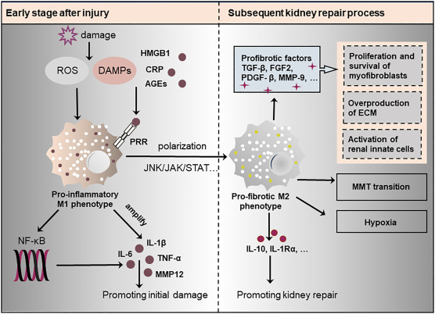
Versatile Macrophage Functions on Acute Kidney Injury and Its Outcomes
At the initial injury phase, M1 macrophages produce various cytokines for robust inflammation.
During kidney repair, macrophages change their phenotype to M2, which produce pro-fibrotic factors or may directly convert into myofibroblasts, leading to the development of interstitial fibrosis.
Fig. 1. Macrophages in kidney repair.
During kidney injury, damage-associated molecular patterns (DAMPs) are released from necrotic and damaged renal tubular cells. These DAMPs interact with pattern recognition receptors (PRRs) on macrophages, leading to macrophage activation. In the early stage, activated macrophages are predominantly of the M1 phenotype and produce inflammatory cytokines to promote injury. However, during kidney repair, inflammatory M1 macrophages undergo a phenotypic switch to a non-inflammatory M2 phenotype, which produces pro-fibrotic factors such as TGF-β1, FGF-2, PDGF, and MMP-9 to activate fibroblasts. In addition, macrophages may directly contribute to the mesenchymal myofibroblast pool for renal fibrosis. Macrophages may also damage glomerular and tubular capillaries to promote hypoxia in fibrotic tissues. Finally, M2 macrophages may produce and secrete repair-promoting cytokines such as IL-10 and IL-1Rα.
FU, Y. Pharmacology & Therapeutics, 2022

Slide 11
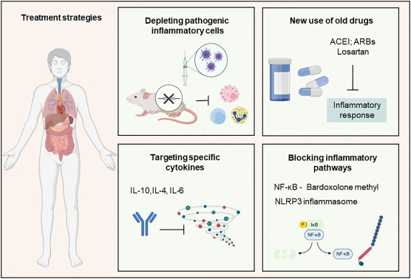
Targeting inflammation to improve kidney repair
Infusion of IL-10-transfected macrophages improved renal function in rats with IRI.
Jung. Kidney Int 2012
Impaired IL-18 processing protects caspase1-deficient mice from ischemic acute renal failure.
Melnikov VY, J Clin Invest 2001
FU, Y. Pharmacology & Therapeutics, 2022

Slide 12
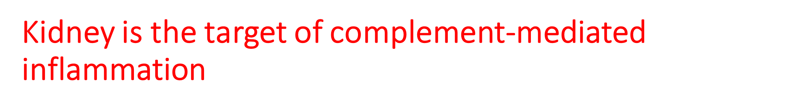

Slide 13

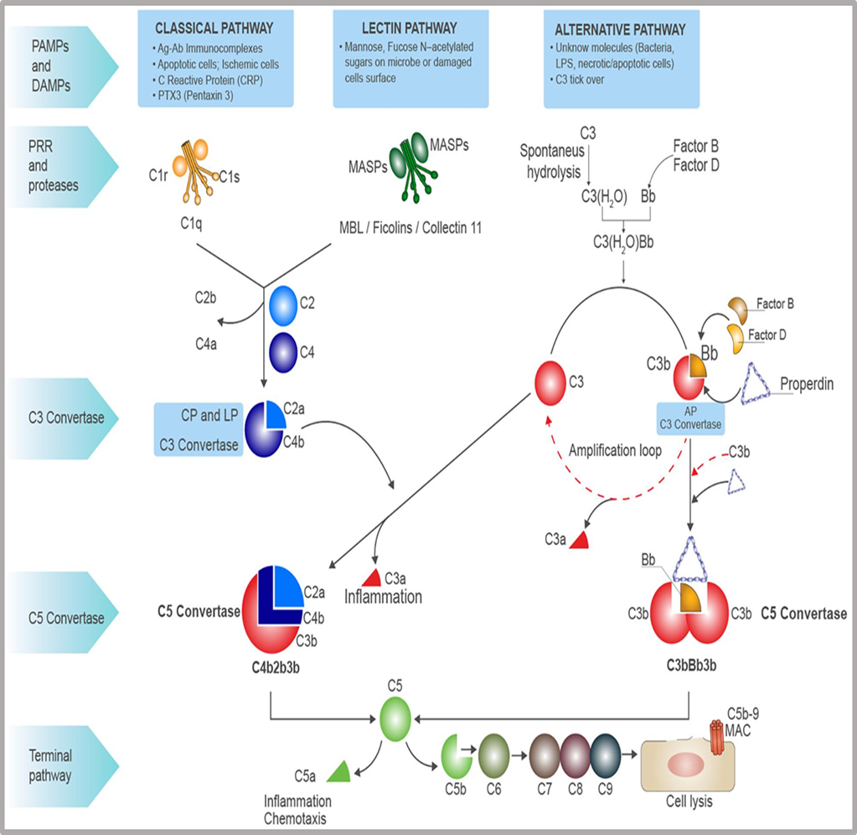

Complement system includes soluble proteins, cell surface receptors and regulatory proteins.
Complement proteins produced in liver and other tissues (kidney, etc)
Major biological roles: host defense, clearance of cellular debris and immune modulation (bridges innate and adaptive immunity )
The major goal of all three pathways:
  opsonization, release of proinflammatory anaphylatoxins (C3a and C5a) and assembly of the membrane attack complex (MAC).

Slide 14
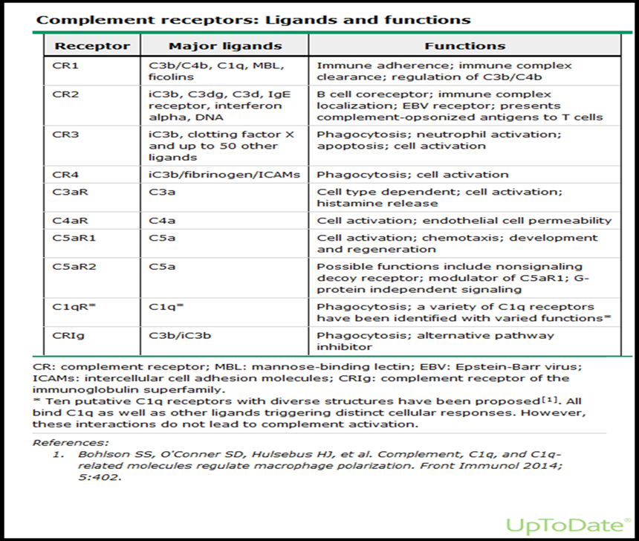
Receptors for complement activation fragments are expressed on many host cells, including immune cells, endothelial cells, and epithelial cells.
Receptors for C3a and C5a are widely distributed where they trigger the local inflammatory response (innate immunity) and also cell activation to prepare for the adaptive immune response.

Slide 15
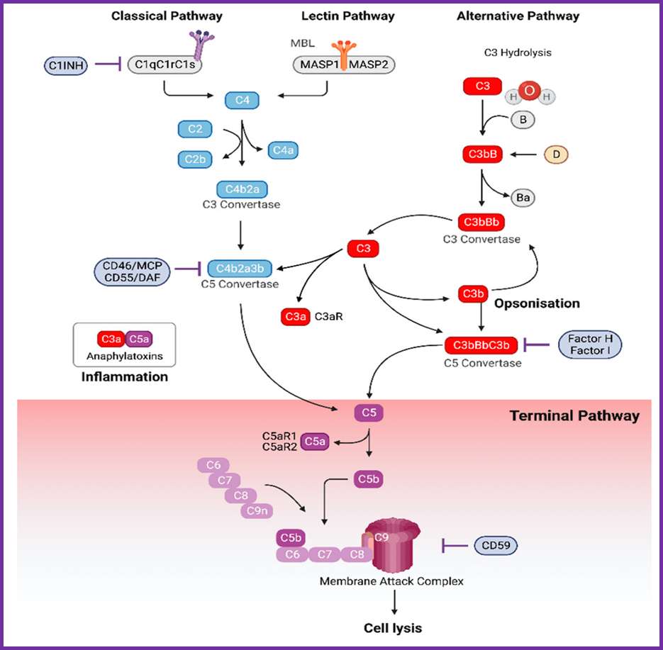
Defective complement regulation is associated with inflammatory diseases
Complement system is controlled by regulatory proteins expressed on cell surface and in plasma:
C1INH: inhibits both classical and lectin pathways
Factor H: alternative pathway regulator
Factor I: inactivates C3b (MCP/CD46 is co-factor Factor I)
CRIg (complement receptor of Ig family) blocks C convertase, inhibits alternative pathway activation
DAF/CD55: breakdown of C3 and C5 convertases
Zipfel PF. Nat Rev Immunol 2009

Slide 16
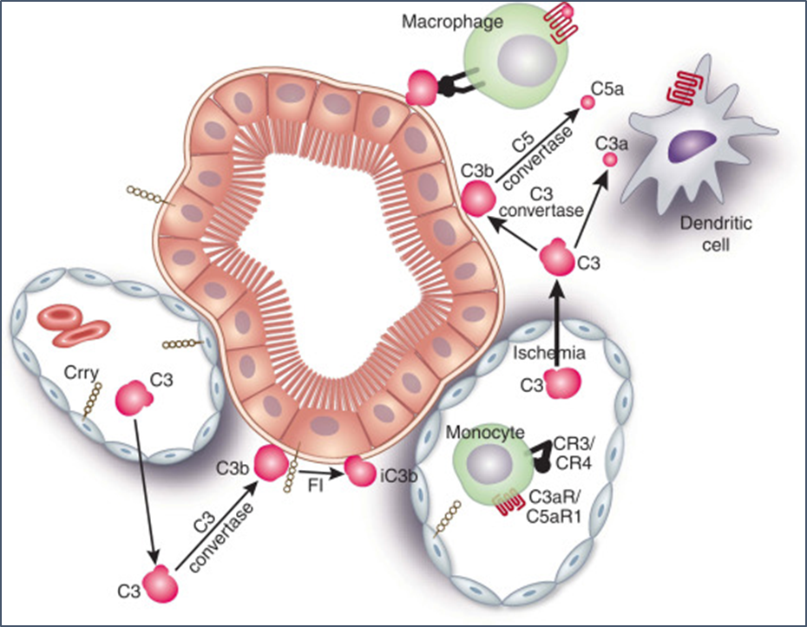
In AKI, complement activation primarily occurs within tubulointerstitium and peritubular capillaries
Complement activating proteins concentrated in glomerular capilleries due to decreased filtration
Acidic environment and ammonia synthesis promote alternative pathway activation, and may also play role in the progression of CKD.
Inflammatory environment is effective initiator of alternative pathway and excessive C3 production.
Nath KA, et al. J Clin Invest 1985
Brar JE, Quigg RJ. Kidney Int 2014

Slide 17
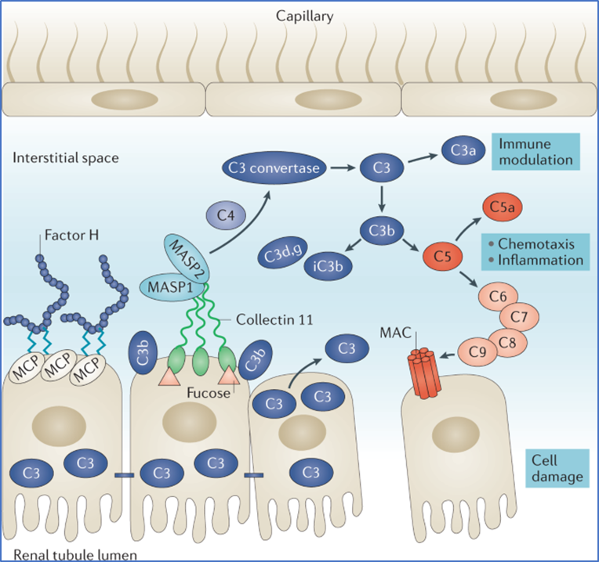
Complement Activation Pathways in ischemic AKI
Important role of alternative pathway:
(C3 breakdown increased & loss of regulatory proteins)
In contrast to C4-/- mice, mice lacking C3 (C3-/-) are protected from IRI.
Zhou Wet al . J Clin Invest 2000
Factor B -/- mice have improved protection from IR Injury and sepsis-AKI.
  Thurman JM. J Immunol 2003
  Zou L. J Immunol 2013
C3d deposits were demonstrated on RTE cells in human AKI biopsies.
Thurman JM. Kidney Int 2005
Ischaemic stress induces the upregulation of fucose and the basolateral secretion of collectin 11 in renal tubule cells^{48,49}. In the presence of locally produced complement components or upon reperfusion, mannan-binding lectin serine protease 1 (MASP1) and MASP2 bind to collectin 11 and initiate the lectin pathway of complement activation leading to the release of anaphylatoxins and a destructive inflammatory response that may ultimately result in the formation of the membrane attack complex (MAC) and cell damage. This response is further fuelled by C3, which is locally synthesized in the renal tubular cells in response to ischaemia⁵¹, and by the ischaemia-induced loss of complement regulators such as membrane cofactor protein (MCP; also known as CD46) and factor H, which facilitates complement activation and deposition, cell death and acute kidney injury.
Collectin 1 (Cl-11) released from ischemic RTE cells and binds L Fucose expressed on cell surfaces.
Lectin pathway activation further amplified through alternative pathway via cleavage of C3.
Farrar Ca. J Clin Invest 2016

Slide 18
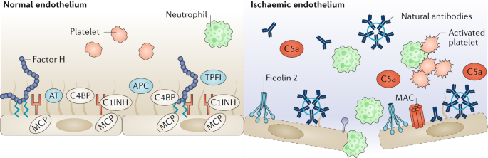
Healthy endothelial cells control complement activation on cell surface effectively by regulatory proteins.
During IR there is breakdown of endothelial glycocalyx and loss of regulatory proteins
inflammatory responses and coagulation increased
The normoxic endothelium is protected by the glycocalyx, which has an affinity for and binds the fluid-phase regulators of the complement system C1 inhibitor (C1INH), factor H and C4b-binding protein (C4BP) as well as the coagulation inhibitors antithrombin (AT), tissue factor pathway inhibitor (TFPI) and activated protein C (APC). The endothelium also expresses membrane cofactor protein (MCP; also known as CD46) which inhibits C3 and C5 convertases. The combined effect of these regulators means that the normoxic endothelium is anti-inflammatory and antithrombotic. During ischaemia and reperfusion, the endothelium becomes activated by cytokines and/or complement activation products such as the membrane attack complex (MAC), resulting in the breakdown of the glycocalyx and subsequent loss of regulators of the complement and coagulation systems. In this setting complement activation can be driven by molecules such as ficolin 2 and natural antibodies, resulting in the formation of complexes between activated platelets and polymorphonuclear leukocytes (PMNs) such as neutrophils. Activated PMNs bind to the endothelial cells and migrate through the endothelium into the parenchyma, thereby aggravating the inflammatory response.
C3-, C5-, C6- deficient transgenic mice are protected againts IR injury.
  Thurman JM. J Immunol 2003

Slide 19
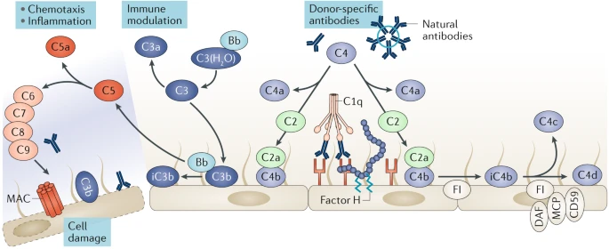
Donor-specific anti-HLA antibodies bind to their targets on the endothelial cells of the graft and trigger activation of the classical pathway of complement.
This activation is further amplified by the alternative pathway which ultimately leads to formation of the membrane attack complex (MAC).
During antibody-mediated rejection, natural antibodies, for example antibodies against blood group antigens or donor-specific anti-HLA antibodies bind to their targets on the endothelial cells of the graft and trigger activation of the classical pathway of complement via assembly of the C3 convertase C4bC2a on the endothelium. This activation is further amplified by the alternative pathway via formation of the C3 convertase C3bBb, which ultimately leads to formation of the membrane attack complex (MAC). Complement activation is counteracted by the cell-bound regulators complement-decay accelerating factor (DAF; also known as CD55), membrane cofactor protein (MCP; also known as CD46) and CD59 glycoprotein, as well as by factor H, which is present in the blood and on the glomerular basement membrane and inhibits the activation of the alternative pathway. FI, factor I.

Slide 20
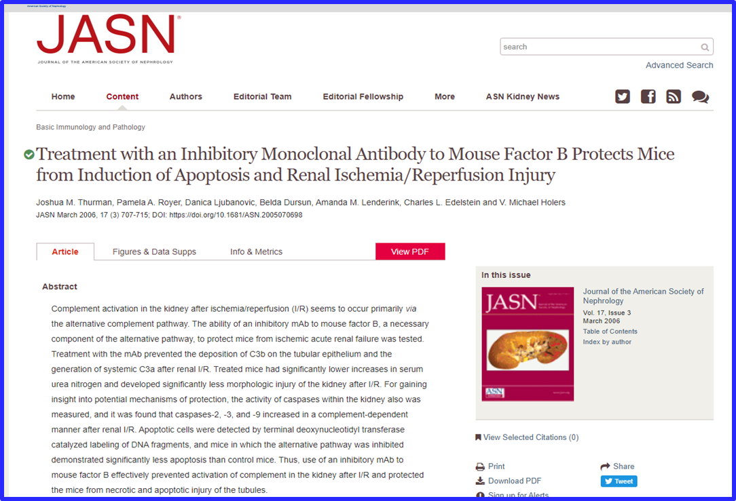
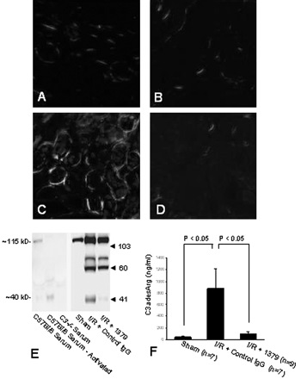
Alternative pathway blokage (mAb 1379 to mouse factor B, necessary component of alternative pathway ) prevented generation of systemic C3a and deposition of C3b on tubular epithelium after IR injury , provided functionally and morphologically less AKI ( caspase-2,3-9 mediated tubular apoptosis and necrosis prevented).

Slide 21
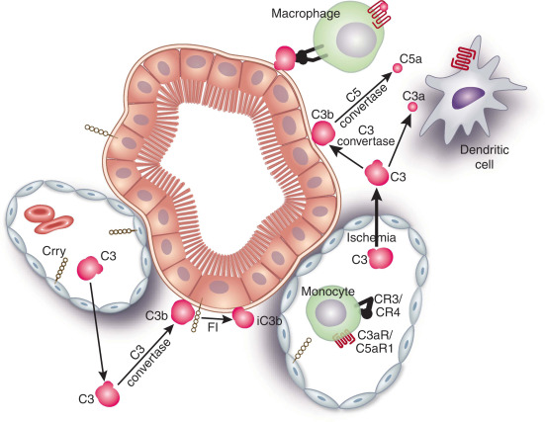
Complement activation in the tubulointerstitium: AKI, CKD, and in between
Rodent complement regulator Crry ( similar to MCP in humans) is present in renal endothelial and epithelial cells.
Normal polarization of Crry is lost in ischemia leading to unrestricted alternative pathway activation.
Crry-/- mice are more susceptible to IR than WT mice.
Thurman JM, J Clin Invest 2006
Crry-/- C3-/- kidneys transplanted into WT mice:
  acute activation of plasma derived C3 led to AKI and then CKD within weeks. Bao L. JASN 2007
Figure 1. Schematic view of the renal cortical tubulointerstitium. Crry is present in the basolateral aspects of tubular cells and the peritubular endothelium. C3 is abundantly present in plasma and accesses the wide interstitial space. There, activation of the alternative pathway, in part or wholly by local ammonia, can generate C3b, which can bind to the basolateral aspects of tubules. Under normal conditions, this is inactivated to iC3b by factor I (FI) with a suitable cofactor such as Crry or factor H. Following ischemia–reperfusion, there is likely greater access of C3 and C5 to the interstitial space along with altered polarization of Crry. In this setting, the balance is tipped toward productive C3 and C5 activation, with generation of active complement fragments. These can lead to inflammation with extrinsic and intrinsic mononuclear cells (macrophages and dendritic cells), and direct cellular injury.
Complement activation results in C3aR activation on monocytes/macrophages and proliferation of resident dendritic cells.
Chaves LD. PlosOne 2014
Brar JE, Quigg RJ. Kidney Int 2014

Slide 22
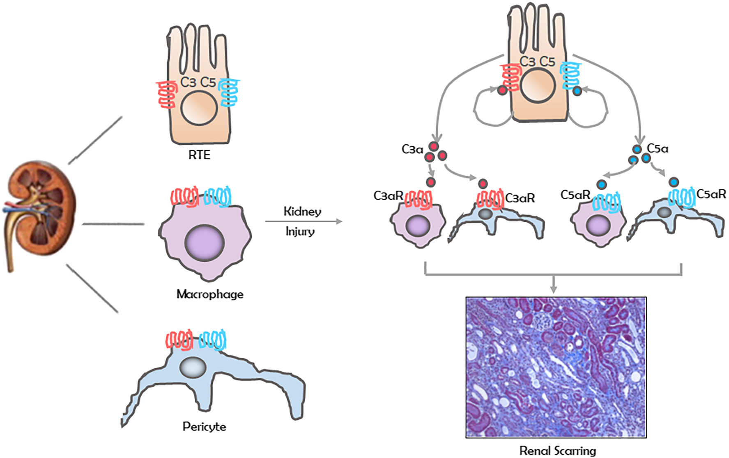
Role of intracellular complement activation in kidney fibrosis
Crry-/- C3-/- kidneys tranplanted into hosts lacking C3ar1 and C5a1r led to reduced TI inflammation and fibrosis
. Bao L. Kidney Int 2011
Blockade of C3ar1 and/or C5ar1 protects against IRI and immune cell infiltration
Peng Q. JASN 2012
Current data indicate both renal resident and infiltrating immune cells contribute to IR injury.
Kidney injury enhances production of complement components C3 and C5 by renal tubular epithelial cell (RTE). Processed fragments of these C3a and C5a ligand their cognate receptors C3a (C3ar1) and C5a₁ (C5ar1) on tissue macrophages and pericytes to drive renal fibrosis
Portilla D, Xavier S. Br J Pharmacol 2021

Slide 23
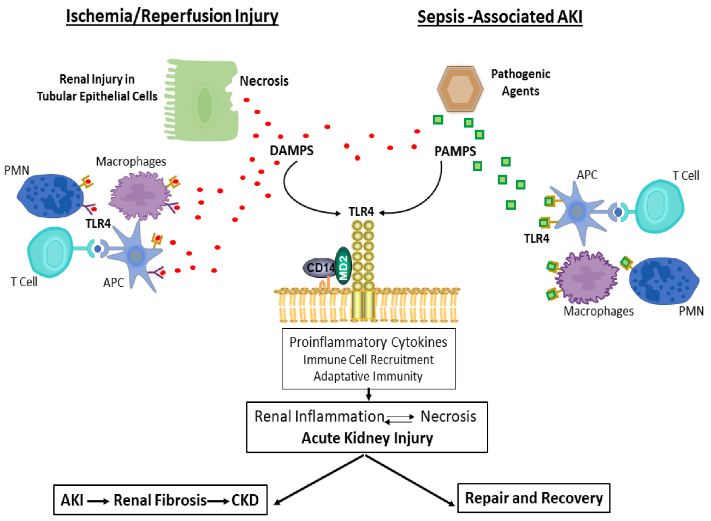
Bi-directional cross talk between TLRs, complement and cytokines
Toll-like receptors (TLRs) are a family of pattern recognition receptors (PRRs) in the first line defense system widely expressed on leukocytes and TEC
TLR induce expression of complement components
Complement receptors regulate TLR-dependent responses.
TLR prime cells to undergo pyroptosis (programmed cell death), cellular lysis and proinflammatory cytokine release (pro-IL-1β, IFN-α/β and NF- κB dependent cytokines)
Proinflammatory cytokine events transmitted systematically and may lead to extended inflammation and distant organ dysfunctions.
Valles PG. Int J Mol Sci 2023

Slide 24
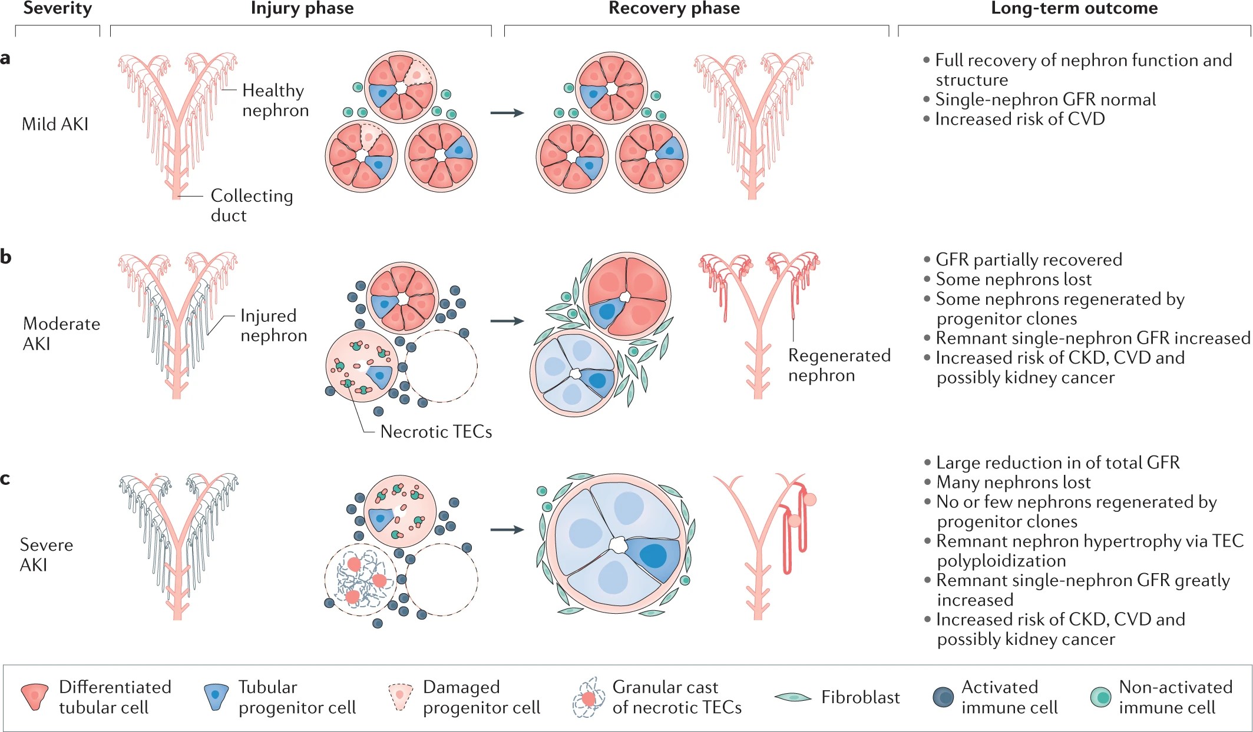
After AKI, the kidney has a remarkable capacity for repair, involving dedifferentiation, proliferation, and redifferentiation of tubular epithelial cells.
However, when injury is severe or persistent, the repair is incomplete or maladaptive and may lead to chronic kidney disease (CKD)
a | Mild acute kidney injury (AKI), defined by a transient decline in urinary output or excretory function, involves no or minimal kidney cell necrosis or loss. Precedent and subsequent nephron numbers remain identical and no persistent adaptive cellular responses are necessary. In the long term, the risk of cardiovascular disease (CVD) is somewhat increased, which may also depend on the underlying cause of AKI. b | Whenever AKI is associated with kidney cell or tubule necrosis, the affected cells are irreversibly lost during the phase of acute necroinflammation, as indicated by activated immune cells in the interstitial compartment. Renal progenitor cells are more resistant to death and their clonal expansion may facilitate the structural and functional recovery of some injured nephrons. Nephrons in which injured segments do not recover undergo atrophy, are irreversibly lost and are replaced by fibrous tissue that stabilizes the structural integrity of remnant nephrons. Resulting hyperfiltration requires an increase of the functional capacity of remnant nephrons achieved through an increase in their dimensions, with tubular epithelial cells (TECs) undergoing polyploidization, indicated by an increased size of cytoplasm and cell nuclei. Depending on the number of remnant nephrons, their capacity for adaption (kidney reserve), and filtration load (dependent on body weight, fluid intake, diet and others), glomerular filtration rate (GFR) can return to baseline. This status already qualifies as CKD, even if GFR returns to baseline. The adaptive changes of CKD imply a higher risk of CVD and possibly kidney cancer, and the irreversible loss of nephrons reduces kidney lifespan. c | When severe AKI involves extensive tubule necrosis, the consequences on nephron number are substantial. Tubule recovery occurs only in those nephrons with surviving progenitor cells. Adaptation to filtration and metabolic demands results in large increases in the dimensions of the few surviving nephrons (megalonephrons). Such adaptations frequently exceed the adaptive capacity of podocytes, leading to secondary focal segmental glomerulosclerosis and subsequent loss of the remnant nephrons (that is, progressive CKD). Cellular adaptation-related polyploidization and senescence, as well as nephron loss-related scarring, drives interstitial fibrosis and progressive kidney atrophy. These adaptive changes strongly increase the risk of CVD and possibly kidney cancer. Kidney lifespan is drastically reduced and some patients remain on kidney replacement therapy
Kellum JA et al. Nature Reviews Disease Primers 2021

Slide 25
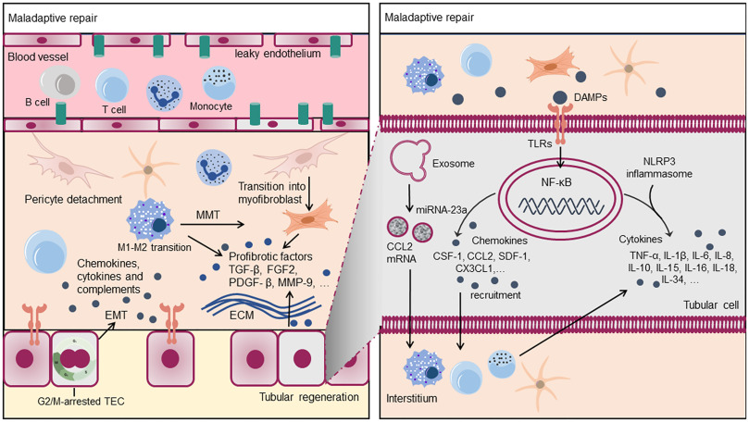
Maladaptive Kidney Repair
Maladaptive kidney repair involves multiple cell types and multifactorial processes, of which inflammation is a key component.
In the process of inflammation, there is a bidirectional interplay between kidney parenchymal cells and the immune system.
Fig. 2. Immune cells and renal intrinsic cells in maladaptive kidney repair.
Immune cells, including T cells, B cells, neutrophils, monocytes, etc., are normally localized in renal microvessels. During kidney injury, these immune cells adhere to activated endothelial cells as a result of vascular damage and the chemoattractant activity of chemokines. Some immune cells migrate into the renal interstitium and undergo phenotypic transitions, such as the M1-M2 transition of macrophages. On the one hand, the immune cells may secrete pro-fibrotic growth factors or transform into myofibroblasts. On the other hand, they secrete chemokines, cytokines, and complements, thereby aggravating the cycle of renal inflammation. Meanwhile, tubular regeneration occurs during this process. Specifically, receptors on TECs, such as TLRs, receive paracrine signals such as DAMPs, activating the transcription of intracellular inflammatory factors or chemokines and further inducing inflammatory cells to enter the renal interstitium. Exosomes produced by TECs can also mediate intercellular crosstalk and exacerbate inflammation in maladaptive kidney repair.
FU, Y. Pharmacology & Therapeutics, 2022

Slide 26
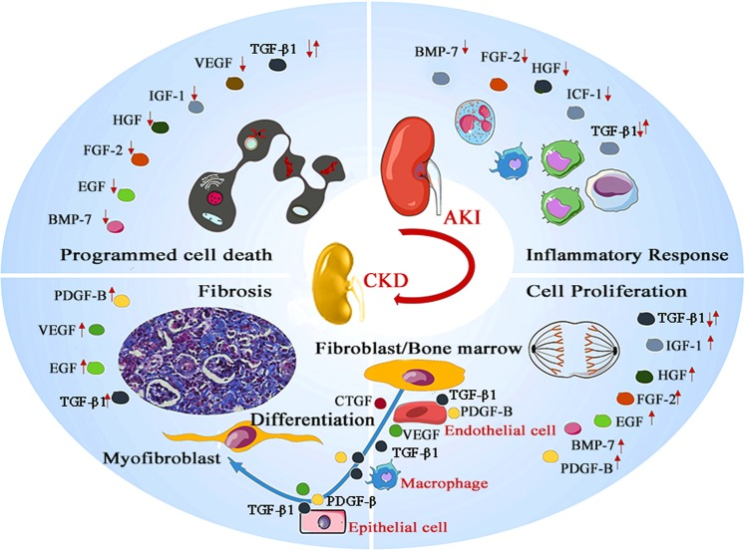
Effect of Growth Factors on AKI and AKI-CKD Transition
Many growth factors (BMP-7, EGF, FGF-2, HGF, IGF-1, VEGF, and TGF-β1) involved in the acute injury phase, inflammatory response (cytokine production and immune cell recruitment) and programmed cell death
After injured epithelial cells fail to regenerate through differentiation, fibrosis is induced leading to CKD
  overproduction of growth factors (TGF-β1, PDGF, and FGF)stimulates fibroblast/pericyte proliferation, transdifferentiation of tubular epithelial cells, endothelial cells, macrophages, and ECM production.
Effect of growth factors on AKI and AKI-CKD progression.Many growth factors, such as BMP-7, EGF, FGF-2, HGF, IGF-1, VEGF, and TGF-β1, are involved in the programmed cell death of endothelial or epithelial cells in the acute injury phase. BMP-7, FGF-2, HGF, TGF-β1, and IGF-1 participate in the regulation of the inflammatory microenvironment that is responsible for cytokine production and immune cell recruitment. TGF-β1 is a double-edged growth factor. In addition, TGF-β1 exerts anti-inflammatory effects, and TGF-β1 overproduction leads to acute tubular injury. After injured epithelial cells fail to regenerate through differentiation, fibrosis is induced as a self-limiting repair process to limit damage. In this stage, overproduction of growth factors such as TGF-β1, PDGF, and FGF induces fibroblast/pericyte proliferation, transdifferentiation of tubular epithelial cells, endothelial cells, and macrophages, and extracellular matrix production, leading to CKD. Concurrently, abnormal synthesis of PDGF-B, VEGF, EGF, and TGF-β1 has a negative impact on endothelial integrity and causes capillary rarefaction, accelerating renal fibrosis.
Signal Transduct Target Ther. 2020

Slide 27
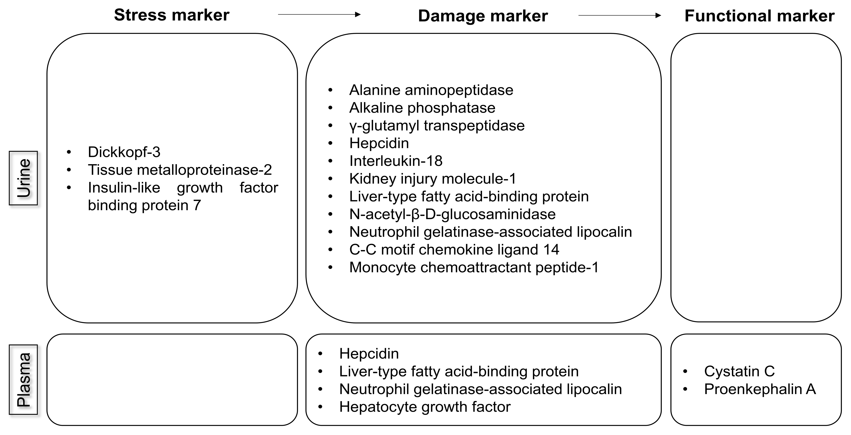
AKI biomarkers from the Acute Disease Quality Initiative Consensus Conference-(ADQI-23)
The urinary markers tissue metalloproteinase-2 (TIMP-2) and insulin-like growth factor binding protein 7 (IGFBP7):
recently discovered inducers of G1 cell-cycle arrest and are key stress biomarkers of AKI,
considered superior to known damage biomarkers such as kidney injury molecule-1 (KIM-1) and neutrophil gelatinase-associated lipocalin (NGAL)
urinary biomarker [TIMP-2] × [IGFBP7] approved in the United States and Europe
Three types of biomarkers exist based on the recommendations on AKI biomarkers from the Acute Disease Quality Initiative Consensus Conference (Figure 1). Stress markers reflect cell stress, which may resolve or become aggravated [7]. A damage marker indicates structural damage that may or may not result in a reduction in renal function [7]. Functional markers correlate with alterations in glomerular filtration [7]. Considering these biomarkers together can offer a precise approach beyond measuring the SCr level or UO alone, and may suggest the most accurate diagnostic and therapeutic methods.

Slide 28
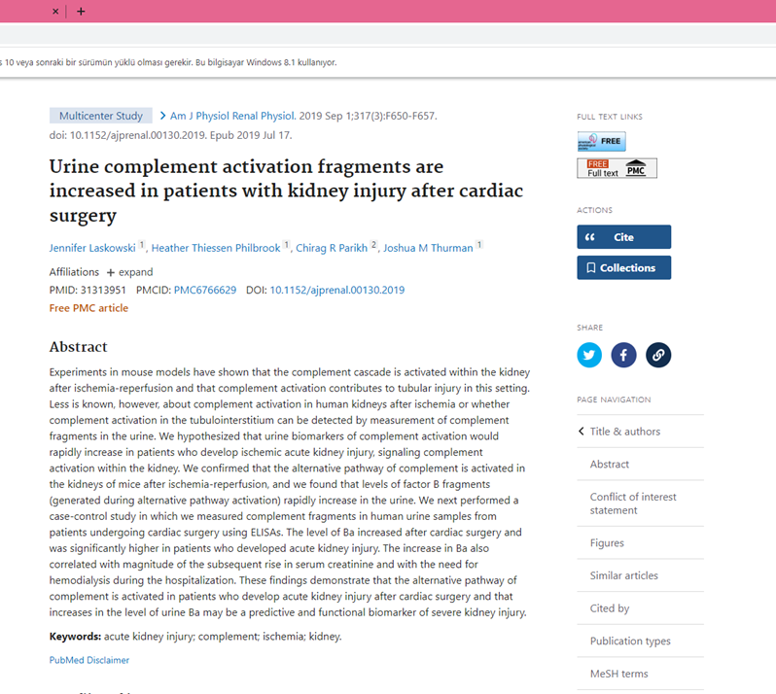
Evidence of complement activation in urine sample in human AKI
Case-control study , AKI after cardiac surgery:
  Urine factor Ba (alternative pathway activation) increased correlated with AKI severity, and preceded the rise in Scr.
  Urine Ba may be a predictive or functional biomarker??

Slide 29
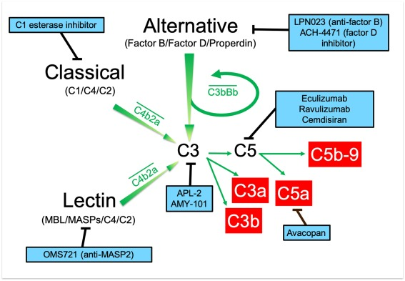

Theraputic agents blocking complement system
Eculizumab and ravilizumab, monoclonal antibodies to C5, aprroved for treatment of aHUS
  safe end effective in conjunction with meningocococal vaccination and/or prophylactic antibiotics).
Avacopan, C5ar antagonist, approved for treatment of vasculitis.
Factor B inhibitor, Factor D inhibitor and C3 inhibitor are being tested on aHUS, C3G, PNH.

Slide 30

Complement targeted agents for prevention of rejection in kidney transplantation
C1INH (recombinant C1 fraction inhibitor, classic and lectin pathways inhibitor) was shown to be protective against IR injury and chronic allograft fibrosis in animal and ex vivo studies.
Delpech PO Transl Med 2016

Slide 31
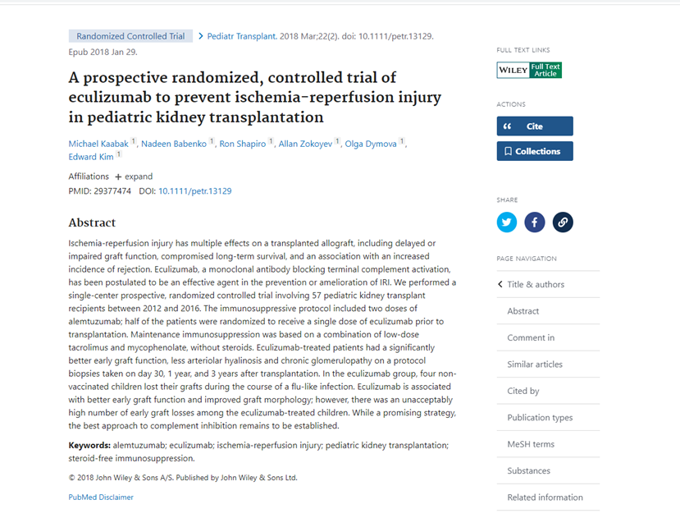
57 pediatric kidney transplantation recipients randomized to a single dose of eculizumab prior to KTx:
  Better early graft function
  Lower arteriolar hyalinosis at subsequent biopsies
  4 patients developed flu-like illness within 60 days and lost allografts .
Peritransplant eculizumab was well tolerated but did not reduce the incidence of delayed graft function (DGF) in adult deceased donor KTx recipients.
Schroppel B. Am J Transplant 2020

Slide 32
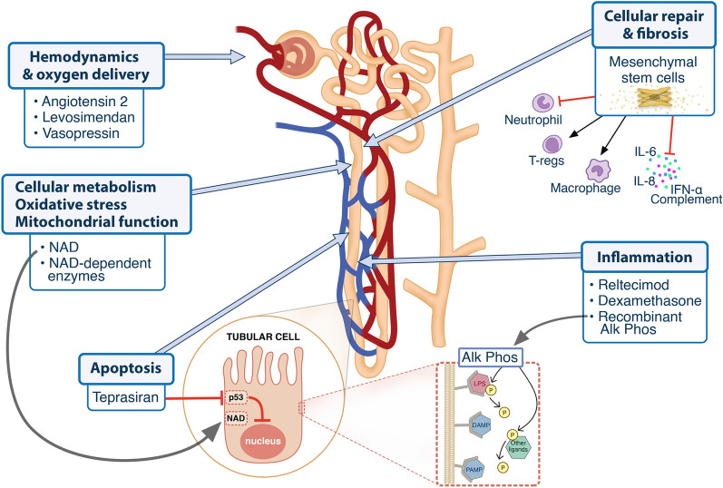
New drugs for acute kidney injury?
Levosimendan (inodilator): may be protective by improving cardiac function or glomerular afferent arteriolar dilatation.
  A meta-analysis of CPB surgery patients indicated less AKI and less use of RRT. Zhou C. AJKD 2016
  LEVOAKI Trial : results awaited
recAlkaline phosphatese: dephosphorylates PAMPs and DAMPs.
  Phase 2 trial sepsis-AKI: short term effects negative, longer term renal function and mortality significantly improved.
  Phase trial REVİVAL: results awaited.
Sirtuins :NAD-dependent enzymes in cellular energy metabolism and maintains undamaged DNA. Phase 2 RCT ongoing.
  siRNA teprasiran :Inhibits protein P53, tumor suppressor protein involved in apoptosis. Post-cardiac surgey and post-Tx: negative
Repair agents: MSC therapy, Bone-morphogenic protein (BMP-7), Hepatocyte growth factor (HGF):
  Anti-inflammatory, anti-apoptotic, anti-fibrotic, immunomodulatory, pro-angiogenic regenerative effects .
  Favorable results with HGF-mimetic, ongoing trial in cardiac surgery and kidney transplantation
  Inconsistent results with BMP-7 and MSC therapy
Selected compounds that impact known pathophysiological processes and have been studied in humans. Alk Phos alkaline phosphatase; DAMP danger associated molecular pattern; IL interleukin; IFN-α interferon alpha; LPS lipopolysaccharide; NAD Nicotinamide adenine dinucleotide; T-regs regulatory T-cells; PAMP pathogen associated molecular pattern
Pickkers P et al Intensive Care Med. 2022

Slide 33
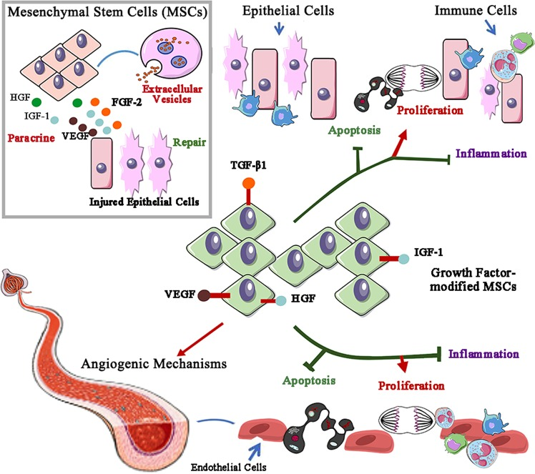
Targeted Therapies in AKI
MSC can migrate to areas of injury and modulate local injury response by paracrine and and ESV delivered release of soluble factos (HGF, IGF, VEGF, FGF etc).
  MSC modified by HGF was shown to attenuate IR injury.
MicroRNA&Ektracellular Vesicles produced and releasd by cells:
  Membrane-bound vesicles (exosomes and microvesicles)
  contain mRNA, miRNA, surface receptors and protein that can program the activites of other cells (gene expression).
  Endothelial-progenitor derived miR-1792 protective in IRI
  Chiba T. JASN 2021
Growth factors and stem cell-based AKI therapy. Extracellular vesicle (EV)-delivered and paracrine factors such as HGF, IGF-1, VEGF, and FGF-2 from mesenchymal stem cells contribute to repair after renal injury. More importantly, stem cells modified by growth factors, including VEGF, TGF-β1, and IGF-1, efficiently protect against AKI by decreasing apoptosis and the inflammatory response and promoting tubular epithelial and endothelial cell proliferation. VEGF-modified stem cells change capillary density via angiogenic mechanisms to attenuate renal ischemia-reperfusion injury.
Signal Transduct Target Ther. 2020

Slide 34
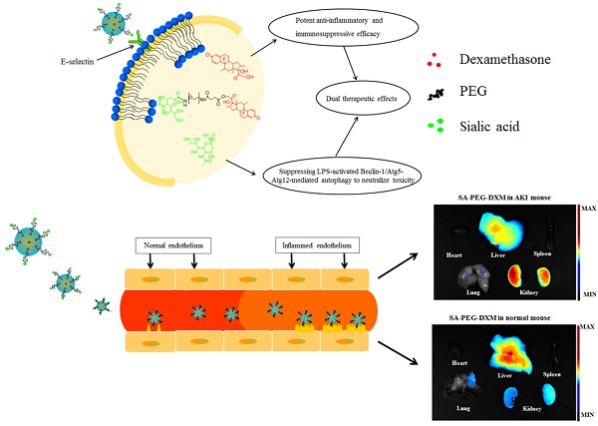
Nanotechnology for specific drug delivery in AKI
Exosome is a promising therapeutic vector to target specific drug delivery to the site of injury.
  Macrophage-derived micro-vesicles packed with dexamethasone effective against renal inflammation and fibrosis. Tang T. et al. Theranostics 2019
  Exosomes loaded with IL-10 showed protective effects against renal IR Injury. Tang T. Science Advances 2020
Use of carrier systems in the renal drug delivery and strategies for the diverse target sites
Hu, JB Theranostics 2017

Slide 35


Conclusion
AKI is an inflammatory syndrome with short and long-term serious complications including CKD, distant organ disease and mortality.
Due to its multifactorial and complex nature and inability to spesifically identify AKI-phenotypes, there is lack of approved therapies in humans.
Advances in understanding AKI pathogenesis, biomarker development and a spectrum of targeted therapies may improve prognosis in AKI.

