Slide 1
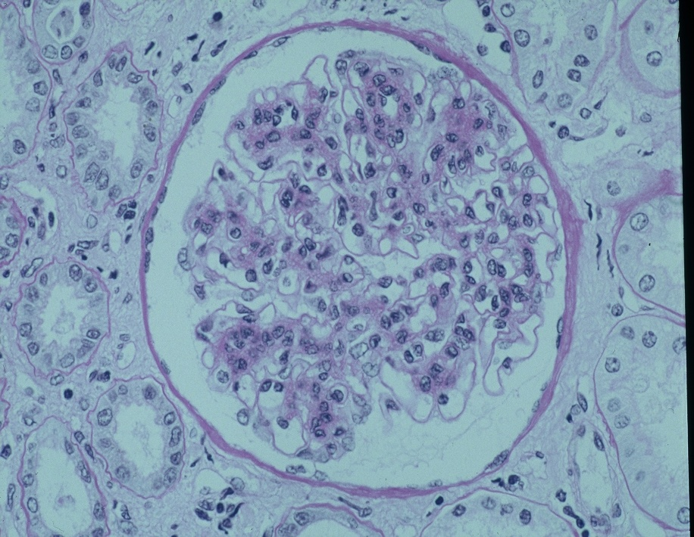
Data from the registry of IgAN in Greece
Δημοσιεύτηκε στο Clin Kidney J 2018; 11 (1): 38-45.

Slide 2
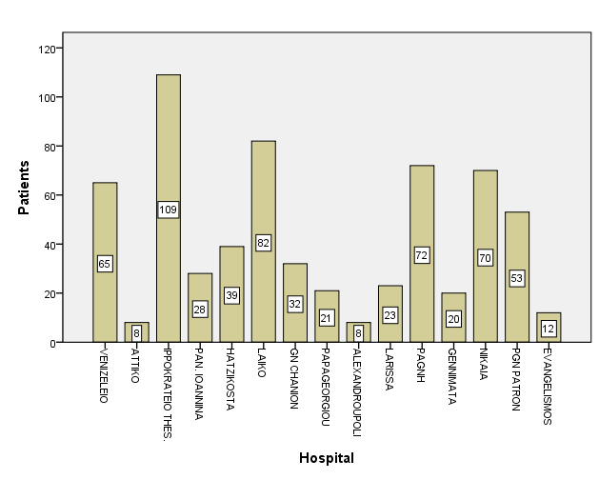
Registry IgAN in Greece
642 patients

Slide 3
IgA nephropathy in Greece
Inclusion criteria
457 patients
All patients with biopsy proven primary IgAN performed between 1990 and 2010 in the larger Departments of Nephrology of the country with a follow up period of at least 12 months were included in the analysis

Slide 4
Clinical and biochemical features of all patients at presentation
Number of patients (n) | n= 457
Gender (M/F) n (%) | 303/154 (66.3/33.7%)
Age (years) | 41.29 ± 14.32
Baseline Scr (mg/dl) | 1.48 ± 1.04
Urine protein (g/24h) | 1.7 ± 2.0
e- GFR (MDRD) ml/min/1.73 m² | 64.09 ± 30.7
Arterial hypertension (BP>140/90mmHg) n (%) | 256 (56%)
Microscopic hematuria n (%) | 403 (88.2%)
Macroscopic hematuria n (%) | 142 (31.1%)
Acute kidney injury n (%) | 30 (6.6%)
Nephrotic Range Proteinuria n (%) | 56 (12.3%)

Slide 5
Histological features of all patients at presentation
Histological features (Oxford classification)
MEST score n (%) | 198 (43.3%)
Mesangial hypercellularity (M0/M1) | 66/132
Endocapillary hypercellularity (E0/E1) | 148/50
Segmental glomerulosclerosis (S0/S1) | 90/108
Tubular atrophy/interstitial fibrosis (T0/T1/T2) | 140 /49//9

Slide 6
Ιστολογική Ταξινόμηση
(Oxford classification)
ΙΣΤΟΛ. ΑΛΛΟΙΩΣΕΙΣ | ΕΚΤΙΜΗΣΗ |  | ΒΑΘΜΟΛΟΓΙΑ
ΜΕΣΑΓΓΕΙΑΚΗ ΥΠΕΡΠΛΑΣΙΑ | < 4 κύτταρα | 0 | Μ.Ο. βαθμολογίας σε όλα τα σπειράματα : Μ0 αν η μέση βαθμολογία είναι <0,5 Μ1 αν η μέση βαθμολογία είναι >0,5
 | 4-5 μεσαγ. κύτταρα | 1
 | 6-7 μεσαγ. κύτταρα | 2
 | >8 κύτταρα | 3
ΕΣΤΙΑΚΗ ΣΠΕΙΡΑΜΑΤΟ ΣΚΛΗΡΥΝΣΗ | Παρούσα | 1 | S1
 | Απούσα | 0 | S0
ΕΝΔΟΤΡΙΧΟΕΙΔΙΚΗ ΥΠΕΡΠΛΑΣΙΑ | Παρούσα | 1 | E1
 | Απούσα | 0 | E0
ΣΩΛΗΝΑΡΟΔΙΑΜΕΣΗ ΙΝΩΣΗ | 0-25% | 0 | T0
 | 26-50% | 1 | T1
 | >50% | 2 | T2

Slide 7
Registry of IgAN in Greece
End-points
Primary end-points
Development of end stage renal disease (ESRD) and/or doubling of baseline Scr
Secondary end-points
Remission of proteinuria to <0.5g/24h

Slide 8
Registry of IgAN in Greece
Parameters related to the development of primary end points (after 10yrs of observation)

Slide 9
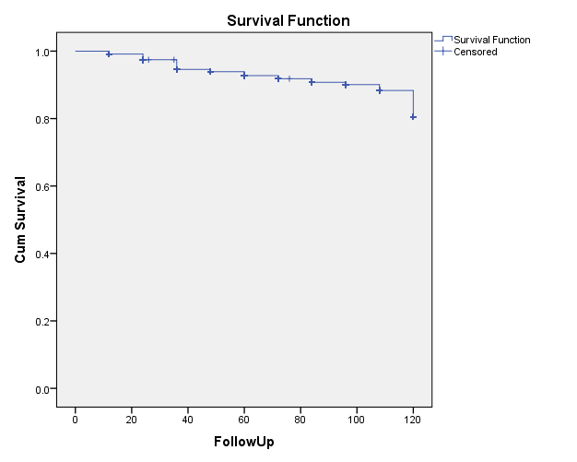
Cumulative renal survival free from the end points of end stage renal disease (ESRD) in all patients
The overall 10-year renal survival was 90.8%.
ESRD developed in 42 (9.2%)

Slide 10
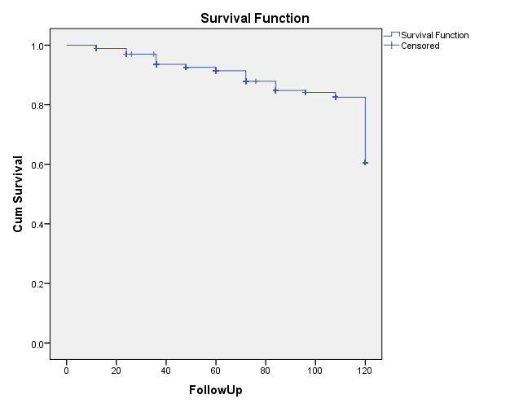
Cumulative renal survival free from the end point of doubling of baseline serum creatinine (Scr) in all patients
The overall 10-year renal survival was 90.8%.
Doubling of baseline Scr developed in 67 (14.7%) patients,

Slide 11
 | ESRD |  |  | Doubling of Serum baseline Creatinine
 | Mean ± SD or no. (%) | p-value | HR CI 95% | Mean ± SD or no. (%) | p-value | HR CI 95%
Baseline serum creatinine (mg/dl) | 2.41 ± 1.3 | 0.000 | 0.118 (0.052- 0.265) | 1.96 ± 1.2 | 0.000 | 0.387 (0.238- 0.631)
Arterial hypertension at diagnosis n (%) | 35 (87.5) | 0.000 | 0.173 (0.068- 0.440) | 50 (72.5) | 0.001 | 0.397 (0.226- 0.697)
Persistent urine protein >0.5g/24h over the follow up n (%) | 37 (92.5) | 0.002 | 0.143 (0.034- 0.591) | 58 (84.1) | 0.014 | 0.424 (0.210-0.858)
Presence of segmental glom/sclerosis (S1- Oxford cl.) n (%) | 19 (47.5) | 0.009 | 0.263 (0.089- 0.777) | 25 (36.2) | 0.003 | 0.284 (0.116- 0.692)
Presence of tubular atrophy/interstitial fibrosis (T1/T2) n (%) | 15 (37.5) | 0.000 | 0.106 (T1) (0.035- 0.339) 0.525 (T2) (0.176- 1.564) | 17 (24.6) | 0.001 | 0.224 (T1) (0.085- 0.589) 0.710 (T2) (0.251- 2.002)

Slide 12
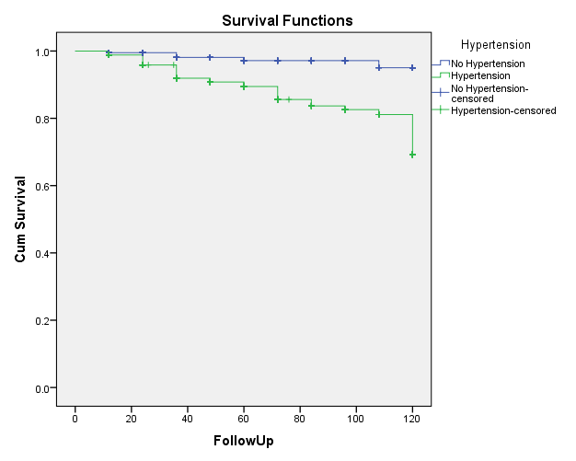
Arterial hypertension at diagnosis and survival free from the end point of ESRD
p=0.000

Slide 13
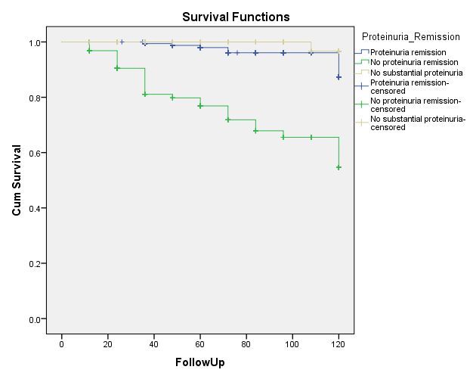
Survival free from the end point of ESRD in patients with no substantial proteinuria, patients with remission and those with no remission of proteinuria
p=0.002

Slide 14
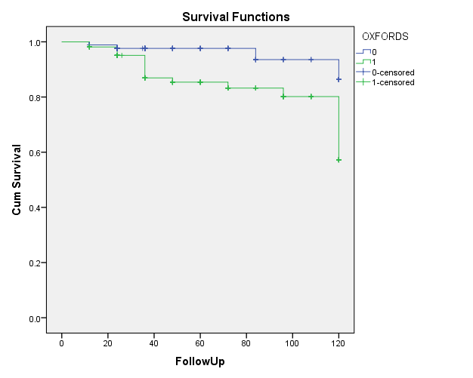
Segmental glomerulosclerosis (S0/S1) in the kidney biopsy and survival free from the end point of ESRD
p=0.009

Slide 15
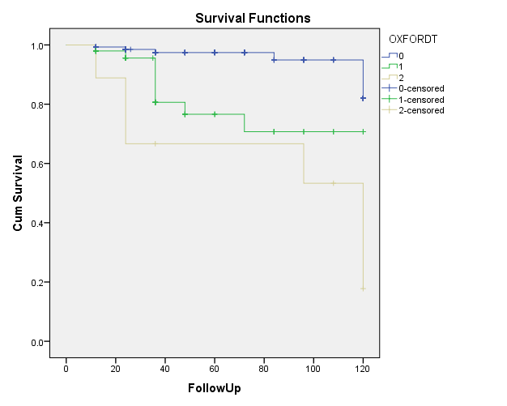
Tubular atrophy/interstitial fibrosis (T0/T1/T2) in the kidney biopsy and survival free from the end point of ESRD
p=0.000

Slide 16
Registry of IgAN in Greece
Therapeutic regimens
No immunosuppressive treatment (n=262)
Patients with normal renal function and proteinuria <1g/24h (n= 225)
Out of them 5 developed ESRD (2.2%) over the follow up period
Patients with baseline Scr>2.5mg/dl and/or severe glomerulosclerosis and tubulointerstitial fibrosis (n= 37)
Out of them 13 developed ESRD (35%) over the follow up period

Slide 17
Registry of IgAN in Greece
Therapeutic regimens
Prednisolone daily per os : n=76
Methylprednisolone IV pulse for three consecutive days
on 1st, 3rd and 5th month of treatment followed by oral prednisolone every other day: n=57
Prednisolone po plus azathioprine : n=32
Prednisolone po plus MMF: n=9
Patients with normal or impaired renal function at diagnosis and persistent proteinuria >1g/24h for more than 6 months
Corticosteroids and cyclophosphamide: n=21
Patients with a rapidly progressive course and/or crescents in the renal biopsy

Slide 18
Clinical features of patients treated by steroids or steroids plus azathioprine at presentation
 | Oral prednisolone daily | IV methylprednisolone and prednisolone on alt day | Prednisolone + Azathioprine | p-value
Number of patients | n=76 | n= 57 | n=32
Gender (M/F) | 50/26 | 43/14 | 25/7 | NS
Age (years) | 39.4 ± 15.3 | 42.36 ± 13.25 | 44.47 ± 10.68 | NS
Baseline Scr (mg/dl) | 1.87 ± 1.7 | 1.37 ± 0.64 | 1.69 ± 0.78 | NS
Urine protein (g/24h) | 2.4 ± 2.8 | 2.9± 2.3 | 2.4 ± 1.3 | NS
e- GFR (MDRD) ml/min/1.73 m² | 59.2 ± 34.4 | 67.7 ± 31.5 | 50.7 ± 28.2 | NS
Arterial hypertension (BP>140/90mmHg) | n =10 | n =4 | n =3 | NS
Microscopic hematuria n: | 12 | 3 | 3 | NS
Macrohematuria n: | 2 | 1 | 0 | NS

Slide 19
Histological features of patients treated by steroids or steroids plus azathioprine at presentation
 | Oral prednisolone daily | IV methylprednisolone and prednisolone on alt day | Prednisolone + Azathioprine | p-value
Histological Characteristics (Oxford classification)
MEST score n: | 29 | 30 | 17
Mesangial proliferation (M0/M1) | 7/22 | 14/16 | 6/11 | NS
Endocapillary hyper/rity (E0/E1) | 21/8 | 22/8 | 9/8 | NS
Segmental glom/sclerosis (S0/S1) | 10/19 | 16/14 | 5/12 | NS
Tubular atrophy/interstitial fibrosis (T0/T1/T2) | 16/8/5 | 18/10/1 | 9/8/0 | NS

Slide 20
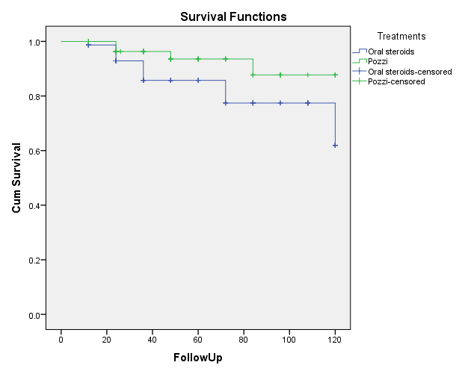
Survival free from the end point of ESRD of patients treated by either oral prednisolone daily or by IV methylprednisolone and oral prednizolone on alternate days
Out of 76 patients treated by prednisolone per os, 14 (18.4%) reached ESRD whereas out of 57 patients treated by methylprednisolone IV and then by oral prednisolone every other day, 4 (7%) reached ESRD
p=ns

Slide 21
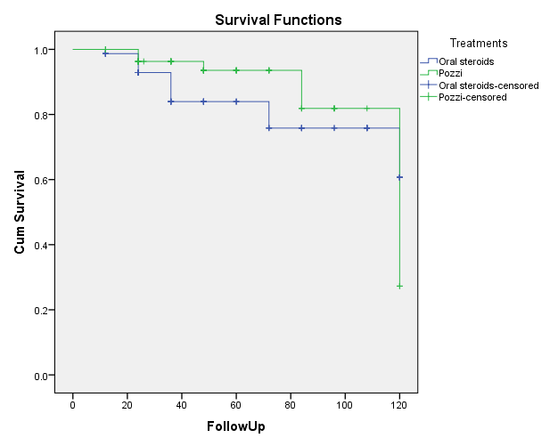
Survival free from the end point of doubling of baseline serum creatinine (Scr) of patients treated by either oral prednisolone daily or by IV methylprednisolone and oral prednizolone on alternate days.
p=ns

Slide 22
Secondary end point of remission of proteinuria in patients treated by either oral prednisolone daily or by IV methylprednisolone and oral prednizolone on alternate days
Remission of proteinuria to <0.5g/24h
In 35 of 76 patients (46%) treated by prednisolone per os
In 41 out of 57 patients (72%) treated by methylprednisolone IV followed by oral prednisolone every other day
p=0.000

Slide 23
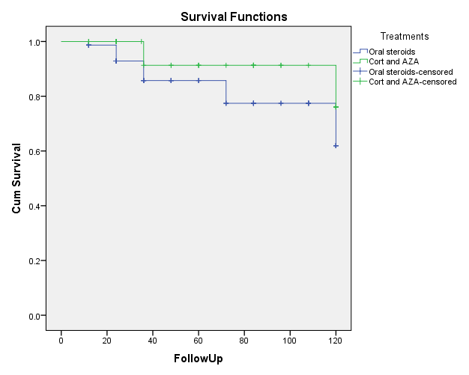
Survival free from the end point of ESRD of patients treated by either oral prednisolone daily or combination of prednisolone and azathioprine daily
No significant difference in the development of primary end points
A trend towards less frequent development of ESRD in patients treated by prednisolone and azathioprine (p=0.081)
(p=0.081)

Slide 24
Secondary end point of remission of proteinuria in patients treated by either oral prednisolone daily or combination of prednisolone and azathioprine
Remission of proteinuria to <0.5g/24h
In 35 of 76 patients (46%) treated by prednisolone per os
In 17 out of 32 patients (53%) treated by prednisolone and azathioprine
Patients treated by prednisolone and azathioprine showed more frequently remission than those treated by prednisolone per os daily
p=0.037

Slide 25
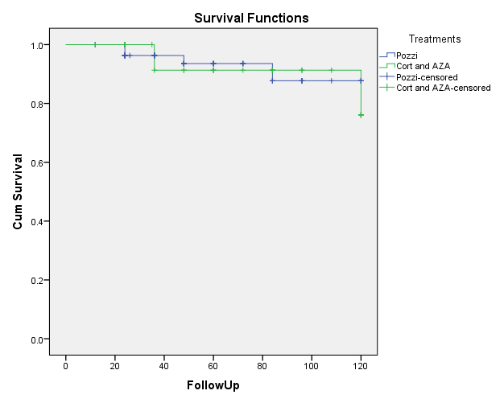
Survival free from the end point of ESRD of patients treated by either IV methylprednisolone and oral prednizolone on alternate days or combination of prednisolone and azathioprine daily
p=ns

Slide 26
Secondary end point of remission of proteinuria in patients treated by either IV methylprednisolone and oral prednizolone on alternate days or combination of prednisolone and azathioprine daily
The remission rate of proteinuria was not different between patients treated by prednisolone and azathioprine and those treated by IV methylprednisolone initially followed by oral prednisolone every other day
p=ns

Slide 27
Side effects of immunosuppressive drugs
Side effects related to immunossuppressive drugs were observed in 25 out of 195 treated patients (12.8%)
Adverse events related to corticosteroids (12%)
Osteonecrosis and/or osteopenia: n= 3
Myopathy: n=4
Glaucoma: n=2
Cushingoid: n=6
Deterioration of a bipolar disease: n= 1

Slide 28
Side effects of immunosuppressive drugs
Adverse events related to azathioprine (15.6%)
Gastrointestinal symptoms: n=2
Elevated liver enzymes: n=2
Leucopenia: n= 1
Adverse events related to MMF
Gastrointestinal symptoms: n=1
Leucopenia: n=1
Osteomyelitis: n=1
Atypia of epithelial cells of the bladder was observed in 1 patient who received corticosteroids and cyclophosphamide followed by azathioprine.

Slide 29
Ευχαριστίες
Ιπποκράτειο Θεσ/νίκης:
Α. Παπαγιάννη, Μ. Στάγκου
Λαικό:
Σ. Μαρινάκη, Α. Ταραντίνη, Ι. Μπολέτης
Κρατικό Νικαίας:
Ν. Βούλγαρη, Κ. Καπετανάκου, Σ. Ζερμπαλά, Χ. Ιατρού
ΠΓΝΗρακλείου:
Δ. Ξυδάκης, Κ. Στυλιανού, Ε. Δαφνής
Βενιζέλειο:
Δ. Ξυδάκης, Α. Παπαδογιαννάκης
ΠΓΝΠατρών:
Μ. Γερόλυμος, Π. Καλλιακμάνη
Χατζηκώστα Ιωαννίνων:
Α. Ανδρίκος,Κ. Κουλούσιος

Slide 30
Ευχαριστίες
Χανίων:
Γ. Τζανάκης, Α. Παπαδάκη
ΠΓΝ Ιωαννίνων:
Ο. Μπαλάφα, Κ. Σιαμόπουλος
ΠΓΝΛάρισας:
Π. Μακρή, Σ. Γκολφινόπουλος, Ι. Στεφανίδης
Παπαγεωργίου:
Γ. Βισβάρδης, Χ. Καλακούδης
Κρατικό Αθηνών- Γεννηματάς:
Γ. Μουστάκας, Μ. Γεωργοπούλου
Ευαγγελισμός:
Κ. Τσούνης, Θ. Αποστόλου, Ν. Νικολοπούλου
ΠΓΝΑλεξανδρούπολης:
Π. Κρίκη, Σ. Παναγούτσος, Π. Πασαδάκης
Αττικό:
Α. Δράκου, Σ. Κατσούδας. Δ. Βλαχάκος

Slide 31
Ιδιαίτερες Ευχαριστίες
Δημήτριος Ξυδάκης (Βενιζέλειο Νοσοκομείο)
Μάριος Παπασωτηρίου (ΠΓΝΠατρών)
Δώρα Οικονομάκη (Νοσοκομείο Ευαγγελισμός)

